Slide 1
AI Updates
June 6, 2025
xxx
Crowd-sourced "Arena" Leaderboard
Phonely 99.2% accuracy - switching models
Meeker Report
Perplexity Pro: Search, Research, Labs
Microsoft Bing Video Creator Powered by Sora
Yoshua Bengio LawZero research center
No Robo Bosses Act
Klarna is hiring back human customer support
AI video Summarization
OpenAI Jony Ive Device as predicted by AI
Apple Vision Air
Robot - High Speed Parkour Navigation
Sakana self-improving coding agent
Andrej Karpathy about Veo 3
AI writes paper which passes peer review
Cerebras beats Nvidia at Inference Speed
Anthropic hits $3 billion in ARR
AI-powered roll-ups
Manus Making Slides
H Company Agentic Systems
xxx
Jobs, Layoffs

Slide 2
Crowd-sourced "LM Arena" Leaderboard
Starting Elo rating = 1000
https://en.wikipedia.org/wiki/Elo_rating_system
Text - June 4
Webdev - May 28
LM Arena secures $100M to expand AI benchmarking (at $600M valuation)
Model | Score
gemini-2.5-pro-preview-05-06 | 1446
o3-2025-04-16 | 1441
chatgpt-4o-latest-20250326 | 1430
gpt-4.5-preview-2025-02-27 | 1424
gemini-2.5-flash-preview-05-20 | 1418
claude-opus-4-20250514 | 1414
gpt-4.1-2025-04-14 | 1400
gemini-2.5-flash-preview-04-17 | 1399
grok-3-preview-02-24 | 1397
claude-sonnet-4-20250514 | 1389
o4-mini-2025-04-16 | 1388
o1-2024-12-17 | 1387
deepseek-v3-0324 | 1386
deepseek-r1 | 1382
o1-preview | 1370
mistral-medium-2505 | 1367
claude-3-7-sonnet-20250219 | 1364
Model | Score
Claude Opus 4 (20250514) | 1416
Gemini-2.5-Pro-Preview-05-06 | 1409
Claude Sonnet 4 (20250514) | 1386
Claude 3.7 Sonnet (20250219) | 1357
Gemini-2.5-Flash-Preview-05-20 | 1313
GPT-4.1-2025-04-14 | 1256
Claude 3.5 Sonnet (20241022) | 1238
DeepSeek-V3-0324 | 1207
DeepSeek-R1 | 1199
o3-2025-04-16 | 1188
GPT-4.1-mini-2025-04-14 | 1186
Qwen3-235B-A22B | 1182
Mistral Medium 3 | 1164
Gemini-2.5-Flash-Preview-04-17 | 1144
o3-mini-high (20250131) | 1136
Claude 3.5 Haiku (20241022) | 1133
o4-mini-2025-04-16 | 1100
https://lmarena.ai/?leaderboard
https://openlm.ai/chatbot-arena/
https://beta.lmarena.ai
https://legacy.lmarena.ai
x.ai
China
China
China
China
China
M
M
Web Leaderboard https://web.lmarena.ai/leaderboard
LLM Leaderboard - by @LlmStats https://llmworld.net/llm_leaderboards/
LLM Leaderboard - by StackAI https://www.stack-ai.com/llm-leaderboard
LLM Leaderboard - by Artificial Analysis https://artificialanalysis.ai/leaderboards/models
Open LLM Leaderboard - by Hugging Face https://huggingface.co/open-llm-leaderboard
LLM Leaderboard - by Vellum https://www.vellum.ai/llm-leaderboard

Slide 3

Phonely 99.2% accuracy
A three-way partnership between AI phone support company Phonely, inference optimization platform Maitai, and chip maker Groq has achieved a breakthrough that addresses one of conversational artificial intelligence’s most persistent problems: the awkward delays that immediately signal to callers they’re talking to a machine.
https://www.phonely.ai
The collaboration has enabled Phonely to reduce response times by more than 70% while simultaneously boosting accuracy from 81.5% to 99.2% across four model iterations, surpassing GPT-4o’s 94.7% benchmark by 4.5 percentage points.
The improvements stem from Groq’s new capability to instantly switch between multiple specialized AI models without added latency, orchestrated through Maitai’s optimization platform.
https://venturebeat.com/ai/phonelys-new-ai-agents-hit-99-accuracy-and-customers-cant-tell-theyre-not-human/

Slide 4
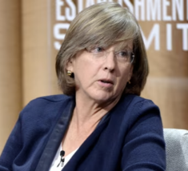
Meeker Report
AI inference costs have dipped 99.7% in last 2 years
Trends – Artificial Intelligence (AI), May 30, 2025
340 slides' report
Mary Meeker / Jay Simons / Daegwon Chae / Alexander Krey
https://www.bondcap.com/reports/tai
Things are accelerating
AI grows much faster than Internet or any other product or service
AI is used to predicts future (people trust AI)
Turing Test - passed. Next - reverse Turing Test
AI good with video, images, ...
Different models are better at different skills, AI vs Google
New expensive services ($200/mo, $2,000/mo)
Physical world AI (robo-taxi)
Mary Meeker

Slide 5
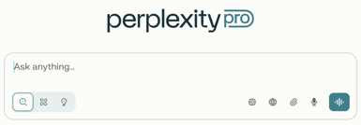
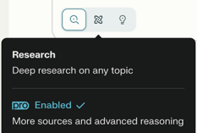
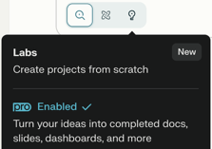
Perplexity Pro: Search, Research, Labs
In Perplexity Pro you can choose between 3 modes: Search, Research, Labs
Search, Research, Labs

Slide 6


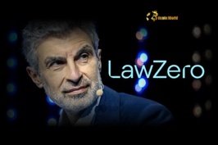
AI Updates 1
Microsoft Bing Video Creator Powered by Sora
Can generate 5-second videos
Users get 10 fast video generations and unlimited slower ones
The feature launches on Bing’s iOS and Android mobile apps, with desktop and Copilot Search releases coming soon.
https://www.youtube.com/watch?v=PoxWxMjA224
Apple Vision Air
https://www.cultofmac.com/news/apple-smart-glasses-iphone-replacement
Yoshua Bengio LawZero research center
AI Safety Non-profit with $30M in Funding
the Zeroth Law of Robotics: protection of humanity above all else.
Mission is building “honest” AI systems to detect and block harmful actions from autonomous agents.
Its first project, Scientist AI, gauges the risk of deception or danger before agents act.
https://techcrunch.com/2025/06/03/yoshua-bengio-launches-lawzero-a-nonprofit-ai-safety-lab
Robot - High Speed Parkour Navigation
https://www.youtube.com/watch?v=645Wk4tKtLQ

Slide 7
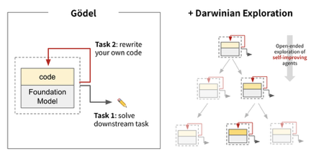

AI Updates 2
sakana.ai - self-improving coding agent, open-source
https://sakana.ai/dgm/
Researchers from Sakana AI (Japan) and the University of British Columbia just introduced the Darwin Gödel Machine (DGM) - an AI agent that rewrites its own code to get better at tasks, achieving up to 150% performance improvements without intervention.
It discovers improvements like editing tools, error memory, and peer review capabilities. It jumped from 20% to 50% on SWE-bench and 14% to over 30% on Polyglot.
Inspired by Darwinian evolution, DGM tries out changes to its code, keeps what works, and archives promising "mutations" for future improvements. It works with different underlying models
Andrej Karpathy about Veo 3
Perspectives of AI video generation tools like Veo 3
High bandwidth, universal appeal, becomes easy, direct optimization capability
Videos can be directly optimized using gradient descent for any objective. This means videos can be generated infinitely and optimized in real-time for specific goals like engagement, ad conversions, or other metrics. Instead of indexing a finite set of human-created videos, platforms could generate and optimize content on-demand
https://x.com/karpathy/status/1929634696474120576

Slide 8
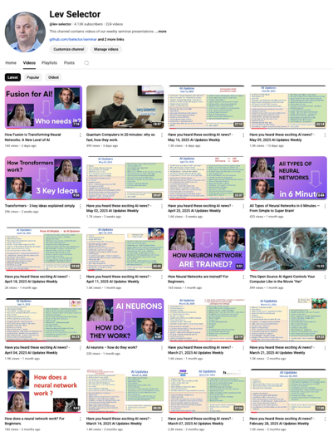
Subscribe to get notified
about new videos
https://www.youtube.com/@lev-selector
We post a video every Friday
It is usually 25-30 min long
Links to slides are under the videos

Slide 9



AI Updates 3
AI writes paper which passes peer review
https://www.intology.ai/blog/zochi-acl
Zochi completed the entire research process and wrote the paper
Zochi is an Intology’s Artificial Scientist
It got a 4.0 meta-review score (top 8.2% of all ACL submissions)
https://arxiv.org/pdf/2503.10619 - paper
Intology is based in San Francisco
Cerebras beats Nvidia at Inference Speed
Cerebras - 2.5 Ktokens for 400B Llama 4 Maverick
Nvidia DGX B200 with 8 Blackwell GPUs - 1 Ktokens
This is the world record
https://analyticsindiamag.com/ai-news-updates/we-smoked-nvidias-blackwell-says-cerebras/
Anthropic hits $3 billion in ARR
Grown from $1 billion in just 5 months
https://finance.yahoo.com/news/exclusive-anthropic-hits-3-billion-200202733.html
AI-powered roll-ups
Buy established companies, improve them with AI, then use the profits to buy again (similar to flipping houses)
https://techcrunch.com/2025/06/01/early-ai-investor-elad-gil-finds-his-next-big-bet-ai-powered-rollups

Slide 10


AI Updates 4
Manus Slides
Manus creates structured presentations (slide decks) from prompts
https://x.com/ManusAI_HQ/status/1928105652444094568
H Company
H Company was founded in late 2023 in Paris, also in London
Founders - former DeepMind scientists and a Stanford researcher
Advanced "multi-agent" solutions to automate complex digital workflows; plan, execute tasks, and solve problems autonomously
Runner H and Surfer H - business process automation, quality assurance, robotic process automation, and web-based task execution
https://www.hcompany.ai
No Robo Bosses Act
California introduced several significant AI and employment law bills (e.g., “No Robo Bosses Act,” Automated Decisions Safety Act, and workplace surveillance limits)
Klarna re-hiring humans
Klarna Bank (Swedish buy-now-pay-later company) has cut 50% of workforce (from 4.2K to 2K). It stopped using Salesforce and HR "Workday" in favor of its own in-house AI solutions
But recently Klarna is planning to hire humans (mostly students and rural areas) to ensure customers will always have the option to speak to a live representative.

Slide 11
AI video Summarization
recapio
copy URL into recapio
https://recapio.com
Copy transcription into Claude
copy transcription, paste it into LLM, get a summary
Copy youtube URL into Perplexity
perplexity will extract transcript from youtube website - and make a summary

Slide 12
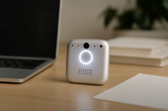
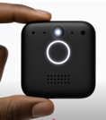
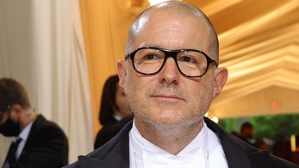
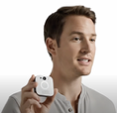
OpenAI IO Device - an prediction by AI
Video created by AI (not a real OpenAI product)
https://www.youtube.com/watch?v=rEAPBT6_-TM
Jony Ive (full name: Sir Jonathan Paul Ive) is a renowned British-American industrial designer best known for his pivotal role at Apple Inc., where he served as Senior Vice President of Industrial Design and later Chief Design Officer from 1992 to 2019. Ive was instrumental in designing some of Apple’s most iconic products, including the iMac, iPod, iPhone, iPad, MacBook, Apple Watch, and even the architectural design of Apple Park and Apple Stores.
In 2019 he left Apple and started LoveFrom, worked with Ferrari, Airbnb, and OpenAI.
Recently LoveFrom was acquired by OpenAI
AI Generated,
not real

Slide 13
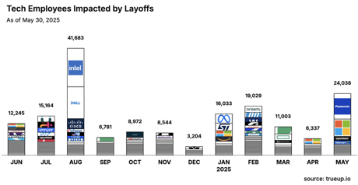
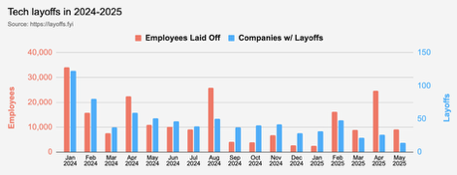
Jobs
https://layoffs.fyi
https://trueup.io/layoffs
Workers with AI skills command a 56% wage premium (up from 25% last year), suggesting the value these workers bring
https://www.pwc.com/gx/en/issues/artificial-intelligence/job-barometer/2025/report.pdf

Slide 14


About the Speaker
Lev Selector, Ph.D.
40+ years of software engineering, data science, and building teams (hiring, training, and managing)
Ph.D. in mathematical modeling and computer simulations
Interests:
Generative AI, Using LLM with your data
Local AI for Local Private Data
Cloud architecture, fin-tech, application security
Find/connect: Linkedin, GitHub, YouTube, Google
https://eais.ai
Enterprise AI Systems

Slide 15
Thank You!

