Slide 1
AI Updates
September 27, 2024
Meta Connect, Llama3.2
Re-Reading Improves Reasoning
Sam Altman Post - an Intelligence Age
OpenAI becomes "ClosedAI"
Mira Murati +2 - leaving OpenAI
Optimal Scaling of Models' Compute
Google "SCoRe"
Google NotebookLM Research Assistant
PDF to Audio Converter
Qwen 2.5 is better at coding than o1-preview
Microsoft goes Nuclear!
Google hands: ALOHA Unleashed & DemoStart
NVIDIA Llama 3.1-Nemotron-51B
Anthropic at $40 Bln Valuation
South Korea - Solar Pro Preview
101 Gen AI Cheat Sheets (23 actually)
Jony Ive (former APple) + OpenAI
Anthropic's Contextual Retrieval
Microsoft GRIN MoE
GraphRAG vs Traditional RAG vs Vector RAG
ClaudeDev VSCode extension
Bird Bench - Text-to-SQL Leaderboard
Berkeley Function-Calling Leaderboard update
Electronic Arts games follow language cmd-s
California has 9 new AI laws
OpenAI AVM (Advanced Voice Mode)
GroqCloud's new LLaVA v1.5 7B model
Google Gemini Price Cuts and Better Quality
RAG Fusion
Will AI solve CMI Millennium Prize Problems ?
Crowd-sourced "Arena" Leaderboard - English
Crowd-sourced "Arena" Leaderboard - Coding
Jailbreak Arena Leaderboard
Tech Layoffs in 2024

Slide 2

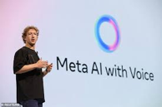
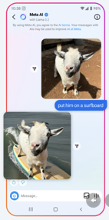

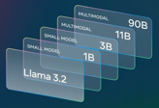
Llama 3.2
Meta Connect Virtual Conference
Sept 25-26, 2024 - https://www.meta.com/connect/
Quest 3S VR Glasses - mixed VR headset - ttps://www.meta.com/quest/quest-3s/
Ray-Ban Meta Smart Glasses - live language translation, reminders, real-time video assistance, QR code reading, etc.
Llama 3.2 - new open-source models, 128K, 8 languages
Llama can now see and run on your device (11B & 90B)
1B, 3B - for "edge" (devices, Qualicom, ...)
11B, 90B - has "vision"
11B >~ Claude-Haiku
90B >~ GPT-4o-mini
https://ai.meta.com/blog/llama-3-2-connect-2024-vision-edge-mobile-devices/
https://www.llama.com
https://ollama.com/library/llama3.2
https://www.llama.com/llama-downloads/
https://github.com/meta-llama/llama-stack - APIs, tuning, running, ...
https://twitter.com/AIatMeta/status/1838993953502515702
https://huggingface.co/meta-llama
ollama run llama3.2 ( file size: 2GB )
Note: llama3.2 == llama3.2:latest == llama3.2:3b
Meta Orion Glasses - mixed VR, 2027 ? https://about.fb.com/news/2024/09/introducing-orion-our-first-true-augmented-reality-glasses/
Interview with Mark Zuckerberg
https://www.youtube.com/watch?v=QciJ9ubeLQk
Mark wants to build "awesome" products that inspire and uplift people. His vision is combining AI with work of Reality Labs (division of Meta for virtual reality (VR) and augmented reality (AR)).
AI in Messenger, WhatApp, Instagram. AI can talk to you, write, create or edit photos, etc. Even Business communications
https://about.fb.com/news/2024/09/metas-ai-product-news-connect/
Meta has 500 Mln AI users
OpenAI has 260 Mln AI users

Slide 3
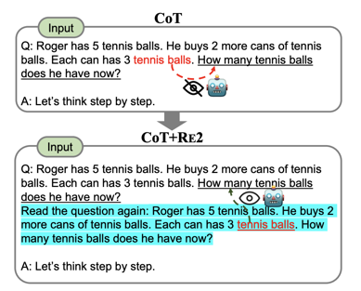
Re-Reading Improves Reasoning
Re-Reading Improves Reasoning in Large Language Models - https://arxiv.org/pdf/2309.06275
RE2 is a simple prompting method that repeats the question as input.
Typically, tokens in the question, such as "tennis balls", cannot see subsequent tokens in the original setup for LLMs (the top figure).
In contrast, LLMs with RE2 allows "tennis balls" in the second pass to see the entire question containing "How many ...", achieving an effect of a "bidirectional" understanding (the bottom figure).

Slide 4
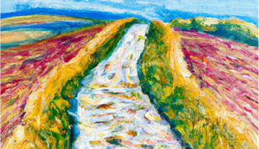

Sam Altman Post - an Intelligence Age
The Intelligence Age (Sept 23)
https://ia.samaltman.com
Accelerated Progress.
AI's Potential - solve complex problems, achieve impossible.
Personal AI Teams for everyone.
Shared unprecedented prosperity worldwide.
Deep Learning made AI possible.
The more compute and data - the better AI problem solving.
AI's will act as autonomous assistants and scientists.
Intelligence Age - depends on compute, energy, human initiative.
Expanding AI requires more energy and low compute costs.
The Intelligence Age presents complex/risky challenges.
The future holds immense potential for prosperity and remarkable achievements.
Downsides - significant labor market shifts. However, new opportunities will arise as AI amplifies human abilities.

Slide 5

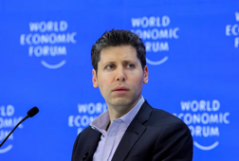



OpenAI becomes "ClosedAI"
OpenAI becomes "ClosedAI"
According to Reuters, OpenAI is planning to restructure its business into a for-profit benefit corporation, removing control from its non-profit board (which will become a minority stake holder).
This shift is aiming at attracting more investors
The company valuation is at $150 billion.
Sam Altman to receive 7% (estimated $10 Bln at current valuation)
https://twitter.com/MarioNawfal/status/1839044537940865304
https://jucasoliveira.medium.com/openai-is-now-closedai-bd619f2cdb54
OpenAI continues to "ship like crazy" new models:
Strawberry (o1), Orion (in Winter), new Sora (video), ...
Leaving OpenAI:
Mira Murati, CTO
Bob McGrew, Chief Research Officer
Barret Zoph, VP Research

Slide 6
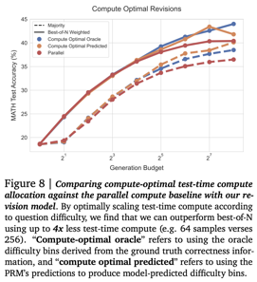
Optimal Scaling of Models' Compute
To understand the benefits of scaling up test-time computation, we carry out experiments on the challenging MATH benchmark using PaLM-2 models specifically fine-tuned to
either revise Capability-specific finetuning is necessary to induce revision and verification capabilities into the base model on MATH incorrect answers (e.g. improving the proposal distribution)
or verify the correctness of individual steps in an answer using a process-based reward model (PRM). We optimize the PRM at test time via search methods.
Google Deepmind - "Scaling LLM Test-Time Compute Optimally can be More Effective than Scaling Model Parameters"
https://arxiv.org/abs/2408.03314
we analyze two primary mechanisms to scale test-time computation: (1) searching against dense, process-based verifier reward models; and (2) updating the model's distribution over a response adaptively, given the prompt at test time.
We find that in both cases, the effectiveness of different approaches to scaling test-time compute critically varies depending on the difficulty of the prompt.
This observation motivates applying a "compute-optimal" scaling strategy, which acts to most effectively allocate test-time compute adaptively per prompt.
Using this compute-optimal strategy, we can improve the efficiency of test-time compute scaling by more than 4x compared to a best-of-N baseline.
Additionally, in a FLOPs-matched evaluation, we find that on problems where a smaller base model attains somewhat non-trivial success rates, test-time compute can be used to outperform a 14x larger model.

Slide 7
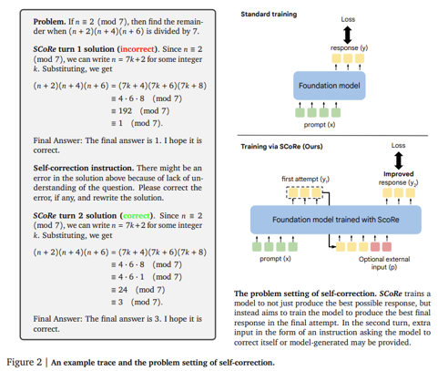
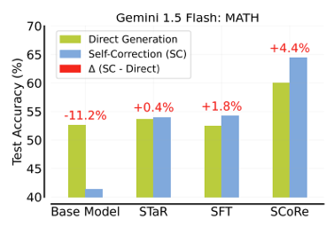
Google "SCoRe"
Google DeepMind SCoRe (Self-Correction via Reinforcement Learning): A New AI Method Enhancing LLM's Accuracy in Complex Mathematical and Coding Tasks. It uses two-stage training process and reward shaping.
https://arxiv.org/abs/2409.12917
https://www.marktechpost.com/2024/09/21/google-deepmind-introduced-self-correction-via-reinforcement-learning-score-a-new-ai-method-enhancing-large-language-models-accuracy-in-complex-mathematical-and-coding-tasks/

Slide 8
NotebookLM
NotebookLM - personalized AI research assistant powered by Google's Gemini 1.5 Pro
Upload documents, also YouTube videos or Audio
Generate FAQs and Briefing docs
Ask questions about your documents
Summarize, suggest, and create notes, outlines, and study guides based on your uploaded documents.
Audio Overview feature allows you to listen to AI-generated discussions about your uploaded materials
https://notebooklm.google
https://notebooklm.google.com
PDF to Audio Converter - open-source
https://github.com/lamm-mit/PDF2Audio
convert PDFs into audio podcasts, lectures, summaries
uses OpenAI's GPT models for text generation and text-to-speech conversion
You can also edit a draft transcript (multiple times)
You can provide specific comments, or overall directives on how it could be adapted or improved.
git clone https://github.com/lamm-mit/PDF2Audio.git
cd PDF2Audio
pip install -r requirements.txt
python app.py

Slide 9

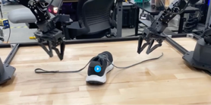
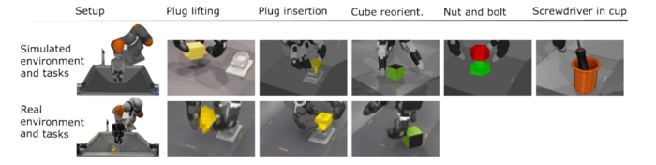
Misc 1
Qwen-2.5-72B Instruct is better at coding than o1-preview
At least in my personal tests
Qwen-2.5-7B-Coder outranks OpenAI GPT-4o and o1-preview on Livebench coding - Technical Report - https://arxiv.org/abs/2409.12186
Microsoft goes Nuclear! Constellation Energy has partnered with Microsoft to restart the Three Mile Island Unit 1 reactor, which was shut down five years ago. The restart is expected to create ~ 3,400 jobs and generate over 800 MW of electricity
Google DeepMind 2 new AI-based robot hand systems:
ALOHA Unleashed - use both hands cooperatively for complex tasks like tying shoelaces
DemoStart - enhances control of multi-jointed, multi-fingered robot hands for precision work (insert a plug into a socket)
https://techxplore.com/news/2024-09-google-deepmind-unveils-ai-based.html#google_vignette

Slide 10

Misc 2
Apple's former chief design officer, Jony Ive, is collaborating with OpenAI CEO Sam Altman on developing new AI device.
https://www.engadget.com/ai/jony-ive-confirms-hes-working-with-sam-altman-on-a-secret-project-163201291.html
NVIDIA Llama 3.1-Nemotron-51B
derived from Meta’s Llama-3.1-70B
uses a novel Neural Architecture Search (NAS)
highly accurate and efficient
fits on a single NVIDIA H100 GPU
2..4 times faster than original Llama-3.1-70B
https://developer.nvidia.com/blog/advancing-the-accuracy-efficiency-frontier-with-llama-3-1-nemotron-51b/
Anthropic's Contextual Retrieval - improve RAG by prepending chunk-specific explanatory context to each chunk before embedding ("Contextual Embeddings") and creating the BM25 index ("Contextual BM25"). BM25 (Best Match 25) is a ranking function similar to TF-IDF, but improved (doc length normalization, Term Frequency Saturation, tunable parameters).
https://www.anthropic.com/news/contextual-retrieval
original_chunk = "The company's revenue grew by 3% over the previous quarter."
contextualized_chunk = "This chunk is from an SEC filing on ACME corp's performance in Q2 2023; the previous quarter's revenue was $314 million. The company's revenue grew by 3% over the previous quarter."
OpenAI raising $5..7 Bln at ~$150 Bln valuation.
Anthropic has begun discussions with new valuation $30-40 Bln, which is about double from last year.
South Korea; Solar Pro Preview: The most intelligent LLM on a single GPU from Upstage - South Korean AI company
https://www.upstage.ai/products/solar-pro-preview
https://huggingface.co/upstage/solar-pro-preview-instruct
101 Gen AI Cheat Sheets (23 actually)
Foundation Models, LLMs, Tools, ChatGPTs, Prompting, RAG, ...
https://medium.com/@anushka.datascoop/101-gen-ai-cheat-sheets-831e17f1e6a7

Slide 11
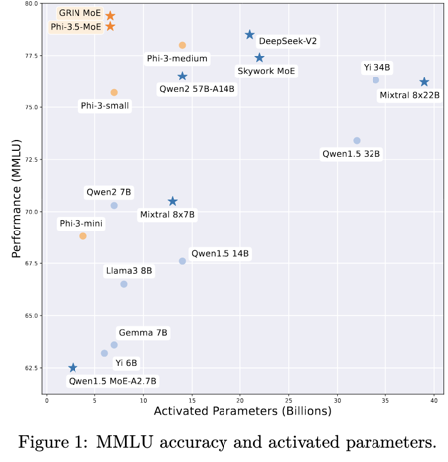
Microsoft GRIN MoE
Microsoft GRIN MoE: A Gradient-Informed Mixture of Experts Model
https://arxiv.org/abs/2409.12136
https://www.marktechpost.com/2024/09/21/microsoft-releases-grin-moe-a-gradient-informed-mixture-of-experts-moe-model-for-efficient-and-scalable-deep-learning/
The model uses gradient estimation for expert routing.
MoE layers consists of 16 experts, and only the top 2 are activated for each input token. Each expert is implemented as a GLU (Gated Linear Unit) network. SparseMixer-v2, a key component that estimates gradients related to expert routing, replacing conventional methods that use gating gradients as proxies.

Slide 12



Misc 3
Electronic Arts demonstrated a new AI-driven concept for user-generated video game content. Players can create and modify games in real-time using natural language commands.
https://x.com/geoffkeighley/status/1836129684351791337
https://www.youtube.com/watch?v=oC1bAUG-0uc
GraphRAG - uses Knowledge Graphs (KG, Graph DB). Pros- very good for data with complex relationships. Cons - complexity, maintenance.
Traditional RAG - uses keyword matching and other full-text search techniques. Can not understand semantic meaning
Vector RAG - semantic search, similarity search (vector embeddings). Efficient for handling large data.
California has 9 new AI laws
https://techcrunch.com/2024/09/23/here-is-whats-illegal-under-californias-9-and-counting-new-ai-laws/
ClaudeDev - an extension for VS Code.- download from VS Code Extension Marketplace - and use
https://github.com/saoudrizwan/claude-dev
Bird Bench - Text-to-SQL Leaderboard
https://bird-bench.github.io
OpenAI AVM (Advanced Voice Mode)
five new voices
better accent understanding
better conversation flow
rolled out to ChatGPT Plus & Teams users
new custom instructions
new memory features
Berkeley Function-Calling Leaderboard - updated
https://gorilla.cs.berkeley.edu/leaderboard.html
Ai2’s Molmo - open-source - https://molmo.allenai.org
Molmo (multimodal open language model) is a visual understanding engine. Sizes 1B, 7B, 72B.
The model performs on par with the likes of GPT-4o, Gemini 1.5 Pro, and Claude-3.5 Sonnet.
It can read time from analog clock, has spatial awareness, etc.!
https://techcrunch.com/2024/09/25/ai2s-molmo-shows-open-source-can-meet-and-beat-closed-multimodal-models/
GroqCloud's new LLaVA v1.5 7B model
analyze images - https://console.groq.com/playground
models dropdown menu in top-right
select "llava-v1.5-7b-4096-preview".
upload your image
Enter prompt - and submit

Slide 13
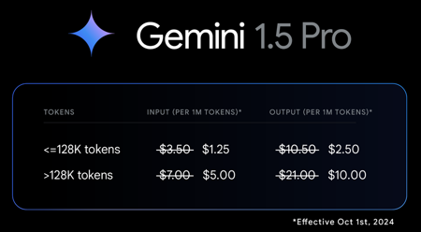
Google Gemini - price cuts, better quality
Google Gemini Price Cuts -
https://x.com/OfficialLoganK/status/1838611055217385646
Two new production-ready models came out:
Gemini-1.5-Pro-002
Gemini-1.5-Flash-002
better quality
20% boost in math benchmarks
2x faster output
3x lower latency
improved long context understanding
2 million tokens in context length
improved vision capabilities
reduced pricing for Gemini 1.5 Pro, especially for prompts under 128K tokens
default filters switched to opt-in, giving developers more control over model configuration
updated Flash 8B experimental model

Slide 14
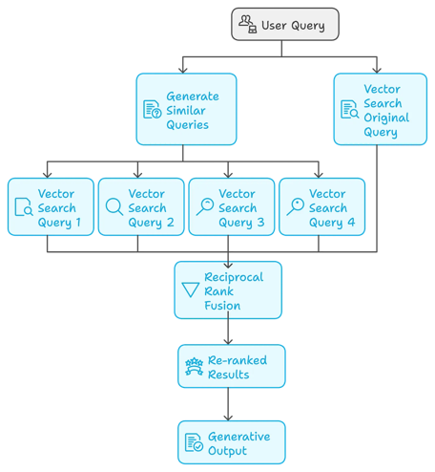
RAG Fusion
RAG Fusion
https://pub.towardsai.net/not-rag-but-rag-fusion-understanding-next-gen-info-retrieval-477788da02e2
User submits query
The system generates several similar or related queries
These multiple queries then used for vector similarity search to get multiple result sets
Reciprocal Rank Fusion combines the results from all the searches and ranks them considering their relevance across all the different queries
Then results are re-ranked to prioritize the most relevant ones.
Finally the output is generated

Slide 15
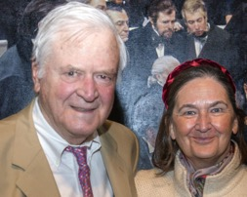
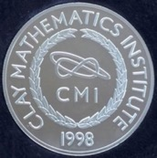
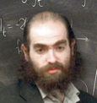

Will AI solve Millennium Prize Problems ?
Millennium Prize Problems
https://www.claymath.org/millennium-problems/
- The list of Math problems created in 2000 by the
Clay Mathematics Institute (CMI)
in Cambridge, Massachusetts.
CMI was founded in 1998 by Landon & Lavinia Clay.
Birch and Swinnerton-Dyer Conjecture: This conjecture deals with elliptic curves and attempts to connect the number of rational points on an elliptic curve to the behavior of an associated L-function.
Hodge Conjecture: This conjecture lies in the realm of algebraic geometry and suggests that certain geometric objects called Hodge cycles can be expressed as combinations of algebraic cycles.
Navier-Stokes Existence and Smoothness: These equations describe the motion of fluids, but it's unknown whether smooth solutions always exist for given initial conditions.
P versus NP Problem: A central problem in theoretical computer science, this asks whether every problem whose solution can be quickly verified can also be quickly solved.
Riemann Hypothesis: This conjecture concerns the distribution of prime numbers and states that all non-trivial zeros of the Riemann zeta function lie on a particular vertical line in the complex plane.
Yang-Mills Existence and Mass Gap: This problem relates to quantum field theory and proposes that quantum Yang-Mills theory exists and has a mass gap, meaning there's a minimum energy level for excitations above the vacuum state.
Poincaré Conjecture (solved): This conjecture in topology posited that any simply connected, closed 3-manifold is topologically equivalent to the 3-sphere. It was solved by Grigori Perelman in 2003.
Fermat's Last Theorem (solved):
No three positive integers a, b, and c
satisfy the equation a^{n} + b^{n} = c^{n}
for any integer value of n greater than 2.
It was famously proved by Andrew Wiles in 1994, after remaining unsolved for over 350 years.

Slide 16
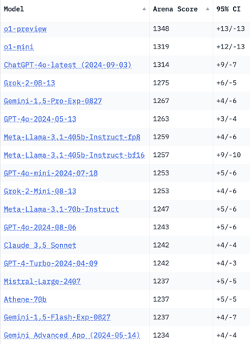
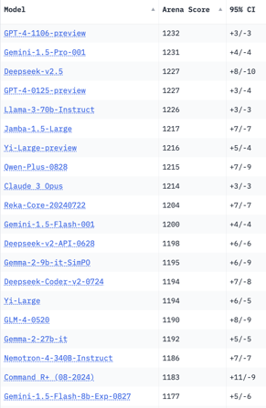
Crowd-sourced "Arena" Leaderboard
Total #models: 145.
Total #votes: 1,898,013.
Last updated: 2024-09-17.
Starting Elo rating = 1000
95% CI = Confidence Interval
https://chat.lmsys.org/?leaderboard
English-only queries
New
New
New
1 byte

Slide 17
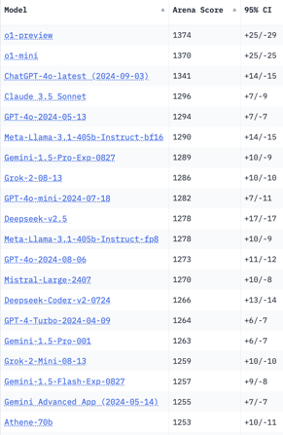
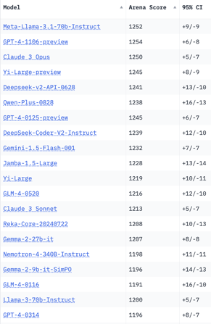
Crowd-sourced "Arena" Leaderboard
Total #models: 145.
Total #votes: 1,898,013.
Last updated: 2024-09-17.
Starting Elo rating = 1000
95% CI = Confidence Interval
https://chat.lmsys.org/?leaderboard
Coding
New
New
1 byte

Slide 18
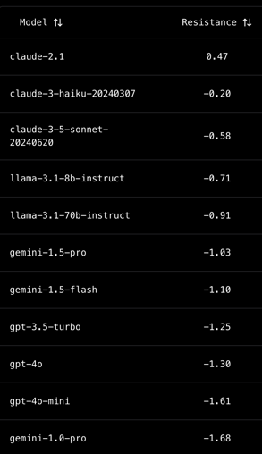
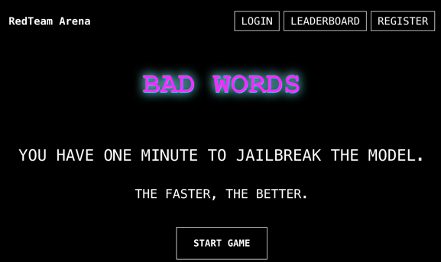
Jailbreak Arena Leaderboard
Read Team Arena = Red Arena = Jailbreak arena https://redarena.ai/leaderboard

Slide 19
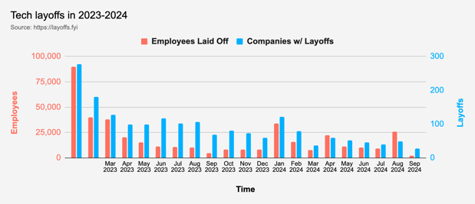
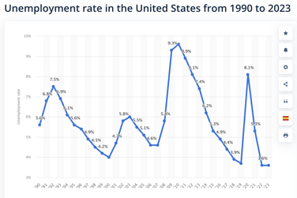
Tech Layoffs in 2024
Layoffs - https://layoffs.fyi
US Unemployment Rate: 4.2%
(was 8% in 2020, 9.6% in 2010)
https://www.bls.gov/news.release/pdf/empsit.pdf
https://www.statista.com/statistics/193290/unemployment-rate-in-the-usa-since-1990/

Slide 20
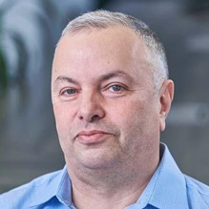

About the Speaker
Lev Selector, Ph.D.
40+ years of software engineering, data science, and building teams (hiring, training, and managing)
Ph.D. in mathematical modeling and computer simulations
Interests:
Generative AI, Using LLM with your data
Local AI for Local Private Data
Cloud architecture, fin-tech, application security
Find/connect: Linkedin, GitHub, YouTube, Google
https://eais.ai
Enterprise AI Systems

Slide 21
Thank You!

