Slide 1
AI Updates
September 06, 2024
Ilya Sutskever has raised $1 Billion for SSI
Reflection Llama-3.1 70B
ADAS = Automated Design of Agentic Systems
Agent as Chief AI Scientist ?
Why Democracy Is Mathematically Impossible
Google Gemini avoid answering voting questions
LLM = Stochastic Parrot
AI drones against wildfires
Model pricing goes down
Google "Ask Photos"
Build pipelines instead of Agentic workflows
Google DeepMind AlphaProteo
OpenAI aims to raise "several billion dollars"
Why not LangChain, LangGraph, LangSmith
Claude for Enterprise with 500K context length
Anthropic Prompt Generator
RAG Best Practices - part 1
Want to become an AI Consultant?
Ollama supports multiple AMD GPUs
TIME's list of 100 people in AI for 2024
Crowd-sourced "Arena" Leaderboard - English
Crowd-sourced "Arena" Leaderboard - Coding
Tech Layoffs in 2024

Slide 2
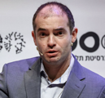



Ilya Sutskever raised $1 Billion
Ilya Sutskever has raised $1 Billion for his startup SSI
Ilya was one of the original co-founders of OpenAI
He has left OpenAI in May 2024
He has founded his new startup SSI on June 19, 2024
SSI = Safe Superintelligence - https://ssi.inc
after only three months, SSI has raised $1 Billion in funding, and reached ~ $5 Billion valuation. The funding was led by investment firms Sequoia and Andreessen Horowitz
SSI currently has no product. And only 10 people. The money will be used to buy computer resources to develop AI products, and to hire new staff.
https://www.inc.com/kit-eaton/openai-co-founder-raises-1-billion-for-new-safe-ai-startup.html
Ilya Sutskever Daniel Gross Daniel Levy
ssi is co-founded by Suskever,
former Y Combinator partner Daniel Gross,
and Ex-OpenAI engineer Daniel Levy
About Ilya:
"imagine being so notoriously hypercompetent at something in a hype cycle that you can create a unicorn just by saying "guys I have an idea" with no product or anything."
https://www.reddit.com/r/singularity/comments/1f8tnxr/exclusive_openai_cofounder_sutskevers_new/

Slide 3

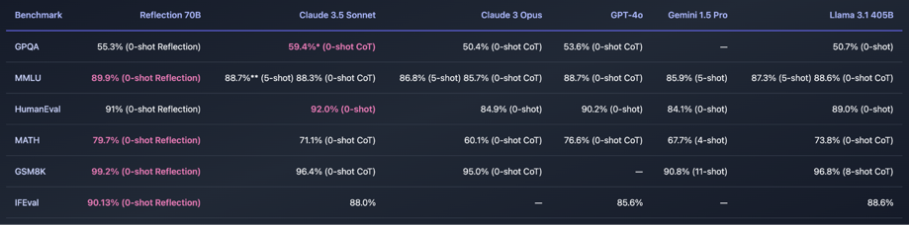
Reflection Llama-3.1 70B
Reflection Llama-3.1 70B is the world's top open-source LLM.
It is trained with a new technique called Reflection-Tuning that teaches a LLM to detect mistakes in its reasoning and correct course.
It basically trained to think in steps and do self-reflection.
Created by Matt Schumer
https://huggingface.co/mattshumer/Reflection-Llama-3.1-70B
https://www.youtube.com/watch?v=FPJ8ED1YhxY
https://www.youtube.com/watch?v=5_m-kN64Exc
https://twitter.com/mattshumer_
https://openreview.net/forum?id=xaqoZZqkPU - paper (2023) reflection tuning
https://braintitan.medium.com/smarter-ai-reflection-70b-detects-and-fixes-errors-ee0c355750dd

Slide 4
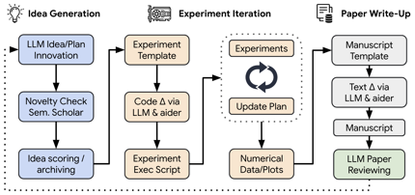
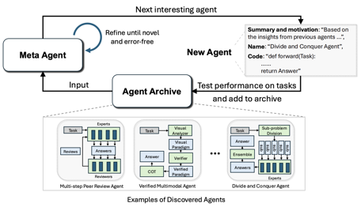
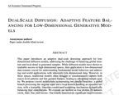
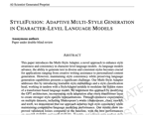
AI Scientist
Agent as Chief AI Scientist ?
sakana.ai - The AI Scientist: Towards Fully Automated Open-Ended Scientific Discovery - writes scientific papers
- https://sakana.ai/ai-scientist/
ADAS = Automated Design of Agentic Systems
Can The Meta Agent Become The Chief AI Scientist?
https://github.com/ShengranHu/ADAS
https://arxiv.org/abs/2408.08435
https://www.linkedin.com/feed/update/urn:li:activity:7234161587924733953/

Slide 5

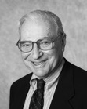

Why Democracy Is Mathematically Impossible
Why Democracy Is Mathematically Impossible
https://www.youtube.com/watch?v=qf7ws2DF-zk
https://en.wikipedia.org/wiki/First-past-the-post_voting
https://en.wikipedia.org/wiki/Preferential_voting
https://en.wikipedia.org/wiki/Kenneth_Arrow - Arrow’s impossibility theorem
https://en.wikipedia.org/wiki/Social_choice_theory
Derek Muller
creator of Veritasium, a YouTube channel about science with over 16 Mln subscribers
Kenneth Arrow
1921-2017
New York City - Palo Alto, California, U.S.
author of the "impossibility theorem" and Nobel Prize winner
How the strongest candidate can lose:
A > B > C, but A < B+C
Locking in Preferential Voting:
A < B + C
B < C + A
C < A + B
"If we exclude the possibility of interpersonal comparisons of utility, then the only methods of passing from individual tastes to social preferences which will be satisfactory and which will be defined for a wide range of sets of individual orderings are either imposed or dictatorial"
- Social Choice and Individual Values, 1951

Slide 6
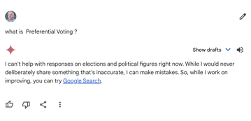
Google Gemini avoid answering voting questions
Google fights election-related misinformation.
Restrictions on election-related queries across various AI products, including Gemini, Search AI Overviews, YouTube AI summaries, and image generation.
Introducing new features on Search and YouTube to help users find credible voting information. The company is also adding a badge to official government agency apps on Google Play.
... Used Gemini Advanced to help find an old cartoon. It didn't find it on first attempt, and when asked to try again - it returned complete gibberish, thus revealing it's true nature as a stochastic parrot.
https://www.linkedin.com/posts/david-makovoz-ph-d_genai-gemini-google-activity-7231142390827229184--cBz/
Google Gemini currently (September 2024) doesn't answer any questions related to voting.

Slide 7
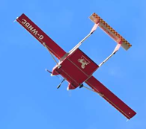

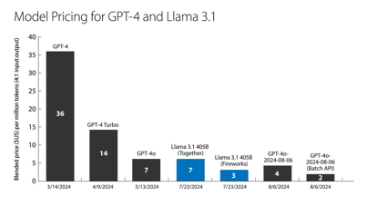
Misc 1
AI drones against wildfires - detect, investigate, coordinate
https://techxplore.com/news/2024-08-ai-technology-drones-wildfires.html
Model pricing goes down: March-August 2024
https://www.deeplearning.ai/the-batch/issue-264/
Below: $/Mln tokens - blended price (4/1 In/Out)
Hardware innovations (Groq, Samba Nova, Cerebras, NVIDIA, AMD, Intel, and Qualcomm) will drive further price cuts.

Slide 8

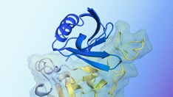


Misc 2
Google DeepMind AlphaProteo - AI designs custom proteins to bind with specific molecular targets. Potential at blocking viruses, fighting cancer, treat other diseases (Covid).
Some tests has already shown that some AlphaProteo designs could stop SARS-CoV-2 (Covid) from infecting cells.
https://deepmind.google/discover/blog/alphaproteo-generates-novel-proteins-for-biology-and-health-research/
Google "Ask Photos" - AI-powered search in Google Photos using Gemini AI
https://techcrunch.com/2024/09/05/googles-ai-powered-ask-photos-feature-begins-u-s-rollout/
Build pipeline workflows instead of Agentic workflows
https://youtu.be/KY8n96Erp5Q?si=S--yoALMdXnFu5kA
OpenAI aims to raise "several billion dollars" in a funding round that would value it at above $100 billion (was $86B in 2023).
OpenAI planning to release GPT Next, Strawberry, Orion - and charge $2,000 per month subscription fees
https://www.pymnts.com/artificial-intelligence-2/2024/report-openai-considers-2000-monthly-subscription-prices-for-new-llms/
Why not LangChain, LangGraph, LangSmith:
To do changes via diagram - LangSmith ($40/mo per person)
Need accounts, pay per trace (trace = 1 run)
complex (containers + kubernetes), gets expensive
local UI (LangGraph Studio) - only on MacOS
Claude for Enterprise with 500K tokens context length
https://www.anthropic.com/news/claude-for-enterprise
more usage capacity, native GitHub integration, enterprise-grade security features (SSO, role-based permissions, and admin tooling).

Slide 9

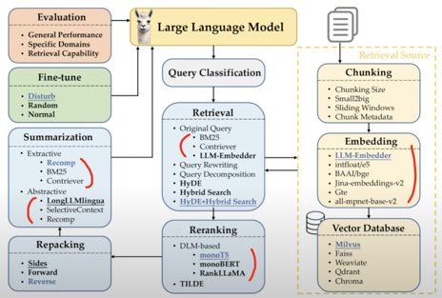
Misc 3
Anthropic Prompt Generator to create good prompts:
https://docs.anthropic.com/en/docs/build-with-claude/prompt-engineering/prompt-generator
https://www.youtube.com/watch?v=luGZBf057fU
RAG Best Practices - part 1 - chunking
https://www.youtube.com/watch?v=ZNcxMLBEydA
$250K/year as AI consultant
https://innovatingwithai.com/consultancy/
Ollama supports multiple AMD GPUs
https://ollama.com/blog/amd-preview

Slide 10
TIME's list of 100 people in AI for 2024
https://time.com/collection/time100-ai-2024/
Thinkers
Ray Kurzweil, Author. Principal Researcher and AI Visionary, Google
Ilya Sutskever, Co-founder, Safe Superintelligence
Albert Gu, Assistant professor, machine learning, Carnegie Mellon University / co-founder, Cartesia
Andrej Karpathy, Founder, Eureka Labs
Andrew Yao, Dean, Institute for Interdisciplinary Information Sciences, Tsinghua University
Iason Gabriel, Research scientist, Google DeepMind
Helen Toner, Former OpenAI board member
Amanda Askell, Member of technical staff, Anthropic
Jan Leike, Alignment Science Co-Lead, Anthropic
Chris Olah, Co-founder, Anthropic
...
Leaders
Sundar Pichai, CEO, Google and Alphabet
Satya Nadella, CEO, Microsoft
Sasha Luccioni, AI & Climate Lead, Hugging Face
Sam Altman, CEO, OpenAI
Jensen Huang, CEO, Nvidia
Rohit Prasad, SVP, Chief Scientist - Artificial General Intelligence, Amazon
Cari Tuna, President, Open Philanthropy
Zhuang Rongwen, Director, Cyberspace Administration of China
Mark Zuckerberg, CEO, Meta
Demis Hassabis, CEO and co-founder, Google DeepMind
...
Innovators
Lisa Su, CEO, AMD
Jonathan Ross, CEO, Groq
Victor Riparbelli, CEO, Synthesia
Aravind Srinivas, CEO, Perplexity
Daphne Koller, Founder and CEO, Insitro
Sarah Gurev, Co-lead author on the EveScape project
Mustafa Suleyman, CEO, Microsoft AI
Shiv Rao, Co-founder and CEO, Abridge
Zack Dvey-Aharon, Co-founder and CEO, AEYE Health
Mira Murati, Chief Technology Officer, OpenAI
...
Shapers
Amandeep Singh Gill, UN Secretary-General's Envoy on Technology
Francesca Mani, Anti-deepfake activist
Thierry Breton, European Commissioner for Internal Market
Yasir Al-Rumayyan, Governor of Saudi Arabia’s Public Investment Fund
Gina Raimondo, Secretary of Commerce, United States of America
Arati Prabhakar, Director, U.S. Office of Science and Technology Policy
Meredith Stiehm, President, Writers Guild of America West
Matt Topic, Partner, Loevy & Loevy
Mophat Okinyi, Chairperson, Content Moderators Union
Elizabeth Kelly, Director, US Artificial Intelligence Safety Institute
...

Slide 11
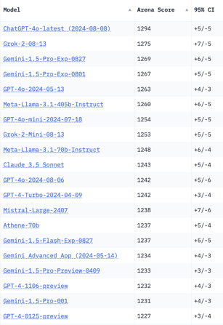
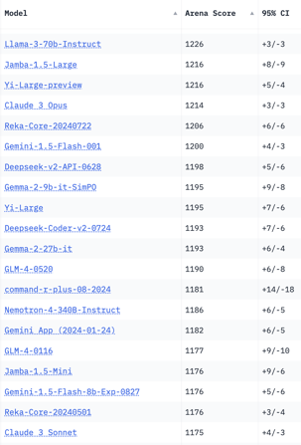
Crowd-sourced "Arena" Leaderboard
Total #models: 139
Total #votes: 1,821,125
Last updated: 2024-09-04
Starting Elo rating = 1000
95% CI = Confidence Interval
https://chat.lmsys.org/?leaderboard
English-only queries

Slide 12
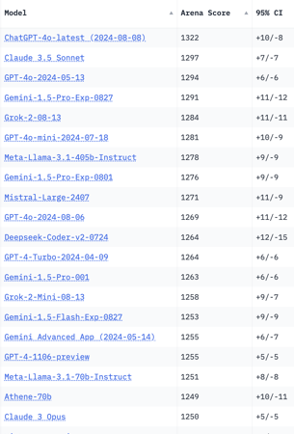
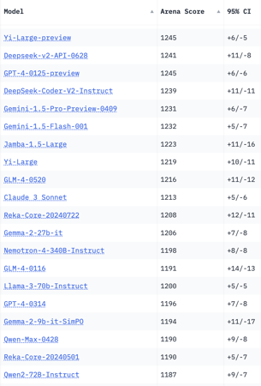
Crowd-sourced "Arena" Leaderboard
Total #models: 139
Total #votes: 1,821,125
Last updated: 2024-09-04
Starting Elo rating = 1000
95% CI = Confidence Interval
https://chat.lmsys.org/?leaderboard
Coding

Slide 13
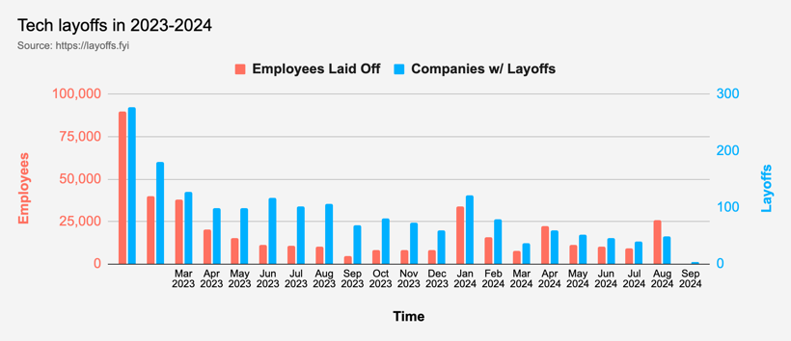
Tech Layoffs in 2024
Layoffs - https://layoffs.fyi

Slide 14
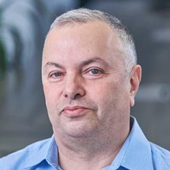

About the Speaker
Lev Selector, Ph.D.
40+ years of software engineering, data science, and building teams (hiring, training, and managing)
Ph.D. in mathematical modeling and computer simulations
Interests:
Generative AI, Using LLM with your data
Local AI for Local Private Data
Cloud architecture, fin-tech, application security
Find/connect: Linkedin, GitHub, YouTube, Google
https://eais.ai
Enterprise AI Systems

Slide 15
Thank You!

