Slide 1
ChatGPT was just the SPARK.
The real explosion is coming in the next 1-2 years.
- Peter Diamandis
AI Updates
March 14, 2025
Google Gemma-3-27B beats DeepSeek-V3
Which AI Model to Use in 2025
OpenAI Agents up to $20,000/month
Amazon formed a new AI agents division
Meta Llama 800+ Mln downloads
MAI - Microsoft AI - new family of models
Tulu-3-405B
Gemini Advanced - 2.0 Models
Gemini Robotics and Gemini Robotics-ER
MCP = Model Context Protocol
Siraj Raval is back!
Meta AI Chips - MTIA
GitHub Models
Startups Raising Money 2024 - 2025
AI Picks & Shovels
xAI acquired a 1 Mln sq-ft property in Memphis
Ilya Sutskever's Startup $2Bln at $30 Bln Valuation
Peter Diamandis - Exponential Mastery Event
Manus AI Assistant
AI Coding Assistants, Lovable.dev, Bolt.new
Autonomous Multi-Agent Systems (AMAS)
Nvidia RTX Pro 6000 Blackwell GPU
Microsoft Belief State Transformer
Alibaba Babel
Alibaba START (Self-taught Reasoner with Tools)
Reflection AI - Build Autonomous Systems
Claudette - a wrapper for Anthropic’s Python SDK
Tencent’s Hunyuan-TurboS AI Hybrid Model
Open AI SWE-Lancer benchmark
DOGE custom chatbot for US government
ServiceNow acquires Moveworks for $2.85 Bln
AI at McDonald’s
CoreWeave & OpenAI $11.9 Bln contract
Crowd-sourced "Arena" Leaderboard
WebDev Arena Leaderboard
Jobs

Slide 2
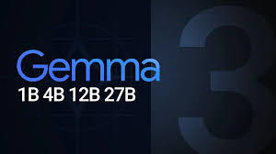
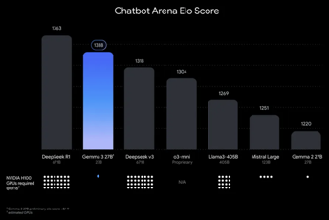
Google Gemma-3
Google Gemma-3 - open source, major improvements
gemma (Feb 2024, 8k-tokens) - 2b, 7b
gemma2 (May 2024, 80k-tokens) - 2b, 9b, 27b
gemma3 (March 2025, 128k-tokens) - 1b, 4b, 12b, 27b
Sizes: 1B, 4B, 12B, and 27B parameters
128k-token context length vs 80k in Gemma-2
Training data as of November 2, 2023
Multimodal (text, image, and short video analysis)
35 languages, up to 140 languages
Function calling, structured outputs
Outperforms Llama-405B, DeepSeek-V3, o1-mini
Requires fewer resources compared to larger models
Can run on NVIDIA and AMD GPUs, and supports CPU execution
Compatible with Hugging Face Transformers and PyTorch
https://blog.google/technology/developers/gemma-3/
https://www.youtube.com/watch?v=UU13FN2Xpyw
https://www.youtube.com/watch?v=hKYvB0TnvcU
https://ollama.com/library/gemma3 - ollama run gemma3:27b
gemma3 receives mixed reviews on Reddit. Some are praising its creative and world-building capabilities, others criticizing its frequent mistakes, suggesting it is less effective than phi4-14b

Slide 3
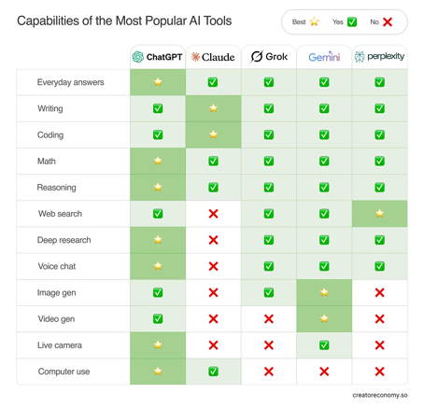
Compare Models
An Opinionated Guide on Which AI Model to Use in 2025
https://creatoreconomy.so/p/an-opinionated-guide-on-which-ai-model-2025

Slide 4
AI Updates 1
MAI - Microsoft AI - new family of models
Benchmarks close to OpenAI and Anthropic
Microsoft plans to use MAI instead of expensive OpenAI models
Microsoft’s research into the Belief State Transformer shows promising advancements in AI reasoning and planning, potentially giving them an edge in future developments.
https://www.reuters.com/technology/artificial-intelligence/microsoft-developing-ai-reasoning-models-compete-with-openai-information-reports-2025-03-07/
OpenAI Agents up to $20,000/month: $2K/mo for knowledge worker $10K/mo for software development, $20K/mo for PhD-level research
OpenAI expects agents to contribute 20-25% of its revenue and has already demonstrated their capabilities in sorting sales leads, coding assistance, and nuclear fusion research
Open AI "Responses API" replaces "Assistants API", web search, file search, Agents API, computer use, ...
https://techcrunch.com/2025/03/11/openai-launches-new-tools-to-help-businesses-build-ai-agents/
https://platform.openai.com/docs/quickstart
https://www.youtube.com/watch?v=gGJWQjynOcg - demo
Tulu-3-405B - new open-source LLM
developed by the Allen Institute for AI (Ai2)
fine-tuned from Meta Llama3.1-405B
Reinforcement Learning with Verifiable Rewards (RLVR), Direct Preference Optimization (DPO), and supervised fine-tuning
Outperforms DeepSeek V3 and OpenAI's GPT-4o
Available on Ai2 Playground, GitHub, Hugging Face
https://allenai.org/blog/tulu-3-405B
Use Claude with Sonar websearch via MCP server
Small TypeScript application - can run locally
https://github.com/ppl-ai/modelcontextprotocol
Amazon formed a new AI agents division
Gemini Robotics and Gemini Robotics-ER
vision, language, and action, built on Gemini 2.0
understand natural language instructions, adapt, perform complex physical tasks with precision.
Partnerships involving Apptronik, Boston Dynamics, and Agile Robots
https://deepmind.google/technologies/gemini-robotics/gemini-robotics-model/
Meta Llama 800+ Mln downloads
The upcoming Llama 4 will power AI agents capable of reasoning and task automation.
Every business will have AI agents for managing customer interactions, AI assistants, ...

Slide 5
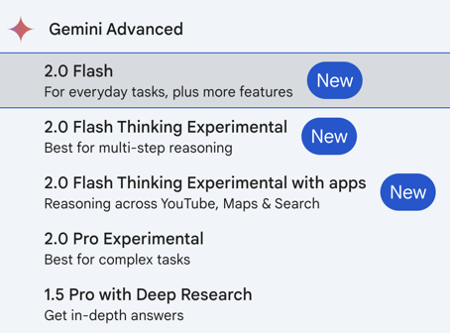
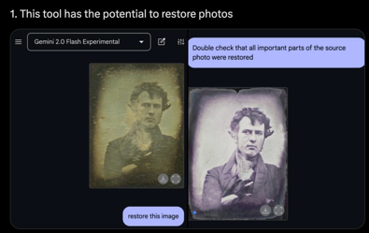
Gemini Advanced - 2.0 Models
Gemini 2.0 Flash can edit or restore images using your textual descriptions
You can have a dialog with Gemini 2.0 Flash to iteratively edit images, refining the desired outcome through multiple rounds of text-based instructions
Gemini 2.0 Flash can leverage its knowledge of the world to create more accurate and realistic images.
You can ask Gemini 2.0 Flash to tell a story and have it generate accompanying illustrations, maintaining consistency in characters and settings
Gemini 2.0 Flash can render correct text in images (so it can be used in advertising)
Gemini Advanced

Slide 6
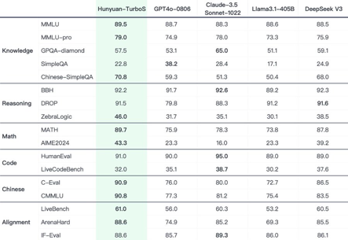
AI Updates 2
Microsoft Belief State Transformer
use both forward and backward encoders to predict both next and previous tokens, improving self-evaluation
a bit more computation
Results: when filling in the middle of children's stories, Belief State Transformers outperformed GPT-style Transformers by a factor of three, as judged by GPT-4
Belief State Transformers learn a compact belief state, enabling strong self-evaluation, which is valuable for test-time computation and generating training data
https://www.youtube.com/watch?v=aqhbRtB2Fyg - video
Tencent’s Hunyuan-TurboS AI
first ultra-large Hybrid-Transformer-Mamba MoE model
combines speed and deep reasoning
outperforming models like GPT-4o
low price (approx $0.15 per Mln tokens)
https://x.com/TXhunyuan/status/1899105803073958010
https://www.news9live.com/technology/artificial-intelligence/tencent-hunyuan-turbos-future-ai-hybrid-architecture-fast-thinking-2831680
Alibaba Babel - Open Multilingual LLM
Alibaba START (Self-taught Reasoner with Tools) - a model fine-tuned from QwQ-32B, achieving strong performance in reasoning and tool use benchmarks
Reflection AI - new startup for Building superintelligent autonomous systems
$130 Mln in Funding
https://www.reflection.ai
Claudette - a wrapper for Anthropic’s Python SDK
https://claudette.answer.ai

Slide 7

AI Updates 3
AI at McDonald’s
43,000 restaurants, 70M daily customers
partnership with Google Cloud
real-time data processing
AI analysis directly in-store
predictive equipment maintenance
order accuracy
generative AI virtual manager
personalized promotions
Open AI SWE-Lancer benchmark
a benchmark of over 1,400 freelance software engineering tasks from Upwork
https://openai.com/index/swe-lancer/
DOGE custom chatbot for US government
General Services Administration started using custom chatbot from Elon Musk’s DOGE "GSAi" - to "draft emails, create talking points, summarize text, write code, ... ". The chatbot gives 3 options - Claude Haiku 3.5 (the default), Claude Sonnet 3.5 v2 and Meta Llama 3.2
https://www.yahoo.com/tech/doge-has-reportedly-started-rolling-out-a-custom-chatbot-to-automate-some-government-tasks-211616079.html
CoreWeave, AI CLoud, has filed for an IPO, aiming for a valuation above $35 billion
CoreWeave & OpenAI $11.9 Bln contract (5 years cloud computing deal)
Siraj Raval is back! - $1 Mln/year using AI https://www.youtube.com/watch?v=W7w97MbZKCc
ServiceNow acquires Moveworks for $2.85 Bln
https://www.servicenow.com - supplies a cloud computing platform for the creation and management of automated business workflows
https://www.moveworks.com - Agentic AI Assistants and automation, grown from automating IT support to serving HR, finance, and facilities management, with clients including Unilever, Instacart, Siemens, and Toyota.
Meta AI Chips - MTIA: MTIA = Meta Training and Inference Accelerator 2024 - inference chip, 2025 - training chip
Chips made at TSMC (Taiwan Semiconductor Manufacturing Co)
Goal - self-reliance, reduce cost, reduce energy requirements
https://www.tomshardware.com/tech-industry/artificial-intelligence/meta-is-reportedly-testing-its-first-rsic-v-based-ai-chip-for-ai-training

Slide 8
MCP = Model Context Protocol
MCP = Model Context Protocol
Anthropic introduced and described MCP on Nov 25, 2024
MCP is defined as an open standard for connecting LLMs to data systems (content repositories, databases, business tools, etc)
You can use pre-built MCP servers for common services or create your own server using the MCP specification and SDKs.
The MCP server acts as an intermediary between your data sources and AI applications, allowing them to communicate via the MCP protocol
https://www.anthropic.com/news/model-context-protocol - announcement
https://modelcontextprotocol.io/introduction - docs
https://spec.modelcontextprotocol.io/specification/2024-11-05/ - specs
https://github.com/modelcontextprotocol - GitHub
https://github.com/modelcontextprotocol/servers - multiple MCP servers
https://www.aihero.dev/what-problem-does-model-context-protocol-solve
https://www.youtube.com/watch?v=5ZWeCKY5WZE - video
MCP is also a framework designed to manage and structure context within LLMs (Context Management (organize and prioritize), Information Hierarchy (instructions, user data, conversation history), Prompt Engineering, Memory Handling, State Management)
Cursor
or other
desktop app
Unified API
MCP Server
Unique APIs
GitHub
Slack
Local Files

Slide 9
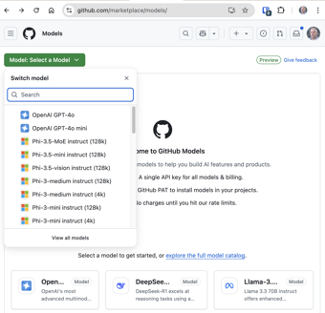
GitHub Models
Available Models:
OpenAI GPT-4o
OpenAI GPT-4o mini
Phi-3.5-MoE instruct (128k)
Phi-3.5-mini instruct (128k)
Phi-3.5-vision instruct (128k)
Phi-3-medium instruct (128k)
Phi-3-medium instruct (4k)
Phi-3-mini instruct (128k)
Phi-3-mini instruct (4k)
Phi-3-small instruct (128k)
Phi-3-small instruct (8k)
Phi-4
Phi-4-mini-instruct
Phi-4-multimodal-instruct
AI21 Jamba 1.5 Large
AI21 Jamba 1.5 Mini
Codestral 25.01
Cohere Command R
Cohere Command R 08-2024
Cohere Command R+
Cohere Command R+ 08-2024
DeepSeek-R1
DeepSeek-V3
Llama-3.2-11B-Vision-Instruct
Llama-3.2-90B-Vision-Instruct
Llama-3.3-70B-Instruct
Meta-Llama-3.1-405B-Instruct
Meta-Llama-3.1-70B-Instruct
Meta-Llama-3.1-8B-Instruct
Meta-Llama-3-70B-Instruct
Meta-Llama-3-8B-Instruct
Ministral 3B
Mistral Large 24.11
Mistral Nemo
Mistral Large
Mistral Large (2407)
Mistral Small
JAIS 30b Chat
"GitHub Models" - allows developers to discover, experiment with, and integrate AI models into their projects
https://github.com/marketplace/models/
It provides a space for experimentation and prototyping.
provides a marketplace with multiple models
offers an interactive "playground"
API Integration
Integration with Development Tools (VS Code, ...)

Slide 10

Startups Raising Money 2024 - 2025
https://techcrunch.com/2025/03/08/9-us-ai-startups-have-raised-100m-or-more-in-2025/
There were 49 startups that raised funding rounds worth $100 Million or more in 2024
Three companies raised more than one "mega-round" last year
Seven companies raised rounds at $1 Billion or larger
January 2025:
ElevenLabs raised a $180 Mln (AI Voice generation)
Hippocratic AI raised $141 Mln (LLMs for health industry)
Major investments continue in AI-driven startups across sectors, from self-driving technology to medical AI
February 2025:
Together AI - $305 Mln - infrastructure
Lambda - $480 Mln - infrastructure
Abridge - $250 Mln - transcribes patient-clinician conversations
Eudia - $105 Mln - legal tech
EnCharge AI - $100 Mln - hardware
Harvey - $300 Mln - AI legal tech
March 2025:
Anthropic - $3.5 Bln - LLMs, Claude

Slide 11

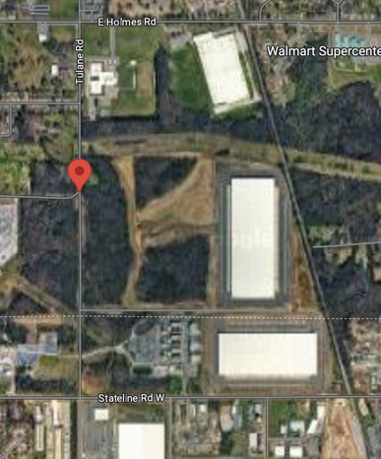
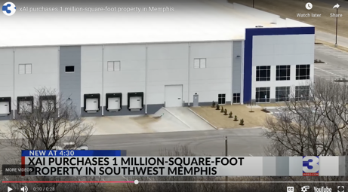
AI Picks & Shovels
AI Gold Rush - sell Picks & Shovels
"Don’t Sell AI Agents, Sell AI Infrastructures Instead ..."
https://medium.com/@julio.pessan.pessan/dont-sell-ai-agents-sell-ai-infrastructures-instead-the-billion-dollar-opportunity-04eb7166b3d9
xAI, Elon Musk’s AI company, has acquired a 1 Mln square foot property in Southwest Memphis ( 5400 Tulane Road, Whitehaven, Memphis ) for $80 Mln to expand its AI data center footprint with plans for 1 Mln GPUs datacenter
https://techcrunch.com/2025/03/07/elon-musks-ai-company-xai-acquires-1-million-square-foot-property-in-memphis/

Slide 12

Ilya Sutskever's Startup $2Bln at $30 Bln Valuation
Safe Superintelligence (SSI) - Ilya Sutskever's startup received additional $2 Bln at $30 Bln valuation
Company has no plans to release a product anytime soon
The startup is solely focused on researching and developing an advanced form of the emerging technology with capabilities far exceeding those of humans
Sutskever’s reputation is SSI’s primary selling point for investors
The 38-year-old researcher was born in Russia, raised in Israel and studied in Canada under A.I. academic Geoffrey Hinton.
He subsequently joined Google before leaving in 2015 for OpenAI to lead the development of ChatGPT. He served as OpenAI’s chief scientist and a board member
Elon Musk, an OpenAI co-founder, described Sutskever as “the linchpin for OpenAI being successful” in a 2023 interview
https://ssi.inc
SSI has its primary locations in Palo Alto, California, and Tel Aviv, Israel.

Slide 13

Exponential Mastery Event
Peter Diamandis - Exponential Mastery Event
https://exponential.su.org/details-v-2
ChatGPT was just the SPARK.
The real explosion is coming in the next 12-24 months.
Humanoid robots that can learn and adapt in real-time
AI systems discovering cures for "incurable" diseases
Neural interfaces allowing direct brain-to-computer connection
Quantum computers solving previously impossible problems
These technologies are CONVERGING and creating the greatest wealth and disruption event in human history. The technological tsunami is coming.
AGI coming online will disrupt everything
Industries are being transformed
Trillion-dollar opportunities are being developed
How to position yourself ahead of these shifts

Slide 14


Manus AI Assistant
How Manus AI Agent is different:
Manus completes weeks of professional work in just hours. Hugging Face and top VCs praise its performance calling it "the most impressive AI tool they’ve used"
Positioned as "the world’s first fully autonomous AI agent", which can work without constant human intervention
It has Multi-Agent Architecture; Cloud-Based - continue working even when user disconnects; Multi-Modal (text, images, code); Can use tools (web browsers, code editors, databases); can adaptively learn from user interactions to personalize responses; Good general AI performance on benchmarks (on par or better than other leading AI models in real-world problem-solving capabilities)
https://monica.im
https://manus.im
https://www.youtube.com/watch?v=wVvfXZm4Lvg - demo
Xiao Hong, founder
Yichao 'Peak' Ji, co-founder and chief scientist
Xiao Hong - born in 1992, graduated from Huazhong University of Science and Technology
2015 - founded Nightingale Technology, launching tools served over 2 million businesses and secured major funding from Tencent and ZhenFund.
2022 - started Butterfly Effect and released Monica, an AI browser extension gained 10 million users globally
2025 March - launched Manus AI, a "universal AI Agent" that autonomously completes tasks
Manus uses good models (possibly Claude) and ~30 tools (mostly open source). It has its own environment to work with files and run code
https://hybrid-rituals.com/everything-we-know-about-the-founder-of-manus-ai-so-far/
From Pipelines to Autonomous Multi-Agent Systems (AMAS)
Last year autonomous multi-agent systems (AMAS) were not reliable, tend to go into infinite loops. So people used structured pipelines instead.
Nowadays agents and collaboration algorithms are much better, so now it is possible to build reliable AMAS-s
Better LLMs; Improved coordination and adaptability algorithms; Better collaboration patterns (parallel and loop) - prevent infinite loops; Better Autonomous Decision-Making (Salesforce);
Today's trend - shift away from traditional structured pipelines to AMAS-s. AMAS can handle complex, dynamic tasks more effectively than structured pipelines, which are often rigid and less adaptable; AMAS can execute tasks independently; AMAS doesn't need manual intervention; AMAS improves overall system efficiency; AMAS can handle and combine structured and unstructured data
OpenManus - open source version
https://github.com/mannaandpoem/OpenManus
https://www.youtube.com/watch?v=W2Ur7FGqsJE

Slide 15

AI Coding Assistants
Top AI no-code tools: Cursor vs. Windsurf vs. Lovable vs. v0 vs. Bolt vs. Replit
.. https://substack.com/home/post/p-158033421 .. https://www.youtube.com/watch?v=HSnJrXWETfM - video testing 6 systems
Here is a list of AI Assistants (can be easily tripled):
Bolt - https://bolt.new
Lovable - https://lovable.dev
v0 - https://v0.dev
Replit - https://replit.com
Cursor - https://www.cursor.com
Windsurf - https://codeium.com/windsurf
Qodo - https://www.qodo.ai - new name for Codeium
GitHub Copilot
Replit Ghostwriter
base44 - https://base44.com
AskCodi - https://askcodi.com
AugmentCode - https://www.augmentcode.com
Snyk - https://snyk.io - AI-powered security analysis
Aider - https://aider.chat - command-line code assistant
Cline - https://cline.bot - for VS Code (former Claude Dev)
Devin - https://devin.ai - by Cognition Labs, $500/month
Tabnine - AI code completion
Amazon CodeWhisperer - https://docs.aws.amazon.com/codewhisperer
Amazon Q Developer - https://aws.amazon.com/q/developer/
Google Gemini Code Assist - https://codeassist.google
Visual Studio IntelliCode - https://visualstudio.microsoft.com/services/intellicode
JetBrains AI Assistant - https://www.jetbrains.com/ai/
CodeRabbit - https://www.coderabbit.ai - code review
Codiga - https://www.codiga.io - code analysis, completion, review
Pixee - https://www.pixee.ai - code quality/security
Sourcery - https://sourcery.ai - real time refactoring
FauxPilot - https://github.com/fauxpilot/fauxpilot - open-source copilot alternative
Tabby - https://github.com/TabbyML/tabby - open-source
90% of Code will be written by AI in 3-6 months
100% in 12 months
- Dario Amodei, Anthropic CEO
Human Coding
AI Assisted Coding (Copilot)
Vibe Coding (AI writes the whole app from description)

Slide 16

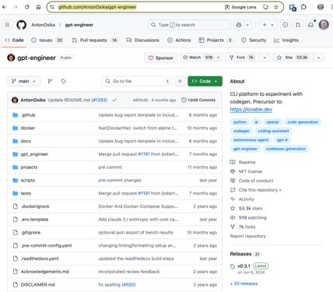
Lovable AI
Lovable AI - https://lovable.dev - AI-powered tool that turns descriptions into working products without requiring any coding knowledge. It both builds and deploys apps
Anton Osika is the co-founder and CEO of Lovable
Since launching three months ago, Lovable hit $4 million ARR in the first four weeks and $10 million ARR in two months with a team of just 15 people, making it Europe’s fastest-growing startup ever.
https://www.lennysnewsletter.com/p/building-lovable-anton-osika
https://www.youtube.com/watch?v=DZtGxNs9AVg
https://x.com/antonosika
Lovable supports popular frameworks like React and integrates with tools such as Stripe and Supabase for backend functionality. It offers features like live rendering, instant undo, and collaboration tools, making it accessible for non-technical users and developers alike.
Users can sync their projects to GitHub for further customization and deployment
Lovable AI itself is NOT open source
Lovable has evolved from an open-source project called "gpt-engineer": https://github.com/AntonOsika/gpt-engineer which remains available on GitHub; gpt-engineer was a command-line tool focused on AI-assisted software development, and its commercial web version was rebranded as Lovable to provide a more user-friendly interface for a broader audience

Slide 17





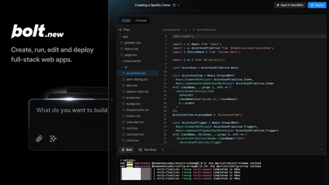
Bolt.new
Bolt (Bolt.new) is developed by the StackBlitz team - https://stackblitz.com
Bolt provides Javascript development platform running in browser WASM (Web Assembly), and use AI (Anthropic Claude) to create Javascript apps
StackBlitz developed "WebContainer" objects to run in WASM in browser. When you spin-off a WebContainer in WASM, you get a virtual environment in the browser where you have a virtual file system, node.js, npm, network access - all you need to develop, test, and run web apps in a browser in a safe isolated sandbox (container). No local setup required.
The WebContainer is probably written in Rust and is NOT open-source
https://bolt.new
https://support.bolt.new/docs/getting-started
https://github.com/stackblitz/bolt.new
https://webcontainers.io
https://github.com/stackblitz/webcontainer-core
Bolt.new provides IDE interface in browser. You can also download the whole GitHub repo, and run everything locally
How you work with Bolt: You chat with AI, give it descriptions and images, go back and forth to refine the plan for the app. Then Bolt creates code, installs dependencies, deploys, tests, runs the app - all within the browser.
Bolt is fast and very useful for fast prototyping and demos.
Bolt writes code in JavaScript (React, Vue, and Astro frameworks)
https://stackblitz.com/pricing - free, $18/mo, ..., token reloads as needed
StackBlitz is in San Francisco, CA, since 2016
The "WebContainer" technology: "TypeScript, Rust, and WebAssembly"
Alternative open-source "OpenWebContainer" written completely in TypeScript: https://github.com/thecodacus/OpenWebContainer
Also: https://github.com/WebContainer/Chrome-WebContainer
Eric Simons
Albert Pai
Matthew Savino

Slide 18
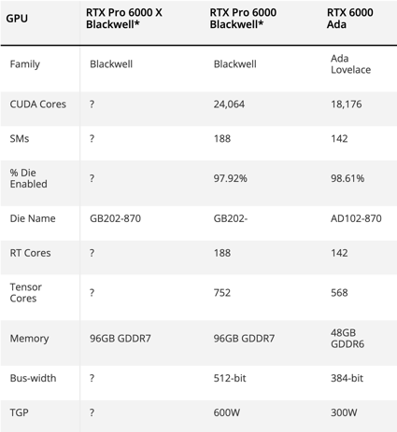
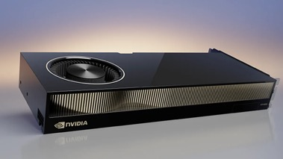
Nvidia RTX Pro 6000 Blackwell GPU
Nvidia RTX Pro 6000 Blackwell GPU 24,064 CUDA cores 96GB GDDR7 600W
https://www.tomshardware.com/pc-components/gpus/nvidia-rtx-pro-6000-blackwell-gpu-spotted-with-24-064-cuda-cores-96gb-gddr7-and-600w-11-percent-more-cores-than-rtx-5090

Slide 19
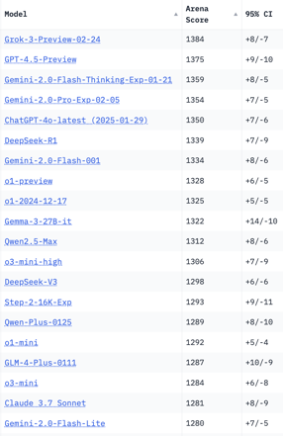
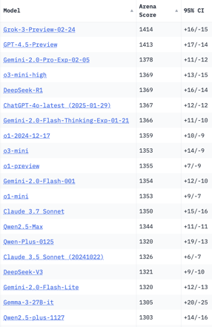
Crowd-sourced "LM Arena" Leaderboard
Total #models: 212
Total #votes: 2,768,389
Last updated: 2025-03-10
Starting Elo rating = 1000
95% CI = Confidence Interval
https://en.wikipedia.org/wiki/Elo_rating_system
https://chat.lmsys.org/?leaderboard
https://lmarena.ai/?leaderboard
English-only queries
Coding
Highlights:
Grok-3 and GPT-4.5 share 1st place
followed by Gemini-2 and DeepSeek-R1
Gemma-3-27B is good
Llama falls behind
x.ai
x.ai
China
China
China
China
China
China
China
China
China
China
China

Slide 20
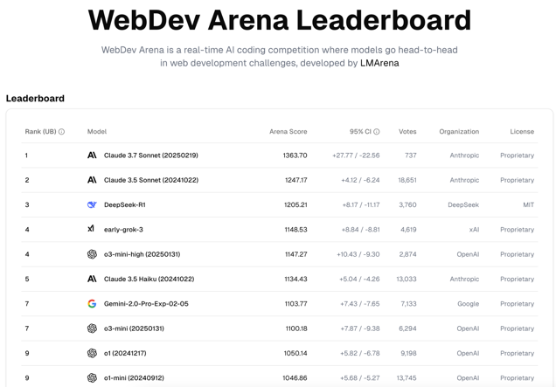
WebDev Arena Leaderboard
https://web.lmarena.ai/leaderboard

Slide 21
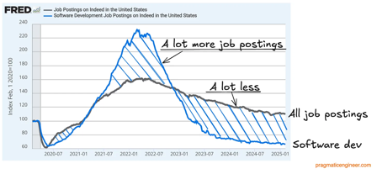
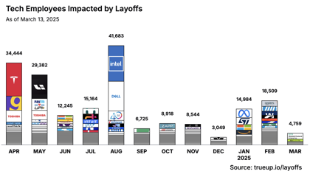
Jobs
Layoffs, Jobs:
https://layoffs.fyi
https://techcrunch.com/2025/02/13/tech-layoffs-2024-list/
https://blog.pragmaticengineer.com/software-engineer-jobs-five-year-low/
https://fred.stlouisfed.org/series/IHLIDXUS
The Tech Layoff Tracker (as of March 13, 2025)
https://www.trueup.io/layoffs
So far in 2025 - 531 people per day, total of 38,252 people
In 2024 - 653 people per day, total of 238,461 people
In 2023: More than 191,000 people
In 2022: More than 93,000 workers laid off
https://news.crunchbase.com/startups/tech-layoffs/
AI jobs percentage:
2022 - 3.3%
2024 - 14.3%
2025 - 25% of all new tech job openings require AI skills
36% of IT job postings tied to AI needs
Number of AI Job postings by year
2020 27K
2021 38K
2022 52K
2023 65K
2024 81K
2025 105 - 200K (projected)

Slide 22


About the Speaker
Lev Selector, Ph.D.
40+ years of software engineering, data science, and building teams (hiring, training, and managing)
Ph.D. in mathematical modeling and computer simulations
Interests:
Generative AI, Using LLM with your data
Local AI for Local Private Data
Cloud architecture, fin-tech, application security
Find/connect: Linkedin, GitHub, YouTube, Google
https://eais.ai
Enterprise AI Systems

Slide 23
Thank You!

