Slide 1


AI Updates
October 11, 2024
2 out of 5 Nobel Prizes
Nobel Prize for Neural Networks in Physics
Nobel Prize for Neural Networks in Chemistry
Is AI a science?
Update on Reflection-70B
Tesla's "We, Robot" Robotaxi event
Abundance - Peter Diamandis
Collection of ~1,400 jailbreak prompts
2-bit quantization
BitNet: Scaling 1-bit Transformers for LLMs
State of AI Report - by Nathan Benaich
Bolt.new - Javascript full-stack AI development
Aria from Rhymes.AI - Open Multimodal MoE
Robotic Process Automation (RPA)
Meta Movie Gen
OpenAI MLE-bench
EuroLLM
H100 - renting is cheaper than buying
Hailuo AI Image-to-Video
AMD Instinct MI325X chip
NVLM 1.0 from Nvidia
Crowd-sourced "Arena" Leaderboard - English
Crowd-sourced "Arena" Leaderboard - Coding
Tech Layoffs in 2024

Slide 2

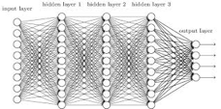

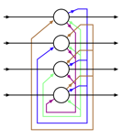

Nobel Prize for Neural Networks - in Physics
The 2024 Nobel Prize in Physics has been awarded
to John J. Hopfield and Geoffrey E. Hinton
"for foundational discoveries and inventions that enable machine learning with artificial neural networks."
https://www.nobelprize.org/prizes/physics/2024/popular-information/
Geoffrey Hinton - https://en.wikipedia.org/wiki/Geoffrey_Hinton
University of Toronto, cognitive psychology and computer science.
Geoffrey Hinton is widely regarded as the "Godfather of AI", famous for his work on artificial neural networks & deep learning.
Backpropagation - popularized and improved.
Boltzmann Machines (1985) - co-invented
Distributed Representations (1992-1993) - patterns of activation among neurons rather than by individual neurons.
Deep Belief Networks (2006) (Restricted Boltzmann Machines).
Worked at Google 2013-2023. Google Translate, CNNs
John Hopfield - https://en.wikipedia.org/wiki/John_Hopfield
Hopfield published his first paper in neuroscience in 1982, titled "Neural networks and physical systems with emergent collective computational abilities"
https://www.pnas.org/doi/epdf/10.1073/pnas.79.8.2554
where he introduced what is now known as Hopfield network, a type of artificial network that can serve as a content-addressable memory, made of binary neurons that can be 'on' or 'off'.
Jürgen Schmidhuber wrote: The #NobelPrizeinPhysics2024 for Hopfield & Hinton rewards plagiarism and incorrect attribution in computer science https://x.com/SchmidhuberAI/status/1844022724328394780
Nobel seems to reward prominence over originality
Amari (1972), Ivakhnenko & Lapa (1965)
Annotated History of Modern AI and Deep Learning
https://people.idsia.ch/~juergen/deep-learning-history.html

Slide 3



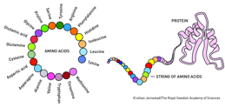
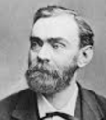
Nobel Prize for Neural Networks in Chemistry
Demis Hassabis & John Jumper
Google Deepmind, co-inventos of AlphaFold, an AI system that performs protein 3d structure prediction based on its amino acid sequence.
The 2024 Nobel Prize in Chemistry has been awarded
to David Baker, Demis Hassabis, and John Jumper for their groundbreaking work in utilizing artificial intelligence to advance protein research - for their development of the AlphaFold Protein Structure Database, which can predict the three-dimensional structures of nearly all known proteins, a feat that had eluded scientists for half a century.
David Baker - https://en.wikipedia.org/wiki/David_Baker_(biochemist)
David Baker is the director of the Institute for Protein Design at the University of Washington. He has developed the Rosetta algorithm for protein structure prediction. His lab has created a wide range of new proteins with diverse functions, including proteins that can be used as pharmaceuticals, vaccines, nanomaterials, and tiny sensors. He has helped create Foldit - a science game that allows players to contribute to protein folding research. He initiated Rosetta@Home, a distributed computing project that utilizes the idle processing power of volunteers' computers to perform protein structure prediction calculations.
Alfred Nobel (Sweden) has invented dynamite and was nicknamed as the "merchant of death". Establishing the Nobel Prize was a way to ensure he was remembered for something positive. He signed his will to establish the Nobel Prize fund in 1895, first 5 prizes were awarded in 1901 after his death.
https://en.wikipedia.org/wiki/Alfred_Nobel
Is AI a science?
Math, Information, Biology, Computer Engineering, ...
Courses & Departments at Universities, scientific research papers, Ph.D. theses, conferences, ...

Slide 4
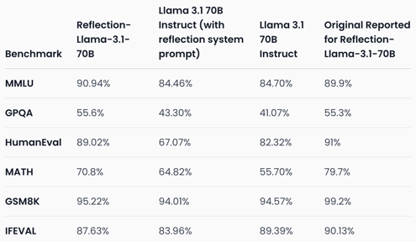


Update on Reflection-70B
Update on Reflection-70B https://glaive.ai/blog/post/reflection-postmortem
On September 5th, Matt Shumer and Sahil Chaudhary announced a new model called Reflection 70B, finetuned on top of Llama 3.1 70B, showing SoTA benchmark results.
The model was trained to use "step-by-step" Chain of Thought approach. This is done by tuning on synthetic data showing examples of using <thinking> and <reflection> tags to remove hallucination and perform self-correction - and fine-tuned the model on these examples.
Model raised suspicions. A month was spent on re-testing and fixing bugs.
Authors were able to reproduce the model benchmark scores (with some minor differences). Authors also reproduced strange behaviors reminding Claude - and proved that they did not used Claude, and that the model itself can generate such responses even running locally.
Authors released everything so community can re-test
Matt Shumer
https://x.com/mattshumer_
https://www.hyperwriteai.com
Sahil Chaudhary
https://twitter.com/csahil28
https://glaive.ai

Slide 5
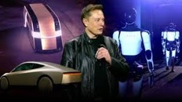
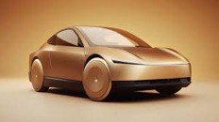

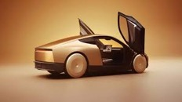

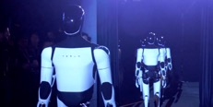
Tesla's "We, Robot" Robotaxi event
October 10, 2024
Location - Warner Brothers Studios in Burbank, LA, CA.
Elon Musk arrived in a Robotaxi, a fully autonomous vehicle designed for ride-hailing services
It features a unique Cybertruck-inspired design with two doors, two seats, and no steering wheel or pedals
Musk emphasized its affordability (~ $30,000)
Robovan Concept - an autonomous van capable of carrying up to 20 passengers or cargo
Optimus humanoid robot - improved motor skills and the ability to sort objects
Tesla aims to use Optimus in its factories and eventually for household tasks
AI and Hardware Advancements: Musk highlighted Tesla's progress in AI training and the development of its Dojo supercomputer, crucial for processing massive amounts of driving data to improve autonomous capabilities.

Slide 6
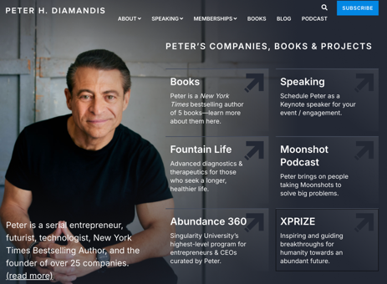
Abundance - Peter Diamandis
Communication: Zoom, FaceTime, ... - effectively free
Generative AI, is free in most cases
Good smartphones for less than $70
Information is free on Google
ICON is now 3D printing homes for $99,000
More evidence of abundance: https://www.diamandis.com/data
Happiness, Equality, Safety, less Violence, Health, Energy, less poverty, Technology, Learning & Literacy, Global Connectivity
Prices go down:
The cost of producing anything =
[Cost of Energy] + [Cost of Intellectual Property]
+ [Cost of Raw Materials] + [Cost of Manufacturing].
Energy costs head toward zero (solar, ...)
The cost of IP diminishes with open source or AI-generated designs. The cost of the raw materials is low ($15 in smartphone)
The manufacturing costs is going down (robots building robots)
So money will become drastically less important.
“As we move into a world of ubiquitous artificial intelligence and automation, the economic model of labor and capital will evolve into a new paradigm where scarcity gives way to abundance.”
- Ray Kurzweil

Slide 7
Misc 1
Collection of ~1,400 jailbreak prompts
https://github.com/verazuo/jailbreak_llms
State of AI Report - by Nathan Benaich, Oct 10, 2024
gdoc: https://docs.google.com/presentation/d/1GmZmoWOa2O92BPrncRcTKa15xvQGhq7g4I4hJSNlC0M/
Video highlights - 22 min
https://www.youtube.com/watch?v=CyOL_4K2Nyo
2-bit quantization for LLMs
https://arxiv.org/pdf/2409.17066
Vector Post-Training Quantization (VPTQ) - compress LLMs to just 1-2 bit precision. So you can run 70B params model on a single RTX 4090 GPU.
It outperforms GPTQ, ... methods, allows high inference speed. Works with PyTorch, TensorFlow, and Hugging Face. Uses "Second-Order Optimization" to minimize quantization errors
Bolt.new - full-stack javascript AI-powered development
https://bolt.new
https://github.com/stackblitz/bolt.new
Bolt.new is an AI-powered web development tool created by StackBlitz. It lets you build full-stack web applications right in your browser using just text prompts. It only uses javascript (or typescript).
The core elements are open-source on GitHub, but the Bolt.new is a commercial product offered by StackBlitz. This means that there are also proprietary components and integrations not available in the public repository. These could include AI models and training data, integrations, specific features and optimizations.
BitNet: Scaling 1-bit Transformers for LLMs
https://arxiv.org/abs/2310.11453 - 17 Oct 2023
BitNet - scalable & stable 1-bit Transformer architecture for LLMs.
BitNet achieves competitive performance while substantially reducing memory footprint and energy consumption
BitNet exhibits a scaling law akin to full-precision Transformers
Training may be unstable. Existing LLM frameworks and hardware are primarily optimized for higher precision arithmetic. Fine-tuning 1-bit LLMs could be more difficult because the reduced precision limits the model's ability to adapt to subtle nuances in the data.
Aria - from Rhymes.AI - First Open Multimodal Native MoE Model
https://www.rhymes.ai/blog-details/aria-first-open-multimodal-native-moe-model
Handles text, images, and videos - all within a single model
Multimodal Native MoE Architecture - different parts of the model specialize in different tasks or data types
Open Source ln params

Slide 8
Misc 2
EuroLLM
https://arxiv.org/abs/2409.16235
Open-Weight Multilingual Language Models
EuroLLM-1.7B and EuroLLM-1.7B-Instruct
Can Understand and Generate Text in All Official European Union languages
Robotic Process Automation (RPA)
- use bots/agents to automate repetitive tasks
https://www.uipath.com
https://www.uipath.com/rpa/robotic-process-automation
Meta Movie Gen, a series of four systems that generate videos, include consistent characters, alter generated imagery, and add matching sound effects and music.
Announcement and examples:
https://ai.meta.com/research/movie-gen/
Movie Gen will be available on Instagram in 2025.
https://www.instagram.com/zuck/reel/DAs_J17Pw0G/
Paper - https://ai.meta.com/static-resource/movie-gen-research-paper
Movie Gen Video can output 256 frames (up to 16 seconds at 16 frames per second) at 1920x1080-pixel resolution.
It includes a convolutional neural network autoencoder, transformer, and multiple embedding models.
H100 - renting is cheaper than buying.
The rent prices: from shortage ($8/hr) to oversupplied ($2/hr)
Hailuo AI Image-to-Video
developed by MiniMax
transform static images into short dynamic videos
control over camera motion, subject animation, and overall scene transitions
Users can guide the AI by providing detailed prompts that specify camera movements (zoom, pan, orbit), subject actions, and desired moods
High-Quality Output: Hailuo AI generates videos with good resolution (currently 720p at 25 FPS) and smooth transitions, making the output look quite professional
Prompt Optimizer: A built-in prompt optimizer helps refine user prompts to achieve better results, even if the initial prompt isn't perfect.
OpenAI MLE-bench - a new benchmark to assess how well AI agents can perform machine learning engineering tasks.
It's essentially a test to see how good AI is at doing the job of a human machine learning engineer.
This is a step towards self-improving AI.

Slide 9
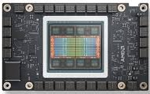
Misc 3
AMD Instinct MI325X chip
new AI chip to compete with Nvidia’s upcoming Blackwell chips
CDNA 3 Architecture
256GB of HBM3E memory, 6TB/s of bandwidth. This surpasses NVIDIA's H200 in memory capacity and bandwidth
400Gbps Infinity Fabric links for high-speed communication between GPUs in a cluster
delivers up to 40% faster inference performance than NVIDIA's H200 on models like Meta's Llama 3.1
optimized for LLMs
Strong FP8 Support - FP8 si a key data type for AI inference.
Power efficiency

Slide 10
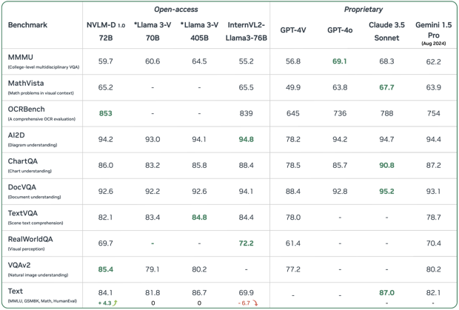
NVLM 1.0 from Nvidia
NVLM 1.0 from Nvidia - open source, multi-modal LLMs https://nvlm-project.github.io
Can process and understanding both images and text. Can perform image captioning, visual question answering, document analysis.
Excellent / improved text performance, text generation and comprehension even after multimodal training.
Strong Performance on Math and Coding
Open-Source on Hugging Face
High accuracy (SOTA) on vision-language tasks

Slide 11
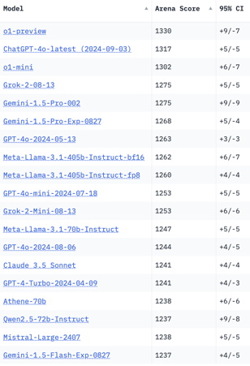
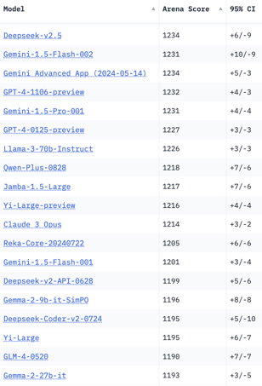
Crowd-sourced "Arena" Leaderboard
Total #models: 152.
Total #votes: 2,011,939.
Last updated: 2024-10-06
Starting Elo rating = 1000
95% CI = Confidence Interval
https://chat.lmsys.org/?leaderboard
English-only queries

Slide 12
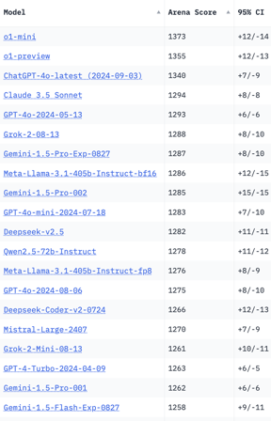
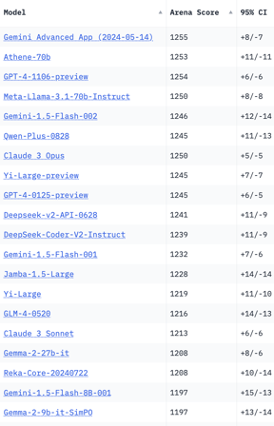
Crowd-sourced "Arena" Leaderboard
Total #models: 152.
Total #votes: 2,011,939.
Last updated: 2024-10-06
Starting Elo rating = 1000
95% CI = Confidence Interval
https://chat.lmsys.org/?leaderboard
Coding

Slide 13
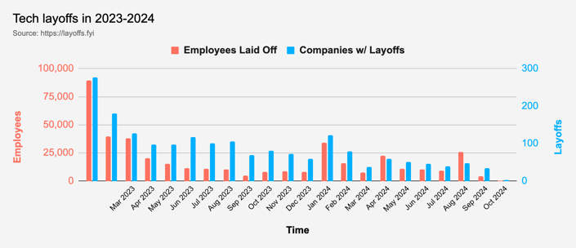
Tech Layoffs in 2024
Layoffs - https://layoffs.fyi

Slide 14
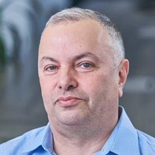

About the Speaker
Lev Selector, Ph.D.
40+ years of software engineering, data science, and building teams (hiring, training, and managing)
Ph.D. in mathematical modeling and computer simulations
Interests:
Generative AI, Using LLM with your data
Local AI for Local Private Data
Cloud architecture, fin-tech, application security
Find/connect: Linkedin, GitHub, YouTube, Google
https://eais.ai
Enterprise AI Systems

Slide 15
Thank You!

