Slide 1
AI Updates
September 27, 2024
Sam Altman Post - an Intelligence Age
Re-Reading Improves Reasoning
Google "SCoRe"
Qwen 2.5 is better at coding than o1-preview
Microsoft goes Nuclear!
Google: ALOHA Unleashed & DemoStart
NVIDIA Llama 3.1-Nemotron-51B
Anthropic at $40 Bln Valuation
Solar Pro Preview
Jony Ive (former APple) + OpenAI
Meta Glasses
Anthropic's Contextual Retrieval
Microsoft GRIN MoE
GraphRAG vs Traditional RAG vs Vector RAG
ClaudeDev VSCode extension
Bird Bench - Text-to-SQL Leaderboard
Berkeley Function-Calling Leaderboard update
Electronic Arts games follow language cmd-s
California has 9 new AI laws
OpenAI AVM (Advanced Voice Mode)
Google Gemini Price Cuts
Will AI solve CMI Millennium Prize Problems ?
Crowd-sourced "Arena" Leaderboard - English
Crowd-sourced "Arena" Leaderboard - Coding
Tech Layoffs in 2024

Slide 2

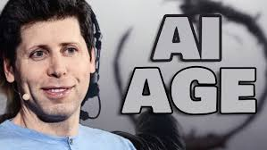
Sam Altman Post - an Intelligence Age
The Intelligence Age (Sept 23)
https://ia.samaltman.com
Accelerated Progress.
AI's Potential - solve complex problems, achieve impossible.
Personal AI Teams for everyone.
Shared unprecedented prosperity worldwide.
Deep Learning made AI possible.
The more compute and data - the better AI problem solving.
AI's will act as autonomous assistants and scientists.
Intelligence Age - depends on compute, energy, human initiative.
Expanding AI requires more energy and low compute costs.
The Intelligence Age presents complex/risky challenges.
The future holds immense potential for prosperity and remarkable achievements.
Downsides - significant labor market shifts. However, new opportunities will arise as AI amplifies human abilities.

Slide 3
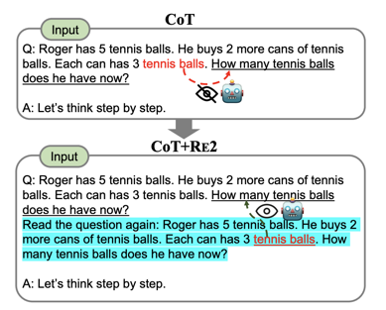
Re-Reading Improves Reasoning
Re-Reading Improves Reasoning in Large Language Models - https://arxiv.org/pdf/2309.06275
RE2 is a simple prompting method that repeats the question as input.
Typically, tokens in the question, such as "tennis balls", cannot see subsequent tokens in the original setup for LLMs (the top figure).
In contrast, LLMs with RE2 allows "tennis balls" in the second pass to see the entire question containing "How many ...", achieving an effect of a "bidirectional" understanding (the bottom figure).

Slide 4
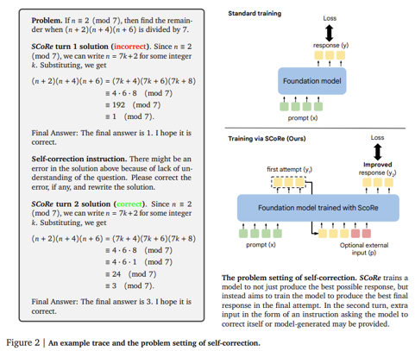
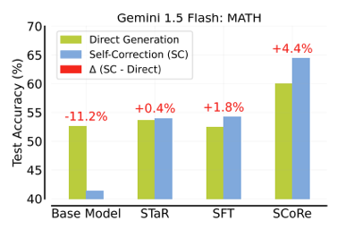
Google "SCoRe"
Google DeepMind SCoRe (Self-Correction via Reinforcement Learning): A New AI Method Enhancing LLM's Accuracy in Complex Mathematical and Coding Tasks. It uses two-stage training process and reward shaping.
https://arxiv.org/abs/2409.12917
https://www.marktechpost.com/2024/09/21/google-deepmind-introduced-self-correction-via-reinforcement-learning-score-a-new-ai-method-enhancing-large-language-models-accuracy-in-complex-mathematical-and-coding-tasks/

Slide 5

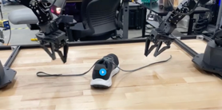
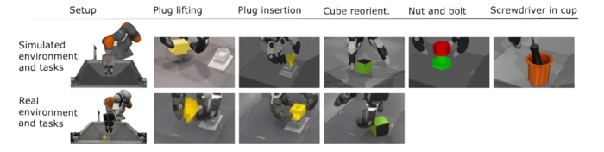
Misc 1
Qwen 2.5-Coder outranks GPT-4o and o1-preview on Livebench coding - Qwen2.5-Coder Technical Report - https://arxiv.org/abs/2409.12186
Qwen 2.5 is better at coding than o1-preview
At least in my personal tests
Microsoft goes Nuclear! Constellation Energy has partnered with Microsoft to restart the Three Mile Island Unit 1 reactor, which was shut down five years ago. The restart is expected to create ~ 3,400 jobs and generate over 800 MW of electricity
Google DeepMind 2 new AI-based robot hand systems:
ALOHA Unleashed - use both hands cooperatively for complex tasks like tying shoelaces
DemoStart - enhances control of multi-jointed, multi-fingered robot hands for precision work (insert a plug into a socket)
https://techxplore.com/news/2024-09-google-deepmind-unveils-ai-based.html#google_vignette

Slide 6


Misc 2
Apple's former chief design officer, Jony Ive, is collaborating with OpenAI CEO Sam Altman on developing new AI device.
https://www.engadget.com/ai/jony-ive-confirms-hes-working-with-sam-altman-on-a-secret-project-163201291.html
NVIDIA Llama 3.1-Nemotron-51B
derived from Meta’s Llama-3.1-70B
uses a novel Neural Architecture Search (NAS)
highly accurate and efficient
fits on a single NVIDIA H100 GPU
2..4 times faster than original Llama-3.1-70B
https://developer.nvidia.com/blog/advancing-the-accuracy-efficiency-frontier-with-llama-3-1-nemotron-51b/
Meta Glasses - interview with Mark Zuckerberg
https://www.youtube.com/watch?v=QciJ9ubeLQk
Mark wants to build "awesome" products that inspire and uplift people. His vision is combining AI with work of Reality Labs (division of Meta for virtual reality (VR) and augmented reality (AR)).
OpenAI raising $5..7 Bln at ~$150 Bln valuation.
Anthropic has begun discussions with new valuation $30-40 Bln, which is about double from last year.
Anthropic's Contextual Retrieval - improve RAG by prepending chunk-specific explanatory context to each chunk before embedding ("Contextual Embeddings") and creating the BM25 index ("Contextual BM25"). BM25 (Best Match 25) is a ranking function similar to TF-IDF, but improved (doc length normalization, Term Frequency Saturation, tunable parameters).
https://www.anthropic.com/news/contextual-retrieval
original_chunk = "The company's revenue grew by 3% over the previous quarter."
contextualized_chunk = "This chunk is from an SEC filing on ACME corp's performance in Q2 2023; the previous quarter's revenue was $314 million. The company's revenue grew by 3% over the previous quarter."
Solar Pro Preview: The most intelligent LLM on a single GPU
from Upstage - South Korean AI company
https://www.upstage.ai/products/solar-pro-preview
https://huggingface.co/upstage/solar-pro-preview-instruct

Slide 7
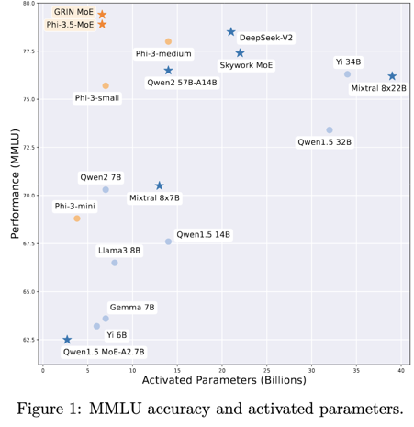
Microsoft GRIN MoE
Microsoft GRIN MoE: A Gradient-Informed Mixture of Experts Model
https://arxiv.org/abs/2409.12136
https://www.marktechpost.com/2024/09/21/microsoft-releases-grin-moe-a-gradient-informed-mixture-of-experts-moe-model-for-efficient-and-scalable-deep-learning/
The model uses gradient estimation for expert routing.
MoE layers consists of 16 experts, and only the top 2 are activated for each input token. Each expert is implemented as a GLU (Gated Linear Unit) network. SparseMixer-v2, a key component that estimates gradients related to expert routing, replacing conventional methods that use gating gradients as proxies.

Slide 8



Misc 3
GraphRAG - good when your data has complex relationships between entities. Uses Knowledge Graphs. Uses graph traversal or subgraph matching algorithms. Problem - complexity, maintenance.
Traditional RAG - good choice for flat document collections where each article is self-contained. Uses full-text search and keyword matching. Problem - can not understand semantic meaning
Vector RAG - good choice when you need to handle a lot of unstructured data (semantic search, similarity search). Uses vector embeddings. Efficient for handling large data.
Electronic Arts demonstrated a new AI-driven concept for user-generated video game content. Players can create and modify games in real-time using natural language commands.
https://x.com/geoffkeighley/status/1836129684351791337
https://www.youtube.com/watch?v=oC1bAUG-0uc
California has 9 new AI laws
https://techcrunch.com/2024/09/23/here-is-whats-illegal-under-californias-9-and-counting-new-ai-laws/
ClaudeDev - an extension for VS Code.
install from the VS Code Extension Marketplace
use Claude AI from your editor
https://github.com/saoudrizwan/claude-dev
OpenAI AVM (Advanced Voice Mode)
five new voices (Arbor, Maple, Sol, Spruce, and Vale)
better accent understanding and conversation flow
is being rolled out to ChatGPT Plus and Teams users
new custom instructions and memory features in AVM
Bird Bench - Text-to-SQL Leaderboard
https://bird-bench.github.io
Berkeley Function-Calling Leaderboard - updated
https://gorilla.cs.berkeley.edu/leaderboard.html

Slide 9
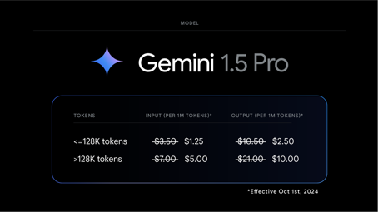
Misc 4
Google Gemini Price Cuts -
https://x.com/OfficialLoganK/status/1838611055217385646
Two new production Gemini models, >2x higher rate limits, >50% price drop on Gemini 1.5 Pro, filters switched to opt-in, updated Flash 8B experimental model, and more.

Slide 10
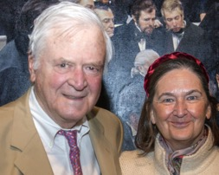
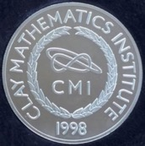
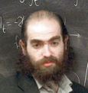

Will AI solve Millennium Prize Problems ?
Millennium Prize Problems
https://www.claymath.org/millennium-problems/
- The list of Math problems created in 2000 by the
Clay Mathematics Institute (CMI)
in Cambridge, Massachusetts.
CMI was founded in 1998 by Landon & Lavinia Clay.
Birch and Swinnerton-Dyer Conjecture: This conjecture deals with elliptic curves and attempts to connect the number of rational points on an elliptic curve to the behavior of an associated L-function.
Hodge Conjecture: This conjecture lies in the realm of algebraic geometry and suggests that certain geometric objects called Hodge cycles can be expressed as combinations of algebraic cycles.
Navier-Stokes Existence and Smoothness: These equations describe the motion of fluids, but it's unknown whether smooth solutions always exist for given initial conditions.
P versus NP Problem: A central problem in theoretical computer science, this asks whether every problem whose solution can be quickly verified can also be quickly solved.
Riemann Hypothesis: This conjecture concerns the distribution of prime numbers and states that all non-trivial zeros of the Riemann zeta function lie on a particular vertical line in the complex plane.
Yang-Mills Existence and Mass Gap: This problem relates to quantum field theory and proposes that quantum Yang-Mills theory exists and has a mass gap, meaning there's a minimum energy level for excitations above the vacuum state.
Poincaré Conjecture (solved): This conjecture in topology posited that any simply connected, closed 3-manifold is topologically equivalent to the 3-sphere. It was solved by Grigori Perelman in 2003.
Fermat's Last Theorem (solved):
No three positive integers a, b, and c
satisfy the equation a^{n} + b^{n} = c^{n}
for any integer value of n greater than 2.
It was famously proved by Andrew Wiles in 1994, after remaining unsolved for over 350 years.

Slide 11
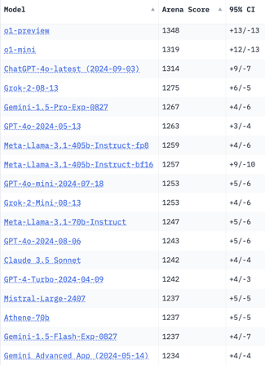
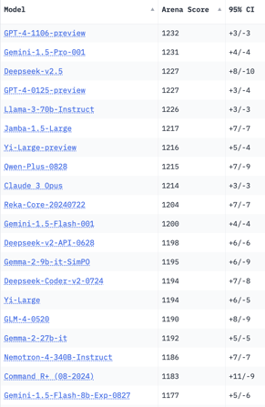
Crowd-sourced "Arena" Leaderboard
Total #models: 145.
Total #votes: 1,898,013.
Last updated: 2024-09-17.
Starting Elo rating = 1000
95% CI = Confidence Interval
https://chat.lmsys.org/?leaderboard
English-only queries
New
New
New
1 byte

Slide 12
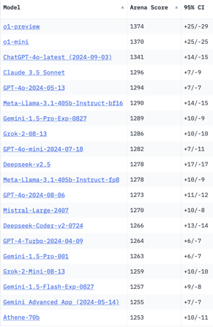
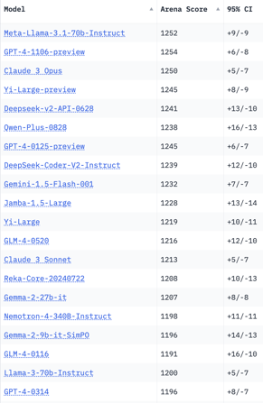
Crowd-sourced "Arena" Leaderboard
Total #models: 145.
Total #votes: 1,898,013.
Last updated: 2024-09-17.
Starting Elo rating = 1000
95% CI = Confidence Interval
https://chat.lmsys.org/?leaderboard
Coding
New
New
1 byte

Slide 13
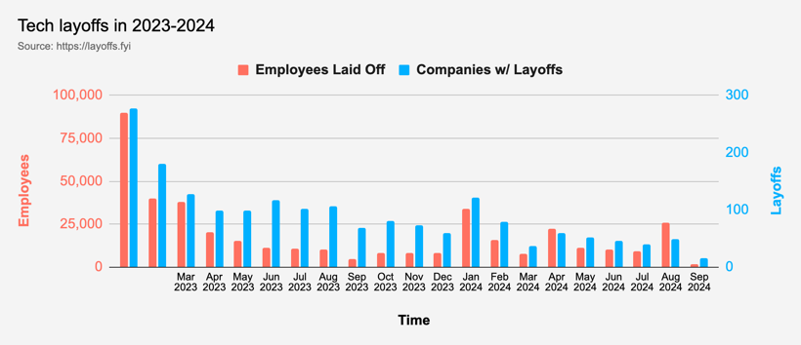
Tech Layoffs in 2024
Layoffs - https://layoffs.fyi
Amazon has mandated that its corporate employees return to the office full-time, five days a week, starting in January 2025.

Slide 14
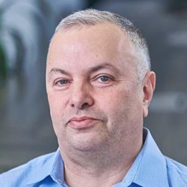

About the Speaker
Lev Selector, Ph.D.
40+ years of software engineering, data science, and building teams (hiring, training, and managing)
Ph.D. in mathematical modeling and computer simulations
Interests:
Generative AI, Using LLM with your data
Local AI for Local Private Data
Cloud architecture, fin-tech, application security
Find/connect: Linkedin, GitHub, YouTube, Google
https://eais.ai
Enterprise AI Systems

Slide 15
Thank You!

