Slide 1

AI Updates
May 30, 2025
from AI co-pilot -- to AI agent
Crowd-sourced "Arena" Leaderboard
Anthropic AI Summit - May 22
DeepSeek-R1-0528
Perplexity Labs
AI models hallucinate less than humans
Anthropic Voice mode for Claude mobile apps
Claude Web Search - even on free plan
Google Stitch - Free AI UI Designer
OpenAI Operator agent to use o3
AI Shows Higher Emotional IQ than Humans
Oracle $40 Bln for 400K GPUs
ConvSearch-R1 improves prompts
Nvidia cheap Blackwell AI chip for China in June
Microsoft GitHub Copilot coding agent
Mistral Launches Agents API
Meta is splitting its AI org into two groups
Recraft V3 model (a.k.a. red_panda)
UAE provides ChatGPT-Plus to all its citizens
UBS using AI Avatars
ByteDance's Seed 1.5VL model
Tencent's Hanyuan Image 2.0
Sergey Brin Interview
Google: x50 more tokens than a year ago
Why Google's AI model is named "Gemini"?
Why Anthropic LLM is named "Claude"
Nvidia Nemotron Models
Augmentcode - AI for large, complex codebases
Google Veo 3 Video Generation
Managing AI Software Development Projects
Builder.ai rise and fall
AI Autonomous Tractors
Jobs, Layoffs

Slide 2
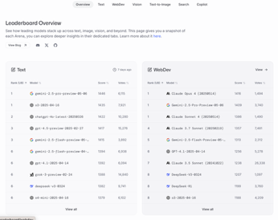
Crowd-sourced "LM Arena" Leaderboard
Starting Elo rating = 1000
https://en.wikipedia.org/wiki/Elo_rating_system
Text - May 23
Webdev - May 28
LM Arena secures $100M to expand AI benchmarking (at $600M valuation)
Model | Score
gemini-2.5-pro-preview-05-06 | 1446
o3-2025-04-16 | 1435
chatgpt-4o-latest-20250326 | 1422
gpt-4.5-preview-2025-02-27 | 1417
gemini-2.5-flash-preview-05-20 | 1415
gemini-2.5-flash-preview-04-17 | 1394
gpt-4.1-2025-04-14 | 1392
grok-3-preview-02-24 | 1388
deepseek-v3-0324 | 1382
o4-mini-2025-04-16 | 1379
o1-2024-12-17 | 1380
deepseek-r1 | 1376
claude-3-7-sonnet-20250219-thinking-32k | 1371
o1-preview | 1363
hunyuan-turbos-20250416 | 1359
mistral-medium-2505 | 1359
claude-3-7-sonnet-20250219 | 1357
Model | Score
Claude Opus 4 (20250514) | 1416
Gemini-2.5-Pro-Preview-05-06 | 1409
Claude Sonnet 4 (20250514) | 1386
Claude 3.7 Sonnet (20250219) | 1357
Gemini-2.5-Flash-Preview-05-20 | 1313
GPT-4.1-2025-04-14 | 1256
Claude 3.5 Sonnet (20241022) | 1238
DeepSeek-V3-0324 | 1207
DeepSeek-R1 | 1199
o3-2025-04-16 | 1188
GPT-4.1-mini-2025-04-14 | 1186
Qwen3-235B-A22B | 1182
Mistral Medium 3 | 1164
Gemini-2.5-Flash-Preview-04-17 | 1144
o3-mini-high (20250131) | 1136
Claude 3.5 Haiku (20241022) | 1133
o4-mini-2025-04-16 | 1100
https://lmarena.ai/?leaderboard
https://openlm.ai/chatbot-arena/
https://beta.lmarena.ai
https://legacy.lmarena.ai
x.ai
China
China
China
China
China
M
China
M
Web Leaderboard https://web.lmarena.ai/leaderboard
LLM Leaderboard - by @LlmStats https://llmworld.net/llm_leaderboards/
LLM Leaderboard - by StackAI https://www.stack-ai.com/llm-leaderboard
LLM Leaderboard - by Artificial Analysis https://artificialanalysis.ai/leaderboards/models
Open LLM Leaderboard - by Hugging Face https://huggingface.co/open-llm-leaderboard
LLM Leaderboard - by Vellum https://www.vellum.ai/llm-leaderboard
Multiple Leaderboards: https://virtualizationreview.com/articles/2025/04/29/ais-heavy-hitters-best-models-for-every-task.aspx

Slide 3

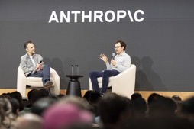


Anthropic AI Summit - May 22
Anthropic "Code with Claude" in San Francisco May 22, 2025
A one-day, hands-on event for developers and founders
Workshops and sessions - Real-World AI Implementations, practical applications of Anthropic’s API, CLI tools, and the Model Context Protocol (MCP). Best practices
Insights into Product Roadmap and Technical Deep Dives by Anthropic’s executive and product teams
New tools - Claude Code, Claude 4
Anthropic’s "virtual collaborator" - an autonomous AI agent.
AI Safety and Responsibility; Community and Networking, interactive labs
Event gathered around 500 participants
AI models hallucinate less than humans
Dario Amodei claims AI models fabricate facts less often than people - thus hallucinations should not block the path to AGI
https://techcrunch.com/2025/05/22/anthropic-ceo-claims-ai-models-hallucinate-less-than-humans/
Anthropic Voice mode for Claude mobile apps
will run on Claude's latest Sonnet 4 model
five voice personalities, real-time transcription
integrates with Google Workspace
Claude Web Search available even on the free plan
Web search is now available to all Claude users on our free plan. Each response includes inline citations, so you can also verify the sources.
https://x.com/AnthropicAI/status/1927440048930128089

Slide 4

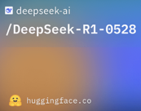
DeepSeek-R1-0528
DeepSeek-R1-0528 - open-source reasoning
sizes: 1.5B, 7B-8B, 14B-32B, 671B params
can run on phones, laptops, consumer GPUs
MoE, Multihead Latent Attention (MLA) with advanced key-value memory compression, reducing VRAM usage by up to 93%
Multi-Token Prediction - 2x faster inference
Implements low-precision (FP8) mixed computation - less memory, faster processing
Reinforcement Learning - hybrid: Cold-start data + RL
Improved readability and coherence
Quantized and distilled variants (DeepSeek-R1-Distill-Qwen-1.5B, ...)
https://huggingface.co/deepseek-ai/DeepSeek-R1-0528

Slide 5

Perplexity Labs
Perplexity Labs - use prompts to create interactive web apps, dashboards, reports, and spreadsheets in minutes
Rapid Prototyping and Automation - generate and run/test code (Python, Javascript), create interactive dashboards or even lightweight web applications from a single prompt
All files, chars, images can be stored in labs and downloaded
You can call multiple AI models into your code via Perplexity API
Labs can handle multi-step tasks, from data gathering to visualization
Use it to analyze data, build prototypes, generate documentation, or visualize system architectures
https://www.perplexity.ai/labs
Perplexity Labs is not free. It is available exclusively to Perplexity Pro subscribers as part of their $20/mo subscription

Slide 6



AI Updates 1
UAE provides ChatGPT-Plus to all its citizens
United Arab Emirates is the first country to provide premium AI to the whole population https://openai.com/index/introducing-stargate-uae/
Google Stitch - Free AI UI Designer
Web-based text to UI design
Gemini 2.5 Pro and Flash models,
Standard & Experimental modes
Separate interfaces for web and mobile design
Can replicate designs from uploaded sketches or images
Built-in theme editor, color schemes, adjustment tools
Design coherence across multiple pages
Code export
https://www.youtube.com/watch?v=MGTSDaloUZM
UBS using AI Avatars
UBS is one of Switzerland’s largest banks. It is using AI avatars of 5% of its analysts in videos that present research content to clients
Each video replicates the analyst’s look and voice. The script is created by OpenAI models based on provided research.
The avatars are developed using Synthesia text-to-video AI video generators ( https://www.synthesia.io )
UBS plans to scale to 5,000 videos annually
https://www.swissinfo.ch/eng/swiss-ai/ubs-deploys-ai-analyst-clones/89349363

Slide 7
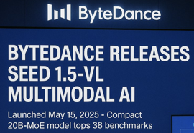


AI Updates 2
ByteDance's Seed 1.5VL model
ByteDance, the parent company of TikTok, released Seed 1.5VL, a new vision-language foundation model
combining visuals and text, video understanding, and automating agentic workflows.
Seed 1.5VL utilizes a 532 Mln params vision encoder and a 20 Bln active parameter MoE LLM
Seed 1.5VL outperforms models from Google, OpenAI, and Anthropic in 38 out of 60 public benchmarks
Its power is attributed to being trained on 3 trillion carefully curated high-quality tokens (text, video, audio, and images)
Tencent's Hanyuan Image 2.0
Generate images almost instantly from text, voice, or sketches
The claimed response time is in milliseconds
delivers hyper-realistic images
accuracy rate exceeding 95% (understanding text instructions)
multi-round text-to-image interactions
can generate images while users are speaking

Slide 8

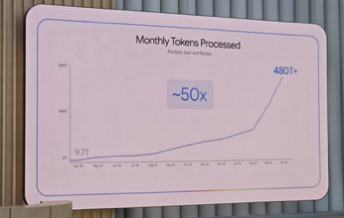
AI Updates 3
Sergey Brin Interview
https://www.youtube.com/watch?v=8g7a0IWKDRE
Sergey Brin returned to Google
He is astonished by the exponential nature and pace of AI development. AI's ability to process information at a volume humans cannot (for example, deep research) while generating detailed results; AI's impact on education and college, Robotics and Hardware, Coding; AI models - trend towards convergence; Open Source vs. Closed Source; Evolution of Human-Computer Interaction; Gemini App; Increasing use of voice chat mode; AI in management
Google processes x50 more token than a year ago
processes 480 trillion tokens a month – 50× more than a year ago – and almost 5x more than the 100 trillion tokens a month that Microsoft’s Satya Nadella said his company processed.
Over 7 million developers are using Gemini API - a five-fold increase since the last I/O.
Gemini usage on Vertex AI has surged more than 40 times
Unit costs keep falling
Google search AI Mode (rolling out in the U.S.) and AI Overviews (already serving 1.5 billion users monthly)
"World Model" - artificial intelligence initiative aimed at developing a foundational AI system that can understand, simulate, and interact with the physical world much like a human
https://venturebeat.com/ai/googles-world-model-bet-building-the-ai-operating-layer-before-microsoft-captures-the-ui/

Slide 9

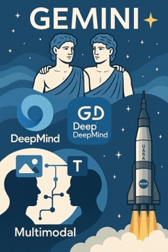


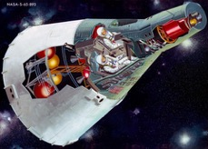
Why Gemini
Why Google's AI model is named "Gemini"?
Gemini is the Latin word for "twins".
It may be symbolizing the merger
of Google's DeepMind and Google Brain teams
into one unit called Google DeepMind.
Gemini is also a star constellation
represents two mythological Greek twins
Castor and Pollux. The "Gemini" thus
metaphorically represents the dual
nature and combined strength.
Also, the model was developed as multimodal
(dual nature) at a time when all LLMs were just
plain text models.
Also Google may have been inspired by NASA's Project Gemini (1965-66),
its pioneering spirit, innovation and exploration.
(NASA programs: Mercury, Gemini, Apollo).
Gemini was also the predecessor of the Apollo program. Maybe "Apollo" model is coming ?

Slide 10


Why Claude
Claude Shannon is called the "father of information theory" because he founded the entire field with his landmark 1948 paper, "A Mathematical Theory of Communication."
In this work, Shannon introduced a rigorous, mathematical approach to quantifying information, defining key concepts such as the "bit" (the basic unit of information), and establishing how information could be efficiently encoded, transmitted, and compressed over communication channels like phone lines or wireless networks.
Shannon's Entropy (information entropy) - a measure of the uncertainty or unpredictability in a set of possible messages. Entropy quantifies the average amount of information produced by a stochastic source of data.
The formula for entropy expresses the expected value of the information content (in bits if the logarithm is base 2) of the outcomes. In practical terms, higher entropy means more unpredictability (as in random noise), while lower entropy means more predictability (as in repetitive or structured messages).
Why Anthropic LLM is named "Claude"
It was named after Claude Shannon, the pioneering mathematician, electrical engineer, and computer scientist widely regarded as the "father of information theory" and a foundational figure in artificial intelligence research.
Additionally, Anthropic chose a "male" name "Claude" to distinguish their AI assistant from others in the market, many of which—such as Alexa, Siri, and Cortana—have female names.

Slide 11




AI Updates 4
OpenAI Operator agent to use o3
Operator, is an autonomous agent to browse the web and use tools
https://openai.com/index/o3-o4-mini-system-card-addendum-operator-o3/
AI Shows Higher Emotional IQ than Humans
six models were tested on standard emotional intelligence (EI) assessments. The AIs achieved an average score of 82%, significantly higher than the 56% scored by human participants.
https://neurosciencenews.com/ai-llm-emotional-iq-29119/
Oracle $40 Bln for 400K GPUs
Oracle signs $40 billion deal for 400,000 Nvidia GB200 chips to power OpenAI’s Texas super-hub, forming the core of OpenAI’s Stargate program
https://www.notebookcheck.net/Oracle-signs-40-billion-deal-for-400-000-Nvidia-GB200-chips-to-power-OpenAI-s-Texas-super-hub.1023913.0.html
ConvSearch-R1 improves prompts (China)
Conversational query reformulation (CQR) using a two-stage alignment framework designed for conversational search
https://github.com/BeastyZ/ConvSearch-R1
https://arxiv.org/abs/2505.15776

Slide 12



AI Updates 5
Nvidia to launch cheaper Blackwell AI chip for China in June
New chips are cheaper than H20 model: $7K vs $11K (weaker specs)
https://www.reuters.com/world/china/nvidia-launch-cheaper-blackwell-ai-chip-china-after-us-export-curbs-sources-say-2025-05-24/
Microsoft GitHub Copilot coding agent
switch from an AI assistant to an autonomous team member
Can resolve a GitHub issue, create a draft pull request and iterate based on review comments
Operates asynchronously by spinning up a secure development environment, and analyzing code using advanced reasoning
Available to Copilot Enterprise and Copilot Pro+ customers
Adding features, fixing bugs, refactoring code, and improving docs
Security is built-in
Microsoft Azure AI Foundry offers more than 10K models
https://github.blog/news-insights/product-news/github-copilot-meet-the-new-coding-agent/
https://ai.azure.com/explore/models/leaderboard
Mistral Launches Agents API
Web Search, Python Code Execution, Image Generation using Flux1.1, RAG using uploaded files, MCP for external API calls
Adding web search increased accuracy fro m23% to 75% on SimpleQA benchmark using Mistral Large model

Slide 13

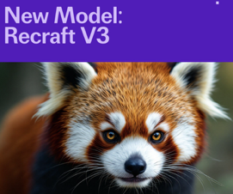
AI Updates 6
Meta is splitting its AI org into two groups:
The AI Products Team - consumer products
The AGI Foundations Team - research, foundation models, reasoning, multimedia, and voice
Recraft V3 model (a.k.a. red_panda) - London, UK
Outperforms Midjourney and DALL·E
Recraft just raised $30 million
https://www.recraft.ai

Slide 14
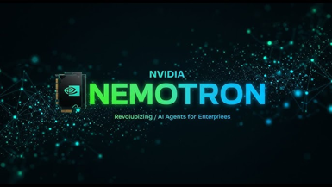
Nvidia Nemotron Models
Nvidia Nemotron models
Llama-3.1-Nemotron-Nano-4B-v1.1 - 128Ktokens, reasoning
Llama-3.1-Nemotron-Nano-8B-v1 - 128Ktokens, reasoning
Llama-3.1-Nemotron-70B-Instruct - reasoning
Llama Nemotron Feedback-Edit - for enterprise use
Llama Nemotron UltraLong - ultra long context for enterprise AI agents.
Nemotron-H-8B
Nemotron-H-56B, Nemotron-H-56B-Base-8K - hybrid (Mamba-2, MLP, 10 Attention layers), 8Ktokens
Nemotron-3 8B - chat & QA
Nemotron 253B v1 - outperforms DeepSeek R1 and Llama 4
Nemotron-4 15B
Nemotron-4 340B
AceReason-Nemotron-14B - math and code reasoning
AceReason-Nemotron-7B - similar to 14B version
Nemotron-CORTEXA - reached the top of the SWEBench leaderboard, solving 68.2% of SWEBench GitHub issues by using a multi-step problem localization and repair process. Average inference cost of $3.28 per problem. Most probably it is built on top of Nemotron-4 15B
https://huggingface.co/nvidia/AceReason-Nemotron-14B
https://huggingface.co/nvidia/Llama-3.1-Nemotron-Nano-4B-v1.1

Slide 15

Augmentcode - coding assistant
Augmentcode - AI for large, complex codebases
Augment Computing, Inc. is a US based startup, proprietary (not open)
Mission is to augment, not replace, human developers
Enabling collective problem-solving
No Training on Customer Code, Enterprise-Grade Security
Accelerated Development, Faster Onboarding
Context Engine - analyze and understand an entire codebase in real time
Memory Persistence - remembers past interactions and code patterns
Multi-Modal Support (can use screenshots or Figma files)
Integrates with GitHub, Jira, Confluence, Notion, Linear, Slack, and major IDEs like VS Code and JetBrains
Runs terminal commands, (e.g., `npm install`, `run dev`), manage Git operations, and even operate in an "Auto Mode" for streamlined, autonomous task completion
https://www.augmentcode.com

Slide 16

Google Veo 3 Video Generation
Google Veo 3 - advanced AI video generation model
announced at Google I/O 2025
High-Quality, Realistic Video (up to 4K), photorealistic, consistent characters, believable motion, mimic real-world physics
Veo 3 can generate synchronized audio including dialogue, ambient sounds, sound effects, and background music directly alongside video content
great at understanding and interpreting complex nuanced prompts and image prompts. Can translate detailed scene descriptions, character actions, and narrative elements into dynamic, coherent video sequences
Users can upload reference images to maintain character consistency and control artistic style
Camera Controls (pans, zooms, angle changes) and flexible motion control of objects and characters
Supports editing (adding or removing objects in a scene, generating seamless transitions between frames, and ensuring smooth continuity throughout a video
Veo 3 powers Google's new Flow filmmaking tool, currently available only in the US, access through the Gemini app and Flow platform, requiring a Gemini Ultra subscription ($250/mo), or via Google’s Vertex AI platform for Enterprise

Slide 17
Managing AI Software Development Projects
backend/
├── src/
│ ├── core/ # Base configurations
│ │ ├── config.py # Environment variables
│ │ ├── database.py # DB connection setup
│ │ └── security.py # Auth base classes
│ └── features/ # Dirs for future modules
│ ├── auth/
│ └── posts/
frontend/
├── src/
│ ├── core/ # Base configurations
│ │ ├── api/ # API client setup
│ │ └── state/ # Empty state management
│ └── features/ # Component directories
│ ├── common/
│ └── layout/
prompts/ # Directory for AI prompts
│ ├── backend_prompts.md
│ ├── frontend_prompts.md
│ └── Claude.md # Optional: persistent memory
Suppose we want to create a web application using Python FastAPI as a backend server, and ReactJS as frontend.
We create a Git repo with 3 directories: backend, frontend, prompts
In backend we use uv and pyproject.toml to configure python virtual environment
In frontend we use yarn to configure basic ReactJS environment
in prompts we create prompts for AI (Claude, Gemini, ...) first prompt - we provide a detailed description of the required result - and ask LLM to provide the architecture with the list of files and directories. The requirement is to make the design modular, split responsibilities, etc. In my case Claude created an architecture with more than 160 files second prompt - to create a step-by-step roadmap for building the app - starting with minimum viable state, then adding features as needed. In my case Claude created 20 steps
Once you create some files, it gets difficult to update them manually. So you want Claude to have access to your code to update multiple files
You can use Cline extension for VS Code which can use Claude and Gemini
Cline maintain context between prompts. While you are working within a single task or conversation in Cline, Claude will have access to the previous exchanges, enabling it to "remember" and build on earlier prompts and answers.
If you start a new task or reset the session, or exhausted the memory of the session, you will lose the context.
Software created by Lovable AI coding has exposed user data and leaked passwords. Lovable has added a Security Scan.
Companies like Amplitude now mandate human audits of all AI-generated code

Slide 18


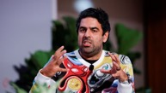
Builder.ai rise and fall
Builder.ai (2016-2025) was founded in London as Engineer.ai
The idea was to us AI to automate app-building process (no-code)
2016 - founded in London
2018 - Builder Studio launches; Series A funding ($29.5M)
2019 - Wall Street Journal investigation revealed that much of Builder.ai’s work was done manually by engineers in India and Ukraine, with little real AI automation involved
2021 - Series B funding ($65M); rebrands to Builder.ai
2022 - Series C funding ($100M); rapid growth claims
2023 - Series D funding ($250M); unicorn status; Microsoft partnership
2025 - Files for Bankruptcy after financial mismanagement
---------------------------------
Total raised: $450 Mln and valuation $1.5 Bln, 1,500 employees
Microsoft was a major investor
Lessons - The Illusion of No-Code; overhyping AI capabilities
"The reality is: great digital products are hard. They take time, thought, and, yes — actual developers, creativity and vision."
"If a platform with $450 million in funding couldn’t automate that, it should tell us something."
https://medium.com/@oceanbcreative/the-illusion-of-no-code-builder-ais-fall-and-what-it-means-for-founders-b8fe7a90634a
Sachin Dev Duggal
former CEO

Slide 19


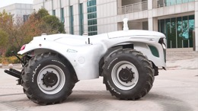
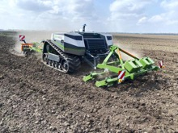
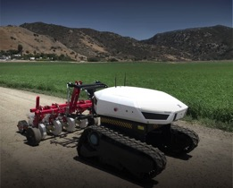
AI Tractors
Driverless tractors - using AI, 5G, GPS navigation
https://www.youtube.com/shorts/QSnMDjYMe6U
https://www.youtube.com/shorts/6TqQNeEq24Y
https://www.youtube.com/shorts/4KYpzXwCB74

Slide 20
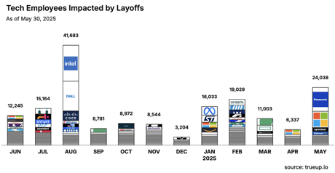
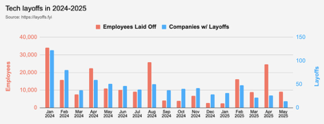
Jobs
https://layoffs.fyi
https://trueup.io/layoffs
74% of CEOs admit their job is at risk if they fail to deliver measurable AI-driven business gains.
94% suspect employees are using GenAI tools without approval — exposing a massive governance failure.
54% admit a competitor already has a superior AI strategy.
https://pages.dataiku.com/global-ai-confessions-report
AI is taking over Entry-Level Jobs. Many young grads now have difficulty getting junior positions, career entry points.
https://fortune.com/2025/05/25/ai-entry-level-jobs-gen-z-careers-young-workers-linkedin/
Anthropic CEO Dario Amodei just warned lawmakers and the public that AI could eliminate 50% of entry-level white-collar positions in the next five years and drive unemployment as high as 20%.
Amodei predicts AI will write 90% of software code within 6 months and virtually all code within a year, completely reshaping tech employment.
He also believes the impact extends to finance, law, consulting, and other white-collar jobs, with entry-level positions most vulnerable to automation.

Slide 21


About the Speaker
Lev Selector, Ph.D.
40+ years of software engineering, data science, and building teams (hiring, training, and managing)
Ph.D. in mathematical modeling and computer simulations
Interests:
Generative AI, Using LLM with your data
Local AI for Local Private Data
Cloud architecture, fin-tech, application security
Find/connect: Linkedin, GitHub, YouTube, Google
https://eais.ai
Enterprise AI Systems

Slide 22
Thank You!

