Slide 1
AI Updates
June 27, 2025
AI is not perfect, it makes errors. But still it is the major amplifier !
Crowd-sourced "LM Arena" Leaderboard
Kuaishou KLING 2.1 video model via API
OpenAI Codex CLI - 10K pull requests per day
DeepMind Magenta Real-time Music Model
Alibaba VideoRefer VideoLLaMA3
Zencoder.ai - AI coding assistant
Crescendo AI customer service 99.8% accuracy
AI Growth Stats
Google donates A2A to Linux Foundation
Warp - AI agents in terminal
Microsoft Mu - on-device Agent in Windows
Google DeepMind Gemini Robotics
ElevenLabs 11ai voice assistant
Zhipu AI - getting government contracts in China
GitHub Copilot: Claude Sonnet 4 & Opus 4
GoogleDeepMind’s AlphaGenome for DNA analysis
Google Doppl - visualize outfit on you
Anthropic Claude - build and host AI apps Artifacts
Use 9 MCP Servers to reduce coding errors
Meta Hires OpenAI Researchers
China Wins Against USA in Sciences
UC Berkeley CyberGym
PoE-World
Context7 MCP - up-to-date code
Thinking Machines Lab Raises $2B
Salesforce Agentforce 3
DeepSeek nano-vllm implementation
Goldman Sachs AI assistant
MMaDA-8B - multimodal diffusion models
Meteor-1 Optical Chip Rivals RTX 4090
LLMs allowed to train on copyrighted books
Chrome browser AI Extension for arXiv, ...
Gemini CLI open-source AI agent
AI Builds a Business in 30 days
How to Make AI Agents Not Fail in Prod
AI music generation
Jobs, Layoffs

Slide 2
Crowd-sourced "LM Arena" Leaderboard
https://lmarena.ai/?leaderboard
Starting Elo rating = 1000
https://en.wikipedia.org/wiki/Elo_rating_system
Text - June 25
Webdev - June 16
LM Arena secures $100M to expand AI benchmarking (at $600M valuation)
Model | Score
gemini-2.5-pro | 1467
o3-2025-04-16 | 1451
gemini-2.5-pro-preview-05-06 | 1446
chatgpt-4o-latest-20250326 | 1442
gpt-4.5-preview-2025-02-27 | 1437
claude-opus-4-20250514 | 1418
gemini-2.5-flash | 1418
deepseek-r1-0528 | 1413
gpt-4.1-2025-04-14 | 1411
grok-3-preview-02-24 | 1409
gemini-2.5-flash-preview-04-17 | 1407
o4-mini-2025-04-16 | 1398
o1-2024-12-17 | 1399
deepseek-v3-0324 | 1397
qwen3-235b-a22b-no-thinking | 1396
deepseek-r1 | 1395
claude-sonnet-4-20250514 | 1393
minimax-m1 | 1391
gemini-2.5-flash-lite-preview-06-17-thinking | 1387
claude-3-7-sonnet-20250219-thinking-32k | 1387
Model | Score
Gemini-2.5-Pro-Preview-06-05 | 1433
DeepSeek-R1-0528 | 1409
Gemini-2.5-Pro-Preview-05-06 | 1408
Claude Opus 4 (20250514) | 1406
Claude Sonnet 4 (20250514) | 1382
Claude 3.7 Sonnet (20250219) | 1357
Gemini-2.5-Flash-Preview-05-20 | 1305
GPT-4.1-2025-04-14 | 1257
Claude 3.5 Sonnet (20241022) | 1238
DeepSeek-V3-0324 | 1207
DeepSeek-R1 | 1198
o3-2025-04-16 | 1190
GPT-4.1-mini-2025-04-14 | 1189
Qwen3-235B-A22B | 1187
Mistral Medium 3 | 1174
Gemini-2.5-Flash-Preview-04-17 | 1157
o3-mini-high (20250131) | 1136
Claude 3.5 Haiku (20241022) | 1133
o4-mini-2025-04-16 | 1102
o3-mini (20250131) | 1092
China
https://openlm.ai/chatbot-arena/
https://beta.lmarena.ai
Web Leaderboard https://web.lmarena.ai/leaderboard
LLM Leaderboard - by @LlmStats https://llmworld.net/llm_leaderboards/
LLM Leaderboard - by StackAI https://www.stack-ai.com/llm-leaderboard
LLM Leaderboard - by Artificial Analysis https://artificialanalysis.ai/leaderboards/models
Open LLM Leaderboard - by Hugging Face https://huggingface.co/open-llm-leaderboard
LLM Leaderboard - by Vellum https://www.vellum.ai/llm-leaderboard
China
x.ai
China
China
China
China
China
M
China
China

Slide 3


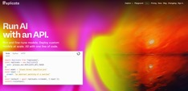

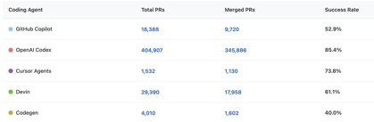

AI Updates 1
Kuaishou KLING 2.1 video model via API
https://www.klingai.com
DeepMind Magenta Real-time Music Model
800M parameter music generation model
Open-source (Apache 2.0)
It is Google's 1000th model on Hugging Face.
Alibaba VideoRefer VideoLLaMA3
2B & 7B video LLM
open source (Apache 2.0)
Zencoder.ai - AI coding assistant
automating complex workflows, agentic workflow, Repo Grokking™, tailored to project context, multi-file editing
Free tier + paid plans ($19–$39/user/month)
Zencoder.ai is a Silicon Valley startup, founded in 2023 by Andrew Filev, venture funded, 50+ employees
https://zencoder.ai
OpenAI Codex CLI usage - 10K pull requests per day
Developers using Codex to write their own software and do GitHub operations. OpenAI collects statistics of usage.
345,000 PRs on github merged in last 35 days. This is 10k pull requests per day on average
https://x.com/gdb/status/1935874544931324325
https://github.com/openai/codex

Slide 4
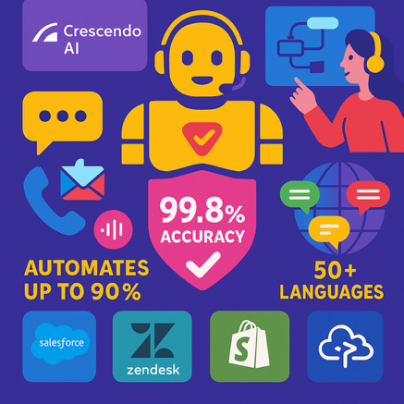
Crescendo cust. service 99.8% accuracy
Crescendo AI customer service 99.8% accuracy
Crescendo.ai is an AI-driven customer service automation platform designed for enterprises
It offers a blend of advanced AI and human expertise to deliver exceptional customer experiences across multiple channels
The platform automates up to 90% of support tickets through chat, voice, email, and other communication methods
Multilingual - 50+ languages
Integrates with Salesforce, Zendesk, Shopify, and Amazon Connect
It recently added Agentic AI capabilities, achieving 99.8% accuracy in responses
https://www.crescendo.ai
https://www.crescendo.ai/news/latest-ai-news-and-updates

Slide 5
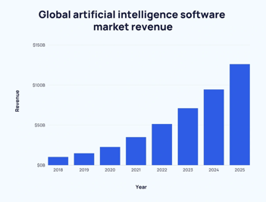
AI Growth Stats
"50 NEW Artificial Intelligence Statistics (June 2025)" https://explodingtopics.com/blog/ai-statistics
Global AI market ~ $391B in 2025; Annual growth rate 35.9%
97 Mln people will work in the AI space by 2025.
83% of companies claim AI is a top priority
48% of businesses use some form of AI to manage big data
38% of medical providers use computers as part of diagnosis
AI adoption is widespread, with 77% of companies either using or exploring AI, and 9 out of 10 organizations backing AI for a competitive edge
AI is expected to eliminate 85 million jobs but create 97 million new ones by 2025, resulting in a net gain of 12 million jobs
Transportation and storage workers face the highest risk of job automation (56.4%), followed by manufacturing (46.4%) and wholesale & retail (44%)
In the US, AI and machine learning are expected to replace 16% of all jobs in less than five years, but new jobs will also be created
Over 8 Bln voice assistants are currently in use worldwide; 95% of online and telephone communications to be AI-assisted by 2025
50% of consumers are optimistic about AI, but only a third believe they are using AI platforms, even though actual usage is much higher (77%)
AI algorithms can increase leads by 50%, reduce call times by 60%, and result in overall cost reductions of up to 60%
Only 7% of people trust chatbots, compared to 49% who trust human advisors
Website visitors from AI search are 4.4 times more valuable than those from organic search, and AI search traffic is projected to overtake organic search by 2028

Slide 6
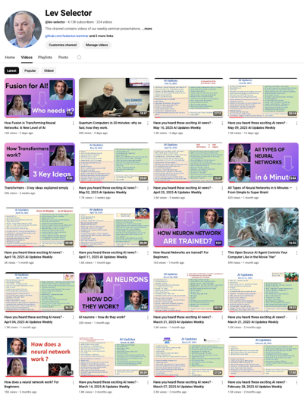
Subscribe to get notified
about new videos
https://www.youtube.com/@lev-selector
We post a video every Friday
It is usually 25-30 min long
Links to slides are under the videos

Slide 7

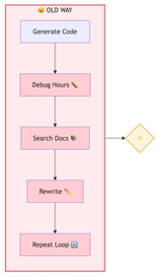
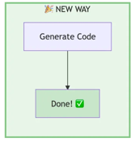

Context7 MCP - up-to-date code
Context7 MCP Server provides up-to-date, version-specific docs and code examples for your AI Assistant
This solves a common problem when LLMs training data doesn't have latest software info
The docs come directly from the source of 20,000 libraries
Context7 works as an MCP server (Model Context Protocol)
It making relevant documentation available to tools like Cursor, Claude, VS Code, Windsurf, Amazon Q Developer, or any LLM
You can get better answers, no hallucinations and an AI that actually understands your stack.
https://medium.com/vibe-coding/13-000-developers-are-obsessed-with-this-unknown-ai-tool-791134a79c8b
https://github.com/upstash/context7
Context7 is built by Upstash and running on their infrastructure
Upstash is a modern, serverless data platform that provides Redis, Vector, QStash, and Workflow services through REST APIs
https://upstash.com
Upstash is a startup in San Jose, CA, founded in 2021. Received 10 Mln venure funding. Less than 20 employees. Most of them in Turkey.
# Just add this to Cursor MCP configuration:
{
"mcpServers": {
"context7": {
"url": "https://mcp.context7.com/mcp"
}
}
}

Slide 8

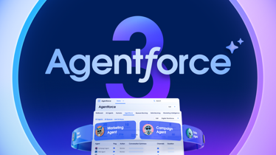

AI Updates 2
Thinking Machines Lab Raises $2B
Former OpenAI CTO Mira Murati secured $2 Bln seed investment (at a $10 Bln valuation) led by Andreessen Horowitz
The company's research specifics is still kept secret
Salesforce Agentforce 3
Salesforce Agentforce is an advanced AI agent platform for deploying autonomous AI agents that can support both employees and customers.
It is built around Atlas Reasoning Engine - modular, plugable, distributed, event-driven publish/subscribe architecture.
The agents can do reasoning, retrieving real-time data, making decisions, and taking actions following guardrails and business rules
Version 3 has new Command Center for monitoring and optimization of AI agents. It provides better visibility, control, global reach. Better Interoperability via MCP and AgentExchange. Faster, more reliable
https://www.salesforce.com/news/press-releases/2025/06/23/agentforce-3-announcement/
DeepSeek nano-vllm implementation
1,200 lines of Python code - matches the inference speed of the original vLLM engine in many offline scenarios.
https://github.com/GeeeekExplorer/nano-vllm
vLLM (virtual Large Language Model) is a fast and easy-to-use library for LLM inference and serving
https://github.com/vllm-project/vllm

Slide 9

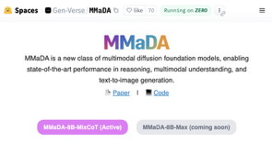
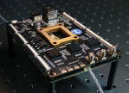
AI Updates 3
Goldman Sachs AI assistant
GS AI Assistant - in-house, natural language, can use various LLMs (OpenAI, Gemini, Claude, ...)
https://www.foxbusiness.com/technology/goldman-sachs-announces-firmwide-launch-ai-assistant
MMaDA-8B - multimodal diffusion foundation models
SOTA in reasoning, multimodal understanding, and text-to-image generation
MMaDA uses a single, modality-agnostic diffusion architecture with a shared probabilistic formulation, eliminating the need for separate components for different data types (like text or images)
git clone https://github.com/Gen-Verse/MMaDA
cd MMaDA
pip install -r requirements.txt
python app.py
https://huggingface.co/spaces/Gen-Verse/MMaDA
https://github.com/Gen-Verse/MMaDA
https://arxiv.org/abs/2505.15809
https://www.youtube.com/watch?v=bpEN0YycmSI
https://medium.com/@PowerUpSkills/i-built-the-same-app-with-4-different-ai-models-then-i-found-mmada-a1135e416176
Meteor-1 Optical Chip Rivals RTX 4090
Chinese researches have unveiled the world’s first highly parallel optical computing chip (up to 2,560 Tera-ops/sec, rivals the performance of RTX 4090 (and approaches that of RTX 5090)

Slide 10
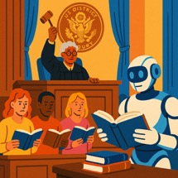

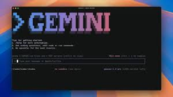
AI Updates 4
LLMs allowed to train on copyrighted books
US District Court ruled that training LLMs on copyrighted books constitutes fair use
A number of authors had filed suit against Anthropic for training its models on their books without permission
The judge concluded that it is fair use for AI models to read books the same way people do
Judge wrote that the authors’ lawsuit against anthropic is “no different than it would be if they complained that training school children to write well would result in an explosion of competing works.”
Chrome browser AI Extension for arXiv, ...
Chat with AI on top of (pdf) documents. Highlight any section of the paper and "@" other papers to quickly add context and compare results, benchmarks, etc
Generate beautiful research blogs with figures, key insights, and clear explanations from the paper with just one click
Read in multiple languages; BibTex citations automatically generated
https://chromewebstore.google.com/detail/alphaxiv-understand-resea/liihfcjialakefgidmaadhajjikbjjab
Google Gemini CLI open-source AI agent
Open source, integrated with Google’s AI Gemini Code Assist
1 Mln context length
https://x.com/Google/status/1937861715061846241
https://blog.google/technology/developers/introducing-gemini-cli-open-source-ai-agent/

Slide 11






AI Updates 5
Google donates A2A to Linux Foundation
Agent2Agent (A2) project with Amazon Web Services, Cisco, Google, Microsoft, Salesforce, SAP, and ServiceNow
https://developers.googleblog.com/en/google-cloud-donates-a2a-to-linux-foundation/
Warp - AI agents in terminal
https://www.warp.dev - https://docs.warp.dev/getting-started/what-is-warp
Warp offers IDE-like editing experience in the terminal; combines code editing, terminal commands, AI-driven automation, and workflow management; run multiple AI agents in parallel - write code, debug, create pull requests, deploy projects, ...; use plain English or shell commands; centralized dashboard for managing all running agents;
Warp supports popular shells (bash, zsh, fish, PowerShell) and runs on Mac, Linux, and Windows
Built in Rust for speed and security
Warp Drive - notebooks, workflows, and environment vars that can be shared with teams, with all data available as context for AI agents
Warp is a venture-capital backed startup in New York City. Founded in June 2020 by Zach Lloyd. 60+ employees, 0.5 Mln users.
Microsoft Mu - on-device Agent in Windows
Mu is an efficient 330M encoder–decoder language model optimized for small-scale deployment, particularly on the NPUs on Copilot+ PCs. 100+ tokens/sec.
https://blogs.windows.com/windowsexperience/2025/06/23/introducing-mu-language-model-and-how-it-enabled-the-agent-in-windows-settings/

Slide 12

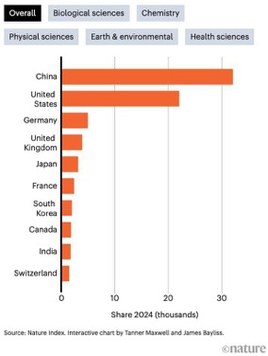

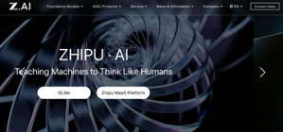
AI Updates 6
Google DeepMind Gemini Robotics
On-Device LLM, controls robot's movements
https://techcrunch.com/2025/06/24/google-rolls-out-new-gemini-model-that-can-run-on-robots-locally/
ElevenLabs 11ai voice assistant
Connects to MCP to execute tasks; 5K+ voice options, voice cloning, running on ElevenLabs’ infrastructure
https://elevenlabs.io/blog/introducing-11ai
Zhipu AI - getting government contracts in China
It is backed by the Chinese Communist Party
Aims to "lock Chinese systems and standards into emerging markets before U.S. or European rivals can"
Providing 'responsible, transparent and audit-ready' Chinese AI alternative to US ChatGPT and other models
https://www.reuters.com/world/china/openai-says-chinas-zhipu-ai-gaining-ground-amid-beijings-global-ai-push-2025-06-25/
https://en.wikipedia.org/wiki/Zhipu_AI
https://zhipuai.cn
China Wins Against USA
Nature Index

Slide 13



AI Updates 7
GitHub Copilot: Claude Sonnet 4 & Opus 4
https://github.blog/changelog/2025-06-25-anthropic-claude-sonnet-4-and-claude-opus-4-are-now-generally-available-in-github-copilot/
GoogleDeepMind’s AlphaGenome for DNA analysis
A new AI model that predicts how DNA mutations affect thousands of molecular processes by analyzing sequences up to 1M base-pairs long; The model reads DNA stretches 100x longer than older tools, predicting how nearby genes will behave and how other regulatory regions function;
DeepMind trained the entire system in just four hours using public genetic databases, consuming half the computing power of their previous DNA model
https://deepmind.google/discover/blog/alphagenome-ai-for-better-understanding-the-genome/
Google Doppl - visualize outfit on you
https://blog.google/technology/google-labs/doppl/

Slide 14
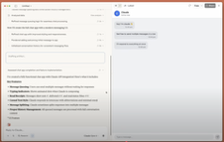

Anthropic Claude - build and host AI apps in "Artifacts"
Anthropic Claude - build and host AI apps in "Artifacts"
When someone uses your Claude-powered app:
They authenticate with their existing Claude account
Their API usage counts against their subscription, not yours
You pay nothing for their usage
No one needs to manage API keys
Claude writes real code that orchestrates complex AI functionality. You can see it, modify it, and share it freely
https://www.anthropic.com/news/claude-powered-artifacts
https://www.youtube.com/watch?v=PBxwtabGltc - video demo
Meta has hired OpenAI researcher Trapit Bansal
Meta hires 3 OpenAI researchers in Zurich
Lucas Beyer, Alexander Kolesnikov and Xiaohua Zhai - all 3 from OpenAI Zurich
https://www.wsj.com/tech/ai/meta-poaches-three-openai-researchers-eb55eea9
https://techcrunch.com/2025/06/26/meta-hires-key-openai-researcher-to-work-on-ai-reasoning-models/

Slide 15

Use 9 MCP Servers to reduce coding errors
Context7 MCP - fetches current, version-specific docs and examples. This is THE favorite https://github.com/upstash/context7
Memory Bank MCP Server - persistent memory across coding sessions https://github.com/alioshr/memory-bank-mcp
Knowledge Graph Memory Server - Maps relationships within project https://github.com/shaneholloman/mcp-knowledge-graph
Filesystem MCP Server - real-time access to project structure and files https://github.com/modelcontextprotocol/servers/tree/main/src/filesystem
GitMCP - Adds git-awareness: repo history, branches, version control context https://gitmcp.io
Obsidian-MCP - Connects AI to your Obsidian knowledge base notes and docs https://github.com/MarkusPfundstein/mcp-obsidian
Tavily MCP - Adds AI-powered search for developer-specific information https://github.com/tavily-ai/tavily-mcp
Sequential Thinking MCP - Breaking complex coding tasks into logical steps https://github.com/modelcontextprotocol/servers/tree/main/src/sequentialthinking
Fetch MCP Server - converts web html docs into context https://github.com/modelcontextprotocol/servers/tree/main/src/fetch
https://medium.com/@joe.njenga/these-9-mcp-servers-improve-ai-context-reduce-99-code-errors-d2ba7acd9d94

Slide 16

UC Berkeley CyberGym
UC Berkeley CyberGym - Cybersecurity Evaluation
Framework to Evaluate AI Agents on Large-Scale Vulnerabilities Across Massive Codebases
Open Source (Apache 2.0)
Includes 1,507 distinct benchmark tasks sourced from actual vulnerabilities found and patched across 188 major open-source software projects
These vulnerabilities were originally identified by OSS-Fuzz continuous fuzzing campaign maintained by Google
Agents must generate a proof-of-concept test that reproduces the vulnerability in the unpatched version, and CyberGym evaluates success based on whether the vulnerability is triggered in the pre-patch version and absent in the post-patch one
This benchmark uniquely emphasizes the generation of Proof of Concepts (PoCs), a task that requires agents to traverse complex code paths and synthesize inputs to meet specific security conditions. CyberGym is modular and containerized, enabling easy expansion and reproducibility.
https://www.cybergym.io
https://arxiv.org/abs/2506.02548
https://github.com/sunblaze-ucb/cybergym
https://huggingface.co/datasets/sunblaze-ucb/cybergym - dataset

Slide 17
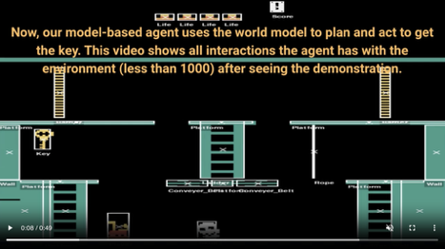
PoE-World
PoE-World: Modular and Probabilistic World Models
PoE = Product of programmatic Experts
Researchers from Cornell, Cambridge, The Alan Turing Institute, and Dalhousie University introduce PoE-World, an approach to learning symbolic world models by combining many small, LLM-synthesized programs, each capturing a specific rule of the environment.
Instead of creating one large program, PoE-World builds a modular, probabilistic structure that can learn from brief demonstrations.
This setup supports generalization to new situations, allowing agents to plan effectively, even in complex games like Pong and Montezuma’s Revenge.
While it doesn’t model raw pixel data, it learns from symbolic object observations and emphasizes accurate modeling over exploration for efficient decision-making
https://arxiv.org/pdf/2505.10819
https://topwasu.github.io/poe-world
https://github.com/topwasu/poe-world
The core idea is to break down world dynamics into smaller, manageable parts (called "experts"), each responsible for a specific aspect of the world's behavior. For example, one expert might handle how conveyor belts affect player objects, while another manages how platforms interact with players during specific actions
The final state of the world is determined by applying each expert in sequence or in parallel, depending on the design
Each expert is activated based on specific conditions or actions
Experts use parameters to determine the extent and nature of object interactions
The use of "RandomValues" and "SeqValues" allows for varied, non-deterministic or sequence-based effects, making simulations more realistic or interesting

Slide 18
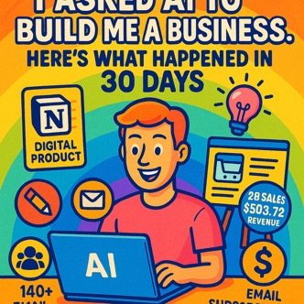
AI Builds a Business in 30 days
"I Asked AI to Build Me a Business. Here’s What Happened in 30 Days"
https://medium.com/write-a-catalyst/i-asked-ai-to-build-me-a-business-heres-what-happened-in-30-days-c9b126db3c42
The author used AI to build a profitable online business from scratch in just 30 days, using only a laptop and AI tools like ChatGPT
Starting with no niche or product, the author asked AI for business ideas and quickly narrowed the focus to selling digital products, specifically, Notion templates for freelancers - due to low startup costs, instant delivery, and ease of scaling
Key steps included using AI to:
Generate product ideas and outlines
Create and refine the digital product (a Notion template)
Write product descriptions, email sequences, and marketing copy
Design branding elements (name, logo, tagline) using AI-powered tools
Build a simple online storefront and landing page
Develop a content strategy for social media promotion
Automate email delivery, customer inquiries, and sales tracking
By the end of the 30 days, the business had made 28 sales, earned $503.72 in revenue, and gained over 140 email subscribers - all without spending money on ads
AI excels at speeding up research, copywriting, design, and execution, but it still requires human decision-making, consistency, and originality
The author concludes that while AI is a powerful assistant for building a business quickly and efficiently, it is not a replacement for vision, work ethic, or willingness to experiment

Slide 19
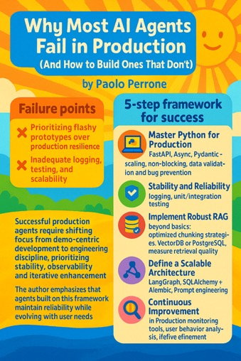
How to Make AI Agents Not Fail in Prod
Why Most AI Agents Fail in Production (And How to Build Ones That Don’t) - by Paolo Perrone
https://medium.com/data-science-collective/why-most-ai-agents-fail-in-production-and-how-to-build-ones-that-dont-f6f604bcd075
Failure points: Prioritizing flashy prototypes over production resilience; Inadequate logging, testing, and scalability
5-step framework for success
Master Python for Production: FastAPI, Async, Pydantic - scaling, non-blocking, data validation and bug prevention
Stability and Reliability - logging, unit/integration testing
Implement Robust RAG beyond basics: Optimized chunking strategies, VectorDB or PostgreSQL, measure retrieval quality
Define a Scalable Architecture (LangGraph, SQLAlchemy + Alembic, Prompt engineering)
Continuous Improvement in Production monitoring tools, user behavior analysis, iterative refinement
Successful production agents require shifting focus from demo-centric development to engineering discipline; prioritizing stability, observability, and iterative enhancement
The author emphasizes that agents built on this framework maintain reliability while evolving with user needs

Slide 20

AI music generation
MusicLM by Google - text into music. Available via Google’s AI Test Kitchen app. High accuracy, strong coherence, and ability to follow detailed instructions about genre, mood, and instrumentation https://musiclm.com
google/magenta-realtime - open model
https://x.com/osanseviero/status/1936415454819676427
https://huggingface.co/google/magenta-realtime
MusicGen by Meta - open-source transformer-based model that generates music from text prompts or existing melodies. Uses Residual Vector Quantization (RVQ) for efficient data compression and high audio quality. Produces coherent musical structures, especially with complex prompts; open-source nature allows for community improvements - https://musicgen.com
Stable Audio 2.0 by Stability AI - generates high-quality audio tracks up to 3 minutes long from text prompts and supports audio-to-audio transformations; Trained on a licensed dataset from AudioSparx; Uses a highly compressed autoencoder and diffusion transformer for advanced sound design and style transfer. High-quality, long-form audio generation; supports remixing and style transfer - https://stability.ai/stable-audio
Project Music GenAI Control by Adobe - detailed editing capabilities, allowing users to fine-tune tempo, intensity, and structure of AI-generated music; “pixel-level control” for music, enabling interactive editing and seamless loops; ideal for content creators needing precise musical fits; require Adobe ecosystem integration - https://research.adobe.com/video/project-music-genai-control/
Suno AI - Song Generator - Complete songs with vocals, mobile app, custom mode - Free (50 credits/day), $8/mo
Boomy - Music Generator Instant genre-based song creation, Spotify release - Free (25 saves/month), $9.99/mo
Soundraw.io - Music Generator Customizable music for videos, games - Free plan, $16.99/mo
Mubert - Music Generator Royalty-free music, API for developers - Free plan, $11.69/mo
Loudly Music Generator - High audio quality, customizable effects Free (1 download/month), $5.99/mo
Splash Pro Music Generator - Royalty-free music, AI voice training Free (unlimited 60s songs), $8/mo

Slide 21
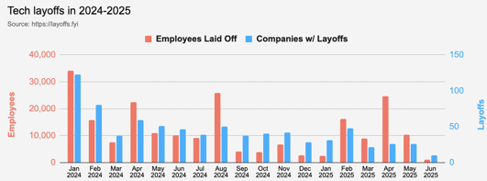
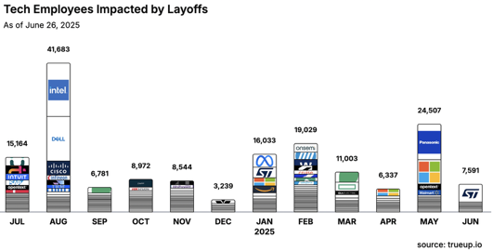
Jobs
https://layoffs.fyi
https://trueup.io/layoffs
Tech Layoffs in 2025: 63,443 people (so far)
Compared to 2024: 152,922 people
First 6 months of 2025 vs 2024: 83% vs 100%
https://layoffs.fyi

Slide 22


About the Speaker
Lev Selector, Ph.D.
40+ years of software engineering, data science, and building teams (hiring, training, and managing)
Ph.D. in mathematical modeling and computer simulations
Interests:
Generative AI, Using LLM with your data
Local AI for Local Private Data
Cloud architecture, fin-tech, application security
Find/connect: Linkedin, GitHub, YouTube, Google
https://eais.ai
Enterprise AI Systems

Slide 23
Thank You!

