Slide 1
AI Updates
August 30, 2024
Cerebras Waffle-Scale Engine
inference.cerebras.ai - 1,800 tok/sec
Jamba 1.5 is not good
Salesforce Einstein AI Agents
Microsoft Phi-3.5 - 3 new models
Google Gemini 1.5 - 3 new models
PostgreSQL pgvectorscale extension
Anthropic added support for LaTeX
Automating Thought of Search (ToS)
Advanced RAG Techniques - Community Hub
Anthropic System Prompts
Anthropic Artifacts
Google Speculative RAG: draft + selection
ChatGPT transforms equations to python
OpenAI to raise money at $100 Bln valuation
OpenAI - Orion & Strawberry
OpenAI ChatGPT hits 200 million weekly users
Google GameNGen simulates DOOM
California AI safety bill, SB 1047
Magic coding startup secures $320M
Magic has 100 Mln tokens context length !
Nvidia "Eagle" works with high resolution images
Big investments into AI in US and Europe
Alibaba releases Qwen2-VL
Meta Llama 350 Mln downloads on HF
Valve - Steam, Gaming - and AI
Valve - no managers
Rapids cuDF - Pandas & Polars Dataframes
How to create AI web-apps
Crowd-sourced "Arena" Leaderboard - English
Crowd-sourced "Arena" Leaderboard - Coding
Tech Layoffs in 2024

Slide 2


About the Speaker
Lev Selector, Ph.D.
40+ years of software engineering, data science, and building teams (hiring, training, and managing)
Ph.D. in mathematical modeling and computer simulations
Interests:
Generative AI, Using LLM with your data
Local AI for Local Private Data
Cloud architecture, fin-tech, application security
Find/connect: Linkedin, GitHub, YouTube, Google
https://eais.ai
Enterprise AI Systems

Slide 3
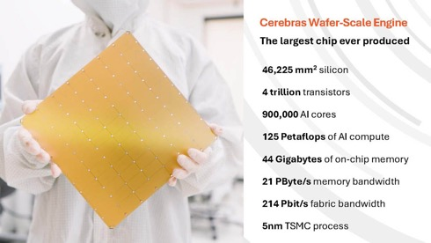
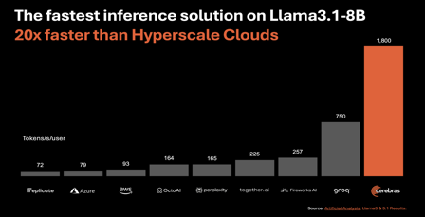
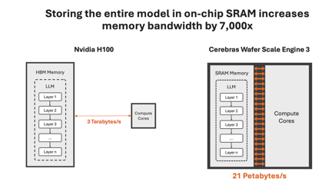
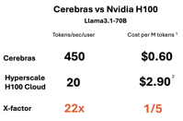
Cerebras Waffle-Scale Engine
Cerebras WSE (Waffle-Scale Engine) - huge 8.5"x8.5" chip
Company: Cerebras - https://cerebras.ai
CS-3 has 900K vs 15K cores in Nvidia H100
CS-3 has 21,000TB/sec vs 3TB/s memory bandwidth
https://cerebras.ai/blog/introducing-cerebras-inference-ai-at-instant-speed
https://www.servethehome.com/cerebras-enters-ai-inference-blows-away-tiny-nvidia-h100-gpus-by-besting-hbm/

Slide 4
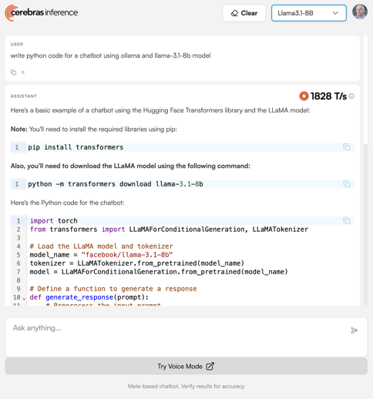
inference.cerebras.ai
Try Cerebras inference:
https://inference.cerebras.ai
Use Llama3.1-70b or 8b
(435 or 1828 tokens/sec)

Slide 5

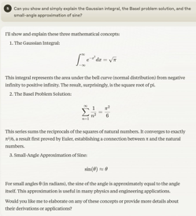
Misc 1
Jamba 1.5 is not good
https://www.youtube.com/watch?v=3f3d1Ej5PVc tests Jamba 1.5 large
pgvectorscale - an extension for PostreSQL database
written in Rust
high performance embedding search
cost-efficient storage for AI applications.
https://github.com/timescale/pgvectorscale
achieves 28x lower p95 latency and 16x higher query throughput compared to Pinecone's storage optimized (s1) index for approximate nearest neighbor queries at 99% recall, all at 75% less cost when self-hosted on AWS EC2.
Salesforce has unveiled two AI agents:
Einstein SDR Agent - talks to inbound prospects (Sales Development Representative)
Einstein Sales Coach Agent - provides real-time selling guidance to sales teams
https://www.zdnet.com/article/salesforce-unveils-ai-agents-for-sales-teams-heres-how-they-help/
Microsoft Phi-3.5 - open-source (MIT license) models:
Phi-3.5-mini-instruct
Phi-3.5-MoE-instruct
Phi-3.5-vision-instruct,
available for developers on Hugging Face, small - but good
Anthropic added support for LaTeX rendering in Claude Web interface. - https://x.com/AnthropicAI/status/1826667671364272301
Google - 3 new experimental models at AI Studio
Gemini 1.5 Flash-8B - new smaller model
Gemini 1.5 Pro - better at coding & complex prompts
Gemini 1.5 Flash - significantly improved https://aistudio.google.com

Slide 6
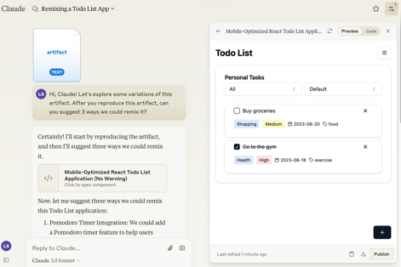
Misc 2
Anthropic Artifacts are now generally available.
Artifacts are content made with Claude which appear in a sub-window alongside with a Claude chat. They may be:
code snippets, text documents, graphics, diagrams, website designs, dashboards, interactive prototypes, etc.
Example: https://claude.site/artifacts/61e95bd8-906b-48f7-b905-60161630aae2
I can re-mix it into my Claude account: https://claude.ai/chat/5ccd3c69-d2df-4b69-bdee-78c92190354e
Automating Thought of Search (ToS) - from Cornell University & IBM Research - https://arxiv.org/pdf/2408.11326
"we automate ToS (AutoToS), completely taking the human out of the loop of solving planning problems.
AutoToS guides the language model step by step towards
the generation of sound and complete search components,
through feedback from both generic and domain specific unit
tests. We achieve 100% accuracy, with minimal feedback iterations, using LLMs of various sizes on all evaluated domains. Step 1: Initial prompt
Step 2: Goal function check
Step 3: Successor function soundness check
Step 4: Successor function completeness check
Advanced RAG Techniques:
A Community-Driven Knowledge Hub
https://github.com/NirDiamant/RAG_Techniques
https://github.com/NirDiamant/RAG_Techniques/tree/main/all_rag_techniques
Anthropic System Prompts:
https://docs.anthropic.com/en/release-notes/system-prompts

Slide 7
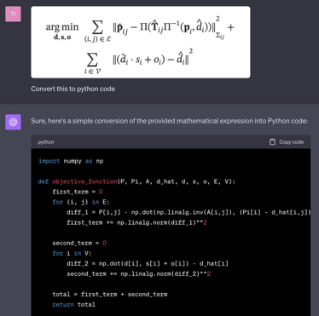
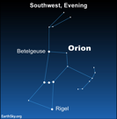

Misc 3
Google: Speculative RAG: uses Speculative Decoding: a smaller LM generates draft texts, then a larger LM used to verify and select the best draft. Result - better accuracy and faster speed.
https://research.google/blog/speculative-rag-enhancing-retrieval-augmented-generation-through-drafting/
OpenAI ChatGPT transforms equations to python functions
https://twitter.com/AlphaSignalAI/status/1713243769762349448
OpenAI ChatGPT hits 200 million weekly users
https://www.theverge.com/2024/8/29/24231685/openai-chatgpt-200-million-weekly-users
OpenAI is in talks to raise a massive amount of money, potentially valuing the company at over $100 Bln.
Thrive Capital is rumored to be leading the charge with a cool $1 Bln investment, and Microsoft, already an OpenAI backer, is likely to join in.
https://www.investing.com/news/economy-news/openai-in-talks-to-secure-new-funding-at-100b-valuation-3591817
OpenAI - Orion & Strawberry.
Orion will use high-quality synthetic data generated by Strawberry.
Using Star (Self-Taught Reasoner) technique from Stanford University: generate explanations, then select and tune. Result - proactively self-improving model, better reasoning, less "hallucinations", better interaction and problem solving.
https://medium.com/@cognidownunder/openais-strawberry-and-orion-the-next-leap-in-ai-evolution-eba8d661e0a9

Slide 8




Misc 4
Google GameNGen simulates DOOM
AI system simulates the classic game DOOM in real-time
running at over 20 frames on a single TPU chip
each frame predicted by a diffusion model
https://gamengen.github.io
https://www.youtube.com/watch?v=SBdDt4BUIW0
California's State Assembly has passed a groundbreaking AI safety bill, SB 1047. The legislation requires AI companies to implement safety measures before training advanced models, including shutdown capabilities and risk assessments.
https://www.theverge.com/2024/8/28/24229068/california-sb-1047-ai-safety-bill-passed-state-assembly-governor-newsom-signature
Alibaba releases Qwen2-VL, SOTA vision model that can understand video up to 20 minutes and maintain flow of conversation in real-time. See on Huggingface
https://huggingface.co/collections/Qwen/qwen2-vl-66cee7455501d7126940800d
https://x.com/minchoi/status/1829543584489668927
AI coding startup Magic secures $320M and partners with Google Cloud, total funding is $465M. https://magic.dev
Note: Magic LTM-2-Mini has 100 Mln tokens context length !!
(not a typo). LTM = Long-Term Memory.
https://magic.dev/blog/100m-token-context-windows
Nvidia "Eagle" - AI models that can process ultra-high-resolution images up to 1024x1024 pixels, tasks like visual question answering and document comprehension. - https://arxiv.org/pdf/2408.15998
Llama models ~ 350 Mln downloads on Hugging Face, marking an over x10-fold increase from a year ago. Llama usage doubled May through July 2024. Adoption increases, including large enterprises like Zoom, Spotify, Infosys, AT&T and Goldman Sachs.
https://venturebeat.com/ai/meta-leads-open-source-ai-boom-llama-downloads-surge-10x-year-over-year/
AI Investments
US: AI startups have achieved nearly 30 deals over $100M in 2024
Europe: WAYVE ($1B), Mistral AI (~$1B), Helsing ($484M), Poolside ($400M), DeepL ($320M), H ($220M), and Flo Health ($200M).

Slide 9


Valve - Steam, Gaming - and AI
Valve Corporation (a.k.a. Valve Software) - known for software distribution platform Steam and game franchises Half-Life, Counter-Strike, Portal, Day of Defeat, Team Fortress, Left 4 Dead and Dota
founded in 1996, private, near Seattle, WA
number of employees - 336
worth ~ 7 Bln (as of March 2024, Bloomberg)
(~ 21 Mln per person : TL;DR: Quality>Quantity)
132+ active monthly users (as of May 2024)
https://www.valvesoftware.com/en/
https://en.wikipedia.org/wiki/Valve_Corporation
Valve Corporation's main source of profit is its Steam platform, which is a major income generator for the company. Steam is a digital store that allows users to buy games and has an estimated 50–70% market share of PC game downloads. Valve originally created Steam to sell its own games, but it has since become a top digital store for many games.
As Valve became its own publisher via Steam, it found the hierarchical structure was hindering progress. After completing Half-Life 2, Valve transitioned to a flat organization; outside of executive management, Valve does not have bosses, and uses an open allocation system.
Gabe Logan Newell
a.k.a Gaben
president & co-founder
https://en.wikipedia.org/wiki/Gabe_Newell
Mike Harrington
co-founder,
director of development,
left in 2000
https://en.wikipedia.org/wiki/Mike_Harrington
Valve recently decided to (temporarily) block AI games from Steam as it is working on how to integrate AI into the existing policies:
copyright (AI-generated content, images)
quality control
consumer protection
ethical considerations (biases, discrimination, harmful negative stereotypes or ideologies).

Slide 10
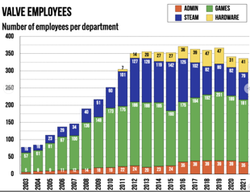
Valve - no managers
Every year, Valve's staff judge each other through a series of meetings that result in an overall ranking of every employee, and that ranking determines who receives higher salaries in the next year.
With no managers to communicate exactly how the judgements should be made, or how the resulting pay changes will be decided—presumably by the board of directors, which Valve still has—the effects on employee behavior seem quite noticeable.
People tend to do riskier projects near the beginning of the year,
and then they'd go back to the more well-known ones as it gets closer to review time
How Valve hires, how it fires, and how much it pays
https://www.gamedeveloper.com/business/how-valve-hires-how-it-fires-and-how-much-it-pays
Valve - created Steam, Half-Life, ...
no managers - see new employee handbook: https://cdn.cloudflare.steamstatic.com/apps/valve/Valve_NewEmployeeHandbook.pdf
hiring process - forming a search committee, interviewing, achieving consensus
payment - base + bonus. Bonus may be x10 of the base. Mutual assessment.
firing - rare, complicated
people work spontaneously, without bosses
easy to move inside company
In 2012 .. 2021 the total number of employees was steady between 325 and 375 employees. But total spending on gross pay for all employees was growing from $300 Mln to $450 Mln (inflation adjusted). Thus the mean gross pay per employee grew from $0.48 Mln to $1.32 Mln. The top 35 members of the Admin department were averaging $4.5 Mln per year in 2021

Slide 11
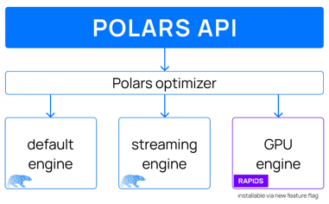
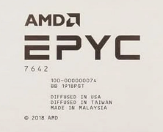
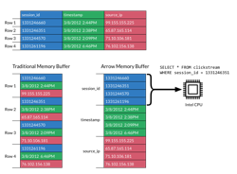
Rapids cuDF - Pandas & Polars DataFrames
RAPIDs cuDF - fast Python DataFrame library from Nvidia.
It basically ports Numpy, Pandas, and Polars to run on Nvidia GPUs.
It also supports Apache Arrow columnar memory format.
Result - calculations on DataFrames are much faster.
https://github.com/rapidsai/cudf
https://pola.rs/posts/polars-on-gpu/
https://pola.rs
https://rapids.ai
Polars cuDF can achieve up to x150 times faster processing times for a 5 GB dataset.
Polars is generally faster than Pandas (with or without Nvidia Cuda).
Alternative way to speedup calculations is to use CPUs with large number of cores. For example AMD Epyc:
AMD EPYC 7763 - 128 cores
AMD EPYC 7642 - 96 cores - $941 at Walmart
AMD EPYC 7F72 - 48 cores
Polars is written in Rust and can do multithreading to take advantage of multiple CPU cores.
Apache Arrow Data Format

Slide 12

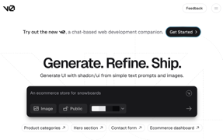
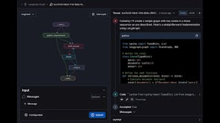
How to create AI web-apps
FastHTML - python
https://fastht.ml
https://about.fastht.ml
https://docs.fastht.ml
https://docs.fastht.ml/tutorials/by_example.html
https://github.com/AnswerDotAI/fasthtml-tut
https://github.com/AnswerDotAI/fasthtml/tree/main/examples
https://www.youtube.com/watch?v=Auqrm7WFc0I
https://h2x.answer.ai - to convert HTML to FastHTML syntax
https://www.youtube.com/watch?v=evAb2x34Jqk - good short demo
LangGraph - python https://www.langchain.com/langgraph https://langchain-ai.github.io/langgraph
v0 by Vercel - Next.js React framework https://v0.dev https://vercel.com

Slide 13
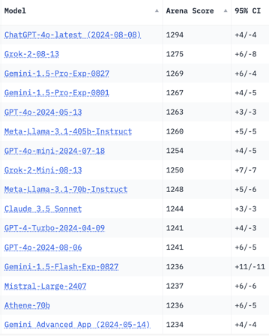
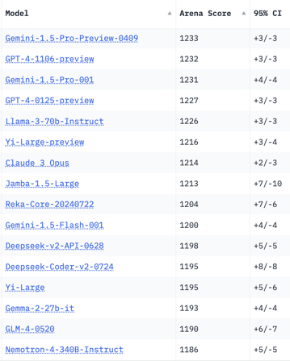
Crowd-sourced "Arena" Leaderboard
Total #models: 136.
Total #votes: 1,765,444.
Last updated: 2024-08-27
Starting Elo rating = 1000
95% CI = Confidence Interval
https://chat.lmsys.org/?leaderboard
English-only queries

Slide 14
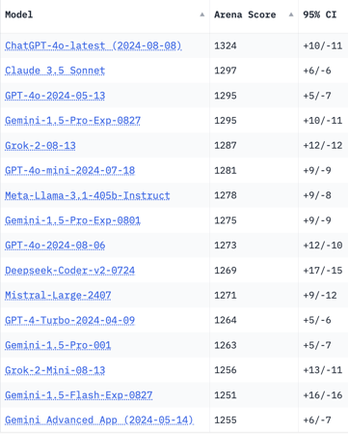
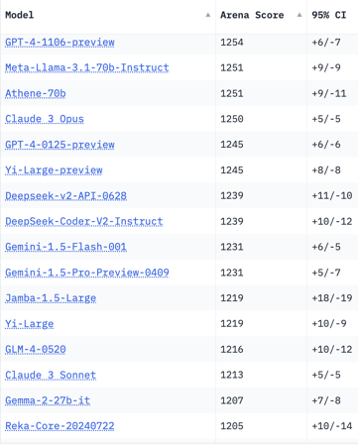
Crowd-sourced "Arena" Leaderboard
Total #models: 136.
Total #votes: 1,765,444.
Last updated: 2024-08-27
Starting Elo rating = 1000
95% CI = Confidence Interval
https://chat.lmsys.org/?leaderboard
Coding

Slide 15
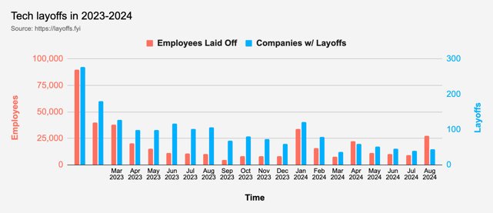


Tech Layoffs in 2024
Layoffs - https://layoffs.fyi
Intel is firing 15% of its personnel (about 15,000 jobs) - Aug 1, 2024
https://x.com/burkov/status/1819214183881187828
Dell Technologies is firing 10% (12,500 employees). This follows a previous round of 13,000 layoffs. The cuts mainly impact sales and marketing divisions.
https://www.pcmag.com/news/dell-makes-cuts-to-boost-ai-pivot-reportedly-laying-off-12500-employees

Slide 16
Thank You!

