Slide 1

AI Updates
March 21, 2025
St. Patrick's Day
March 17th
Manus AI - 2 models, 29 tools
Open Manus
Baidu's ERNIE X1 & 4.5 - powerful and cheap
Nvidia GTC (GPU Tech Conference)
PC Agent
Mistral Small 3.1
Anthropic Claude can now search the web
R1-Searcher & Search-R1
Models double their skills every 7 months
Cohere's Command A
Meta - Transformers without Normalization
Gemini Embedding, Google Gems
CODI Self-Distillation
Allen Institute for AI (AI2) OLMo 32B
Agent S2 from Similar.ai
Google Gemini - Canvas
12 Rules to Vibe Coding
Boston Dynamics - Cartwheel
In-Browser Graph RAG with Kuzu-Wasm
RAG Chatbot on your data for $200
Everyone Offers AI-Agents Studios
autoMate - AI-Powered Local Automation
Chitu - open-source fast LLM inference
OpenAI o1-pro - expensive
OpenAI AI Audio models
Llama - more than 1 Billion downloads
Google has bought Wiz for $32 Billion
Qodo (aka Codium) != Codeium
QwenLM/QwQ - now open source
alphaXiv - Discover, Discuss, Read arXiv papers
SmolDocling - ultra-compact OCR model
Crowd-sourced "Arena" Leaderboard
Jobs

Slide 2
Manus AI - 2 models, 29 tools
Manus AI
Manus AI, the autonomous AI agent developed by Chinese startup Butterfly Effect
Manus AI uses existing foundation models: Anthropic's Claude 3.5 "Sonnet v1" (3.7 is being tested) fine-tuned versions of Alibaba's Qwen LLM (possibly for Chinese language tasks)
Manus uses multiple AI models for different subtasks
Manus has access to 29 different tools. The main ones are:
Browser Use - browser_view, browser_navigate, browser_move_mouse, browser_press_key, browser_select_option, browser_scroll_up, browser_scroll_down, browser_console_exec
File System Operations - file_find_by_name, file system operations including reading, writing, searching for content, creating directories, and compressing files
Shell and Command Line Execution - shell_exec, shell_kill_process
Knowledge and Data Processing - Knowledge module, knowledge base, Datasource module (API access), Retrieval-Augmented Generation (RAG) capabilities
Other capabilities - Information gathering, fact-checking, and documentation; Data processing, analysis, and visualization; Content creation across multiple formats; Code generation and execution; Deployment of websites and applications
Manus operates as a multi-agent system, meaning it integrates various AI models to handle tasks autonomously. This architecture includes:
1. A planning system for breaking down complex tasks
2. Memory components for maintaining context during task execution
3. Tool execution loops that allow the system to take actions and observe results
4. Asynchronous operation capabilities, allowing tasks to continue running even when users are not actively engaged
The system runs from the cloud, enabling users to assign tasks and check back later for results, as the AI continues working in the background
Open Manus
https://www.youtube.com/watch?v=FbfbCMoNdlU - video
https://digialps.com/openmanus-a-powerful-open-source-ai-agent-alternative-to-manus-ai/
https://github.com/mannaandpoem/OpenManus

Slide 3
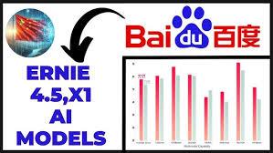
Baidu's ERNIE X1 & ERNIE 4.5
Baidu's ERNIE X1 & ERNIE 4.5
beats o3, R1 & Sonet 3.7
100x times cheaper
https://www.youtube.com/watch?v=hpzBzHOSECw
ERNIE 4.5 - Heterogeneous Multimodal (text, images, audio, and video), Mixture-of-Experts, good at understanding, generation, reasoning, and memory; hallucination prevention, logical reasoning, and coding.
ERNIE X1 - deep-thinking reasoning model, multimodal; focuses on understanding context, planning thought processes, reflecting on responses, and evolving over time; autonomous tools' use for complex tasks, such as advanced search, image understanding, and complex calculations; comparable to DeepSeek R1, at a lower cost.
ERNIE 4.5 at 1% of GPT-4.5's cost
ERNIE X1 at half the price of DeepSeek R1

Slide 4

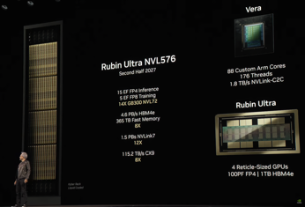
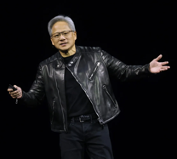
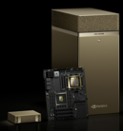

Nvidia GTC
Vera CPU: 88-cores, 176 threads
Rubin GPU - two chips, up to 50 PFLOPs of FP4, 288 GB of HBM4 memory
Vera Rubin NVL576 system (2027 ?): Rubin GPUs - 576 (15 EF FP4) Vera CPUs - 12,672 Cores, 25,344 threads ExaFlops in one rack
GTC = GPU Technology Conference
March 16-21 in San Jose, CA
Keynote: Tue March 18 - NVIDIA CEO Jensen Huang
https://www.nvidia.com/gtc/
https://www.youtube.com/watch?v=erhqbyvPesY - summary
 | 2022 | 2024 | 2025 | 2026 | 2027 | 2028
GPU Codename | Hopper | Blackwell | Blackwell (Ultra) | Rubin | Rubin (Ultra) | Feynman
GPU Family | GH200 / GH100 | GB200 / GB100 | GB300 | GR200? | GR300? | GF200?
GPU SKU | H100/H200 | B100/B200 | B300 | R200? | R300? | F200?
Groot N1 - foundation model for humanoid robotics, thinking fast and slow
NVIDIA Llama Nemotron reasoning models Nano: 8B distilled from Llama 3.1 8B Super: 49B distilled from Llama 3.3 70B Ultra: 253B distilled from Llama 3.1 405B
DGX Spark (formerly Project DIGITS) GB10, 128GB memory
DGX Station - GB300 Grace Blackwell Ultra Desktop Superchip, 784GB memory
CEO Jensen Huang in his trademark
black leather motorcycle jacket

Slide 5
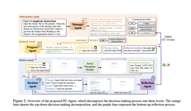
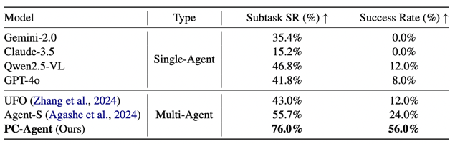
PC Agent
Active Perception Module - extracts locations and meaning via accessibility trees + MLLM-driven intention understanding and OCR for precise text localization (MLLM = Multimodal LLM)
Hierarchical Multi-agent Collaboration implements a three-level decision process (Instruction-Subtask-Action) where a Manager Agent decomposes instructions into parameterized subtasks and manages dependencies, a Progress Agent tracks operation history, and a Decision Agent executes steps with perception and progress information.
Reflection-based Dynamic Decision-making introduces a Reflection Agent that assesses execution correctness and provides feedback, enabling top-down task decomposition with bottom-up precision feedback across all four collaborating agents.
PC-Agent: A Hierarchical Multi-Agent Collaboration Framework for Complex Task Automation on PC
https://arxiv.org/abs/2502.14282 - paper
https://github.com/X-PLUG/MobileAgent/tree/main/PC-Agent - GitHub
Researchers from: MAIS, Institute of Automation, Chinese Academy of Sciences, China, School of Artificial Intelligence, University of Chinese Academy of Sciences, Alibaba Group, Beijing Jiaotong University, School of Information Science and Technology, ShanghaiTech University

Slide 6



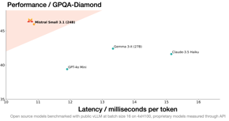
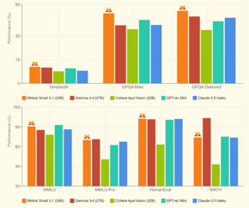
Mistral Small 3.1
Mistral Small 3.1
Small (24b parameters)
Open source - Apache 2.0
Outperforms Gemma 3, GPT-4o Mini, Claude 3.5 Haiku
Multimodal (text, images).
Multilingual (dozens of languages).
24b parameters
Ollama: https://ollama.com/library/mistral-small ollama run mistral-small
can run on a single RTX 4090 or a Mac with 32GB RAM
128k tokens context length
150 tokens per second
Agent-Centric - function calling, JSON outputting
Advanced Reasoning
https://mistral.ai/news/mistral-small-3-1
https://huggingface.co/mistralai/Mistral-Small-3.1-24B-Instruct-2503

Slide 7


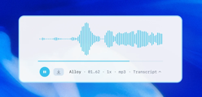
AI Updates 1
Anthropic Claude can now search the web
Available now in preview for paid Claude users in the U.S
Example: what was the weather yesterday?
Who has won the latest Super Bawl ?
Google has bought Wiz for $32 Billion
Wiz makes security tools to protect information in remote data centers
Wiz based in New York, since 2020
AI & Data Security - two hottest trends
autoMate - AI-Powered Local Automation Tool
open-source free alternative to Manus
https://github.com/yuruotong1/autoMate
Llama - more than 1 Billion downloads
Chitu - open-source LLM inference framework from China
300% faster while using 50% less GPU
can effectively run on Chinese chips
https://www.scmp.com/tech/tech-war/article/3302516/chip-war-chinese-start-aims-break-nvidias-grip-ai-new-model-framework
https://qc-ai.cn - Qingcheng.AI, startup, since 2023
OpenAI o1-pro - expensive
$150 / $600 per 1 Mln in/out tokens
This is twice the price of GPT-4.5
This is 10x the price of o1
https://platform.openai.com/docs/models/o1-pro
It is using more compute "to think harder".
Early reviews weren’t very positive. The model is only slightly better. It struggled with Sudoku puzzles, fails on simple optical illusions
OpenAI AI Audio models
Audio-to-Audio directly (without intermediate text)
Faster, Understands intonations, accents, emotion
Via API (Voice Agents SDK), 70% cheaper than ElevenLabs
https://openai.com/index/introducing-our-next-generation-audio-models/
https://www.openai.fm

Slide 8



Qodo (aka Codium) != Codeium
Qodo (formerly known as Codium or CodiumAI) and Codeium are entirely different AI coding assistant tools
Qodo - code quality, testing, and review processes "quality-first" approach to software development "Qodo" is derived from "Quality" and "Code" pricing: free & $19 per user-month https://www.qodo.ai
Codeium - speed-focused code completion and generation numerous programming languages. https://codeium.com , windsurf editor - https://codeium.com/windsurf pricing: free & $15 per user-month

Slide 9
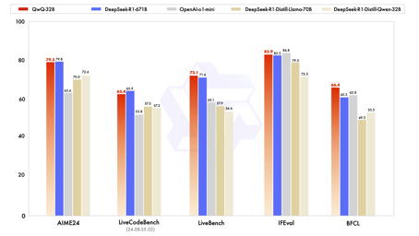


AI Updates 2
QwenLM/QwQ - now open source
QwQ is the reasoning-specialized model within the Qwen series
QwQ-32B, is a mid-sized model that competes effectively with top-tier reasoning models like DeepSeek-R1 and o1-mini
https://github.com/QwenLM/QwQ
alphaXiv - Discover, Discuss, and Read arXiv papers
https://www.alphaxiv.org/explore
developed by students at Stanford University's AI Lab
uses Mistral OCR to read PDFs
uses Claude 3.7 to understand and summarize it
Users can access any arXiv paper on AlphaXiv by simply changing "arXiv" to "alphaXiv" in the URL of any arXiv paper
SmolDocling - ultra-compact OCR model
only 256M parameters
https://arxiv.org/abs/2503.11576

Slide 10
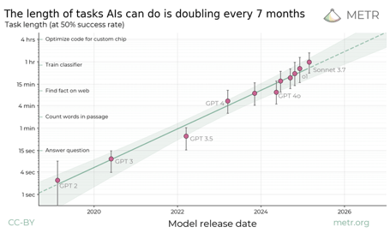
AI Updates 2
R1-Searcher
A Reinforcement Learning-Based Framework for Enhancing LLM Search Capabilities
https://arxiv.org/abs/2503.05592
https://github.com/SsmallSong/R1-Searcher
https://www.marktechpost.com/2025/03/12/this-ai-paper-introduces-r1-searcher-a-reinforcement-learning-based-framework-for-enhancing-llm-search-capabilities/
Search-R1
Search-R1: Training LLMs to Reason and Leverage Search Engines with Reinforcement Learning
https://arxiv.org/abs/2503.09516
https://github.com/PeterGriffinJin/Search-R1
Models double their skills every 7 months
Measuring AI Ability to Complete Long Tasks https://arxiv.org/abs/2503.14499
For each year we look at tasks that best AI model agents can complete with 50% reliability, and how long it would take human professionals to do them (vertical axis)
2019 - 3 sec, 2022 - 1 min, now - 1 hour, 2028 - 1 day, 2030 - 1 month
https://metr.org/blog/2025-03-19-measuring-ai-ability-to-complete-long-tasks/
https://github.com/METR/eval-analysis-public

Slide 11
AI Updates 2
Cohere's Command A - 111B dense model
Artificial Analysis Intelligence Index of 40, close to OpenAI GPT-4o
256K context window,
185 tokens/s
Price $2.5/$10 per million input/output tokens
available on Hugging Face for research
available commercially with a license from Cohere
https://digialps.com/openmanus-a-powerful-open-source-ai-agent-alternative-to-manus-ai/
Meta - Transformers without Normalization
Dynamic Tanh (DyT)
https://arxiv.org/abs/2503.10622
https://jiachenzhu.github.io/DyT/
https://www.linkedin.com/posts/yann-lecun_more-details-about-normalization-free-training-activity-7306430053733617664-xRzr/
works better, but doesn't need extra calculations or tuning
images, language, supervised learning, and self-supervised learning
Gemini Embedding
universal embedding model that maintains high quality across languages, domains, and tasks
https://www.arxiv.org/abs/2503.07891

Slide 12
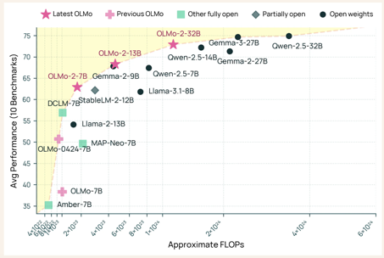
AI Updates 3
Google Gems - personalized versions of Gemini (since August 2024)
for paid subscribers - Gemini Advanced, Gemini for Google Workspace
Frequent use: translators, prompt engineers, math tutors, and copywriters
Gems now can reference a set of files (up to 10)
New Pre-made Gems: Marketing insights, Sales pitch ideator, Hiring consultant, Outreach specialist (sales and customer support), Copy creator, Sentiment analyzer
https://workspace.google.com/blog/product-announcements/new-gemini-gems-deeper-knowledge-and-business-context
https://blog.google/products/gemini/google-gems-tips/
https://support.google.com/gemini/answer/15235907
CODI: A Self-Distillation Framework for Efficient and Scalable Chain-of-Thought Reasoning in LLMs
xxx
https://www.marktechpost.com/2025/03/09/this-ai-paper-introduces-codi-a-self-distillation-framework-for-efficient-and-scalable-chain-of-thought-reasoning-in-llms/
Allen Institute for AI (AI2) OLMo 32B
Fully Open Model to Beat GPT 3.5 and GPT-4o mini
https://github.com/allenai/OLMo-core
https://huggingface.co/allenai/OLMo-2-0325-32B-Instruct
https://allenai.org/blog/olmo2-32B

Slide 13


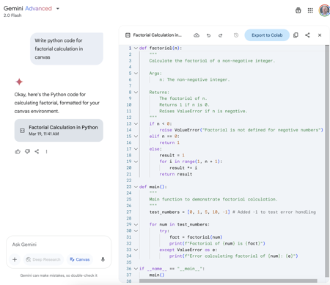
AI Updates 4
Agent S2 from Similar.ai
Open, Modular, Scalable Framework for "Computer Use" Agents
https://www.simular.ai/agent-s2
https://github.com/simular-ai/agent-s
Google Gemini - Canvas
It can show python code, but can not run it
It can show and run Javascript
Doesn't work well with Mermaid diagrams yet

Slide 14
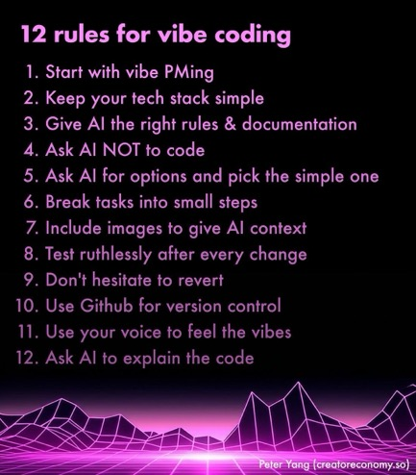
12 Rules to Vibe Code Without Frustration
12 Rules to Vibe Code Without Frustration
by Peter yang
https://creatoreconomy.so/p/12-rules-to-vibe-code-without-frustration
Ask AI to create a plan, to create a README that includes: Requirements, Tech stack, Milestones (up to 5) to test. Consider using Grok for planning (or Sonet 3.7).
Keep your tech stack simple. Most of the time, you can build apps with client and local storage. There’s often no need for: Servers, databases, or complex tooling.
Give AI the right rules & documentation. Ask AI which version of libraries it knows - and use that. Or provide/paste-in documentation. Set up global and project rules in your AI IDE (Cursor). For example, Explain what you’ll do first and ask for my confirmation before coding. Do the simple thing first. Use modules instead of just a single file. Only make requested changes. Do not write duplicate code - please look for existing solutions in the codebase.
Ask AI NOT to code: "Tell me your plan first; don’t code."
Ask AI for simple options: "Give me a few options, starting with the simplest first. Don’t code."; "Think as long as you need and ask me questions if you need more info."
Break tasks into small steps. Ask AI to "Keep it simple". Ask AI to "Implement the simplest next step I can test." Ask AI to change a specific file only. Start a fresh chat for each feature
Include images (screenshots, graphs, diagrams) to give AI context
Test after every change. AI can break your app. Ask AI to write tests for you.
Don't hesitate to revert. Cursor and Windsurf have a "Revert to checkpoint" button that restores past versions of your code. Periodically ask "Look for duplicate code or redundancies and list them." Then ask AI to make the simple fixes to keep your code base clean.
Use Github for version control.
Talk to AI - install voice dictation software like Superwhisper
Ask AI to explain the code. "Explain how this file works in simple terms." or "Add comments that explain the code." Put all code into one text file, paste it to AI - and ask "Can you explain how this app works? Give me an overview of the tech architecture."

Slide 15
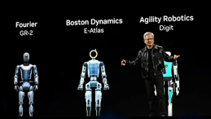

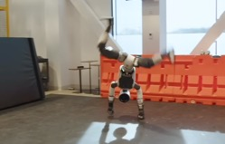
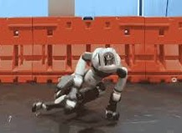

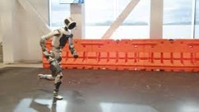
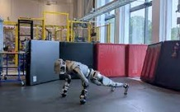
Boston Dynamics - Cartwheel
Boston Dynamics Atlas Robot can now do gymnastics:
cartwheel, walk, run, crawl, roll, lower brake, handstand, ...
https://www.youtube.com/watch?v=I44_zbEwz_w
https://www.youtube.com/shorts/Oi7gROJPhVw

Slide 16
In-Browser Graph with Kuzu-Wasm
import { CreateMLCEngine } from "@mlc-ai/web-llm";
async main() {
const appConfig = {
"model_list": [
{
"model": "/url/to/my/llama",
"model_id": "MyLlama-3b-v1-q4f32_0",
"model_lib": "/url/to/myllama3b.wasm",
}
],
};
// override default
const chatOpts = {
"repetition_penalty": 1.01
};
// load a prebuilt model with a chat option override
// and app config under the hood,
// it will load the model from myLlamaUrl
// and cache it in the browser cache
// The chat will also load the model library
// from "/url/to/myllama3b.wasm",
// assuming that it is compatible to the model in myLlamaUrl.
const engine = await CreateMLCEngine(
"MyLlama-3b-v1-q4f32_0",
{ appConfig }, // engineConfig
chatOpts,
);
}
Fully In-Browser Graph RAG with Kuzu-Wasm
https://blog.kuzudb.com/post/kuzu-wasm-rag/
https://github.com/mlc-ai/web-llm - WebLLM
https://mlc.ai - Machine Learning Compilation
https://mlc.ai/models - MLC Models
https://www.w3.org/TR/webgpu/ - WebGPU
https://github.com/WebAssembly/memory64 - Memory
Linkedin Example: https://github.com/kuzudb/wasm-linkedin-example
Running Llama-3.1-8B 4-bit quantized model in WASM Llama-3.1-8B-Instruct-q4f32_1-MLC https://huggingface.co/mlc-ai/Llama-3.1-8B-Instruct-q4f32_1-MLC
How to download our Linkedin Account data:
https://www.linkedin.com/help/linkedin/answer/a1339364/downloading-your-account-data
DeepSeek R1 1.5B running FULLY LOCALLY in your browser at 60 tok/ sec powered by WebGPU
https://x.com/reach_vb/status/1881809400995934640

Slide 17
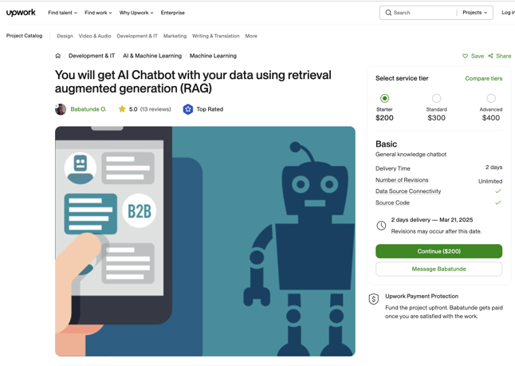
RAG Chatbot on your data for $200
Prices for developing standard RAG chatbots went down from half-a-million to $200
Development time went down from several months to two days
https://www.upwork.com/services/product/development-it-ai-chatbot-with-your-data-using-retrieval-augmented-generation-rag-1742353320763936768
Costs for a RAG project
https://www.reddit.com/r/Rag/comments/1h2iitk/what_is_a_range_of_costs_for_a_rag_project/?rdt=59328

Slide 18
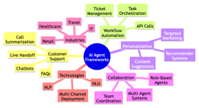
Everyone Offers AI-Agents Studios
Today's trend: vendors offer Agent Building Frameworks, Studios, etc. Example - Oracle "AI Agent Studio": https://www.oracle.com/news/announcement/oracle-introduces-ai-agent-studio-2025-03-20/
Microsoft
OpenAI
Amazon AWS
Google
Oracle
IBM
Cohere
Anthropic (USA)
NVIDIA (USA)
Salesforce (USA)
Meta (USA)
DeepMind (UK)
Hugging Face (USA/France)
Mistral AI (France)
SAP (Germany)
Siemens (Germany)
Baidu (China)
Alibaba Cloud (China)
Tencent (China)
SenseTime (China)
Samsung (South Korea)
LG AI Research (South Korea)
SoftBank (Japan)
Yandex (Russia)
Mubadala Invest Company (UAE)
Dubai Electricity and Water Authority (UAE)
Etisalat (UAE)
Saudi Aramco (Saudi Arabia)
Infosys (India)
Wipro (India)
Moveworks (USA)
ServiceNow (USA)
UiPath (USA)
Relay.app (USA)
Postman (USA)
Vertex AI Agent Builder (USA)
LangChain (USA)
LangGraph (USA)
CrewAI (USA)
Typically you get:
Agent template libraries: pre-built templates paired with natural language prompts for different business scenarios
Agent team orchestration: set up multiple agents to work alongside people (checkpoints, approvals, ...)
Agent extensibility: modify and extend the 50+ (or 1000+) pre-packaged Applications AI agents by adding documents, tools, prompts, or APIs
Choice of LLMs: select from LLMs specifically optimized for Vendor's platform/cloud. Usually Llama, Cohere, OpenAI, Claude, Gemini, or plug in other LLMs (may be industry-specific)
Native integration with Vendor's platform/cloud (direct access, knowledge stores, predefined tools)
Third-party system integration through secure APIs
Trust and security framework - security configurations, policies, and access controls
Validation and testing tools - for reliability, repeatability, explainability, security, and performance of AI outputs.

Slide 19
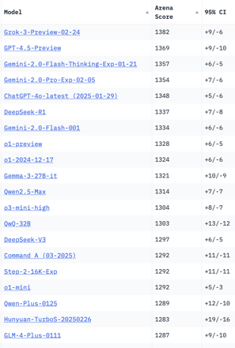
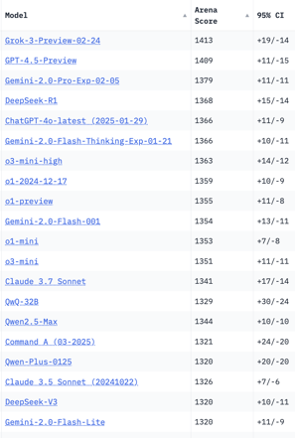
Crowd-sourced "LM Arena" Leaderboard
Total #models: 216
Total #votes: 2,787,691
Last updated: 2025-03-16
Starting Elo rating = 1000
95% CI = Confidence Interval
https://en.wikipedia.org/wiki/Elo_rating_system
https://chat.lmsys.org/?leaderboard
https://lmarena.ai/?leaderboard
English-only queries
Coding
x.ai
x.ai
China
China
China
China
China
China
Cohere
China
China
Cohere
China
China
China
China
China

Slide 20
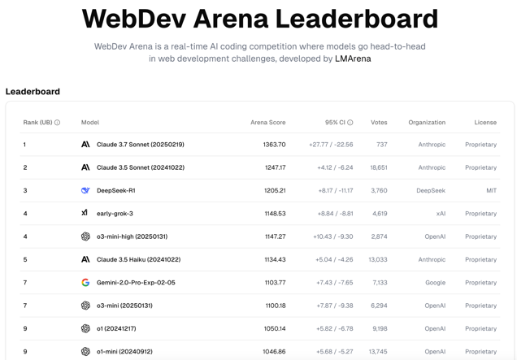
WebDev Arena Leaderboard
https://web.lmarena.ai/leaderboard

Slide 21
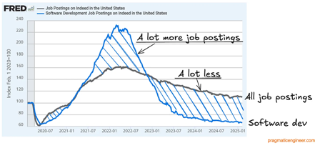
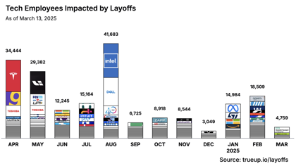
Jobs
Layoffs, Jobs:
https://layoffs.fyi
https://techcrunch.com/2025/02/13/tech-layoffs-2024-list/
https://blog.pragmaticengineer.com/software-engineer-jobs-five-year-low/
https://fred.stlouisfed.org/series/IHLIDXUS
The Tech Layoff Tracker (as of March 13, 2025)
https://www.trueup.io/layoffs
So far in 2025 - 531 people per day, total of 38,252 people
In 2024 - 653 people per day, total of 238,461 people
In 2023: More than 191,000 people
In 2022: More than 93,000 workers laid off
https://news.crunchbase.com/startups/tech-layoffs/
AI jobs percentage:
2022 - 3.3%
2024 - 14.3%
2025 - 25% of all new tech job openings require AI skills
36% of IT job postings tied to AI needs
Number of AI Job postings by year
2020 27K
2021 38K
2022 52K
2023 65K
2024 81K
2025 105 - 200K (projected)

Slide 22
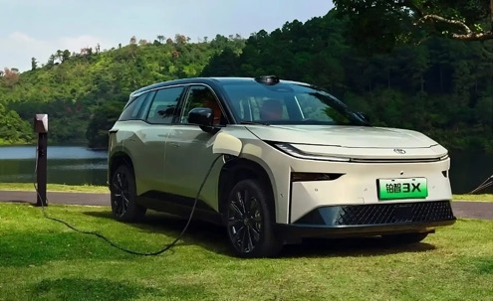
Electric Vehicle for 13,000 euros
GAC-Toyota starts pre-sales of the bZ3X in China
13K .. 20K euros
GAC Toyota Motor Co., Ltd. (GTMC) is a 50:50 joint venture between Guangzhou Automobile Group (GAC) and Toyota Motor Corporation that manufactures Toyota vehicles specifically for the Chinese market, headquartered in Guangzhou.
https://www.electrive.com/2024/12/09/gac-toyota-starts-pre-sales-of-the-bz3x-in-china/

Slide 23


About the Speaker
Lev Selector, Ph.D.
40+ years of software engineering, data science, and building teams (hiring, training, and managing)
Ph.D. in mathematical modeling and computer simulations
Interests:
Generative AI, Using LLM with your data
Local AI for Local Private Data
Cloud architecture, fin-tech, application security
Find/connect: Linkedin, GitHub, YouTube, Google
https://eais.ai
Enterprise AI Systems

Slide 24
Thank You!

