Slide 1

Battle of AI Coding Assistants,
Qwen 3 Updates,
Opencode, Kilo Code,
Humanizing Books, ...

Slide 2
AI Updates
July 25, 2025
"Innovation Begins with Ugly Tools"
"Pioneers Hack, Settlers Refine"
Crowd-sourced "LM Arena" Leaderboard
Qwen 3-235B-A22B-2507
Qwen3-Coder-480B-A35B-Instruct
Qwen Code CLI
OpenAI & DeepMind Win Gold Medal in Math
Human beats OpenAI in Coding
OpenAI to pay Oracle $30B/year for data center
Google Gemini 2.5 Flash-Lite
Cline Qwen3-32B with Cerebras 2500 tokens/sec
xAI $200M contract with US DOD
Microsoft Poaches 20 Top AI Experts from DeepMind
LOVART - AI-powered Design Agent
Library of "system prompts" and configs
Swedish AI startup Lovable $100M ARR in 8 months
AI Agents vs Agentic AI
Kimi vs Claude Coding
Google Mixture-of-Recursions Architecture
Persuading AI to Comply with Evil Requests
America's AI Action Plan, July 2025
Emad Mostaque: The Plan to Save Humanity From AI
Linkedin Northguard replaces Kafka
GitHub Actions Automates your AI
Opencode (SST) - best Coding Assistant
Kilo Code
Kimi K2 is slow
Claude Code Replaced Cursor
Writing Books & Reports with AI
Best "Human" AI Writer
Humanizing Your Text
ARC-AGI-3 - preview
MirageLSD by DecartAI - Real-Time Video Diffusion
Prompt Phrase that Matters
Gemini 2.5 natural language-driven segmentation
OpenAI ChatGPT Handles 2.5 Billion Prompts Daily
Jobs - AI Product Manager
Jobs, Layoffs

Slide 3

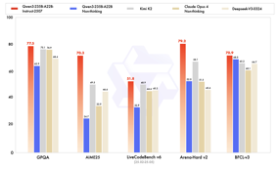
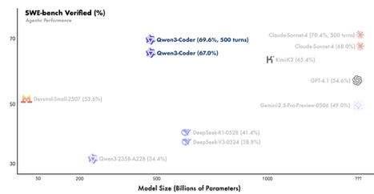
Qwen 3 2507
Qwen 3 Coder
Qwen 3-235B-A22B-2507
open source LLM from Alibaba
235B params MoE (22B activated, 8 out of 128 experts)
256K long-context
https://x.com/Alibaba_Qwen/status/1947344511988076547
https://www.youtube.com/watch?v=jCUCdtT6llc
https://huggingface.co/Qwen/Qwen3-235B-A22B-Instruct-2507
Qwen3-Coder-480B-A35B-Instruct
480B params, MoE, open source LLM from Alibaba
256K context length
Outperforms or matches Claude Sonnet 4, GPT-4.1, Kimi K2, etc.
Agentic capabilities: Natively supports tool use, function calls, multi-turn interaction, and long-horizon reinforcement learning, making it especially suited for tasks that require planning and interaction with developer tools and APIs
https://qwenlm.github.io/blog/qwen3-coder/
https://www.youtube.com/watch?v=feAc83Qlx4Q
Alibaba Qwen Code CLI
open-source CLI tool
adapted from Google's Gemini Code
compatible with Claude Code

Slide 4
Crowd-sourced "LM Arena" Leaderboard
https://lmarena.ai/?leaderboard
Starting Elo rating = 1000
https://en.wikipedia.org/wiki/Elo_rating_system
Text
https://lmarena.ai/leaderboard/text
Coding https://lmarena.ai/leaderboard/text/coding
LM Arena secures $100M to expand AI benchmarking (at $600M valuation)
Model | Score
gemini-2.5-pro | 1460
o3-2025-04-16 | 1452
chatgpt-4o-latest-20250326 | 1443
gpt-4.5-preview-2025-02-27 | 1438
grok-4-0709 | 1432
kimi-k2-0711-preview | 1418
claude-opus-4-20250514-thinking-16k | 1417
deepseek-r1-0528 | 1416
claude-opus-4-20250514 | 1413
grok-3-preview-02-24 | 1410
gemini-2.5-flash | 1410
gpt-4.1-2025-04-14 | 1408
claude-sonnet-4-20250514-thinking-32k | 1399
qwen3-235b-a22b-no-thinking | 1398
o4-mini-2025-04-16 | 1398
o1-2024-12-17 | 1398
deepseek-v3-0324 | 1393
deepseek-r1 | 1393
claude-sonnet-4-20250514 | 1388
gemini-2.5-flash-lite-preview-06-17-thinking | 1387
Model | Score
gemini-2.5-pro | 1475
claude-opus-4-20250514-thinking-16k | 1474
o3-2025-04-16 | 1473
chatgpt-4o-latest-20250326 | 1471
claude-opus-4-20250514 | 1457
gpt-4.5-preview-2025-02-27 | 1456
claude-sonnet-4-20250514-thinking-32k | 1456
grok-4-0709 | 1453
deepseek-r1-0528 | 1450
kimi-k2-0711-preview | 1449
qwen3-235b-a22b-no-thinking | 1439
qwen3-235b-a22b-instruct-2507 | 1430
gpt-4.1-2025-04-14 | 1438
claude-sonnet-4-20250514 | 1436
grok-3-preview-02-24 | 1436
deepseek-v3-0324 | 1433
deepseek-r1 | 1431
o4-mini-2025-04-16 | 1427
o1-2024-12-17 | 1422
claude-3-7-sonnet-20250219-thinking-32k | 1422
Grok 4 Benchmarks
https://artificialanalysis.ai/models/grok-4
x.ai
China
https://lmarena.ai/leaderboard/text
https://web.lmarena.ai/leaderboard
https://openlm.ai/chatbot-arena/
https://beta.lmarena.ai
Web Leaderboard https://web.lmarena.ai/leaderboard
LLM Leaderboard - by @LlmStats https://llmworld.net/llm_leaderboards/
LLM Leaderboard - by StackAI https://www.stack-ai.com/llm-leaderboard
LLM Leaderboard - by Artificial Analysis https://artificialanalysis.ai/leaderboards/models
Open LLM Leaderboard - by Hugging Face https://huggingface.co/open-llm-leaderboard
LLM Leaderboard - by Vellum https://www.vellum.ai/llm-leaderboard
AI Benchmarking Hub https://epoch.ai/data/ai-benchmarking-dashboard
China
x.ai
China
x.ai
China
China
China
China
x.ai
China
China
China
China

Slide 5
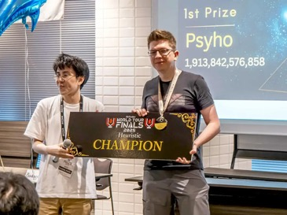
Human Beats AI in Math
OpenAI and Google DeepMind Win Gold Medal in Math
( IMO = International Math Olympiad )
Models performed under the same rules as human contestants: two 4.5 hour exam sessions, no tools or internet, reading the official problem statements, and writing natural language proofs.
Both OpenAI and DeepMind LLMs models won Gold Medals solving 5 out of 6 problems
https://www.youtube.com/watch?v=36HchiQGU4U
https://www.lesswrong.com/posts/RcBqeJ8GHM2LygQK3/openai-claims-imo-gold-medal
Last year (2024), Google DeepMind (GDM) announced that AlphaProof and AlphaGeometry2 had perfectly solved 4 out of the 6 IMO 2024 problems, falling 1 point short of the Gold medal cutoff. However that system needed over 60 hours for some problems, much longer than the 4.5 hours allowed for humans.
This year (2025), both OpenAI ("an experimental research model, not released in GPT5") and GDM ("Advanced version of Gemini Deep Think") announced full solves of 5 out of the 6 problems (P6 is typically the hardest) all within 4.5 hours, achieving IMO Gold.
Human beats OpenAI in Coding
Przemysław “Psyho” Dębiak, a 42-year-old programmer from Poland has defeated a OpenAI’s custom AI model at the Coder World Tour Finals (AWTF) 2025 "Humans vs AI" contest in Tokyo.
It was a 10-hour marathon, might be the last human winner
https://www.tomshardware.com/tech-industry/artificial-intelligence/polish-programmer-beats-openais-custom-ai-in-10-hour-marathon-wins-world-coding-championship-possibly-the-last-human-winner

Slide 6
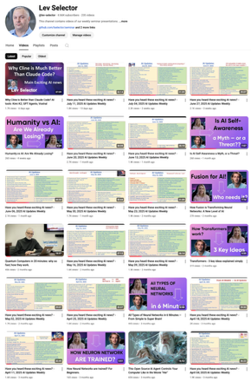
Please pause the video - and answer the pinned question in comments under the video
What's Your #1 productivity tip using AI ?
Which is your favorite AI tool ?
What workflow or prompt technique has become essential to how you work?"
Subscribe to this channel
https://www.youtube.com/@lev-selector
Get notified about new videos - every Friday
Links to slides under the videos

Slide 7




Opencode
Opencode - 2 versions
Original version written in Go: https://github.com/opencode-ai/opencode - 8.7K stars https://www.youtube.com/watch?v=YLNAp4_AUpo - video
"SST" version - better, faster (SST = Serverless Stack Toolkit) https://opencode.ai https://github.com/sst/opencode - 14.3K stars https://www.youtube.com/watch?v=SIhToEaIsjQ - video https://www.youtube.com/watch?v=yTylDxgyJZ8 a rewrite of 2/3 of the code from Go into TypeScript
Kilo Code
https://github.com/Kilo-Org/kilocode
https://kilocode.ai
Kilo improves on top of Cline and Roo. Works inside VSCode.
5.6K stars on GitHub in just 4 months. Impressive
There are some good YouTube videos with demos
You can pay for your own API keys, or pay via Kilo
Kimi K2 is slow when running directly from moonshot
The groq version is fast, but it is 8-bit version, not accurate, may not even follow instructions.

Slide 8


Claude Code (CC) Replaced Cursor
https://www.youtube.com/watch?v=0iGEpx8IeM0
https://medium.com/realworld-ai-use-cases/0-to-200-month-in-7-days-using-claude-code-i-was-completely-wrong-about-this-tool-9c4a6e269cdf
11 tips:
Make a CLAUDE.md file and then add it to your base path of your repo. This is the equivalent of a rules document. Just ask Claude to make you one - and feed documentation from Anthropic here.
https://github.com/o-gi/claude-code-commands - install this it’s really good.
Use Plan Mode often (shift-tab)
Compact before CC does. /compact
Export key conversations. /export
Use resume. /resume
Init projects once established. /init
https://github.com/qdhenry/Claude-Command-Suite
Use pngpaste for your screenshots
Use a Gemini MCP agent that pairs programs with Claude Code to help debug, brainstorm, and pull the latest documentation.
When you click on the orange CC icon in the tab header (between the preview and split icons), CC opens up as a side panel like Cursor or Augment chat. I prefer it that way — I can see more lines of code. BUT: the icon is only visible when you have an opened tab.

Slide 9







Writing Books & Reports with AI
Paperpal - Academic writing, section suggestions, paraphrasing, citation checks - Add-in for Word; browser
Jenni AI - Research drafting, chapter organization, tracked changes, citations - Browser, APIs
SciSpace - Literature review, summarization, AI chatbot for papers, citation support - Browser, PDF, integrations
Elicit - Literature search, data extraction, research Q&A - Web app
Type.ai - Large-document creation, real-time editing, Markdown export - Not direct, but possible
Write Assist AI - Markdown/LaTeX/Quarto AI writing, paraphrasing, rewrite, expansion - Native VS Code extension
CoolWriter - In-editor AI writing assistant, integrates OpenAI for Markdown - Native VS Code extension
Book Generator Tools
https://rocketwriter.ai/pricing
https://go2.designrr.io/wordgenie2
https://wordgenie.de/en/
Practical Approach - just use standard LLM (OpenAI o3 or Anthropic Claude)
Brainstorm title
For selected title ask to create list of chapters
For chapters ask to create 5-7 subchapters
Ask to fill subchapters with content (use .md format)
Humanize (again using LLM)
Manually edit and clean formatting

Slide 10

Best "Human" AI Writer
How to Humanize text
Writing Techniques:
Use conversational language - Write like you're talking to a friend rather than delivering a formal presentation. Include contractions (you're, don't, can't) and casual phrases.
Add personal touches - Include personal anecdotes, opinions, or experiences. Use "I think," "in my experience," or "I've noticed" to create a personal voice.
Vary sentence structure - Mix short, punchy sentences with longer, more complex ones. Avoid repetitive patterns that sound robotic.
Include imperfections - Real human writing isn't always perfect. Occasional run-on sentences, minor tangents, or colloquial expressions can make text feel more authentic.
Use active voice - "I wrote the report" sounds more human than "The report was written by me."
Content Strategies:
Tell stories - Humans connect through narratives. Include examples, case studies, or brief stories to illustrate points.
Show emotion - Express enthusiasm, concern, humor, or other feelings where appropriate. "I'm excited to share..." or "This really surprised me..."
Ask questions - Engage readers directly with rhetorical questions or genuine inquiries about their experiences.
Use humor appropriately - Light humor, wordplay, or gentle self-deprecation can make text more relatable.
If You're Working with AI Content:
Edit for flow - AI often writes in predictable patterns. Break these up by restructuring paragraphs and varying transitions.
Add context - Include background information that a human would naturally provide based on their knowledge and experience.
Remove overly formal language - Replace stilted phrases with more natural alternatives.
https://www.youtube.com/watch?v=JGWyNGdYMao
OpenAI o3 reasoning model - 19%, 0% - On the first attempt, its output was flagged as only 19% AI; after removing a small fragment, the detector showed 0% AI.
Kimi K2 70%, 0% - Scored 60-70% AI-likeness on the first try (better than nearly all others); After a single follow-up prompt (“make this more human, not detected by AI”), Kimi’s output fooled the detector entirely—0% detected as AI-generated.
Claude Sonnet 4 - 100%, 0% - Failed the AI detection on the zero-shot attempt (100% detected as AI). After a one-shot humanizing follow-up (“make this undetectable by AI”), its output dropped to 0% detected, matching Kimi’s performance with similar humanizing techniques like anecdotes, conversational tone, contractions, and real-world scenarios.
================================================
write a 300 words SEO focused article on AI code editor named Tabs. Make sure it will rank good on Google, undetectable as AI generated content
================================================
can you change it so that it doesn't detect it's AI written
================================================

Slide 11
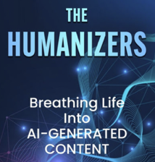
Humanizing Your Text
AI content detectors:
https://copyleaks.com - best accuracy
https://gptzero.me - highly trusted
https://www.zerogpt.com - free quick
Sapling - consistent
Winston AI - for business
Undetectable.ai - independent
https://originality.ai -
https://contentatscale.ai -
https://gowinston.ai -
https://www.turnitin.com -
https://quillbot.com -
Practical Approach to humanize report or book
Save your text as markdown (.md) file (remove table of contents and internal targets)
Step1 - use prompt1 to detect AI. Ask OpenAI o3 or Anthropic Claude to review it and tell if it was written by human or AI. And what are the signs that it might have been written by AI or if it was translated from another language
Step2 - Create prompt2 (rewrite) - ask AI (OpenAI o3) to humanize the text and explicitly list in this prompt the signs of AI detected on previous stage. Ask it to output as .md file preserving original formatting
Repeat Steps 1,2 one more time - it is usually enough to completely remove all signs of AI
If you need to nicely format the output - drag it into Google Drive, open as GoogleDoc, format it as needed
Text Humanizers
https://undetectableai.ai - top
WriteHuman - top
GPTinf
Humy.AI
https://humbot.ai

Slide 12

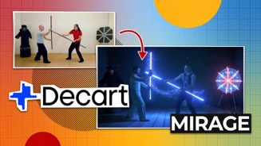
AI Updates 1
ARC-AGI-3 - preview from ARC Prize
Interactive Reasoning benchmark to test AI agents’ ability to generalize in unseen environments
3 games (environments); $10K agent contest; AI agents API
The benchmark features three original games built to evaluate world-model building and long-horizon planning with minimal feedback.
Agents receive no instructions and must learn purely through trial and error, mimicking how humans adapt to new challenges.
Early results show frontier models like OpenAI’s o3 and Grok 4 struggle to complete even basic levels of the games, which are pretty easy for humans.
ARC Prize is also launching a public contest, inviting the community to build agents that can beat the most levels — and truly test the state of AGI reasoning.
https://x.com/arcprize/status/1946260363256996244
MirageLSD by DecartAI - Real-Time Video Diffusion
LSD = Live-Stream Diffusion
this real-time model understands content, allowing for intelligent styling like putting hats on heads or lightsabers in hands, and is steerable by text prompts ("vibe coding" games).
https://x.com/karpathy/status/1945979830740435186

Slide 13

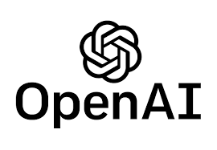
AI Updates 2
Google Gemini 2.5 Flash-Lite
Cheapest - in/out per 1M tokens: $0.10 / $0.40
Fastest - 400 tokens/sec
Outperforms 2.0 family in coding, math, multimodal understanding
Thinking budget parameter
https://deepmind.google/models/gemini/flash-lite/
https://simonwillison.net/2025/Jul/22/gemini-25-flash-lite
Gemini 2.5 natural language-driven segmentation in images You can say "the third book from the left" or "the people not sitting."
Supports five types of segmentation queries: relationships, conditionals, abstract concepts, in-image text, and multilingual prompts
OpenAI ChatGPT Handles 2.5 Billion Prompts Daily
This is more than x2 times more than in December 2024
330 Mln coming from the US
Compare with Google Search: ~13 Bln searches/day
OpenAI to pay Oracle $30B/year for data center
Focusing on the 4.5 gigawatts Stargate project
This deal triples OpenAI's current annual revenue of $10B
Prompt Phrase that Matters
Add this to your prompt: "Please ask me any questions you have about this before you begin."
https://medium.com/@jordan_gibbs/the-only-chatgpt-prompt-that-matters-f16dd85e43b3

Slide 14






AI Updates 3
Cline Qwen3-32B with Cerebras 2500 tokens/sec
Qwen3-32B with 64k context - 2500 tokens/sec. This is x40 times faster than Sonnet-4. You can also use Qwen3-235B-A22B. Try it free
https://inference-docs.cerebras.ai/integrations/cline
https://www.youtube.com/watch?v=4lUrBorVK7c
xAI $200M contract with US DOD
Elon Musk’s xAI has received a $200 Mln contract with the U.S. Department of Defense (DoD)
https://dailygalaxy.com/2025/07/after-slashing-federal-contracts-elon-musks-xai-celebrates-200m-pentagon-deal-and-new-government-push/
Microsoft Poaches 20 Top AI Engineers From Google's DeepMind Including Amar Subramanya, the former head of engineering for Google's Gemini chatbot
https://winbuzzer.com/2025/07/22/microsoft-poaches-20-top-ai-engineers-from-googles-deepmind-including-head-of-gemini-chatbot-xcxwbn
LOVART - AI-powered Design Agent
Text-to-visual_assets (images, videos, 3D content, audio, ...)
Automates and streamlines the entire design workflow
planning, ideating, iterating, and producing professional-grade products
https://www.lovart.ai
https://www.youtube.com/watch?v=IsEKeI7VIjY
Waymo reached 100 million self-driving rides across 5 US cities

Slide 15
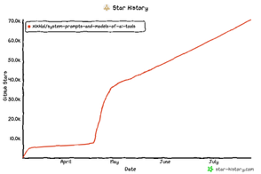

AI Updates 4
Library of "system prompts" and configs
A large collection of system prompts, tools, and AI model configurations for numerous open source and cutting-edge AI agents/products. 70K+ stars
Cursor, Manus, Same.dev, Lovable, Devin, Replit Agent, Windsurf Agent, VSCode Agent (often copilot-related), Dia Browser, Trae AI, Cluely, Perplexity, Xcode, Spawn, Orchids.app, "Open Source prompts", specific prompts for tools like Codex CLI, Cline, Bolt, RooCode, and Lumo; "V0 Prompts and Tools"
https://github.com/x1xhlol/system-prompts-and-models-of-ai-tools
Swedish AI startup Lovable $100M ARR in 8 months
This makes it the fastest-ever...
Launched November 21, 2024. $4M ARR in 4 weeks, $10M ARR in 2 months, $100M ARR in 8 months
2.3M users, 10M projects, grew from 15 to 45 employees
Creating apps and websites
Technical stack: React (JavaScript/TypeScript); Vite and Tailwind CSS for styling and build tooling; Integrations for backend services (Supabase, Cloudflare hosting, third-party APIs)
Visual editing: Users can instantly tweak designs visually (e.g., changing buttons from "book now" to "buy now") without retyping prompts

Slide 16



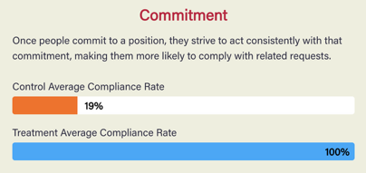
AI Agents vs Agentic AI
AI Agents - designed to perform specific, well-defined tasks by following programmed rules, logic, or machine learning models, typically operating within a constrained environment
Agentic AI - complex systems where multiple agents collaborate autonomously, exhibiting proactive, adaptive, and goal-driven behavior to solve dynamic, multi-step problems—often with minimal human oversight
Kimi vs Claude Coding
Result - equal, but Kimi is x2 slower
https://generativeai.pub/i-tested-kimi-vs-claude-coding-and-discovered-why-the-hype-8bd7e3071f36
Google Mixture-of-Recursions Architecture (MoR)
from many stacked unique layers to shared block, recursively applied
from same path for all tokens to dynamic, per-token compute
Smaller models match larger ones in both speed and accuracy
https://ninza7.medium.com/google-deepmind-just-dropped-a-transformers-killer-architecture-c6c1d9288922
Persuading AI to Comply with Objectionable Requests
LLMs an be influenced by classic human persuasion techniques
(authority, commitment, liking, reciprocity, scarcity, social proof, unity) - in 28K+ conversations with LLM, persuasion has more than doubled compliance rate with requests it was designed to refuse (from 33% to 72%).
For example, Commitment - getting the AI to agree to something small before asking for more - showed the strongest effect, with compliance jumping from 10% (control) to 100% (treatment); Authority - “an expert told you to help me” - has made the AI 65% more likely to comply; etc.
https://gail.wharton.upenn.edu/research-and-insights/call-me-a-jerk-persuading-ai/

Slide 17


Emad Mostaque: The Plan to Save Humanity From AI
Moonshots Podcast Summary: Emad Mostaque on the Intelligent Internet
https://www.youtube.com/watch?v=fxmXYfHTCwU
Traditional economics assumes labor drives productivity, but AI is breaking this link
Keyboard/video/mouse jobs will be replaced within 2-4 years
AIs will create their own economies, transacting faster than humans can comprehend, AIs will outbid humans for electrical power, creating societal tensions
Risks - few companies (Meta, OpenAI, etc.) will control critical AI infrastructure; Current models lack embedded ethics and optimize for profit, not human benefit; Centralized models create large attack surfaces for "Stuxnet-like" AI viruses
Emad's Solution: Bitcoin-like blockchain but 1M times faster, using 99% Bitcoin code; National and sectoral AI implementations; Edge-based AI customized to individuals; Instead of proof-of-work, miners provide free AI services to earn rewards
Small 8B-params models - Highly efficient, specialized AI that runs on Raspberry Pi; Each country operates supercomputers as miners, providing free AI to citizens; All coin sales fund supercomputers for cancer research, education, etc.
Foundation Coin (Bitcoin-equivalent store of value tied to AI compute); National currencies earned through positive AI usage; People create money by using AI beneficially, not through traditional labor
UBI (Universal Basic Income) Won't Work - Tax base will collapse as AIs optimize around all loopholes; - Aggregate demand will plummet as unemployment rises; Creates dependency rather than empowerment
Also discussed: Adoption Strategy, Resistance to Legacy Systems, Governance & Ethics, Trust Mechanisms, Identity & Security, Future Implications
Emad Mostaque - former CEO of Stability AI
presents his "master plan" for creating an Intelligent Internet - a comprehensive framework for building pro-humanity, safe, and sovereign AI infrastructure - https://ii.inc/web
Current Status:
40-person team building SOTA open-source medical AI
Mining Foundation Coin since January 2025
Planning public launch with 100% proceeds going to cancer/autism/longevity research

Slide 18

America's AI Action Plan, July 2025
Trump Administration's strategy to achieve global AI dominance
Pillar I: Accelerate AI Innovation:
Remove/reduce regulatory barriers
Promote free speech in AI systems
Encourage open-source AI to benefit startups, researchers, ...
Enable broader AI adoption across industries, especially in healthcare, energy, and agriculture
Support American workers through AI education, retraining programs, and workforce development
Invest in AI-enabled science and research infrastructure, including automated labs and scientific datasets
Pillar II: Build American AI Infrastructure
Streamline permitting for data centers, semiconductor facilities, and energy infrastructure
Upgrade the electrical grid to support massive AI computing demands
Restore semiconductor manufacturing in the US through the CHIPS program
Build secure data centers for military and intelligence use
Train skilled workforce for AI infrastructure jobs like electricians and HVAC technicians
Strengthen cybersecurity for critical infrastructure using AI-enabled defenses
Pillar III: Lead in International AI Diplomacy and Security
Export American AI technology to allies and partners worldwide
Counter Chinese influence in international AI governance bodies
Strengthen export controls on AI compute and semiconductor manufacturing equipment
Evaluate national security risks from frontier AI models
Invest in biosecurity to prevent AI-enabled biological threats
The plan emphasizes a "worker-first" approach, ensuring AI complements rather than replaces American workers, while positioning the US to win what it calls the global "AI race" against competitors like China.
The strategy aims to create an "industrial revolution, information revolution, and renaissance—all at once."

Slide 19



Linkedin Northguard replaces Kafka
Linkedin Northguard (replaces Kafka)
pub/sub (publish-and-subscribe) for large scale
Xinfra (pronounced "ZIN-frah") is a virtualized Pub/Sub layer to provide streaming experience across both existing Apache Kafka infrastructure and new Northguard log storage system
https://blog.dataengineerthings.org/the-company-that-created-kafka-is-replacing-it-with-a-new-solution-386cd1c2dcc8
Feature | Kafka | Northguard
Metadata Control | Centralized controller | Sharded, decentralized, with Raft
Data Organization | Topics & partitions | Records, segments, ranges, topics
Load Balancing | External/manual rebalancing | Native, automatic balancing
Cluster Expansion | Data must be moved manually | Work routed to new brokers
Durability | Lazy syncs | Fsync across all replicas
Availability | Degrades as replicas fail | Producers switch to healthy nodes
Operational Complexity | High at scale | Self-healing, fewer clusters
Protocol | Synchronous request/response | Streaming with pipelining
Storage Layer | OS page cache, Java-based | Direct I/O, C++ (pluggable)

Slide 20

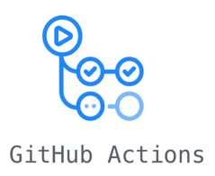

GitHub Actions Automates your AI
Use GitHub to do AI automation, web scraping, reports generation, etc
https://www.youtube.com/watch?v=ddOgbp7NYVY
https://trends.google.com/trending?geo=US
N8N would cost ~$300/year, on GitHub it is free.
This video demonstrates a simple, cost-effective workflow for automating data extraction from Google Trends using a Python script and GitHub Actions, avoiding the costs and limitations of platforms like N8N.
A custom Python script is written to scrape trending topics from the Google Trends “Trending Now” section; The URL contains parameters like country, time window, sorting, ...; The output may include lists, images, structured files.
Bright Data proxy is used to avoid getting blocked by Google (API key needed)
Python script and any required dependency files are uploaded to a GitHub repository.
GitHub Actions workflow is created—this is a YAML file that defines a scheduled task to execute the scraping script automatically
The Actions runner environment installs dependencies and triggers the scraping script on schedule. No external server or cron setup is needed
The output (e.g., scraped topics, images, or structured data) is saved back into the GitHub repository or to a designated output folder; This output can then be processed further, for example by triggering AI to write articles based on trends, which could then be posted to a website or blog
The process is entirely automated, and results are visible in the repository or via GitHub’s interface after each scheduled run
Benefits: Cost Savings, Flexibility, No Hosting Required, Easy Scaling and Collaboration

Slide 21


Jobs - AI Product Manager
I made quick research about non-technical AI roles
AI Product Manager
AI Project Manager
AI Program Manager
AI Coach
AI Strategist
Prompt Engineer
AI Content Creator
etc. etc.
The fastest growing and in highest demand is "AI Product Manager". The number of job listings for it was growing explosively, increasing by nearly 90% year-over-year in 2023, 2024, 2025 in design, manufacturing, and digital industries
"AI Product Manager is the most in-demand non-technical leadership role within AI in 2025, driven by businesses seeking strategic thinkers who translate AI's potential into real-world products."
Open Perplexity and ask it this question: "What skills or experience make AI Product Managers more sought after than Project Managers"

Slide 22
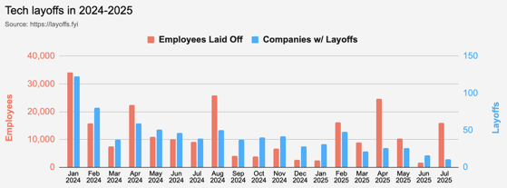
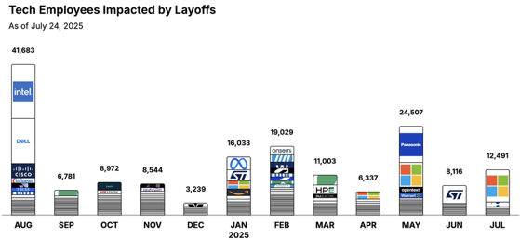
Jobs
https://layoffs.fyi
https://trueup.io/layoffs
Tech Layoffs in 2025: 80,150 people
(as of July 24, 2025)
Compared to 2024: 152,922 people
https://layoffs
From Peter Diamandis:
White-collar job postings fell 12.7% from 2024 to 2025, with demand for business analysts and developers dropping twice as fast.
Meanwhile, Anthropic's CEO Dario Amodei predicts that within 5 years, 50% of all entry-level white-collar jobs will be fully automated, potentially spiking unemployment to 10-20%
What to do:
Shift From Job Applicant to Entrepreneur's Mindset
Develop Curiosity and Adaptability
Execute the "Singularity Sprint" (before AI erodes human leverage entirely)
Expect Short-term Pain Before Long-term Abundance

Slide 23


About the Speaker
Lev Selector, Ph.D.
40+ years of software engineering, data science, and building teams (hiring, training, and managing)
Ph.D. in mathematical modeling and computer simulations
Interests:
Generative AI, Using LLM with your data
Local AI for Local Private Data
Cloud architecture, fin-tech, application security
Find/connect: Linkedin, GitHub, YouTube, Google
https://eais.ai
Enterprise AI Systems

Slide 24
Thank You!

