Slide 1
AI Updates
October 18, 2024
LLMS CANNOT Reason (paper from Apple)
Stochastic parrot
Nvidia/Llama-3.1-Nemotron-70B-Instruct-HF
Zamba2-7B hybrid model
Ministral-8B
OpenAI Swarm multi-agent orchestration
MatMamba
O1 Replication Journey (model & report)
Tesla new autonomous tesla bot
Crowd-sourced "Arena" Leaderboard - English
Crowd-sourced "Arena" Leaderboard - Coding
Tech Layoffs in 2024

Slide 2

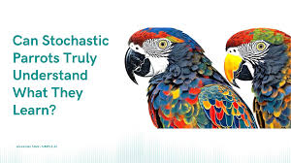
Stochastic parrot
Stochastic parrot
https://en.wikipedia.org/wiki/Stochastic_parrot
The term stochastic parrot is a metaphor to describe the theory that LLMs, though able to generate plausible language, do not understand the meaning of the language they process.
The term was coined by Emily M. Bender (2021) in the AI paper "On the Dangers of Stochastic Parrots: Can Language Models Be Too Big?"
https://s10251.pcdn.co/pdf/2021-bender-parrots.pdf
LLM answers questions by statistical parroting. It simply predicts the most probable answer from its training data.
Token by token.
A model is a compressed version of the training data:
All internet => training data => model
Chain of Thought: Once LLM gives answer, you can ask it if this is a good answer. And it will answer this question using (again) statistical parroting, but this time the answer may come from training data based on online discussions. But it is still statistical parroting.
LLM doesn't do reasoning - it mimics reasoning by mimicking reasoning texts in its training data
An LLM always gives you not a correct answer, but generates a most common answer. It converges to the mean. It will happily give you the most common misconception. It does not understand.

Slide 3
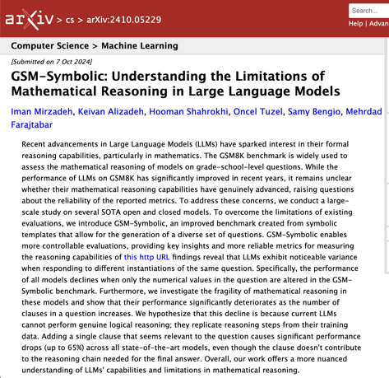
LLMS CANNOT Reason
GSM-Symbolic: Understanding the Limitations of Mathematical Reasoning in Large Language Models
new paper from Apple
https://arxiv.org/abs/2410.05229
https://arxiv.org/pdf/2410.05229
https://www.youtube.com/watch?v=tTG_a0KPJAc - video
Idea: take standard test (GSM8K), change (or add) irrelevant information (GSM-Symbolic), use it to test models.
The performance of all models declines significantly. Multiple models were tested, including recent GPT-o1.
This decline is due to the fact that current LLMs are not capable of genuine logical reasoning; instead, they attempt to replicate the reasoning steps observed in their training data.
When we add a single clause that appears relevant to the question, we observe significant performance drops (up to 65%) across all state-of-the-art models, even though the added clause does not contribute to the reasoning chain needed to reach the final answer.
"We found no evidence of reasoning in LLMs"

Slide 4
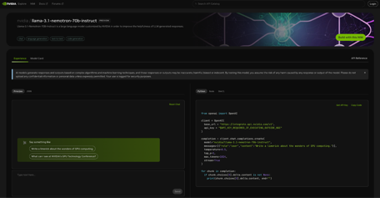
Nvidia/Llama-3.1-Nemotron-70B-Instruct-HF
This model is NOT open source
Llama-3.1-Nemotron-70B-Instruct-HF has been converted from Llama-3.1-Nemotron-70B-Instruct to support it in the HuggingFace Transformers codebase.
Llama-3.1-Nemotron-70B-Instruct is customized by NVIDIA.
As of 1 Oct 2024, this model is #1 on all three automatic alignment benchmarks (verified tab for AlpacaEval 2 LC), edging out models such as GPT-4o and Claude 3.5 Sonnet.
This model was trained using RLHF (specifically, REINFORCE), Llama-3.1-Nemotron-70B-Reward and HelpSteer2-Preference prompts on a Llama-3.1-70B-Instruct model as the initial policy.
https://build.nvidia.com/nvidia/llama-3_1-nemotron-70b-instruct/modelcard
https://huggingface.co/nvidia/Llama-3.1-Nemotron-70B-Instruct-HF
https://build.nvidia.com/nvidia/llama-3_1-nemotron-70b-instruct

Slide 5
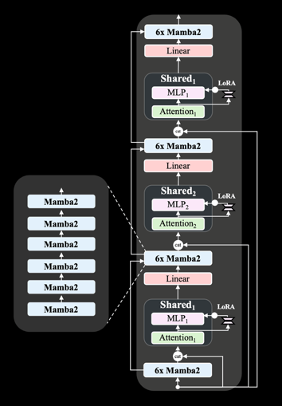
Zamba2-7B
Zamba2-7B
Open source (Apache 2.0)
It is a hybrid model: transformer + Mamba2 blocks
Outperforms Mistral, Google’s Gemma and Meta’s Llama3 series in both quality and performance.
We believe Zamba2-7B is the leading model for running on-device and on consumer GPUs
https://www.zyphra.com/post/zamba2-7b
https://huggingface.co/Zyphra/Zamba2-7B
https://huggingface.co/Zyphra/Zamba2-7B-Instruct
Not on ollama yet
from transformers import AutoModelForCausalLM, AutoTokenizer
model_name = "Zyphra/Zamba2-7B"
tokenizer = AutoTokenizer.from_pretrained(model_name)
model = AutoModelForCausalLM.from_pretrained(model_name)

Slide 6
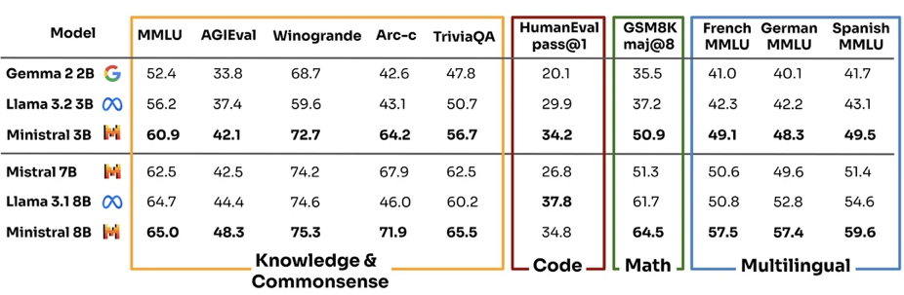
Ministral-8B
Ministral-8B - LLM by Mistral AI.
3B & 8B models
"research" license, not on ollama
Designed for for edge computing
128K context length
Multilingual

Slide 7
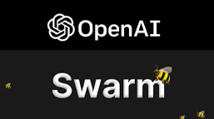
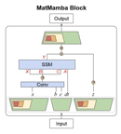
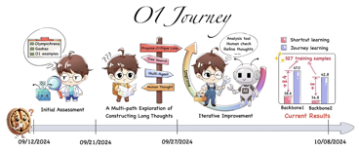
Misc 1
OpenAI Swarm - an educational framework exploring ergonomic, lightweight multi-agent orchestration currently is in experimental (not production ready) state. The goal of Swarm is to showcase the handoff & routines patterns explored in the Orchestrating Agents: Handoffs & Routines cookbook.
https://github.com/openai/swarm
MatMamba - open source a sequence processing based on Mamba2. It has a nested Matryoshka structure in a Mamba2 block. "We jointly train a few chosen granularities to get a single model from which we can flexibly extract a large number of nested submodels for adaptive inference based on the available deployment compute."
https://github.com/scaledfoundations/matmamba
O1 Replication Journey: A Strategic Progress Report
new training paradigm called "journey learning" and propose
the first model that successfully integrates search and learning in mathematical reasoning (trial-and-error, correction, backtracking, and reflection).
https://github.com/GAIR-NLP/O1-Journey/blob/main/resource/report.pdf
https://github.com/GAIR-NLP/O1-Journey

Slide 8
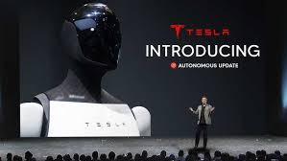
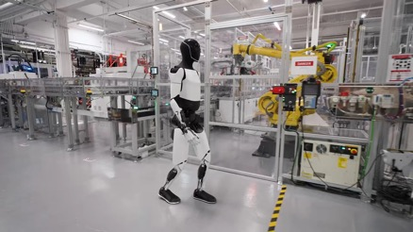
Tesla new autonomous tesla bot
Tesla's Optimus = Tesla Bot = humanoid robot
walk & navigate complex environments, including stairs and uneven terrain, and locate its charging station autonomously.
grasp and manipulate objects with its hands (picking items, carrying boxes, and even watering plants).
interact safely with humans (voice commands and gestures)
learning from experience
custom-designed actuators and sensors
Tesla's Full Self-Driving computer
Battery packs for power
Tesla's AI software: vision, Neural networks, motion planning and control algorithms
Optimus is under development. Goal is to mass-produce it. It can be used for:
hazardous or tedious tasks - working in factories, construction sites, or disaster zones)
Home tasks - cooking, cleaning, and laundry
companionship and assistance to elderly individuals.

Slide 9
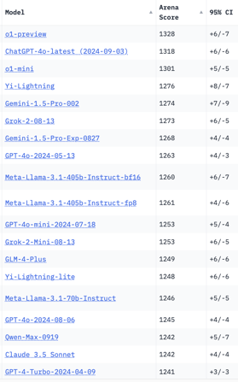
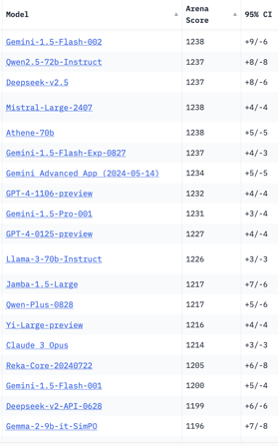
Crowd-sourced "Arena" Leaderboard
Total #models: 156.
Total #votes: 2,082,385.
Last updated: 2024-10-14.
Starting Elo rating = 1000
95% CI = Confidence Interval
https://chat.lmsys.org/?leaderboard
English-only queries
China
x.ai
x.ai
China
China
China
China
China

Slide 10
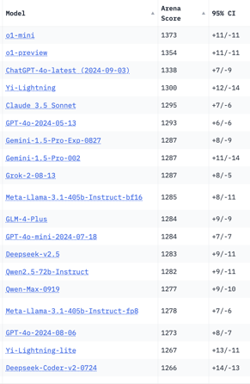
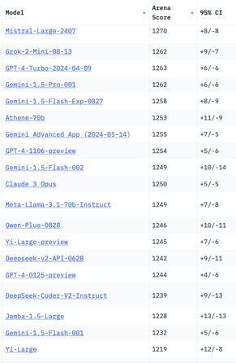
Crowd-sourced "Arena" Leaderboard
Total #models: 156.
Total #votes: 2,082,385.
Last updated: 2024-10-14.
Starting Elo rating = 1000
95% CI = Confidence Interval
https://chat.lmsys.org/?leaderboard
Coding
x.ai
China
x.ai
China
China
China
China

Slide 11
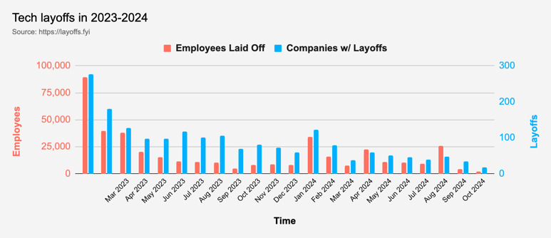
Tech Layoffs in 2024
Layoffs - https://layoffs.fyi
Job market for IT: much worse than before COVID.
IT has become a commodity. Lower salaries/rates ($100/hr => $75/hr).
Much more competition, hundreds of applications for each position

Slide 12
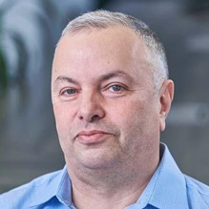

About the Speaker
Lev Selector, Ph.D.
40+ years of software engineering, data science, and building teams (hiring, training, and managing)
Ph.D. in mathematical modeling and computer simulations
Interests:
Generative AI, Using LLM with your data
Local AI for Local Private Data
Cloud architecture, fin-tech, application security
Find/connect: Linkedin, GitHub, YouTube, Google
https://eais.ai
Enterprise AI Systems

Slide 13
Thank You!

