Slide 1

Publishing an eBook on Amazon

Slide 2
How to format using MS Word
https://www.youtube.com/watch?v=Ymu4oaso_IQ
Step 1: Clean the text:- copy your book into text edit and copy the cleaned data into new MS Word document.
Step 2: Change the view from print to draft.
Step 3: Set up Styles for title, subtitle, headings, chapters and text. Times of Roman is the best
Step 4: Add emphasis styling. Bold, Italics etc..
Step 5: No page numbering required
Step 6: Add page breaks only when required
Step 7: Interactive table of contents. Include links to go directly to other pages
Step 8: Add images only when required.
https://helpmenaomi.com/formatting-template-for-nonfiction-kindle-books/
Template for formatting

Slide 3
Kindle Previewer
After formatting the book, we can view it on kindle previewer to see how will it look to the audience.
Kindle Previewer is a free desktop application that enables authors, publishers and eBook service providers to preview how their books will appear when delivered to Kindle customers and makes it easy to audit books for different screen sizes, display orientations and font sizes.
https://www.amazon.com/Kindle-Previewer/b?node=21381691011
Download here

Slide 4
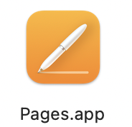

Calibre
Calibre is, in my opinion, the best. It is the oldest ePUB reader and it has excellent functionalities such as managing metadata, managing covers and even transferring files from one device to another
Simply select the book you want to convert for your Kindle and click on Connect / Share. Email it to your Kindle account and within a few seconds, provided that your Kindle has a wifi connection, it will appear on your device as a Kindle book that you can open and use

Slide 5
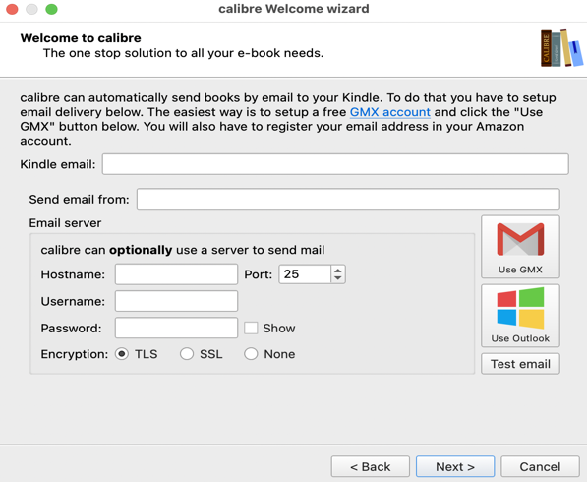
Calibre - install
Download Calibre here
https://calibre-ebook.com/download

Slide 6
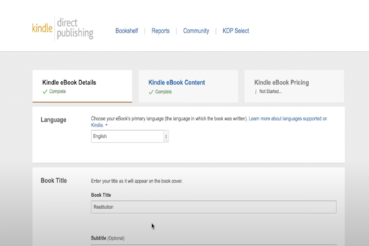
Calibre - Upload book to Kindle
https://www.youtube.com/watch?v=mcxLNcuHT0w
Step 1: Download Calibre
Step 2: Upload your word document to calibre
Step 3: Upload the cover page
Step 4: Convert to Epub format using Calibre
Step 5: Set up your KDP account
Step 6: Upload the EPUB format book to kindle
Step 7: Upload cover page
Step 8: Finish uploading

Slide 7
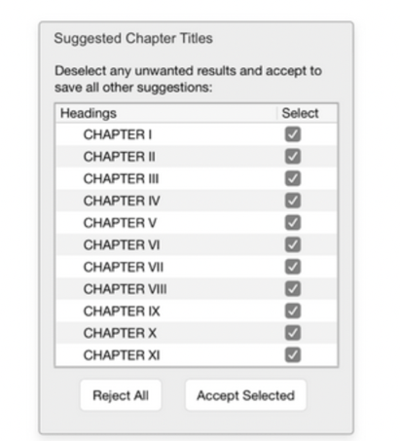
Kindle Create
Download here
https://www.amazon.com/Kindle-Create/b?ie=UTF8&node=18292298011
Step 1: Import unformatted file into Kindle Create
To import the sample manuscript file, start Kindle Create and click Create New.
Step 2: Add front matter pages
Kindle Create allows you to easily add front matter pages like title page, copyright, dedication, and more in a few clicks. For example, to add a title page:
1. Click the + sign next to the Front matter section and select Title Page.
2. Fill in the available fields like Title, Subtitle, and add a publisher image (optional). 3. Click Create Page and Kindle Create will generate a preformatted title page.

Slide 8
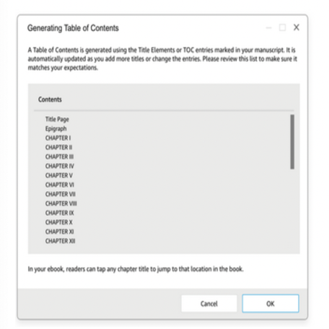
Step 3: Add table of contents page (optional)
To add a table of contents (TOC) page, click your first chapter in the Contents pane, click Insert, and choose Table of Contents. A list of detected chapter titles will appear.
Step 4: Choose a theme
Give your book the right look and feel by applying a theme that automatically updates the layout and font.
The Modern theme is the default.
To change it, click the Theme button in the upper right-hand corner of Kindle Create. You have four options: Modern, Classic, Cosmos, and Amour.

Slide 9
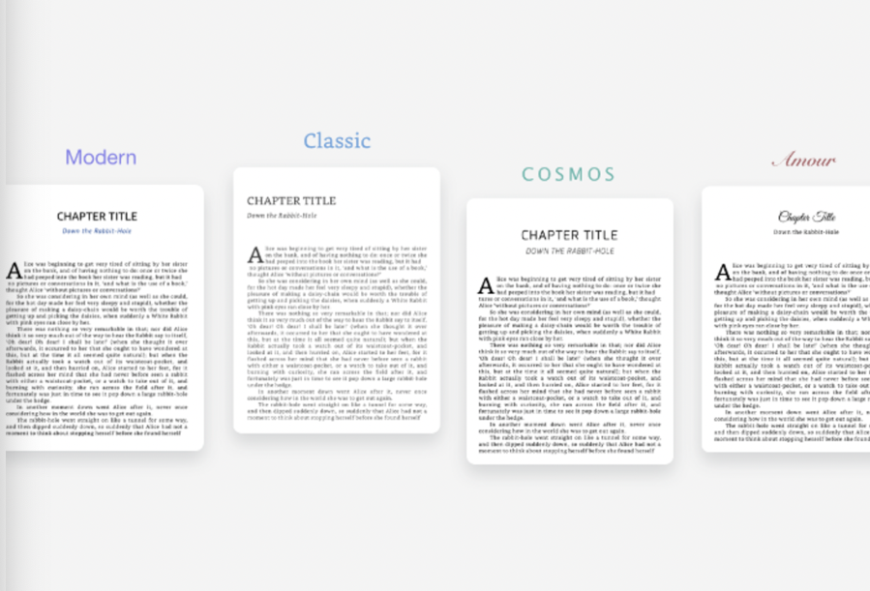

Slide 10
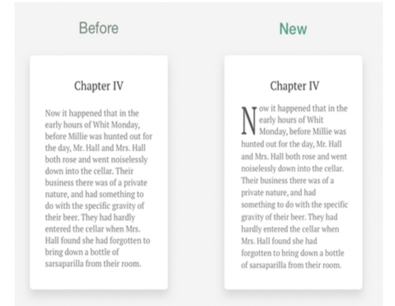
Step 5: Style chapter title pages
When you accept the chapter title pages Kindle Create detects, the tool automatically styles the chapter titles. To apply drop caps and add spacing between the chapter title and first paragraph:
Click next to the first word of your chapter's body text.
Go to the Text Properties pane.
Click the Chapter First Paragraph button

Slide 11
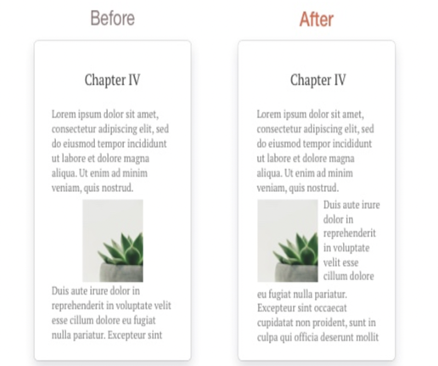
Step 6: Insert an image
Right-click where you want to insert the image.
Click Insert Image in the menu that appears.
Find the sample image file on your computer and open it. This inserts the image into your book.
After you insert the image, you can change its size and position. For example, to put the image on the left margin and have the text wrap around it, go to the Image Properties pane and click the left position icon:

Slide 12
Step 7: Insert hyperlinks
With Kindle Create, you can insert hyperlinks to webpages. A common reason for inserting hyperlinks is to add external references such as wiki pages or blogs. For example, if you want to add a hyperlink to a word in chapter 1:
Open Chapter 1 and highlight the word
Right-click the word and then click Insert hyperlink in the menu that appears
Enter a URL and click Insert hyperlink

Slide 13
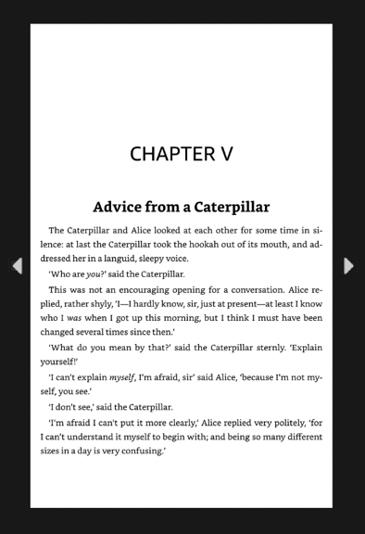
Step 8: Preview and export file
After you finish formatting your book, you can preview it in Kindle Create to see what it would like look on a tablets, E-readers, and phones. To preview your book, click the Preview button in the upper right-hand corner of Kindle Create.
https://kdp.amazon.com/en_US/help/topic/GYVL2CASGU9ACFVU

Slide 14
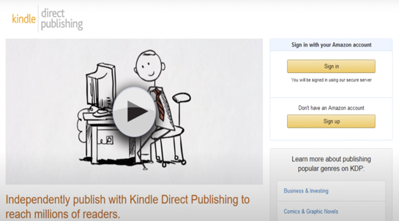
eBook to Paper Book
https://www.youtube.com/watch?v=1KZYLvKTy5Y
KDP print-on-demand helps to print your eBook and ship to customers.
Step 1: Set up an account on KDP
Step 2: Enter book details like barcode etc..
Step 3: Upload a print formatted manuscript
Step 4: Create a cover
Step 5: Set the price and royalties

Slide 15
Basic templates for formatting epub books
https://diybookformats.com/
Just sign up with your email and get basic templates mailed to you.

Slide 16
Summary
MS Word - write, format your book
Then use one of two workflows to publish it as Kindle ebook:
WORKFLOW 1 (preferred) - use Kindle Create App
upload MS Word or epub doc into Kindle Create app
customize/format in Kindle Create app
submit the ebook from Kindle Create to KDP
WORKFLOW 2 - use other tools (Calibre, Pages, ...)
preview in Kindle Previewer
convert to ePub using Apple "Pages" app on Mac
convert to ePub using Calibre (also, preview, upload)
upload to KDP (Kindle Direct Publishing)
If you also want to create a Paper version of your book
and submit it via KDP (using MS Word or ePub doc)

