Slide 1
AI Updates
January 17, 2024
2025 - year of AI Agents
MiniMax-01 - 4M tokens Context Length
Sky-T1-32B-Preview 32b - trained for $450
Fireship Code Report
AI Agents with Memory (Mervin Praison)
AI agents as primary application users
Mistral Codestral 25.01 22b Coding Model
LlamaV-o1 - Visual Reasoning
LLMs - numbers of parameters
ChatGPT Tasks - schedule tasks or reminders
AGI ROBOTS
Metagene.ai - Detect Bio Threats
Microsoft "Core AI Platform and Tools"
Sony Economical Text-to-Image Model
OpenAI's Economic Blueprint
OpenAI Re-enters Robotics Development
ReaderLM-v2 - HTML to markdown or JSON
Andrew Ng - PMs to write software
Sakana.ai Transformer Squared
MatterGen - Generate Inorganic Materials
Google Titans - Memorize at Test Time
NDEA (François Chollet & Mike Knoop)
Luma AI Ray 2 Video Generation
AI for Education - Great Results
2025 - Year of Agents
Google Workspace now includes AI features
Step-2 LLM from StepFun
El Capitan supercomputer
Crowd-sourced "Arena" Leaderboard
Jobs

Slide 2

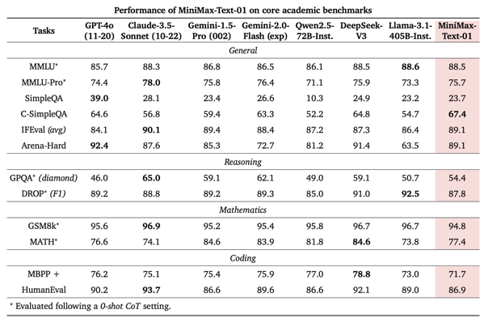
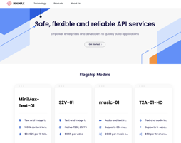
MiniMax-01 - 4M tokens Context Length
MiniMax-01 - open source, 4M Context
https://arxiv.org/abs/2501.08313
https://github.com/MiniMax-AI
https://huggingface.co/MiniMaxAI/MiniMax-Text-01
https://www.minimaxi.com/en/news/minimax-01-series-2
https://www.hailuo.ai - try the chat
456B parameters, Mixture of Experts (MoE),
32 experts, 45.9B activated for each token
Context length 4M tokens during inference
Open Source, can download or use via API
API Pricing (in/out per 1m) : $0.2 / $1.1
Matches the performance of GPT-4o and Claude-3.5-Sonnet while x32 longer context
MiniMax-VL-01 - vision model
MiniMax is located in Shanghai, China

Slide 3




AI Updates - 1
AI Agents with Memory (Mervin Praison)
https://www.youtube.com/watch?v=1hVfVxvPnnQ
https://github.com/MervinPraison/PraisonAI/
https://docs.praison.ai/concepts/memory
https://mer.vin/2025/01/ai-agents-with-memory/
Sky-T1-32B-Preview - an open source reasoning model from UC BERKELEY (team NovaSky)
The model matches or exceeds an earlier version of OpenAI's o1 on several benchmarks, particularly excelling in math and coding
challenges competes with earlier versions of OpenAI’s o1
Sky-T1 is a fine-tuned version of Alibaba’s Qwen2.5-32-Instruct, with training data generated using the open-source reasoning model QwQ-32B-Preview.
Training took just 19 hours on 8 H100 GPUs, total cost was around $450
AI agents may soon surpass people as primary application users
https://www.zdnet.com/article/ai-agents-may-soon-surpass-people-as-primary-application-users/ - by Joe McKendrick
The amazing, but unsettling future of technology ... (Fireship - the code report) - https://www.youtube.com/watch?v=v4H2fTgHGuc
The rise of AI, reasoning models like Open AI o3
AI agents - LLMs which can access and analyze data - and take action.
Rise of robots (Tesla's Optimus and Nvidia's army of robots, ...).
Tech job market
Growing demand for programmers who can use AI
Brain chips - first installed in real humans in 2024
Apple Vision Pro
Quantum computing, Willow chip
Use of Rust in the military
Slowdown in the development of new JavaScript Frameworks
Cryptocurrencies - Bitcoin is at $100,000
Growing anti-Cloud movement among many businesses
Mistral Codestral 25.01
.. https://docs.mistral.ai/capabilities/code_generation/
.. https://mistral.ai/news/codestral-2501/ - latest
.. https://ollama.com/library/codestral
SOTA coding model, 80+ languages, 256K context length, fast response, 22b params (also Codestral Mamba 7.3b)

Slide 4

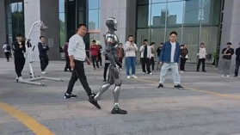
AI Updates - 2
ChatGPT Tasks - schedule reminders and actions. Tell ChatGPT what you want and when. Simply type in your request, like "Remind me to buy groceries tomorrow at 10 AM" or "Give me a daily weather report every morning at 7 AM." ChatGPT will interpret your request and create a task accordingly. You can view and manage your tasks in a dedicated section in the profile menu. ChatGPT will send you push notifications via its website or app when a task is due.
LlamaV-o1 - Visual Reasoning
https://github.com/mbzuai-oryx/LlamaV-o1
https://arxiv.org/abs/2501.06186
Mohamed bin Zayed University of Artificial Intelligence, UAE
LlamaV-o1 uses step-by-step reasoning for general visual question answering, mathematical and scientific reasoning, handling language hallucinations and visual illusions
It is fine-tuned from Llama-3.2-11B-Vision-Instruct
LLMs - numbers of parameters (estimates):
GPT-2 - 1.5b
GPT-3 - 175b
GPT-4 - 1,760b
GPT-4o - 200b+
OpenAI o1-mini - 100b
OpenAI o1-preview - 300b
Gemini 1.5 Pro - over 200b+
Claude 3.5 Sonnet - 180b
Llama3 - 405b
Qwen1.5-110B
Qwen2-72B
Minimax-01 - 456b
DeepSeek V3 - 671B
NVIDIA CEO's Shocking Prediction: "AGI ROBOTS"
https://www.youtube.com/watch?v=UeXOOYYAiis
Humanoid Robot EngineAI's SE01 Walked Outside
https://www.youtube.com/watch?v=ZGtoXQw3Lo4
https://www.threads.net/@mr.sojib13/post/DEqq0XTtBTr

Slide 5
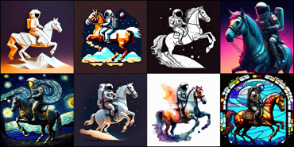
AI Updates - 3
Metagene.ai - Detect Bio Threats
https://metagene.ai
https://www.youtube.com/watch?v=wAJ7WIszJrg
AI can be used for Bioweapon Development. A company "Prime Intellect" has developed an AI system Metagene-1 designed to detect and monitor biological threats in wastewater samples (identify emerging pathogens and anomalies in genetic data).
OpenAI released their economic blueprint (policy proposals)
https://openai.com/global-affairs/openais-economic-blueprint/
The blueprint emphasizes the importance of the US winning the race against China in AI development.
It highlights the need for the U.S. to attract global funds that are waiting to be invested in AI projects.
The blueprint suggests that AI companies should work closely with the government, particularly on matters of national security, to streamline regulations and ensure that AI is developed safely and responsibly.
It also stresses the importance of investing in AI infrastructure, including energy and chips, to support the growing industry.
Microsoft formed a new “Core AI Platform and Tools” division, (developer and AI teams)
Microsoft open-sourced its Phi-4 14b LLM on Hugging Face under the MIT license
Sony Research economical text-to-image model
1.16b parameters, budget less than $2K (x100 cost reduction)
https://arxiv.org/abs/2407.15811
https://github.com/SonyResearch/micro_diffusion/tree/main
OpenAI Re-enters Robotics Development
A former Meta employee is leading the project. The company is hiring engineers to build these robots, which will be designed to work in various real-world situations.
OpenAI had a robotics team before, but it closed in 2020. This new effort suggests they believe controlling both the physical and digital sides of AI is key to achieving their goals.
https://openai.com/index/learning-dexterity/ - hand
https://openai.com/index/solving-rubiks-cube/ - solving rubik's cube
https://x.com/kalinowski007/status/1877809579154948223 - jobs
https://openai.com/careers/mechanical-product-engineer-robotics/ - jobs

Slide 6
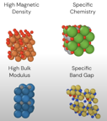

AI Updates - 4
MatterGen - generate inorganic materials
across the periodic table, stable, fine-tuned to fit property constraints.
https://www.microsoft.com/en-us/research/publication/mattergen-a-generative-model-for-inorganic-materials-design/
https://www.youtube.com/watch?v=yWXPV3bsC2c
ReaderLM-v2 - HTML to markdown or JSON
a 1.5B parameter language model
converts raw HTML into markdown or JSON
HTML parsing, transformation, and text extraction.
accurate,
long content (512K tokens in+out)
supports 29 languages
https://huggingface.co/jinaai/ReaderLM-v2
Andrew Ng - writing software - what to build vs how to build
Writing software, especially prototypes, is becoming cheaper. This will lead to increased demand for people who can decide what to build. AI Product Management has a bright future! The demand for good AI Product Managers will be huge.
https://x.com/AndrewYNg/status/1879939058211971420
Sakana.AI is a new AI research company based in Tokyo, Japan.
They were founded in 2023.
Their main focus is on developing new kinds of foundation models based on nature-inspired intelligence.
They are known for project "AI Scientist"
New paper: Transformer²:Self-adaptive LLMs
https://sakana.ai/transformer-squared/ -
https://arxiv.org/abs/2501.06252 -
a novel self-adaptation framework that adapts LLMs for unseen tasks in real-time

Slide 7

AI Updates 5
Titans: Learning to Memorize at Test Time new research from Google https://arxiv.org/pdf/2501.00663v1 - paper https://www.youtube.com/watch?v=x8jFFhCLDJY - video
idea - improve attention mechanism in Transformers by giving models a more human-like memory
Current Transformer models have limited context windows due to quadratic cost, hindering their performance with longer sequences.
Titans Solution: Inspired by the human brain, Titans introduces multiple memory modules (short-term, long-term, meta-memory) that work together, enabling the model to learn and memorize information at test time (inference time).
Surprise Mechanism: A core innovation is the "surprise mechanism," where the model prioritizes memorizing events that violate its expectations, similar to how humans remember unusual or surprising occurrences.
Forgetting Mechanism: To manage memory and avoid over-memorization, Titans incorporates an adaptive forgetting mechanism that discards less important information over time.
Memory Incorporation: The paper explores three ways to incorporate memory into the model: as a context (Mac), as a gate (Mac Mag), and as a layer, each with its own trade-offs.
Performance: Titans outperforms current Transformer models, especially with long context windows ("needle in a haystack" test)
NDEA - new research lab
founders - François Chollet & Mike Knoop
https://ndea.com
Ndea is building frontier AI systems that blend intuitive pattern recognition and formal reasoning into a unified architecture.
Ndea's core strategy is to create AI that can learn and adapt with human-level efficiency.
Ndea plans to build what they call a "factory for rapid scientific advancement," focusing on both known frontiers like drug discovery and unexplored territories.
Chollet also recently launched the ARC Prize Foundation, a nonprofit that is developing benchmarks to evaluate human-level AI capabilities.

Slide 8


AI Updates 6
Google Workspace now includes AI features inside Gmail, Docs, Sheets, Meet, and the rest of the Workspace suite. The monthly price increased by ~ $2 (for example from $12 to $14 per user)
https://www.theverge.com/2025/1/15/24343794/google-workspace-ai-features-free
Luma AI Ray2 - video generative model
Ray2 creates realistic videos with natural and coherent motion
http://lumalabs.ai/ray
https://x.com/LumaLabsAI/status/1879592852151558258
AI for Education - Great Results
https://blogs.worldbank.org/en/education/From-chalkboards-to-chatbots-Transforming-learning-in-Nigeria
A new study in Nigeria: students using AI as an after-school tutor made learning gains equivalent to two years of traditional education in just six weeks !
2025 is shaping up to be a pivotal year for AI agents
AI models have advanced significantly (better NLP, Enhanced Reasoning and Decision-Making, Greater Personalization, better Integration with Existing Systems)
The tools and platforms for developing and deploying AI agents are becoming more user-friendly and accessible to businesses
Businesses are increasingly looking for ways to automate processes, improve efficiency, and reduce costs.
The focus is shifting from experimental AI agent projects to real-world deployments that solve specific business problems and deliver tangible value.
Step-2 LLM from StepFun - https://www.stepfun.com
StepFun is a Chinese AI startup based in Shanghai.
Developing LLMs and other AI models
Step-2 - A trillion-parameter Mixture of Experts (MoE) language model that ranked 5th on Livebench, a global AI model benchmarking platform.
This is notable as the first trillion-parameter MoE model from a Chinese company and a top performer in China.
Step-1.5V: A powerful multimodal large model.
Step-1V: An innovative image generation model.
https://platform.stepfun.com

Slide 9
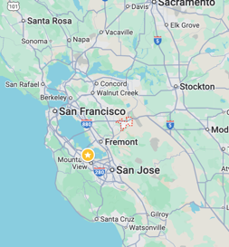
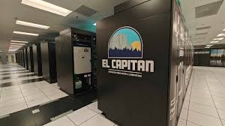
El Capitan supercomputer
Hewlett Packard Enterprise El Capitan Supercomputer
Sponsored by U.S. Department of Energy
https://en.wikipedia.org/wiki/El_Capitan_(supercomputer)
an exascale supercomputer, hosted at the Lawrence Livermore National Laboratory in Livermore, United States and becoming operational in 2024. It is based on the Cray EX Shasta architecture.
Uses a combined 11,039,616 CPU and GPU cores consisting of 43,808 AMD 4th Gen EPYC 24C "Genoa" 24 core 1.8 GHz CPUs (1,051,392 cores) and 43,808 AMD Instinct MI300A GPUs (9,988,224 cores).
The MI300A consists of 24 Zen4 based CPU cores and a CDNA3 based GPU integrated onto a single organic package, along with 128GB of HBM3 memory.
Blades are interconnected by an HPE Slingshot 64-port switch that provides 12.8 terabits/second of bandwidth.
Groups of blades are linked in a dragonfly topology with at most three hops between any two nodes.
Cabling is either optical or copper, customized to minimize cable length. Total cabling runs 145 km (90 mi).
El Capitan uses an APU architecture, where the CPU and GPU share an internal on-chip coherent interconnect.
El Capitan takes up 7,500 square feet of floor space, similar to two tennis courts.
It is made up of at least 87 compute racks, including the "Rabbit" NVM-Express fast storage arrays and compute nodes.
El Capitan has a total of 11,136 nodes in liquid-cooled Cray EX racks, with four MI300A compute engines per node and a total of 44,544 devices across the system.
Each device has 128 GB of HBM3 main memory shared across the CPU and GPU chiplets, which runs at 5.2 GHz and delivers an aggregate 5.3 TB/sec of aggregate bandwidth into and out of the CPU and GPU chiplets.

Slide 10
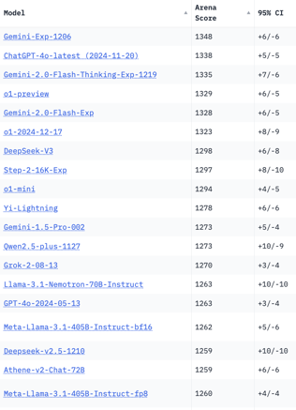
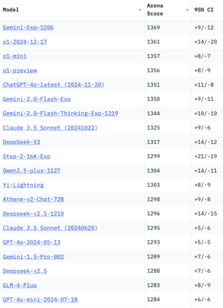
Crowd-sourced "Arena" Leaderboard
Total #models: 192.
Total #votes: 2,541,965.
Last updated: 2025-01-15
Starting Elo rating = 1000
95% CI = Confidence Interval
https://en.wikipedia.org/wiki/Elo_rating_system
https://chat.lmsys.org/?leaderboard
English-only queries
Coding
China
China
China
China
China
China
China
x.ai
China
China
China

Slide 11

AI Jobs - in demand and pay well
https://trueup.io/job-trend
https://www.coursera.org/articles/artificial-intelligence-salary

Slide 12


About the Speaker
Lev Selector, Ph.D.
40+ years of software engineering, data science, and building teams (hiring, training, and managing)
Ph.D. in mathematical modeling and computer simulations
Interests:
Generative AI, Using LLM with your data
Local AI for Local Private Data
Cloud architecture, fin-tech, application security
Find/connect: Linkedin, GitHub, YouTube, Google
https://eais.ai
Enterprise AI Systems

Slide 13
Thank You!

