Slide 1
AI Updates
December 13, 2024
OpenAI Day 3 - Sora
OpenAI Day 4 - Canvas
OpenAI Day 5 - XXX
OpenAI Day 6 - XXX
OpenAI Day 7 - XXX
Copilot Arena Extension for VS Code
David Sacks - "AI & Crypto Chief"
Deepmind GraphCast Weather Forecasting
MinerU - PDF to markdown or JSON
Google Gemini exp-1121 & exp-1206
ClearerVoice-Studio
Grok is now FREE for all X users
Llama 3.3 70B
Ollama v. 0.5 supports structured outputs
Generating Podcasts
Text to audio
Dialog to audio podcast
Create Video Podcast (audio+slides)
5 AI Prompts to Create Content
25% of tasks can be outsourced to AI
Crowd-sourced "Arena" Leaderboard
Tech Layoffs in 2024

Slide 2
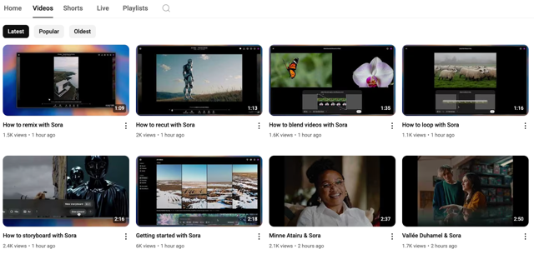
OpenAI Day 3 - Sora
Sora - with fast "Turbo" model:
up to 20-second outputs in various aspect ratios
Remix for scene editing, Storyboard for stitching multiple outputs together, Blend, Loop, Style presets, Sora’s web platform to organize and view generated videos
GPT Plus - up to 50 videos at 480p or fewer at 720p per month
GPT Pro - x10 times more, hire resolutions, longer durations.
Sora is NOT available in EU, UK, ... due to regulations
OpenAI is restricting content with real people, minors, or copyrighted material, with only a ‘subset’ of users allowed to upload real people as input initially
all Sora-generated videos include C2PA metadata and a watermark
https://www.youtube.com/@OpenAI/streams
https://www.youtube.com/@OpenAI/videos
Mon Dec 9 - Sora - text-to-video generation
https://www.youtube.com/watch?v=2jKVx2vyZOY
https://www.youtube.com/watch?v=98gEvnftQZg

Slide 3
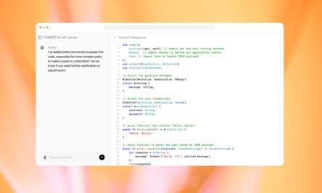
OpenAI Day 4 - Canvas
OpenAI day 4 of 12 - Canvas
https://www.youtube.com/watch?v=qZ0ImE41pVs
https://openai.com/index/introducing-canvas/
Select gpt-40 with Canvas
Canvas opens to the side of the chat
You can edit the canvas while ChatGPT is working on it
Canvas can be used for writing and for programming tasks
Canvas includes a code editor with syntax highlighting and autocomplete
Canvas allows you to run their code within it
Canvas can be integrated with custom GPTs

Slide 4
OpenAI Day 5 - xxx
OpenAI day 4 of
day 5

Slide 5
OpenAI Day 6 - xxx
OpenAI day 4 of
day 6

Slide 6
OpenAI Day 7 - xxx
OpenAI day 4 of
day 7

Slide 7
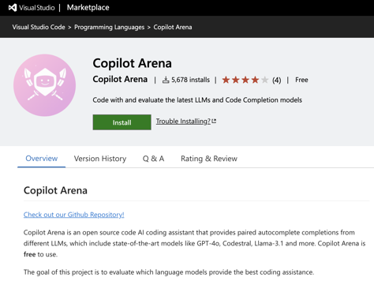
Copilot Arena Extension for VS Code
Copilot Arena is an open source code AI coding assistant that provides paired autocomplete completions from different LLMs, which include state-of-the-art models like GPT-4o, Codestral, Llama-3.1 and more. Copilot Arena is free to use.
The goal of this project is to evaluate which language models provide the best coding assistance.
https://marketplace.visualstudio.com/items?itemName=copilot-arena.copilot-arena
https://github.com/lmarena/copilot-arena

Slide 8

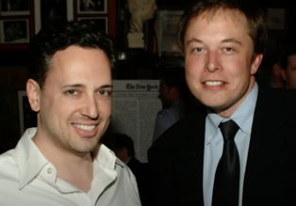
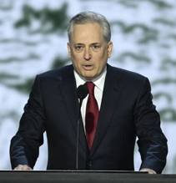
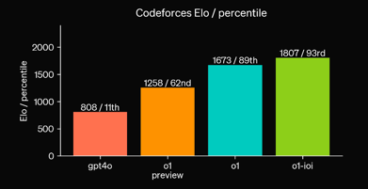
Trump names David Sacks as "AI & Crypto Csar"
Sam Altman's new $200 ChatGPT has a big Elon problem...
https://www.youtube.com/watch?v=Sf4WqHBCYSY
Trump names David Sacks as a White House’s artificial intelligence and cryptocurrency policy chief.
David Oliver Sacks is a South African-American entrepreneur, author, and investor in internet technology firms. He is a general partner of Craft Ventures, a venture capital fund he co-founded in late 2017 .. https://en.wikipedia.org/wiki/David_O._Sacks
.. https://www.wsj.com/tech/trumpplans-to-appoint-musk-confidant-david-sacks-as-ai-crypto-czar-9a9d400c
ioi = International Olympiad in Informatics
o1-ioi - a specialized version of OpenAI's o1 AI model specifically designed to excel at coding.
https://openai.com/index/learning-to-reason-with-llms/
https://textcortex.com/post/openai-o1-vs-gpt-4o
September 2024

Slide 9


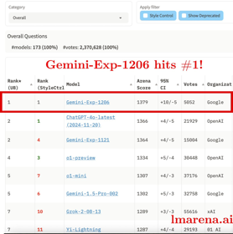

AI Updates 1
Deepmind GraphCast - AI model for fast and accurate global weather forecasting
10-day weather predictions in under one minute
https://deepmind.google/discover/blog/graphcast-ai-model-for-faster-and-more-accurate-global-weather-forecasting/
MinerU - tool to convert PDFs into machine-readable formats (e.g., markdown, JSON)
https://github.com/opendatalab/MinerU
Google Gemini-exp-1121 & exp-1206 models
high (top) ranking
2M context window
really good at coding
ClearerVoice-Studio - open-source, AI-powered speech processing toolkit - speech enhancement, speech separation, target speaker extraction, ...
https://github.com/modelscope/ClearerVoice-Studio

Slide 10
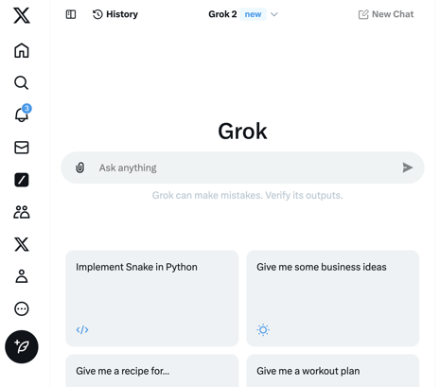
AI Updates 1
Grok is now FREE for all X users
https://x.com/i/grok

Slide 11

Llama 3.3 70B
Ollama v. 0.5 now supports structured outputs - making it possible to constrain a model’s output to a specific format defined by a JSON schema.
You need to update Ollama and Python or JavaScript libraries (pip install -U ollama).
Pass in the schema as a JSON object to the format parameter as either dict or use Pydantic (recommended) to serialize the schema using model_json_schema()
https://github.com/ollama/ollama-python/blob/main/examples/structured-outputs.py
https://www.youtube.com/watch?v=7T7Nv5RMZqs
Llama 3.3 70B model is here
Open-source
Multilingual
70B, but comparable to 405B Llama 3.1
Available on Ollama: ollama run llama3.3
(4bit quantized file is ~43..44GB)
https://ollama.com/library/llama3.3
from ollama import chat
from pydantic import BaseModel
class FriendInfo(BaseModel): # Define the schema for the response
name: str
age: int
is_available: bool
class FriendList(BaseModel):
friends: list[FriendInfo]
response = chat(
model='llama3.1:8b',
messages=[{'role': 'user',
'content': '... Return a list of friends in JSON format'
}],
format=FriendList.model_json_schema(),# Use Pydantic to generate
# the schema or format=schema
options={'temperature': 0}, # Make responses more deterministic
)
# Use Pydantic to validate the response
friends_response = FriendList.model_validate_json(response.message.content)
print(friends_response)

Slide 12




Generating Podcasts
Google Illuminate - https://illuminate.google.com
NotebookLM - https://notebooklm.google
Elevenlabs GenFM - https://elevenlabs.io/genfm
Key leaders behind Google’s viral NotebookLM are leaving to create their own startup
https://techcrunch.com/2024/12/04/key-leaders-behind-googles-viral-notebooklm-are-leaving-to-create-their-own-startup/
Raiza Martin - https://www.linkedin.com/in/whatsaraiza/
Jason Spielman - https://www.linkedin.com/in/jason-spielman-creative/
Stephen Hughes - https://www.linkedin.com/in/stephen-hughes-44bb3497/

Slide 13
Text to audio
SpeechT5 (Hugging Face Transformers)
Can generate high-quality, expressive speech.
from transformers import SpeechT5Processor, SpeechT5ForTextToSpeech
from datasets import load_dataset
import torch
import soundfile as sf
processor = SpeechT5Processor.from_pretrained("microsoft/speecht5_tts")
model = SpeechT5ForTextToSpeech.from_pretrained("microsoft/speecht5_tts")
inputs = processor(text="This is some text I want to convert to speech.", return_tensors="pt")
with torch.no_grad():
speech = model.generate_speech(inputs["input_ids"], inputs["speaker_embeddings"])
sf.write("output.wav", speech.numpy(), samplerate=16000)
gTTS (Google Text-to-Speech) - Easy of Use, a simple interface to Google Translate's TTS API, produces natural-sounding speech, but requires an internet connection.
from gtts import gTTS
text = "This is some text I want to convert to speech."
tts = gTTS(text=text, lang='en') # 'en' for English
tts.save("output.mp3")
pyttsx3 - works offline, cross-platform, different voices - but slightly less natural-sounding speech compared to gTTS
import pyttsx3
engine = pyttsx3.init()
engine.say("This is some text I want to convert to speech.")
engine.runAndWait()
OpenAI's Text-to-Speech API - very natural and expressive, High-quality output, multiple voices and styles
import openai
openai.api_key = "YOUR_API_KEY"
response = openai.Audio.speech.create(
model="tts-1",
voice="alloy",
input="This is some text I want to convert to speech."
)
response.stream_to_file("output.mp3")

Slide 14
Dialog to audio podcast
Script the Conversation - create a text file like this:
Man: Hey there, welcome back to our podcast!
Woman: It's great to be here. Today we're talking about...
Man: ...the amazing world of AI!
...
Convert the pieces for man and woman into audio pieces using one of TTS libraries (generate audio for each speaker). Save each line of dialog into a separate audio file.
Combine audio segments using MoviePy or pydub
concatenate_audioclips() # MoviePy
audio_segment_1 + audio_segment_2 # pydub
from gtts import gTTS
from moviepy.editor import *
def create_audio_from_text(text, speaker):
tts = gTTS(text=text, lang='en')
filename = f"{speaker}_{i}.mp3"
tts.save(filename)
return AudioFileClip(filename)
audio_clips = []
with open("podcast_script.txt", "r") as f:
for i, line in enumerate(f):
speaker, text = line.strip().split(": ", 1)
if speaker == "Man":
audio_clips.append(create_audio_from_text(text, "man"))
elif speaker == "Woman":
audio_clips.append(create_audio_from_text(text, "woman"))
podcast_audio = concatenate_audioclips(audio_clips)
podcast_audio.write_audiofile("podcast.mp3")
# may add (natural) pauses between voices

Slide 15
Create a list of timestamps where voices switch in podcast
Librosa - Excellent for audio analysis, feature extraction, and loading audio files.
PyAudioAnalysis - Provides tools for audio segmentation and feature extraction, which can be helpful for speaker diarization.
SpeechRecognition - A versatile library for interfacing with speech-to-text engines (like Google Speech Recognition).
Kaldi (Advanced) - a powerful toolkit for speech recognition research, offering more advanced speaker diarization capabilities.
from pyAudioAnalysis import audioBasicIO
from pyAudioAnalysis import audioSegmentation
[Fs, x] = audioBasicIO.readAudioFile("your_podcast_audio.wav")
segments = audioSegmentation.speakerDiarization(x, Fs, num_speakers=2)
timestamps = []
current_speaker = None
for i in range(len(segments)):
if segments[i] != current_speaker:
timestamps.append(i * 0.2) # Assuming each segment
# is 0.2 seconds
current_speaker = segments[i]
print(timestamps)
Extract relevant audio (voices) features (e.g., MFCCs - Mel-Frequency Cepstral Coefficients) using Librosa
Speaker Diarization (Option 1 - Simpler):
Use PyAudioAnalysis's speaker diarization functionality. It might not be as accurate as Kaldi, but it's easier to set up.
Speaker Diarization (Option 2 - More Robust) using Kaldi. It involves a steeper learning curve but provides more advanced algorithms.
Timestamp Extraction
If you have a very clean audio recording, you might even try using Google Speech Recognition to transcribe the audio and then analyze the text to identify speaker changes.

Slide 16
Create Video Podcast (audio+slides)
from moviepy.editor import *
audio = AudioFileClip("your_audio.mp3")
# set durations of clips in seconds
image_clips = [ ImageClip("image1.jpg").set_duration(3),
ImageClip("image2.png").set_duration(5),
ImageClip("image3.jpeg").set_duration(2)
]
video = concatenate_videoclips(image_clips, method="compose")
final_video = video.set_audio(audio)
final_video.write_videofile("output_video.mp4", fps=24)
MoviePy
FFmpeg
import ffmpeg
# Input files
input_images = ffmpeg.input('image%d.jpg', pattern_type='sequence', framerate=1)
input_audio = ffmpeg.input('audio.mp3')
# Combine and output
(
ffmpeg
.concat(input_images, input_audio, v=1, a=1)
.output('output_video.mp4')
.run()
)

Slide 17
5 AI Prompts to Create Content
"5 AI Prompts that I Use to Create Content for 100K+ Readers"
- by Peter Yang - https://www.youtube.com/watch?v=xUN6udKi50E
Extract insights from long podcasts, YouTube videos, and articles
Turn raw transcripts into polished articles with my best interviews
Craft headlines and YouTube thumbnails using the best examples
Create viral posts using my best LinkedIn and X posts (1M+ impressions)
Edit newsletter articles using my best-performing articles

Slide 18
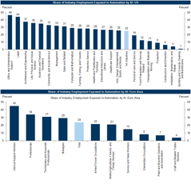
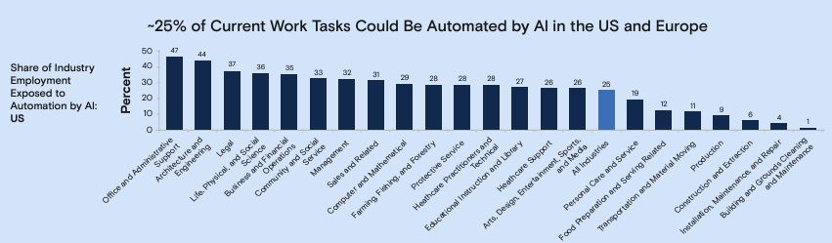
25% of tasks can be outsourced to AI
Approx 25% of current work tasks could be automated by AI in the US and Europe (across industries) - from the Goldman Sachs Global Investment Research team
https://www.gspublishing.com/content/research/en/reports/2023/03/27/d64e052b-0f6e-45d7-967b-d7be35fabd16.html

Slide 19
Education in Different Countries
Top countries in Education:
South Korea, Denmark, Netherlands
Other countries frequently found in the top 10 include:
Belgium, Slovenia, Japan, Germany, Finland, Norway, Ireland
USA is at ~ 20th places. For example, PISA (Programme for International Student Assessment) 2022: the US ranked 28th in math and 12th in science among OECD countries.
Note: OECD = Organization for Economic Co-operation and Development. It's an intergovernmental organization with 38 member countries - founded in 1961.
Note: Education in the US used to be ranked #1, but ranking went down over the last 44 years since the creation of the US Department of Education.
Note: The US Department of Education's (ED) budget for 2024 is $238 billion. This makes it the sixth highest-funded federal agency.

Slide 20
XXX
xxx

Slide 21
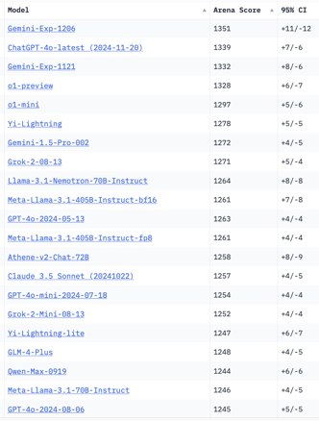
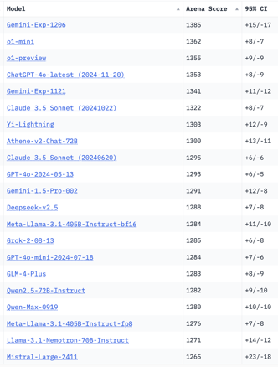
Crowd-sourced "Arena" Leaderboard
Total #models: 173.
Total #votes: 2,370,628.
Last updated: 2024-12-05.
Starting Elo rating = 1000
95% CI = Confidence Interval
https://chat.lmsys.org/?leaderboard
English-only queries
Coding
China
China
x.ai
x.ai
x.ai
China
China
China
China

Slide 22
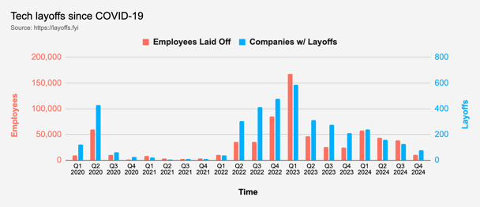
Tech Layoffs in 2024
Layoffs - https://layoffs.fyi
"Who is AI Replacing? The Impact of Generative AI on Online Freelancing Platforms" - paper October 2024
https://papers.ssrn.com/sol3/papers.cfm?abstract_id=4991774
The study found that AI tools have led to a decrease in demand for jobs in areas like writing and coding.
At the same time there is an increase in demand for individuals skilled in utilizing AI tools.
Legal: $8,000 work now can be done for only $3 in GPT credits.
Translation - mostly outsourced to AI
Phone Sales and Customer service
Job market for IT: much worse than before COVID.
IT has become a commodity. Lower salaries/rates ($100/hr => $75/hr).
Much more competition, hundreds of applications for each position

Slide 23


About the Speaker
Lev Selector, Ph.D.
40+ years of software engineering, data science, and building teams (hiring, training, and managing)
Ph.D. in mathematical modeling and computer simulations
Interests:
Generative AI, Using LLM with your data
Local AI for Local Private Data
Cloud architecture, fin-tech, application security
Find/connect: Linkedin, GitHub, YouTube, Google
https://eais.ai
Enterprise AI Systems

Slide 24
Thank You!

