Slide 1
AI Updates
July 25, 2025
xxx
Question:??? - Please Comment!
Crowd-sourced "LM Arena" Leaderboard
Qwen 3-235B-A22B-2507
Qwen3-Coder-480B-A35B-Instruct
Qwen Code CLI
OpenAI & DeepMind Win Gold Medal in Math
Human beats OpenAI in Coding
Prompt Phrase that Matters
Gemini 2.5 natural language-driven segmentation
OpenAI ChatGPT Handles 2.5 Billion Prompts Daily
OpenAI to pay Oracle $30B/year for data center
Google Gemini 2.5 Flash-Lite
AI Agents vs Agentic AI
Kimi vs Claude Coding
Google Mixture-of-Recursions Architecture
Linkedin Northguard replaces Kafka
GitHub Actions Automates your AI
Opencode (SST) - best Coding Assistant
Kilo Code
Kimi K2 is slow
Claude Code Replaced Cursor
Writing Books & Reports with AI
Best "Human" AI Writer
Humanizing Your Text
ARC-AGI-3 - preview
Build AI content writing assistant with Grok 4
MirageLSD by DecartAI - Real-Time Video Diffusion
Jobs - AI Product Manager
Jobs, Layoffs

Slide 2

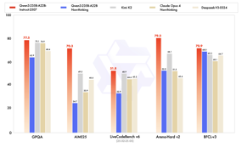
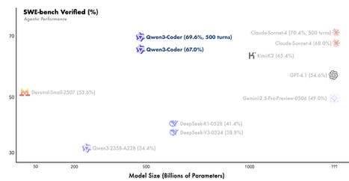
Qwen 3 2507
Qwen 3 Coder
Qwen 3-235B-A22B-2507
open source LLM from Alibaba
235B params MoE (22B activated, 8 out of 128 experts)
256K long-context
https://x.com/Alibaba_Qwen/status/1947344511988076547
https://www.youtube.com/watch?v=jCUCdtT6llc
https://huggingface.co/Qwen/Qwen3-235B-A22B-Instruct-2507
Qwen3-Coder-480B-A35B-Instruct
480B params, MoE, open source LLM from Alibaba
256K context length
Outperforms or matches Claude Sonnet 4, GPT-4.1, Kimi K2, etc.
Agentic capabilities: Natively supports tool use, function calls, multi-turn interaction, and long-horizon reinforcement learning, making it especially suited for tasks that require planning and interaction with developer tools and APIs
https://qwenlm.github.io/blog/qwen3-coder/
https://www.youtube.com/watch?v=feAc83Qlx4Q
Alibaba Qwen Code CLI
open-source CLI tool
adapted from Google's Gemini Code
compatible with Claude Code

Slide 3
Question
Question

Slide 4
Crowd-sourced "LM Arena" Leaderboard
https://lmarena.ai/?leaderboard
Starting Elo rating = 1000
https://en.wikipedia.org/wiki/Elo_rating_system
Text
https://lmarena.ai/leaderboard/text
Coding https://lmarena.ai/leaderboard/text/coding
LM Arena secures $100M to expand AI benchmarking (at $600M valuation)
Model | Score
gemini-2.5-pro | 1462
o3-2025-04-16 | 1452
chatgpt-4o-latest-20250326 | 1443
grok-4-0709 | 1437
gpt-4.5-preview-2025-02-27 | 1437
kimi-k2-0711-preview | 1420
claude-opus-4-20250514-thinking-16k | 1420
claude-opus-4-20250514 | 1416
deepseek-r1-0528 | 1415
gemini-2.5-flash | 1414
gpt-4.1-2025-04-14 | 1412
grok-3-preview-02-24 | 1409
claude-sonnet-4-20250514-thinking-32k | 1402
qwen3-235b-a22b-no-thinking | 1400
o4-mini-2025-04-16 | 1400
o1-2024-12-17 | 1399
deepseek-v3-0324 | 1397
deepseek-r1 | 1395
claude-sonnet-4-20250514 | 1392
gemini-2.5-flash-lite-preview-06-17-thinking | 1387
Model | Score
gemini-2.5-pro | 1482
claude-opus-4-20250514-thinking-16k | 1476
chatgpt-4o-latest-20250326 | 1475
o3-2025-04-16 | 1473
claude-sonnet-4-20250514-thinking-32k | 1462
claude-opus-4-20250514 | 1462
grok-4-0709 | 1460
gpt-4.5-preview-2025-02-27 | 1459
deepseek-r1-0528 | 1454
kimi-k2-0711-preview | 1451
qwen3-235b-a22b-no-thinking | 1442
gpt-4.1-2025-04-14 | 1441
deepseek-v3-0324 | 1438
claude-sonnet-4-20250514 | 1437
grok-3-preview-02-24 | 1435
deepseek-r1 | 1434
o4-mini-2025-04-16 | 1429
mistral-medium-2505 | 1423
gpt-4.1-mini-2025-04-14 | 1423
o1-2024-12-17 | 1423
Grok 4 Benchmarks
https://artificialanalysis.ai/models/grok-4
x.ai
China
x.ai
https://lmarena.ai/leaderboard/text
https://web.lmarena.ai/leaderboard
https://openlm.ai/chatbot-arena/
https://beta.lmarena.ai
Web Leaderboard https://web.lmarena.ai/leaderboard
LLM Leaderboard - by @LlmStats https://llmworld.net/llm_leaderboards/
LLM Leaderboard - by StackAI https://www.stack-ai.com/llm-leaderboard
LLM Leaderboard - by Artificial Analysis https://artificialanalysis.ai/leaderboards/models
Open LLM Leaderboard - by Hugging Face https://huggingface.co/open-llm-leaderboard
LLM Leaderboard - by Vellum https://www.vellum.ai/llm-leaderboard
AI Benchmarking Hub https://epoch.ai/data/ai-benchmarking-dashboard
China
China
China
China
x.ai
China
China
x.ai
China
China
China
M

Slide 5
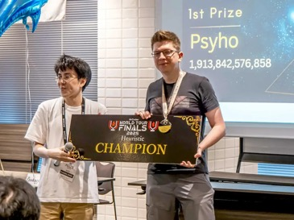
Human Beats AI in Math
OpenAI and Google DeepMind Win Gold Medal in Math
( IMO = International Math Olympiad )
Models performed under the same rules as human contestants: two 4.5 hour exam sessions, no tools or internet, reading the official problem statements, and writing natural language proofs.
Both OpenAI and DeepMind LLMs models won Gold Medals solving 5 out of 6 problems
https://www.youtube.com/watch?v=36HchiQGU4U
https://www.lesswrong.com/posts/RcBqeJ8GHM2LygQK3/openai-claims-imo-gold-medal
Last year (2024), Google DeepMind (GDM) announced that AlphaProof and AlphaGeometry2 had perfectly solved 4 out of the 6 IMO 2024 problems, falling 1 point short of the Gold medal cutoff. However that system needed over 60 hours for some problems, much longer than the 4.5 hours allowed for humans.
This year, both OpenAI ("an experimental research model, not released in GPT5") and GDM ("Advanced version of Gemini Deep Think") announced full solves of 5 out of the 6 problems (P6 is typically the hardest) all within 4.5 hours, achieving IMO Gold.
Human beats OpenAI in Coding
Przemysław “Psyho” Dębiak, a 42-year-old programmer from Poland has defeated a OpenAI’s custom AI model at the Coder World Tour Finals (AWTF) 2025 "Humans vs AI" contest in Tokyo.
It was a 10-hour marathon, might be the last human winner
https://www.tomshardware.com/tech-industry/artificial-intelligence/polish-programmer-beats-openais-custom-ai-in-10-hour-marathon-wins-world-coding-championship-possibly-the-last-human-winner

Slide 6
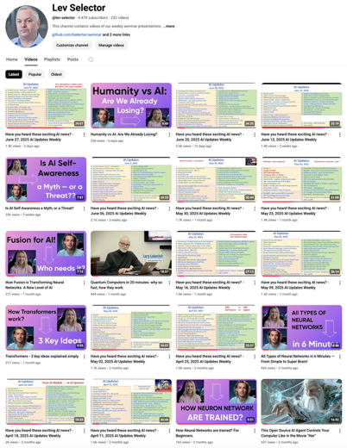
Please pause the video - and answer the pinned question in comments under the video
Subscribe to this channel
https://www.youtube.com/@lev-selector
Get notified about new videos - every Friday, links to slides under the videos

Slide 7
Opencode
Opencode - 2 versions
Original version written in Go: https://github.com/opencode-ai/opencode - 8.7K stars https://www.youtube.com/watch?v=YLNAp4_AUpo - video
"SST" version - better, faster (SST = Serverless Stack Toolkit) https://opencode.ai https://github.com/sst/opencode - 14.3K stars https://www.youtube.com/watch?v=SIhToEaIsjQ - video https://www.youtube.com/watch?v=yTylDxgyJZ8 SST version is a rewrite of 2/3 of the code from Go into TypeScript. It is faster, better, more features
Kilo Code
https://github.com/Kilo-Org/kilocode
https://kilocode.ai
Kilo improves on top of Cline and Roo. Was published first time 4 months ago - but already has 4.9K stars on GitHub. There are some good YouTube videos with demos - impressive !
Kimi K2 is slow when running directly from moonshot
The groq version is fast, but it is 8-bit version, not accurate, may not even follow instructions.

Slide 8
Claude Code Replaced Cursor
https://www.youtube.com/watch?v=0iGEpx8IeM0
https://medium.com/realworld-ai-use-cases/0-to-200-month-in-7-days-using-claude-code-i-was-completely-wrong-about-this-tool-9c4a6e269cdf
11 tips:
Make a CLAUDE.md file and then add it to your base path of your repo. This is the equivalent of a rules document. Just ask Claude to make you one - and feed documentation from Anthropic here.
https://github.com/o-gi/claude-code-commands - install this it’s really good.
Use Plan Mode often (shift-tab)
Compact before CC does. /compact
Export key conversations. /export
Use resume. /resume
Init projects once established. /init
https://github.com/qdhenry/Claude-Command-Suite
Use pngpaste for your screenshots
Use a Gemini MCP agent that pairs programs with Claude code to help debug, brainstorm, and pull the latest documentation.
When you click on the orange CC icon in the tab header (between the preview and split icons), CC opens up as a side panel like Cursor or Augment chat. I prefer it that way — I can see more lines of code. BUT: the icon is only visible when you have an opened tab.

Slide 9
Writing Books & Reports with AI
Paperpal - Academic writing, section suggestions, paraphrasing, citation checks - Add-in for Word; browser
Jenni AI - Research drafting, chapter organization, tracked changes, citations - Browser, APIs
SciSpace - Literature review, summarization, AI chatbot for papers, citation support - Browser, PDF, integrations
Elicit - Literature search, data extraction, research Q&A - Web app
Type.ai - Large-document creation, real-time editing, Markdown export - Not direct, but possible
Write Assist AI - Markdown/LaTeX/Quarto AI writing, paraphrasing, rewrite, expansion - Native VS Code extension
CoolWriter - In-editor AI writing assistant, integrates OpenAI for Markdown - Native VS Code extension
Continue - Connects LLMs (local/cloud) for code/text in VS Code, supports Markdown - Native VS Code extension
Book Generator Tools
https://rocketwriter.ai/pricing
https://go2.designrr.io/wordgenie2
https://wordgenie.de/en/

Slide 10

Best "Human" AI Writer
How to Humanize text:
Add "Human" elements:
- Personal anecdotes ("Last week, I commented...")
- Conversational tone("Honestly", "Here's where Tabs really shines")
- Informal contractions and casual language
- Real-world scenarios and specific examples
- opinion-based statements and subjective experiences
- Natural imperfections in flow
- First-person perspective mixed with general observations
Natural SEO Integration:
- Keywords woven naturally conversational con
- Varied sentence structures
- Authentic user experience descriptions
...
=====================================================
write a 300 words SEO focused article on AI code editor named Tabs. Make sure it will rank good on Google, undetectable as AI generated content
=====================================================
can you change it so that it doesn't detect it's AI written
=====================================================
https://www.youtube.com/watch?v=JGWyNGdYMao
OpenAI o3 reasoning model - 19%, 0% - On the first attempt, its output was flagged as only 19% AI; after removing a small fragment, the detector showed 0% AI.
Kimi K2 70%, 0% - Scored 60-70% AI-likeness on the first try (better than nearly all others); After a single follow-up prompt (“make this more human, not detected by AI”), Kimi’s output fooled the detector entirely—0% detected as AI-generated.
Claude Sonnet 4 - 100%, 0% - Failed the AI detection on the zero-shot attempt (100% detected as AI). After a one-shot humanizing follow-up (“make this undetectable by AI”), its output dropped to 0% detected, matching Kimi’s performance with similar humanizing techniques like anecdotes, conversational tone, contractions, and real-world scenarios.

Slide 11
Humanizing Your Text
AI content detectors:
https://copyleaks.com - best accuracy
https://gptzero.me - highly trusted
https://www.zerogpt.com - free quick
Sapling - consistent
Winston AI - for business
Undetectable.ai - independent
https://originality.ai -
https://contentatscale.ai -
https://gowinston.ai -
https://www.turnitin.com -
https://quillbot.com -
Text Humanizers
https://undetectableai.ai - top
WriteHuman - top
GPTinf
Humy.AI
https://humbot.ai

Slide 12

AI Updates 1
ARC-AGI-3 - preview from ARC Prize
Interactive Reasoning benchmark to test AI agents’ ability to generalize in unseen environments
3 games (environments); $10K agent contest; AI agents API
The benchmark features three original games built to evaluate world-model building and long-horizon planning with minimal feedback.
Agents receive no instructions and must learn purely through trial and error, mimicking how humans adapt to new challenges.
Early results show frontier models like OpenAI’s o3 and Grok 4 struggle to complete even basic levels of the games, which are pretty easy for humans.
ARC Prize is also launching a public contest, inviting the community to build agents that can beat the most levels — and truly test the state of AGI reasoning.
https://x.com/arcprize/status/1946260363256996244
Build AI content writing assistant with Grok 4
https://app.therundown.ai/guides/how-to-build-your-own-ai-content-writing-assistant-with-grok-4
https://colab.research.google.com/drive/1CyOGv8YxXkp3mfzV8SMu5iGQdRO0s90t
MirageLSD by DecartAI - Real-Time Video Diffusion
LSD = Live-Stream Diffusion
this real-time model understands content, allowing for intelligent styling like putting hats on heads or lightsabers in hands, and is steerable by text prompts ("vibe coding" games).
https://x.com/karpathy/status/1945979830740435186

Slide 13
AI Updates 2
Prompt Phrase that Matters
Add this to your prompt: "Please ask me any questions you have about this before you begin."
https://medium.com/@jordan_gibbs/the-only-chatgpt-prompt-that-matters-f16dd85e43b3
Gemini 2.5 natural language-driven segmentation in images You can say "the third book from the left" or "the people not sitting."
Supports five types of segmentation queries: relationships, conditionals, abstract concepts, in-image text, and multilingual prompts
OpenAI ChatGPT Handles 2.5 Billion Prompts Daily
This is more than x2 times more than in December 2024
330 Mln coming from the US
Compare with Google Search: ~13 Bln searches/day
OpenAI to pay Oracle $30B/year for data center
Focusing on the 4.5 gigawatts Stargate project
This deal triples OpenAI's current annual revenue of $10B
Google Gemini 2.5 Flash-Lite
most cost-efficient and fastest 2.5 family model
faster and more cost-efficient than the 2.0 Flash models
while outperforming them across coding, math, and multimodal understanding

Slide 14
AI Agents vs Agentic AI
AI Agents - designed to perform specific, well-defined tasks by following programmed rules, logic, or machine learning models, typically operating within a constrained environment
Agentic AI - complex systems where multiple agents collaborate autonomously, exhibiting proactive, adaptive, and goal-driven behavior to solve dynamic, multi-step problems—often with minimal human oversight
Kimi vs Claude Coding
Result - equal, but Kimi is x2 slower
https://generativeai.pub/i-tested-kimi-vs-claude-coding-and-discovered-why-the-hype-8bd7e3071f36
Google Mixture-of-Recursions Architecture
xxx
https://ninza7.medium.com/google-deepmind-just-dropped-a-transformers-killer-architecture-c6c1d9288922

Slide 15



Linkedin Northguard replaces Kafka
Linkedin Northguard (replaces Kafka)
pub/sub (publish-and-subscribe) for large scale
Xinfra (pronounced "ZIN-frah") is a virtualized Pub/Sub layer to provide streaming experience across both existing Apache Kafka infrastructure and new Northguard log storage system
https://blog.dataengineerthings.org/the-company-that-created-kafka-is-replacing-it-with-a-new-solution-386cd1c2dcc8
Feature | Kafka | Northguard
Metadata Control | Centralized controller | Sharded, decentralized, with Raft
Data Organization | Topics & partitions | Records, segments, ranges, topics
Load Balancing | External/manual rebalancing | Native, automatic balancing
Cluster Expansion | Data must be moved manually | Work routed to new brokers
Durability | Lazy syncs | Fsync across all replicas
Availability | Degrades as replicas fail | Producers switch to healthy nodes
Operational Complexity | High at scale | Self-healing, fewer clusters
Protocol | Synchronous request/response | Streaming with pipelining
Storage Layer | OS page cache, Java-based | Direct I/O, C++ (pluggable)

Slide 16
GitHub Actions Automates your AI
Use GitHub to do AI automation, web scraping, reports generation, etc
https://www.youtube.com/watch?v=ddOgbp7NYVY
https://trends.google.com/trending?geo=US
N8N would cost ~$300/year, on GitHub it is free.
This video demonstrates a simple, cost-effective workflow for automating data extraction from Google Trends using a Python script and GitHub Actions, avoiding the costs and limitations of platforms like N8N.
A custom Python script is written to scrape trending topics from the Google Trends “Trending Now” section; The URL contains parameters like country, time window, sorting, ...; The output may include lists, images, structured files.
Bright Data proxy is used to avoid getting blocked by Google (API key needed)
Python script and any required dependency files are uploaded to a GitHub repository.
GitHub Actions workflow is created—this is a YAML file that defines a scheduled task to execute the scraping script automatically
The Actions runner environment installs dependencies and triggers the scraping script on schedule. No external server or cron setup is needed
The output (e.g., scraped topics, images, or structured data) is saved back into the GitHub repository or to a designated output folder; This output can then be processed further, for example by triggering AI to write articles based on trends, which could then be posted to a website or blog
The process is entirely automated, and results are visible in the repository or via GitHub’s interface after each scheduled run
Benefits: Cost Savings, Flexibility, No Hosting Required, Easy Scaling and Collaboration

Slide 17
Jobs - AI Product Manager
I made quick research about non-technical AI roles
AI Product Manager
AI Project Manager
AI Program Manager
AI Coach
AI Strategist
Prompt Engineer
AI Content Creator
etc. etc.
The fastest growing and in highest demand is "AI Product Manager". The number of job listings for it was growing explosively, increasing by nearly 90% year-over-year in 2023, 2024, 2025 in design, manufacturing, and digital industries
"AI Product Manager is the most in-demand non-technical leadership role within AI in 2025, driven by businesses seeking strategic thinkers who translate AI's potential into real-world products."
Open Perplexity and ask it this question: "What skills or experience make AI Product Managers more sought after than Project Managers"

Slide 18
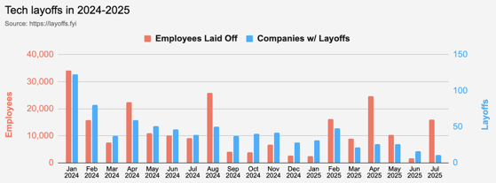
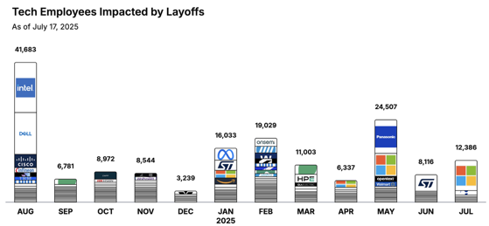
Jobs
https://layoffs.fyi
https://trueup.io/layoffs
Tech Layoffs in 2025: 80,003 people
(as of July 17, 2025)
Compared to 2024: 152,922 people
https://layoffs
From Peter Diamandis:
White-collar job postings fell 12.7% from 2024 to 2025, with demand for business analysts and developers dropping twice as fast.
Meanwhile, Anthropic's CEO Dario Amodei predicts that within 5 years, 50% of all entry-level white-collar jobs will be fully automated, potentially spiking unemployment to 10-20%
What to do:
Shift From Job Applicant to Entrepreneur's Mindset
Develop Curiosity and Adaptability
Execute the "Singularity Sprint" (before AI erodes human leverage entirely)
Expect Short-term Pain Before Long-term Abundance

Slide 19


About the Speaker
Lev Selector, Ph.D.
40+ years of software engineering, data science, and building teams (hiring, training, and managing)
Ph.D. in mathematical modeling and computer simulations
Interests:
Generative AI, Using LLM with your data
Local AI for Local Private Data
Cloud architecture, fin-tech, application security
Find/connect: Linkedin, GitHub, YouTube, Google
https://eais.ai
Enterprise AI Systems

Slide 20
Thank You!

