Slide 1
AI Updates
January 19, 2024
NVIDIA Blackwell B100 GPUs
LLM - Transformer, Mistral, Mixtral
History - Transformer & Attention
How Translation Models Work
Mixtral Layers
Mixtral - How it Works
What is MoE (Mixture of Experts)
How an LLM Generates Output
Tokenization & Embeddings
How Embedding Models Work
Positional Encoding
What weights are learned inside LLM
Multi-head attention, Group Attention
Steps of the Attention Mechanism
Sliding Window Attention
Why Not Combine Query & Key Matrices
The End of the Transformer Process
TensorRT-LLM and Triton
Is Having More Experts Better?
AlphaGeometry
AlphaCodium
Mark Zuckerberg Announcement (2min)
Run SDXL Locally With ComfyUI
Samsung Galaxy S24 AI Features
ML & AI on AWS, Azure, GCP
LLM Leaderboards - Hugging Face, "Arena", YALL, Coding
The AI Tools

Slide 2
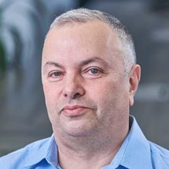

About the Speaker
Lev Selector, Ph.D.
40+ years of software engineering, data science, and building teams (hiring, training, and managing)
Ph.D. in mathematical modeling and computer simulations
Interests:
Generative AI, Using LLM with your data
Local AI for Local Private Data
Cloud architecture, fin-tech, application security
Find/connect: Linkedin, GitHub, YouTube, Google
https://eais.ai

Slide 3
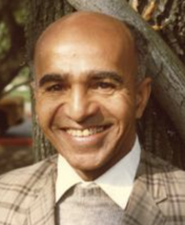
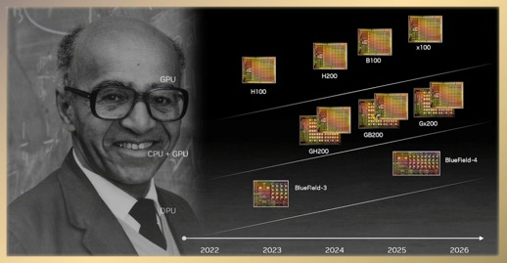
NVIDIA Blackwell B100 GPU
NVIDIA Blackwell B100 GPUs is expected to be released in Q2 of 2024. https://wccftech.com/nvidia-blackwell-b100-gpus-2x-faster-hopper-h200-2024-launch/
More Than Double The Performance of Hopper H200 GPUs.
"B" comes from David Harold Blackwell
https://en.wikipedia.org/wiki/David_Blackwell
https://en.wikipedia.org/wiki/Rao%E2%80%93Blackwell_theorem
The Rao-Blackwell theorem in statistics says that if you have an (unbiased) estimator for some parameter, you can often improve its accuracy (lower variance) by averaging on additional information (statistic).
David Harold Blackwell
(1919 – 2010)
American statistician and mathematician,
UC Berkeley (1954-88)

Slide 4
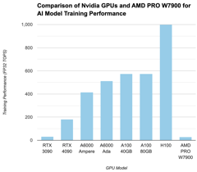
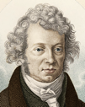

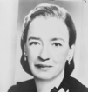

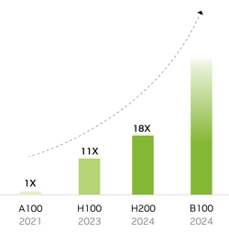
Next GPUs for AI
 | GPU | Released | Generation | Memory GB | Price
Nvidia | RTX 3090 | 2020 Q3 | Ampere | 24 | 0.7K
Nvidia | RTX 4090 | 2022 Q4 | Ada Lovelace | 24 | 2K
Nvidia | RTX A6000 | 2020 Q4 | Ampere | 48 | 4K
Nvidia | RTX 6000 Ada | 2022 Q4 | Ada Lovelace | 48 | 7K
Nvidia | A100 (40GB) | 2020 Q2 | Ampere | 40 | 6K
Nvidia | A100 (80GB) | 2021 Q2 | Ampere | 80 | 18K
Nvidia | H100 (80GB) | 2023 Q1 | Hopper | 80 | 32K
Nvidia | H200 (141GB) | 2024 | Hopper | 141 | ?
Nvidia | B100 | 2024 | Blackwell |  | ?
AMD | RX 7900 XTX | 2022 Q4 | RDNA 3 | 24 | 0.9K
AMD | PRO W7900 | 2023 Q4 | RDNA 3 | 48 | 3.5K
AMD | AMD MI250 | 2021 Q4 | CDNA 2 | 48 | ~10K
Training Performance
Inference Performance
Confusion about Nvidia 6000:
Quadro 6000 (2010) - old, discontinued
RTX A6000 (2020) - Ampere
RTX 6000 Ada (2023) - Ada Lovelace

Slide 5
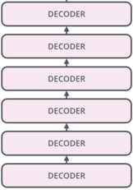


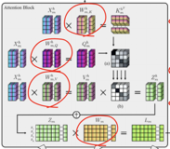
LLM - Transformer, Mistral, Mixtral, ...
Next Token
LLM (Large Language Model) is typically a multi-layer model following the "decoder" part of the standard "transformer" architecture.
It accepts a sequence of tokens, converts them into sequence of embeddings (vectors), transforms them over multiple "decoder" layers, and generates the text token, which is then added to the input.
Each layer consists of two parts: Self-Attention and Feed-Forward
Next
token
Feed Forward Layer
Output
Input
Feed-Forward
.
.
.
.
.
.
.
.
.
.
.
.
Self-attention
.
.
. . .
.
.
.
.
.
.
.
.
.
.
T1
T2
. . .
TN

Slide 6
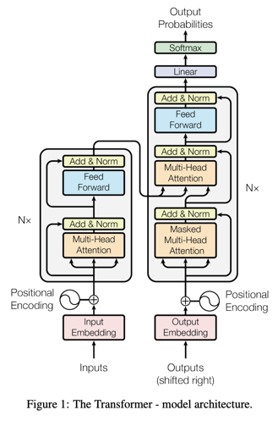
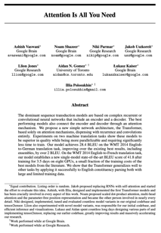
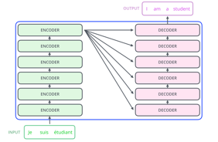
History - Transformer & Attention
2016-2017 - Google, Transformer Architecture
"Attention is All You Need" - https://arxiv.org/abs/1706.03762
The dominant sequence transduction models are based on complex recurrent or convolutional neural networks that include an encoder and a decoder. The best performing models also connect the encoder and decoder through an attention mechanism.
We propose a new simple network architecture, the Transformer, based solely on attention mechanisms, dispensing with recurrence and convolutions entirely.
https://jalammar.github.io/illustrated-transformer/

Slide 7
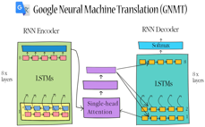
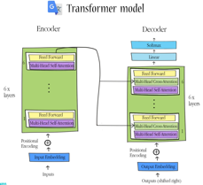
How Translation Models Work (Google Translate)
"How Google Translate works - Architecture explained" - by La Vivien
- https://www.youtube.com/watch?v=z3XKMnu2pgg
Some Multi-Lingual LLMs can translate between multiple languages. But specialized translation models historically were designed differently.
In 2016 the NMT (Neural Machine Translation) was switched to use RNN Encoder and Decoder (LSTMs) with an attention block between them.
In 2020 a hybrid approach was adopted (Transformer + LSTMs).
Nowadays (2024) most translators are purely Transformer based (no RNNs)
In 2017 this architecture was substituted by a Transformer with multiheaded attention ("Attention is All You Need", 2017)
Input tokens are encoded into intermediate representation, then decoded into another language.
Each new token is generated based on the already translated sequence (previous tokens in the target language) and the input sentence's encoded representation.
The newly generated token is then added to the sequence of translated tokens and used in generating subsequent tokens.
Modern NMT systems are designed to be context-aware. They don't just translate words in isolation; they also consider the surrounding words and sentences.
They use attention mechanism to focus on different parts of the input sentence as it translates.
Some advanced translation models may use iterative refinement techniques.

Slide 8
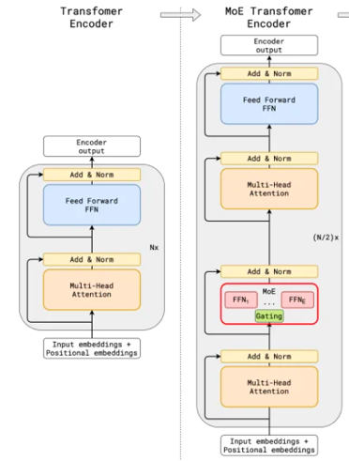
Mixtral Layers
https://www.unite.ai/mistral-ais-latest-mixture-of-experts-moe-8x7b-model/
Next Token
Next
token
32 Layers
32 Layers
16 Layers
.
.
.
.
.
.
.
.
.
.
.
.
.
.
. . .
.
.
.
.
.
.
.
.
.
.
T1
T2
. . .
TN

Slide 9
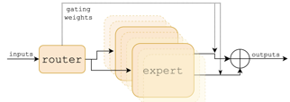
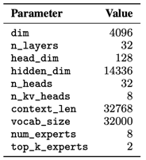
Mixtral - how it works
Feed-Forward Sub-Layers have this structure with router, experts, and aggregation outputs.
Mixtral of Experts paper - https://arxiv.org/abs/2401.04088
We introduce Mixtral 8x7B, a Sparse Mixture of Experts (SMoE) language model.
Mixtral has the same architecture as Mistral 7B, with the difference that each layer has 8 feedforward blocks (i.e. experts).
For every token, at each layer, a router network selects two experts to process the current state and combine their outputs.
Even though each token only sees two experts, the selected experts can be different at each timestep. As a result, each token has access to 47B parameters, but only uses 13B active parameters during inference.
Mixtral was trained with a context size of 32k tokens and it outperforms or matches Llama 2 70B and GPT-3.5 across all evaluated benchmarks.
In particular, Mixtral vastly outperforms Llama 2 70B on mathematics, code generation, and multilingual benchmarks.
We also provide a model fine-tuned to follow instructions, Mixtral 8x7B - Instruct, that surpasses GPT-3.5 Turbo, Claude-2.1, Gemini Pro, and Llama 2 70B - chat model on human benchmarks.
Both the base and instruct models are released under the Apache 2.0 license.
The aggregation at the output of each layer is implemented by taking the softmax over the Top-K logits of a linear layer of experts in this layer
=4096/n_heads
dim_MLP
Understanding Mixtral-8x7b - https://huggingface.co/blog/vtabbott/mixtral
Google 2022 review of sparse expert models - https://arxiv.org/pdf/2209.01667.pdf
https://github.com/huggingface/transformers/blob/main/src/transformers/models/mixtral/configuration_mixtral.py
https://github.com/huggingface/transformers/blob/main/src/transformers/models/mistral/configuration_mistral.py
https://arxiv.org/abs/2305.13245 - group attention mechanism
group attention

Slide 10
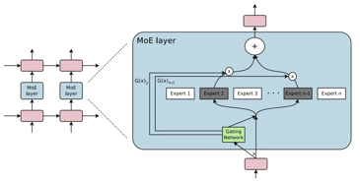
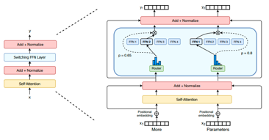
What is MoE
Mixture of Experts (MoE):
MoE is a neural network architecture. It consists of multiple parts (experts), a trainable gating routing mechanism which directs each input to one or more experts, and a mechanism to aggregate outputs together.
MoE allows for efficient scaling since not all parts of the network are active at the same time, reducing computational load.
Switch Transformer:
Switch Transformer is an MoE developed by Google for (extremely) large-scale language processing tasks.
It employs a trainable 'switch' mechanism to route each token to the most relevant expert.
Mixture of Experts (MoE):
https://huggingface.co/blog/moe (since 1991)
https://en.wikipedia.org/wiki/Mixture_of_experts
https://arxiv.org/pdf/1701.06538.pdf
https://medium.com/@sthanikamsanthosh1994/the-mixer-of-experts-moe-modern-architecture-for-divide-and-concur-learning-dbe10ffa8436
Switch Transformer:
https://arxiv.org/pdf/2101.03961.pdf - paper (2022)
https://huggingface.co/google/switch-c-2048 (2048 experts (1.6T parameters for 3.1 TB))

Slide 11
How an LLM Generates Output (Inference)
Softmax Layer: softmax function is applied to the outputs of the linear layer - and convert them into a probability distribution over the entire vocabulary of the model. Each element in this distribution represents the probability that a particular token from the vocabulary is the next token in the sequence.
Token Selection: The token with the highest probability is usually selected as the output. In some cases, techniques like beam search, temperature-controlled sampling, or top-k sampling are used to generate more varied or contextually appropriate responses.
The generated token is fed back into the model - it is converted into embedding and added as part of the input at the very first transformer layer. It becomes part of the input sequence for the next iteration of the processing.
The new sequence is propagated through all layers - and end up generating next output token. This process repeated again and again. Each generated token is fed back into the model as part of the input for generating the next token, continuing until a stop condition is met (like generating a full stop or reaching a maximum length).
Tokens are converted into words - and printed on the output.
Initially, the input text (sequence of words) is converted into sequence of tokens.
Then sequence of tokens is converted into a sequence of embeddings (vectors). These embeddings represent the input tokens in a way that captures their semantic and syntactic properties. Also positional info of each token is calculated as sin() and cos() and sum-ed into their vectors.
Transformer Layers: The embeddings then pass through multiple layers of the transformer architecture. Each layer consists of self-attention mechanisms and feed-forward neural networks. The self-attention mechanism allows the model to weigh the importance of different parts of the input sequence differently (helps to understand context and relationships between words).
Output Embeddings: vectors after processing through the transformer layers.
Linear Layer: a type of fully connected neural network layer. Maps the high-dimensional vectors from the transformer output to a much larger, but fixed-size, vocabulary space of tokens.

Slide 12

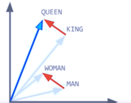
LLM: Tokenization & Embeddings
The tokenizer used by Mistral is a SentencePiece Byte-Pair Encoding tokenizer.
https://github.com/google/sentencepiece
Tokenization (especially subword tokenization) - reduce vocabulary size, facilitate sequence modeling, improve generalization, reduces complexity
Average length of a token in English is 4 chars (a word is 5 chars)
Embeddings = vectors representing words or tokens
"Efficient Estimation of Word Representations in Vector Space"
word2vec (Tomas Mikolov, 2013, Google) - https://arxiv.org/abs/1301.3781
(note - dimensions of vectors were only 50..100)
Tomas Mikolov
word2vec
Google, 2013
LLM: Converting a Sequence or Tokens into a Sequence of Vectors (dimensions ~ 4K)
A vector representation is better because it can hold the "meaning" of a word/token. Also can represent usage, context, or relationships with other tokens/vectors.
Mistral doesn't use a separate, standalone 'embedding matrix'. Mistral uses its own trainable function as part of the model architecture.
.
.
.
.
.
.
.
.
.
T1
T2
. . .
TN
.
.
.
.
.
. . .
.
.
.
.
.
.
.
.
.
.

Slide 13
How Embedding Models Work
An Embedding Model creates a single embedding vector from a large number of input tokens.
First, the input text is tokenized. Then each token is mapped to initial embeddings (typically of size 256, 512, 768, ...) which are obtained from a pre-trained embedding layer (using a lookup table).
In advanced context-aware models like transformers (BERT, GPT), these embeddings are processed through multiple layers of self-attention and feed-forward neural networks.
To compress these many token embeddings into a single vector,
the model employs an aggregation strategy. Common methods include:
Pooling: Techniques like mean pooling or max pooling (averaging)
Attention Mechanisms - to weight the embeddings differently before combining them, focusing on more relevant parts of the input
Linear fully-connected layers to reduce number of dimensions
The resulting vector might undergo normalization and other processing steps
The final output is a single embedding vector of the desired length, encapsulating the information from the large number of input tokens.
Note:
Embeddings saturate their information capacity at around 300-500 tokens.
https://twitter.com/TangriKunal/status/1748114153833660766
Embedding models optimistically store 1 byte per dimension (768 dim = 768 bytes). With optimal text compression (3.5x loss-free), this means 2688 bytes (768 *3.5) of text can compress into a 768 dim embedding.
Increasing the dimensionality of embeddings isn’t a solution either. Embedding models struggle to encode > 1 topic per embedding effectively. Longer text > more topics > worse embeddings.
As a result, truncation and chunking are still the best strategies for longer contexts.

Slide 14

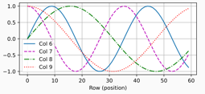
LLM: How Positional Information is Added into Embeddings
Adding Positional Information to Embedding Vectors:
The positional encoding for each position is added element-wise to the corresponding embedding vector. This is done at the "bottom" of encoder and decoder stacks of the transformer.
For each even/odd index of the embedding vector we calculate positional encoding using sin() or cos() functions as following:
.
.
.
.
.
.
.
.
.
T1
T2
. . .
TN
.
.
.
.
.
. . .
.
.
.
.
.
.
.
.
.
.
pos
The reason for using both sine and cosine is to allow the model to more easily learn to attend by relative positions since for any fixed offset k, sin(x+k) and cos(x+k) can be represented as linear transformations of sin(x) and cos(x).
This positional encoding is added element-wise to the embedding vector of the corresponding token. This way, each index "i" in the embedding vector is adjusted based on the position of the token in the sequence, with even indices being adjusted by a sine-based value and odd indices by a cosine-based value.

Slide 15
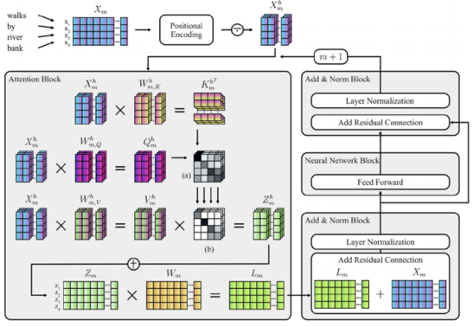
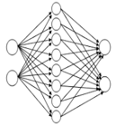
What weights are learned inside LLM
https://www.researchgate.net/publication/357047476_Transformer-Based_Deep_Neural_Language_Modeling_for_Construct-Specific_Automatic_Item_Generation
Embedding weights
Each "head" of the attention mechanism uses 3 learned matrices Query (Q), Key (K), Value (V)
and also learned Weight Matrix.
Also learned are weights of the Feed Forward Layer (FFL). The same FFL is applied separately to each vector.
The FFL is typically comprised of two linear (fully connected) layers. The middle layer adds non-linearity. It is also usually 4 times larger than the input (and output) size (which is simply the size of embedding vectors).
Feed Forward Layer
Output
Input
Attention Matrix
Weight Matrix
(Value Matrix)
Output Matrix
Also learned are the weights in the output layer for generating next word predictions

Slide 16
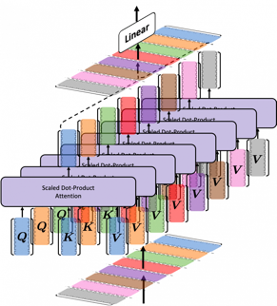
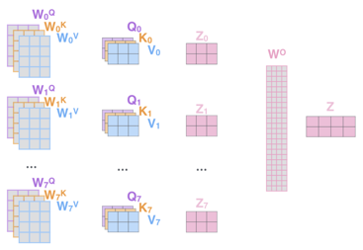
Multi-head attention
In case of a multi-head attention, each head has its own Q,K,V matrixes. The outputs of heads are concatenated. This means that a single, long vector is created for each token.
Then the combined output goes through a linear transformation using another learned weight matrix, often denoted as Wº (where "o" stands for "output") which projects the concatenated vector back to the original embedding dimension.
https://wikidocs.net/167211
Mistral uses "Grouped Query Attention" for faster inference. This means that 32 attention heads are split into 8 groups of 4 heads. The heads inside each group share their learned K & V matrixes (heads) for faster inference.
https://jalammar.github.io/illustrated-transformer/

Slide 17
Steps of the Attention Mechanism
Multiply input embeddings by Q, K, V matrices - to get Q, K, V vectors: Q=X⋅W^{Q} , K=X⋅W^{K} , V=X⋅W^{V}
Multiply Q by K-transposed to get a score for each query token against each key, measuring similarity: score = Q * K^T
Divide the scores by √dk (square root of key vector dimensionality) for normalization: score = score / √dk
Apply softmax to the scores to convert them to attention weights on the values. High scores mean the query is very relevant to that key: attention_weights = softmax(score)
Multiply the attention weights by V to get the weighted sum of values for each query. The higher weights mean more focus/attention put on those values: attention_output = attention_weights * V
The attention output then becomes the new representations for each query token, focused on the most relevant key/value pairs.
An optional final linear transformation can be applied on the output to project it back into the model dimensionality
The sizes of the attention mechanism matrices are the same. Normally they would depend on the length of the input sequence and the hidden dimensionality. For Mistral the numbers are 32K and 4K.
However Mistral uses the sliding window attention with a window size of 4K. So the size of attention matrices will be 4k x 4K.
In the code you will see the shapes as following:
(batch_size, num_heads, seq_length, head_dimension)

Slide 18
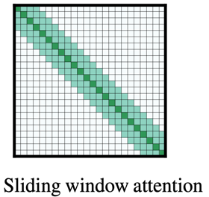
Sliding Window Attention
Mistral 7B has a maximum input sequence length of 32,768 tokens (approx 50 pages).
It is a long sequence.
Each layer processes these long sequence using a Sliding Window Attention (SWA).
It does it in overlapping chunks (window) of 4096 tokens (approx 6 pages).
This window is sliding across the entire input sequence.
Here's a breakdown of how it works:
Initial Window: The model starts by processing the first 4096 vectors.
Sliding Forward: It then shifts the window by a certain amount (e.g., 256 vectors), attending to both new tokens and information from the previous window.
Iterative Processing: This process continues until the entire 32,768-token sequence has been processed.

Slide 19
Why Can't we Combine the Query & Key Matrices into One ?
The power of Gen AI system grows with increasing the number of parameters. A good model (like Mistral) has Billions of parameters. They are structured into 32 layers, each layer having 32 attention heads and a Feed-Forward layer. And each attention head has multiple matrices and normalization layers.
Combining matrices may appear attractive initially, but doing so actually reduces representational power, limits comparisons, and eliminates potential design innovations afforded by maintaining distinct Query, Key, and Value matrices.
Extra matrices and extra nonlinearity provided by splitting the embeddings across multiple matrices contributes significantly to the success of attention-based models.
Benefits of having separate Query, Key, and Value matrices:
Having more than one vector enables better representation learning and improves the overall performance of the model.
Dot product of Q & K = a simple way of computing similarity.
Having separate matrices helps maintain the distinction between the importance weights and actual content information.
Breaking down the embedding space into smaller subspaces via multiple matrices helps reduce the memory footprint and improve parallelization opportunities during training.
Introducing multiple learnable parameters (matrices) increases the capacity of the network while allowing for richer interactions among the components.
It also offers regularization benefits due to increased parameter count, reducing the risk of overfitting.
Allowing independent manipulation of the Query, Key, and Value matrices opens possibilities for designing new variants of self-attention mechanisms.

Slide 20
The End of the Transformer Process - Next Token
Suppose an LLM input has 5 tokens. We convert them into embedding vectors of size "d".
These embeddings pass through multiple Transformer layers. The output of the final Transformer layer consists of 5 updated vectors, each still having a size of d.
We multiply the output by an unembedding matrix W_u, yielding a matrix of "logits" (unnormalized probabilities) of size 5 x |V|, where |V| represents the size of the vocabulary of tokens (commonly around 30,000 tokens).
We apply softmax function to each of 5 "rows". We still have the matrix of shape 5 x |V|, but the values are now probabilities.
Finally, to determine the most probable token we find the maximum value in the last row (corresponding to the last token). The column of this last value will give us the id of the next token.
Alternatively, we can use sampling. We find several top values in the last row - and randomly sample one of them.
A more advanced tactics is called Beam Search - we keep track of multiple potential sequences (beams) and expand them at each step, eventually selecting the sequence with the highest overall probability.

Slide 21
How Mixtral was trained and run
In the Mixtral paper:
"We thank the CoreWeave and Scaleway teams for technical support as we trained our models. We are grateful to NVIDIA for supporting us in integrating TensorRT-LLM and Triton and working alongside us to make a sparse mixture of experts compatible with TensorRT-LLM." OK, so what is TensorRT-LLM and what is Triton?
Open Inference Engines:
https://github.com/lapp0/lm-inference-engines/
Performance: https://nvidia.github.io/TensorRT-LLM/performance.html
TensorRT Toolbox for Optimized LLM Inference
https://github.com/NVIDIA/TensorRT-LLM - open source (Apache)
https://github.com/triton-inference-server/server - open source (BSD 3)
TensorRT-LLM provides users with an easy-to-use Python API (similar to PyTorch) to define LLMs and build TensorRT engines that contain state-of-the-art optimizations to perform inference efficiently on NVIDIA GPUs. To create Python and C++ runtimes for those TensorRT engines.
It also includes a backend for integration with the NVIDIA Triton Inference Server to serve LLMs.
Models built with TensorRT-LLM can be executed on a wide range of configurations going from a single GPU to multiple nodes with multiple GPUs (using Tensor Parallelism and/or Pipeline Parallelism).
TensorRT supports running models saved in various formats,
for example:
TensorFlow formats
ONNX (Open Neural Network Exchange) format
PyTorch TorchScript (.pt) format

Slide 22
Is Having More Experts Better?
Inside Common Models:
For example, can Mixtral 8x7B be improved by increasing the number of experts from 8 to 16 ?
The answer is "it depends".
Here are some factors to consider:
More experts - more compute needed, more expensive
For smaller datasets or simpler problems, adding more experts may result in redundancy, overfitting and reduced generalization performance.
A more complicated gating network may be needed when increasing the number of experts to maintain good routing decisions.
So, increasing the number of experts in a Mixtral model from eight to sixteen might lead to improvements in certain scenarios. Decision depends on available resources, dataset characteristics, and overall goals.
Here are some LLMs:
---------------------------------------------------------
Year | Model | Params | Layers | Embed dim | heads
---------------------------------------------------------
2020 | GPT-3 | 175B | 96 | 12,288 | 96
2021 | Gopher | 280B | 80 | 16,384 | 128
2021 | Anthropic LM | 52B | 64 | 8,192 | -
2022 | PaLM. | 540B | 118 | 18,432 | 48
2022 | Chinchilla | 70B | 80 | 8,192 | 64
2023 | Llama-2-7B | 7B | 32 | 11,008 | 32
2023 | Mistral-7B | 7B | 32 | 14,336 | 32
2023 | Mixtral-8x7B | 47B | 32 | 14,336 | 32
---------------------------------------------------------
Unfortunately there is no public info about architectures of GPT-4-Turbo, GPT-3-Turbo, Claude-2, Gemini Pro, ...
Llama 7B 70B
----------------------------------------
hidden_size 4096 8192
intermediate_size 11008 28672
num_attention_heads 32 64
num_hidden_layers 32 80
num_key_value_heads 32 8
use_cache true false
The Rise of Sparse Mixtures of Experts: Switch Transformers https://mlfrontiers.substack.com/p/the-rise-of-sparse-mixtures-of-experts

Slide 23
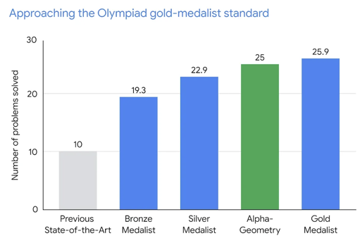
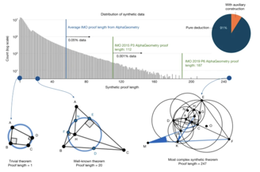
AlphaGeometry
Google Deepmind - AlphaGeometry:
An Olympiad-level AI system for geometry
https://www.nature.com/articles/s41586-023-06747-5
https://deepmind.google/discover/blog/alphageometry-an-olympiad-level-ai-system-for-geometry/
AlphaGeometry is a neuro-symbolic system made up of a neural language model and a symbolic deduction engine, which work together to find proofs for complex geometry theorems.

Slide 24
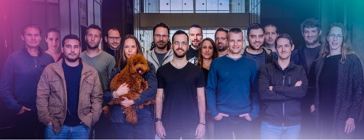
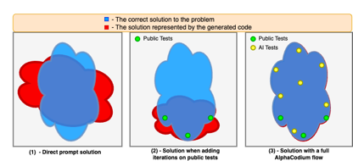
AlphaCodium
AlphaCodium - Code Generation
https://github.com/Codium-ai/AlphaCodium - Open Source
https://arxiv.org/abs/2401.08500
https://www.codium.ai/products/alpha-codium/
AlphaCodium - a test-based, multi-stage, code-oriented iterative flow, that improves the performances of LLMs on code problems
Andrej Karpathy:
Prompt engineering (or rather "Flow engineering") intensifies for code generation. Great reading and a reminder of how much alpha there is (pass@5 19% to 44%) in moving from a naive prompt:answer paradigm to a "flow" paradigm, where the answer is constructed iteratively.
https://twitter.com/karpathy/status/1748043513156272416
CodiumAI is a small, fast-paced startup in Tel Aviv.

Slide 25

Mark Zuckerberg Announcement (Instagram 2 min video)
Mark Zuckerberg just dropped a huge announcement and confirmed LLaMA 3 is in training
https://www.instagram.com/p/C2QARHJR1sZ
January 18, 2024 :
Hey everyone. Today I am bringing Meta's two AI research efforts closer together to support our long-term goals of building general intelligence, open-sourcing it responsibly and making it available and useful to everyone in all of our daily lives.
It's become clearer that the next generation of services requires building full general intelligence. Building the best AI assistants ,AIs for creators, AIs for businesses and more that needs advances in every area of AI from reasoning to planning to coding to memory and other cognitive abilities.
This technology is so important and the opportunities are so great, that we should open-source and make it as widely available as we responsibly can, so that everyone can benefit.
We were building an absolutely massive amount of infrastructure to support this. By the end of this year we're going to have around 350,000 Nvidia H100s, or around 600,000 H100 equivalent of compute if you include other gpus we're currently training llama 3.
And we've got an exciting road map of of future models that we're going to keep training responsibly and safely too.
People are also going to need new devices for AI, and this brings together AI and the metaverse, because over time I think a lot of us are going to talk to AIs frequently throughout the day, and a lot of us are going to do that using glasses, because glasses are the ideal form factor for letting an AI see what you see and hear what you hear, so it's always available to help out. Ray-Ban Meta glasses with meta AI are already off to a very strong start, and overall across all this stuff we are just getting started.
Zuck: "We're currently training LLaMA 3 ... Open-Source AGI"
GPU cost ~ $20 Bln
600K * $32K
Total cost ~ $50 Bln

Slide 26
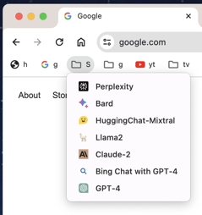
Misc
Run SDXL Locally With ComfyUI:
https://www.youtube.com/watch?v=9k-yb83ZHfc
https://github.com/comfyanonymous/ComfyUI
https://github.com/ltdrdata/ComfyUI-Manager
https://www.youtube.com/watch?v=m9jg1fdOiVY - on Mac
https://huggingface.co/stabilityai/stable-diffusion-xl-base-1.0
https://huggingface.co/stabilityai/stable-diffusion-xl-refiner-1.0
https://huggingface.co/stabilityai/sdxl-vae
Also:
https://github.com/AUTOMATIC1111/stable-diffusion-webui
https://huggingface.co/CompVis/stable-diffusion-v-1-4-original
Volkswagen and Mercedes Benz demonstrated dashboard LLM-based voice assistants.
Taiwanese startup Neuchips displayed an add-in board that enables desktop computers to run 7B LLMs at 55 watts
OpenAI ChatGPT Pricing Calculator:
https://gptforwork.com/tools/openai-chatgpt-api-pricing-calculator
I often give the same question to multiple chats. Then aggregate their answers.
New Samsung Galaxy S24 AI Features (proprietary)
Circle to Search
Live Translate (real time)
Nightography Zoom
Note - Google Pixel 8 Pro also has Circle to Search and live translate.
Microsoft launches Copilot Pro for $20 per month per user

Slide 27
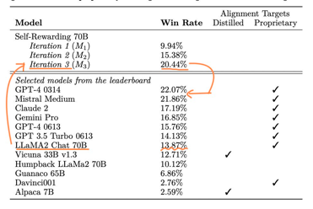


Misc 2
Self-Rewarding Language Models
https://arxiv.org/pdf/2401.10020.pdf
This is huge! Iterative DPO (three iterations) on LLama 2 70B yields a model that beats Mistral Medium, Claude 2, Gemini Pro, GPT-4 0613 on Alpaca v2 benchmark
MegaDolphin 2.2 120b - merging of two Llama-2 based dolphin models (interleaving a model with itself).
New in 2.2 is conversation and empathy. With an infusion of curated Samantha and WizardLM DNA, Dolphin can now give you personal advice and will care about your feelings, and with extra training in long multi-turn conversation.
This model is uncensored. It will be highly compliant to any requests, even unethical ones.
https://huggingface.co/cognitivecomputations/MegaDolphin-120b
Ads on Meta bring 32% more returns thanks to AI
200+ page book on vector retrieval: https://arxiv.org/pdf/2401.09350.pdf
Cheap Mixtral via API
https://twitter.com/wenquai/status/1748016451808530863
https://monsterapi.ai
https://colab.research.google.com/drive/17dM_lGdD80NqEUB_R1_dKqQXpJfublkV
https://developer.monsterapi.ai/
https://developer.monsterapi.ai/docs/monster-deploy-beta
https://developer.monsterapi.ai/reference/post_generate-codellama-13b-instruct

Slide 28



ML & AI on AWS, Azure, GCP
Amazon:
Amazon Trainium
Amazon Bedrock
AWS Inferentia
Amazon CodeWhisperer
Amazon Sagemaker
Comprehend (extract from text)
CodeGuru (auto code review)
Lex (Chatbots)
Forecast
Textract (extract text & data from millions of docs)
Kendra (Natural Language Search)
Fraud Detector
Rekognition - image/video analysis,
Personalize - recommendation engine,
Translate - real time translation
Polly - text-to-speech
Transcribe - speech to text
QuickSight - Analytics dashboards
Azure:
Azure Open AI
Azure ML Studio
PySpark
Azure Data Fabric
Azure Cognitive Services
(Vision, Speech, Language, Knowledge, Search)
GCP Google Cloud AI Services
Generative AI on Vertex AI
Generative AI App Builder
Duet AI
Cloud Vision API
Video Intelligence API
Cloud Speech API
Cloud Natural Language
Cloud Translation
DataLab
ML Engine
AutoML
Colab - free jupyter notebooks with GPU
Kaggle - ML competitions, code, notebooks (kernels), ... - https://www.kaggle.com
Benefits of Gen AI Cloud Platforms
train and deploy
Build and scale
Latest Gen AI models, LLMs
High performance
pay-as-you-go pricing
Pre-built ML/AI Frameworks
Frameworks for images, videos, business use
Advanced models offered by Cloud providers

Slide 29
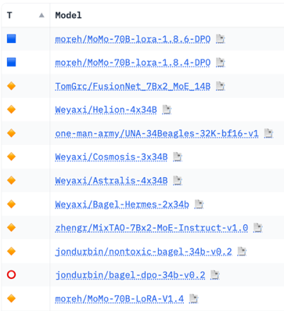
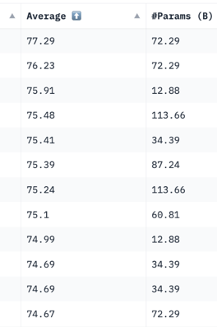
Hugging Face LLM Leaderboard
https://huggingface.co/spaces/HuggingFaceH4/open_llm_leaderboard
https://huggingface.co/datasets/open-llm-leaderboard/results
https://huggingface.co/spaces/felixz/open_llm_leaderboard
https://huggingface.co/spaces/felixz/meta_open_llm_leaderboard
https://github.com/lselector/ai/blob/master/llm_leaderboard.py
January 19, 2024

Slide 30
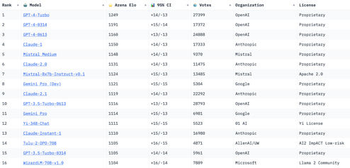
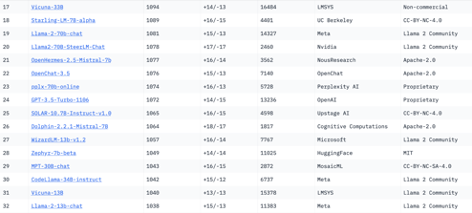
Crowd-sourced "Arena" leaderboard
https://huggingface.co/spaces/lmsys/chatbot-arena-leaderboard
Jan 18, 2024
54 Models
231K+ votes
Starting Elo rating = 1000
for each model
95% CI = Confidence Interval
What is the architecture
of Mistral Medium?
It is probably MoE ?
8x30b ? 32x7b ?
https://www.reddit.com/r/LocalLLaMA/comments/18m2t0z/deducing_mistral_medium_size_from_pricing_is_it_a/
7B
7B
7B

Slide 31
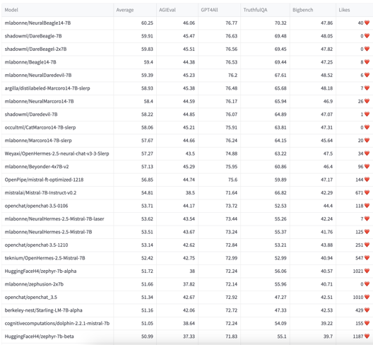
YALL - Yet Another LLM Leaderboard
https://huggingface.co/spaces/mlabonne/Yet_Another_LLM_Leaderboard
Leaderboard made with LLM AutoEval using Nous benchmark suite.
Other - EvalPlus Leaderboard
https://evalplus.github.io/leaderboard.html

Slide 32
The AI Tools
Cloud Platforms:
.. Microsoft, Azure
.. Hugging Face
.. Amazon Bedrock
.. AWS EC2
.. Google Vertex AI
.. Google CoLab
.. IBM Watson
.. Nvidia
.. cloud.vast.ai
.. paperspace.com
.. LambdaLabs
.. brev.dev
Tools:
.. RAG tools: Vector DBs, Graph DBs, PostgreSQL
.. AutoGen
.. TaskWeaver
.. CrewAI
.. MemGPT
.. vLLM + AutoAWQ
Model Safety:
.. Meta Purple Llama
Nov 30, 2022 - ChatGPT release
has pushed many companies to completely change their agenda and to re-organize around AI
2023 - year of discoveries, POCs
2024 - year of deployments
Front-End Dev:
.. LangChain Studio
.. Windows AI Studio
.. AutiGen Studio
.. Streamlit, Flask, Gradio
.. voiceflow.com
.. Text Generation WebUI
Chats:
.. ChatGPT
.. Bard
.. Claude
.. labs.perplexity.ai
.. llama2.ai
.. pi.ai
AI Research:
.. Berkeley, Carnegie
Mellon, MIT, ...
.. OpenAI
.. Microsoft
.. Meta
.. Mistral.ai
.. Stability.ai
.. Anthropic
.. Google DeepMind
.. 01.ai
.. X.ai
.. Inflection.ai
.. IBM
AI Coding Tools:
.. GPT Pilot in VS Code
.. GitHub Copilot
.. Google’s Duet AI
.. JetBrains AI IDEs
Model Training, Fine-tuning:
.. HuggingFace
.. Axolotl
.. LoRA, QLoRA, S-LoRA
.. wandb.ai (weights & biases)
.. fast.ai
Datasets:
.. HuggingFace
.. Orca2, Open Orca
.. Dolphin
.. scale.com
Software:
.. Python, PyTorch, JAX
.. Rust Candle
.. Nvidia CUDA, cuDNN, TensorRT
SDK, DeepStream SDK, ...
.. HuggingFace python modules (datasets, transformers) models, datasets, ...
.. LangChain, LlamaIndex
.. Apple MLX
AI Chips:
.. Nvidia
.. Google TPUs
.. Microsoft
.. OpenAI
.. Meta
.. Apple
.. Rain NPU
.. Cerebras
Local Apps:
.. Ollama
.. LMStudio
.. TextGen WebUI
.. GPT4All
.. MLC LLM
.. PrivateGPT
.. h2oGPT
Cloud App Dev:
.. Hugging Face
.. platform.openai.com
.. Cohere.com
.. RunPod.io
.. replit.com
+ voiceflow.com
.. chatbase.co

Slide 33
Thank You!

