Slide 1
Vector DB, OpenSearch, Lucene, FAISS, etc.
February 09, 2024
Popular Vector Databases
Indexing Vectors for Similarity Search
PostgreSQL, Milvus, Vespa, Neo4j
Apache Lucene
FAISS = Facebook AI Similarity Search
Databricks Vector Search
OpenSearch vs ElasticSearch
Using Elasticsearch from Python
Elasticsearch Clients GUI

Slide 2


About the Speaker
Lev Selector, Ph.D.
40+ years of software engineering, data science, and building teams (hiring, training, and managing)
Ph.D. in mathematical modeling and computer simulations
Interests:
Generative AI, Using LLM with your data
Local AI for Local Private Data
Cloud architecture, fin-tech, application security
Find/connect: Linkedin, GitHub, YouTube, Google
https://eais.ai

Slide 3
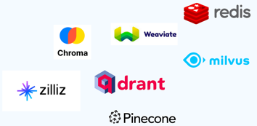
Popular Vector Databases
Vector Databases are becoming very popular. They are used in AI-enabled systems for storing and searching embedding vectors.
Embedding Vectors are used for semantic representations of data - text, images, audio, and other complex data types
Semantic search = search by "meaning", not only by keywords.
Vector Databases are becoming much better at scaling - handling massive datasets and providing fast query response times
Typical applications: Question answering, Recommendation Engines, Image Search, Fraud Detection.
Here is a list of some Vector Databases (2023) - https://sourceforge.net/software/vector-databases/
More Vector DBs:
Zilliz Cloud
Nomic Atlas
Vald
pgvector
FAISS
Metal
MyScale
Deep Lake
Supabase
Embeddinghub
Popular Vector Databases:
Pinecone
Weaviate - open source
Chroma - open source
Redis Vector Database
Qdrant - open source
Milvus Project - open source
Vespa.ai - open source

Slide 4
Vector Databases
https://thenewstack.io/top-5-vector-database-solutions-for-your-ai-project/
https://towardsdatascience.com/milvus-pinecone-vespa-weaviate-vald-gsi-what-unites-these-buzz-words-and-what-makes-each-9c65a3bd0696
https://www.reddit.com/r/SoftwareEngineering/comments/107vhoq/vector_databases_like_pinecone_or_weaviate_are/
Vector DB (VDB) | Type
Pinecone |  | https://www.pinecone.io
Redis Vector DB |  | https://redis.io/docs/interact/search-and-query/search/vectors/
Chroma | Open Source | https://www.trychroma.com https://python.langchain.com/docs/modules/data_connection/vectorstores/integrations/chroma (shows how to use db.persist() to save on disk) https://github.com/chroma-core/chroma https://docs.trychroma.com/getting-started https://docs.trychroma.com/deployment - hosted Chroma (still in "alpha" stage)
PGVector | Open Source PostgresSQL extension | https://github.com/pgvector/pgvector - vector similarity search, up to 16,000 dimensions https://www.youtube.com/watch?v=aBeVM5q0f5A https://www.youtube.com/watch?v=y10Wmr4fmlA
pg_embedding | Open Source, fast PostgresSQL extension | https://github.com/neondatabase/pg_embedding https://neon.tech/blog/pg-embedding-extension-for-vector-search - 20x times faster
Qdrant | Open Source - Rust | https://qdrant.tech https://qdrant.tech/documentation/guides/installation/ - docker
Milvus Project | Open Source - Go, C++, Python | https://milvus.io https://milvus.io/blog/how-to-get-started-with-milvus.md - docker
Weaviate (SeMI) | Open Source - Go | https://www.semi.technology/developers/weaviate/current/ https://weaviate.io/developers/weaviate/installation - docker
Vespa.ai (Yahoo!) | Open Source - Java, C++ | https://vespa.ai https://docs.vespa.ai/en/getting-started.html - docker
Faiss | Open Source Lib - C++, Python | FAISS = Facebook AI Similarity Search (library in C++ with Python wrapper) https://github.com/facebookresearch/faiss
Vald (Yahoo!) | Open Source - Go | https://vald.vdaas.org https://github.com/vdaas/vald - distributed, Kubernetes

Slide 5
Indexing Vectors for Similarity Search
Large modern models (GPT, Diffusion) use huge latent vectors or tensors
(GPT/Diffusion latent dimensions: 12K .. 60K numbers per vector/tensor).
If you put these huge vectors in a vector database, how do you query them?
Here are some common indexing techniques (to speed-up the similarity search):
Locality-sensitive hashing (LSH) - similar vectors mostly get into same buckets
Product quantization (PQ) - lossy compression to reduce the size of vectors while preserving similarity
Hierarchical Navigable Small World (HNSW) - create a graph where each vector is connected to its nearest neighbor(s)
Hierarchical Grid Index (HGI) - divides a multidimensional space into a hierarchy of grids
Ball Tree Index (BTI) - a tree of nodes (balls) and leaves (actual points)
Random Forest Index (RFI) - trees represent regions in space, and the leaves represent the actual points.
Examples:
Pinecone uses a hybrid approach : an HGI with a LSH index. Fast search on large and small datasets
Weaviate uses a hybrid approach : an HGI with a BTI index. Fast performance for both range and point queries
Chroma uses a single-level grid index, which is a simple but effective approach for vector indexing
Redis Vector Database uses a Sorted Set data structure to store vectors, which allows for efficient range queries
Qdrant uses a hybrid approach : an HGI with a RFI index. Good performance for both range and point queries
Milvus Project uses an HGI
Vespa.ai uses a hybrid approach : an HGI with a LSH index. Fast search on large and small datasets

Slide 6
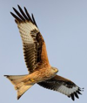


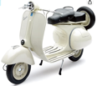



Narrowing Down Open Source VDBs
PostgreSQL - pgvector & pg_embedding
extensions
https://github.com/pgvector/pgvector - vector similarity search, up to 16,000 dimensions
https://www.youtube.com/watch?v=aBeVM5q0f5A
https://www.youtube.com/watch?v=y10Wmr4fmlA
https://github.com/neondatabase/pg_embedding
https://neon.tech/blog/pg-embedding-extension-for-vector-search
support only 4-Bytes precision
Milvus
https://milvus.io
https://milvus.io/blog/how-to-get-started-with-milvus.md
Uses FAISS
Vespa
https://vespa.ai
https://docs.vespa.ai/en/getting-started.html
support int8 and more
1973 - Ingres db (INteractive Graphics REtrieval System), Berkeley
(also, Ingres is similar to ingress, which means "access")
1985 - Postgres (Post Ingres, Berkeley)
1994 - Open Sourced under MIT license
1996 - PostreSQL (signifying full support for SQL)
Neo4j Graph Database - community edition is open source. Now has support for Vector Similarity Search via Lucene. 1-byte precision will hopefully be available soon

Slide 7


Apache Lucene
Neo4j vector similarity search is based on Apache Lucene.
https://lucene.apache.org
Apache Lucene is an open-source Java library
Designed for text search
Uses an inverted full-text index
Doug Cutting originally wrote Lucene in 1999.
Key elements: Indexes, Documents, Inverted indexes, Scoring, Tokenization.
Inverted full-text index: Splits documents into words and builds an index for each word.
Inverted indexing: Maps keywords to pages, similar to a glossary, instead of mapping pages to keywords.
Fast search responses: Searches through an index instead of searching through text directly.
Doug Cutting
https://www.linkedin.com/in/cutting/
Lucene is adding support for int8 precision in vectors (Nov 2023)
https://www.elastic.co/search-labs/blog/articles/scalar-quantization-in-lucene
So hopefully it will soon propagate to systems that use it - Elasticsearch, AWS Opensearch, Solr, Neo4j, ...

Slide 8
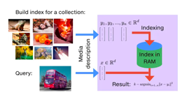

FAISS = Facebook AI Similarity Search
FAISS specializes in efficient similarity search and clustering operations on dense numerical vectors (images, recommendation systems, and information retrieval in non-text data).
FAISS employs specialized indexes (like Inverted File with Product Quantization) optimized for searching dense vectors.
FAISS written in C++ with Python bindings.
FAISS doesn't have native support for 1-byte precision vectors, but it supports Product Quantization (PQ) where the original 4-Byte precision floating-point vector is decomposed into multiple sub-vectors, which are quantized to 1-Byte representation
FAISS is used by Milvus and Weaviate vector databases.
It is also used for similarity search by itself.
Note about Vespa Vector DB.
Vespa does NOT use FAISS of Lucene.
Vespa has its own in-built system for approximate nearest neighbor (ANN) searches. It is built around the Hierarchical Navigable Small World (HNSW) algorithm.
Vespa has its own native support for tensors, not vectors.
Vespa is a full-fledged search engine and big data serving platform. Its vector similarity search capabilities are tightly integrated with other features like text search, data ranking, and distributed serving.
FAISS does not use Apache Lucene
Apache Lucene is a text search engine library. It uses primarily inverted indexes for text search, and it is written in Java.
While both libraries (FAISS and Lucene) deal with search, they operate on fundamentally different data types and different use cases.

Slide 9
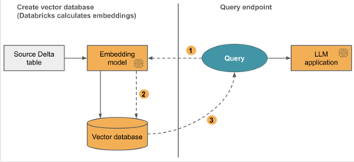
Databricks Vector Search (DVS)
Databricks Vector Search (DVS) is a vector DB https://docs.databricks.com/en/generative-ai/vector-search.html
DVS uses vector search index from a Delta table - the index includes embedded data with metadata
Index can automatically sync when the underlying Delta table is updated.
DVS uses Hierarchical Navigable Small World (HNSW) algorithm for its approximate nearest neighbor searches and the cosine similarity distance metric to measure embedding vector similarity.
Create DVS Index https://docs.databricks.com/en/generative-ai/create-query-vector-search.html
RAG on Databricks https://docs.databricks.com/en/generative-ai/retrieval-augmented-generation.html

Slide 10


OpenSearch vs ElasticSearch
https://www.chaossearch.io/blog/opensearch-vs-elasticsearch-comparison
2010 - Elasticsearch open source Apache 2.0 license
2015 - Amazon Elasticsearch Service (Amazon ES) - cloud managed calable Elasticsearch clusters
2019 - Elastic N.V. filed suit against Amazon
2021 - Elastic N.V. announced new SSPL licensing
https://github.com/elastic/elasticsearch/
https://github.com/elastic/kibana
2021 - Amazon made fork from last open-source version of Elasticsearch (7.10.2) to launch a new open-source search engine project OpenSearch - and a cloud service under the name “Amazon OpenSearch Service”.
https://github.com/opensearch-project
https://aws.amazon.com/opensearch-service/
Both ES and OS share all the basic functionality of search (full-text search and distributed search), analytics, and dashboards.
Elasticsearch engine is 40-140% faster while using less compute.
Both can be downloaded and installed.
Both available as managed cloud solutions
ChaosSearch - cheaper and better alternative to use with telemetry and log data
https://www.chaossearch.io/use-cases/elasticsearch-replacement

Slide 11
Using Elasticsearch from Python
# https://elasticsearch-py.readthedocs.io/en/v7.16.0/
# pip install elasticsearch
from elasticsearch import Elasticsearch
es = Elasticsearch([{'host':'localhost', 'port':9200}])
doc = {'title':'Example Doc', 'content':'Example Content'}
res = es.index(index='my-index', id=1, body=doc)
search_query = {'query':{'match':{'content':'example'}}}
response = es.search(index='my-index', body=search_query)
print('Search result:', response['hits']['hits'])

Slide 12
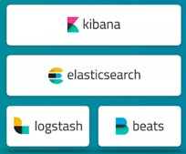
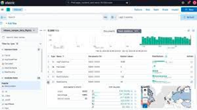
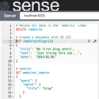

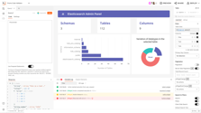
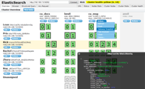

Elasticsearch Clients GUI
Kibana - official Elasticsearch visualization tool (custom dashboards, advanced searches); Kibana is part of the Elastic Stack (Elasticsearch, Kibana, Logstash, Beats)
Sense - plugin for Chrome and Firefox to run queries, manage indices, explore data
ElasticHQ - web-based GUI (queries, indexes, data visualization)
Inquisitor - Chrome extension (queries, indexes, data visualization)
ElasticSearch Head - web-based GUI
ES Admin - web-based GUI

