Slide 1
Neo4j
Graph Database
February 09, 2024

Slide 2


About the Speaker
Lev Selector, Ph.D.
40+ years of software engineering, data science, and building teams (hiring, training, and managing)
Ph.D. in mathematical modeling and computer simulations
Interests:
Generative AI, Using LLM with your data
Local AI for Local Private Data
Cloud architecture, fin-tech, application security
Find/connect: Linkedin, GitHub, YouTube, Google
https://eais.ai

Slide 3
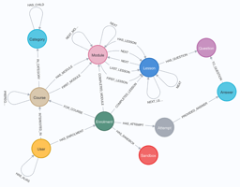

Neo4j
Neo4j Graph DB - deploy anywhere
Neo4j AuraDB - managed (SaaS) on AWS or GCP
Neo4j Graph Data Science (platform)
Deployment Center
Dev Tools: Desktop, Browser, Data Importer
Workspace: Import, Explore, Query
Bloom - graph visualization
GraphQL - API library
Data Connectors: Apache Kafka, Spark, BI Tools
Cypher Query Language
https://neo4j.com
https://en.wikipedia.org/wiki/Neo4j
https://neo4j.com/download/
Neo4j is a graph database management system
Developed by Neo4j, Inc.
Since 2007, v.1 - 2010, current v.5.16
Neo4j stores nodes, edges, and attributes of nodes and edges.
ACID-compliant transactional database
"community edition" is open source
advanced features - closed source commercial license
Neo4j is written in Java ("4j")
uses Cypher query language through a transactional HTTP endpoint
uses the binary "Bolt" protocol
Choosing the Right Client
Neo4j Browser or Neo4j Desktop - ad-hoc queries, schema exploration
Cypher Shell - run commands in terminal
Programming language drivers.

Slide 4
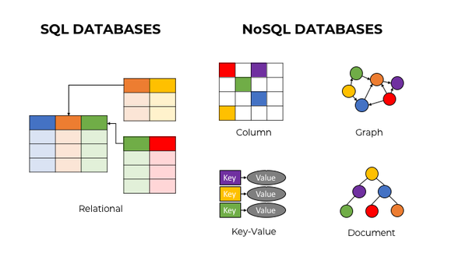
Types of Databases
Relational SQL database
NoSQL database
Object database
Document databases
Hierarchical database
Key-value databases
Graph database
Vector database
OLTP vs OLAP
Columnar databases
Data warehouses
Document stores
https://yottadb.com/use-cases/universal-nosql/

Slide 5
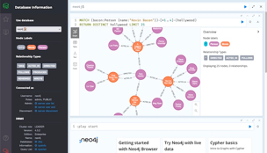
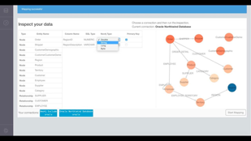
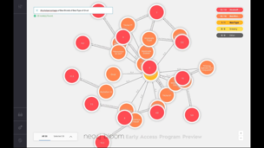
Neo4j Clients
Neo4j Browser
Neo4j Desktop
Neo4j Bloom
https://neo4j.com/developer/neo4j-bloom/
Great for visualizing and exploration. A user can define rules for size and color of nodes

Slide 6
CQL = Cypher Query Language
20 short examples of Neo4j Cypher queries
// 1. Create a single node with properties:
CREATE (p:Person {name: 'Alice', age: 30})
// 2. Create a relationship between nodes:
MATCH (a:Person {name: 'Alice'}),
(b:Person {name: 'Bob'})
CREATE (a)-[:FRIENDS_WITH]->(b)
// 3. Find a node by property:
MATCH (p:Person {name: 'Alice'})
RETURN p
// 4. Update a node's property:
MATCH (p:Person {name: 'Alice'})
SET p.age = 31
// 5. Add a label to a node:
MATCH (p:Person {name: 'Alice'})
SET p:Friend
// 6. Remove a property from a node:
MATCH (p:Person {name: 'Alice'})
REMOVE p.age
// 7. Delete a node (when no relationships):
MATCH (p:Person {name: 'Alice'})
DELETE p
// 8. Find nodes related by a specific relationship:
MATCH (p:Person)-[:FRIENDS_WITH]->(friend)
RETURN p.name, friend.name
// 9. Return nodes and relationships together:
MATCH path = (p:Person)-[:FRIENDS_WITH]->(friend)
RETURN path
// 10. Conditional query with `WHERE`:
MATCH (p:Person)
WHERE p.age > 25
RETURN p.name, p.age
// 11. Return count of nodes:
MATCH (p:Person)
RETURN count(p)
// 12. Aggregate data with `GROUP BY` equivalent:
MATCH (p:Person)
RETURN p.age, count(*) AS num_people
// 13. Order results:
MATCH (p:Person)
RETURN p.name, p.age
ORDER BY p.age DESC
// 14. Limit the number of results returned:
MATCH (p:Person)
RETURN p.name
ORDER BY p.name
LIMIT 5
// 15. Skip results (useful for pagination):
MATCH (p:Person)
RETURN p.name
ORDER BY p.name
SKIP 5 LIMIT 5
// 16. Create a unique path (if it doesn't exist):
MERGE (p:Person {name: 'Alice'})
ON CREATE SET p.created = timestamp()
// 17. Set multiple properties on a node (with a map):
MATCH (p:Person {name: 'Alice'})
SET p += {email: 'alice@example.com', city: 'London'}
// 18. Pattern matching to find complex relationships:
MATCH (p:Person)-[:FRIENDS_WITH*2]->(friend)
WHERE p.name = 'Alice'
RETURN p.name, friend.name
// 19. Delete a relationship:
MATCH (p:Person)-[rel:FRIENDS_WITH]->(friend {name: 'Bob'})
DELETE rel
// 20. Find shortest path between two nodes:
MATCH (start:Person {name: 'Alice'}), (end:Person {name: 'Bob'}),
path = shortestPath((start)-[*..15]-(end))
RETURN path

Slide 7
Storing and Querying Embeddings in Neo4j
Neo4j supports array properties
CREATE (n:Item {embedding: [0.12, 0.23, 0.34, ..., 0.56]})
but similarity search on them was slow.
August 2023 - Neo4j added native vector similarity search: https://neo4j.com/blog/vector-search-deeper-insights/
https://neo4j.com/docs/cypher-manual/current/indexes/semantic-indexes/vector-indexes/
Example: work with the index from LangChain:
https://neo4j.com/developer-blog/neo4j-langchain-vector-index-implementation/
https://neo4j.com/developer-blog/langchain-library-full-support-neo4j-vector-index/
CREATE VECTOR INDEX 'abstract-embeddings'
FOR (n: Abstract) ON (n.embedding)
OPTIONS {indexConfig: {
'vector.dimensions': 1536,
'vector.similarity_function': 'cosine'
}}
// similarity search for 5 top matches
// similar to $embedding vector
// searching in vector index called 'products':
CALL db.index.vector.queryNodes('products', 5, $embedding) yield node as product, score
// enrich with explicit relationships from Knowledge Graph
MATCH (product)-[:HAS_CATEGORY]->(cat), (product)-[:BY_BRAND]->(brand)
OPTIONAL MATCH (product)<-[:BOUGHT]-(customer)-[rated:RATED]->(product)
WHERE rated.rating = 5
OPTIONAL MATCH (product)-[:HAS_REVIEW]->(review)<-[:WROTE]-(customer)
RETURN product.Name, product.Description,
brand.Name, cat.Name,
collect(review { .Date, .Text })[0..5] as reviews
Neo4j vector indexes are powered by the Apache Lucene indexing and search library.
https://lucene.apache.org - Ultra Fast Search Library
Lucene implements a Hierarchical Navigable Small World (HNSW) Graph to perform a K-ANN (K-Approximate Nearest Neighbors) query over the vector fields.
Vectors can be stored as floats or doubles (4 or 8 bytes)
To have 4 bytes, use db.create.setNodeVectorProperty()
Unfortunately smaller precisions are not supported yet.

Slide 8
Scaling Neo4j
Capacity Planning Example: https://neo4j.com/developer/kb/capacity-planning-example/
200 users; 75 M nodes; 150 M relationships; 5 prop/node, 2 prop/relationship; 200 queries/sec;
Indexes ~ 20%; estimated disk - ~40GB
So we need server: 20 vCPU cores, 100GB RAM
Neo4j Enterprise Edition supports a distributed architecture (multiple servers). You can partition graph across multiple servers (manual or automatic partitioning). Optimize configuration: memory allocation, page cache size, and transaction log management. Optimize indexes for specific queries. Use Neo4j's native full-text search, or use Elasticsearch for performance.
Neo4j does NOT support AWS S3.
You can use S3 to store backups:
neo4j-admin backup --backup-dir /mypath/ --database=graph.db
aws s3 cp /mypath/ s3://your-s3-bucket-name --recursive
neo4j-admin restore --from=/mypath/ --database=graph.db
Monitoring and performance tuning (tweaking configuration settings, optimizing queries, or adding additional hardware resources to the system).
Adding embedding vector [1536 dim] at standard float (32bit) precision. So a vector is ~ 6KB.
This effectively increases properties size x150 fold (from 40B to 6KB).
So we estimate 6TB disk, 3K vCPUs and 15TB memory?
Wow!
We either need a distributed system,
or use alternatives which do support int8 (8-bit) precision:
OpenSearch v 2.9 (July 2023) https://opensearch.org/blog/byte-quantized-vectors-in-opensearch/
Vespa vector DB.
Apache Lucene is adding int8 as of Nov 2023.
Elasticsearch & OpenSearch (AWS) are using Apache Lucene, so they should have int8 precision soon.
FAISS has support for compressing to 1-byte.
Minimal Server:
8+ CPU cores
8GB+ RAM (1GB per 100K nodes in graph)
Disk: depends on graph size
GPU - not required

Slide 9
Installing Neo4j on Linux
https://www.techrepublic.com/article/how-to-install-neo4j-ubuntu-server/
sudo apt-get update && sudo apt-get upgrade -y # and then reboot
sudo apt-get install wget curl nano software-properties-common dirmngr apt-transport-https gnupg gnupg2 ca-certificates lsb-release ubuntu-keyring unzip -y
# add the official Neo4j GPG key:
curl -fsSL https://debian.neo4j.com/neotechnology.gpg.key | sudo gpg --dearmor -o /usr/share/keyrings/neo4j.gpg
# Add the Neo4j repository with:
echo "deb [signed-by=/usr/share/keyrings/neo4j.gpg] https://debian.neo4j.com stable latest" | sudo tee -a /etc/apt/sources.list.d/neo4j.list
# Update apt and run install:
sudo apt-get update
sudo apt-get install neo4j -y
# start service:
sudo systemctl enable --now neo4j
sudo systemctl start neo4j
sudo systemctl status neo4j
sudo nano /etc/neo4j/neo4j.conf # edit config
server.default_listen_address=0.0.0.0
sudo systemctl restart neo4j
sudo nano /etc/hosts
cypher-shell -a 'neo4j://192.168.1.7:7687' # test
sudo neo4j-admin set-initial-password mypassword
Note: default user is "neo4j"
Access the Neo4j web interface:
http://localhost:7474
http://your_server_ip:7474

Slide 10
Neo4j from Python
# pip install neo4j
from neo4j import GraphDatabase
uri = "neo4j://localhost:7687"
username = "neo4j"
password = "password"
driver = GraphDatabase.driver(uri, auth=(username, password))
def insert_data(tx):
query = ("""
CREATE (a:Person {name: 'Alice', age: 32}),
(b:Person {name: 'Bob' , age: 28}),
(a)-[:KNOWS]->(b)
""")
tx.run(query)
def run_query(tx):
query = """ MATCH (p:Person) WHERE p.age <= 30
RETURN p.name AS name, p.age AS age"""
result = tx.run(query)
for record in result:
print(f"Name: {record['name']}, Age: {record['age']}")
with driver.session() as session:
session.write_transaction(insert_data)
session.read_transaction(run_query)
driver.close()

Slide 11
Thank You!

