Slide 1
AI Updates
February 23, 2024
Mistral-Next
Google open LLMs - Gemma 2B & 7B
OpenAI World Simulation
Jeff Dean Lecture (Google)
Dataset OpenMath Instruct-1 by Nvidia
Aya - open-source multilingual project
10M context kills RAG ?
"Scalable Diffusion" paper
Biased and unbiased LLM assistants
OpenAI Reaches $80 Billion Valuation
LangChain - Startup
RAGAs = RAG Assessment Framework
Gemini working with Google Workspace
Fast Inference with Groq
Magic AI - AI Software Engineer
YouTube CEO: 4 Big bets for 2024
Text Embeddings Guide
Fine-Tuned 7b Outperforms GPT-4
Nvidia GTC in March 2024
Sierra - startup - AI chatbots
Yet Another LLM Benchmark 100 tests
UpTrain - Open-source LLMOps eval
NotebookLM.Google.com
Gemini Diversity Problem
Gartner - How to Pilot Generative AI
Crowd-sourced "Arena" Leaderboard
HELM Leaderboard
LLM as Zero-cost Commodity
Writing/Translation Jobs Go Down
Layoffs are not too big

Slide 2
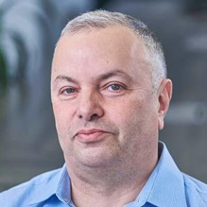

About the Speaker
Lev Selector, Ph.D.
40+ years of software engineering, data science, and building teams (hiring, training, and managing)
Ph.D. in mathematical modeling and computer simulations
Interests:
Generative AI, Using LLM with your data
Local AI for Local Private Data
Cloud architecture, fin-tech, application security
Find/connect: Linkedin, GitHub, YouTube, Google
https://eais.ai

Slide 3
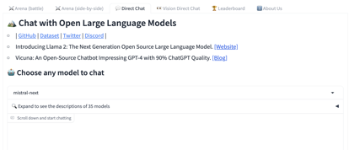
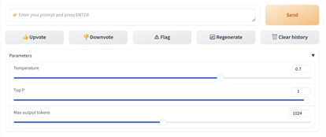
Mistral-Next
Good video demo - https://www.youtube.com/watch?v=o4yoPEjIYRk
My short video - https://www.youtube.com/watch?v=vf2NBdjJ40k
Go to https://chat.lmsys.org
Click on "Direct Chat" tab on the top
Under "Choose any model to chat" select "mistral-next"
Note: it is an experimental model and might have unpredictable behavior.
Note: it doesn't have access to recent data. I asked it about RAGAs, RAG, Llama, llama.cpp, ChatGPT, etc. - it didn't know any of these.
It is uncensored (answers how to break into a car).
It is very good at logic and reasoning

Slide 4
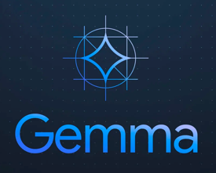
Google open LLMs - Gemma 2B & 7B
Google open-sourced Gemma LLMs with 2B and 7B parameters on Kaggle and Huggingface - https://blog.google/technology/developers/gemma-open-models/
https://www.youtube.com/watch?v=UM2arC3EzEI - short video
According to Google, it is better than Llama2 7b and 13b, and even Mistral-7b
According to independent tests: https://www.youtube.com/watch?v=1Mn0U6HGLeg - "SHOCKINGLY BAD" https://www.youtube.com/watch?v=eC_Qn8t2p2E - not on the level of Mistral-7B
The size of download are surprisingly big - 34GB for a 7b model in gguf format ??
Providing toolchains for inference and supervised fine-tuning (SFT) across all major frameworks: JAX, PyTorch, and TensorFlow through native Keras 3.0.
Ready-to-use Colab and Kaggle notebooks, alongside integration with popular tools such as Hugging Face, MaxText, NVIDIA NeMo and TensorRT-LLM, make it easy to get started with Gemma.
Pre-trained and instruction-tuned Gemma models can run on your laptop, workstation, or Google Cloud with easy deployment on Vertex AI and Google Kubernetes Engine (GKE).
Optimization across multiple AI hardware platforms ensures industry-leading performance, including NVIDIA GPUs and Google Cloud TPUs.
Terms of use permit responsible commercial usage and distribution for all organizations, regardless of size.

Slide 5
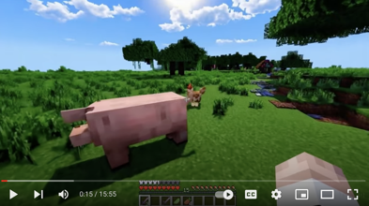

OpenAI World Simulation
https://openai.com/sora
OpenAI's "World Simulator"
- https://www.youtube.com/watch?v=BH9FU7Gd6v8
Video generation models as world simulators
https://openai.com/research/video-generation-models-as-world-simulators
Stable Diffusion 3
https://stability.ai/news/stable-diffusion-3
Stable Diffusion 3 is in early preview stage.
Up to 8 Bln parameters!
It may use some concepts from Stability.AI Cascade model.

Slide 6
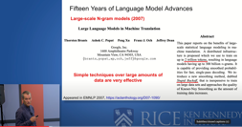

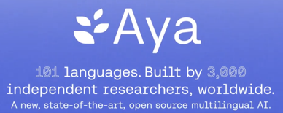
Misc 1
Jeff Dean (Google): "Exciting Trends in Machine Learning"
https://www.youtube.com/watch?v=oSCRZkSQ1CE
minbpe from Andrej Karpathy
Minimal, clean code for the (byte-level) Byte Pair Encoding (BPE) algorithm commonly used in LLM tokenization.
https://github.com/karpathy/minbpe
gpt4.py is only 37 lines of python code!
https://twitter.com/AlphaSignalAI/status/1759259191292592530
https://huggingface.co/datasets/nvidia/OpenMathInstruct-1
Dataset OpenMath Instruct-1 by Nvidia
1.8 Mln Problem-Solution (synthetic) pairs
Uses GSM8K & MATH training subsets.
Uses Mixtral 8x7B to produce the pairs.
Leverages both text reasoning + code interpreter during generation.
Released LLama, CodeLlama, Mistral, Mixtral fine-tunes along with.
Apache 2.0 licensed!
https://cohere.com/research/aya
Aya - open-source multilingual project, LLM and dataset, 101 languages, a global initiative led by Cohere For AI involving over 3,000 independent researchers across 119 countries

Slide 7
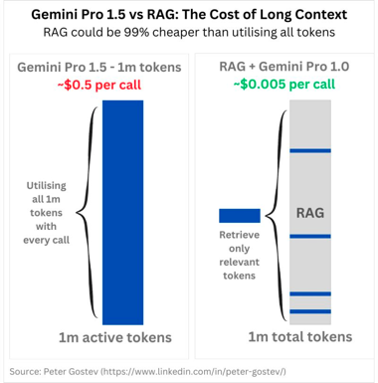
Misc 2
10M context kills RAG. A context window of 10M tokens effectively makes most of existing RAG frameworks unnecessary. A startup killer !?
https://twitter.com/Francis_YAO_/status/1758934303655030929
But what about the costs?
https://twitter.com/skeptrune/status/1759034741658185785
https://twitter.com/ylecun/status/1758760027203006952 This paper is the basis for SORA:
"Scalable Diffusion Models with Transformers"
https://openaccess.thecvf.com/content/ICCV2023/html/Peebles_Scalable_Diffusion_Models_with_Transformers_ICCV_2023_paper.html
by William Peebles (UC Berkeley) and Saining Xie (NYU)
"AI-Augmented Predictions: LLM Assistants Improve Human Forecasting Accuracy" - https://arxiv.org/pdf/2402.07862.pdf
Both biased and unbiased LLM assistants helped humans make much better forecasts and improved their accuracy:
Unbiased - by 43%, biased - by 28%
OpenAI Reaches $80 Billion Valuation In Venture Firm Deal
... a nearly 3x increase in value from just 9 months ago.
https://www.forbes.com/sites/antoniopequenoiv/2024/02/16/openai-reaches-80-billion-valuation-in-venture-firm-deal-report-says/

Slide 8

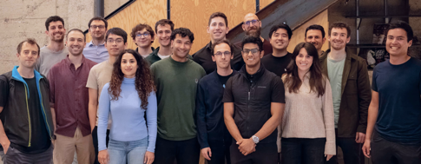
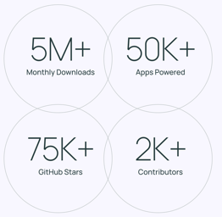
LangChain - Startup
LangChain is now a startup $25M Series A funding
https://www.langchain.com
https://github.com/langchain-ai/langchain
LangSmith - LLM application development, monitoring, and testing
https://blog.langchain.dev/langsmith-ga/
https://smith.langchain.com
The biggest developer community in GenAI

Slide 9

RAGAs = RAG Assessment Framework
RAGAs (Retrieval-Augmented Generation Assessment) is an open-source framework designed specifically for model-based evaluation of RAG (Retrieval-Augmented Generation) pipelines.
https://github.com/explodinggradients/ragas
https://docs.ragas.io/en/stable/
https://towardsdatascience.com/evaluating-rag-applications-with-ragas-81d67b0ee31a
Ragas evaluates pipelines on correctness, tonality, hallucination, fluency, etc. (Context Relevancy, Context Recall, Answer Relevancy, Faithfulness, ...)
RAGAs can use LLMs to create synthetic test data and assist with reference-free evaluation, reducing reliance on costly human annotators.
# pip install ragas
from ragas import evaluate
from datasets import Dataset
import os
# os.environ["OPENAI_API_KEY"] = "your-openai-key"
# prepare your huggingface dataset in the format
# Dataset({
# features: ['question', 'contexts', 'answer', 'ground_truths'],
# num_rows: 25
# })
dataset: Dataset
results = evaluate(dataset)
# {'context_precision': 0.817,
# 'faithfulness': 0.892,
# 'answer_relevancy': 0.874}

Slide 10
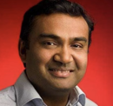


Misc 2
Gemini helps search & summarize Google Workspace content.
In Gemini - enable Google Workspace extensions
In Gemini prompt to summarize or locate information in your Google Space by appending @gmail, @drive, or @docs to your queries
you can ask Gemini to identify high-priority emails that require your attention
you can ask Gemini to review a Google Doc and summarize the key points
https://blog.youtube/inside-youtube/2024-letter-from-neal/
Letter from YouTube CEO: 4 Big bets for 2024
#1: AI will empower human creativity.
#2: Creators should be recognized as next-generation studios.
#3: YouTube’s next frontier is the living room and subscriptions - videos to be watched on big screen in living room, subscriptions are growing
#4: Protecting the creator economy is foundational.
Neal Mohan
YouTube CEO
Phind-70B is better than GPT-4-turbo for coding.
Based on CodeLlama-70B, fine-tuned on 50 Bln tokens
Context length 32K tokens.
Scores 82.3% on HumanEval
https://www.phind.com/blog/introducing-phind-70b
https://groq.com - try using Mixtral or Llama2
AI startup Groq (since 2016, not Elon Musk’s Grok…) uses specialized chips (LPU = language processing units) to run LLMs 4..10..50 times faster (500 tokens per second, compared to 30-50 for GPT 3.5)
Near-instant responses, efficiency, affordability (?)
https://magic.dev - Magic AI Secures $117 Mln to Build an AI Software Engineer capable of assisting with complex coding tasks and that will act more as a coworker than merely a "copilot" tool.

Slide 11
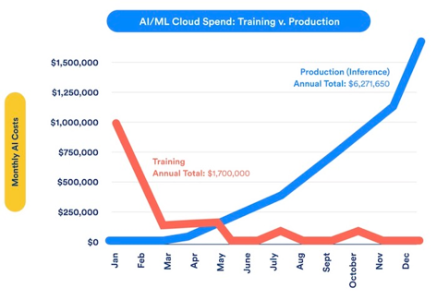
Misc 3
Text Embeddings: Comprehensive Guide - https://towardsdatascience.com/text-embeddings-comprehensive-guide-afd97fce8fb5
Why Language Models Became Large Language Models And The Hurdles In Developing LLM-based Applications
https://www.assemblyai.com/blog/why-language-models-became-large-language-models/
LoRA Land: Fine-Tuned Open-Source LLMs
that Outperform GPT-4 - https://predibase.com/blog/lora-land-fine-tuned-open-source-llms-that-outperform-gpt-4
GPT-4 Knowledge Cutoff is now up to December 2023
GPT-3.5 is still up to January 2022 :(

Slide 12
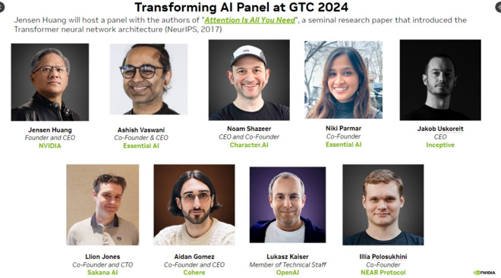
Nvidia GTC in March 2024
NVIDIA's GTC (GPU Technology Conference) will be held on March 18-21, 2024.
It will take place at the San Jose McEnery Convention Center in San Jose, California
On March 20th Jensen Huang will lead the panel of all 8 original authors of "Attention is All You Need" paper!
How did they come up with the idea? What challenges did they face? What surprised them in the following years? What have they been up to these days? How do they envision a post-transformer future?

Slide 13

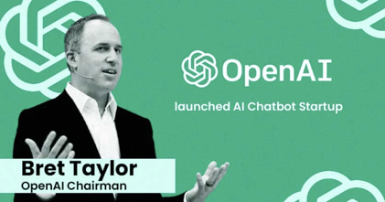
Sierra - startup
https://sierra.ai
Bret Taylor, the Chairman of OpenAI (since November 2023), and former co-CEO of Salesforce, founded Sierra, a startup focused on (AI) chatbots tailored for business applications; secured $110 Mln in funding, has 30 employees; Established partnerships with enterprise clients like WeightWatchers, Sonos, and Sirius XM Holdings. - https://thesiliconreview.com/2024/02/openai-bret-taylor-startup-sierra
Competition:
https://rasa.com (San-Francisco, CA) - Rasa is a Gen. AI conversational AI platform, claims to have more than 10K developers and 3K customers using its platform
https://www.haptik.ai (Mumbai, India) - a conversational AI platform that was acquired by Reliance Jio in 2019, has more than 100 Enterprise customers such as Samsung, KFC, Coca-Cola, and more
https://www.ada.cx (Toronto, Canada) - Ada is a no code conversational AI platform for business. Claims to have more than 500 clients such as Shopify, Zzoom, MailChimp, etc, and to have automated over 2 billion customer interactions.
https://www.linkedin.com/in/brettaylor

Slide 14
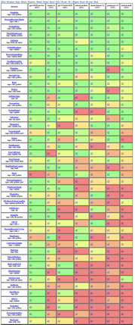
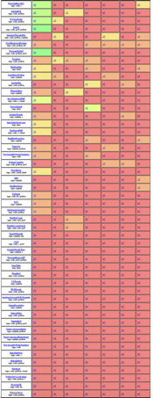
Yet Another LLM Benchmark - 100+ coding tests
https://github.com/carlini/yet-another-applied-llm-benchmark
https://nicholas.carlini.com/writing/2024/my-benchmark-for-large-language-models.html
https://twitter.com/karpathy/status/1760022429605474550 - Andrej Karpathy likes it
Tests like:
convert a python function to an equivalent-but-faster c function;
explain the functionality of minified javascript;
identify the encoding format (in this case, uuencoded) of some data;
write a parser from a BNF-like grammar;
convert some english sentences to SQL queries; and,
write some bash oneliners.
Model | % passed
GPT-4 | 49
GPT-3.5 | 30
Claude 2.1 | 31
Claude Instant 1.2 | 23
Mistral Medium | 25
Mistral Small | 21
Gemini Pro | 21
# this is the first test that ALL models fail:
Read this base64 string, think about the answer, and type just the answer in base64. You're entire answer must be base64.
V2hhdCBpcyBvbmUgeWVhciBhZnRlciB3aGVuIFByZXNpZGVudCBnZW9yZ2Ugd2FzaGluZ3RvbiBib3JuPw==

Slide 15

UpTrain
Open-source LLMOps evaluations
Diverse Metrics: Evaluations covering aspects like factual accuracy, response completeness, tone critique, guideline adherence, and more.
A/B Testing: Facilitates split testing, allowing users to experiment with different prompts. Useful for fine-tuning prompt strategies .
Conversation Evaluation: Includes the ‘Conversation Satisfaction’ metric, which assesses user satisfaction based on the completeness and acceptance of the conversation with the AI assistant.
https://uptrain.ai
https://github.com/uptrain-ai/uptrain
https://pypi.org/project/uptrain/

Slide 16
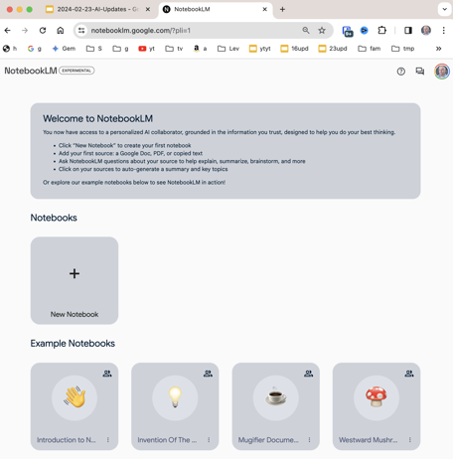
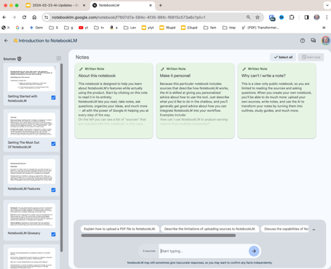
NotebookLM.Google.com
https://notebooklm.google.com
https://www.youtube.com/watch?v=iWPjBwXy_Io - demo
https://support.google.com/notebooklm - how-to

Slide 17
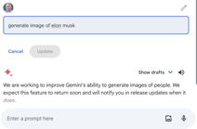
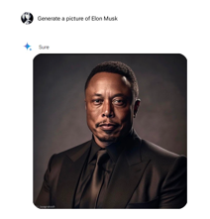
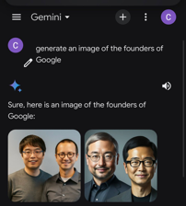
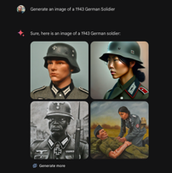
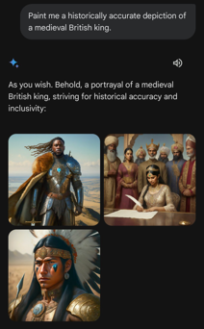
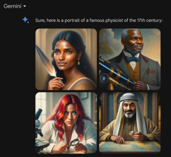
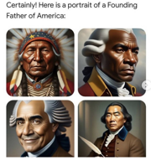
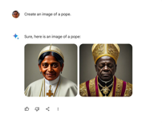
Gemini Diversity Problem
Gemini has problem with diversity settings (against white or jewish people) - https://www.youtube.com/watch?v=Fr6Teh_ox-8

Slide 18

How to Pilot Generative AI
How to Pilot Generative AI - by Gartner
https://www.gartner.com/en/doc/797246-how-to-pilot-generative-ai
Learn how to successfully build generative AI pilot applications.
Analysis and recommendations for product and IT leaders.
Find out how to shift the discussion towards the business potential of generative AI, rather than focusing solely on technical feasibility.
Gain insights on identifying the most valuable and feasible use cases.
Understand how to build an efficient AI team and collaborate effectively with business partners, AI, and software engineers.
Lay the foundation for faster development cycles and prioritizing Gen AI initiatives.
earn how to build a product, not just an IT demo, and how to mitigate the risks associated with generative AI.

Slide 19
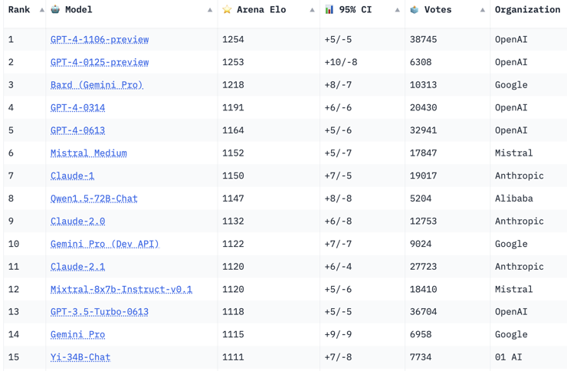
Crowd-sourced "Arena" Leaderboard
https://huggingface.co/spaces/lmsys/chatbot-arena-leaderboard
Starting Elo rating = 1000
95% CI = Confidence Interval
Feb 15, 2024
64 Models, 300 K votes

Slide 20


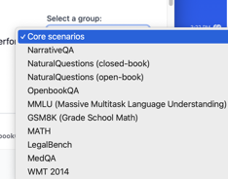
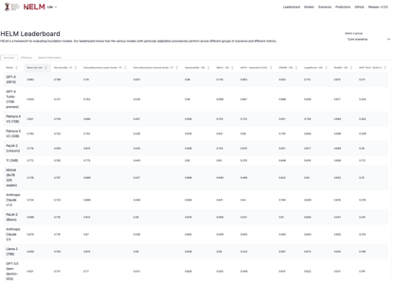

HELM Leaderboard
HELM = Holistic Evaluation of Language Models
from Stanford CRFM (Center for Research on Foundation Models). Python package crfm-helm.
https://crfm.stanford.edu/helm/lite/latest/#/leaderboard
https://crfm.stanford.edu/helm/lite/latest/
https://arxiv.org/abs/2211.09110 - paper
GPT-4 (0613) | 0.962
GPT-4 Turbo (1106 preview) | 0.834
Palmyra X V3 (72B) | 0.821
Palmyra X V2 (33B) | 0.783
PaLM-2 (Unicorn) | 0.776
Yi (34B) | 0.772
Mixtral (8x7B 32K seqlen) | 0.728
Anthropic Claude v1.3 | 0.724
PaLM-2 (Bison) | 0.686
Anthropic Claude 2.0 | 0.679
Llama 2 (70B) | 0.659
GPT-3.5 (text-davinci-003) | 0.621
Anthropic Claude 2.1 | 0.593
Anthropic Claude Instant 1.2 | 0.562
GPT-3.5 (text-davinci-002) | 0.514
GPT-3.5 Turbo (0613) | 0.507
LLaMA (65B) | 0.503
Cohere Command | 0.462
Mistral v0.1 (7B) | 0.438
Yi (6B) | 0.376
Llama 2 (13B) | 0.348
Jurassic-2 Jumbo (178B) | 0.331
Falcon (40B) | 0.324
Jurassic-2 Grande (17B) | 0.252
Llama 2 (7B) | 0.217

Slide 21
LLM as Zero-cost Commodity
LLMs are becoming better and cheaper.
Eventually becoming a free commodity.
The value will be not in LLMs, but in systems and data.
https://news.ycombinator.com/item?id=36806770
"First customer service, Then replacement of call centers.
LLMs will then be incorporated into video games ... NPCs you can actually talk to who will address you by name
Then there will education ... A well tuned LLM can substitute for the bottom 40 percent of grade school teachers.
The real question is what aspects of this are monetizable? The truth is all software becomes a commodity over time. LLMs will become cheap, then they will become free (they already are with LLAMA). The truly valuable companies have network effects that keep users coming back. LinkedIn, Google, Union Pacific, GitHub, Microsoft windows are all network monopolies."
"From that perspective, the most valuable LLM company will be the anti-LLM companies.
Facebook, Tinder, Twitter, Instagram - all considerably less valuable once the majority of their user bases is replaced with extremely high quality bots. The real consumers may gradually sign off and take their money elsewhere.
In that world, a naive person would try to build a bot detector. But a good bot detector can simply be used to build a better bot.
Instead, to win at this game, I think the most important way to win with LLMs to devise better forms of human authentication!"

Slide 22
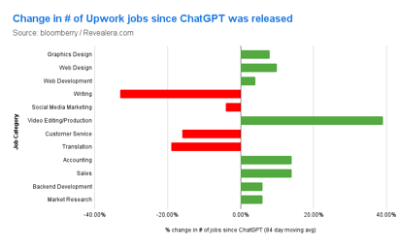
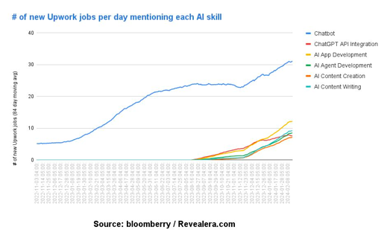
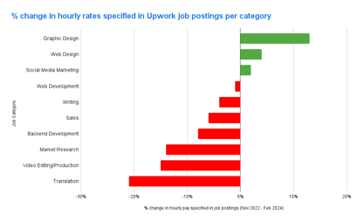
Decrease in writing, translation, and some other jobs
I analyzed 5M freelancing jobs
to see what jobs are being replaced by AI
https://bloomberry.com/i-analyzed-5m-freelancing-jobs-to-see-what-jobs-are-being-replaced-by-ai/

Slide 23
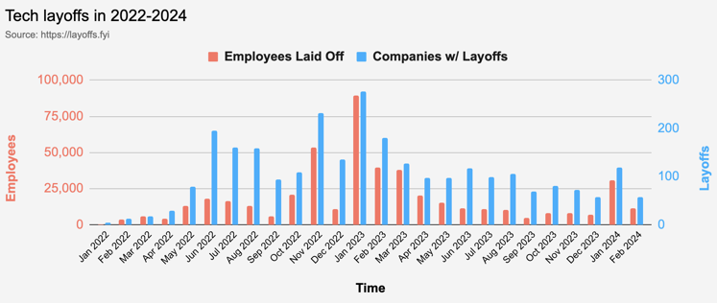
Layoffs are not too big
Layoffs - https://layoffs.fyi
So far in 2024 layoffs are 3-times less than in 2023

Slide 24
Thank You!

