Slide 1
Military AI Robots?
MilitAIry Applications,
Attack of the Killer Robots?

Slide 2
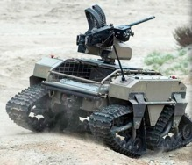
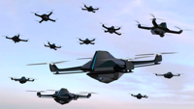
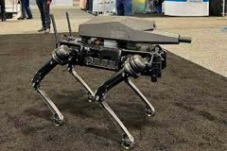

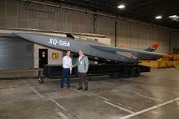
The US military uses artificial intelligence (AI) in a variety of ways, including:
Surveillance: Small drones are used in special operations missions.
Fitness tracking: AI can track soldiers' fitness.
Maintenance: AI can predict when Air Force planes need maintenance.
Space tracking: AI can help keep tabs on rivals in space.
Weapon delivery: The Valkyrie XQ-58A drone can deliver weapons or assist fighter jets.
Image recognition: AI image recognition systems can analyze drone footage and other intelligence streams to help identify military objects.
Lethal autonomous weapons systems: AI-enabled munitions are already being used on the battlefield, notably in the Russia-Ukraine War.
The US is also developing the Valkyrie AI drone.
The Army has also been testing quadrupedal "robot dogs" armed with six-and-a-half-millimetre rifles.

Slide 3
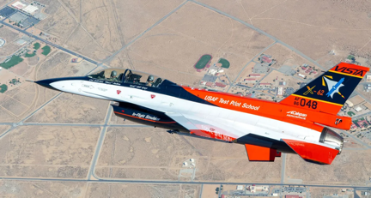
X-62A – An AI-flown F-16 Viper
Lockheed Martin is testing a mass-produced 4th-gen fighter plane (50 y/o design)
AI flies the plane very aggressively in BFM (Basic Fighting Maneuvers)
Possibly may mean fighter planes flown past the human G-strain limit (high performance fighter jets may exert more than 9 Gs (9x the force of gravity) on the human body, to the point that the human becomes the bottleneck for fighter jet performance.)
Though need for high maneuverability may be a thing of the past with more potent missiles, sensors, and stealth.
https://interestingengineering.com/innovation/ai-powered-f-16-jets

Slide 4
Autonomous Weapons Systems (the meaner AWS)
https://nationalinterest.org/blog/buzz/killer-robots-are-coming-battlefield-209406
Research into fully computerized warfighting agents.
Lots of concern at the UN with regard to fully autonomous agents killing human beings.
Quite possibly, the UN is an outdated forum for dictators and terrorists. Dismantle it.
From a certain point of view, fully autonomous weapons systems are humane and ethical as forms of deterrent, since enemy/terrorist propaganda often involves capturing/killing usually young soldiers. Who would want to start a war when the retaliation would be a tide of endlessly expendable metal?
Logical conclusion: AWS would allow high-economy nation-states (usually also ahead on human rights, other civilized developments) to win wars of attrition against low-economy states (many of whom harbor or sponsor terrorists) just by virtue of endlessly expendable automatons that have much lower political cost if/when lost compared to badly injured or killed humans. A reusable AWS that costs as much as a few missiles has next to zero political cost if lost to frontline attrition.

Slide 5
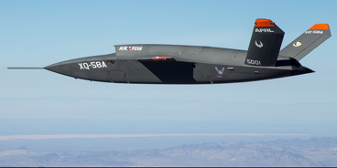
Loyal Wingman—AI-operated Unmanned Combat Aerial Vehicle (UCAV)
Unmanned combat aerial vehicles
Much cheaper than manned air combat assets such as 6th-gen fighter (NGAD) or B-21 Raider stealth bomber
Multiple drone wingman aircraft per humanly-controlled aircraft.
Can carry additional missiles, allowing a single manned stealth fighter to multiply their missile count several times over.
https://en.wikipedia.org/wiki/Loyal_wingman
Video game series from Namco Studios called "Ace Combat" features aircraft carrying many more missiles than one plane often can, sometimes accompanied by many drones. UCAVs bring that much closer to reality.

