Slide 1
AI Updates
March 01, 2024
Mistral Large
Robotics
NVIDIA Foundation Agent
Klarna AI assistant replaced 700 jobs
invideo.io - text-to-video
Andrej Karpathy - Tokenizers
Alibaba EMO - live portraits
Microsoft: models 1.58 bits (-1,0,1)
OpenAI sued and investigated again
Sensei - synthetic data creation
OpenCodeInterpreter
MS AI Copilot for Finance
Google DeepMind's Genie - games
Google Content Rewriting Tool
Glean - RAG work assistant
Gorilla: LLM + APIs, Leaderboard
qdrant - Vector DB for RAG
When AI Robots Will Do Everything
Post-Scarcity Economics
Exponential Growth - Ray Kurzweil
Multiple Ways to Create AI Chatbots (Flask, Streamlit, Chainlit, Ollama, ...)
Crowd-sourced "Arena" Leaderboard
Layoffs.fyi

Slide 2
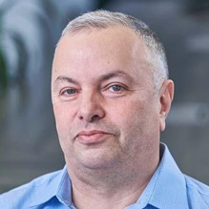

About the Speaker
Lev Selector, Ph.D.
40+ years of software engineering, data science, and building teams (hiring, training, and managing)
Ph.D. in mathematical modeling and computer simulations
Interests:
Generative AI, Using LLM with your data
Local AI for Local Private Data
Cloud architecture, fin-tech, application security
Find/connect: Linkedin, GitHub, YouTube, Google
https://eais.ai

Slide 3
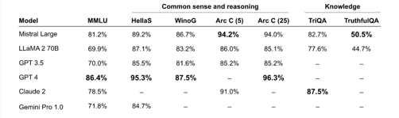
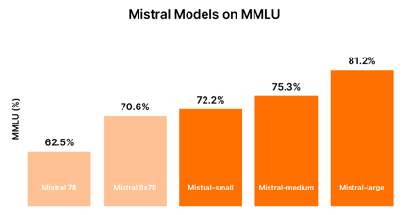
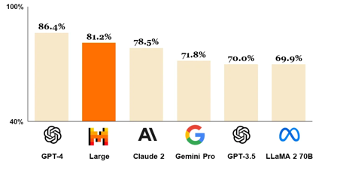
Mistral Large
Mistral Large model - https://mistral.ai/news/mistral-large/
Really close to GPT-4, good at reasoning, multilingual. good at following instructions
Mistral models also available from Microsoft
open-mistral-7B
open-mixtral-8x7b.
mistral-small-2402
mistral-medium
mistral-large-2402
MMLU

Slide 4
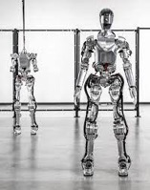
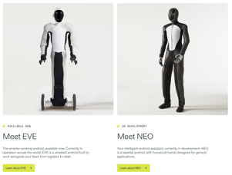
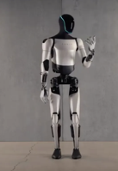
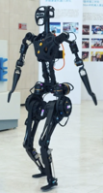
Robotics
Figure.ai just raised $675 Mln at a $2.6 Bln valuation:
https://www.figure.ai -
https://www.youtube.com/watch?v=sSKxxVtAANQ
1x: https://www.1x.tech
Tesla: https://www.tesla.com/AI
Fourier Intelligence: https://www.youtube.com/@FourierIntelligence-Robotics
figure.ai
1x
Eureka: Human-Level Reward Design via Coding LLMs (Nvidia, UPenn, Caltech, UT Austin)
https://eureka-research.github.io
https://arxiv.org/abs/2310.12931
https://eureka-research.github.io/assets/eureka_paper.pdf
https://github.com/eureka-research/Eureka
Tesla
Fourier Intelligence

Slide 5
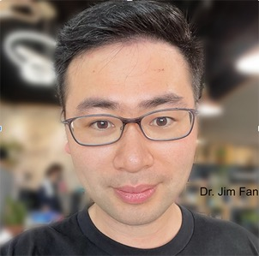
NVIDIA Foundation Agent
NVIDIA’s Foundation Agent
Dr. Jim Fan
ISAC Sim, a simulation platform that accelerates physical training a thousandfold
https://medium.com/@gerardo.pdm/beyond-imagination-nvidias-foundation-agent-transforming-ai-and-reality-38c827b83096
The Voyager project in Minecraft demonstrated the agent’s capacity for continuous learning and self-improvement. Engaging in a game with over 140 million active players,
text-to-action
Dr. Jim Fan
https://jimfan.me
https://www.linkedin.com/in/drjimfan/
https://twitter.com/DrJimFan

Slide 6

Misc - 1
Andrej Karpathy - Tokenizers
https://twitter.com/karpathy/status/1759996551378940395
https://www.youtube.com/watch?v=zduSFxRajkE
https://twitter.com/karpathy/status/1760350892317098371
Klarna AI assistant:
https://www.klarna.com/international/press/klarna-ai-assistant-handles-two-thirds-of-customer-service-chats-in-its-first-month/
Klarna is a Swedish financial services company.
The AI assistant using OpenAI has had 2.3 million conversations in 1 month, two-thirds of Klarna’s customer service chats
It is doing the equivalent work of 700 full-time agents
It is on par with human agents in regard to customer satisfaction score
It is more accurate in errand resolution, leading to a 25% drop in repeat inquiries
Customers now resolve their errands in less than 2 mins compared to 11 mins previously
It’s available in 23 markets, 24/7 and communicates in more than 35 languages
It’s estimated to drive a $40 million USD in profit improvement to Klarna in 2024
Alibaba EMO brings portraits to life: EMO: Emote Portrait Alive - Generating Expressive Portrait Videos with Audio2Video Diffusion Model
https://arxiv.org/pdf/2402.17485.pdf
https://www.youtube.com/watch?v=f_d-8BGIzPI - video
Meta Llama-3 release is planned for July
Microsoft: models 1.58 bits (-1,0,1)
High performance, low cost https://arxiv.org/abs/2402.17764
OpenAI is sued again - now by news outlets The Intercept, Raw Story, and AlterNet for scraping their news websites and using the content to train models.
The Securities and Exchange Commission (SEC) is conducting an investigation into OpenAI
https://invideo.io - Create videos with text prompts
Realistic, using your voice; ($0/month; $20/month)

Slide 7
Misc - 2
Sensei - a simple, powerful, minimal codebase to generate synthetic data using OpenAI or MistralAI
https://github.com/migtissera/Sensei
Google DeepMind's Genie is a foundation world model trained on Internet videos that can generate an endless variety of playable (action-controllable) worlds from synthetic images, photographs, and even sketches. https://sites.google.com/view/genie-2024/home
OpenCodeInterpreter - 33B - close to GPT-4
https://opencodeinterpreter.github.io
Google Testing AI Tool That Finds & Rewrites Quality Content
(plagiarism? diluting online content)
https://www.searchenginejournal.com/google-testing-ai-tool-that-finds-rewrites-quality-content/509912/
Microsoft introduces Copilot AI chatbot for finance workers in Excel and Outlook - variance analysis, reconcile data, speed up the collections process in Outlook, draw data from SAP and Microsoft Dynamics 365. Microsoft themselves already using it.
https://www.cnbc.com/2024/02/29/microsoft-introduces-copilot-ai-chatbot-for-finance-workers.html
Use Gemini mobile app to figure out home repairs
Make a picture from mobile Gemini app.
Describe the problem, ask how to fix it.
Gemini may figure out the brands, the model, find documentation and even video instructions.
Apple has shut down their cars program, and moved resources (~2,000 people) to generative AI division.
AI outperforms doctors in summarizing health records
https://www.news-medical.net/news/20240228/AI-outperforms-doctors-in-summarizing-health-records-study-shows.aspx
Glean - a startup raised $200 Mln at 2.2 Bln valuation - provides AI-powered work assistant (using RAG)
https://www.glean.com

Slide 8
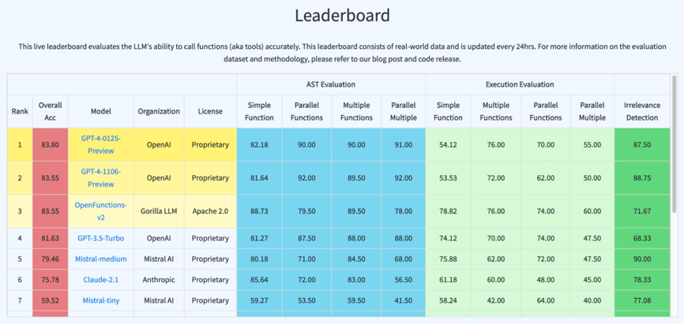
Gorilla: LLM + APIs
Berkeley Function-Calling Leaderboard (100 Java, 50 JavaScript, 70 REST API, 100 SQL and 1,680 Python on various simple, parallel, multiple, executable functions calling scenarios as well as function relevance detection)
https://gorilla.cs.berkeley.edu/blogs/8_berkeley_function_calling_leaderboard.html

Slide 9
qdrant - Vector DB for RAG
qdrant - vector database for RAG
https://qdrant.tech/
open source, github since May 2021
written in Rust - very fast, concurrency, memory safety
designed to do similarity search
high performance HNSW (Hierarchical Navigable Small World) indexing algorithm
Scalability!
Hybrid Filtering: combine vector similarity search with precise filtering rules (metadata constraints, ...)
Easy to use API
Active development community
There is no query language.
from qdrant_client import QdrantClient
from qdrant_client.http import models
client = QdrantClient(host="localhost", port=6333)
# Assuming recent dates are within 30 days
import datetime
now = datetime.datetime.now()
thirty_days_ago = now - datetime.timedelta(days=30)
# Replace with your encoding method here
search_vector = some_encoder.encode("wireless headphones")
client.search(
collection_name="products",
vector=search_vector,
filter=models.Filter(
must=[
models.FieldCondition(
key="category",
match=models.MatchValue(value="electronics")
),
models.FieldCondition(
key="creation_date",
range=models.Range(gte=thirty_days_ago.isoformat())
)
]
),
top=10, # Retrieve the top 10 most similar results
)

Slide 10


When AI Robots Will Do Everything
Moore's Law for Everything
by Sam Altman · March 16, 2021
https://moores.samaltman.com
https://www.youtube.com/watch?v=JEFEJsTxPCc
Sam Altman predicts technological advancement (AI, robotics) causing all costs decreasing exponentially over time (like Moore's Law in computing)
This will expand in all areas beyond just computing.
It will dramatically lower costs in key sectors like healthcare, education, energy, and more.
He believes this will lead to unprecedented abundance.
Key Points
Progress beyond computing: Similar exponential improvement curves are happening in areas like DNA sequencing, solar energy, battery storage, and AI development.
Massive cost reductions: These advancements will drastically reduce costs in essential sectors, making them accessible to far more people than ever before.
A shift in societal focus: As the cost of necessities decreases, society can refocus on goals beyond basic survival such as human connection and creativity.
Proposal: A Universal Basic Income (UBI) funded by the wealth generated by new technologies could offer stability and alleviate poverty in the face of potential job displacement.

Slide 11
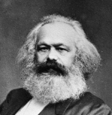
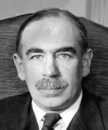
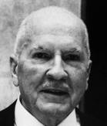

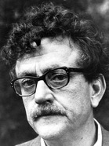


Post-Scarcity Economics
Karl Marx theorized about the potential of automation to displace labor, leading to economic upheaval.
John Maynard Keynes predicted "technological unemployment" due to machines replacing workers.
Robert Heinlein "Waldo & Magic, Inc." - remote manipulators ("waldoes")
Isaac Asimov: His stories often explore how robots and AI impact jobs and society.
Kurt Vonnegut (Player Piano): Novel about automation displacing skilled workers, leading to social unrest.
Star Trek: replicator technology can produce most goods on demand.
Iain M. Banks' Culture series: A galactic society where AI provides for all needs.

Slide 12
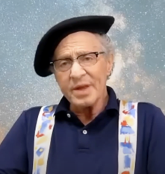
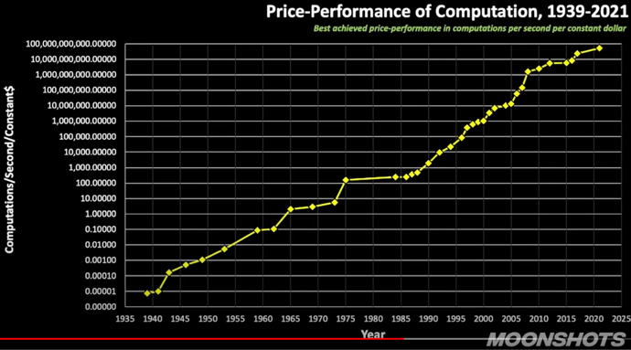
Exponential Growth
1939 - 0.00001 = 1e-5
2021 - 100 Bln = 1e11
82 years, 16 orders of 10, 53 orders of 2
82/16 = 5.125 years to x10 performance
82/53 = 1.55 years to x2 performance
Ray Kurzweil
https://www.youtube.com/watch?v=hLFzBZz5IkY

Slide 13

How To Make a Simple Flask AI Chatbot
python app.py
templates/index.html
# pip install flask, openai
import os
from flask import Flask, render_template, request
from openai import OpenAI
client = OpenAI(api_key=os.environ.get("OPENAI_API_KEY"))
app = Flask(__name__)
@app.route("/")
def index():
return render_template("index.html")
@app.route("/chat", methods=["POST"])
def chat():
user_input = request.form["user_input"]
response = client.chat.completions.create(
messages=[
{"role":"user","content":f"{user_input}",}
],
model="gpt-3.5-turbo",
)
ai_response = response.choices[0].message.content.strip()
return render_template("index.html",
user_input=user_input,
ai_response=ai_response)
if __name__ == "__main__":
app.run(debug=True) # http://127.0.0.1:5000
<!DOCTYPE html>
<html>
<head>
<title>Chatbot</title>
</head>
<body>
<h1>Chatbot</h1>
<form action="/chat" method="POST">
<input type="text" name="user_input"
placeholder="Enter your message">
<button type="submit">Send</button>
</form>
{% if user_input %}
<p>You: {{ user_input }}</p>
<p>Chatbot: {{ ai_response }}</p>
{% endif %}
</body>
</html>

Slide 14
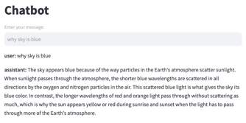
How To Make a Simple AI Chatbot Using Streamlit
streamlit run app.py
# pip install streamlit
import os
import streamlit as st
from openai import OpenAI
client = OpenAI( api_key=os.environ.get("OPENAI_API_KEY") )
st.session_state.messages = [] # chat history
# --------------------------------------------------------------
def generate_response(user_input):
response = client.chat.completions.create(
messages=[ { "role": "user", "content": f"{user_input}", } ],
model="gpt-3.5-turbo",
)
return response.choices[0].message.content.strip()
# --------------------------------------------------------------
def main():
st.title("Chatbot")
user_input = st.text_input("Enter your message:")
if user_input:
ai_response = generate_response(user_input)
dict_user = {"role": "user", "content": user_input}
st.session_state.messages.append(dict_user)
dict_assistant = {"role": "assistant", "content": ai_response}
st.session_state.messages.append(dict_assistant)
for message in st.session_state.messages:
with st.container():
st.markdown(f"**{message['role']}:** {message['content']}")
# --------------------------------------------------------------
if __name__ == "__main__":
main()

Slide 15
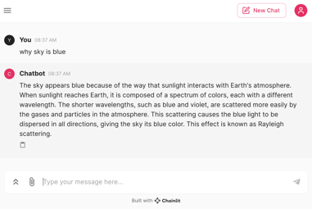
How To Make a Simple AI Chatbot Using Chainlit
chainlit run app.py
# pip install chainlit
import chainlit as cl
import os
from openai import OpenAI
client = OpenAI(api_key=os.getenv("OPENAI_API_KEY"))
openai_model = "gpt-3.5-turbo"
@cl.on_message
async def handle_message(message: cl.Message):
response = client.chat.completions.create(
messages = [{"role": "user", "content": message.content}],
model=openai_model,
max_tokens=1024, # Control response length
n=1,
stop=None,
temperature=0.7
)
await cl.Message(content=response.choices[0].message.content).send()

Slide 16
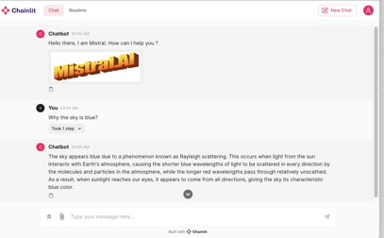
How To Make a Simple AI Chatbot Using Chainlit & Ollama
chainlit run app.py
from langchain_community.llms import Ollama
from langchain.prompts import ChatPromptTemplate
from langchain.schema import StrOutputParser
from langchain.schema.runnable import Runnable
from langchain.schema.runnable.config import RunnableConfig
import chainlit as cl
# ----------------------------------------------------------
@cl.on_chat_start
async def on_chat_start():
elements = [cl.Image(name="image1",
display="inline",
path="images/mistral_logo.jpg")]
ss = "Hello there, How can I help you ?"
await cl.Message(content=ss, elements=elements).send()
model = Ollama(model="mistral:latest")
prompt = ChatPromptTemplate.from_messages([
( "system",
"You're a very knowledgeable historian who provides accurate and eloquent answers to historical questions.",), ("human", "{question}"),])
runnable = prompt | model | StrOutputParser()
cl.user_session.set("runnable", runnable)
# ----------------------------------------------------------
@cl.on_message
async def on_message(message: cl.Message):
runnable = cl.user_session.get("runnable")
msg = cl.Message(content="")
async for chunk in runnable.astream(
{"question": message.content},
config=RunnableConfig(
callbacks=[cl.LangchainCallbackHandler()]
)):
await msg.stream_token(chunk)
await msg.send()

Slide 17
Multiple Ways to Create AI Chatbots
LMStudio - https://lmstudio.ai - app to run chat locally
Ollama - https://ollama.com - server, prompt, python API. Uses llama.cpp, automatically distributes between CPU & GPU
llama.cpp - https://github.com/ggerganov/llama.cpp - runtime to efficiently run LLMs (cmd, server). Has option "--n-gpu-layers" to specify hoW many layers on GPU. Uses GGUF or HF files.
Chainlit - build app in minutes (integrates with LangChain)
https://docs.chainlit.io/get-started/overview
https://github.com/Chainlit/chainlit
Open WebUI (Formerly Ollama WebUI) - supports Ollama and OpenAI-compatible APIs. Python and Javascript.
https://github.com/open-webui/open-webui
https://docs.openwebui.com
Text-Generation - open source, but problem installing (it installs its own miniconda). Python based. Uses transformers and datasets modules, as well as llama.cpp
https://github.com/oobabooga/text-generation-webui
https://github.com/oobabooga/text-generation-webui/wiki/12-%E2%80%90-OpenAI-API#examples
Ollama GUI - open-source pure Javascript chat app to use local LLMs via Ollama.
https://github.com/HelgeSverre/ollama-gui
GPT4All - ecosystem to train and deploy LLMs that run locally on consumer grade CPUs. Written in C++, has python and Javascript bindings.
https://gpt4all.io
https://github.com/nomic-ai/gpt4all
PrivateGPT - python-based, llama.cpp, gradio UI
https://github.com/imartinez/privateGPT
https://docs.privategpt.dev
https://www.gradio.app
MLC LLM - open-source apps (cpp, python, rust)
https://llm.mlc.ai
https://github.com/mlc-ai/mlc-llm
Streamlit GUI - primitive
https://github.com/alejandro-ao/chat-with-websites
https://github.com/shashankdeshpande/langchain-chatbot
LangChain
https://github.com/kyrolabs/awesome-langchain
https://github.com/homanp/superagent
https://www.analyticsvidhya.com/blog/2023/06/langflow-ui-for-langchain-to-develop-applications-with-llms/ - LangFlow
https://www.langflow.org ; https://github.com/logspace-ai/langflow
https://github.com/chatscope/chat-ui-kit-react
LlamaIndex
https://github.com/run-llama - LlamaIndex
https://github.com/run-llama/LlamaIndexTS - Javascript apps

Slide 18
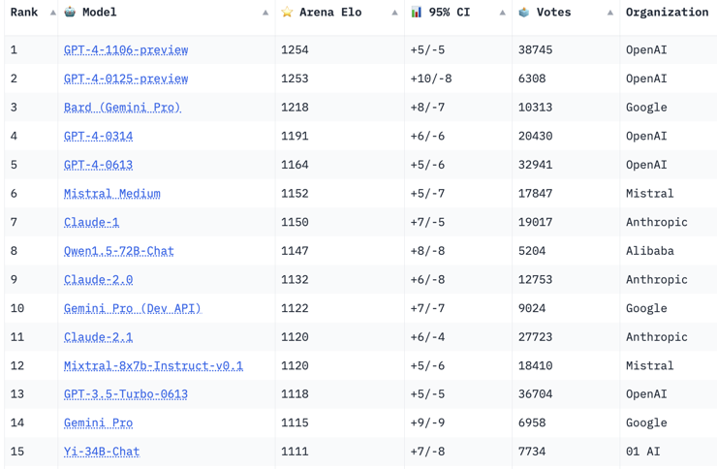
Crowd-sourced "Arena" Leaderboard
https://huggingface.co/spaces/lmsys/chatbot-arena-leaderboard
Starting Elo rating = 1000
95% CI = Confidence Interval
Feb 15, 2024
64 Models, 300 K votes

Slide 19
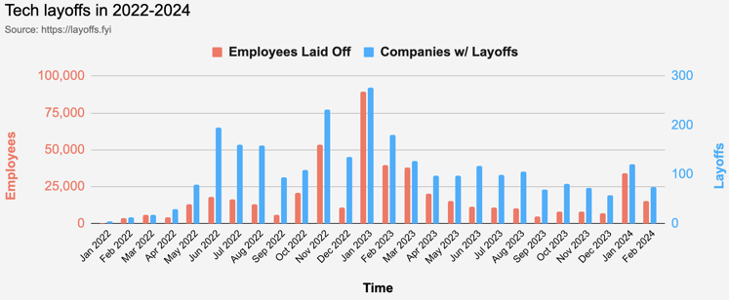
Layoffs are x3 times lower than in 2023
Layoffs - https://layoffs.fyi
So far in 2024 layoffs are 3-times less than in 2023

Slide 20
Thank You!

