Slide 1

AI Updates
March 29, 2024
Today we celebrate and enjoy
the lemon variety of the chiffon cake
Groq - fast inference hardware & API
AI Consumption Growth, Consulting $
Emad Mostaque Has Left Stability.AI
Mistral 7b v0.2
Agentic Workflows - Andrew Ng
Databricks DBRX
Jamba from AI21 Labs
Simba from Microsoft
Context Length / Output Length
Open Interpreter 01 Light
OpenAI Sora and Hollywood
Elon Musk - AGI in 1-2-3 years
h2o-wizardlm - turn docs into Q:A pairs
Microchips are the new oil
How Google let OpenAI take the lead?
Simple RAG on AWS
Multi-Agent RAG Systems
RAG - Evaluate and Improve
RAG - Advanced
RAG - activeloop.ai, Deep Lake
GraphRAG
Quantize to 1-2 bit
Crowd-sourced "Arena" Leaderboard
Tech Layoffs is lower this year

Slide 2
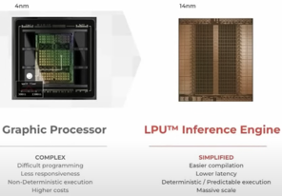
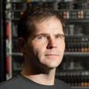
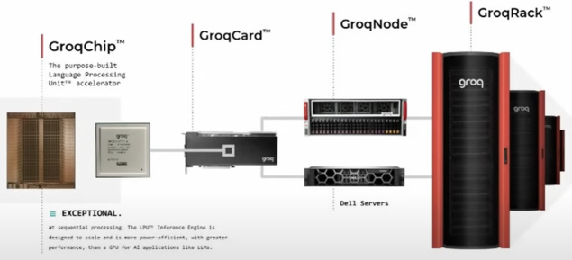
Groq - fast inference hardware and platform
GROQ - Super fast LPU Inference Engine
LPU = Language Processing Unit
Up to 500 tokens/sec, x100 - x600 faster than GPUs
https://www.youtube.com/watch?v=gmzd8dhlc0g
https://www.youtube.com/watch?v=fv69M1M_fXw
https://www.youtube.com/watch?v=WQDMKTEgQnY
https://groq.com
https://console.groq.com/docs/quickstart
Groq's LPU card cost $20K,
which is much cheaper than $35K for Nvidia's H100
Jonathan Ross* is Groq’s founder and CEO. He has began Google’s TPU effort as a 20% project,
and became a member of Google X’s Rapid Eval Team (Moonshots factory).

Slide 3

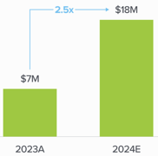
AI Consumption Growth
Accenture is pushing AI. At their current billing rate, they are at $2.4 Billion annualized revenues from Gen AI. Yes, it is only ~3% of their overall bookings, but it grows 33% Quarter over Quarter. Which means more than doubling in a year. And they are planning to double the number of data scientists and AI consultants (from 40K to 80K) in next 2 years.
https://analyticsindiamag.com/accentures-generative-ai-revenue-surpasses-all-vc-backed-startups-combined/
https://www.ciodive.com/news/accenture-ai-investments-billions-data-modernization/711132/
https://en.wikipedia.org/wiki/Accenture
Accenture plc is a US multinational professional services company based in Dublin, specializing in IT services and consulting. A Fortune Global 500 company, it reported revenues of $64.1 billion in 2023. 733,000 employees.
Accenture partnered with AWS and Anthropic to build industry-specific AI solutions and ease enterprise adoption
Average enterprise more than doubles budgets for AI in 2024 - https://a16z.com/generative-ai-enterprise-2024/
In one case an enterprise increased budget x8 after seeing ~90% cost savings.
While 80-90% utilized closed source models in 2023, nowadays 46% of leaders prefer open source.
Internal uses (coding assistants, text summarization) are moving faster than external apps (chatbots).

Slide 4
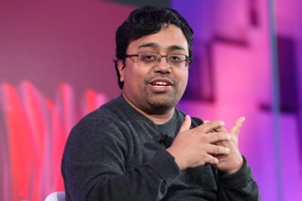
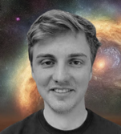

Emad Mostaque Has Left Stability.AI
Emad Mostaque, the founder and SEO of Stabiltiy.AI has left the company "to pursue decentralized AI".
https://www.theverge.com/2024/3/23/24109511/stability-ai-ceo-emad-mostaque-resignation-decentralized-ai
https://twitter.com/EMostaque/status/1771400218170519741
This departure is following reports of million-dollar burn rates and high-profile research team exits (3 out of 5 of the researchers behind Stable Diffusion reportedly followed suit, including leader Robin Rombach).
This move raises questions about the future of Stable Diffusion. With Mostaque leaving and key developers gone, is the highly anticipated Stable Diffusion 3 release in jeopardy?
... push toward developing commercialized AI products is likely a big part of why Mostaque has stepped down.
"Not going to beat centralized AI with more centralized AI," said Mostaque in a post on X, following his resignation. "It is now time to ensure AI remains open and decentralized," says Mostaque in a separate statement.
Emad Mostaque
Robin Rombach
Andreas Blattmann
Dominik Lorenz

Slide 5
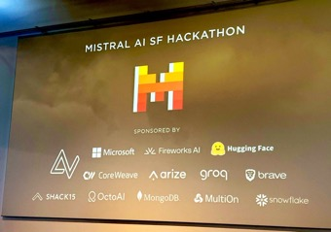
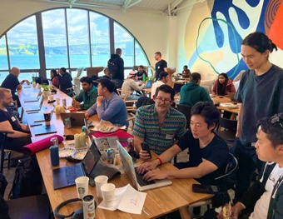

Mistral 7b v0.2
Mistral-7B-v0.2 has the following changes compared to Mistral-7B-v0.1
32k context window (vs 8k context in v0.1)
Rope-theta = 1e6
No Sliding-Window Attention
https://twitter.com/dchaplot/status/1771672289953866212
https://twitter.com/osanseviero/status/1771654833830821949
https://huggingface.co/mistralai/Mistral-7B-Instruct-v0.2
https://twitter.com/ofermend/status/1772070911937560748
https://ollama.com/library/mistral - updated to v0.2
https://arxiv.org/abs/2310.06825 (Oct 2023)
https://docs.mistral.ai/models/
https://github.com/mistralai-sf24/hackathon/tree/main
https://www.youtube.com/watch?v=62gpF6Uq6Rc

Slide 6

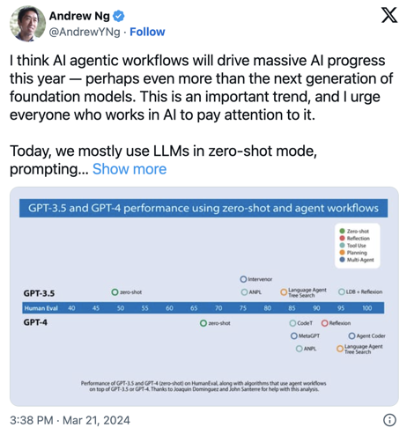
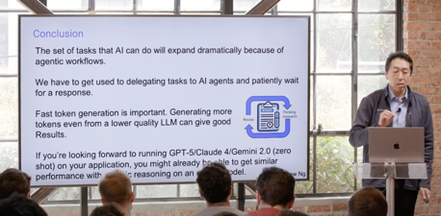
Agentic Workflows - Andrew Ng
Reflection, self-reflection, self-improvement
Tool Use (RAG or websearch, calculator, code execution, ...)
Planning - devise and implement multi-step strategy (chain-of-thought, tree-of-thought, ...)
Multi-Agent Collaboration, distribute tasks, exchanging ideas to forge superior solutions.
https://www.deeplearning.ai/the-batch/issue-241/
https://www.youtube.com/watch?v=sal78ACtGTc

Slide 7

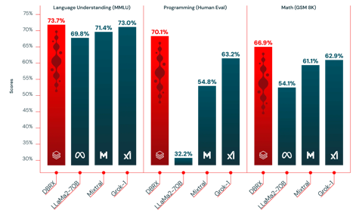
Databricks DBRX
DBRX - new open-source LLM from Databricks' Mosaic team.
Better than Llama-2, Grok, and Mixtral
Open-source, 32K context length
LLM, transformer-based, decoder-only, 132B params
Mixture-of-Experts (MoE) - 16 experts, chooses 4 (32B).
Rotary Position Encodings (RoPE)
Gated Linear Units (GLU)
Grouped Query Attention (GQA)
GPT-4 tokenizer
x2 faster than comparable models
needs 4 80GB GPUs to run inference with 16-bit precision
https://www.databricks.com/blog/announcing-dbrx-new-standard-efficient-open-source-customizable-llms
https://github.com/databricks/dbrx
https://huggingface.co/collections/databricks/dbrx-6601c0852a0cdd3c59f71962
https://www.databricks.com/blog/introducing-dbrx-new-state-art-open-llm

Slide 8


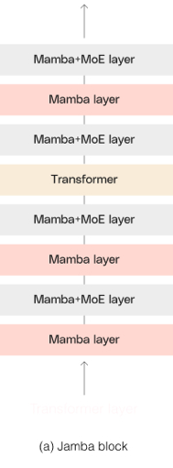
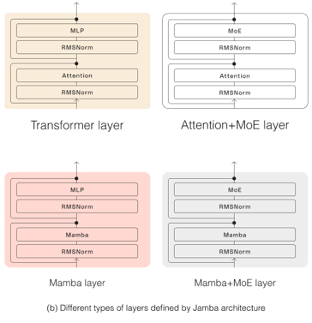
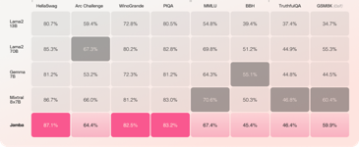
Jamba
AI21 Labs just announced Jamba - an open-source and improved Mamba!
Hybrid SSM / Transformer model (SSM = State Space Model)
MoE with 52B parameters (active 12B).
SSM reduces quadratic complexity
256K context length - while x3 faster than Mixtral 8x7B on long contexts
Fits up to 140K context on a single GPU
Competitive performance to Mixtral!
Open weights: Apache 2.0.
https://twitter.com/Yampeleg/status/1773364830423937090
https://www.ai21.com/blog/announcing-jamba https://arxiv.org/pdf/2312.00752.pdf - Mamba, 2023
AI21 Labs founded in 2017 in Israel
Yoav Shoham (Stanford)
Ori Goshen (CrowdX)
Amnon Shashua (Mobileye)

Slide 9
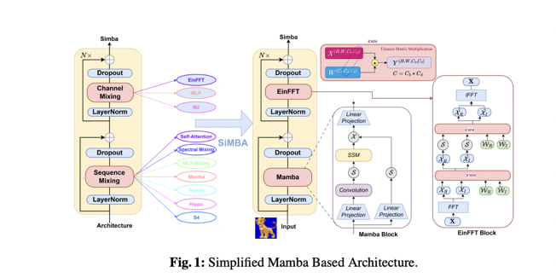
Simba
SiMBA: Simplified Mamba-Based Architecture ... (Microsoft)
https://arxiv.org/abs/2403.15360
https://github.com/badripatro/Simba
https://www.marktechpost.com/2024/03/27/this-ai-paper-from-microsoft-present-simba-a-simplified-mamba-based-architecture-for-vision-and-multivariate-time-series/

Slide 10

Misc 1
OpenAI is pitching Sora to Hollywood
https://www.theverge.com/2024/3/22/24108858/openai-is-pitching-sora-to-hollywood
Context Length / Output Length
gpt-3.5-turbo-0125 - 16K / 4K tokens in/out, data as of Sept 2021
gpt-4-0125-preview - 128K / 4K tokens in/out, data as of Dec 2023
Claude-3 - 200K / 4K tokens in/out, data as of Aug 2023
Gemini Pro 1.5 - 1Mln / 8K tokens in/out, data as of ... 2023 ?
Mistral-7B v0.2 - 32K / ?? tokens in/out, data as of ... .... ?
10% of US workers are in jobs most exposed to artificial intelligence, White House says
https://www.cnn.com/2024/03/21/business/ai-jobs-white-house-work-force/
Elon Musk - AGI may be achieved in 1-2-3 years, definitely in less than 5 years.
Amazon Invests Another $2.75 Bln In Anthropic, thus finalizing its $4 Bln investment in Anthropic.
Amazon is planning to invest $150 Bln over the next 15 years on digital infrastructure.
Stable Code Instruct 3B from Stability.ai
Grok-1.5 - will be available for early testers soon. This new version is has 128K context length and better reasoning and math. It is matching accuracy of Claude3 Sonnet and Gemini Pro 1.5. They didn’t say if it will be open-sourced.
https://x.ai/blog/grok-1.5
The Open Interpreter 01 Light is an open-source hardware device: talk to it to control computer!
This device is part of a broader open-source project aimed at creating a more accessible and flexible computing experience.
https://github.com/OpenInterpreter/01
https://www.geeky-gadgets.com/pocket-ai-agent/
h2o-wizardlm - turn documents into Q:A pairs https://github.com/h2oai/h2o-wizardlm
NaLLM - Neo4j graph DB and LLMs https://github.com/neo4j/NaLLM

Slide 11

Chip War
Microchips are the new oil
Today, military, economic, and geopolitical power are built on a foundation of computer chips.
Virtually everything— from missiles to microwaves, smartphones to the stock market — runs on chips.
Until recently, America designed and built the fastest chips and maintained its lead as the #1 superpower.
Now, America's edge is slipping, undermined by competitors in Taiwan, Korea, Europe, and, above all, China. Today, as Chip War reveals, China, which spends more money each year importing chips than it spends importing oil, is pouring billions into a chip-building initiative to catch up to the US.
At stake is America's military superiority and economic prosperity.

Slide 12
How Google let OpenAI take the lead?
Google had a huge lead. Google created Google Translate, Attention mechanism, Transformer architecture (2017). Google understood the value of language models.
Google created multiple models, some of them better than ChatGPT. But Google was hesitant about releasing them because chatbots were wrong often (hallucination) - and Google had a reputation and goal to always provide correct answers.
But releasing ChatGPT and other models made it clear that even with all shortcomings they are still useful and popular, and this has pushed Google to release their model eventually.
https://www.linkedin.com/pulse/why-google-missed-chatgpt-alex-kantrowitz/

Slide 13
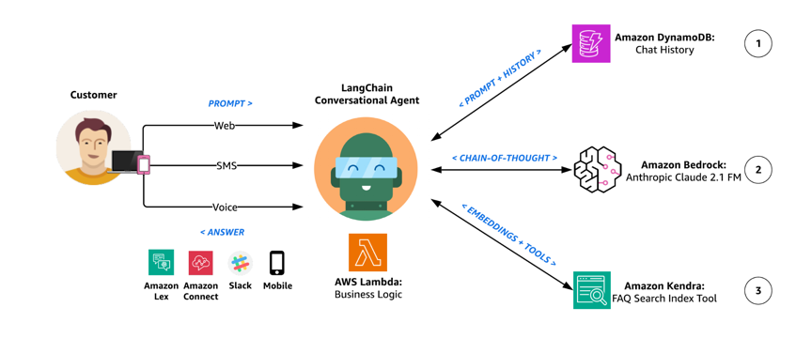
Simple RAG on AWS
Build generative AI agents with Amazon Bedrock, Amazon DynamoDB, Amazon Kendra, Amazon Lex, and LangChain
https://github.com/aws-samples/generative-ai-amazon-bedrock-langchain-agent-example
https://python.langchain.com/docs/templates/rag-aws-kendra

Slide 14
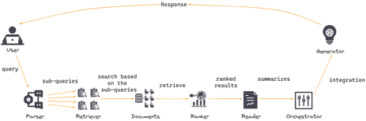
Multi-Agent RAG Systems
Use Microsoft AutoGen framework https://superlinked.com/vectorhub/enhancing-rag-with-a-multi-agent-system https://www.youtube.com/watch?v=b3ofDE-XSP0 https://pub.aimind.so/a-quick-tutorial-on-multi-agent-workflows-with-autogen-354a394d3df1
Improving RAG using LangGraph and LangChain https://medium.com/data-science-in-your-pocket/improving-rag-using-langgraph-and-langchain-bb195bfe4b44 https://www.youtube.com/watch?v=TlZ5BFx_m3M
Using LangChain ReAct Agents for Answering Multi-hop Questions in RAG Systems https://towardsdatascience.com/using-langchain-react-agents-for-answering-multi-hop-questions-in-rag-systems-893208c1847e
ARAG = Augentic RAG https://www.linkedin.com/pulse/deep-dive-agentic-retrieval-augmented-generation-a-rag-sai-panyam-22dlc/
LLamaIndex Agentic RAG Demo https://cobusgreyling.medium.com/llamaindex-agentic-rag-demo-56e3f3cd973a
Adding Agentic Layers to RAG https://www.youtube.com/watch?v=aQ4yQXeB1Ss
Multi-Agent RAG using AWS & Kendra
Multi-Agent RAG using CrewAI
RAG on Azure
Multi-Agent RAG on Azure
Enhancing RAG with a Multi-Agent System
using LangChain, Microsoft AutoGen, LLamaIndex, ...
Multiple agents: query understanding, retriever, ranker, reader, and orchestrator agents.
Multi-agent RAG can mitigate single-agent RAG's relevance, scalability, and latency limitations.

Slide 15
RAG - Evaluate and Improve
Naive RAG, how to evaluate RAG Applications
.. https://www.youtube.com/watch?v=CgQdg0SRuC0
Bad retrieval:
low precision, not relevant data, hallucination, lost in the middle
low recall, not all relevant data retrieved, so not enough data to synthesize and answer
redundant or outdated data
Bad Response Generation:
Hallucination, Irrelevance, Toxicity/Bias
How to improve?
Store additional information, multi-model data store like Activeloop's Deep Lake
Embeddings - make them better
Retrieval - make better using Activeloop's Deep Memory
Synthesis - use LLMs for more than generation
Evaluate RAG:
e2e (End-to-end) or evaluate separately retrieval and synthesis.
retrieval - precision & recall
synthesis - labeled (accuracy), non-labeled ( faithfulness, relevancy, adheres to guidelines, toxicity-free)

Slide 16
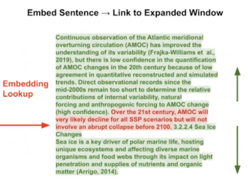
RAG - Advanced
https://www.youtube.com/watch?v=TdjvzSpjBuI
Better Parsers, Chunk Sizes, Hybrid Search, Metadata Filters
Deep Memory, Reranking
Recursive Retrieval, Embedded Tables, Small-to-Big Retrieval
Agents, Multi-agents, routing, query planning, multi-document agents
Embedding Fine-tuning & LLM Fine-tuning
Pain Point | Solutions
Retrieval is bad | Deep Memory Adjusting chunk sizes / parsers Reranking Small-to-big retrieval Fine-tuning Embeddings
Handling structured/unstructured data | Metadata Filters Augmenting SQL with semantic search
Parsing embedded tables in PDFs | Recursive Retrieval
Handling Complex Questions | Routing Query Planning Multi-Document Agents
Deep Memory - a set of tools offered by Activeloop.ai
https://docs.activeloop.ai/example-code/tutorials/vector-store/improving-search-accuracy-using-deep-memory
Deep Memory a tiny neural network, it analyzes your data and computes a tailored transformation for your embeddings, placing embeddings in an optimized space, significantly improving the accuracy of vector search (up to 22% increase in accuracy).
Small-to-big retrieval - embed sentence, return with text before and after (implemented in LlamaIndex)

Slide 17
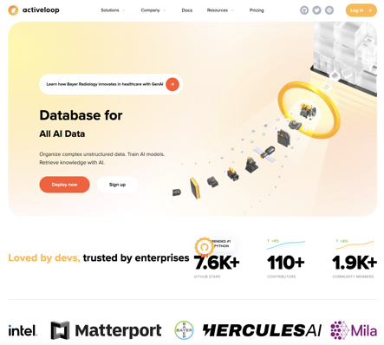

RAG - activeloop.ai, Deep Lake
activeloop.ai is a startup in Mountain View, CA
just received $11 Mln funding.
Main product - a "Deep Lake" database specifically designed for AI data (text, embeddings, images, ...)
Deep Lake can be used locally, in memory, on your cloud, or managed.
pip3 install deeplake
https://www.activeloop.ai
https://www.activeloop.ai/about/
https://github.com/activeloopai/deeplake/
https://docs.activeloop.ai
https://docs.activeloop.ai/quickstart
Davit Buniatyan
CEO, co-founder

Slide 18

GraphRAG, Other Graph RAG Systems
Microsoft GraphRAG - uses LLM to create knowledge graph as a GNN (Graph Neural Network). GNN is used to both embedding the knowledge into the graph (as numeric embedding vectors) and to identify key information (ranked retrieval).
https://www.microsoft.com/en-us/research/blog/graphrag-unlocking-llm-discovery-on-narrative-private-data/
Neo4j - graph database - https://neo4j.com .. https://www.youtube.com/watch?v=ftlZ0oeXYRE - Neo4j RAG .. https://www.youtube.com/watch?v=jMKRUo4wVKA - Neo4j RAG - Andrew Ng course .. https://www.youtube.com/watch?v=DuUtzRYbpNM - Neo4j in 10 min .. https://medium.com/singapore-gds/from-conventional-rag-to-graph-rag-a0202a1aaca7 - DIY example
Amazon Neptune - fully managed graph database - https://aws.amazon.com/neptune/
Stardog - enterprise knowledge graph platform - https://www.stardog.com
Ontotext GraphDB - an RDF database, great for semantic search. RDF = Resource Description Framework, stores information as graph of tripples (subject, predicate (property or relationship), object) https://www.ontotext.com/products/graphdb/
NebulaGraph - Graph RAG https://www.nebula-graph.io/posts/graph-RAG
Graph Engine Service (GES) on Huawei Cloud - distributed high scale graph DB - https://www.huaweicloud.com/intl/en-us/product/ges.html

Slide 19
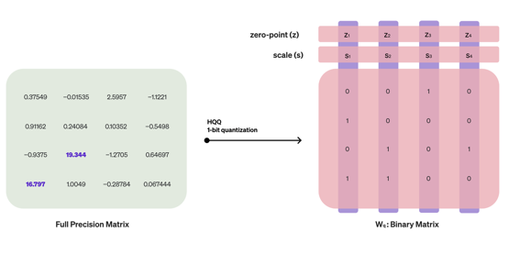
Quantize to 1-2 bit
Quantize the Linear layers of a language model without sacrificing performance. This can result in a 70B model running on consumer GPUs.
Towards 1-bit Machine Learning Models
https://mobiusml.github.io/1bit_blog/
https://huggingface.co/mobiuslabsgmbh/Llama-2-7b-chat-hf_1bitgs8_hqq
https://huggingface.co/mobiuslabsgmbh/Llama-2-7b-chat-hf_2bitgs8_hqq

Slide 20
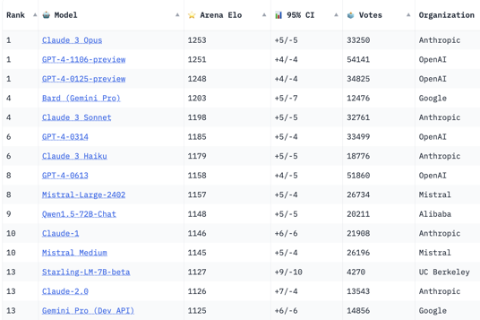
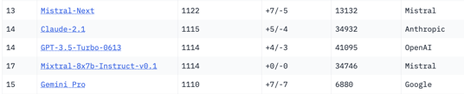
Crowd-sourced "Arena" Leaderboard
https://huggingface.co/spaces/lmsys/chatbot-arena-leaderboard
Starting Elo rating = 1000
95% CI = Confidence Interval
models: 75
votes: 477,471
March 26, 2024
open source
open source
open source

Slide 21
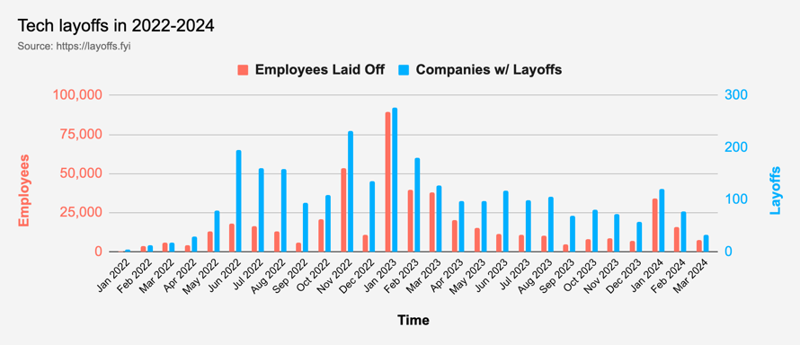
Tech Layoffs are x3 times lower than in 2023
Layoffs - https://layoffs.fyi
Salaries for AI engineers rose 12% from the third to fourth quarter last year
The average salary for a senior AI engineer nationally is more than $190,000, according to Comprehensive.io.
AI has a talent shortage, meaning $1 Mln salary job offers! Even during tech layoffs https://qz.com/tech-layoffs-high-ai-struggling-find-talent-1851368861

Slide 22
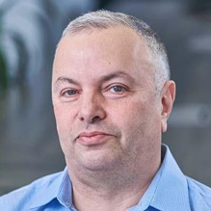

About the Speaker
Lev Selector, Ph.D.
40+ years of software engineering, data science, and building teams (hiring, training, and managing)
Ph.D. in mathematical modeling and computer simulations
Interests:
Generative AI, Using LLM with your data
Local AI for Local Private Data
Cloud architecture, fin-tech, application security
Find/connect: Linkedin, GitHub, YouTube, Google
https://eais.ai
Enterprise AI Systems

Slide 23
Thank You!

