Slide 1
AI Updates
April 19, 2024
Llama-3 8B & 70B from Meta
Grok 1.5 Vision
Most Frequent AI Use Cases
Atlas Robot
Create talking avatar in a minute
LLM Response Time comparison
Andrej Karpathy - llm.c with CUDA
135 re-ranking models on Huggingface
GPT-4-Turbo has reclaimed the No. 1 spot
Gemini 1.5 Pro - audio, JSON mode
NSA Guide for AI System Security
Mistral AI valuation of $5 Billion
Microsoft VASA-1
U.S. Air Force AI controlled Jets
AI Models Improve Faster
The Rise Of The Chief AI Officer (CAIO)
NVIDIA speech and translation AI
ISO 42001 - IT AI Management system
Google’s new Infini-attention
AI in Marketing
Modern Fast Storage
Conventional media companies are losing visitors
Crowd-sourced "Arena" Leaderboard
Tech Layoffs are lower than in 2023
Position Yourself as an AI Expert

Slide 2


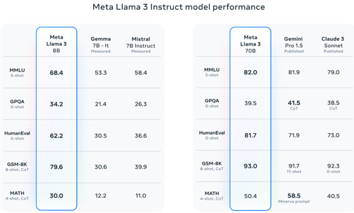

Llama-3 from Meta
"Our model and weights are licensed for both researchers and commercial entities, upholding the principles of openness. "
Released 8B and 70B with 8K context length
Trained with 15 trillion tokens on a custom-built 24K GPU cluster.
Next releases coming soon:
400B (free on WhatsApp and other FB products)
longer context
multimodality
Llama 8B is better than Mistral 7B
Llama 70B is on par with Gemini Pro 1.5
Llama Days:
July 18, 2023 - Llama 2
April 18, 2024 - Llama 3
(also Andrew Ng was born on April 18, 1976 in London, UK)
https://ai.meta.com/blog/meta-llama-3/
https://meta.ai
https://github.com/meta-llama/llama3
https://llama.meta.com/llama-downloads/
https://llama.meta.com/trust-and-safety/
https://huggingface.co/meta-llama
https://ollama.com/library/llama3 -
Meta adds its Llama3 AI chatbot to the search bar across its apps.
import transformers
import torch
model_id = "meta-llama/Meta-Llama-3-8B-Instruct"
pipeline = transformers.pipeline(
"text-generation",
model="meta-llama/Meta-Llama-3-8B-Instruct",
model_kwargs={"torch_dtype": torch.bfloat16},
device="cuda",
)

Slide 3
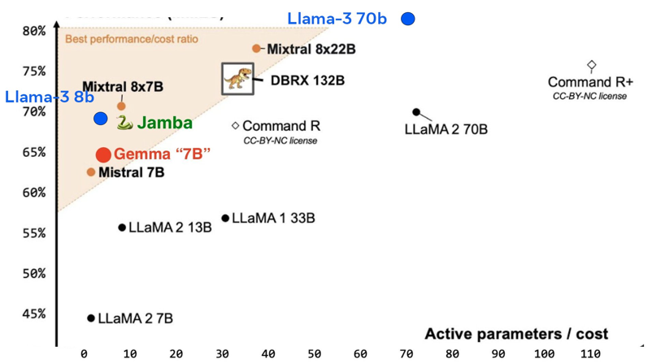
Llama-3 from Meta
DBRX, Mixtral 8x22B, Llama-3 all released within weeks.
The open-source AI scene shows no sign of slowing down. https://twitter.com/hardmaru/status/1781161411974217803
https://twitter.com/garridoq_/status/1780992965214609683
MMLU

Slide 4

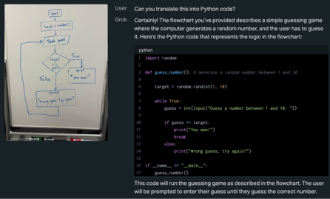


Grok 1.5 Vision
https://x.ai/blog/grok-1.5v - announcement
https://www.youtube.com/watch?v=s7kfifYX43w - video
Grok-1.5V - can now process visual information, including documents, diagrams, charts, screenshots, and photographs.
Grok-1.5V is very good at understanding our physical world.
Benchmark | Grok-1.5V | GPT-4V | Claude 3 Sonnet | Claude 3 Opus | Gemini Pro 1.5
Multi-discipline | 53.60% | 56.80% | 53.10% | 59.40% | 58.50%
Mathvista | 52.80% | 49.90% | 47.90% | 50.50% | 52.10%
AI2D | 88.30% | 78.20% | 88.70% | 88.10% | 80.30%
TextVQA | 78.10% | 78.00% | - | - | 73.50%
ChartQA | 76.10% | 78.50% | 81.10% | 80.80% | 81.30%
DocVQA | 85.60% | 88.40% | 89.50% | 89.30% | 86.50%
RealWorldQA | 68.70% | 61.40% | 51.90% | 49.80% | 67.50%

Slide 5
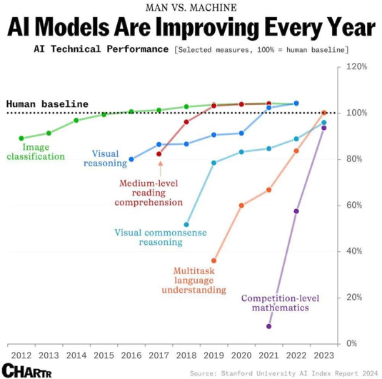
AI Models Improve Faster
AI goes into new territories.
The speed of improvements grows
https://twitter.com/burny_tech/status/1781080287193006469

Slide 6
Most Frequent AI Use Cases
RAG = Retrieval Augmented Generation
LLM = Large Language Model
NLP = Natural Language Processing
ML = Machine Learning
RF = Random Forest, XGB = XGBoost
DL = Deep Learning
Application | Technology | Examples
AI Chatbots | RAG, LLM | Customer service, sales
Co-pilots / assistants (agents) | RAG, LLM | work assistants, coding, ...
Sentiment Analysis | NLP, LLM | Customer Service (satisfaction), Sales (social media, surveys)
Personalized Recommendations, Personalized targeted ads | Collaborative & content filtering, LLM | Sales
Predictive Lead Scoring | ML: RF or XGB | Sales
Forecasting, trend analysis | ML: regression, RF, XGB, DL | sales, demand vs inventory, ...
Writing (posts, articles, newsletters, email responses, business plans, reports) | LLM, RAG | Any organization
Multi-lingual ability | LLM | Any organization or service
HR - screening candidates, training | RAG, LLM | Any organization
Document management: classifying / tagging / extracting data (from invoices, contracts, reports), formatting, storing | data engineering/storage, LLM, RAG | Any organization
Fraud detection, Anomaly Detection | ML: Isolation Forest | Finance Transactions, Manufacturing
Risk Assessment | ML, DL, LLM | Finance

Slide 7
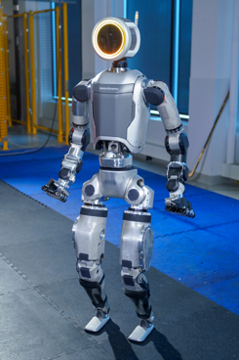

Atlas Robot
Create talking avatar in a minute
Boston Dynamics' New Atlas Robot
https://www.youtube.com/watch?v=efebwb2DW3w
https://www.d-id.com - Natural User Interface
Create talking avatar, etc.
https://studio.d-id.com/agents/create

Slide 8
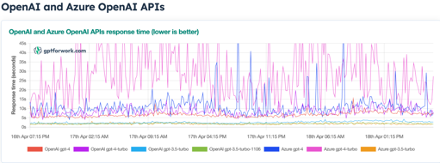
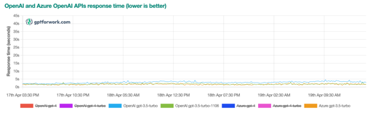
LLM Response Time
gpt-3.5-turbo response time is ~2-4 sec
gpt-4 is much slower (10-40 sec and more)
https://gptforwork.com/tools/openai-api-and-other-llm-apis-response-time-tracker
https://artificialanalysis.ai/models/claude-21#latency

Slide 9
Misc 1
Andrej Karpathy - llm.c is now as fast as PyTorch
"llm.c is now down to 26.2ms/iteration, exactly matching PyTorch (tf32 forward pass). "
https://twitter.com/karpathy/status/1779272336186978707
Sam Altman: "GPT-4 now significantly smarter and more pleasant to use"
https://twitter.com/sama/status/1778578689984270543
GPT-4-Turbo has reclaimed the No. 1 spot on the Arena leaderboard, outperforming others across diverse domains like Coding, Longer Query, and Multilingual capabilities. It performs even stronger in English-only prompts and conversations containing code snippets.
135 different text re-ranking models on huggingface: https://huggingface.co/models?other=text-reranking
https://huggingface.co/models?sort=downloads&search=rerank
https://huggingface.co/BAAI/bge-reranker-base
# bge is short for BAAI general embedding.
# pip install -U FlagEmbedding
from FlagEmbedding import FlagReranker
reranker = FlagReranker('BAAI/bge-reranker-large', use_fp16=True)
score = reranker.compute_score(['query', 'passage'])
# higher score = more relevant
print(score)
# example
scores = reranker.compute_score([
['what is panda?', 'hi'],
['what is panda?', 'The giant panda (Ailuropoda melanoleuca), sometimes called a panda bear or simply panda, is a bear species endemic to China.']])
print(scores)
Gemini 1.5 Pro now understands audio, uses unlimited files, acts on your commands, has JSON mode!
DeepLearning.ai - new lesson: Quantization Fundamentals
https://learn.deeplearning.ai/courses/quantization-fundamentals/lesson/1/introduction

Slide 10
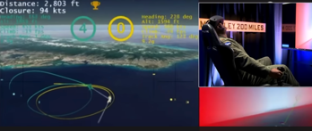
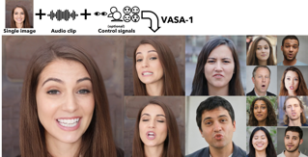
Misc 2
NSA Publishes Guidance for Strengthening AI System Security
Deploying AI Systems Securely
Best Practices for Deploying Secure and Resilient AI Systems
https://media.defense.gov/2024/Apr/15/2003439257/-1/-1/0/CSI-DEPLOYING-AI-SYSTEMS-SECURELY.PDF
Training costs for frontier AI models like OpenAI’s GPT-4 and Google’s Gemini Ultra have reached up to $191 Mln
U.S. Air Force: an AI controlled jet has successfully outflown a human pilot in a simulated dogfight. This test was managed by DARPA (Defense Advanced Research Projects Agency)
https://www.edwards.af.mil/News/Article-View/Article/3744695/usaf-test-pilot-school-and-darpa-announce-breakthrough-in-aerospace-machine-lea/
https://www.youtube.com/watch?v=C8yjtaZfNCw - video
Mistral AI has been speaking to investors about raising several hundred million dollars at a valuation of $5 Billion
Microsoft VASA-1: Lifelike Audio-Driven real time talking faces -
https://www.microsoft.com/en-us/research/project/vasa-1/
This is similar to EMO, but real time: https://github.com/HumanAIGC

Slide 11
Misc 3
ISO/IEC 42001 - an international standard that specifies requirements for establishing, implementing, maintaining, and continually improving an Artificial Intelligence Management System (AIMS) within organizations.
It is designed for entities providing or utilizing AI-based products or services, ensuring responsible development and use of AI systems. - https://www.iso.org/standard/81230.html
Google’s new Infini-attention - LLMs with infinite context
https://venturebeat.com/ai/googles-new-technique-gives-llms-infinite-context/
Paper: "Leave No Context Behind: Efficient Infinite Context Transformers with Infini-attention" - https://arxiv.org/abs/2404.07143
Infini-attention retains and compresses the attention memory from all previous segments. This means in the same 500K document, each 100K window maintains access to the full document's context.
"14 Ways to Use AI in Marketing that Actually Work (Recommended by Pros!)" - by Rob Glover
https://www.wordstream.com/blog/ai-in-marketing
Pull insights from past campaigns for future strategy
Complete competitive analysis
Roleplay for customer sentiment
Produce internal project management assets
Find thinking models for thought leadership content
Analyze data for SEO audits
Link ideas while you write automatically
Repurpose long-form content for social media posts
Create customized SMS and email marketing campaigns
Prepare an interview question list
Improve design elements in email headers
Build article outlines quickly
Write craftier subheadings
Scale product descriptions and ad copy

Slide 12
The Rise Of The Chief AI Officer (CAIO)
US government now requires all the agencies of federal government to name Chief AI Officers.
https://www.shrm.org/topics-tools/news/inclusion-equity-diversity/federal-government-commits-to-ai-fairness
Finding a specialized AI executive is rapidly becoming as critical
as the roles of CFO or CMO. The CAIO will likely be the most transformative C-suite recruit yet. CAIO must operate as C-suite peers, not subordinate managers.
What are the qualities of a rare individual to blend new technical
vision with strategic foresight?
Craft an AI Vision and Strategy
Scouting Use Cases and Feasibility
Separate hype from reality
Communicate the intricacies and possibilities of AI
Get key stakeholders on board
Recruit right people (talent gap)
Evangelizing and Education
Governance and Risk Management
Proactively apply AI for the benefit of enterprise
Cross-disciplinary strategic thinking
Avoid the leadership traps
Avoid budget/fires battles
AI landscape is evolving at an unprecedented pace.
The complexity and pace of AI system development make
it nearly impossible for existing executives to master while still focusing on their core responsibilities.
A CAIO offers a strategic advantage, guiding an organization through the complexities of AI integration.
Where to look for the Right CAIO Candidates?
Seasoned AI/ML
Cross-Disciplinary
Strategic Innovators
Transformation Trailblazers
The benchmarks for an exceptional CAIO will sharpen over time.
https://www.ft.com/content/4c5d823e-004b-4f00-9536-9fea93330453
https://www.kdnuggets.com/the-rise-of-chief-ai-officer

Slide 13
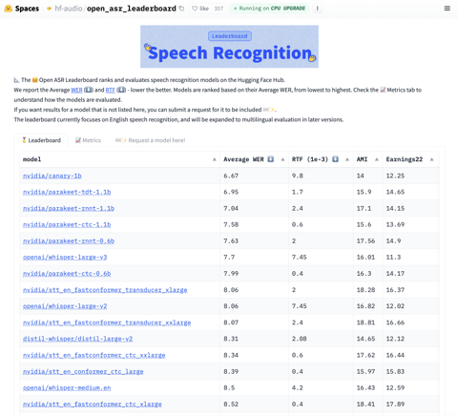

NVIDIA speech and translation AI
The NVIDIA Parakeet automatic speech recognition (ASR) family of models and the NVIDIA Canary multilingual, multitask ASR and translation model currently top the Hugging Face Open ASR Leaderboard due to their speed, accuracy, and robustness against diverse and noisy audio environments.
https://huggingface.co/spaces/hf-audio/open_asr_leaderboard
https://developer.nvidia.com/blog/nvidia-speech-and-translation-ai-models-set-records-for-speed-and-accuracy/

Slide 14
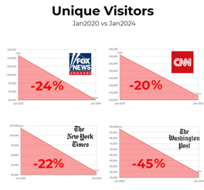
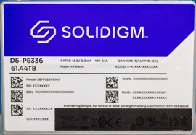
Modern Fast Storage
Media is losing visitors
Solidigm D5-P5336 series of SSDs
the first quad-level cell (QLC) solid-state storage drive
Just started accept orders in 2024.
Sizes: 7.7 TB, 15.4 TB, 30.7 TB, 61.4 TB
Speed: up to 7,000 MB/s read and 3,300 MB/s write
Prices ~ $110 - $160 per TB
So 30TB at $3.3K, 60TB at ~7K
Elon Musk: "Legacy media simply can’t compete with hundreds of millions of humans providing real-time, AI-assisted, interactive information"
https://twitter.com/elonmusk/status/1780370067987009711

Slide 15
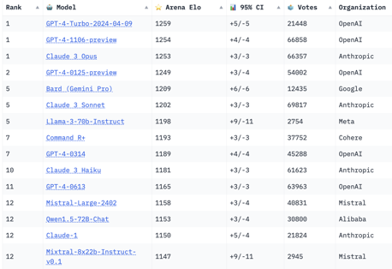
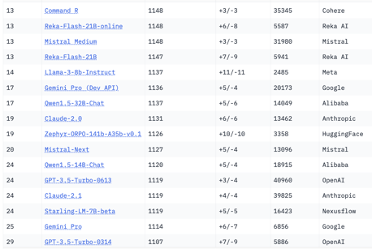

Crowd-sourced "Arena" Leaderboard
Total #models: 89.
Total #votes: 722,009.
Last updated: April 13, 2024
Starting Elo rating = 1000
95% CI = Confidence Interval
https://chat.lmsys.org/?leaderboard

Slide 16
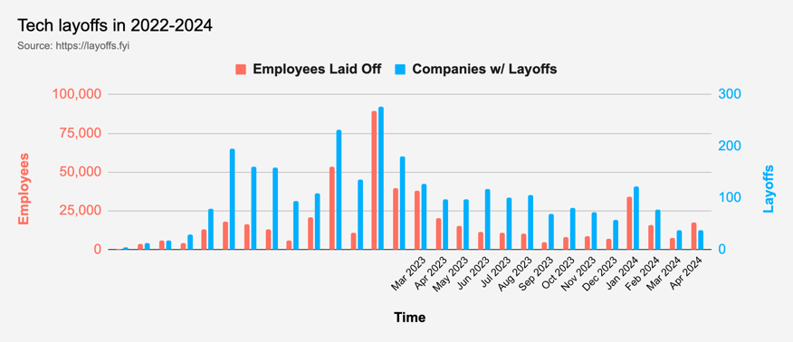
Tech Layoffs are lower than in 2023
Layoffs - https://layoffs.fyi
Salaries for AI engineers rose 12% from the third to fourth quarter last year
The average salary for a senior AI engineer nationally is more than $190,000, according to Comprehensive.io.
AI has a talent shortage, meaning $1 Mln salary job offers! Even during tech layoffs https://qz.com/tech-layoffs-high-ai-struggling-find-talent-1851368861

Slide 17
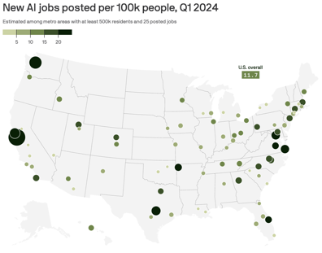
Position Yourself as an AI Expert
The Top 3 Resume Mistakes Costing You the Job
No clear objective, No results, only activities, Too many words
https://blog.bytebytego.com/p/the-top-3-resume-mistakes-costing
Top AI skills to include in the resume:
Prompt engineering
Programming languages for AI
Machine learning
Neural networks and deep learning
Natural language processing (NLP)
Cognitive computing skills (mimic human thinking) - recognize images, patterns, sentiment, risk, ...
America's AI job hotspots - San Jose, Seattle and San Francisco.
Also Austin, Washington, D.C. and Northwest Arkansas, as well as Raleigh and Atlanta.
https://www.axios.com/2024/04/16/ai-jobs-us-cities-hotspots-2024
xxx
How do you show AI skills on a resume?
Mention the specific AI tools you used (e.g., Python, TensorFlow, PyTorch, Scikit-Learn).
Summarize the outcomes achieved (improvements, accuracy rates, ... )

Slide 18


About the Speaker
Lev Selector, Ph.D.
40+ years of software engineering, data science, and building teams (hiring, training, and managing)
Ph.D. in mathematical modeling and computer simulations
Interests:
Generative AI, Using LLM with your data
Local AI for Local Private Data
Cloud architecture, fin-tech, application security
Find/connect: Linkedin, GitHub, YouTube, Google
https://eais.ai
Enterprise AI Systems

Slide 19
Thank You!

