Slide 1
AI ChatBots
and Multi-Agent Systems
April 05, 2024
RAG
RAG under the hood
Challenges with “Naive” RAG
What can we do to reduce this failures and improve metrics?
How to Measure performance
Chatbot: Langchain + ChainLit + GPT4
Chatbot: Langchain + Groq + RAG
Chatbot: Langchain + ChainLit + local Mixtral
Chatbot: Langchain + ChainLit + local Mixtral + conversation history
Chatbot: LMStudio
Chatbot: GPT4ALL + RAG
Chatbot: using Ollama local console models
Chatbot: Langchain + Open AI + RAG + conversation history console chatbot
Multi-agent: Web Research using SerpAPI and Langchain Agents

Slide 2


About the Speaker
Vitalii Stinskii
AI Expert, Data Scientist, Python Programmer
Interests:
Generative AI, Using LLM with your data
Local AI for Local Private Data
Cloud architecture, fin-tech, application security
www.vitalii-stinskii.com
https://www.linkedin.com/in/vitalii-stinskii/
https://github.com/vstinskii
https://eais.ai
Enterprise AI Systems

Slide 3
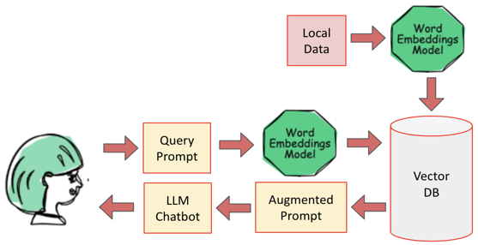
RAG
The most common AI Application nowadays is a RAG (Retrieval Augmented Generation) Chatbot
which can answer questions about a company's data.
It may be a customer service chatbot, a sales chatbot, a copilot, etc. etc.
User asks a question, this question is converted into an embedding vector - and matched against available data in a vector database. Best matches are retrieved - and used to synthesise the response.
It is easy to create a chatbot. It consists of:
browser widget where user types questions and reads responses.
python script in the middle.
vector database to search and retrieve data needed to answer questions.
LLM (Large Language Model) to compose the response from retrieved data.
Here are two short videos explaining RAG and how to evaluate its quality:
https://www.youtube.com/watch?v=0j4aIX5SCXw
https://www.youtube.com/watch?v=CgQdg0SRuC0
For Example:
We work at transport company and have a year report about our cars. We want to know the summary about top 5 most expensive cars.
To to get it we need:
Put the report into a chat bot
Chatbot will generate embedding from the report and save it in Vector DB
Write a prompt.
Chatbot will convert it to embeddings and do the search.
Chatbot generates the result using most relevant parts of our report

Slide 4
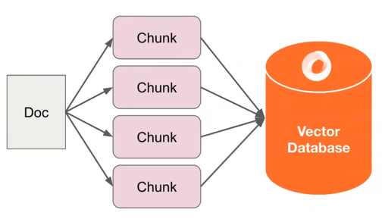
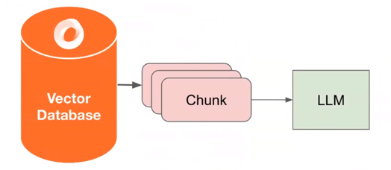
RAG under the hood
RAG consists of two components:
Data Ingestion:
Split up documents(s) into even chunks
Each chunk is a piece of raw text
Generate embedding for each chunk(e.g. OpenAI embeddings, sentence_transformer)
Store each chunk into a vector database
Data Querying (Retrieval + Synthesis):
Find top-k most similar chunks from vector database collection
Plug into LLM Response synthesis module

Slide 5
Challenges with “Naive” RAG
Bad Data Retrieval
Low Precision: Not all chunks in retrieved set are relevant.
Hallucinations + Lost in the Middle Problems.
Low Recall: Not all relevant chunks are retrieved.
Lacks enough content for LLM to synthesize an answer.
Outdated information: The data is redundant or out of date.
Bad Response Generation
Hallucinations: Model makes up an answer that isn’t in the context.
Irrelevance: Model makes up an answer that doesn’t answer the question.
Toxicity/Bias: Model makes up an answer that's harmful/offensive.

Slide 6
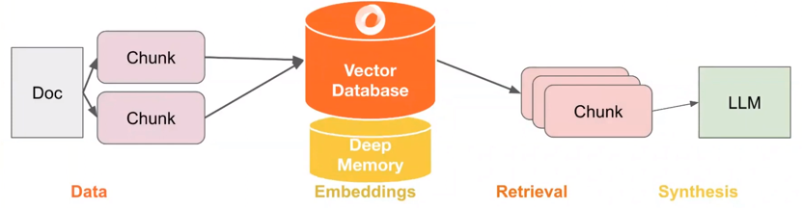
What can we do to reduce this failures and improve metrics?
Rag applications and other LLM centered applications do not just consist of LLM,
but actually attach a lot of components around the LLM.
The main ones: Data, Embeddings, Retrieval, Synthesis.
To improve our application we need to look more closely at how our main components work:
Data: Can we store additional information beyond raw text chunks? (e.g. with multi-modal data store like Activeloop`s Deep Lake)
Embeddings: Can we optimize our embeddings representations?
Retrieval: Can we do better than top-k embedding lookup? (with systems like Activeloop`s Deep Memory)
Synthesis: Can we use LLMs for more than generations? (can we use it for reasoning, planning and handle more diverse set of questions)

Slide 7
How to Measure performance
The key part in building a production grade RAG application is to know how to evaluate it
To properly evaluate the RAG system we have two strategies:
Isolation: take different stages of the pipeline and evaluate them independently. Evaluate the quality of retrieved chunks given user query:
Create Deep Lake dataset (store question - context pair). This can be done manually or synthetically. In the 2nd way we need to use LLM to take in some sort of unstructured data and generate questions from it.
Create the ground truth.
Evaluate the quality of the retrieved data.
End to end: evaluate the entire system In this case we have the entire RAG pipeline and a user query. We need to look at the final generator response and give a measurement about it. Metrics:
Correctness
Quality of the generated response
Relevance

Slide 8
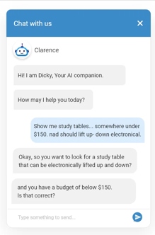
In the next slides we will see several examples of chatbots.
A chatbot may use an LLM via an online API (OpenAI, Gemini, Groq, ...),
or using a local LLM
A chatbot may be created using different python and/or Javascript libraries.
There are multiple examples on my GitHub.
https://github.com/vstinskii/ai_chatbots

Slide 9
Multiple Ways to Create AI Chatbots
LMStudio - https://lmstudio.ai - app to run chat locally
Ollama - https://ollama.com - server, prompt, python API. Uses llama.cpp, automatically distributes between CPU & GPU
llama.cpp - https://github.com/ggerganov/llama.cpp - runtime to efficiently run LLMs (cmd, server). Has option "--n-gpu-layers" to specify hoW many layers on GPU. Uses GGUF or HF files.
Chainlit - build app in minutes (integrates with LangChain)
https://docs.chainlit.io/get-started/overview
https://github.com/Chainlit/chainlit
Open WebUI (Formerly Ollama WebUI) - supports Ollama and OpenAI-compatible APIs. Python and Javascript.
https://github.com/open-webui/open-webui
https://docs.openwebui.com
Text-Generation - open source, but problem installing (it installs its own miniconda). Python based. Uses transformers and datasets modules, as well as llama.cpp
https://github.com/oobabooga/text-generation-webui
https://github.com/oobabooga/text-generation-webui/wiki/12-%E2%80%90-OpenAI-API#examples
Ollama GUI - open-source pure Javascript chat app to use local LLMs via Ollama.
https://github.com/HelgeSverre/ollama-gui
GPT4All - ecosystem to train and deploy LLMs that run locally on consumer grade CPUs. Written in C++, has python and Javascript bindings.
https://gpt4all.io
https://github.com/nomic-ai/gpt4all
PrivateGPT - python-based, llama.cpp, gradio UI
https://github.com/imartinez/privateGPT
https://docs.privategpt.dev
https://www.gradio.app
MLC LLM - open-source apps (cpp, python, rust)
https://llm.mlc.ai
https://github.com/mlc-ai/mlc-llm
Streamlit GUI - primitive
https://github.com/alejandro-ao/chat-with-websites
https://github.com/shashankdeshpande/langchain-chatbot
LangChain
https://github.com/kyrolabs/awesome-langchain
https://github.com/homanp/superagent
https://www.analyticsvidhya.com/blog/2023/06/langflow-ui-for-langchain-to-develop-applications-with-llms/ - LangFlow
https://www.langflow.org ; https://github.com/logspace-ai/langflow
https://github.com/chatscope/chat-ui-kit-react
LlamaIndex
https://github.com/run-llama - LlamaIndex
https://github.com/run-llama/LlamaIndexTS - Javascript apps

Slide 10
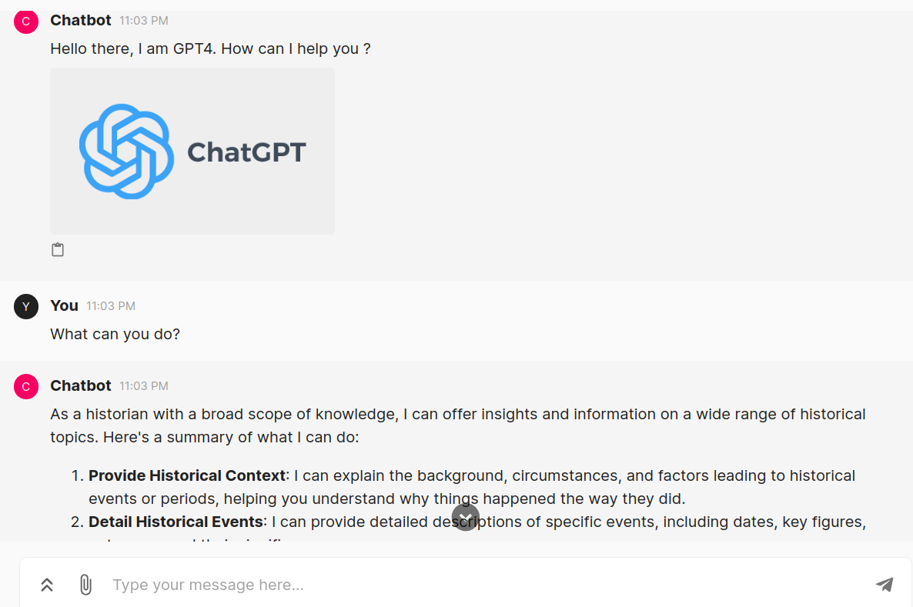
Example of a Chatbot using Langchain + ChainLit + GPT4
Langchain & ChainLit & GPT4
It's GPT4 but in your custom interface
GitHub link:
https://github.com/vstinskii/ai_chatbots/blob/master/langChain_ChainLit/langchain-gpt-chainlit/langchain_gpt.py

Slide 11
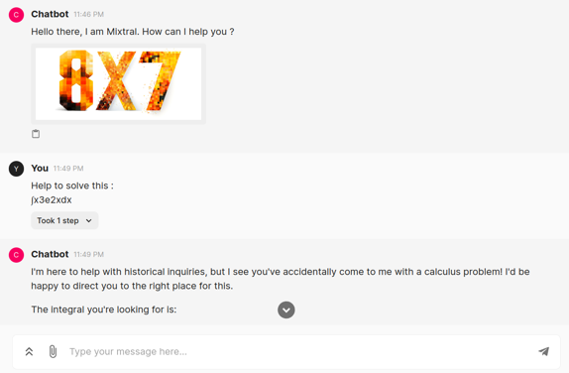
Example of a Chatbot using Local Mixtral Model with ChainLit Frontend
Langchain & ChainLit & Mixtral
Powerful local Mixtral will help to solve your tasks!
GitHub link:
https://github.com/vstinskii/ai_chatbots/blob/master/langChain_ChainLit/langchain-mixtral-ollama-chainlit/langchain_mixtral_ollama.py

Slide 12
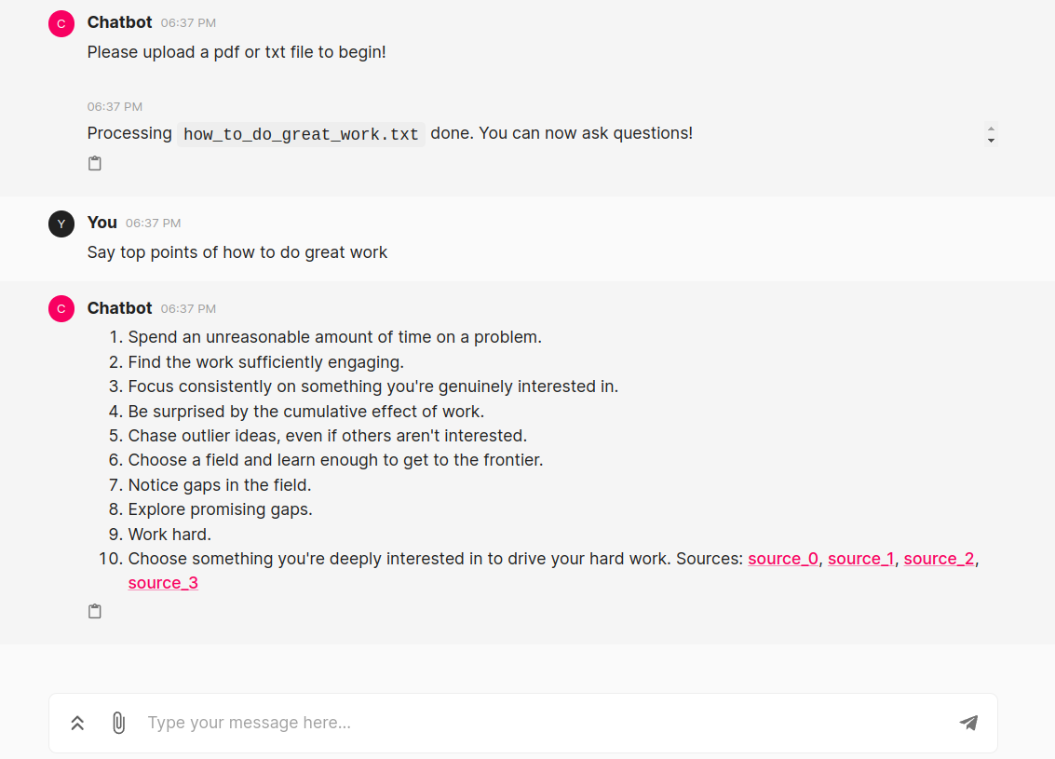
Example of a Chatbot RAG system
using Langchain + ChainLit + GPT4 or Ollama
Langchain + ChainLit + GPT4 + RAG or Ollama
Chat with documents Using GPT4 or Local Ollama model
with memory and vectordb
GitHub link:
https://github.com/vstinskii/ai_chatbots/blob/master/RAG/langchain-local_or_api_llm-chainlit-rag-memory/rag-local-or-api-llm.py

Slide 13
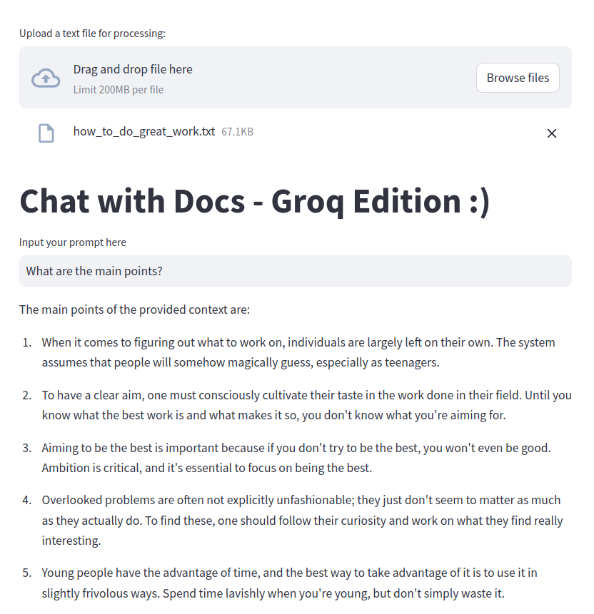
Example of a Chatbot RAG system using Langchain + Groq
Groq + Langchain + Rag
Chat with our documents using Groq free API!
GitHub link:
https://github.com/vstinskii/ai_chatbots/blob/master/RAG/groq/langchain_groq_rag_local_files.py

Slide 14
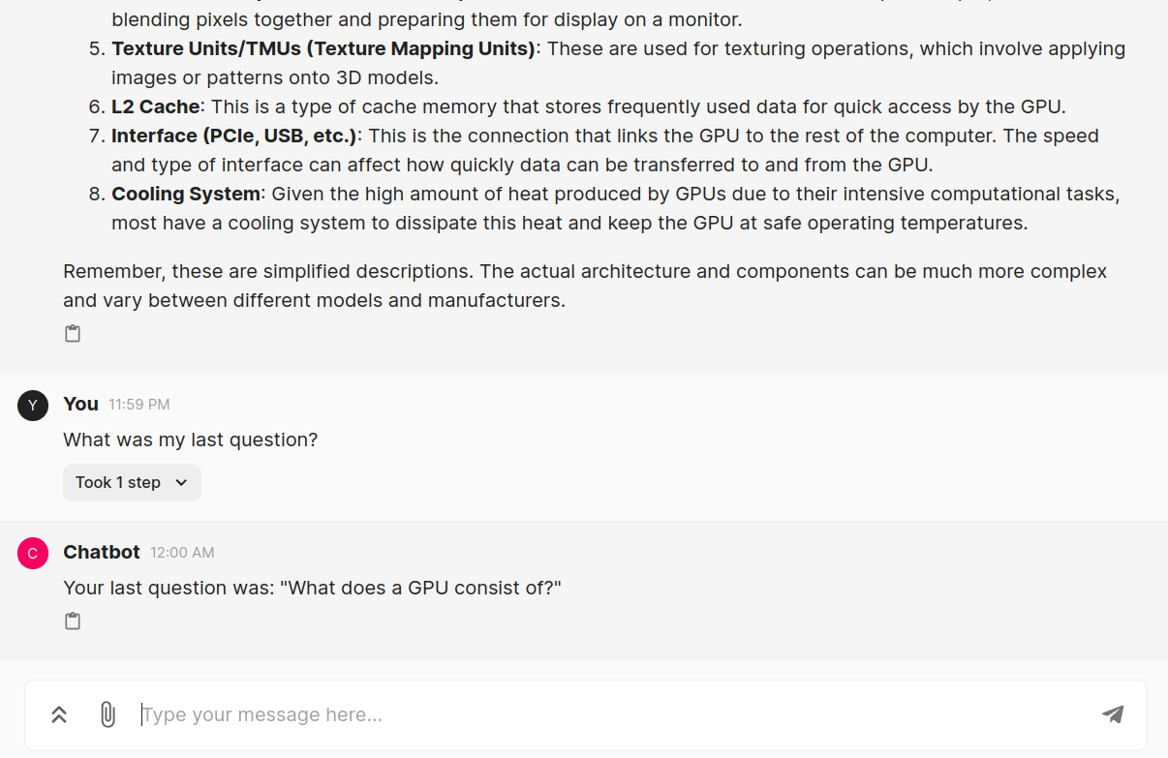
Example of a Chatbot using Local Mixtral + ChainLit + Chat History
Langchain & ChainLit & Mixtral & Memory
Local Mixtral that remembers your chat history!
GitHub link:
https://github.com/vstinskii/ai_chatbots/blob/master/langChain_ChainLit/langchain-mixtral-ollama-chainlit/langchain_mixtral_memory_ollama.py

Slide 15
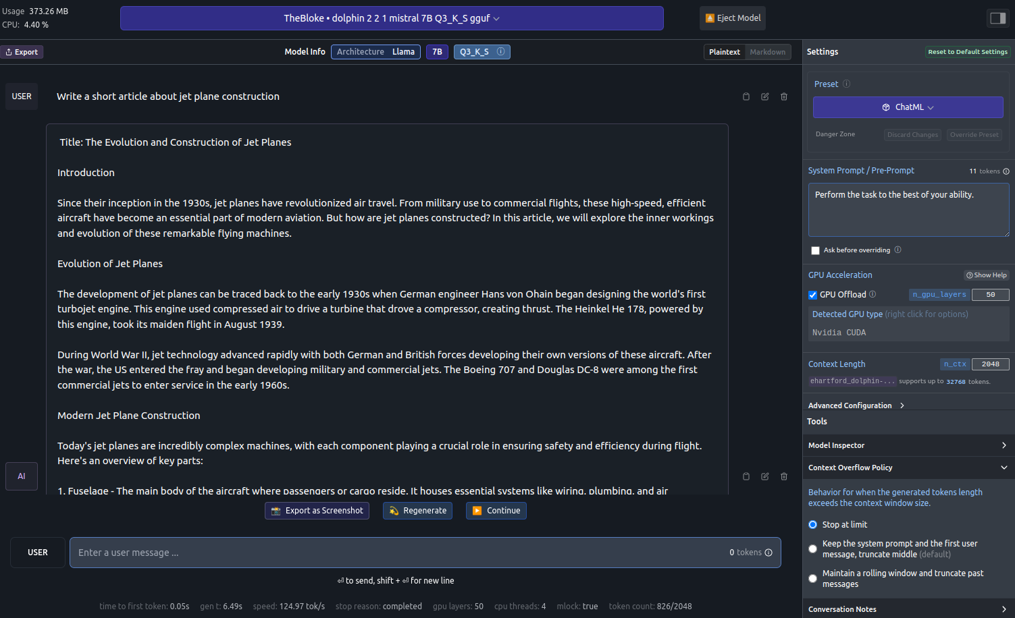
Example of a Chatbot using Local LLM with LM Studio
LM Studio has a lot of useful settings!

Slide 16
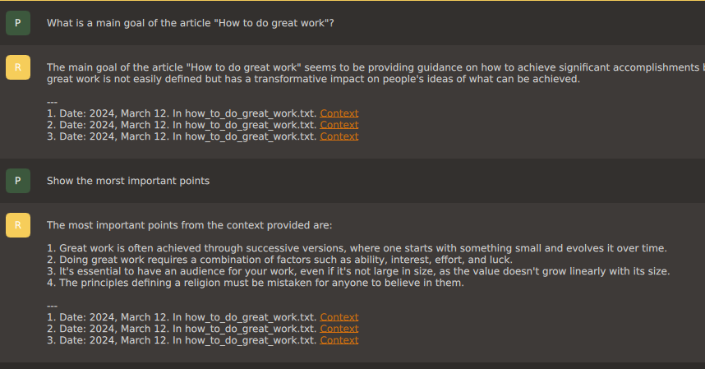
Example of a Chatbot using GPT4ALL + Local LLM + RAG
GPT4ALL & RAG
Chat with your files easily!

Slide 17
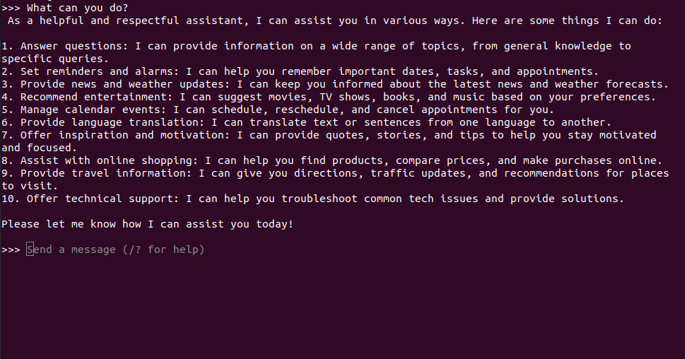
Example of a Chatbot using Ollama local console models
Example of local Mixtral

Slide 18
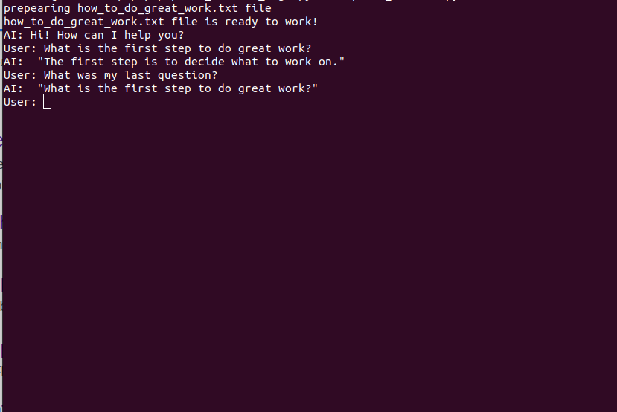
Example of a Chatbot Open AI + langchain + RAG + conversation history console chatbot
Console version of Open AI langchain RAG Chatbot
GitHub link:
https://github.com/vstinskii/ai_chatbots/blob/master/console/openai_console_rag/OpenAI_Chatbot.py

Slide 19
Example of a Multi-agent Web Research using SerpAPI and Langchain Agents
# The Pioneers of the Slopes: Unraveling the 2023-2024 Ski Season's Victories
As the frost of the 2023-2024 ski season thaws, it leaves behind tales of triumph, resilience, and a new chapter in the annals of winter sports. The FIS Alpine Ski World Cup, a battleground for the world's elite skiers, not only tested their limits but also showcased their indomitable spirit. Let's dive deeper into the lives of these champions, their journey's impact, and how their victories are paving the way for the future of skiing.
## Champions of the Slopes: Heroes of the Season
This season's podiums were graced by athletes who demonstrated unparalleled skill, dedication, and passion. Among them:
- **Marco Odermatt (SUI)** - The Swiss maestro, Odermatt, continued to dominate the men's circuit, defending his overall champion title with grace and power. His performances have been a masterclass in consistency and excellence.
- **Mikaela Shiffrin (USA)** - American skiing sensation, Shiffrin, despite facing fierce competition, dazzled the slopes with her remarkable prowess, adding to her legacy.
- **Lara Gut-Behrami (SUI)** - In the women's super-G, Gut-Behrami rose above the rest, proving that perseverance and hard work are the cornerstones of success in this demanding sport.
### The Glittering Path of Victory
Winning on this elite stage brings with it not just medals, but a treasure trove of opportunities and benefits:
- **Spotlight and Sponsorship**: The visibility that comes with victory attracts lucrative sponsorships, providing financial support and opportunities to make a significant impact on the sport.
….
Multi-agent chatbot based on GPT4 can do much more effective work than just the model
For example it can write a very good article using google search
It has attention module to get adjusted to any theme.
Let's try "2023/2024 FIS alpine ski World Cup season winners” search
Full article you can see on my Github: https://github.com/vstinskii/ai_chatbots/blob/master/multi-agents/gpt4-multi-agent/main.ipynb

Slide 20
Thank You!

