Slide 1


AI Updates
May 03, 2024
May 1 is a public holiday in 160+ countries! Mostly as an International Worker's Day. Germany: Der Erste Mai is an ancient festival to welcome the Spring weather and to drive away evil spirits
Gradient.AI LLama3 8B with 1 Mln Tokens Context
Testing Llama3 on Apple Silicone
GPT2-Chatbot - temporary excitement
ChatGPT new long-term memory feature
System Prompts for GPT , Gemini, and Claude
Amazon Q Business - AI Assistant
Claude on Apple App Store
GitHub Copilot Workspace
8 major U.S. newspapers sue OpenAI & Microsoft
mistral.rs - Blazingly fast LLM inference
Vidu - Chinese Text-to-Video competitor to Sora
Andrej Karpathy - LLM (llm.c) in space
Andrew Ng - Agents to create training data
RALM_Survey - Retrieval Augmented LMs
Multi-token Prediction (Meta)
Llama3 is available on AWS Bedrock, Azure, GCP
Med-Gemini (from Google)
Dilated Attention - path to Bln tokens
Sam Altman Q/A at Stanford
@gemini at Google Chrome browser
AdvPrompter - fast adversarial prompting
Google TeraHAC - trillion-edge graphs
AI Safety Board (Dept. of Homeland Security)
Regulatory Capture
Yann LeCun: LLMs are flawed, but useful
LLMs - Key Terminology
Kolmogorov-Arnold Networks
Longevity Escape Velocity
Demis Hassabis and Mustafa Suleyman
Open Source Growth 2029-2013
Scarlett Dreams - a Play About AI
Crowd-sourced "Arena" Leaderboard
AI bots flooding job postings
Tech Layoffs are lower than in 2023

Slide 2
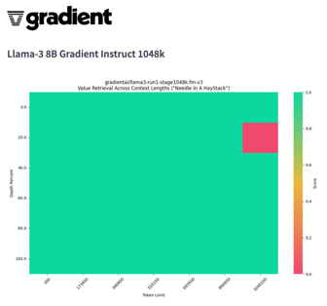

Gradient.AI - LLama-3 8B with 1 Mln Tokens Context Length
"Excited to release the first @AIatMeta LLama-3 8B with a context length of over 1M on @huggingface"
https://twitter.com/Gradient_AI_/status/1785030931407143040
https://huggingface.co/LoneStriker/Llama-3-8B-Instruct-262k-GGUF
https://gradient.ai
This model extends LLama-3-8b context length from 8k to more than 1 Mln tokens
It is developed by Gradient
It demonstrates that SOTA LLMs can learn to operate on long context with minimal training by appropriately adjusting RoPE theta
PoSE Technique: The Positional Skip-wisE (PoSE) method simulates long inputs during training to increase context length, powering Llama 3's extension to 128k tokens.
https://twitter.com/rohanpaul_ai/status/1783574428858696161
The gradient models are available in LM Studio & ollama.
https://ollama.com/library/llama3-gradient
You can have 1 Mln tokens context, but it takes a lot of memory. 512K tokens take ~ 95 GB memory. Ollama allocates this memory even if actual input/output are small.
ollama run llama3-gradient --verbose
>>> /set parameter num_ctx 512000

Slide 3
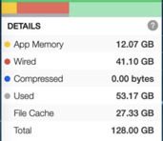
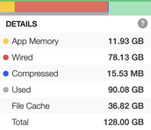

Testing Llama3 on Apple Silicone MacBook Pro
I have tested llama3-8b 4-bit quantized on two MacBook laptops:
Apple M1 Pro with 32 GB memory
Apple M3 Max with 128 GB memory (loads in ~2-3 sec)
I also tested more models on M3 (4-bit and 6-bit quantized):
llama3:70b-instruct - ~40 GB of "Wired" memory, 22s to load
mixtral:8x22b - ~80 GB of "Wired" memory, 112s to load
llama3-gradient:8b-instruct-1048k-q6_K (6.6GB, 45 t/s)
llama3:8b-instruct-q6_K (6.6GB, 46.4 t/s)
I used ollama with following settings:
/set verbose
/set parameter num_gpu 999
The prompt was:
Please make a numbered chronological list of the last ten (10) US presidents. Look back 50 years. Make a list. The list should contain 10 rows. Important - make a fresh list. Disregard the chat history. Output only the list itself, nothing else.
The output speed (eval rate in tokens/s) was:
59.10 for M3 llama3-8b (total 1.1 sec)
32.22 for M1 llama3-8b (total 2.3 sec)
8.51 for M3 llama3:70b-instruct (total ~17.4 sec)
13.78 for M3 mixtral:8x22b (total ~16 sec)
45 for M3 llama3-gradient:8b-instruct-1048k-q6_K
46.4 for M3 llama3:8b-instruct-q6_K
Llama3:70b Mixtral:8x22b
M3: Disk is very fast
5..6 GByte/sec

Slide 4
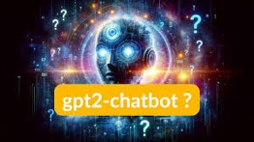
GPT2-Chatbot
GPT2-Chatbot just showed up on lmsys.org - and then was removed "Due to unexpectedly high traffic & capacity limit".
It is believed to come from OpenAI
It is believed to be an early version of GPT-4.5.
It is on par or better than GPT-4 and Claude3 Opus.
Note: GPT2-Chatbot is NOT GPT-2 form 2019.
https://rentry.co/GPT2 - read
https://www.youtube.com/watch?v=3BDboYfjWE8 - view
https://www.youtube.com/watch?v=YDvHre2bAYc - view
https://www.analyticsvidhya.com/blog/2024/04/new-ai-model-gpt-chatbot-is-going-viral/
https://twitter.com/albfresco/status/1784964830887104999
Solved an International Math Olympiad problem on first attempt - a competition where only top 4 U.S. high school students qualify annually.
Exceeded GPT-4 and Claude Opus benchmarks on complex coding prompts used for model evaluation at AI startups like CodeGen.
Demonstrated iterative dialogue capabilities, self-awareness in refining responses, and ability to plan out solution steps.
Exhibited rule-breaking behavior and willingness to solve logic puzzles that historically stumped GPT-4.
Matched or exceeded GPT-4 performance on ASCII art generation.

Slide 5


Misc 1
ChatGPT now has permanent memory feature (to remember your preferences). You can selectively manage it. https://www.youtube.com/watch?v=KgrSXWZIvAc
Claude on Apple App Store
https://apps.apple.com/us/app/claude/id6473753684
GitHub Copilot Workspace
(in preview) - a new service in GitHub. Directed by prompts can offer suggestions on how to start the project and provide a step-by-step process (and execute it).
https://github.blog/2024-04-29-github-copilot-workspace/
System Prompts for GPT , Gemini, and Claude https://levelup.gitconnected.com/inside-the-leaked-system-prompts-of-gpt-4-gemini-1-5-claude-3-and-more-4ecb3d22b447
Amazon Q Business
https://www.youtube.com/watch?v=frOJDGG0Xds
Amazon Q Business is a generative AI–powered assistant that can answer questions, provide summaries, generate content, and securely complete tasks based on data and information in your enterprise systems. It empowers employees to be more creative, data-driven, efficient, prepared, and productive.
8 major U.S. newspapers sue OpenAI & Microsoft.
Including The NY Daily News, The Chicago Tribune, The Denver Post, The San Jose Mercury News, and more.
They accusing of illegally using their copyrighted articles to train AI chatbots like ChatGPT and Copilot.
https://www.nytimes.com/2024/04/30/business/media/newspapers-sued-microsoft-openai.html
mistral.rs - Blazingly fast LLM inference
Mistral.rs is a fast LLM inference platform
inference on a variety of devices
quantization
easy-to-use HTTP server and Python bindings
https://github.com/EricLBuehler/mistral.rs

Slide 6
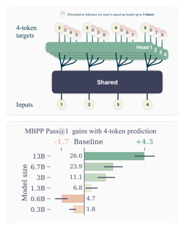

Misc 2
Better & Faster Large Language Models via Multi-token Prediction (Meta)
https://arxiv.org/abs/2404.19737
"at each position in the training corpus, we ask the model to predict the following n tokens using n independent output heads, operating on top of a shared model trunk"
Vidu - the New Chinese Text-to-Video AI - a competitor to OpenAI's Sora, is capable of generating a 16-second video in 1080p resolution https://writingmate.ai/blog/get-access-to-vidu-ai - read
https://www.youtube.com/watch?v=1pTCsI-7y-w - video
Andrej Karpathy - idea to offer NASA to use LLM (llm.c) in spaceships. "harden llm.c to pass the NASA code standards and style guides, certifying that the code is super safe, safe enough to run in Space."As the code is compact, it can be done!
Andrew Ng - "an LLM wrapped in an agentic workflow may produce higher-quality output than it can generate directly. In this case, the LLM’s higher-quality output might be useful as pretraining data for the LLM itself."
https://twitter.com/AndrewYNg/status/1786057567178834328
RALM_Survey - (Retrieval Augmented Language Models)
Retrieval-Augmented Generation (RAG)
Retrieval-Augmented Understanding (RAU) Retrievers, Language Models, Augmentations
robustness, accuracy, and relevance
https://github.com/2471023025/ralm_survey
https://arxiv.org/abs/2404.19543
Llama3 is available on AWS Bedrock (both 8b & 70b models), Azure, GCP, Huggingface, Groq, ... :
https://aws.amazon.com/bedrock/llama/
https://azuremarketplace.microsoft.com/en-us/marketplace/apps/metagenai.meta-llama-3-8b-chat-offer
https://console.cloud.google.com/vertex-ai/publishers/meta/model-garden/llama3

Slide 7

Misc 3
Med-Gemini (from Google)
A family of Gemini models fine-tuned for medical tasks!
Achieves SOTA on 10 of the 14 benchmarks, spanning text, multimodal & long-context applications.
Surpasses GPT-4 on all benchmarks!
https://twitter.com/iScienceLuvr/status/1785247498744778886
https://arxiv.org/abs/2404.18416 - paper, 67 authors
Sam Altman at Stanford and Harvard:
Sama called GPT-4 "mildly embarrassing at best", saying it will be the "worst model" we will ever use as each new version gets smarter.
He said that he ‘doesn’t care’ whether the company burns 500M or 50B a year, as long as it stays on a trajectory for creating AGI, it will be worth it.
He also spoke about the importance of global access to compute, stating the mission to make ChatGPT free for all
He also revealed that the mysterious gpt2-chatbot model that appeared on Lmsys earlier this week was not GPT 4.5.
Dilated Attention
A technique for scaling to 1 BILLION tokens context-window
Inspired by dilated convolutions in CNNs
allow tokens to attend to others at increasing distances, skipping over intermediate ones
Dilation Factor - a hyperparameter specifying how far apart the tokens that are attended to are. A dilation factor of 2, for example, means that each token attends to every other token in the sequence.
Multiple Layers - stacking multiple layers with different dilation factors. This results in sparse connections within the attention matrix, reducing the complexity from O(N^2) to something more manageable, like O(N log N) or even linear, depending on the dilation pattern. https://twitter.com/rohanpaul_ai/status/1783835331529199748

Slide 8


Misc 3
Google just introduced a new Chrome shortcut that lets users initiate Gemini conversations directly from the browser's address bar: type @ - and select '@gemini' and type prompt into the Chrome’s desktop address bar to get responses from the AI
AdvPrompter: Fast Adaptive Adversarial Prompting for LLMs
https://arxiv.org/abs/2404.16873
Researchers from Meta AI and the Max-Planck-Institute for Intelligent Systems introduced a novel method that uses another LLM, AdvPrompter, to generate human-readable adversarial prompts in seconds. Compared to other optimized approaches, this method is ∼ 800× faster. The AdvPrompter is trained by utilizing an AdvPromterTrain algorithm that does not need access to the TargetLLM gradients. The trained AdvPrompter can generate suffixes and veil the input instruction, keeping its meaning intact. This tactic lures the TargetLLM into providing a harmful response.
Google TeraHAC: Scaling hierarchical clustering to trillion-edge graphs
https://research.google/blog/scaling-hierarchical-agglomerative-clustering-to-trillion-edge-graphs/

Slide 9

AI Safety Board (Dept. of Homeland Security, USA)
FACT SHEET: DHS Facilitates the Safe and Responsible Deployment and Use of Artificial Intelligence in Federal Government, Critica
https://www.dhs.gov/news/2024/04/29/fact-sheet-dhs-facilitates-safe-and-responsible-deployment-and-use-artificial
Protecting water supplies, power grids, telecommunications and other critical infrastructure from AI-enabled threats
Incorporating AI into Carrying Out the Homeland Security mission through safe, responsible and trustworthy use
Ensuring the economic security, and competitiveness of American AI innovation
Damon Hewitt, President and Executive Director, Lawyers’ Committee for Civil Rights Under Law;
Vicki Hollub, President and CEO, Occidental Petroleum;
Jensen Huang, President and CEO, NVIDIA;
Arvind Krishna, Chairman and CEO, IBM;
Fei-Fei Li, Ph.D., Co-Director, Stanford Human-centered Artificial Intelligence Institute;
Wes Moore, Governor of Maryland;
Satya Nadella, Chairman and CEO, Microsoft;
Shantanu Narayen, Chair and CEO, Adobe;
Sundar Pichai, CEO, Alphabet;
Arati Prabhakar, Ph.D., Assistant to the President for Science and Technology; Director, the White House Office of Science and Technology Policy;
Chuck Robbins, Chair and CEO, Cisco; Chair, Business Roundtable;
Adam Selipsky, CEO, Amazon Web Services;
Dr. Lisa Su, Chair and CEO, Advanced Micro Devices (AMD);
Nicol Turner Lee, Ph.D., Senior Fellow and Director of the Center for Technology Innovation, Brookings Institution;
Kathy Warden, Chair, CEO and President, Northrop Grumman; and
Maya Wiley, President and CEO, The Leadership Conference on Civil and Human Rights.
Established the AI Safety and Security Board (AISSB) - 22 members.
Mostly CEOs of big companies - effectively capturing regulations in their own corporate interests.
Note - Elon Musk, Mark Zuckerberg, Yann LeCun are NOT included.
https://www.youtube.com/watch?v=2GGLCvA6Rfg
https://www.dhs.gov/news/2024/04/26/over-20-technology-and-critical-infrastructure-executives-civil-rights-leaders
Sam Altman, CEO, OpenAI;
Dario Amodei, CEO and Co-Founder, Anthropic;
Ed Bastian, CEO, Delta Air Lines;
Rumman Chowdhury, Ph.D., CEO, Humane Intelligence;
Alexandra Reeve Givens, President and CEO, Center for Democracy and Technology
Bruce Harrell, Mayor of Seattle, Washington; Chair, Technology and Innovation Committee, US Conference of Mayors;

Slide 10
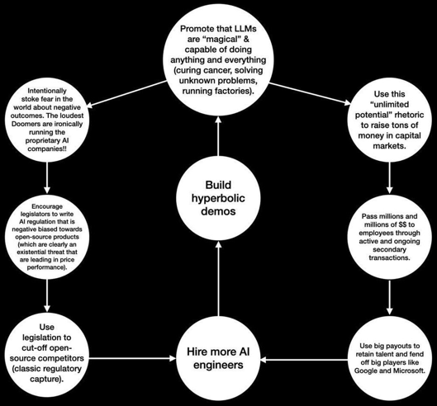

Regulatory Capture
What’s really happening in the background around AI regulation
https://twitter.com/bgurley/status/1786073617316360670
Bill Gurley, Investor

Slide 11


"LLMs are flawed, but useful in the short term"
Yann LeCun - how to be smart as auto-regressive LLMs
https://twitter.com/ylecun/status/1785290144561373351
https://twitter.com/ylecun/status/1785504408534388878
memorize lots of problem statements together with recipes on how to solve them.
to solve a new problem, retrieve the recipe whose problem statement superficially matches the new problem.
apply the recipe blindly and declare victory.
do not use basic logic.
do not use common sense to check your solution.
do not use a mental model of the situation as a sanity check.
do not simulate the scenario in your mind using your world model.
when someone tells you your solution is wrong, reply "I'm sorry, you are right" and apply another irrelevant recipe.
Knowledge accumulation is not a substitute for actual understanding. I'm pointing out that merely scaling up LLMs will not lead to human-level AI.
I don't hate LLMs. They are useful. Some of my best friends are LLMs
LLMs are flawed but useful in the short term. FAIR is working on the next generation of AI systems.
Yann LeCun

Slide 12
LLMs - Key Terminology
Sampling - generating text by randomly picking the next word based on its probability distribution.
Top-k Sampling - model’s choice for the next word is limited to the k most likely next words according to the model’s predictions.
RLHF (Reinforcement Learning from Human Feedback) - a model is fine-tuned based on human feedback rather than just raw data.
Decoding Strategies - determine how LMs select output sequences during generation (greedy decoding, beam search).
Prompt Engineering - designing inputs (prompts) that guide the model in generating specific types of outputs.
Transformer-XL - extends the existing transformer architecture, enabling learning dependencies beyond a fixed length.
MLM (Masked Language Modeling) - train the model to predict masked input segments.
Seq2Seq (Sequence-to-Sequence Models) - convert sequences from one domain to another (encoder+decoder) - translation between languages, converting questions to answers, etc.
GPT (Generative Pre-trained Transformer) - OpenAI models.
Perplexity - related to predictive accuracy. Low perplexity suggests superior prediction of test data.
Multi-head Attention - enables the model to focus on various representation subspaces at different positions simultaneously.
Contextual Embeddings - dynamic embeddings that consider the context (surrounding text).
Autoregressive Models - predict subsequent words based on previous ones. This is the foundation of LLMs.
https://www.marktechpost.com/2024/04/25/understanding-key-terminologies-in-large-language-model-llm-universe/
LM = Language Model, LLM = Large LM
Training LLM (usually on Tera-tokens of text)
Fine-tuning - training a pre-trained model for specific tasks
Parameters (network weights) are adjusted during training
Vector - array of numbers. Words or phrases are converted into vectors (called embeddings), which capture semantic meanings.
Embeddings - vector representations of text where familiar words have similar representations in vector space.
Tokenization - splitting text into pieces, called tokens, which could be words, subwords, or characters. 4K tokens ~ 6 pages
Transformer - neural network architecture that uses self-attention mechanism to weigh the influence of different parts of the input data differently.
Attention - mechanisms to concentrate on different segments of the input, mirroring how human attention operates.
Inference - using a trained model to make predictions
Temperature - a hyperparameter that controls the randomness. Higher temperature - more random output, lower - more deterministic.
Frequency - a parameter that adjusts the likelihood of tokens based on their frequency of occurrence (common versus rare words).

Slide 13
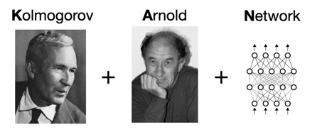
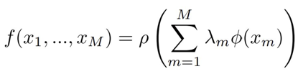
Kolmogorov-Arnold Networks
A new AI architecture promises a revolution in how we understand and construct neural networks.
Dubbed the Kolmogorov-Arnold Network (KAN), this innovative framework from MIT is poised to transform traditional models with its unique approach.
https://medium.com/@isaakmwangi2018/a-simplified-explanation-of-the-new-kolmogorov-arnold-network-kan-from-mit-cbb59793a040
https://arxiv.org/abs/2404.19756
https://github.com/KindXiaoming/pykan
https://kindxiaoming.github.io/pykan/
Imagine you have a big box full of all sorts of colorful building blocks. The Kolmogorov-Arnold representation theorem says that no matter how complicated a building you can make with those blocks, you only need two special moves:
You can use single-colored blocks, like only blue blocks or only green blocks.
You can stack the single-colored block buildings on top of each other.
Neural networks can compute any function. https://www.youtube.com/watch?v=O45AaRPQhuI
Kolmogorov-Arnold representation:
any continuous multivariate function can be presented by using two functions (outer and inner): ρ and Φ :
Traditional Neural Networks (MLPs): Information moves in "layers" (like building upwards). Each "neuron" does a simple calculation and passes it on to the next layer.
Kolmogorov-Arnold Networks (KANs): Information flows along connections between pieces, like putting puzzle pieces together. Each connection has its own function, like a strangely shaped puzzle piece that changes the information it connects.

Slide 14

Longevity Escape Velocity
“Today, by some estimates, science is adding about
three (3) months to your lifespan every year.
In the near future (at some point), additional scientific breakthroughs will extend your lifespan
by more than a year for every year you remain alive.
Once that happens, we have reached Longevity Escape Velocity.”
Question:
when we might reach Longevity Escape Velocity.
Ray Kurzweil:
“Sooner Than You Might Imagine! For those in reasonably good shape and with reasonable means, I believe they will have access to longevity escape velocity by the end of 2030.”

Slide 15
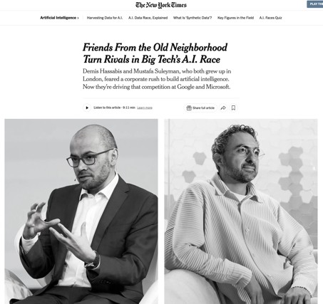
Demis Hassabis and Mustafa Suleyman
Demis Hassabis and Mustafa Suleyman:
both grew up in London and knew each other.
Nowadays:
Dr. Hassabis, 47, is the chief executive of Google DeepMind
Mr. Suleyman, 39, was recently named Chief Executive of Microsoft AI overseeing A.I. consumer products.
https://www.nytimes.com/2024/04/29/technology/ai-google-microsoft.html

Slide 16
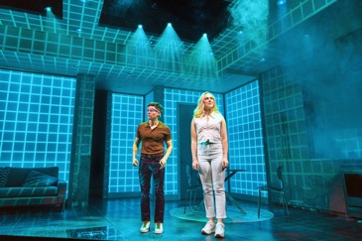


Scarlett Dreams
Scarlett Dreams - Off-Broadway Play
Directed by S. Asher Gelman
Greenwich House Theater, NY,NY
SYNOPSIS: Two siblings, Milo and Liza, have created a fitness app "RealFit" for a virtual reality headset that runs on artificial intelligence.
Against Milo’s better judgment, they convince Milo’s husband, Kevin, to be their beta tester. Kevin quickly become obsessed with Scarlett - an AI fitness instructor programmed by Liza.
The AI app begins to change the world as they know it by changing people's motivations and destroying relationships.
The play is very energetic, engaging, funny
https://playbill.com/production/scarlett-dreams-off-broadway-greenwich-house-theater-2024
https://www.tiktok.com/@scarlettdreamsplay/video/7358121249899449646

Slide 17
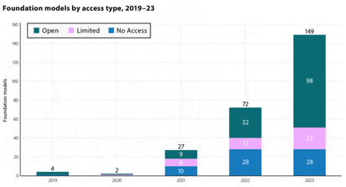
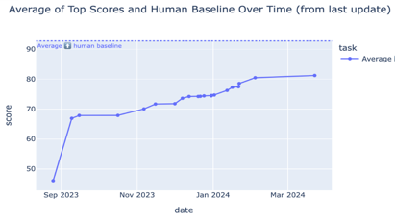
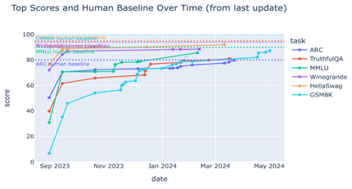
Open Source Growth 2019-2023
https://huggingface.co
Models: 635K (was 300K in January)
Text generation : 88K (was 20K+ in Summer 2023)
Text Classification : 58K
Text2Text Generation: 28K
etc.
Datasets: 141K (was 60K in September 2023)

Slide 18
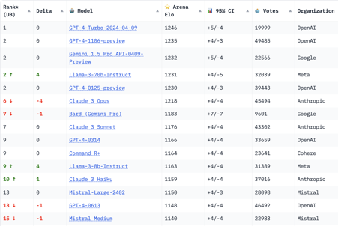


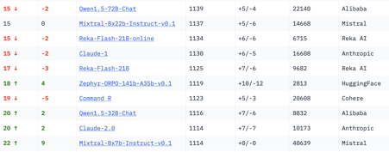
Crowd-sourced "Arena" Leaderboard
Total #models: 92
Total #votes: 910,122
Last updated: 2024-05-01
Starting Elo rating = 1000
95% CI = Confidence Interval
https://chat.lmsys.org/?leaderboard
This is for English-only queries.
Llama3 70b is on 2nd place, better than Claude 3 Opus
Llama3 8b is like Claude 3 Sonnet, better than Mixtral 8x22b
The GPT-3.5-Turbo-0613 is on 27th place

Slide 19



AI bots are flooding job postings with applications
Software Engineers REAL problem with "AI" and Jobs
https://youtu.be/NQmN6xSorus?si=tobwvNj8T2iiNYe6
AI bots are flooding job postings with applications - thus making it almost impossible for competent software engineers to have their resumes seen by hiring managers. Linkedin and other services stopped being as effective as they used to be.
AI bots use GPT-generated spam cover letters and auto-submitted resumes with buzzwords added to match the job posting list. And they can submit your resume to different postings 100s of times per hour.
AI bots to screen out applicants. These are becoming a necessity as the number of bot submitted job applications is otherwise too large for humans to filter
You can't beat the "AI" at job postings!
So the best thing to do is go back to the old ways - talk to humans. Meet with people. Meetup groups. Conferences. Organizations. Call the recruiters yourself. Find their websites - and call them. Human to human.
To stand out, add more to your packaging - articles, videos, books, github, personal website.
Recruiters also return to old-school methods: https://www.wired.com/story/recruiters-ai-application-overload/
https://www.forbes.com/sites/jodiecook/2023/12/08/outsmarting-ai-the-new-challenge-for-job-seekers-and-employers
https://www.cbsnews.com/news/ai-job-applications-mass-apply-autofill-job-search/
https://theconversation.com/computer-says-no-more-employers-are-using-ai-to-recruit-increasing-the-risk-of-discrimination-218598
Skills-based hiring for IT: The White House Press Release: National Cyber Director Encourages Adoption of Skill-Based Hiring to Connect Americans to Good-Paying Cyber Jobs
https://www.whitehouse.gov/oncd/briefing-room/2024/04/29/press-release-wh-cyber-workforce-convening/

Slide 20
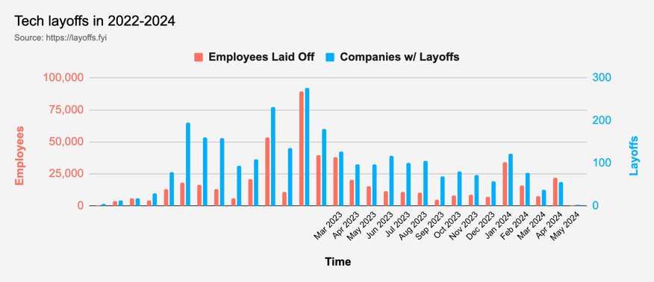
Tech Layoffs were lower than in 2023
Layoffs - https://layoffs.fyi
Salaries for AI engineers rose 12% from the third to fourth quarter last year
The average salary for a senior AI engineer nationally is more than $190,000, according to Comprehensive.io.
AI has a talent shortage, meaning $1 Mln salary job offers! Even during tech layoffs

Slide 21


About the Speaker
Lev Selector, Ph.D.
40+ years of software engineering, data science, and building teams (hiring, training, and managing)
Ph.D. in mathematical modeling and computer simulations
Interests:
Generative AI, Using LLM with your data
Local AI for Local Private Data
Cloud architecture, fin-tech, application security
Find/connect: Linkedin, GitHub, YouTube, Google
https://eais.ai
Enterprise AI Systems

Slide 22
Thank You!

