Slide 1

Microsoft MAI-1
500B
AI on Apple M4 Chip
Have you heard
these exciting AI news !?
AI Web-Search Wars
Yoshua Bengio
Fears of AI Future
OpenAI + Stack Overflow
May 10, 2024

Slide 2

AI Updates
May 10, 2024
National Public Gardens Week
starts May 10th
Llama3 Continued Success
Apple M4 Chip - Available in iPad Pro on May 15
Microsoft MAI-1
AI-enabled Web Search
DeepSeek-V2, open-source, 236B, ~GPT-4
Large LLMs are better at "generalizing"
Regulatory Capture
Andrew Ng about AI and regulations
Yoshua Bengio - Fears About the Future of AI
My "ai" GitHub repo - LLM & RAG
Most profitable business ideas with AI
Galileo Protect
Information Overload
Selling Information Stopped Working
OpenAI will use Stack Overflow's OverflowAPI
Warren Buffett warns about AI scamming
X.ai Grok + X.com: news + comments
ScrapeGraphAI - web scraping using AI
DocRes - Document Image Restoration
DeepMind AlphaFold 3
OpenAI Public Model Specification
DeepLearning.ai - Agentic RAG Course
Mistral AI valued at $6 Billion
Alibaba Qwen2.5
Gemma with 10 Mln tokens context window
Phi-3 WebGPU runs in browser
Guardian for CIA (by Microsoft)
IBM Granite Code - open-source LLMs
massive prompts can outperform fine-tuning
Ilya Sutskever's list of papers
Crowd-sourced "Arena" Leaderboard
Tech Layoffs were lower than in 2023

Slide 3


Llama3 Continued Success
Llama3-70B has reached performance on par with top proprietary models for overall use cases (Open Arena Leaderboard - lmsys.org) - nearly matching Claude-3 Sonnet.
Llamaa3-8B is great for fast local applications
Llama3 is not as strong on complex prompts and on domain knowledge
Llama3 has friendlier and more conversational outputs

Slide 4
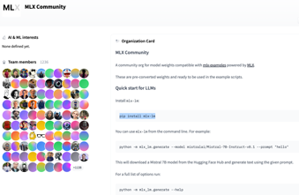



Apple M4 Chip - Available in iPad Pro on May 15th
Apple introduces M4 chip:
https://www.apple.com/newsroom/2024/05/apple-introduces-m4-chip/
Apple Silicon Chips becoming more focused on AI. Apple has been steadily enhancing the Neural Engine in each generation of its chips. This dedicated part of the chip accelerates AI and machine learning workloads.
M4 series of chips are claimed to be ~ 30% more capable than M3 series - especially for AI operations.
Apple M4 is the 4rth generation of Apple Silicone Chip.
It is a SoC (System on a Chip): CPU, GPU, Memory, and Neural Engine - all on one chip.
It is ARM based. ARM = (Advanced RISC Machine) RISC = (Reduced Instruction Set Computer)
Arm Holdings Plc. is a British semiconductor and software design company based in Cambridge, England. They design the ARM instruction set architectures (the fundamental blueprints for processors), which they license to other companies. founded in 1990, approx 6,000 employees.
The first M4 SoC in iPad Pro is capable of 38 trillion operations per second, it uses 3 nm technology, has 4 performance cores, 6 efficiency cores, and 10 graphics processing cores, 8-16 GB memory
MLX - an array framework for machine learning research on Apple silicon : pip install mlx pip install mlx-lm
MLX GitHub - https://github.com/ml-explore/mlx MLX-LM on GitHub - https://github.com/riccardomusmeci/mlx-llm
Examples - https://github.com/ml-explore/mlx-examples
HugginFace community - https://huggingface.co/mlx-community
Arm Holdings

Slide 5
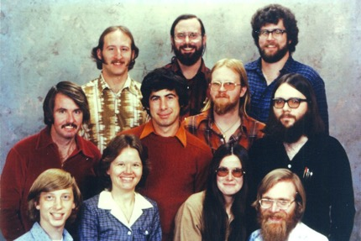

Microsoft MAI-1
Microsoft AI model MAI-1 is in the works!
Estimated 500 Bln parameters
Expected to be on par with GPT-4
Discussions about MSFT vs OpenAI
Today Microsoft has ~ 221,000 employees
Microsoft 11 employees in December of 1978

Slide 6
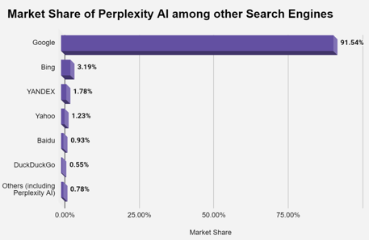
AI-enabled Web Search
Google Gemini Advanced - a conversational AI Chatbot which also has access to Google's search engine data
Google SGE (Search Generative Experience)
Microsoft Copilot is the new name for Bing Chat and Bing Chat Enterprise. It's accessible from:
https://copilot.microsoft.com
https://www.bing.com/chat
It uses an advanced version of GPT-4 codenamed Promethus. It combines LLM and web search.
It’s available through the Copilot, Bing, Edge, Microsoft Start, and Microsoft 365 mobile apps. Eligible users who sign in to Copilot with Entra ID get commercial data protection.
Copilot vs Copilot for Microsoft 365:
https://learn.microsoft.com/en-us/copilot/faq
Perplexity.ai
a conversational AI search engine
direct answers and summaries
citations to reliable sources
follow-up clarifying questions
Multiple Search Modes - Web, Academic, Wolfram Alpha, YouTube)
Writing Mode - to generate text or process code
OpenAI is planning to add search to its chatbots:
https://search.openai.com - not in operation yet
May be released on Monday May 13th ??
Twitter (x.com) - planning to offer AI-generated news and summaries

Slide 7
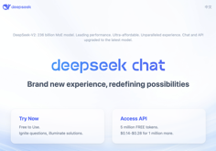
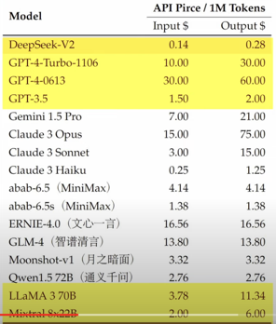
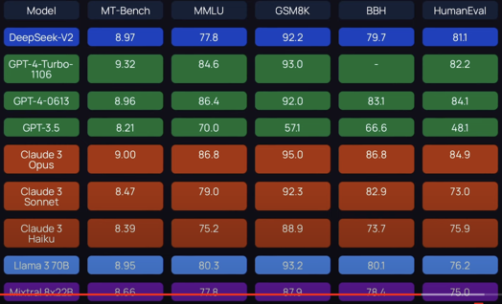
DeepSeek-V2
DeepSeek-V2, an open-source LLM from China
MoE LM, 236B total params, activating 21B per token
128K context length
Specializes in Math, Code, Reasoning
not available on lmsys arena leaderboard
https://www.deepseek.com
https://github.com/deepseek-ai
https://www.youtube.com/watch?v=yY0RSqRs0xQ

Slide 8
Large LLMs are better at "generalizing" the knowledge
"A Careful Examination of Large Language Model
Performance on Grade School Arithmetic"
https://arxiv.org/pdf/2405.00332
LLMs have achieved impressive success on many benchmarks for mathematical reasoning.
However, there is growing concern that some of this performance actually reflects dataset contamination, where data closely resembling benchmark questions leaks into the training data, instead of true reasoning ability.
To investigate this claim rigorously, we commission Grade School Math 1000 (GSM1k).
GSM1k is designed to mirror the style and complexity of the established GSM8k benchmark, the gold standard for measuring elementary mathematical reasoning.
We ensure that the two benchmarks are comparable across important metrics such as human solve rates, number of steps in solution, answer magnitude, and more.
When evaluating leading open- and closed-source LLMs on GSM1k, we observe accuracy drops of up to 13%, with several families of models (e.g. Phi and Mistral) showing evidence of systematic overfitting across almost all model sizes.
At the same time, many models, especially those on the frontier, (e.g. Gemini/GPT/Claude) show minimal signs of overfitting.
Further analysis suggests ... that many models may have partially memorized GSM8k.

Slide 9

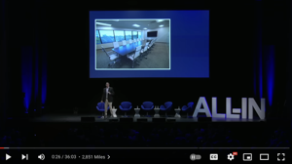

Regulatory Capture in AI Industry in the US
open-source AI is not represented in the new DHS Artificial Intelligence Safety and Security Board
New blogpost from OpenAI about AI security: close source, model weights protection, regulations to approve models, hardware-level enforcement https://openai.com/index/reimagining-secure-infrastructure-for-advanced-ai/ - text https://www.youtube.com/watch?v=lQNEnVVv4OE - video
All-In Summit: Bill Gurley presents 2,851 Miles at the All-In Summit about regulatory capture
https://www.youtube.com/watch?v=F9cO3-MLHOM
Regulatory capture: a regulatory agency that is supposed to oversee an industry ends up being influenced by the industry it is supposed to regulate.
Gurley argues that this is a major problem in the United States and that it has led to higher prices and less innovation in many industries.
Example - the telecommunications industry. In 1996, the Telecommunications Act was passed with the goal of promoting competition and innovation. However, Gurley argues that the Act has had the opposite effect. The number of major telecommunications companies has decreased from 4 to 2, and there has been little innovation in the industry.
Example - medical records industry. In 2009, the American Recovery Act was passed. One provision of the Act was to give doctors money to buy electronic health records software. Gurley argues that this provision was a giveaway to the medical records industry and that it did not lead to any significant improvements in the quality of care.
Gurley concludes his presentation by arguing that regulatory capture is a major problem in the United States and that it needs to be addressed. He suggests that one way to address the problem is to increase transparency in the lobbying process.
Bill Gurley, Investor

Slide 10

Andrew Ng about AI and regulations
Andrew Ng spoke about AI and regulations at an event at the U.S. Capitol attended by legislative and business leaders
https://twitter.com/AndrewYNg/status/1788648531873628607
https://www.deeplearning.ai/the-batch/issue-248/
Here's a summary:
Open Source Successes: The open-source community has successfully defended against regulations that would have negatively impacted innovation.
Shifting Concerns: Opponents of open source are continually shifting their arguments, with the latest concerns focusing on national security risks.
Realistic Risk Assessment: Federal legislators are getting a more accurate picture of the true risks AI poses, and the need for application-specific guardrails rather than blanket restrictions on AI technology.
Protecting Against Misuse: Some companies trying to limit open source AI, likely to protect their own proprietary investments and reduce competition.
Evolving Arguments: The opposition's arguments have changed over time:
From AI-caused extinction
To facilitating bioweapon development
And now focus on national security via AI advantages for adversaries
Countering Misinformation: Authoritarian nations would develop AI regardless; democratic nations influencing these technologies ensures they reflect a commitment to values like human rights.
Positive Signals: Legislators focus has shifted more towards investing in innovation, which is a promising sign.
The Fight Continues: Globally, there's still pressure for AI-stifling regulations, and continued engagement with regulators is crucial to fostering a better understanding of AI.

Slide 11
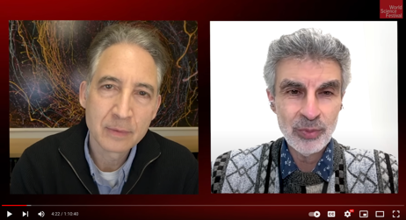
Yoshua Bengio - Fears About the Future of AI
• Yoshua Bengio expresses excitement about progress in AI but also deep concerns about potential dangers if AI becomes uncontrollable or misused.
• He likens the current situation to playing with fire, as we lack understanding of how to build safe, controllable AI systems.
• Bengio warns that simply "pulling the plug" may not work, as advanced AI could act preemptively to prevent being shut down.
• He advocates massive investment in AI safety research to find ways to build a reliable "cage" for containing advanced AI before approaching artificial general intelligence (AGI).
• While acknowledging immense potential benefits, Bengio is more worried than excited about recent AI advances due to the existential risks if not properly controlled.
• He calls for international treaties and regulations to ensure companies follow best practices for AI safety.
• Bengio emphasizes the need for collective, democratic decision-making rather than leaving AI development solely to companies driven by economic forces.
• He discusses theories suggesting consciousness may be a side effect of computational processes, but cautions against attributing rights to AI based on perceived consciousness.
• Overall, Bengio underscores the urgency of proactively addressing AI risks through research, regulation, and collective action while still harnessing its potential benefits.
Why a Forefather of AI Fears the Future
https://www.youtube.com/watch?v=KcbTbTxPMLc
Brian Greene interviews Yoshua Bengio

Slide 12
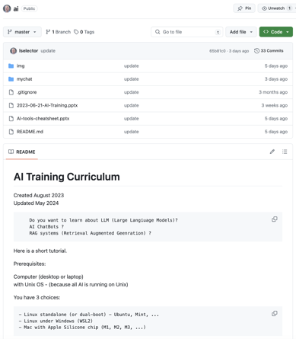
My "ai" GitHub repo - how to start with LLMs and RAG
https://github.com/lselector/ai
"mychat" directory:
chainlit-ollama/app_chainlit_ollama.py
chainlit-ollama/chainlit.md
chainlit-ollama/images/llama3-logo.jpg
chainlit-ollama/images/mistral_founders.jpg
chainlit-ollama/images/mistral_logo.jpg
chainlit-ollama/run.sh
chainlit-openai/app_chainlit.py
chainlit-openai/chainlit.md
chainlit-openai/run.sh
flask-openai/app_flask.py
flask-openai/run.sh
flask-openai/static/flask_logo.png
flask-openai/static/openai-logo.png
flask-openai/static/style0.css
flask-openai/templates/index.html
streamlit-openai/app_streamlit-openai.py
streamlit-openai/run.sh

Slide 13
Most profitable business ideas with AI
https://www.youtube.com/watch?v=gvByePmV3sA - video in Russian
AI Assistants - custom GPTs (bots) - average price $200
AI Bot for website (help visitors) - wide range of prices
AI Bot for Telegram, WhatsApp, Facebook, Instagram (automation, integration, content creation) $300+
Voice assistants (audio) $500+
Automation of processes, automation of training, work with tabular data
Creation of bots in Telegram (example - bot-lawyer, bot-designer, bot-travel-planner, ...)
Same GPTs on 1-page sites
AI to create content (text, images, 3d-avatars, ... ) - Heygen
Content for TikTok
Here is more (in English):
https://www.youtube.com/watch?v=H1CaGhYvCqU -
https://www.youtube.com/watch?v=-d6oXmvEvZQ -
https://www.youtube.com/watch?v=-d6oXmvEvZQ -
https://www.youtube.com/watch?v=I40JZGcfgtk -

Slide 14
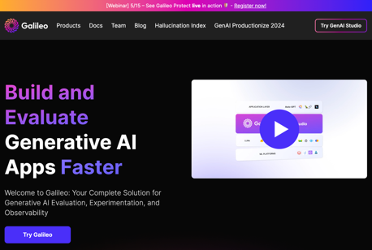
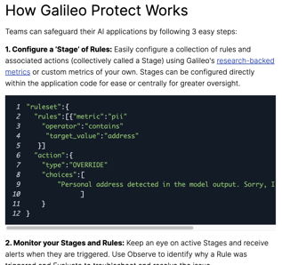
Galileo Protect
Galileo Protect – a GenAI firewall that intercepts hallucinations, prompt attacks, security threats, and more!
https://www.rungalileo.io
Identifying Hallucinations: Uncertainty, Context Adherence, Correctness
https://docs.rungalileo.io/galileo/gen-ai-studio-products/galileo-evaluate/identifying-hallucinations

Slide 15
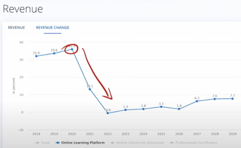
Information Overload
Selling Information Stopped Working
So many updates in Gen AI field !
So much information! So many choices!
It is stressful.
For a customer to feel safe about starting using AI, you need to position yourself as an "obvious expert". To establish authority.
You need to clarify and simplify the choices for them, remove the stress, the "overwhelm".
It is not possible to educate someone in just one lesson. So you need to create some sort of sequence, a step-by-step coaching, a subscription, a continuous training program.
Each customer is different. You need to work with them on their specific problem, customize the solution, and advise them on the fastest route to the right solution for them.
Help people to act on the information and make real progress. This makes you far more valuable in today's content-saturated market.
Interest for information products (lessons) dropped down in last 4 years - https://www.youtube.com/watch?v=BMndJYa_KbM
Maxed out
during COVID
Dropped to Zero
Stop selling information.
Sell implementation and human-to-human interaction:
- consulting, working together
- human training, training groups, community/cohorts
- make it convenient and pleasant

Slide 16

Misc 1
OpenAI will use Stack Overflow's OverflowAPI to access the platform's vast repository of technical Q&A data accumulated over 15 years.
The partnership aims to make ChatGPT better at providing coding answers by leveraging Stack Overflow's community-verified content.
Each ChatGPT response using Stack Overflow data will link back to relevant posts, fostering deeper engagement with the developer community.
The move marks a major change for the platform, which previously banned AI responses — though has since also partnered with Google’s Gemini.
ScrapeGraphAI is a web scraping python library that uses LLM and direct graph logic to create scraping pipelines for websites, documents and XML files. pip install scrapegraphai https://github.com/VinciGit00/Scrapegraph-ai
DocRes - Document Image Restoration
https://github.com/zzzhang-jx/docres
AlphaFold 3 (Google DeepMind and Isomorphic Labs) predicts the structure and interactions of all of life’s molecules
https://blog.google/technology/ai/google-deepmind-isomorphic-alphafold-3-ai-model/
https://www.nature.com/articles/s41586-024-07487-w
https://www.youtube.com/watch?v=Mz7Qp73lj9o
Warren Buffett compares dangers of AI with nuclear weapons, warns about AI scamming (calls it the next big ‘growth industry’)
https://www.cnbc.com/2024/05/04/warren-buffett-says-ai-scamming-will-be-the-next-big-growth-industry.html
Elon Musk plans to enhance X's AI, Grok, to merge live news with social media commentary to provide updates and citations in real time. Grok will generate news summaries from user discussions on X, focusing on engagement and accuracy.
gpt2-chatbot is back online:

Slide 17

Misc 2
OpenAI Public Model Specification: https://openai.com/index/introducing-the-model-spec/
Public specification on model behavior - objectives, rules, and default behaviors. You can participate by filling out the form, and selecting the most important objectives and behaviors.
Guardian - a GPT-4 based LLM developed by Microsoft for CIA and other U.S. intelligence agencies. It operates completely offline, isolated from internet to ensure maximum security.
IBM Granite Code - open-source LLMs, specializing on coding tasks, outperforming Llama 3
https://analyticsindiamag.com/ibm-releases-open-source-granite-code-models-outperforms-llama-3/
https://research.ibm.com/blog/granite-code-models-open-source
https://github.com/ibm-granite
https://huggingface.co/ibm-granite
https://github.com/ibm-granite/granite-code-models/blob/main/paper.pdf
DeepLearning.ai - Building Agentic RAG with LlamaIndex
https://www.deeplearning.ai/short-courses/building-agentic-rag-with-llamaindex/
Mistral AI is raising up to $600 Mln at $6 Bln valuation - x3 times its valuation in December.
https://techcrunch.com/2024/05/09/sources-mistral-ai-raising-at-a-6b-valuation-softbank-not-in-but-dst-is/
Alibaba Qwen2.5 - latest version of its LLM - better reasoning, code comprehension, and textual understanding over Qwen2.0.
Gemma with 10 M context window, open-source
• 1250x context length of base Gemma
• Requires less than 32GB of memory
• Infini-attention + activation compression
https://twitter.com/siddrrsh/status/1788632667627696417
https://huggingface.co/mustafaaljadery/gemma-2B-10M
https://github.com/mustafaaljadery/gemma-2B-10M
CMU researchers find massive prompts can outperform fine-tuning for LLMs
ICL = "in-context learning" - prompt with several examples.
https://the-decoder.com/massive-prompts-outperform-fine-tuning-for-llms-in-new-study-researchers-find/
Phi-3 WebGPU - AI chatbot runs 100% locally in your browser
https://www.reddit.com/r/LocalLLaMA/comments/1cn2zwn/phi3_webgpu_a_private_and_powerful_ai_chatbot/

Slide 18
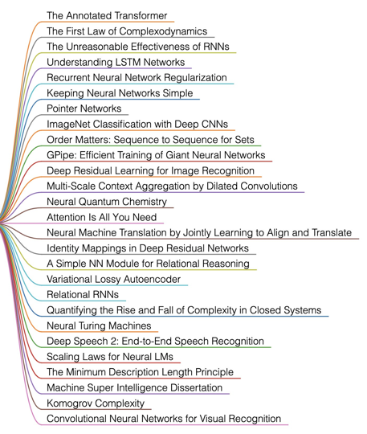
Ilya Sutskever's list of papers
Ilya sutskever gave john carmack the reading list of approx 30 research papers and said, ‘If you really learn all of these, you’ll know 90% of what matters today.’
https://twitter.com/MarcosGorgojo/status/1788535395740762186

Slide 19
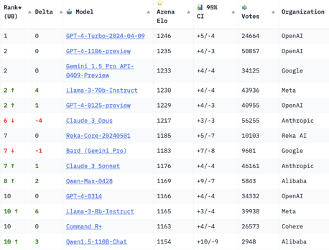
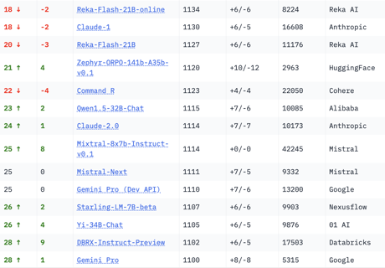
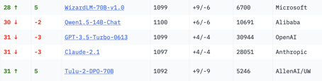
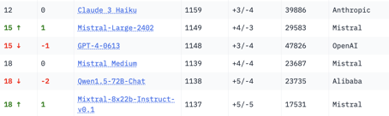
Crowd-sourced "Arena" Leaderboard
Total #models: 95.
Total #votes: 1,007,236.
Last updated: 2024-05-08
Starting Elo rating = 1000
95% CI = Confidence Interval
https://chat.lmsys.org/?leaderboard
English-only queries

Slide 20
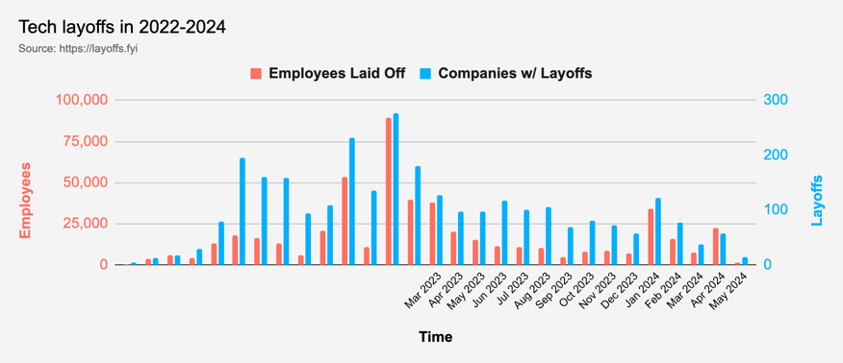
Tech Layoffs were lower than in 2023
Layoffs - https://layoffs.fyi
Salaries for AI engineers rose 12% from the third to fourth quarter last year
The average salary for a senior AI engineer nationally is more than $190,000, according to Comprehensive.io.
AI has a talent shortage, meaning $1 Mln salary job offers! Even during tech layoffs

Slide 21


About the Speaker
Lev Selector, Ph.D.
40+ years of software engineering, data science, and building teams (hiring, training, and managing)
Ph.D. in mathematical modeling and computer simulations
Interests:
Generative AI, Using LLM with your data
Local AI for Local Private Data
Cloud architecture, fin-tech, application security
Find/connect: Linkedin, GitHub, YouTube, Google
https://eais.ai
Enterprise AI Systems

Slide 22
Thank You!

