Slide 1
AI Updates
June 21, 2024
Anthropic Sonnet v.3.5
Ollama Concurrent Models
Calling models without LangChain or LlamaIndex
DELL AI Workstations - 96GB GPU memory
Snapdragon X Elite Laptops
Ilya Sutskever starting a new company
NVIDIA Nemotron 4 340B
Google now offers ‘web’ search
DeepSeek-Coder-V2
deeplearning.ai course "Function-Calling ..."
Nvidia surpassing Microsoft
AI factory for xAI with 100K H100 GPUs
Runway’s Gen-3 Alpha Video Generation
Meta Chameleon and other new models
Subobject-level Image Tokenization for Images
Decagon human-like AI customer support
Claudette python library
The Last Screenwriter (movie)
Apple models and datasets on Huggingface
factory.ai - AI-powered Software Development
Self-hosting LLMs on cloud - expensive
AI in Finance - jobs displacements
Meta Llama3-400b - in July ?
Simulations of Cyberattacks on AI systems
Andrej Karpathy "Micrograd"
Crowd-sourced "Arena" Leaderboard
Tech Layoffs were lower than in 2023

Slide 2

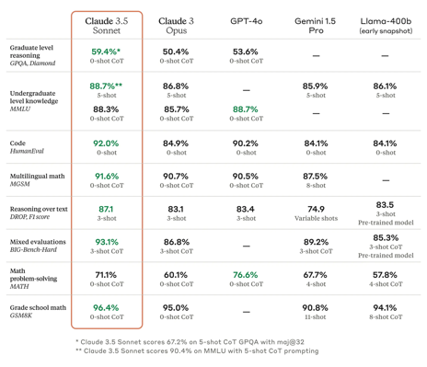
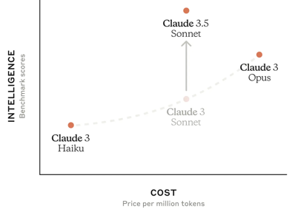
Anthropic Sonnet v.3.5
Anthropic has just released new version of their Sonnet - v.3.5
https://www.anthropic.com/news/claude-3-5-sonnet
https://x.com/anthropicai/status/1803790676988920098
Surpasses gpt-4o, x2 faster than 3.0 Opus, x2 more intelligent, 80% cheaper - $3 in/ $15 out per 1M tokens
Context Window - 200K
The model excels in graduate-level reasoning (GPQA), undergraduate-level knowledge (MMLU), and coding proficiency (HumanEval)
Opus and Haiku models coming later this year

Slide 3
Run Multiple Models In Parallel - Ollama example
Both LM Studio and Ollama allow to run multiple models at once in parallel.
For Ollama:
export OLLAMA_NUM_PARALLEL=4 # multiple requests simultaneously for a single model
export OLLAMA_MAX_LOADED_MODELS=4 # load multiple models simultaneously
ollama serve
https://www.youtube.com/watch?v=Cd6f86zsAyg
https://github.com/mneedham/LearnDataWithMark/blob/main/ollama-parallel/app.py
https://www.markhneedham.com/blog/2024/05/11/side-by-side-local-llms-ollama-streamlit/
import ollama, asyncio
from openai import AsyncOpenAI
from token_count import TokenCount
client = AsyncOpenAI(base_url="http://localhost:11434/v1", ap_key="ignore-me")
models = [ m['name'] for m in ollama.list()["models"] if m["details"]["family"] in ["llama", "gemma"] ]
async def run_prompt(placeholder, meta, prompt, model):
tc = TokenCount(model_name="gpt-3.5-turbo")
stream = await client.chat.completions.create(
model=model,
messages=[{"role":"system","content":"You are a helpful assistant."},
{"role":"user" ,"content":prompt"},], stream=True)
async for chunk in stream:
chunk_content = chunk.choices[0].delta.content
if chunk_content is not None:
...
async def main():
await asyncio.gather(
run_prompt( body_1, meta_1, prompt=prompt, model=model_1),
run_prompt( body_2, meta_2, prompt=prompt, model=model_2))

Slide 4
Calling models without LangChain or LlamaIndex
from openai import OpenAI
import ollama
# bag is a custom dictionary class, used to pass parameters
def call_model(bag, prompt_string):
""" accepts/returns string """
if bag.arg_service == "ollama": # -------------------------------------
if not test_avail(bag, "client"):
bag.client = ollama.Client()
resp = bag.client.generate(model=bag.arg_model, prompt=prompt_string)
ss = resp['response']
if type(ss) != str:
ss = ss.content
return ss
elif bag.arg_service == "openai": # -------------------------------------
if not test_avail(bag, "client"):
bag.client = OpenAI()
resp = bag.client.chat.completions.create(
model=bag.arg_model,
messages=[
{"role": "system", "content": "You are a helpful assistant."},
{"role": "user", "content": prompt_string}
])
ss = resp.choices[0].message.content
if type(ss) != str:
ss = ss.content
return ss
else: # -------------------------------------
print("ERROR in call_model() - wrong model, Exiting ... ")
sys.exit(1)

Slide 5
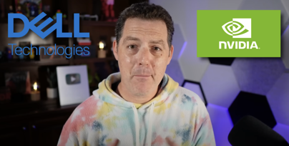
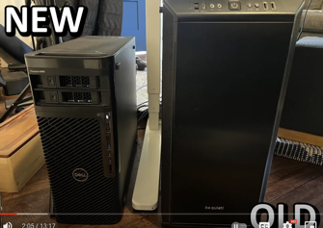

DELL AI-Ready Workstations
https://www.dell.com/en-us/dt/ai-technologies/
Precision 5860 Tower Workstation - $24K+
Intel® Xeon® W7-2475X (37.5 MB cache, 20 cores, 40 threads)
Dual NVIDIA® RTX™ A6000 Ada, 2*48 = 96GB total
128GB RAM (8 x 16 GB) DDR5
2*4TB SSD
Matthew Berman testing DELL
https://www.youtube.com/watch?v=8HC6aRMmg3I
https://www.dell.com/en-us/shop/desktop-computers/precision-5860-tower/spd/precision-5860-workstation/xctopt5860us_vp?configurationid=1cda8e9b-b3af-40fb-a43d-72242abd5f55
Tested models running in parallel using LM Studio:
llama-3-70b-instruct q8
Mistral-7b-instruct fp16 (42 t/s)
llama-3-70b-instruct q6
Phi-3-mini-4k-Instruct fp16 (~60 ts)
llama3-8b-Instruct q8
llama3-8b-Instruct q4 (~60 ts) (12t/s if run 10 in parallel)
Phi-3-medium-128k-instruct f32

Slide 6



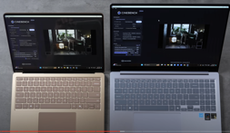
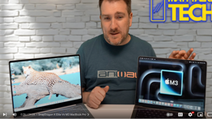
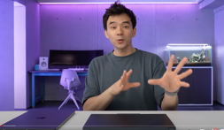
Snapdragon X Elite Laptops - 30+ hrs battery life, Sys-on-Chip
Dell - https://www.dell.com/en-us/shop/laptops/snapdragon/spd/xps-13-9345-laptop (a 64GB memory with 1TB SSD - $2K, 3 days delivery)
Lenovo ThinkPad T14s Gen 6 - up to 64GB memory, 2.7 lbs
https://www.lenovo.com/us/en/p/laptops/thinkpad/thinkpadx/thinkpad--x13s-(13-inch-snapdragon)/len101t0019
https://www.youtube.com/watch?v=gxc5kvzoddE
Asus Vivobook S 15 - https://www.asus.com/us/news/mm4mlmblcvod5vin/
Samsung Galaxy Book4 Edge 16" screen
Microsoft Surface - https://www.youtube.com/watch?v=GZy5NOYwYiw
Acer - https://www.acer.com/us-en/laptops/swift/swift-14-ai
HP - https://www.hp.com/us-en/shop/vwa/business-solutions/proc=Snapdragon
Snapdragon has CPU, GPU, and NPU Hexagon 45 TOPS.
GPU is Adreno, it uses OpenCL instead of CUDA.
But you can run PyTorch using NPU: https://developer.qualcomm.com/sites/default/files/docs/snpe/setup_pytorch.html
Microsoft vs Samsung
SnapDragon vs Mac
Dave2D:
Macbooks finally have competition

Slide 7
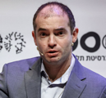



Ilya Sutskever starting a new company
Ilya Sutskever starting a new company:
Safe Superintelligence Inc. ( ssi )
https://twitter.com/ssi/status/1803472825476587910
https://ssi.inc
Superintelligence is within reach.
Building safe superintelligence (SSI) is the most important technical problem of our​​ time.
We've started the world’s first straight-shot SSI lab, with one goal and one product: a safe superintelligence.
It’s called Safe Superintelligence Inc.
SSI is our mission, our name, and our entire product roadmap, because it is our sole focus. Our team, investors, and business model are all aligned to achieve SSI.
We approach safety and capabilities in tandem, as technical problems to be solved through revolutionary engineering and scientific breakthroughs. We plan to advance capabilities as fast as possible while making sure our safety always remains ahead.
This way, we can scale in peace.
Our singular focus means no distraction by management overhead or product cycles, and our business model means safety, security, and progress are all insulated from short-term commercial pressures.
Ilya Sutskever Daniel Gross Daniel Levy
ssi is co-founded by Suskever,
former Y Combinator partner Daniel Gross,
and Ex-OpenAI engineer Daniel Levy
We are an American company with offices in Palo Alto and Tel Aviv, where we have deep roots and the ability to recruit top technical talent.
We are assembling a lean, cracked team of the world’s best engineers and researchers dedicated to focusing on SSI and nothing else.
If that’s you, we offer an opportunity to do your life’s work and help solve the most important technical challenge of our age.
Now is the time. Join us.
Ilya Sutskever, Daniel Gross, Daniel Levy
June 19, 2024

Slide 8

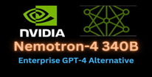

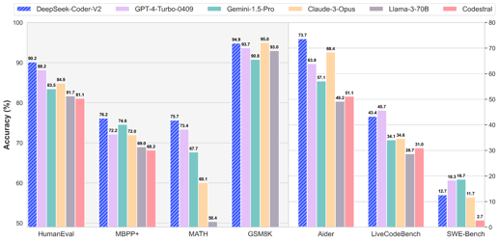
Misc 1
Google now offers ‘web’ search — and an AI opt-out button. The optional setting filters out almost all the other blocks of content that Google crams into a search results page, leaving you with links and text
NVIDIA Nemotron 4 340B is a family of open-source AI models released by NVIDIA. The models are designed to generate synthetic data for training LLMs.
The Nemotron-4 340B Reward model can be used to enhance the quality of responses generated by AI models, to filter for high-quality responses generated by AI models, based on attributes like helpfulness, correctness, coherence, complexity, and verbosity.
https://www.youtube.com/watch?v=_7QgNfpGUhM
NeMo - Framework for Building GenAI Models
https://docs.nvidia.com/nemo-framework/
DeepSeek-Coder-V2 - an open-source Mixture-of-Experts (MoE) code language model that achieves performance
comparable to GPT4-Turbo in code-specific tasks
https://github.com/deepseek-ai/DeepSeek-Coder-V2
https://www.youtube.com/watch?v=0Xp7K2rHcZg

Slide 9

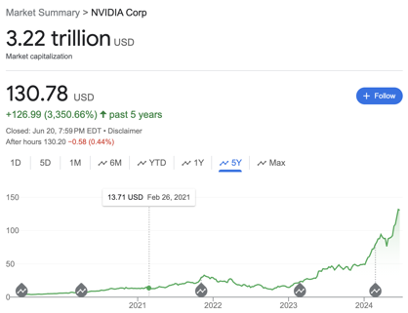
Misc 2
deeplearning.ai - new course
"Function-Calling and Data Extraction with LLMs"
Dell, Nvidia, and Super Micro Computer are building an AI factory for xAI’s massive supercomputer to train Grok AI.
Dell is assembling half of the server racks for xAI's planned supercomputer, with Super Micro handling the other half.
The system aims to use up to 100,000 Nvidia H100 GPUs, potentially making it 4x larger than the biggest existing AI clusters.
Musk wants the supercomputer to be fully operational by Fall 2025 to accelerate the development of advanced Grok models.
Nvidia grew x9 since the end of 2022, surpassed Apple and on par with Microsoft
Runway’s Gen-3 Alpha - another Sora AI Video Competitor
https://nofilmschool.com/runway-gen-3-alpha .
Meta - new models:
https://ai.meta.com/blog/meta-fair-research-new-releases/
https://twitter.com/ylecun/status/1803200026094739734
Meta Chameleon - a family of "early fusion" models that operate on images and text tokens simultaneously.
Paper - https://arxiv.org/abs/2405.09818
Code and model - https://github.com/facebookresearch/chameleon
Subobject-level Image Tokenization - https://arxiv.org/abs/2402.14327v1?utm_source=tldrai

Slide 10

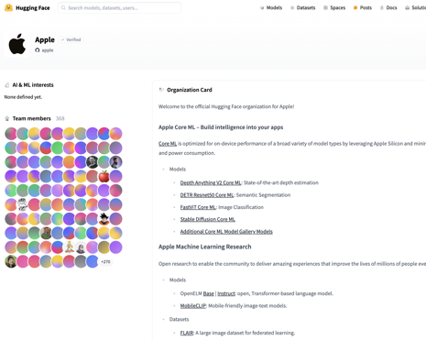
Misc 3
Decagon raises $35m Series A to build human-like AI agents for customer support. It raised a $30M Series A from Accel and $5M Seed from a16z. Decagon's product already handles global support for companies like Eventbrite, Rippling, Webflow, BILT, and Substack. - https://decagon.ai/blog/series-a
Apple contribute core models and datasets to huggingface
https://huggingface.co/apple
Claudette - a convenient python library to work with Claude models - https://claudette.answer.ai . Some features:
A Chat class that creates stateful dialogs
Support for prefill, which tells Claude what to use as the first few words of its response
Support for images
Support for Tool Use API
pip install claudette
import claudette from claudette import *
chat = Chat(model, sp="You are a helpful assistant.")
resp = chat("Why is the sky blue?")
print(resp)
The Last Screenwriter - movie, ChatGPT-generated drama
https://lastscreenwriter.com/
https://www.imdb.com/title/tt32236000/

Slide 11
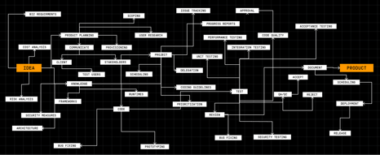

Misc 4
factory.ai raises $15M Series A
AI-powered software development tools known as Droids
https://www.factory.ai
https://www.factory.ai/news/series-a-announcement
Self-hosting LLMs on cloud is actually more expensive than using standard APIs - https://blog.lytix.co/posts/self-hosting-llama-3
AI in Finance (report by Citigroup):
https://www.citigroup.com/global/insights/citigps/ai-in-finance-bank-to-the-future
They predict that in finance many jobs will be automated by AI:
in banking - 54%
in insurance - 48%
in energy - 43%
Also report predicts that banks will hire more AI managers and compliance officers.
Meta Llama3-400b
https://llama-2.ai/llama-3-400b/
Planned for release in July
Microsoft, OpenAI & NVIDIA working with US federal agencies in case critical AI systems get attacked.
Planning the first joint simulation of a cyberattack on major critical AI systems.
https://www.firstpost.com/tech/microsoft-openai-nvidia-working-with-us-federal-agencies-in-case-critical-ai-systems-get-attacked-13783484.html

Slide 12
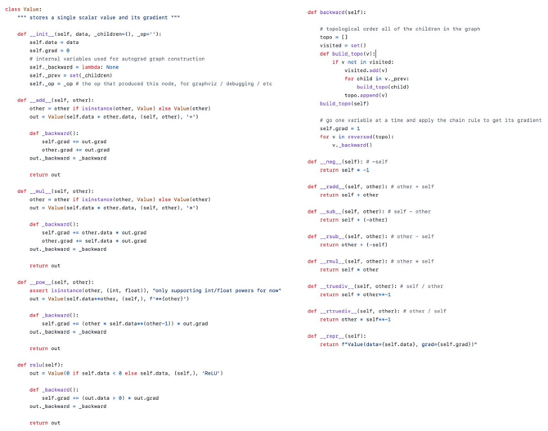
Micrograd
Andrej Karpathy "Micrograd"
"These 94 lines of code are everything that is needed to train a neural network. Everything else is just efficiency."
https://twitter.com/karpathy/status/1803963383018066272
https://github.com/karpathy/micrograd
https://www.youtube.com/watch?v=VMj-3S1tku0

Slide 13
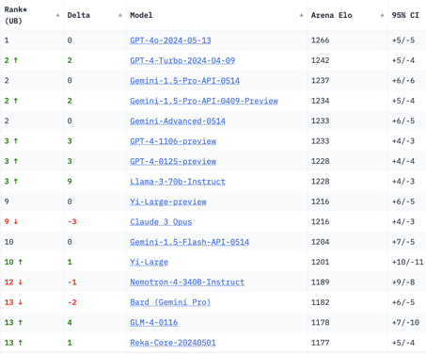
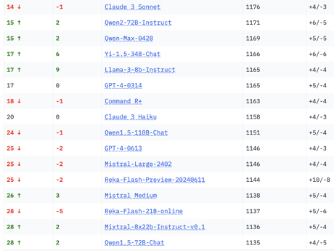
Crowd-sourced "Arena" Leaderboard
Total #models: 109.
Total #votes: 1,314,230.
Last updated: 2024-06-17.
Starting Elo rating = 1000
95% CI = Confidence Interval
https://chat.lmsys.org/?leaderboard
English-only queries

Slide 14
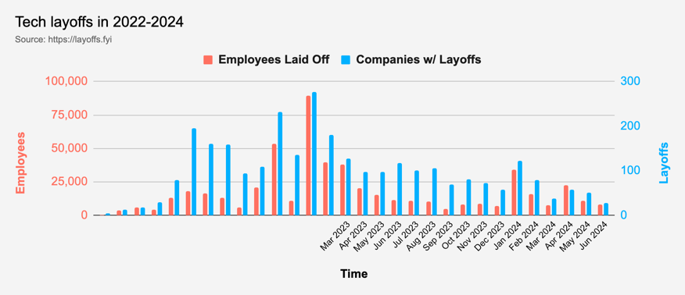
Tech Layoffs in 2024 are lower than last year
Layoffs - https://layoffs.fyi
Salaries for AI engineers rose 12% from the third to fourth quarter last year
The average salary for a senior AI engineer nationally is more than $190,000, according to Comprehensive.io.
AI has a talent shortage, meaning $1 Mln salary job offers! Even during tech layoffs

Slide 15
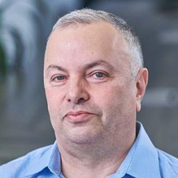

About the Speaker
Lev Selector, Ph.D.
40+ years of software engineering, data science, and building teams (hiring, training, and managing)
Ph.D. in mathematical modeling and computer simulations
Interests:
Generative AI, Using LLM with your data
Local AI for Local Private Data
Cloud architecture, fin-tech, application security
Find/connect: Linkedin, GitHub, YouTube, Google
https://eais.ai
Enterprise AI Systems

Slide 16
Thank You!

