Slide 1
AI Updates
June 28, 2024
"Learning to ask AI the right questions is the key to success"
- Jill Kramer
Claude 3.5 is #2 on Crowd-sourced Arena
Claude 3.5 is #1 for Coding on Arena
Gemini in Google Workspace Apps
Evolutionary Scale - biological model
DeepMind - training via joint-example selection
Huggingface Open LLM Leaderboard Upgraded
Rabbit R1 Security Flaw
KREA video upscaling
Google Gemma 2 - 27B and 9B
Etched "Sohu" chips for transformers
Stability AI secures new investment
imbue - training a 70B LLM to outperform GPT-4o
Amazon BASE TTS model
Anthropic Claude AI "Projects"
OpenAI CriticGPT
Low Energy LLM using Ternary Numbers (-1,0,1)
Google Vertex for Enterprise
Amazon Metis powered by Olympus
OpenAI ChatGPT on MacOS
75% of workers using AI
RAG fine-tuning
Multiple ways to extend context length
A 240T tokens dataset
Andrej Karpathy LLM101n Storyteller AI course
Chrome Canary can run Gemini locally
GPT-5 in 2025-2026
Small Language Models (SML) - on-device
AMD MI300X GPU beats H100
pdfplumber - extract tables from PDFs
ParaLLM: 1600+ tok/s on a MacBook
Don't use LangChain
Mixture-of-Agents (MoA) in 50 lines
15 Life and Work Principles from Jensen Huang
Tech Layoffs in 2024 are lower than last year

Slide 2
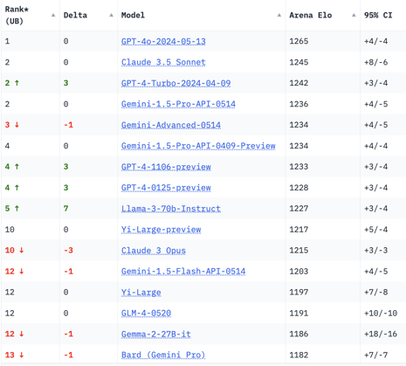
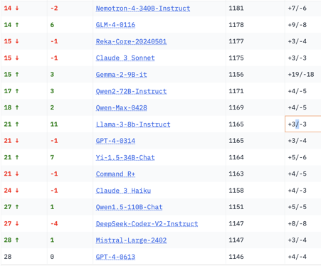
Crowd-sourced "Arena" Leaderboard
Total #models: 114.
Total #votes: 1,385,252.
Last updated: 2024-06-26.
Starting Elo rating = 1000
95% CI = Confidence Interval
https://chat.lmsys.org/?leaderboard
English-only queries

Slide 3
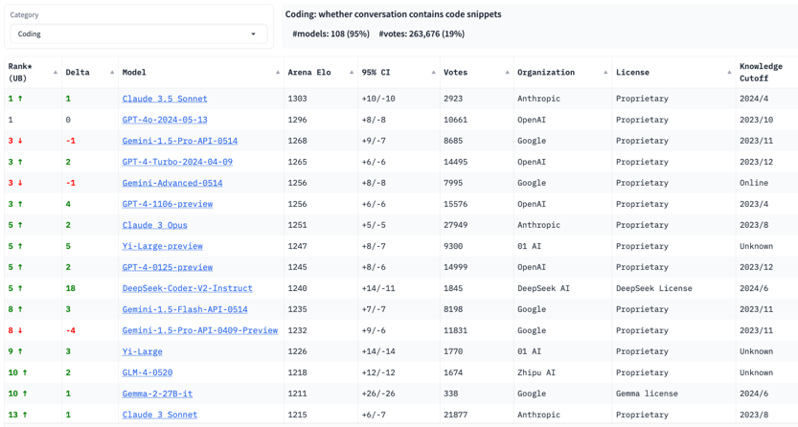
Crowd-sourced "Arena" Leaderboard - Coding
Total #models: 114.
Total #votes: 1,385,252.
Last updated: 2024-06-26.
Starting Elo rating = 1000
95% CI = Confidence Interval
https://chat.lmsys.org/?leaderboard

Slide 4
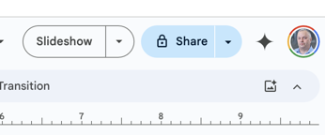
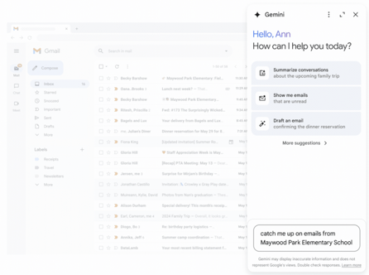
Gemini Access in Google Workspace Apps
Gemini
Gemini out to the world and is now adding it as a side panel to Google Drive, Docs, Sheets, Slides, and Gmail, the company announced Monday.
This means Gemini 1.5 Pro will soon be present as a pop-out sidebar via a button on your Google Drive. When you search or ask a question, it will sift through documents or scan data for specific information. In Gmail, Gemini can write emails or summarize incoming messages.
In Google's PowerPoint and Keynote rival Slides, the Gemini sidebar will be able to create agendas based on existing presentations, summarize presentations, create new slides, or create custom images, for example. In its Excel-like Sheets, the Gemini sidebar will generate table templates and formulas or help users sort their data in a sheet.

Slide 5


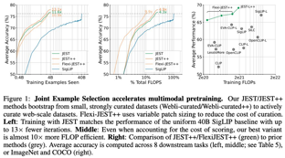
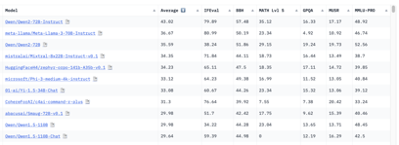
Misc 1
Evolutionary Scale, a biology startup,raises $142M
The company released foundation model, ESM 3, 98B params, trained on 771B biology tokens. It allowed to discover a novel fluorescent green protein
https://evolutionaryscale-public.s3.us-east-2.amazonaws.com/research/esm3.pdf
Rabbit R1 Security Flaw
A community-led group called Rabbitude uncovered hardcoded API keys in Rabbit’s codebase, which allowed access to all R1 responses. Rabbit acknowledged via a Discord post, but claims no customer data was leaked.
DeepMind paper - effective training using joint-example selection
"Data curation via joint example selection further accelerates multimodal learning" - DeepMind paper on how to achieve SOTA with just 10% calculations by actively selecting the next best batch
We show that picking good batches of data is more important than selecting data points independently. Small high quality datasets can be bootstrapped to leverage much larger un-curated datasets! Our method, which we call JEST (Joint Example Selection ) allows us to beat the previous SOTA with 10% of the FLOP budget.
https://arxiv.org/abs/2406.17711
https://twitter.com/talfanevans/status/1805996144662573467
https://www.krea.ai - video upscaling
image generation, free video upscaling
Hugging Face upgraded its Open LLM Leaderboard
adding six new benchmarks and eval methods to be more challenging and less prone to contamination.
New normalized scoring, new community voting.
Qwen2-72B-Instruct is leading, followed by Meta's Llama-3-70B-Instruct and Mixtral 8×22b.
https://huggingface.co/open-llm-leaderboard
https://huggingface.co/spaces/open-llm-leaderboard/open_llm_leaderboard

Slide 6


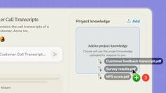



Misc 2
Researchers at Amazon have trained a new LLM for text-to-speech.
BASE TTS with 980 Million params is the largest text-to-speech model yet created. Feb 2024
Google Gemma 2 - two new models: 27B and 9B
Trained on 13T tokens (27B) and 8T tokens (9B)
Used Soft Attention, Distillation, RLHF & Model Merging
Whole lineup: 2B, 7B, 9B, and 27B sizes
Etched "Sohu" chips for transformers - raises $120M
https://www.etched.com
Etched is working to produce chips on their state-of-the-art, 4nm node Its chips can achieve 500K tokens/second.
One 8xSohu server can replace 160 H100s.
Open-source AI startup Stability AI has appointed a new CEO and has received a cash injection, following months of turmoil and the departure of former CEO Emad Mostaque.
https://stability.ai/news/stability-ai-secures-significant-new-investment
Prem Akkaraju
CEO of Stability.AI
Anthropic Claude AI "Projects" - allow users to organize files, chats, and info within a single location - a shared 200K context window, giving Claude quick access. Users can share Projects, collaborate with teammates. Users may have custom instructions for each Project,
imbue - training a 70B model to match/outperform GPT-4o
https://imbue.com/research/70b-intro/

Slide 7

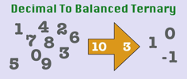
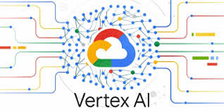

Misc 3
OpenAI ChatGPT on MacOS (Option-SPACE)
https://twitter.com/OpenAI/status/1805679342439284831
https://openai.com/chatgpt/mac/
OpenAI trained a model, CriticGPT, to catch bugs in GPT-4’s code.
https://twitter.com/OpenAI/status/1806372369151426673
Low Energy LLM
Idea - use Ternary Numbers: [-1, 0, +1]. This allows to use addition instead of multiplication
50+ times less energy use
https://arxiv.org/abs/2406.02528
https://www.santacruzworks.org/news/revolutionizing-energy-in-large-language-models
Google Vertex AI for enterprise (since 2021):
Grounding with Google Search, allowing models to retrieve live internet information
Upcoming (in Q3) integration of 3rd party datasets from providers like Moody’s and Thomson Reuters, available in
"high-fidelity mode" enables organizations to use their own datasets for AI outputs (now in preview)
expanded Vector Search capabilities
https://cloud.google.com/blog/products/ai-machine-learning/vertex-ai-offers-enterprise-ready-generative-ai
Amazon Metis - new Chatbot powered by new model "Olympus" to be released in September.
Instead of previous "Titan" (since Nov 2023) - a family of foundation models (text, image, multimodal embeddings and semantic search) available on AWS Bedrock

Slide 8

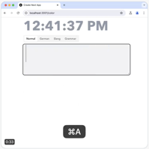

Misc 4
A 240T tokens dataset is now available!
If FineWeb 15T comes out to 48 Terabytes,
can you imagine what a 240T looks like?
8× larger than previous SOTA (RedPajama-Data-v2 30T 125TB)
https://twitter.com/rohanpaul_ai/status/1805389473892778185
75% of workers using AI.
It is becoming rare to find people not using AI.
Even small productivity boosts from AI are highly valuable for busy people and startups
RAG fine-tuning outperforms larger models.
For example, fine-tuned Mistral 7B models using RAG match or beat larger models like GPT-4o & Claude 3 Opus on popular open source codebases, with 150x lower cost & 3.7x faster speed.
Andrej Karpathy announces LLM101n Storyteller AI course - https://github.com/karpathy/LLM101n
Chrome Canary - can run Gemini locally, not stable
https://www.google.com/chrome/canary/
https://x.com/mortenjust/status/1805249068588834893
Multiple ways to extend context length:
KVQuant for 10M token context
Activation Beacon for 400K context
Google Infini-attention for 1M sequence length
Microsoft LongEmbed for 32K context
PoSE for 128K context
Microsoft LongRoPE for 2M context
Self-Extend for long context
Dual Chunk Attention for 100K context
OpenAI's CTO, Mira Murati, has revealed that GPT-5 will likely be released only in late 2025 or early 2026. It will have Ph.D. level intelligence in some areas.
https://www.youtube.com/watch?v=yUoj9B8OpR8
Google Translate now supports 243 languages !
Nvidia’s Synthesia 2.0 - Full-Body AI Avatars
https://www.techopedia.com/news/nvidias-synthesia-2-0-introduces-full-body-ai-avatars-and-screen-recording
Apple & Microsoft move towards efficient Small Language Models (SML) for local on-device operation

Slide 9
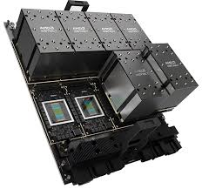

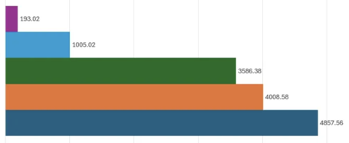
AMD MI300X
AMD MI300X vs H100 comparison on the LLaMA-2 70B model:
AMD's MI300X is ~5% slower - but 46% cheaper with 2.5X the memory of NVIDIA's H100.
https://www.tomshardware.com/pc-components/gpus/amd-mi300x-performance-compared-with-nvidia-h100
The MI300X is AMD's latest and greatest AI GPU flagship (to compete with Nvidia H100). The upcoming MI325X will take on the H200 the MI350 and MI400 - on Blackwell B200.
At times the MI300X was 5X faster than the H100, and at worst it was roughly 40% faster.
Tokens per Second
H100
MI300X

Slide 10
Misc 5
pdfplumber - a python module to extract content from PDF files, including text, tables, and metadata.
import pdfplumber
import pandas as pd
pdf_path = "path/to/your/pdf_file.pdf"
with pdfplumber.open(pdf_path) as pdf:
for page in pdf.pages:
tbl = page.extract_table()
if tbl:
df = pd.DataFrame(tbl[1:], columns=tbl[0])
print(df)
Don't use LangChain
It uses abstractions on top of abstractions and actually makes your code needlessly complicated. Just write API calls and add a vector database instead.
https://twitter.com/levelsio/status/1804078191385956668
# ParaLLM: 1600+ tok/s on a MacBook - https://willcb.com/blog/parallm/
from mlx_parallm.utils import load, generate, batch_generate
# fun trick for generating workloads
import string
capital_letters = string.ascii_uppercase
distinct_pairs = [(a, b) for i, a in enumerate(capital_letters) for b in capital_letters[i + 1:]]
prompt_template = "Think of a real word containing both the letters {l1} and {l2}. Then, say 3 sentences which use the word."
prompts_raw = [prompt_template.format(l1=p[0], l2=p[1]) for p in random.sample(distinct_pairs, 325)]
model, tokenizer = load("google/gemma-1.1-2b-it")
responses = batch_generate(model, tokenizer, prompts=prompts_raw, max_tokens=100, verbose=True, temp=0.0)

Slide 11
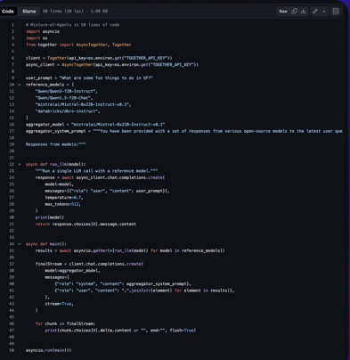
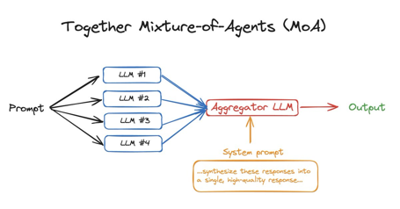
Mixture-of-Agents (MoA) in 50 lines
Mixture-of-Agents (MoA) in 50 lines of code
https://github.com/togethercomputer/MoA/tree/main
https://github.com/togethercomputer/MoA/blob/main/moa.py
https://twitter.com/togethercompute/status/1805289022241259803

Slide 12
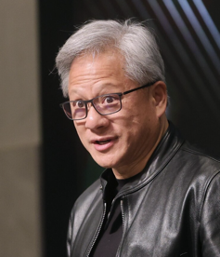
15 Life and Work Principles from Jensen Huang
15 Life and Work Principles from Jensen Huang (NVIDIA CEO)
- https://creatoreconomy.so/p/15-life-and-work-principles-from-jensen
by Peter Yang - https://substack.com/@petergyang
Create conditions for amazing people to do their life's work by empowering them with information, reasoning through problems publicly, and creating a full-stack company.
Information should not be based on privileged access; everyone should have access to the same information and contribute to problem-solving.
Feedback is learning, and everyone should learn from each other’s mistakes.
Reasoning through decisions publicly empowers employees to understand how leaders think.
Include people from all levels of the organization in meetings, based on their skills and expertise.
Don’t give up on people easily, help them learn and grow instead.
Focus on doing something that has never been done before, rather than competing for market share.
Decide what to give up on to achieve success.
Strategy is action, not words; understand what your employees are doing by getting a feel for their top five priorities.
Embrace pain and suffering as part of the journey to greatness.
Develop resilience and be willing to do any task, no matter how small.
Have the humility to confront failure and ask for help.
Run, don't walk; choose something you're destined to do and love working on it.
Dedicate yourself to your work and think about it even when you're not working.
Prioritize your life and you will have plenty of time to do the important things.
Jensen Huang
NVIDIA CEO
Jensen cleaned toilets and washed dishes before leading NVIDIA to become the most valuable company in the world.

Slide 13
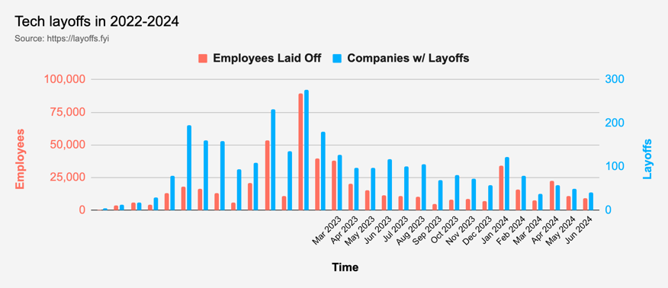
Tech Layoffs in 2024 are lower than last year
Layoffs - https://layoffs.fyi
Salaries for AI engineers rose 12% from the third to fourth quarter last year
The average salary for a senior AI engineer nationally is more than $190,000, according to Comprehensive.io.
AI has a talent shortage, meaning $1 Mln salary job offers! Even during tech layoffs

Slide 14


About the Speaker
Lev Selector, Ph.D.
40+ years of software engineering, data science, and building teams (hiring, training, and managing)
Ph.D. in mathematical modeling and computer simulations
Interests:
Generative AI, Using LLM with your data
Local AI for Local Private Data
Cloud architecture, fin-tech, application security
Find/connect: Linkedin, GitHub, YouTube, Google
https://eais.ai
Enterprise AI Systems

Slide 15
Thank You!

