Slide 1
AI Updates
July 26, 2024
"Remote jobs get
1,000 applicants each"
- Dr. Derek Austin
Meta Llama 3.1
Meta: New Models + Tools
Open-source catches up with Closed-source
Mistral-Nemo-Instruct-2407
Stanford STORM AI - write Wikipedia post
Mem0 - memory across sessions
AI cancer diagnostics 84% vs 64% Human
Trump: "Make America First in AI"
AI Alzheimer's diagnostics with 80% accuracy
OpenAI to design its own custom chips
Nvidia's new AI chip B20 for China
Apple DCLM-Baseline-7B model
window.ai - run LLM in Google Chrome
SKILD.AI model for robots
Triplex - a SOTA LLM for Knowledge Graphs
Ollama Tool Calling
Nvidia Minitron 8B and 4B
Stability.ai Stable Video 4D
Mistral Large 2
Andrej Karpathy's YouTube playlist
Yann LeCun: Fine-tuned Llama-3.1-8b vs GPT-4o
PandasAI
CARTE: Pretraining & Transfer for Tabular Learning
Deepmind’s AlphaProof
OpenAI GPT-4o Mini "instruction hierarchy"
OpenAI SearchGPT
Tenstorrent
Crowd-sourced "Arena" Leaderboard
Tech Layoffs in 2024 are lower than last year

Slide 2


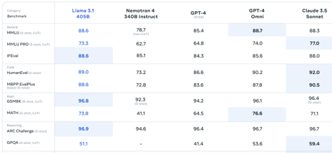
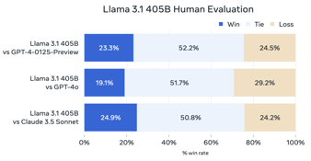
Meta Llama 3.1
On Ollama:
.. 405b 231 GB
.. 70b 40 GB
.. 8b 4.7 GB
Llama 3.1 was trained on over 15T tokens on 16,000 Nvidia H100 GPUs, 31 Mln GPU hours, training cost $500 Mln.
SFT (Supervised Fine-Tuning) was used for post-training for Code, Math, Multilinguality, Long Context, Tool Use
Meta Llama 3.1 - 405B, 70B, 8B versions, open-source
405B on par with GPT-4o and Claude 3.5 Sonnet
128k context length, multi-lingual, coding, reasoning, tool use
Open/free weights and code, license that enables fine-tuning, distillation into other models, and deployment anywhere.
Llama Stack APIs, over 25 partners, including AWS, NVIDIA, Databricks, Groq, Dell, Azure, and Google Cloud.
https://ollama.com/library/llama3.1
https://twitter.com/ylecun/status/1815772369572520120
https://ai.meta.com/blog/meta-llama-3-1/
https://llama.meta.com
https://twitter.com/AIatMeta/status/1816189043706847626
https://huggingface.co/meta-llama
https://github.com/meta-llama/llama-agentic-system - Agentic System
Octo.ai offers Llama 3.1 405B at ($3/$9) per M in/out tokens
GPT-4o (5/15)
GPT-4o mini (0.15/0.6)
Hardware for 405B model:
405b*2Bytes = 810 GB of VRAM
2 nodes * 8 Nvidia H100
16 * 80GB = 960GB VRAM
Or 1 node with 5 AMD Instinct MI300X
5 * 192GB = 960GB

Slide 3

Meta: New Models + Tools
Mark Zuckerberg on Llama 3.1, Open Source, AI Agents, Safety, and more
https://www.youtube.com/watch?v=Vy3OkbtUa5k
https://about.fb.com/news/2024/07/open-source-ai-is-the-path-forward/
Release of Llama 3.1 405B - first open-sourced frontier AI model
Real-world use cases for Llama 3.1 in various industries
Stack of open-source AI tools to build custom solutions
Meta to become universal framework for creating custom solutions
Effects that open-source AI may have on society
Balancing power and managing bad actors, mitigate risks
Open source and global competition
AI Tools to accelerate innovation and economic growth
Mark on Apple and lessons from the past. Open vs closed.
Future of AI: Llama 3 and beyond.
Prediction: Billions of personalized AI agents
Factors to changing anti-AI sentiment: Analysis of the reasons behind shifting public perceptions regarding AI technology.
Price per Mln tokens (in+out):
------------------------------------
Llama 3.1 405b $6
Llama 3.1 405b Groq $1.64 (250 t/s)
Llama 3.1 70b $1.27
Llama 3.1 8b $0.18
------------------------------------
GPT-4o $20
GPT-4-turbo $40
Claude 3.5 Sonnet $18
Claude 3 Opus $90
------------------------------------
https://llmpricecheck.com/fireworks/llama-3.1-405b-instruct/
https://openai.com/api/pricing/
https://docs.anthropic.com/claude/docs/models-overview
Meta tools
to distill
and finetune
Billions of custom models and personalized AI agents
Meta Llama models

Slide 4
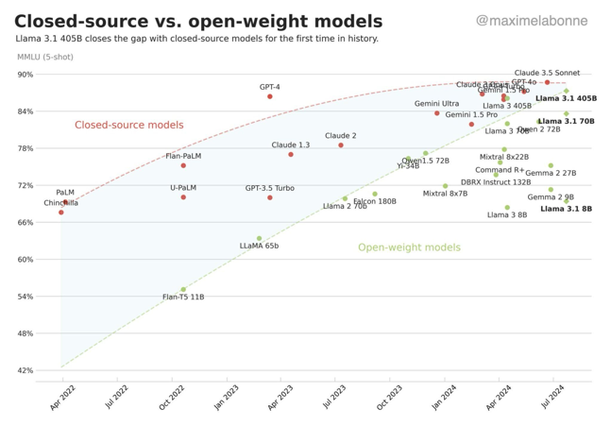
Open-source catches up with Closed-source
The trend is clear ... small open-source models, distillation and fine-tuning, serving, and data collection. One or two frontier closed-source models will still be valuable.
https://twitter.com/AravSrinivas/status/1816248208802336975

Slide 5
Mistral-Nemo-Instruct-2407
Layers: 40 (vs 32 in 7b)
Dim: 5,120 (vs 4k in 7b)
Hidden dim: 14,436 (vs 4k in 7b)
Vocab. size: 128k (vs 32k in 7b)
Activation Function: SwiGLU
Head dim: 128
Number of heads: 32
Number of kv-heads: 8 (GQA)
Rotary embeddings (theta = 1M)
On Hugginface:
https://huggingface.co/mistralai/Mistral-Nemo-Instruct-2407 (safetensors)
https://huggingface.co/QuantFactory/Mistral-Nemo-Instruct-2407-GGUF/tree/main (GGUF)
https://huggingface.co/InferenceIllusionist/Mistral-Nemo-Instruct-12B-iMat-GGUF/tree/main (GGUF)
July 23 - Ollama was updated to version 0.2.8,
and it can now run mistral-nemo:
ollama run mistral-nemo
Drop-in replacement of Mistral 7B
Apache 2 License
Pre-trained and instruct
128k context window
Multilingual and code
12B params
q4 file 7 GB

Slide 6


Misc 1
Stanford STORM AI - write Wikipedia post
https://www.youtube.com/watch?v=GtGW9pExqV0
OpenAI looking for partners to design its own custom chips
https://www.silicon.co.uk/ai/openai-broadcom-in-talks-over-development-of-ai-chip-report-572277
Mem0 - platform to maintain memory across sessions
https://www.youtube.com/watch?v=fW9rdtuuQ-Y
A new study from UCLA found that an AI tool identified prostate cancer with 84% accuracy, compared to 67% accuracy for cases detected by physicians.
https://www.foxnews.com/health/artificial-intelligence-detects-cancer-17-more-accuracy-than-doctors-ucla-study?utm_source=substack&utm_medium=email
Allies of former President Donald Trump have reportedly drafted a sweeping AI executive order that aims to boost military technology and reduce regulations on AI development.
"Make America First in AI".
https://arstechnica.com/information-technology/2024/07/trump-allies-want-to-make-america-first-in-ai-with-sweeping-executive-order/
Researchers from Cambridge University have developed an AI tool that can predict the progression of Alzheimer's disease with over 80% accuracy using speech data.
https://www.windowscentral.com/software-apps/a-new-cutting-edge-ai-tool-predicts-the-progression-of-alzheimers-disease-with-over-80-accuracy-minus-the-scalpel
Nvidia is developing a new B20 AI chip for China which is tailored to comply with U.S. export controls for the Chinese market.

Slide 7

Misc 2
Apple DCLM-Baseline-7B model. - context length = 2K
open-source, trained on 2.5T DCLM dataset
DCLM = DataComp for Language Models
https://huggingface.co/apple/DCLM-7B
Triplex - a SOTA LLM for Knowledge Graph Construction
https://owencolegrove.substack.com/p/triplex-a-sota-llm-for-knowledge
outperforms few-shot prompted GPT-4 at 1/60th the inference cost.
small, can run directly on your laptop
Open Source https://huggingface.co/SciPhi/Triplex , https://ollama.com/sciphi/triplex
Specifically trained for triple extraction, the cornerstone of knowledge graph construction.
Instructable: You can specify exact input entity types and relationships, ensuring high-fidelity output tailored to your needs.
Triplex efficiently converts unstructured text into "semantic triples" - the building blocks of knowledge graphs. These triples follow a (subject > predicate > object) format. For example:
Input: "Paris is the capital of France" Output: CITY: Paris > CAPITAL_OF > COUNTRY: France CITY: Paris > LOCATED_IN > COUNTRY: France
window.ai API - new Google Chrome API (currently only available in Chrome Canary) - native AI models that are ran locally and completely offline.
https://afficone.com/blog/window-ai-new-chrome-feature-api/
SKILD.AI - https://www.skild.ai - since 2023, founded by Abhinav Gupta and Deepak Pathak, two former Carnegie Mellon University professors, created a foundational model for a "general purpose brain" that can be slotted into a variety of robots, enabling them to do things like climbing steep slopes, walking over objects obstructing its path and identifying and picking up items. Raised $300 Mln at a $1.5 Bln valuation

Slide 8

Ollama Tool Calling
Ollama now supports tool calling with popular models such as Meta's Llama 3.1, Mistral Nemo, Firefunction v2, Command-R+, and many others). Typical usage:
Functions and APIs
Web browsing
Code interpreter
and more!
To have models call tools, you can provide a list of available tools via the tools field in Ollama’s API. The supported models will now answer with a tool_calls response in the API.
Tool responses can be provided via messages with the tool role.
Ollama’s OpenAI compatible endpoint also now supports tools, making it possible to switch to using Llama 3.1 and other models.
Python Example:
https://github.com/ollama/ollama-python/blob/main/examples/tools/main.py
Ollama Python Library:
https://github.com/ollama/ollama-python
Ollama is a company founded in July 2023 by Jeffrey Morgan and Michael Chiang in Toronto, Ontario, Canada
https://www.linkedin.com/in/jmorganca/
https://www.linkedin.com/in/mchiang0610/

Slide 9
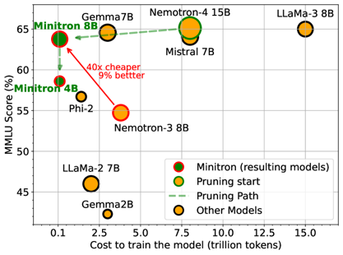
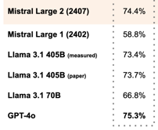

Misc 3
Nvidia Minitron 8B and 4B - pruned versions of Nemotron-4 15B model, which require up to 40x fewer training tokens and result in 1.8x compute cost savings compared to training from scratch.
These models show up to 16% improvement in MMLU scores compared to training from scratch, perform comparably to models like Mistral 7B and Llama-3 8B, and are intended for research and development purposes only.
Pruning is similar to quantization.
Stability.ai Stable Video 4D: 128k context length, 123Bln params
https://stability.ai/news/stable-video-4d
https://huggingface.co/stabilityai/sv4d
Mistral Large 2 - new model on Mistral la Plateforme
128k context window, 123 Bln params
non-commercial license
supports dozens of languages including French, German, Spanish, Italian, Portuguese, Arabic, Hindi, Russian, Chinese, Japanese, and Korean
supports 80+ coding languages including Python, Java, C, C++, JavaScript, and Bash.
https://mistral.ai/news/mistral-large-2407/
Accuracy for coding

Slide 10
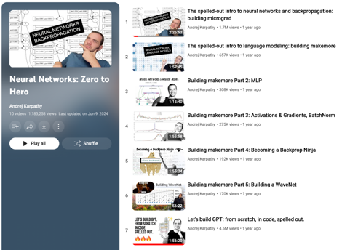

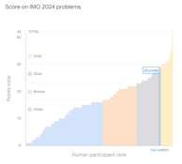
Misc 4
Andrej Karpathy's YouTube playlist on Neural Networks
https://www.youtube.com/playlist?list=PLAqhIrjkxbuWI23v9cThsA9GvCAUhRvKZ
Yann LeCun: Fine-tuned Llama 3.1 8B blows GPT-4o mini out of the water on every task. There has never been an open model this small, this good.
https://twitter.com/ylecun/status/1815858771610210756
PandasAI is a Python platform that makes it easy to ask questions to your data in natural language.
https://github.com/Sinaptik-AI/pandas-ai
CARTE: Pretraining and Transfer for Tabular Learning
https://arxiv.org/abs/2402.16785
https://gael-varoquaux.info/science/carte-toward-table-foundation-models.html
https://x.com/GaelVaroquaux/status/1814198479045931141
Deepmind’s AlphaProof & AlphaGeometry 2 AlphaProof scores silver in math olympiad
https://deepmind.google/discover/blog/ai-solves-imo-problems-at-silver-medal-level/

Slide 11
Misc 5
OpenAI GPT-4o Mini model "instruction hierarchy" - a new technique to block the "ignore all previous instructions" loophole. The enhanced prioritization of system instructions over user prompts aims to address growing safety and trust concerns surrounding AI models.
OpenAI SearchGPT - blends traditional web searches with AI capabilities. Is launched for testing.
Microsoft is adding AI-powered summaries to Bing search results. https://www.engadget.com/microsoft-is-adding-ai-powered-summaries-to-bing-search-results-203053790.html
Grammarly is dead. Apple Just Completely Wrecked Grammarly with Apple Intelligence
https://medium.com/swlh/apple-just-completely-wrecked-grammarly-with-apple-intelligence-ea9bdc27c317
Run models in Browser

Slide 12

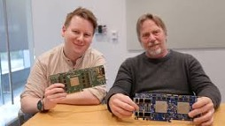
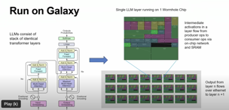
Tenstorrent
Idea - put each layer of a 32-layer transformer on a separate chip.
Put 32 chips in one box - making a pipeline for transformer.
n150 and n300 cards ($1K .. $1.4K)
TT-LoudBox for $12K, TT-QuietBox for $15K
https://tenstorrent.com
https://www.youtube.com/watch?v=lPX1H3jW8ZQ - AI Hardware w/ Jim Keller
Tenstorrent's AI accelerator architecture - reducing data movement bottlenecks.
Tenstorrent's Grayskull AI accelerator cards use a grid of 12x12 "Tensix" cores, each containing 5 RISC-V RV32IMC cores = 720 cores.
The Tensix cores do not have direct access to DRAM, data must be moved via explicit DMA.
There are no caches, so caching must be done in software
This architecture is designed to reduce unnecessary data movement compared to GPUs
The Grayskull e75 & e150 cards have 8GB memory
High performance on LLMs is achieved by pipelining multiple matrix-vector multiplications
However, the memory bandwidth is still a bottleneck for LLMs
Tenstorrent's solution is to link multiple chips together via 100G Ethernet to distribute compute and increase effective memory bandwidth
This distributed approach is not ideal, the current Grayskull cards have limited memory capacity and bandwidth which could be a bottleneck. Future generations with more memory and multi-chip scaling may be better suited for LLMs.

Slide 13
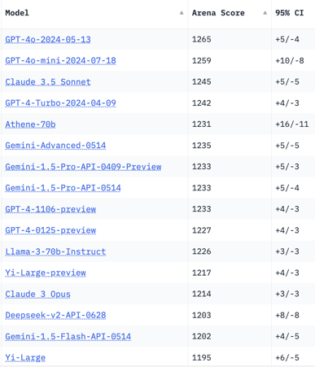
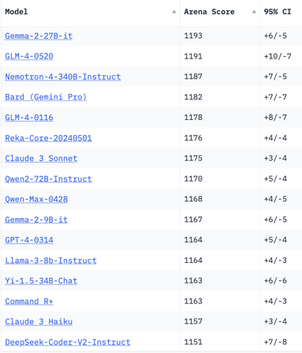
Crowd-sourced "Arena" Leaderboard
Total #models: 118.
Total #votes: 1,531,686.
Last updated: 2024-07-25.
Starting Elo rating = 1000
95% CI = Confidence Interval
https://chat.lmsys.org/?leaderboard
English-only queries

Slide 14
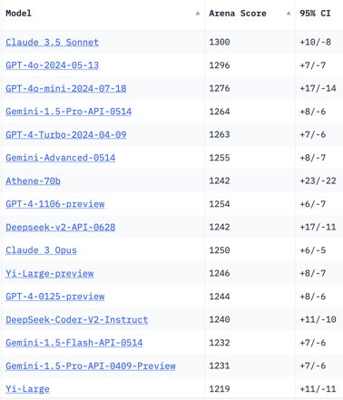
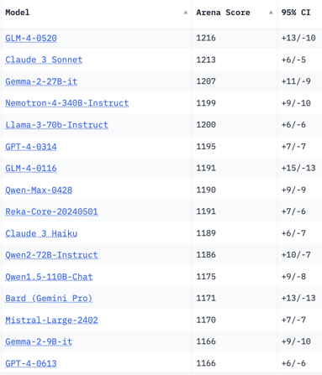
Crowd-sourced "Arena" Leaderboard
Total #models: 115.
Total #votes: 1,450,208.
Last updated: 2024-07-08.
Starting Elo rating = 1000
95% CI = Confidence Interval
https://chat.lmsys.org/?leaderboard
Total #models: 118.
Total #votes: 1,531,686.
Last updated: 2024-07-25.
Coding

Slide 15
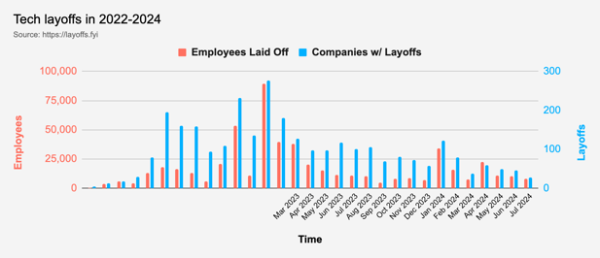
Tech Layoffs in 2024 are lower than last year
Layoffs - https://layoffs.fyi
Employees: "You told us things will get better this year! But… why firings? Revenues are increasing… Productivity is at an all-time high!"
Company: "Take your pick, we've got
… 'Cost-cutting efforts'
… 'Strategic restructuring'
… 'Unexpected Macro Environment'
… 'Optimizing for growth'
… Oh, this one's good, 'A renewed focus on AI.'
https://entreprenal.com/the-layoffs-wont-stop-anytime-soon-23784dcb8e50
Be an early applicant:
https://medium.com/career-programming/i-paid-3-000-for-career-coaching-this-1-tip-paid-me-a-1000-roi-4d21e1bd6862

Slide 16
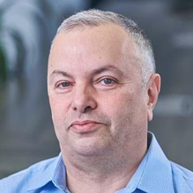

About the Speaker
Lev Selector, Ph.D.
40+ years of software engineering, data science, and building teams (hiring, training, and managing)
Ph.D. in mathematical modeling and computer simulations
Interests:
Generative AI, Using LLM with your data
Local AI for Local Private Data
Cloud architecture, fin-tech, application security
Find/connect: Linkedin, GitHub, YouTube, Google
https://eais.ai
Enterprise AI Systems

Slide 17
Thank You!

