Slide 1
AI Updates
August 2, 2024
Coders rejecting LLMs for writing quality code today are like 2000s photographers denying digital cameras because "film is unmatched."
- Andriy Burkov - https://twitter.com/burkov/status/1818053123123953791
Google 1.5 Flash in Gemini
xAI Grok 2 and Grok 3
JP Morgan AI Research Analyst
IntelePeer’s Gen AI raises $140 Mln
Mixture of Agents (MoA) with Groq API
Legal: Not possible to assure no harm from AI
AI at the Paris 2024 Summer Olympic Games
Claude rewrites Python into C
Text-to-SQL Survey
Ollama works with AMD GPUs
Apple - 47 pages paper describing their AI
Canva is acquiring Leonardo AI
Hugging Face starts using Nvidia NIM
Meta SAM 2 - Segment Anything Model 2
Jensen Huang and Mark Zuckerberg talk
GPT-4o Long Output 64K tokens
Runway's Gen-3 Alpha - text-to-video
Neural Magic Quantized Llama 3.1 405B Model
Amazon AI chip faster and cheaper than Nvidia
Cohere Raises $500M
OpenAI could lose up to $5 Billion this year
Midjourney V6.1 is now live!
Jeremy Howard announced Python FastHTML
Llama 3.1 405B quantized using EXL2 to 125GB
Mark Zuckerberg "Inflection Point" post
GraphRAG + AutoGen + Ollama + Chainlit
OpenAI Talking ChatGPT Bot
Meta AI Studio - create custom AI
Crowd-sourced "Arena" Leaderboard
Tech Layoffs in 2024 are lower than last year

Slide 2
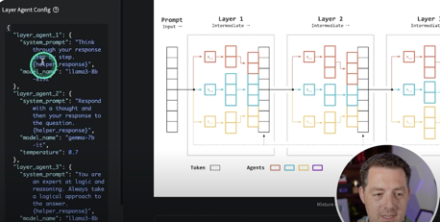
Misc 1
California legislation "SB-1047 Safe and Secure Innovation for Frontier Artificial Intelligence Models Act" is requiring developers to certify, under penalty of perjury, this:
> "Identifies specific tests and test results that would be sufficient to provide reasonable assurance ... covered model derivatives do not pose an unreasonable risk of causing or enabling a critical harm"
But ...
it is not possible to provide assurance that a released model can't be used to cause harm, because a released model can be changed.
This is what nearly all AI researchers agree on, but most politicians don't know. - https://twitter.com/jeremyphoward/status/1816997950264053904
Google 1.5 Flash in Gemini - free, better quality responses.
32K context length
xAI:
Grok 2 to be released in August
Grok 3 to be released in December / January.
JP Morgan has built its own AI Chatbot that acts like a Research Analyst. The chatbot is not using external LLMs (like OpenAI).
https://decrypt.co/241834/jp-morgan-ai-chatbot-llm-suite
IntelePeer’s Gen AI automates up to 90% of your customer interactions and delivers ROI inside 90 days.
https://intelepeer.ai
IntelePeer raises $140 Mln
MOA = Mixture of Agents. Easy setup with Groq API:
https://www.youtube.com/watch?v=R6F3T3Bykqg
https://x.com/KapadiaSoami/status/1811657156082712605
https://github.com/skapadia3214/groq-moa
git clone https://github.com/skapadia3214/groq-moa.git
cd groq-moa
pip install -r requirements.txt
GROQ_API_KEY=your_api_key_here
streamlit run app.py

Slide 3


Misc 2
AI at the Paris 2024 Summer Olympic Games
AthleteGPT - AI chatbot, Athlete365 mobile app.
AI-powered 3D athlete tracking (3DAT)
AI for talent scouting
NBC using AI to provide personalized highlights and enhanced real-time statistics for viewers.
asked Claude to rewrite Python into C
Result: 2.3 min vs 63 min run time.
This is the future for production cost savings.
https://twitter.com/burkov/status/1817720357647761622
Python => C
Text-to-SQL Survey
discussing benchmark datasets, prompt engineering, fine-tuning methods, and future research directions
https://arxiv.org/abs/2407.15186
SQL
Ollama works with AMD GPUs
latest ollama v. 0.3.0 works with AMD GPUs
For example, AMD's 7900 XTX with 24GB (~$750 on ebay) or PRO W7900 with 48GB (~$3K on ebay)
OpenAI utilizes the equivalent of 350,000 Nvidia A100 chip servers, mainly for ChatGPT, with discounted rates from Azure.
Apple - 47 pages paper describing their AI
https://machinelearning.apple.com/papers/apple_intelligence_foundation_language_models.pdf
https://x.com/bindureddy/status/1818068830570299521?utm_source=ainews&utm_medium=email

Slide 4




Misc 3
Canva is acquiring Leonardo AI
Leonardo AI is an Australian startup ~120 people, 19 Mln users who have generated over a Billion images
Canva has 190 Mln users. It plans to integrate Leonardo's tech into its Magic Studio AI features
https://www.canva.com/newsroom/news/leonardo-ai/
Hugging Face starts using Nvidia NIM microservices to power inference of popular AI models. Expecgted up to x5 better token efficiency for 4 Mln HF developers.
https://huggingface.co/blog/inference-dgx-cloud
Meta SAM 2 - Segment Anything Model 2 (SAM 2) is a foundation model for promptable visual segmentation in both images and videos at 44 frames/sec. Users can select objects in videos and images using clicks, boxes, or masks.
https://ai.meta.com/sam2
https://ai.meta.com/blog/segment-anything-2/
Jensen Huang and Mark Zuckerberg - one hour conversation at SIGGRAPH 2024 on July 29, 2024 in Denver, CO. Meta releases AI Studio (create AI characters), shifting to generating personalized content on the fly. Jensen predicted a shift from turn-based AI interactions to more fluid, multi-option simulations. Both spoke about the importance of AI in their companies' developments. They also discussed AI's potential to transform education, entertainment, and work through smart glasses.
https://www.youtube.com/watch?v=w-cmMcMZoZ4
https://qz.com/mark-zuckerberg-jensen-huang-meta-nvidia-ai-assistants-1851608544

Slide 5



Misc 4
GPT-4o Long Output - experimental
64k tokens output
price $6.00 / $18 for 1M in/out tokens
https://openai.com/gpt-4o-long-output/
Runway's Gen-3 Alpha
the first of the next generation of foundation models trained by Runway on a new infrastructure built for large-scale multimodal training. Generating incredibly realistic video in seconds from simple text prompts
https://runwayml.com/research/introducing-gen-3-alpha
https://runwayml.com/about - since 2018, in Manhattan, NY
Neural Magic Releases Fully Quantized FP8 Version of Meta’s Llama 3.1 405B Model.
It may run on one 8xH100 node without the common out-of-memory (OOM) errors typically encountered with the original FP8 and FP16 versions.
https://www.marktechpost.com/2024/07/29/neural-magic-releases-fully-quantized-fp8-version-of-metas-llama-3-1-405b-model-fp8-dynamic-quantization-and-fp8-static-quantization/
Neural Magic is headquartered in Somerville, MA, and was founded in 2018 by MIT professor Nir Shavit and MIT Research Scientist Alex Matveev. - https://neuralmagic.com

Slide 6
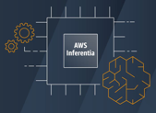


Misc 5
Amazon testing its latest AI chip - AWS Inferentia
performance up to 50% higher than NVIDIA's at half the cost
According to Reuters, engineers at Amazon’s chip lab in Austin, Texas, recently tested highly confidential new servers.
https://www.trendforce.com/news/2024/07/30/news-amazon-unveiled-the-latest-ai-chip-performance-up-by-50/
Beautiful AI video
https://twitter.com/omooretweets/status/1815113401359880196
Cohere Raises $500M
Cohere builds enterprise-grade frontier AI models
Cohere provides industry-leading LLMs and RAG capabilities
Cohere is co-headquartered in Toronto and San Francisco, with key offices in London and New York. Since 2019.
OpenAI could lose up to $5 Billion this year.
OpenAI's expenses: $4B for renting Microsoft's servers, $3B for AI training costs, and $1.5B for staffing - total $8.5 Billion.
OpenAI's revenue: $2B annually from ChatGPT and over $80M per month from API access, OpenAI's potential revenue of up to $4.5B falls short of its $8.5B in operating costs.

Slide 7

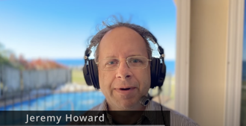
Misc 6
Midjourney V6.1 is now live!
V6.1 greatly improves image quality, coherence, text, and comes with brand-new upscaling and personalization models. It’s smarter, faster, clearer, and more beautiful.
https://x.com/midjourney/status/1818342703618482265
FastHTML
Jeremy Howard announced FastHTML - a new way to create modern interactive web apps in Python - https://fastht.ml
Offers authentication, databases, caching, styling, and more.
1-click deployment to Railway, Vercel, and Huggingface
Jeremy created a 1-hour mini-course on FastHTML showing how to create and deploy a complete interactive web app from scratch using pure Python.
https://www.youtube.com/watch?v=Auqrm7WFc0I
Llama 3.1 405B model was quantized using EXL2.
Result - 125-150GB model size range.
Outperforms Meta's distillation to 70B.
EXL2 - Mixed Quantization Levels within the same model
Mark Zuckerberg "Inflection Point" post: "I believe the Llama 3.1 release will be an inflection point in the industry where most developers begin to primarily use open source, and I expect that approach to only grow from here. I hope you’ll join us on this journey to bring the benefits of AI to everyone in the world."

Slide 8
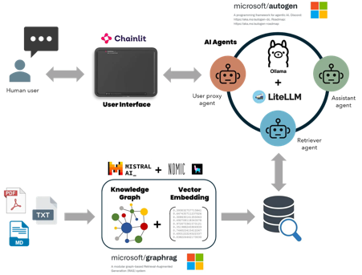
Misc 7
Microsoft: Local Free Multi-Agent RAG
GraphRAG + AutoGen + Ollama + Chainlit
https://ai.gopubby.com/microsofts-graphrag-autogen-ollama-chainlit-fully-local-free-multi-agent-rag-superbot-61ad3759f06f
OpenAI Talking ChatGPT Bot
OpenAI is launching a new AI voice chatbot powered by the GPT-4o model with features that include natural, fluent conversation capabilities. It is initially available to select ChatGPT Plus subscribers.
https://www.technologyreview.com/2024/07/30/1095489/openai-has-released-a-new-chatgpt-bot-that-you-can-talk-to/

Slide 9
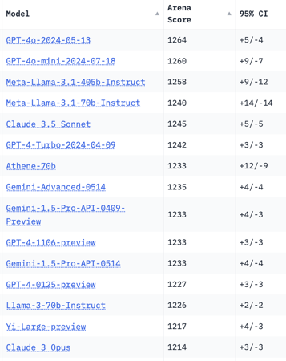
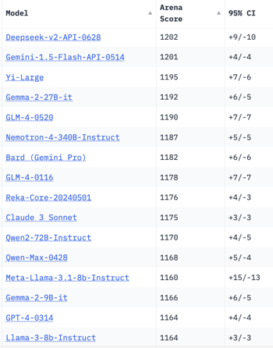
Crowd-sourced "Arena" Leaderboard
Total #models: 121.
Total #votes: 1,552,386.
Last updated: 2024-07-29.
Starting Elo rating = 1000
95% CI = Confidence Interval
https://chat.lmsys.org/?leaderboard
English-only queries

Slide 10
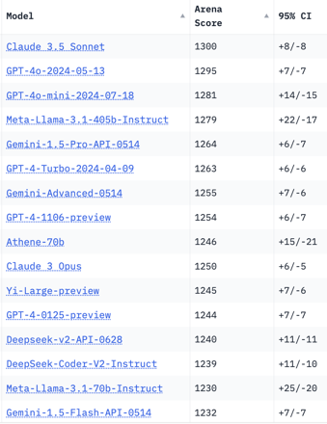
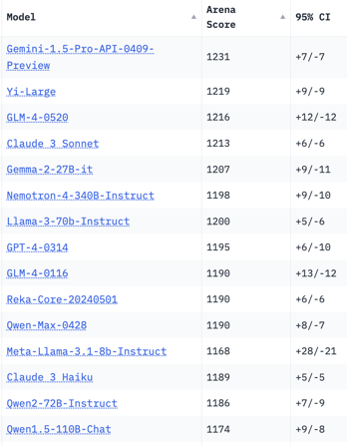
Crowd-sourced "Arena" Leaderboard
Total #models: 115.
Total #votes: 1,450,208.
Last updated: 2024-07-08.
Starting Elo rating = 1000
95% CI = Confidence Interval
https://chat.lmsys.org/?leaderboard
Total #models: 121.
Total #votes: 1,552,386.
Last updated: 2024-07-29.
Coding

Slide 11
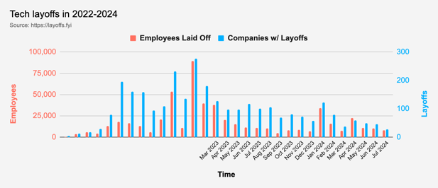
Tech Layoffs in 2024 are lower than last year
Layoffs - https://layoffs.fyi
Employees: "You told us things will get better this year! But… why firings? Revenues are increasing… Productivity is at an all-time high!"
Company: "Take your pick, we've got
… 'Cost-cutting efforts'
… 'Strategic restructuring'
… 'Unexpected Macro Environment'
… 'Optimizing for growth'
… Oh, this one's good, 'A renewed focus on AI.'
https://entreprenal.com/the-layoffs-wont-stop-anytime-soon-23784dcb8e50
Be an early applicant:
https://medium.com/career-programming/i-paid-3-000-for-career-coaching-this-1-tip-paid-me-a-1000-roi-4d21e1bd6862

Slide 12
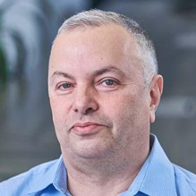

About the Speaker
Lev Selector, Ph.D.
40+ years of software engineering, data science, and building teams (hiring, training, and managing)
Ph.D. in mathematical modeling and computer simulations
Interests:
Generative AI, Using LLM with your data
Local AI for Local Private Data
Cloud architecture, fin-tech, application security
Find/connect: Linkedin, GitHub, YouTube, Google
https://eais.ai
Enterprise AI Systems

Slide 13
Thank You!

