Slide 1
AI Updates
August 2, 2024
Coders rejecting LLMs for writing quality code today are like 2000s photographers denying digital cameras because "film is unmatched."
- Andriy Burkov - https://twitter.com/burkov/status/1818053123123953791
Gemini 1.5 Pro is #1 on "Arena" Leaderboard
Claude 3.5 is #1 for Coding
From Central LLM to Local Custom Models
Google 1.5 Flash in Gemini
xAI Grok 2 and Grok 3
JP Morgan AI Research Analyst
IntelePeer’s Gen AI raises $140 Mln
Mixture of Agents (MoA) with Groq API
Legal: Not possible to assure no harm from AI
AI at the Paris 2024 Summer Olympic Games
Claude rewrites Python into C
Text-to-SQL Survey
Ollama works with AMD GPUs
Apple - 47 pages paper describing their AI
Canva is acquiring Leonardo AI
Hugging Face starts using Nvidia NIM
Meta SAM 2 - Segment Anything Model 2
Jensen Huang and Mark Zuckerberg talk
GPT-4o Long Output 64K tokens
Runway's Gen-3 Alpha - text-to-video
Neural Magic Quantized Llama 3.1 405B Model
Amazon AI chip faster and cheaper than Nvidia
Cohere Raises $500M
OpenAI could lose up to $5 Billion this year
Midjourney V6.1 is now live!
Jeremy Howard announced Python FastHTML
Llama 3.1 405B quantized using EXL2 to 125GB
Mark Zuckerberg "Inflection Point" post
GraphRAG + AutoGen + Ollama + Chainlit
OpenAI Talking ChatGPT Bot
Meta AI Studio - create custom AI
Tech Layoffs in 2024 are lower than last year

Slide 2
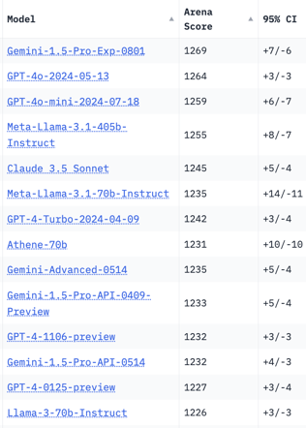
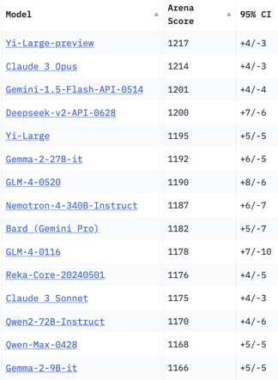
Crowd-sourced "Arena" Leaderboard
Total #models: 123.
Total #votes: 1,575,901.
Last updated: 2024-07-31.
Starting Elo rating = 1000
95% CI = Confidence Interval
https://chat.lmsys.org/?leaderboard
English-only queries
#1: Gemini-1.5-Pro-Exp-0801
Gemini 1.5 Pro latest experimental version has won #1 place (for the first time)! And on both the overall and vision leaderboards
It is available for early testing in Google AI Studio, the Gemini API, and the LMSYS Chatbot Arena
Google DeepMind hasn't disclosed the details/specs yet
Gemini 1.5 Pro is a multi-modal model from Google that was released in May.
https://console.cloud.google.com/vertex-ai/publishers/google/model-garden/gemini-1.5-pro-001

Slide 3
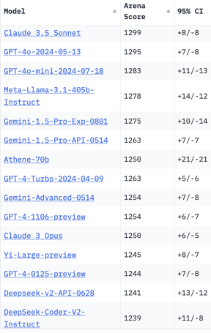
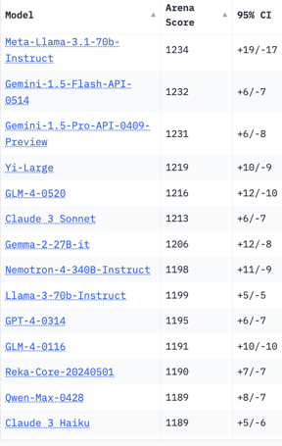
Crowd-sourced "Arena" Leaderboard
Total #models: 115.
Total #votes: 1,450,208.
Last updated: 2024-07-08.
Starting Elo rating = 1000
95% CI = Confidence Interval
https://chat.lmsys.org/?leaderboard
Total #models: 123.
Total #votes: 1,575,901.
Last updated: 2024-07-31.
Coding

Slide 4

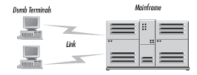

From Mainframe to PC
From ChatGPT to local models
1960s - 70s - Central Mainframe Computer
2022-2024 - Servers on Cloud
OpenAI, Anthropic, Gemini, Groq, ...
Meta Llama 3.5
models and tools
From Central
To Local
1980s ++ PCs, Mobile
Today's small local models
(like Llama 3.1 8b)
are already MUCH better
than last year ChatGPT-3.5-Turbo
2024-2025 ++
Open Source
Local Custom Models

Slide 5
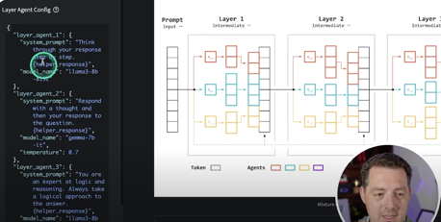
Misc 1
California legislation "SB-1047 Safe and Secure Innovation for Frontier Artificial Intelligence Models Act" is requiring developers to certify, under penalty of perjury, this:
> "Identifies specific tests and test results that would be sufficient to provide reasonable assurance ... covered model derivatives do not pose an unreasonable risk of causing or enabling a critical harm"
But ...
it is not possible to provide assurance that a released model can't be used to cause harm, because a released model can be changed.
This is what nearly all AI researchers agree on, but most politicians don't know. - https://twitter.com/jeremyphoward/status/1816997950264053904
Google 1.5 Flash in Gemini - free, better quality responses.
32K context length
xAI:
Grok 2 to be released in August
Grok 3 to be released in December / January.
JP Morgan has built its own AI Chatbot that acts like a Research Analyst. The chatbot is not using external LLMs (like OpenAI).
https://decrypt.co/241834/jp-morgan-ai-chatbot-llm-suite
IntelePeer’s Gen AI automates up to 90% of your customer interactions and delivers ROI inside 90 days.
https://intelepeer.ai
IntelePeer raises $140 Mln
MOA = Mixture of Agents. Easy setup with Groq API:
https://www.youtube.com/watch?v=R6F3T3Bykqg
https://x.com/KapadiaSoami/status/1811657156082712605
https://github.com/skapadia3214/groq-moa
git clone https://github.com/skapadia3214/groq-moa.git
cd groq-moa
pip install -r requirements.txt
GROQ_API_KEY=your_api_key_here
streamlit run app.py

Slide 6


Misc 2
AI at the Paris 2024 Summer Olympic Games
AthleteGPT - AI chatbot, Athlete365 mobile app.
AI-powered 3D athlete tracking (3DAT)
AI for talent scouting
NBC using AI to provide personalized highlights and enhanced real-time statistics for viewers.
asked Claude to rewrite Python into C
Result: 2.3 min vs 63 min run time.
This is the future for production cost savings.
https://twitter.com/burkov/status/1817720357647761622
Python => C
Text-to-SQL Survey
discussing benchmark datasets, prompt engineering, fine-tuning methods, and future research directions
https://arxiv.org/abs/2407.15186
SQL
Ollama works with AMD GPUs
latest ollama v. 0.3.0 works with AMD GPUs
For example, AMD's 7900 XTX with 24GB (~$750 on ebay) or PRO W7900 with 48GB (~$3K on ebay)
OpenAI utilizes the equivalent of 350,000 Nvidia A100 chip servers, mainly for ChatGPT, with discounted rates from Azure.
Apple - 47 pages paper describing their AI
https://machinelearning.apple.com/papers/apple_intelligence_foundation_language_models.pdf
https://x.com/bindureddy/status/1818068830570299521?utm_source=ainews&utm_medium=email

Slide 7




Misc 3
Canva is acquiring Leonardo AI
Leonardo AI is an Australian startup ~120 people, 19 Mln users who have generated over a Billion images
Canva has 190 Mln users. It plans to integrate Leonardo's tech into its Magic Studio AI features
https://www.canva.com/newsroom/news/leonardo-ai/
Hugging Face starts using Nvidia NIM microservices to power inference of popular AI models. Expecgted up to x5 better token efficiency for 4 Mln HF developers.
https://huggingface.co/blog/inference-dgx-cloud
Meta SAM 2 - Segment Anything Model 2 (SAM 2) is a foundation model for promptable visual segmentation in both images and videos at 44 frames/sec. Users can select objects in videos and images using clicks, boxes, or masks.
https://ai.meta.com/sam2
https://ai.meta.com/blog/segment-anything-2/
Jensen Huang and Mark Zuckerberg - one hour conversation at SIGGRAPH 2024 on July 29, 2024 in Denver, CO. Meta releases AI Studio (create AI characters), shifting to generating personalized content on the fly. Jensen predicted a shift from turn-based AI interactions to more fluid, multi-option simulations. Both spoke about the importance of AI in their companies' developments. They also discussed AI's potential to transform education, entertainment, and work through smart glasses.
https://www.youtube.com/watch?v=w-cmMcMZoZ4
https://qz.com/mark-zuckerberg-jensen-huang-meta-nvidia-ai-assistants-1851608544

Slide 8



Misc 4
GPT-4o Long Output - experimental
64k tokens output
price $6.00 / $18 for 1M in/out tokens
https://openai.com/gpt-4o-long-output/
Runway's Gen-3 Alpha
the first of the next generation of foundation models trained by Runway on a new infrastructure built for large-scale multimodal training. Generating incredibly realistic video in seconds from simple text prompts
https://runwayml.com/research/introducing-gen-3-alpha
https://runwayml.com/about - since 2018, in Manhattan, NY
Neural Magic Releases Fully Quantized FP8 Version of Meta’s Llama 3.1 405B Model.
It may run on one 8xH100 node without the common out-of-memory (OOM) errors typically encountered with the original FP8 and FP16 versions.
https://www.marktechpost.com/2024/07/29/neural-magic-releases-fully-quantized-fp8-version-of-metas-llama-3-1-405b-model-fp8-dynamic-quantization-and-fp8-static-quantization/
Neural Magic is headquartered in Somerville, MA, and was founded in 2018 by MIT professor Nir Shavit and MIT Research Scientist Alex Matveev. - https://neuralmagic.com

Slide 9



Misc 5
Amazon testing its latest AI chip - AWS Inferentia
performance up to 50% higher than NVIDIA's at half the cost
According to Reuters, engineers at Amazon’s chip lab in Austin, Texas, recently tested highly confidential new servers.
https://www.trendforce.com/news/2024/07/30/news-amazon-unveiled-the-latest-ai-chip-performance-up-by-50/
Beautiful AI video
https://twitter.com/omooretweets/status/1815113401359880196
Cohere Raises $500M
Cohere builds enterprise-grade frontier AI models
Cohere provides industry-leading LLMs and RAG capabilities
Cohere is co-headquartered in Toronto and San Francisco, with key offices in London and New York. Since 2019.
OpenAI could lose up to $5 Billion this year.
OpenAI's expenses: $4B for renting Microsoft's servers, $3B for AI training costs, and $1.5B for staffing - total $8.5 Billion.
OpenAI's revenue: $2B annually from ChatGPT and over $80M per month from API access, OpenAI's potential revenue of up to $4.5B falls short of its $8.5B in operating costs.

Slide 10

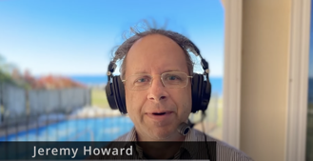
Misc 6
Midjourney V6.1 is now live!
V6.1 greatly improves image quality, coherence, text, and comes with brand-new upscaling and personalization models. It’s smarter, faster, clearer, and more beautiful.
https://x.com/midjourney/status/1818342703618482265
FastHTML
Jeremy Howard announced FastHTML - a new way to create modern interactive web apps in Python - https://fastht.ml
Offers authentication, databases, caching, styling, and more.
1-click deployment to Railway, Vercel, and Huggingface
Jeremy created a 1-hour mini-course on FastHTML showing how to create and deploy a complete interactive web app from scratch using pure Python.
https://www.youtube.com/watch?v=Auqrm7WFc0I
Llama 3.1 405B model was quantized using EXL2.
Result - 125-150GB model size range.
Outperforms Meta's distillation to 70B.
EXL2 - Mixed Quantization Levels within the same model
Mark Zuckerberg "Inflection Point" post: "I believe the Llama 3.1 release will be an inflection point in the industry where most developers begin to primarily use open source, and I expect that approach to only grow from here. I hope you’ll join us on this journey to bring the benefits of AI to everyone in the world."

Slide 11
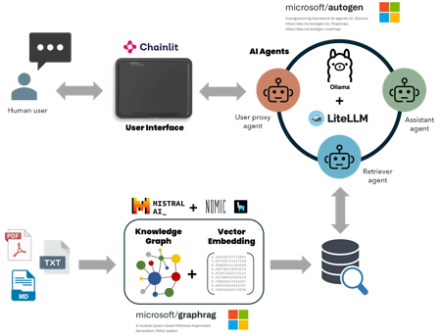
Misc 7
Microsoft: Local Free Multi-Agent RAG
GraphRAG + AutoGen + Ollama + Chainlit
https://ai.gopubby.com/microsofts-graphrag-autogen-ollama-chainlit-fully-local-free-multi-agent-rag-superbot-61ad3759f06f
OpenAI Talking ChatGPT Bot
OpenAI is launching a new AI voice chatbot powered by the GPT-4o model with features that include natural, fluent conversation capabilities. It is initially available to select ChatGPT Plus subscribers.
https://www.technologyreview.com/2024/07/30/1095489/openai-has-released-a-new-chatgpt-bot-that-you-can-talk-to/

Slide 12
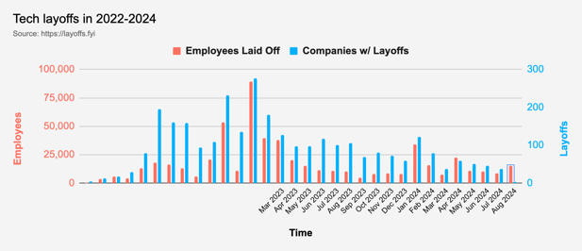

Tech Layoffs in 2024 are lower than last year
Layoffs - https://layoffs.fyi
Intel is firing 15% of its personnel (about 15,000 jobs) - Aug 1, 2024
https://x.com/burkov/status/1819214183881187828

Slide 13
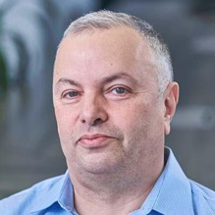

About the Speaker
Lev Selector, Ph.D.
40+ years of software engineering, data science, and building teams (hiring, training, and managing)
Ph.D. in mathematical modeling and computer simulations
Interests:
Generative AI, Using LLM with your data
Local AI for Local Private Data
Cloud architecture, fin-tech, application security
Find/connect: Linkedin, GitHub, YouTube, Google
https://eais.ai
Enterprise AI Systems

Slide 14
Thank You!

