Slide 1
AI Updates
August 9, 2024
Prices down, quality up
OpenAI - Structured Output
Meta Tools
Snapdragon is All You Need ?
OpenAI executives leaving
Figure 2 robot
Gemini 1.5 Pro Experimental - what has changed?
Model with 95% accuracy in predicting diseases
Napkin.ai - turn your text into visuals
Google DeepMind Robot plays ping-pong
AI Python for Beginners - from DeepLearning.ai
Qwen2-Math-72B
Microsoft GitHub Models
Microsoft and Palantir partner - US Defence
A Visual Guide to Quantization
AI Agents
Making Proposal to an Insurance Company
Most Frequent AI Use Cases
The Rise Of The Chief AI Officer (CAIO)
Crowd-sourced "Arena" Leaderboard - English
Crowd-sourced "Arena" Leaderboard - Coding
Tech Layoffs in 2024

Slide 2
Prices down, quality up
Pricing in $ (in/out) per Mln tokens Ranking in LMsys
Google Gemini 1.5 Flash Ranking
$0.075/$0.3 #1
https://developers.googleblog.com/en/gemini-15-flash-updates-google-ai-studio-gemini-api/
Meta Llama-3.1
on https://www.together.ai :
------------------------
Model Price Ranking
405B $5 #4
70B $0.88 #11
8B $0.18 #38
------------------------
https://www.reddit.com/r/LocalLLaMA/comments/1elx04l/cloud_services_that_run_llama_31_on_a_price_per/
Even better options:
https://fireworks.ai
https://www.lepton.ai
https://www.hyperstack.cloud
https://wow.groq.com
Price cuts in the last 30 days:
Rank 2: GPT-4o cut ~50% from May to Aug
Rank 3: GPT-4o mini cut prices 70-98% (comparing with GPT3.5T or GPT4T)
Rank 4: Llama 3.1 405b was initially offered at $5/15 by Together AI, within 48 hours this was cut 46% to $2.7 by DeepInfra, and Lepton
Rank 8: Mistral Large 2 cut prices vs Feb's Large v1 by 62% ($3)
Rank 17: Gemini 1.5 Flash cut ~70% - on top of their existing 1 million tokens per minute free tier ($0.075)
Rank 17: Deepseek v2 reducing cache hit input token price by a max 90% ($0.014 - not a typo).
Models below Lmsys Rank 17 (Gemma 2, Nemotron 4, GLM 4, Reka Flash, Llama 3 7b, Qwen 72B, etc.) are effectively dead for most use cases.
Anthropic Sonet 3.5 Ranking
$3/$15 #3
OpenAI:
New models:
gpt-4o : $5/$15 in May, $2.50/$10 in August
gpt-4o-mini-2024-07-18: $0.3 / $1.2, #3
Old models:
gpt-4: $30/$60
gpt-32k: $60/$120
GPT-3.5 Turbo: $2/$2 orig, $3/$6 current, #59
Context length grew from 4kt to 128kt
Fine-tuned Llama3.1-8B delivers 1.23x more quality and 25x lower cost over GPT-4o !
https://octo.ai/cp/webinar-optimizing-llms/

Slide 3
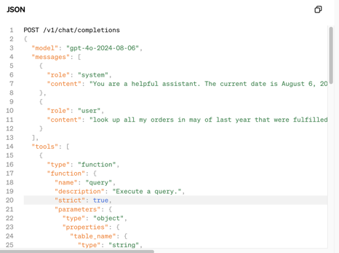
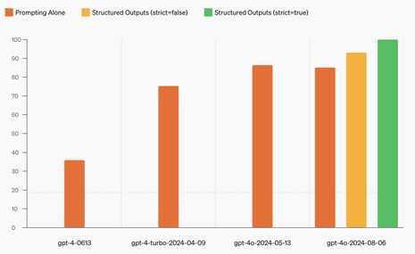
OpenAI - Structured Output
New model gpt-4o-2024-08-06 with Structured Outputs scores a perfect 100%. Model outputs now reliably adhere to developer-supplied JSON Schemas.
https://openai.com/index/introducing-structured-outputs-in-the-api
Function calling: Structured Outputs via tools is available by setting strict: true within your function definition.
June 2023
August 2024

Slide 4
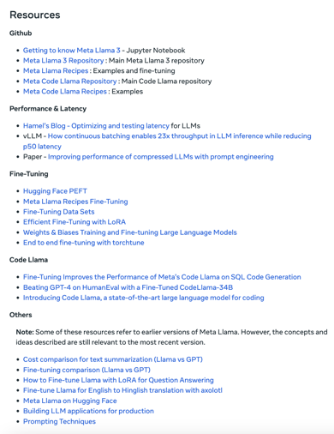
Meta Tools
Meta License explicitly allows to use their models to generate datasets to train other models
Open source eventually stronger than any single company or country
Build on top of closed platforms or open platforms?
https://llama.meta.com/docs/get-started/
Llama 3.1 foundation models
Prompt Guard
Llama Guard 3
Llama Everywhere - https://llama.meta.com/docs/llama-everywhere/
How-to Guides - https://llama.meta.com/docs/how-to-guides/
Integration Guides - https://llama.meta.com/docs/integration-guides/
Community Support - https://llama.meta.com/docs/community-support-and-resources/
Meta may need 10x more compute to train Llama 4 than Llama 3.
Meta used over 16K of NVIDIA's H100 to train Llama 3.1 405b
According to Mark Zuckerberg, they should have 340k H100's, but who knows what their largest cluster is.
https://techcrunch.com/2024/08/01/zuckerberg-says-meta-will-need-10x-more-computing-power-to-train-llama-4-than-llama-3/
https://www.reddit.com/r/singularity/comments/1ehpvtz/mark_zuckerberg_said_at_q2_earnings_call_the/

Slide 5
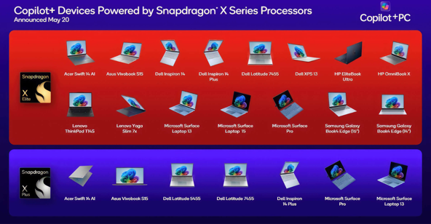

Snapdragon is All You Need ?
Snapdragon X Elite Chip is similar to Apple Silicon.
So now we have MS Windows laptops which can run LLMs
Snapdragon X CPU inference is fast!
https://www.reddit.com/r/LocalLLaMA/comments/1emd3bg/snapdragon_x_cpu_inference_is_fast_q_4_0_4_8/
Snapdragon laptops are $1K - $2K
Snapdragon Dev Kit is only $900
It can run your local LLMs
https://www.arrow.com/en/products/c8380-12c-mp-32g/thundercomm
https://www.techradar.com/pro/qualcomm-quietly-debuts-snapdragon-x-elite-mini-pc-thats-the-perfect-alternative-to-the-apple-mac-mini-and-its-not-as-expensive-as-youd-think

Slide 6





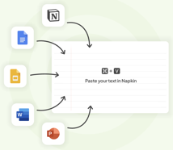
Misc 1
OpenAI executives leaving:
Greg Brockman - long sabbatical leave
Peter Deng - leaving
John Schulman (co-founder) - leaves to Anthropic
https://www.reddit.com/r/OpenAI/comments/1el4thx/greg_brockman_john_schulman_and_peter_deng_leave/
Figure 2 robot - lots of upgrades. Speech-to-text, GPT-4 (omni ?), output text-to-speech. Onboard vision model. Onboard batteries up to 20 hrs/day, upgraded mechanics, hands, ...
https://www.youtube.com/watch?v=0SRVJaOg9Co
Possible reasons for Gemini 1.5 Pro Experimental becoming #1.
There is no single reason. There are improvements in overall performance across various dimensions, including enhanced multilingual capabilities, bigger context length (1 Mln standard), potential improvements in reasoning and coding.
Napkin turns your text into visuals
https://www.napkin.ai
The new model analyzes patient data, uses a smart algorithm (SEV-EB) to identify crucial health markers, achieves 95% accuracy in predicting specific diseases like coronary artery disease, type 2 diabetes, and breast cancer. https://arxiv.org/pdf/2408.03151

Slide 7
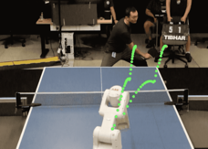
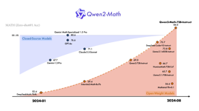
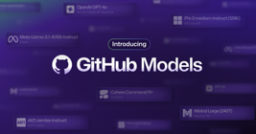
Misc 2
Google DeepMind Robot plays ping-pong
https://techcrunch.com/2024/08/08/google-deepmind-develops-a-solidly-amateur-table-tennis-robot/
The robot won 100% of matches against beginners and 55% against intermediate players across 29 matches. It can adapt to opponents' playing styles in real time, adjusting its strategy on the fly.
AI Python for Beginners - from DeepLearning.ai
https://learn.deeplearning.ai/courses/ai-python-for-beginners
Qwen2-Math-72B
The Qwen team has released a 72B math model that outperforms all open and closed models on MATH. It also outperforms Llama-3.1-405B on a number of reasoning benchmarks. It is limited to English only, with multilingual models coming soon.
https://qwenlm.github.io/blog/qwen2-math/
Microsoft GitHub Models - provides access to a variety of AI models (Llama 3.1, GPT-4o, Mistral Large 2, ...) through a built-in model playground on GitHub, also integrations into Codespaces and Visual Studio Code.
It is backed by Azure AI.
https://betanews.com/2024/08/01/microsoft-github-models-ai/

Slide 8


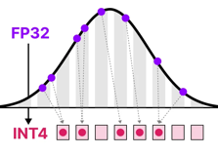
Misc 3
Microsoft and Palantir partnered to deliver advanced AI to U.S. Defense and Intelligence agencies through classified cloud environments.
https://news.microsoft.com/2024/08/08/palantir-and-microsoft-partner-to-deliver-enhanced-analytics-and-ai-services-to-classified-networks-for-critical-national-security-operations/
A Visual Guide to Quantization:
https://newsletter.maartengrootendorst.com/p/a-visual-guide-to-quantization
More links about Quantization:
https://twitter.com/osanseviero/status/1820124474965897466

Slide 9
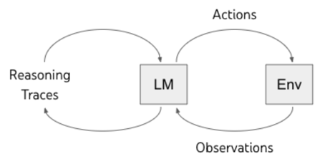
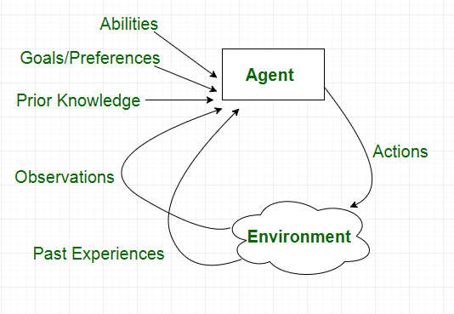
AI Agents
AI agents - autonomous systems:
interpret data from the environment (text, images, ...)
make decisions based on that data (reasoning, decision making, planning steps to achieve goals)
act to achieve set goals, using feedback (learning and adapting over time)
Key components of an Agent:
Model - need best reasoning and planning
Prompt Engineering: Role, Goals, Tools, Constraints
Tools: Function Calling, external APIs
--------
Implement the agent loop, for example:
Receive user input
Analyze the input, use knowledge and history
Decide what to do next
Execute the chosen action
Eventually output to the user, or to another agent

Slide 10
Making Proposal to an Insurance Company
What possible AI projects can I recommend to an insurance company? Please make a bulleted list of projects that are most valuable for insurance company.
Core Insurance Operations:
Claims Automation: AI-powered triage for claims routing and prioritization. Automated document processing (e.g., accident reports, medical bills) to extract key data. Fraud detection models to identify suspicious claims patterns and anomalies. Claims estimation using AI to analyze damage reports and medical records.
Underwriting Optimization: Risk assessment models to predict the likelihood of claims and customize premiums. Automated document analysis for underwriting applications (medical history, financial records). Customer profiling based on demographics and behavior for targeted pricing.
Customer Service Enhancement: AI chatbots for handling routine inquiries, policy management, and claims initiation. Sentiment analysis of customer feedback to gauge satisfaction and identify pain points. Personalized policy recommendations based on customer profiles and needs.
Additional High-Value Areas:
Telematics and Usage-Based Insurance (UBI): Analyze data from telematics devices (e.g., in-car sensors) to assess driving behavior. Offer customized premiums based on actual driving patterns (e.g., safe driving discounts).
Marketing and Sales: Lead scoring models to prioritize prospects based on their likelihood to convert. Customer segmentation for targeted marketing campaigns and personalized offers.
Healthcare (if relevant): Predictive models for healthcare costs based on medical history and demographics. Fraud detection in healthcare claims.
Important Considerations: Data Availability and Quality. Integration with Existing Systems. Ethical and Regulatory Compliance (data privacy, anti-discrimination, etc.). Explainable AI (XAI) - especially in critical areas like underwriting and claims.
Consider specific insurance company's needs and pain points. Conducting a preliminary assessment of their data and processes will help you recommend the most impactful AI projects.

Slide 11
Most Frequent AI Use Cases
RAG = Retrieval Augmented Generation
LLM = Large Language Model
NLP = Natural Language Processing
ML = Machine Learning
RF = Random Forest, XGB = XGBoost
DL = Deep Learning
Application | Technology | Examples
AI Chatbots | RAG, LLM | Customer service, sales
Co-pilots / assistants (agents) | RAG, LLM | work assistants, coding, ...
Sentiment Analysis | NLP, LLM | Customer Service (satisfaction), Sales (social media, surveys)
Personalized Recommendations, Personalized targeted ads | Collaborative & content filtering, LLM | Sales
Predictive Lead Scoring | ML: RF or XGB | Sales
Forecasting, trend analysis | ML: regression, RF, XGB, DL | sales, demand vs inventory, ...
Writing (posts, articles, newsletters, email responses, business plans, reports) | LLM, RAG | Any organization
Multi-lingual ability | LLM | Any organization or service
HR - screening candidates, training | RAG, LLM | Any organization
Document management: classifying / tagging / extracting data (from invoices, contracts, reports), formatting, storing | data engineering/storage, LLM, RAG | Any organization
Fraud detection, Anomaly Detection | ML: Isolation Forest | Finance Transactions, Manufacturing
Risk Assessment | ML, DL, LLM | Finance

Slide 12
The Rise Of The Chief AI Officer (CAIO)
US government now requires all the agencies of federal government to name Chief AI Officers.
https://www.shrm.org/topics-tools/news/inclusion-equity-diversity/federal-government-commits-to-ai-fairness
Finding a specialized AI executive is rapidly becoming as critical
as the roles of CFO or CMO. The CAIO will likely be the most transformative C-suite recruit yet. CAIO must operate as C-suite peers, not subordinate managers.
What are the qualities of a rare individual to blend new technical
vision with strategic foresight?
Craft an AI Vision and Strategy
Scouting Use Cases and Feasibility
Separate hype from reality
Communicate the intricacies and possibilities of AI
Get key stakeholders on board
Recruit right people (talent gap)
Evangelizing and Education
Governance and Risk Management
Proactively apply AI for the benefit of enterprise
Cross-disciplinary strategic thinking
Avoid the leadership traps
Avoid budget/fires battles
AI landscape is evolving at an unprecedented pace.
The complexity and pace of AI system development make
it nearly impossible for existing executives to master while still focusing on their core responsibilities.
A CAIO offers a strategic advantage, guiding an organization through the complexities of AI integration.
Where to look for the Right CAIO Candidates?
Seasoned AI/ML
Cross-Disciplinary
Strategic Innovators
Transformation Trailblazers
The benchmarks for an exceptional CAIO will sharpen over time.
https://www.ft.com/content/4c5d823e-004b-4f00-9536-9fea93330453
https://www.kdnuggets.com/the-rise-of-chief-ai-officer

Slide 13
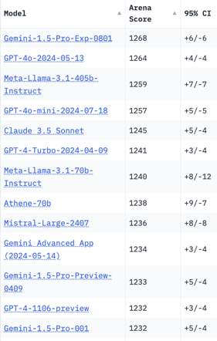
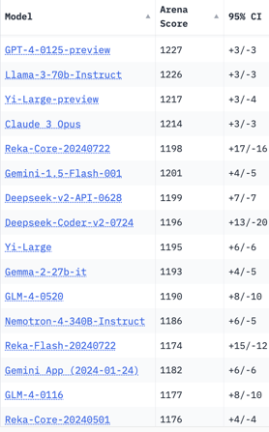
Crowd-sourced "Arena" Leaderboard
Total #models: 127.
Total #votes: 1,610,507.
Last updated: 2024-08-06.
Starting Elo rating = 1000
95% CI = Confidence Interval
https://chat.lmsys.org/?leaderboard
English-only queries

Slide 14
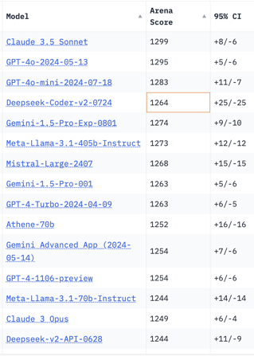
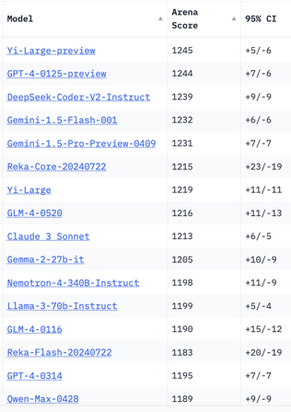
Crowd-sourced "Arena" Leaderboard
Total #models: 115.
Total #votes: 1,450,208.
Last updated: 2024-07-08.
Starting Elo rating = 1000
95% CI = Confidence Interval
https://chat.lmsys.org/?leaderboard
Total #models: 127.
Total #votes: 1,610,507.
Last updated: 2024-08-06.
Coding

Slide 15
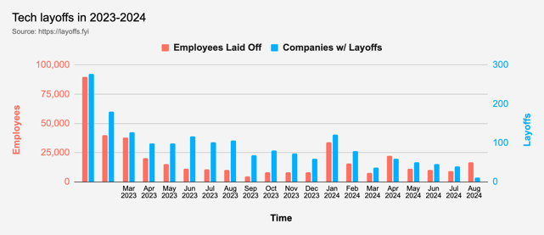


Tech Layoffs in 2024 are lower than last year
Layoffs - https://layoffs.fyi
Intel is firing 15% of its personnel (about 15,000 jobs) - Aug 1, 2024
https://x.com/burkov/status/1819214183881187828
Dell Technologies is firing 10% (12,500 employees). This follows a previous round of 13,000 layoffs. The cuts mainly impact sales and marketing divisions.
https://www.pcmag.com/news/dell-makes-cuts-to-boost-ai-pivot-reportedly-laying-off-12500-employees

Slide 16


About the Speaker
Lev Selector, Ph.D.
40+ years of software engineering, data science, and building teams (hiring, training, and managing)
Ph.D. in mathematical modeling and computer simulations
Interests:
Generative AI, Using LLM with your data
Local AI for Local Private Data
Cloud architecture, fin-tech, application security
Find/connect: Linkedin, GitHub, YouTube, Google
https://eais.ai
Enterprise AI Systems

Slide 17
Thank You!

