Slide 1

Why Cline is Much Better
Than Claude Code?
Main Exciting AI news

Slide 2
AI Updates
July 18, 2025
Claude Code vs Cline with Claude ??
Question: Claude Code or Cline? - Please Comment!
CheatSheet for Claude Code
Moonshot AI Kimi K2
Grok-4 Reception
Crowd-sourced "LM Arena" Leaderboard
Windsurf, Cognition/Devin, Google Licensing
Comet Browser from Perplexity
Energy-Based Transformers (EBTs)
LLMS match patterns without understanding
Microsoft Phi-4-mini-Flash-Reasoning
Voxtral speech transcription models
Gemini Robotics On-Device foundation model
LTX-Video - open weights, 60 sec video
Muon optimizer into PyTorch
Switzerland - A national, open-source LLM
AWS IDE Kiro
Cline System Prompt & Rules Files
App Store for Custom Agents
Which OpenAI Model is the Best?
ChatGPT Agent Mode
Marketplaces for AI Agents
META is building Microkernel OS
Meta plans Manhattan-sized AI centers
Thinking Machines Lab Raises $2B at $12B valuation
Graphene AI Tongue
AI and Learning – Derek Muller
The Expert Myth - Derek Muller
Prisoner's Dilemma - Robert Axelrod
Dave Ramsey 5 Rules
Jobs, Layoffs

Slide 3


What is Better - Cline or Claude Code ?
Please Pause The Video - and provide your comments/opinion under the video (Terminal based vs Cline)
https://www.youtube.com/watch?v=uIKmG3M0X3M
"Cline: The MCP-first IDE" - interview, Latent Space (July 16, 2025)
Cline is an open-source coding agent, mainly a VS Code extension, soon expanding to JetBrains, Neovim, and CLI
It acts as infrastructure for agentic systems, modular, and designed to build any agent, not just for coding
Users give Cline a task; it automates workflows across terminals, editors, browsers, and connects to "MCP"
Cline pioneered the "Plan and Act" paradigm
Workflow is highly collaborative in plan mode, then shifts to automation in act mode, with user oversight (auto-approve or step-by-step). Cline sought to simplify user experience, making advanced agent workflows accessible and intuitive
Though mainly for coding, Cline is used in varied domains (marketing, slide generation, data analysis) due to its general, modular nature; Examples include automating presentations and integrating with tools like Reddit or Slack via MCP servers.
Coding is seen as the highest-value application for LLMs/agents; Despite MCP ecosystem growth into non-coding areas, most value and use is with developer tasks. Marketplace for MCPs in Cline, listing 150+ servers with significant usage.
Cline emphasizes transparency (what the model is doing, errors, prompt context) for better user control and quick course correction.
You can run various LLMs (Claude, OpenAI, Gemini, DeepSeek, ...) - thus ensure performance and low cost
Fully autonomous tools for rapid prototyping, high-insight agentic tools for complex/creative coding; Both agentic power and transparency - hybrid workflows - some users oversee every step, others "auto-approve" and review results afterward.
Cline support architecture design for senior engineers and coding / explanation for junior level
Cline is often preferred by professionals who value control, system-level integration, and safety in complex code changes.
Claude Code also allows pausing for reviews (in CLAUDE.md or similar project files, or explicitly in the prompt). But ... there are credible user reports that Claude Code sometimes misses subtle bugs or hallucinates - more than when using “Claude in Cline”
Users recommend pairing “Claude” models with Cline for best-of-both-worlds: Cline’s workflow features and Claude’s reasoning power
CheatSheet for Claude Code: https://github.com/Njengah/claude-code-cheat-sheet

Slide 4

Moonshot AI Kimi K2
Moonshot AI Kimi K2 open-source model
Kimi K2 is a new open-source LLM developed by Moonshot AI, a Chinese AI company
Better coding, good at general agent tasks and tool integration
Base and Instruct (no "reasoning" option)
Outperforms DeepSeek's V3, and rivals Anthropic Claude
Uses DeepSeek v3-like architecture - MoE architecture (Mixture of Experts) - 1 Trillion params (32B active at any time) - one of the largest open models ever released.
Up to 2 Mln tokens context length
Achieved SOTA or near-SOTA results on several major industry benchmarks (SWE-bench Verified, LiveCodeBench, Agentic Tasks, Math & Reasoning, General Intelligence MMLU)
Rivals or exceeds the capabilities of top commercial AIs; optimized not just for answering questions, but for acting autonomously using tools, writing and executing code, and performing complex workflows; its open nature and high performance threaten positions of AI leading providers; potential for misuse
Kimi K2 achieves its results at a fraction of the training and inference costs of closed models (x6 times cheaper than Grok-4 or Claude Sonnet, x25 times cheaper than Claude Opus)
But ... Kimi K2 is approximately 2x slower than Claude Sonnet-4
Kimi K2 is very fast on Groq platform - 185 t/s There is no direct extension for VSCode. It is possible to use (OpenRouter + Cline or Fake Ollama + Copilot) https://apidog.com/blog/kimi-k2-vscode-copilot/
Largest Open Models
Llama 4 Behemoth (2T), Meta AI, still in training, teacher model
Kimi K2 (1T), Moonshot AI
DeepSeek R1 (671B), DeepSeek AI
Llama 3.1 (405B), Meta AI
Tülu 3 (405B), Allen Institute for AI (AI2) - fine-tuned Llama 3.1 405B
Falcon (180B), Technology Innovation Institute (TII, UAE)
BLOOM (176B), BigScience (led by Hugging Face), - 46 languages
Model | In price per 1M tokens | Out price per 1M tokens | Context Length
Grok-4 | $3.00 | $15.00 | 256K
Claude-4-Sonnet | $3.00 | $15.00 | 200K
Claude-4-Opus | $15.00 | $75.00 | 200K
OpenAI o3 | $10.00 | $40.00 | 200K
Gemini 2.5-Pro (200K ctx) | $1.25 | $10.00 | 200K
Gemini 2.5-Pro (1000K ctx) | $2.50 | $15.00 | 1,000K
Kimi-K2 | $0.57 | $2.30 | 128K
Moonshot created a new tool called MuonClip that enabled stable training with zero crashes, potentially solving a major cost bottleneck in development - https://arxiv.org/abs/2502.16982

Slide 5

Grok-4 Reception
Grok-4’s reception is thus a mix of awe and apprehension: it is technically formidable, especially in academic and competitive benchmarks, but dogged by ethical, political, and practical concerns that limit its mainstream and enterprise acceptance
Positive Reception. Grok 4 passed complex tests like the "hexagon test" with impressive physics simulations and 3D graphics capabilities. Tim Sweeney (Epic Games CEO) called it "artificial general intelligence"
Very good on Benchmarks, including "Humanity’s Last Exam" and the ARC-AGI v2, very good in math, science, reasoning, PhD-level
Can effectively search through users' old X (Twitter) posts
Strong at physics simulations, 3D graphics, and analyzing images
Code Generation - 256K context window (1.7T params)
75 tokens/sec - faster than Claude 4 Opus, but slower than GPT, Claude, or Gemini - users prefer faster models
Bias (defaults to Elon Musk's positions rather than being neutral)
Safety Concerns - lacks comprehensive safety policies and evaluation frameworks
GPT-5 may slightly outperform Grok 4 (internal evaluations)

Slide 6
Crowd-sourced "LM Arena" Leaderboard
https://lmarena.ai/?leaderboard
Starting Elo rating = 1000
https://en.wikipedia.org/wiki/Elo_rating_system
Text
https://lmarena.ai/leaderboard/text
Coding https://lmarena.ai/leaderboard/text/coding
LM Arena secures $100M to expand AI benchmarking (at $600M valuation)
Model | Score
gemini-2.5-pro | 1462
o3-2025-04-16 | 1452
chatgpt-4o-latest-20250326 | 1443
grok-4-0709 | 1437
gpt-4.5-preview-2025-02-27 | 1437
kimi-k2-0711-preview | 1420
claude-opus-4-20250514-thinking-16k | 1420
claude-opus-4-20250514 | 1416
deepseek-r1-0528 | 1415
gemini-2.5-flash | 1414
gpt-4.1-2025-04-14 | 1412
grok-3-preview-02-24 | 1409
claude-sonnet-4-20250514-thinking-32k | 1402
qwen3-235b-a22b-no-thinking | 1400
o4-mini-2025-04-16 | 1400
o1-2024-12-17 | 1399
deepseek-v3-0324 | 1397
deepseek-r1 | 1395
claude-sonnet-4-20250514 | 1392
gemini-2.5-flash-lite-preview-06-17-thinking | 1387
Model | Score
gemini-2.5-pro | 1482
claude-opus-4-20250514-thinking-16k | 1476
chatgpt-4o-latest-20250326 | 1475
o3-2025-04-16 | 1473
claude-sonnet-4-20250514-thinking-32k | 1462
claude-opus-4-20250514 | 1462
grok-4-0709 | 1460
gpt-4.5-preview-2025-02-27 | 1459
deepseek-r1-0528 | 1454
kimi-k2-0711-preview | 1451
qwen3-235b-a22b-no-thinking | 1442
gpt-4.1-2025-04-14 | 1441
deepseek-v3-0324 | 1438
claude-sonnet-4-20250514 | 1437
grok-3-preview-02-24 | 1435
deepseek-r1 | 1434
o4-mini-2025-04-16 | 1429
mistral-medium-2505 | 1423
gpt-4.1-mini-2025-04-14 | 1423
o1-2024-12-17 | 1423
Grok 4 Benchmarks
https://artificialanalysis.ai/models/grok-4
x.ai
China
x.ai
https://lmarena.ai/leaderboard/text
https://web.lmarena.ai/leaderboard
https://openlm.ai/chatbot-arena/
https://beta.lmarena.ai
Web Leaderboard https://web.lmarena.ai/leaderboard
LLM Leaderboard - by @LlmStats https://llmworld.net/llm_leaderboards/
LLM Leaderboard - by StackAI https://www.stack-ai.com/llm-leaderboard
LLM Leaderboard - by Artificial Analysis https://artificialanalysis.ai/leaderboards/models
Open LLM Leaderboard - by Hugging Face https://huggingface.co/open-llm-leaderboard
LLM Leaderboard - by Vellum https://www.vellum.ai/llm-leaderboard
AI Benchmarking Hub https://epoch.ai/data/ai-benchmarking-dashboard
China
China
China
China
x.ai
China
China
x.ai
China
China
China
M

Slide 7

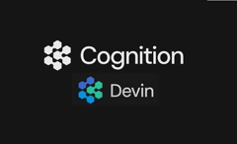

Windsurf
OpenAI's attempt to acquire Windsurf for $3B ultimately failed
Tensions with Microsoft: One of the main reasons cited for the collapse was friction with Microsoft which wanted to get access to Windsurf technology, whereas OpenAI sought to pursue its own developer tools strategy, potentially conflicting with Microsoft’s interests in GitHub Copilot and related products
Alphabet’s Google moved quickly to hire Windsurf’s CEO Varun Mohan, co-founder Douglas Chen, and several core R&D staff, for $2.4 Bln, bringing them into its DeepMind division
Cognition (creator of Devin) has acquired Windsurf for undisclosed amount.
Google and Windsurf have entered into a non-exclusive licensing agreement following the collapse of OpenAI’s attempted acquisition of Windsurf. Windsurf retains the right to license its technology to other companies as well.
The financial specifics of the licensing arrangement have not been publicly disclosed

Slide 8
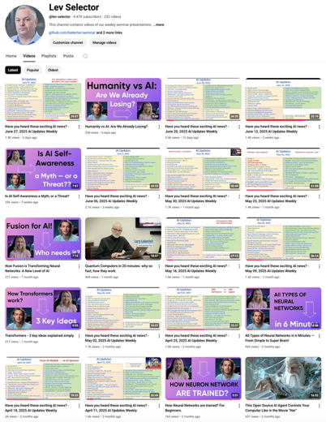
Please pause the video - and answer the pinned question in comments under the video
Subscribe to this channel
https://www.youtube.com/@lev-selector
Get notified about new videos - every Friday, links to slides under the videos

Slide 9

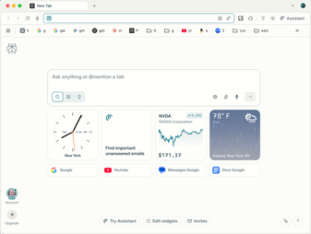
Comet Browser from Perplexity
https://www.perplexity.ai/comet/gettingstarted
Automate online tasks - shopping, checking your schedule, and handling email/calendar tasks.
Find and summarize info fast
Instantly summarize videos, scan social media, search your history and docs for quick, precise answers.
Streamline your workflow
Automatically group tabs, close unused files, track action items, and keep your daily priorities in focus.
Personalize your browsing
Let Comet adapt to your habits, such as highlighting important news and focusing answers on open tabs.

Slide 10
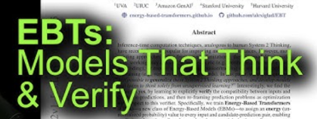
Energy-Based Transformers (EBTs)
Energy-Based Transformers (EBTs) are significantly different from standard Transformer architecture
EBTs substitute standard feed-forward direct mapping of input to output by an iterative optimization process, trying minimize "Energy"
EBTs assign an energy value (a scalar representing unnormalized probability or compatibility) to each (input, prediction) pair. The goal is to find the prediction that minimizes this energy, which is interpreted as the most compatible or likely outcome
During inference, EBTs iteratively refine predictions using gradient descent to minimize the energy, rather than making a one-shot prediction. This process is analogous to “thinking” or “reasoning” over possible outputs
EBTs implement System 2 Thinking - slow, analytical, and deliberate reasoning by spending more computation on harder problems. This is achieved by allowing the model to perform multiple steps of energy minimization, dynamically allocating more resources when needed
In experiments, this approach led to 29% better performance on language tasks compared to advanced feed-forward Transformers
EBTs combine generation and verification in a single model. The energy function acts as both the predictor and the verifier, enabling the model to check the compatibility of its own predictions as part of the inference process
EBTs are designed to be agnostic to input modality and problem type. They have demonstrated strong results in both discrete (text) and continuous (vision) domains, outperforming not only feed-forward Transformers but also Diffusion Transformers in image denoising tasks, with fewer forward passes required
EBTs show superior scaling properties: they achieve up to 35% higher scaling rates with respect to data size, batch volume, parameters, FLOPs, and network depth compared to state-of-the-art Transformers
They also exhibit better generalization, especially on out of distribution data, suggesting a more robust understanding of tasks beyond memorization
https://www.arxiv.org/abs/2507.02092 - paper

Slide 11

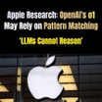
LLMS match patterns without understanding
LLMS match patterns without understanding
https://www.youtube.com/watch?v=jxB-lQyAAxU
Research from Harvard and MIT tests whether AI models truly understand the world (create world models) or just memorize patterns
Researchers trained transformer models to predict planetary positions with high accuracy, then fine-tuned them to predict gravitational forces - the underlying physical principle that governs orbital motion.
Models achieved 99%+ accuracy predicting orbital positions, but failed catastrophically when asked to predict gravitational forces
Using symbolic regression, researchers discovered the models learned nonsensical, non-physical formulas; Each solar system configuration produced different arbitrary "laws" - no universal understanding
Instead of discovering Newton's elegant F = GMm/r² law, models created complex, wiggly mathematical functions that Perfectly fit the training data through overfitting, Had no relationship to actual physics, Couldn't generalize to related tasks, Were essentially sophisticated memorization
Testing Commercial Models (GPT-4, Claude Sonnet 4, Gemini 2.5 Pro) using in-context learning - all failed similarly, despite having physics knowledge in training data, they couldn't apply it coherently. Models defaulted to simple, incorrect heuristics
Knowing ≠ Understanding ≠ Applying
Even models trained on all of Wikipedia's physics content failed to spontaneously access and apply coherent world models when needed
This suggests current AI lacks genuine intelligence and operates through pattern matching rather than principled understanding
The research provides strong evidence that current foundation models, regardless of architecture (Transformers, LSTMs, Mamba), are sophisticated pattern matchers without true world understanding - calling into question claims about emerging intelligence in AI systems

Slide 12

OpenAI
OpenAI ChatGPT Agent Mode - July 17th
ChatGPT can now use a virtual computer to run various tasks on users' behalf - like parsing emails, generating spreadsheets, creating slides, summarizing upcoming meetings, and even shopping online or planning meals
It unifies capabilities from previous OpenAI agent projects (Operator, Deep Research) and is immediately available for ChatGPT Pro, Plus, and Team users
https://openai.com/index/introducing-chatgpt-agent/
GPT Agents connect to your Google workspace (Gmail, Calendar, Docs, etc.) via secure APIs. When the agent needs access, you’ll be sent to Google’s consent screen where you explicitly grant the required permissions. The agent’s backend then receives limited tokens which it uses to perform actions (like reading emails or creating events) on your behalf
Which OpenAI Model is the Best?
GPT-4.5 preview - best, most advanced, multilingual
o3, o4-mini-high - deep reasoning, technical tasks
GPT-4o, GPT-4.1 - general use GPT-4.1 - more advanced for developers and long-context tasks; GPT-4o - image generation
Expecting final GPT-4.5 from OpenAI soon (in July ?)
App Stores for Custom Agents
Anthropic doesn't offer similar Functionality yet.
Anthropic has tools to build agents which can do web search, use MCP and interact with external productivity tools (like Asana, Canva, Figma), pull user data from apps, and automate tasks such as reporting or project management
But they still lack direct, deep integration with your email, calendar, or browsing as you.
OpenAI - https://chatgpt.com/gpts
Anthropic agents will be offered via AWS AI Agent Marketplace (being launched now) https://www.youtube.com/watch?v=NV9wK7-2Mv0
Google AI-Agent Marketplace https://cloud.google.com/products/agentspace https://partnerinsight.substack.com/p/googles-ai-agent-marketplace-1000s
Microsoft Azure Marketplace https://azuremarketplace.microsoft.com/en-us/marketplace/apps/category/ai-plus-machine-learning
LangChain, CrewAI, Superagent, Flowise, Botpress, Agno AI, ...
Google’s Gemini offers some (but not all) features.
Gemini is directly embedded in Google Workspace, enabling automation and agentic collaboration across email, docs, calendar, spreadsheets, and presentations. It can perform multi-step workflows, research, scheduling, and content creation for users.
Browser control is coming (Project Mariner), also Google Search, Maps, and Lens integration, and potential for executing tasks via virtual environments.

Slide 13
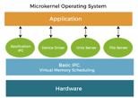
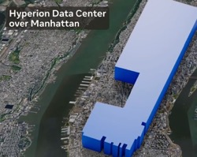
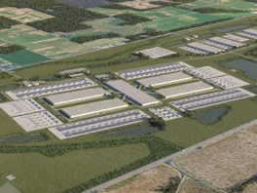
Meta
META is building Microkernel OS
A microkernel system communicates through message-passing, reducing the size of trusted code in kernel space. This improves modularity, reliability, and (potentially) upgradability.
// Linux - Monolithic
sys_read() {
// Kernel-space file system call
// Direct disk I/O and scheduling
// Memory mapped file buffers
}
// MetaOS - Microkernel Style
sys_read() {
send_msg(FS_SERVICE, "read")
}
// FS_SERVICE (runs in userspace)
read_handler() {
// Handles logic
// Requests disk I/O through another IPC
}
Windows OS - Monolithic
Linux - Kernel + multiple utilities/processes communicating using pipes, signals, etc.
Microkernel OS - even less Monolithic
Meta plans Manhattan-sized AI centers
Prometheus: Located in New Albany, Ohio, this is slated to deliver over 1 gigawatt (GW) of power capacity, with operations expected to commence in 2026.
Hyperion: Planned for Richmond Parish, Louisiana, this facility is designed to scale up to 5 GW of capacity over several years, making it one of the largest AI projects of its kind

Slide 14

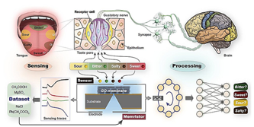
AI Updates - 2
Thinking Machines Lab Raises $2B at $12B valuation
Mira Murati and several other former OpenAI researchers
Mira Murati - Former CTO of OpenAI; CEO of Thinking Machines Lab
John Schulman - Co-founder of OpenAI; now Chief Scientist at Thinking Machines Lab
Barret Zoph - Former VP of Research at OpenAI; now CTO at Thinking Machines Lab
Lilian Weng - Former researcher and VP at OpenAI
Graphene AI Tongue
Researchers from Pennsylvania State University (Penn State) have created an artificial taste sensor using graphene oxide sheets that can identify flavors with 98.5% accuracy on known tastes and 75-90% on new ones.
The device mimics human taste perception and could be used for medical screening, food safety, or robotic cooking.
When a solution (liquid food sample) is placed on the graphene oxide sensor, various taste molecules interact with the graphene oxide surface and alter the electrical properties (primarily conductivity) in a distinct way, depending on its chemical structure.
Each taste—sweet, salty, sour, bitter (and in some systems, umami or even ammonia chloride) - generates a unique signal profile.
https://www.nature.com/articles/d41586-025-02158-w
https://phys.org/news/2025-07-graphene-based-artificial-tongue-human.html

Slide 15

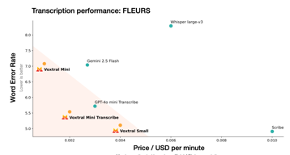
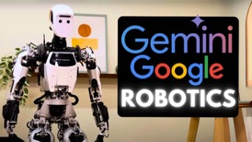
AI Updates - 3
Microsoft Phi-4-mini-Flash-Reasoning
3.8B params, open-source, on Hugging Face, Azure, Nvidia
long-context 64K tokens
Built on the SambaY architecture with Gated Memory Units
Up to 10× faster decoding and outperforms prior Phi models on math benchmarks
Voxtral speech transcription models
3B & 24B
open source Apache 2.0 license
Also available via API (API pricing starts at $0.001/min)
https://mistral.ai/news/voxtral
3B
Gemini Robotics On-Device foundation model
Vision-Language-Action (VLA) on-device model - low latency !!
can be fine-tuned for specific tasks with as few as 50 demonstrations.
This is the first model that can be fine-tuned.
It is intended for applications that need to run locally on the robot hardware for low latency or because of a lack of networking
The model follows natural language instructions and uses vision to find and reason about objects in its environment
https://www.infoq.com/news/2025/07/google-gemini-robotics/
https://github.com/google-deepmind/aloha_sim
24B

Slide 16
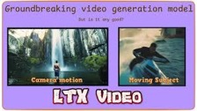
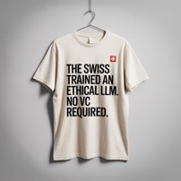
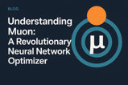
AI Updates - 4
LTX-Video - open weights, 60 sec video
The open-source model has both 13B and mobile-friendly 2B parameter versions, available free on GitHub and Hugging Face.
An update to its open-weights LTXV model, now allowing for image-to-video generations over 60 seconds long
streamed in real time, with live prompt control and efficient performance on consumer GPUs.
Users can control inputs throughout generation, adjusting poses, depth, and style mid-stream for dynamic scene evolution.
LTXV is trained on fully licensed data, with direct integration with LTX Studio’s production suite and the ability to run efficiently on consumer devices
https://github.com/Lightricks/LTX-Video
Muon optimizer (used in Kimi K2's training), has become popular,
PyTorch is adding it to the main library
Switzerland - A national, open-source LLM
Multilingual LLM on a national supercomputer, using a dataset spanning over 1,500 languages.
It’s open source (Apache licensed), aligned with both Swiss data law and the EU AI Act. Built for public good, research, education, and civic purpose. With transparency in training data. With ethical oversight.
Should more countries be developing their own models built on public infrastructure, governed by public values?
https://ethz.ch/en/news-and-events/eth-news/news/2025/07/a-language-model-built-for-the-public-good.html

Slide 17

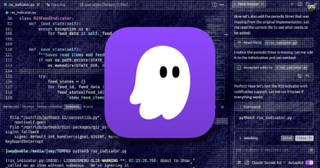
AWS IDE Kiro
Kiro - AI-powered IDE from AWS
It is a customized fork of VS Code
https://kiro.dev
It uses Claude Sonnet 4. But not supporting Gemini, Ollama, OpenRouter, ...
Kiro turns your text prompts, docs, diagrams and images into detailed requirements, EARS-style user stories, technical designs, and a granular, executable checklist. Specs live in Markdown files within your project. Kiro creates and executes sequenced tasks, tests implementation, and creates documentation
Kiro automates repetitive tasks by triggering agent-directed actions (like running tests or updating docs) on events such as file saves or commits, ensuring best practices aren't just suggested but enforced
Kiro can use MCP (Model Context Protocol) to connect to external tools and data, like documentation sites, APIs, GitHub, or even whiteboard photos
As Kiro works, you can accept, edit, or skip changes, or allow Kiro to run on "autopilot" through sequences of tasks with full transparency
Kiro is currently free during preview

Slide 18

Cline System Prompt & Rules Files
I am using Cline VSCode extension as AI Coding Assistant for LLMs like Anthropic Claude, Google Gemini, etc.
Cline has its own system prompt that defines its behaviour. It is baked into Cline and can not be seen. But you can see it in Cline's Github: https://github.com/cline/cline : https://github.com/cline/cline/blob/main/src/core/prompts/system.ts
There used to be the "custom instructions" section in settings. But it was removed in recent versions.
It is possible to modify Cline's behaviour by adding a ".clinerules" file to the root of any project. Or a ".clinerules/" directory with multiple .md files inside to separate rules for different aspects like formatting, documentation, or testing
Cline’s newer releases include a popover UI (under the chat input) for selecting which rules from your .clinerules/ files and folders are active at any given moment.
https://github.com/nickbaumann98/cline_docs/tree/main
https://docs.cline.bot/getting-started/for-new-coders
The .clineignore file is a project-level configuration for the Cline VSCode extension, modeled after .gitignore. It lets you specify which files and directories Cline should ignore during codebase analysis and AI operations. This helps keep responses relevant, block access to specific files (e.g., .env, secrets.txt), or folders (like node_modules/, dist/, build/) or file types ( like *.csv, *.log).
This reduces processing time by excluding large or irrelevant files or directories (like dependencies or auto-generated files).
To create the file, just copy your .gitignore - or ask some LLM (like Perplexity) to give you .clineignore file for specific type of a project (for example, for working with python and jupyter and doing data science / machine learning)

Slide 19
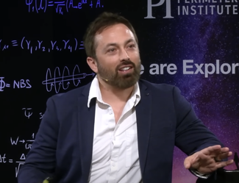



AI and Learning - Derek Muller
https://www.youtube.com/watch?v=0xS68sl2D70
Why Educational "Revolutions" Keep Failing (1920 .. 2010). The problem isn't access to information - it's getting people to engage in the hard work of learning
How Learning Actually Works: Daniel Kahneman's "System 1" (fast, automatic) vs "System 2" (slow, effortful) thinking framework. Real learning happens when System 2 builds knowledge through repeated practice, which then becomes automatic in System 1
Expertise comes from domain-specific knowledge structures, not general "thinking skills"
AI's Role in Education: Positive - can provide immediate feedback and personalized tutoring; Concerning - may reduce the effortful practice that's essential for learning (like using AI to write essays instead of learning to write)
Education won't be "revolutionized" by technology because the fundamental challenge isn't distributing information - it's motivating people to do the hard, repetitive work of building expertise. Teachers act like "personal trainers" who create accountability and social motivation that technology alone cannot replace
The talk emphasizes that learning requires struggle and effort, and AI's biggest risk is making it too easy to avoid that necessary difficulty.
Derek Muller (creator of Veritasium)
B
A
Info, Feedback
Motivation, Energy, Hard Work, Repetition

Slide 20

The Expert Myth - Derek Muller
https://www.youtube.com/watch?v=5eW6Eagr9XA
Experts like chess masters don't have higher IQs or better general memory. Instead, they recognize patterns instantly through "chunking" - seeing complex configurations as single units rather than individual pieces.
The Four "Must Have" Requirements for True Expertise:
Many (thousands) repeated attempts with feedback
Valid environment with learnable patterns (one-off and very random events can not be predicted reliably)
Timely feedback
Deliberate practice - you must consistently work at the edge of your ability, not just repeat comfortable tasks
Examples when "Experts" perform poorly: Political pundits - perform worse than random chance; Stock fund managers fail to beat market averages 80-90% of the time; Experienced doctors perform poorly at diagnosing rare diseases; College admissions officers often perform worse than simple algorithms because they get delayed or no feedback
Reaching plateau - and breaking through it via challenge and discomfort of deliberate practice
Conclusion: True expertise requires thousands of hours of uncomfortable, deliberate practice in environments where patterns can be learned and feedback is immediate. Without all four criteria, you get people who seem like experts but actually aren't.

Slide 21

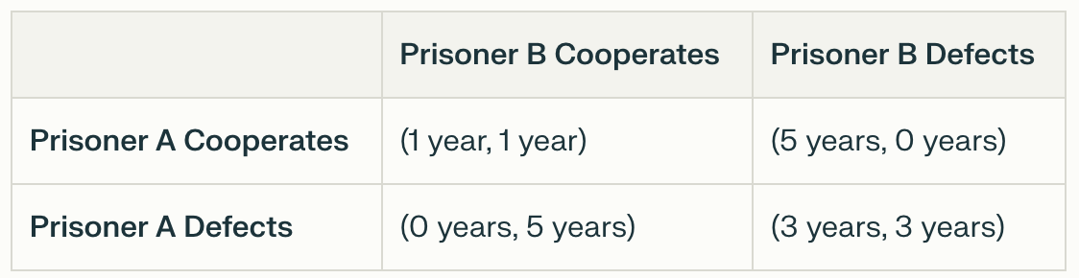
Prisoner's Dilemma - Robert Axelrod
Two individuals are arrested and interrogated separately for a crime they allegedly committed together. Each person has two options: cooperate with the other by remaining silent - or defect by betraying the other and testifying against them.
If both cooperate (remain silent), they each receive a light sentence.
If one defects while the other cooperates, the defector goes free while the cooperator receives a heavy sentence.
If both defect, they both receive moderate sentences, which is worse than if they had both cooperated.
Robert Axelrod's famous computer tournaments (1980-1984) https://www.youtube.com/watch?v=mScpHTIi-kM https://en.wikipedia.org/wiki/Robert_Axelrod_(political_scientist) https://en.wikipedia.org/wiki/The_Evolution_of_Cooperation
Winning Strategy: "Tit for Tat" - a simple strategy that starts by cooperating, then copies whatever the opponent did in the previous round - won both tournaments despite being the simplest entry
Four Key Principles of Successful Strategies:
Nice - Never defect first
Forgiving - Don't hold grudges beyond the last round
Retaliatory - Strike back immediately when defected against
Clear - Be predictable so others can establish patterns of trust
In repeated interactions, cooperation can emerge even among purely self-interested players. Nice strategies consistently outperformed nasty ones. Being "generous" (occasionally forgiving defections) helps in noisy environments.
There's no single best strategy - success depends on what other strategies you're playing against.
Most of life is not zero-sum - mutual cooperation can benefit everyone
The findings helped explain everything from animal behavior (like impala grooming) to international relations (US-Soviet nuclear disarmament), showing how cooperation can evolve and spread even in competitive environments

Slide 22
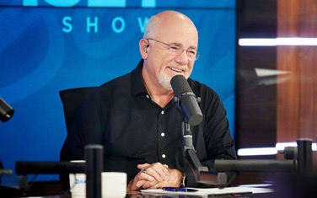
Dave Ramsey 5 Rules
The 5 Wealth-Building Rules - by Dave Ramsey https://www.youtube.com/watch?v=ZCrAin5ycXA
1. Get on a Budget. Create a written plan for your money. Do a budget on paper, on purpose, before each month begins. Treat managing your personal money like you would manage money for a company. You can decide today to start budgeting and managing money well
2. Get Out of Debt. Stop borrowing money entirely ("have a plasectomy" - cut up credit cards). Recognize that debt makes you a slave to lenders. Understand that your income is your most powerful wealth-building tool. Example: A $500/month car payment invested from age 30-70 could become $5.6 million instead of making car companies rich
3. Foster High Quality Relationships. Be careful about who you spend time with because "you become who you hang around with". Your income will approximate within 10-20% of your 10 closest friends' average income over 10 years. Choose to associate with people you want to be like. Avoid people with poor financial habits and attitudes
4. Save and Invest. "In the house of the wise are stores of choice food and oil" - wise people save money. Save for emergencies because "it's gonna rain" (unexpected expenses will happen). Save and invest so you can retire with dignity. Don't rely on the government to take care of you in retirement
5. Practice Generosity. Develop a generous spirit, not just transferring funds. Generous people are more attractive, cheerful, and helpful. Be generous in everyday situations (good tips, helping others). Generosity changes everything in your life, but it's hard to give when you're broke

Slide 23
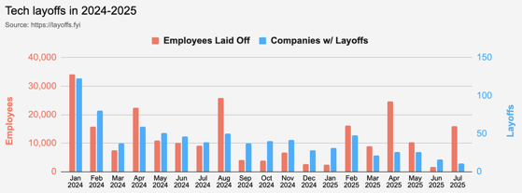
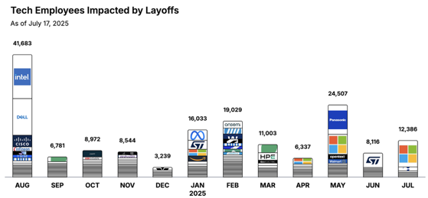
Jobs
https://layoffs.fyi
https://trueup.io/layoffs
Tech Layoffs in 2025: 80,003 people
(as of July 17, 2025)
Compared to 2024: 152,922 people
https://layoffs
AWS Laid Off 40% of Its DevOps Staff !!
Linkedin Post (removed) from a senior AWS solutions architect:
"After automating most of our infrastructure — around 90% of it — my entire DevOps team was labeled redundant."
The post disappeared within hours, but not before it got screenshotted and shared all over Twitter.

Slide 24


About the Speaker
Lev Selector, Ph.D.
40+ years of software engineering, data science, and building teams (hiring, training, and managing)
Ph.D. in mathematical modeling and computer simulations
Interests:
Generative AI, Using LLM with your data
Local AI for Local Private Data
Cloud architecture, fin-tech, application security
Find/connect: Linkedin, GitHub, YouTube, Google
https://eais.ai
Enterprise AI Systems

Slide 25
Thank You!

