Slide 1

AI Updates
February 14, 2025
How to Rig Chatbot Arena Results
DeepScaleR - 1.5B model beats OpenAI o1 in math
Add Reasoning to a Model
Ensembles of Models or Agents
Chinese AI Chips
Groq (AI cips) - $1.5 Bln from Saudi Arabia
February: Anthropic Claude 4 & x.ai Grok 3
DeepSeek R1 - Safety Nightmare"
Stanford (S1) and Berkeley (TinyZero)
Diverse Preference Optimization (DivPO)
Computing gets cheaper, market gets bigger
Meta VideoJAM
Perplexity "Million Dollar" Question
Andrew Krapivin - Fast hash algorithm
Meta - Convert EEG/MEG Brain Activity Into Text
Ask LLM to run code to count characters
Ask Yourself This Question: how AI can help?
IBM Granite-Vision-3.1-2B, OpenThinker-32B, Bydance Goku & Goku+, Luma Ray2
ChatGPT Search for Everyone
OpenAI o3-mini & mini-high
o3-mini displays its chain of thought (CoT)
Anthropic's "Constitutional Classifiers"
OpenAI Deep Research - Good vs Original
Anthropic Economic Index
Goodbye RAG
Latent Reasoning
DeepSeek VL2 MoE - understand images and text
Safe Superintelligence $20 Bln valuation
Cerebras DeepSeek R1 70B at 1,600 tok/sec
Crowd-sourced "Arena" Leaderboard
Jobs

Slide 2
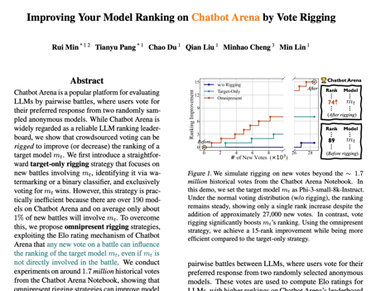
How to Rig Chatbot Arena Results
https://www.fastcompany.com/91273226/rigged-votes-ai-model-rankings-chatbot-arena
https://arxiv.org/pdf/2501.17858
Pang and his colleagues trained a classifier to identify which model is being used based on its outputs, with a high accuracy level.
Then we can utilize the rating system to more efficiently improve the model ranking with the least number of new votes

Slide 3
DeepScaleR - tiny 1.5B Model beats OpenAI o1
DeepScaleR - a small 1.5B model which beats OpenAI's o1 at math
Developed at Berkeley using Deep Seek method
Achieves 43.1% score on AIM 2024 benchmark, beating GPT-4's 40%
Only cost $4,500 to train using 3.8K GPU hours (18.42x reduction compared to Deep Seek R1)
Open-sourced and publicly available
Uses distributed RL (Reinforcement Learning)
Employs an outcome reward model rather than a process reward model
Available in different versions (full F32 precision at 7GB, quantized Q5 version at 1.12GB)
Can run efficiently on consumer hardware like an M2 Mac
This demonstrates how smaller models can achieve impressive results with high-quality training data distilled from larger models.
https://www.youtube.com/watch?v=QxZ7oQRJqik
https://ollama.com/library/deepscaler:1.5b
https://pretty-radio-b75.notion.site/DeepScaleR-Surpassing-O1-Preview-with-a-1-5B-Model-by-Scaling-RL-19681902c1468005bed8ca303013a4e2
https://github.com/agentica-project/deepscaler
https://huggingface.co/agentica-org/DeepScaleR-1.5B-Preview

Slide 4
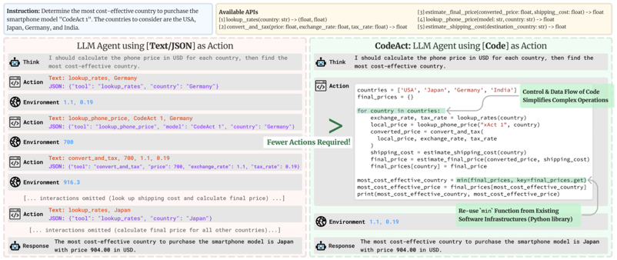
Add Reasoning to a Model
Add Reasoning using RL
DeepSeek started with a small dataset with step by step reasoning examples (Chain of Thought); trained the model with RL, then generated a large dataset (using rejection sampling) - and fine-tuned the model again.
DeepResearch - open-source
https://huggingface.co/blog/open-deep-research
The bump in performance is due mostly to letting our agents write their actions in code instead of JSON.
Use DeepSeek R1 to generate 800k reasoning traces (distillation), then use them to train/fine-tune your model
Add Reasoning to a model without training:
Chain-of-Thought (CoT) Prompting
Few-shot prompting (examples in prompt)
Connect model to a RAG or Wiki system
Use Rule-Based Systems, Agentic systems
https://x.com/dzhng/status/1886603396578484630
https://github.com/assafelovic/gpt-researcher
https://github.com/nickscamara/open-deep-research
https://github.com/jina-ai/node-DeepResearch
https://x.com/mattshumer_/status/1886558939434664404

Slide 5
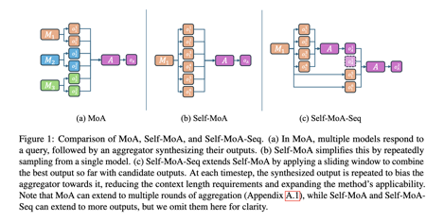
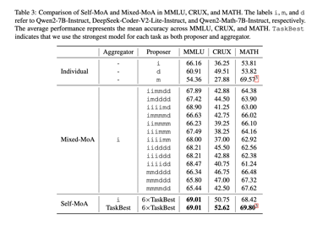
Ensembles of Models or Agents
Ensembling - multiple models are combined to generate a final output. The assumption is that diversity among models leads to better performance.
Mixture-of-Agents (MoA) - aggregate responses from different LLMs to synthesize a high-quality response - introduces fundamental trade-off between diversity and quality. Low quality responses decrease the performance
Self-MoA - aggregating various outputs from a single high-performing model - repeatedly sampling from the same model. This approach ensures that only high-quality responses contribute to the final output, addressing the quality-diversity trade-off observed in Mixed-MoA configurations.
Princeton University Researchers Introduce Self-MoA and Self-MoA-Seq: Optimizing LLM Performance with Single-Model Ensembles
https://www.marktechpost.com/2025/02/07/princeton-university-researchers-introduce-self-moa-and-self-moa-seq-optimizing-llm-performance-with-single-model-ensembles/

Slide 6
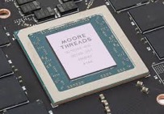

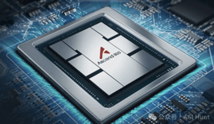

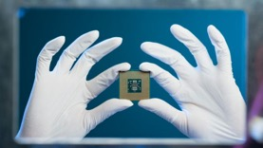
Chinese AI Chips
US restricts exports of high-performance AI chips to China due to security concerns
Chinese manufacturers have been developing domestic AI chip
The performance of the Ascend 910 is barely sufficient for the cost-efficient training of large AI models.
Still, when it comes to inference, it delivers 60% of Nvidia's H100 performance, according to researchers from DeepSeek.
While the Ascend 910C is not a performance champion, it can succeed in reducing China's reliance on Nvidia GPUs.
https://wccftech.com/chinese-gpu-manufacturers-push-out-support-for-running-deepseek-ai-models-on-local-systems/
https://www.technetbooks.com/2025/02/chinese-made-gpus-power-up-ai-models.html
Huawei's AI chip Ascend 910C with 80 GB memory achieves 60% of the inference performance of NVIDIA H100 as tested by DeepSeek
Moore Threads chip in GPU MTT S4000 - 48GB and 200 TOPS
Kunlun Core P800 chip from Baidu with 16GB memory. Baidu is using the P800 in a 30,000-unit AI cluster. https://x.com/GameGPU_com/status/1887878461819068821

Slide 7
AI Updates
February 14, 2025
How to Rig Chatbot Arena Results
DeepScaleR - 1.5B model beats OpenAI o1 in math
Add Reasoning to a Model
Ensembles of Models or Agents
Chinese AI Chips
Groq (AI cips) - $1.5 Bln from Saudi Arabia
February: Anthropic Claude 4 & x.ai Grok 3
DeepSeek R1 - Safety Nightmare"
Stanford (S1) and Berkeley (TinyZero)
Diverse Preference Optimization (DivPO)
Computing gets cheaper, market gets bigger
Meta VideoJAM
Perplexity "Million Dollar" Question
Andrew Krapivin - Fast hash algorithm
Meta - Convert EEG/MEG Brain Activity Into Text
Ask LLM to run code to count characters
Ask Yourself This Question: how AI can help?
IBM Granite-Vision-3.1-2B, OpenThinker-32B, Bydance Goku & Goku+, Luma Ray2
ChatGPT Search for Everyone
OpenAI o3-mini & mini-high
o3-mini displays its chain of thought (CoT)
Anthropic's "Constitutional Classifiers"
OpenAI Deep Research - Good vs Original
Anthropic Economic Index
Goodbye RAG
Latent Reasoning
DeepSeek VL2 MoE - understand images and text
Safe Superintelligence $20 Bln valuation
Cerebras DeepSeek R1 70B at 1,600 tok/sec
Crowd-sourced "Arena" Leaderboard
Jobs

Slide 8
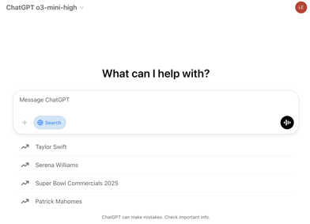
ChatGPT Search for Everyone
OpenAI o3-mini is better than o1 in STEM (science, coding, math)
faster than o1
reasoning not very deep
In ChatGPT window click on "Search" button
OpenAI o3-mini-high: additional chain-of-thought steps, deeper analysis
Enhanced accuracy and detail for complex problems.
Advanced coding tasks, complex math, logical puzzles
OpenAI has changed the way that its new ChatGPT o3-mini model displays its chain of thought (CoT) to "make it easier for people to understand how the model thinks,"
While the model’s raw CoT remains hidden, the model can organise those thoughts so that they are easy to read. The model reviews the raw chain of thought, removing any unsafe content and then simplifies any complex ideas.
It has faced an almost immediate backlash from users and accusations that it is copying the way that DeepSeek's R1 model displays its reasoning 😀
OpenAI said: "Users have told us that understanding how the model reasons through a response not only supports more informed decision-making but also helps build trust in its answers."

Slide 9
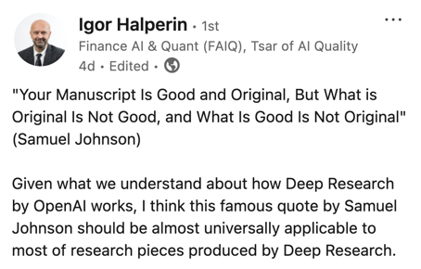
Anthropic's "Constitutional Classifiers"
OpenAI Deep Research
Good vs Original
Anthropic's "Constitutional Classifiers" are a sophisticated framework designed to safeguard large language models (LLMs), like Claude, against "jailbreaking" attempts
This system builds on Anthropic's earlier "Constitutional AI" approach
The system operates based on a "constitution," which is a set of explicit principles defining permissible and restricted content
Classifiers are trained on special synthetic prompts and completions
Input Classifier - screens user prompts before reaching LLM
Output Classifier - evaluates LLM output, halting generation if harmful content is detected
The constitution can be updated to address emerging threats
Extensive testing over 3,000 hours with 405 participants demonstrated that Constitutional Classifiers blocked 95% of jailbreak attempts, compared to only 14% for unguarded models
The classifiers introduced minimal disruption to legitimate queries, with only a 0.38% increase in refusal rates for benign prompts
Computational overhead increased by 23.7%
https://www.hackster.io/news/anthropic-researchers-develop-constitutional-classifiers-to-protect-llms-from-universal-jailbreaks-178110139d64
https://www.linkedin.com/posts/igor-halperin-092175a_your-manuscript-is-good-and-original-but-activity-7293411967724081152-KjlB/

Slide 10
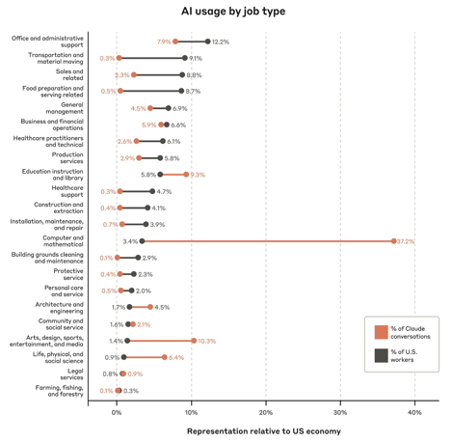
Anthropic Economic Index
The Anthropic Economic Index - an initiative aimed at understanding AI's effects on labor markets and the economy over time.
https://www.anthropic.com/news/the-anthropic-economic-index
The initial report shows that questions in the "computer and mathematical" category made up 37.5% of all queries sent to Claude.
"in just over half of cases, AI was not being used to replace people doing tasks, but instead worked with them."

Slide 11
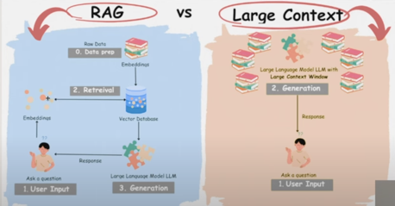
Goodbye RAG
Goodbye RAG? Google Finally Shipped Something useful!
https://www.youtube.com/watch?v=iK9wefkOjkY
two steps : (1) search - select documents; (2) - load whole documents

Slide 12
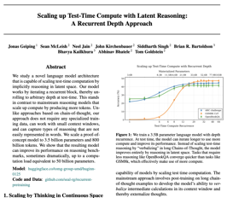
Latent Reasoning
Scaling up Test-Time Compute with Latent Reasoning: A Recurrent Depth Approach - https://arxiv.org/pdf/2502.05171
New AI model architecture allows AI to “think” without generating any tokens.
This new model architecture allows AI to scale test time computation by “thinking” in latent space.
Latent space is the space of compressed data representations within a model. This new model architecture is different from Chain of Thought (CoT) reasoning, which uses test time compute to generate a chain of thought to answer questions.
The new model architecture is more efficient than Chain of Thought reasoning because it does not require specialized training data, massive context windows, or multiple GPUs.
The new model architecture is also able to capture different types of reasoning that are not easily represented with words alone.
https://huggingface.co/tomg-group-umd/huginn-0125
https://github.com/seal-rg/recurrent-pretraining
https://www.youtube.com/watch?v=ZLtXXFcHNOU - video
We study a novel language model architecture that is capable of scaling test-time computation by implicitly reasoning in latent space.
Our model works by iterating a recurrent block, thereby unrolling to arbitrary depth at test-time. This stands in contrast to mainstream reasoning models that scale up compute by producing more tokens.
Unlike approaches based on chain-of-thought, our approach does not require any specialized training data, can work with small context windows, and can capture types of reasoning that are not easily represented in words.
We scale a proof-of-concept model to 3.5 billion parameters and 800 billion tokens.
We show that the resulting model can improve its performance on reasoning benchmarks, sometimes dramatically, up to a computation load equivalent to 50 billion parameters.

Slide 13

AI Updates - 1
DeepSeek VL2 MoE - a family of open-source vision-language models
understand and process both images and text
Mixture-of-Experts (MoE) architecture
Visual Question Answering, OCR (Optical Character Recognition), extracting information from Documents/Tables/Charts, identifying objects or regions within an image based on a text description
https://huggingface.co/deepseek-ai/deepseek-vl2
Safe Superintelligence $20 Bln valuation
a Startup founded by Ilya Sutskever
In talks to raise capital at a $20 Bln valuation.
They have already raised $1 Bln at a $5 Bln valuation just few months ago
https://www.calcalistech.com/ctechnews/article/hk8utbhtke
Cerebras runs DeepSeek R1 70B at 1,600 tokens/second
this is 57x faster than any R1 provider using GPUs
The move comes after Groq and Microsoft confirmed they would also bring this model to their clouds.
AWS and Google Cloud have yet to do so but anybody can run the open source model anywhere, even locally.

Slide 14
AI Updates
February 14, 2025
How to Rig Chatbot Arena Results
DeepScaleR - 1.5B model beats OpenAI o1 in math
Add Reasoning to a Model
Ensembles of Models or Agents
Chinese AI Chips
Groq (AI cips) - $1.5 Bln from Saudi Arabia
February: Anthropic Claude 4 & x.ai Grok 3
DeepSeek R1 - Safety Nightmare"
Stanford (S1) and Berkeley (TinyZero)
Diverse Preference Optimization (DivPO)
Computing gets cheaper, market gets bigger
Meta VideoJAM
Perplexity "Million Dollar" Question
Andrew Krapivin - Fast hash algorithm
Meta - Convert EEG/MEG Brain Activity Into Text
Ask LLM to run code to count characters
Ask Yourself This Question: how AI can help?
IBM Granite-Vision-3.1-2B, OpenThinker-32B, Bydance Goku & Goku+, Luma Ray2
ChatGPT Search for Everyone
OpenAI o3-mini & mini-high
o3-mini displays its chain of thought (CoT)
Anthropic's "Constitutional Classifiers"
OpenAI Deep Research - Good vs Original
Anthropic Economic Index
Goodbye RAG
Latent Reasoning
DeepSeek VL2 MoE - understand images and text
Safe Superintelligence $20 Bln valuation
Cerebras DeepSeek R1 70B at 1,600 tok/sec
Crowd-sourced "Arena" Leaderboard
Jobs

Slide 15

AI Updates - 2
Groq (AI cips) secures $1.5 Bln commitment from Saudi Arabia
https://www.reuters.com/technology/artificial-intelligence/ai-chip-startup-groq-secures-15-billion-commitment-saudi-arabia-2025-02-10/
Anthropic CEO Dario Amodei has reported severe safety flaws in DeepSeek R1 AI model
"Safety Nightmare"
"worst" performer after safety assessments, this AI was found generating sensitive bioweapon information
Rumors:
Anthropic Claude 4 in February ? (hybrid with reasoning)
x.ai Grok 3 in February ?
Llama 4 release date ?
Gemini 2.0 - released, added memory recall feature
OpenAI GPT-5 - rumored
Feb 10 (Reuters) - A consortium led by Musk offered $97.4 billion to buy the nonprofit that controls OpenAI.
This offer is twice higher than estimated value of the nonprofit. This effectively increases its valuation - thus making it more difficult for OpenAI to switch to for-profit model (the switching requires paying to noprofit its value).
OpenAI CEO Sam Altman & the board are rejecting the offer
https://www.reuters.com/markets/deals/openai-ceo-says-board-will-reject-musks-97-billion-offer-information-reports-2025-02-11/

Slide 16



AI Updates - 2
Perplexity "Million Dollar" question (sweepstakes)
Perplexity AI CEO Aravind Srinivas posted on LinkedIn: "There will be no Perplexity Super Bowl ad. Instead, there's a Super Bowl contest."
"You install the app (not needed if you have the app already), and ask at least five questions on the app during the game, and we will pick one winner to give $1mm. Ask like a millionaire," he added.
https://x.com/Analyticsindiam/status/1888810544297296003
Reactions on LinkedIn were positive, with one user commenting: "A specific time frame, a massive audience, and a life-changing incentive? Genius. Perplexity won't just get downloads - it'll embed itself as a new way for people to think and search for information in the moment. This is the cleverest case study in AI adoption I've seen so far. I can't wait to see the results [sic]!"
Stanford (S1) and Berkeley (TinyZero) - Alibaba’s Qwen AI models used to create low-cost DeepSeek alternatives from
https://www.scmp.com/tech/big-tech/article/3298073/alibabas-qwen-ai-models-enable-low-cost-deepseek-alternatives-stanford-berkeley
Diverse Preference Optimization (DivPO), an optimization method which learns to generate much more diverse responses than standard pipelines, while maintaining the quality of the generations
https://arxiv.org/abs/2501.18101 - paper from Meta
Cerebras CEO Andrew Feldman on DeepSeek: Every time computing gets cheaper, the market gets bigger.
https://www.zdnet.com/article/cerebras-ceo-on-deepseek-every-time-computing-gets-cheaper-the-market-gets-bigger/
Meta VideoJAM - framework improves motion coherence in video modeling
https://hila-chefer.github.io/videojam-paper.github.io/
https://www.youtube.com/watch?v=m6aaQoPv5r8
Fast hash algorithm
https://arxiv.org/abs/2501.02305 - January 2025 paper
https://arxiv.org/abs/2111.12800 - tiny pointers paper (2021)
Andrew Feldman
Andrew Krapivin

Slide 17

AI Updates - 3
Meta - Convert EEG/MEG Brain Activity Into Text
(non-invasive magnetoencephalography (MEG) and electroencephalography (EEG)) https://www.techspot.com/news/106721-meta-researchers-unveil-ai-models-convert-brain-activity.html
IBM Granite-Vision-3.1-2B - a Small Vision Language Model (Fine-tuned from a Granite LLM)
Document understanding, extracting content from diverse visual formats, including tables, charts, and diagrams
Ask LLM to run code to count characters
If the model can write and run the code, you can ask it to use this tool to answer questions which require counting (strawberry question).
- https://www.youtube.com/watch?v=DoM-kvOJCPw
Goku and Goku+ - Hyperrealistic AI Video
by ByteDance and HKU
https://arxiv.org/pdf/2502.04896
https://saiyan-world.github.io/goku/
Luma Ray2 - realistic videos from images
https://x.com/LumaLabsAI/status/1889003847260979440
https://lumalabs.ai/ray
OpenThinker-32B - open source model developed by the Open Thoughts consortium, beats DeepSeek in math
https://www.open-thoughts.ai
https://decrypt.co/305878/new-open-source-ai-model-rivals-deepseeks-performance-with-far-less-training-data
Sam Altman & Kevin Weil talking to students in Tokyo:
"You will not outrun the AI - same as you can't "outrun the calculator" at arithmetic.
Ask yourself "Is there a way that AI could help me do this faster?" Develop new skills to leverage AI to your advantage. Integrate AI into your daily life, start using AI tools
"The skills that you need in that world are figuring out what people want, sort of creative vision, quick adaptability, resilience as everything is changing around you, and the sort of learning how to work with these tools to do way more than people could without it"
Closing the US Department of Education
https://www.newsweek.com/doge-announces-its-slashing-881m-education-department-contracts-live-updates-2029353
"The cuts come as President Donald Trump is expected to issue an executive order closing down the department."
https://www.youtube.com/watch?v=uyy1zx8j9MY - video

Slide 18
AI Updates
February 14, 2025
How to Rig Chatbot Arena Results
DeepScaleR - 1.5B model beats OpenAI o1 in math
Add Reasoning to a Model
Ensembles of Models or Agents
Chinese AI Chips
Groq (AI cips) - $1.5 Bln from Saudi Arabia
February: Anthropic Claude 4 & x.ai Grok 3
DeepSeek R1 - Safety Nightmare"
Stanford (S1) and Berkeley (TinyZero)
Diverse Preference Optimization (DivPO)
Computing gets cheaper, market gets bigger
Meta VideoJAM
Perplexity "Million Dollar" Question
Andrew Krapivin - Fast hash algorithm
Meta - Convert EEG/MEG Brain Activity Into Text
Ask LLM to run code to count characters
Ask Yourself This Question: how AI can help?
IBM Granite-Vision-3.1-2B, OpenThinker-32B, Bydance Goku & Goku+, Luma Ray2
ChatGPT Search for Everyone
OpenAI o3-mini & mini-high
o3-mini displays its chain of thought (CoT)
Anthropic's "Constitutional Classifiers"
OpenAI Deep Research - Good vs Original
Anthropic Economic Index
Goodbye RAG
Latent Reasoning
DeepSeek VL2 MoE - understand images and text
Safe Superintelligence $20 Bln valuation
Cerebras DeepSeek R1 70B at 1,600 tok/sec
Crowd-sourced "Arena" Leaderboard
Jobs

Slide 19
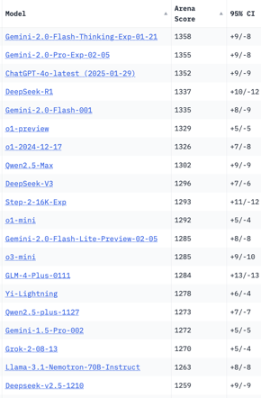
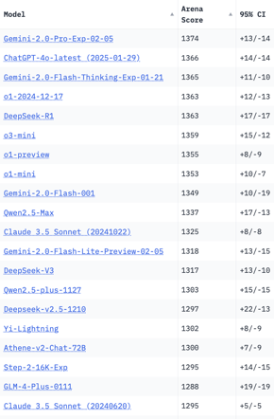
Crowd-sourced "Arena" Leaderboard
Total #models: 203
Total #votes: 2,645,647
Last updated: 2025-02-11
Starting Elo rating = 1000
95% CI = Confidence Interval
https://en.wikipedia.org/wiki/Elo_rating_system
https://chat.lmsys.org/?leaderboard
English-only queries
Coding
China
China
China
China
China
China
China
China
China
China
China
China
China
x.ai
China
China

Slide 20
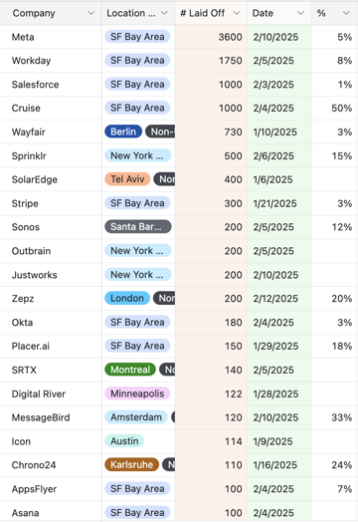
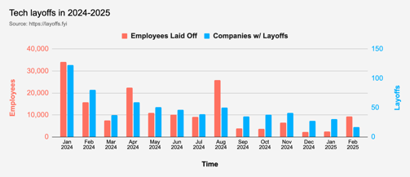
Jobs
Layoffs:
https://layoffs.fyi
https://techcrunch.com/2025/02/13/tech-layoffs-2024-list/
Google offers “voluntary exit” to all US platforms and devices employees
Microsoft has initiated performance based job cuts, resulting in immediate termination of affected employees without severance pay.

Slide 21


About the Speaker
Lev Selector, Ph.D.
40+ years of software engineering, data science, and building teams (hiring, training, and managing)
Ph.D. in mathematical modeling and computer simulations
Interests:
Generative AI, Using LLM with your data
Local AI for Local Private Data
Cloud architecture, fin-tech, application security
Find/connect: Linkedin, GitHub, YouTube, Google
https://eais.ai
Enterprise AI Systems

Slide 22
Thank You!

