Slide 1

AI Updates
January 24, 2024
Office => Copilot
DeepSeek-R1 on Huggingface and Ollama
Google Gemini 2.0 Flash - Reasoning
PerfCodeGen from Salesforce AI Research
Meta's SEAMLESSM4T real-time translator
Stargate AI Infrastructure Project
CAG: Cache-Augmented Generation
RAG Best Practices
Firecrawl
ChatGPT Task Feature - Set up Daily News Brief
Microsoft CoreAI group led by Jay Parikh
Microsoft Copilot Chat agents for businesses
Microsoft Premium AI in MS 365 subscriptions
Microsoft Renamed "Office" to "Copilot"
Trump rescinded 2023 order on AI
Test-Time Compute (TTC)
Deloitte report on AI ROI
Cline 3.2 AI Coding Assistant
Google Mind Evolution
Anthropic "Citations"
"Humanity’s Last Exam" (HLE) Benchmark
ByteDance $20 Bln for AI this year
AI to Surpass Humans in 2-3 years (Dario Amodei)
Perplexity Sonar Pro
ByteDance Doubao 1.5 Pro
OpenAI Operator
Browser Use - control your browser
Gemini Advanced 1.5 Pro with Deep Research
Perplexity Assistant
OpenAI GPT-4b micro - RetroBio
Rust & WebAssembly (Wasm)
Microsoft Hyperlight is now open source
How To Be Productive
Crowd-sourced "Arena" Leaderboard
Salesforce Stops Hiring Programmers

Slide 2

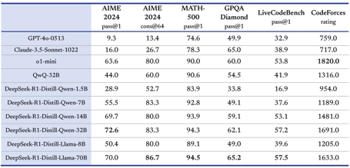

DeepSeek-R1
DeepSeek-R1 released January 20th
https://github.com/deepseek-ai/DeepSeek-R1
https://github.com/deepseek-ai/DeepSeek-R1/blob/main/DeepSeek_R1.pdf
https://huggingface.co/deepseek-ai/DeepSeek-R1 - downloads
https://ollama.com/library/deepseek-r1 - Ollama sizes (B): 1.5, 7, 8, 14, 32, 70, 671
https://chat.deepseek.com
https://x.com/deepseek_ai/status/1881318130334814301
https://www.youtube.com/watch?v=J8wM1L97pSo - This DeepSeek AI RAG Agent
Open Source AI model (MIT license), open weight
Model is developed by a Chinese company DeepSeek
Performance rivals that of OpenAI's o1
Can run quantized versions (Ollama) on laptops
Self-evolution
Affordable (significantly cheaper than comparable models)
Democratization of AI
Acceleration of AI research (open source / open weights)
Geopolitical implications (coming from China)
DeepSeek-R1 self-evolution through RL (Reinforcement Learning)
Traditional LLM Training - supervised learning (labeled data)
DeepSeek-R1 uses RL during post-training phase. This means the model is given a task and allowed to "explore" different solutions. It receives rewards for correct answers and penalties for incorrect ones, learning and improving over time without needing explicit labeled data.
Self-Evolution - DeepSeek-R1 essentially evolves its own reasoning abilities. It learns to break down problems, consider different approaches, and even self-correct, much like a human would when tackling a challenging task.
Testing the model: Matthew Berman video: https://www.youtube.com/watch?v=bOsvI3HYHgI
CPU: 128 cores 256 threads
SSD: 8 * 3.58 TBytes
GPU: 8 AMD Instinct GPUs (192GB VRAM each)

Slide 3

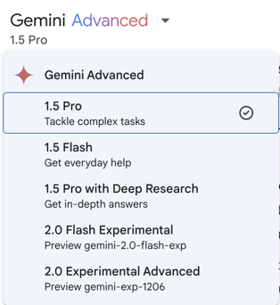
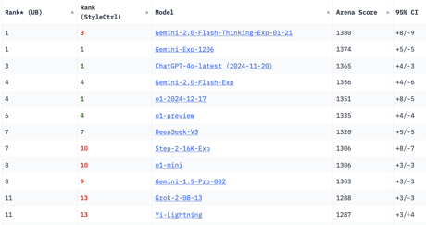
Google Gemini 2.0 Flash
Google Gemini 2.0 Flash - a new reasoning model
Gemini-2.0-Flash-Thinking-Exp-01-21
significant improvements in mathematics and sciences
larger context window - 1 Mln tokens in , 65K tokens out
native code execution - the model can directly execute code within its environment using these languages: Python, Java, C++, JavaScript, Go
Available via API or Google Studio
Not here yet

Slide 4
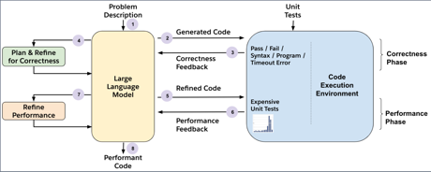

AI Updates - 1
PerfCodeGen from Salesforce AI Research
generates more efficient software code by using feedback loop based on results of the execution. Operates in two phases: 1. refining correctness; 2. optimizing performance.
https://x.com/SFResearch/status/1880490301523128766
https://arxiv.org/abs/2412.03578
https://github.com/SalesforceAIResearch/perfcodegen
Meta's SEAMLESSM4T translator
translates speech to speech, text into text, text into speech, and vice versa
translates 101 languages into 36 others
the algorithm is 23 percent more accurate than today’s top models
Model is nearly as fast as expert human interpreters
https://www.nature.com/articles/s41586-024-08359-z
Stargate AI Infrastructure Project
https://openai.com/index/announcing-the-stargate-project/
https://www.youtube.com/watch?v=6vqN8jBfQb8 - video
new company "Stargate" to grow AI infrastructure (build data centers) in the US (invest up to $500 Bln)
Initial founders: SoftBank, OpenAI, Oracle, and MGX. Also - Arm, Microsoft, NVIDIA
Trump called this the "largest AI infrastructure project in history."
The project is expected to create 100,000 US jobs, Trump said.
https://www.cnn.com/2025/01/21/tech/openai-oracle-softbank-trump-ai-investment/index.html

Slide 5

AI Updates - 2
Cache-Augmented Generation (CAG)
How to ground LLM responses in facts:
Fine-tune the entire model
Fine-tune a model using Low-Rank Adaptation (LoRA)
Using RAG (Retrieval-Augmented Generation)
Using CAG (Cache-Augmented Generation)
CAG works by pre-loading all relevant knowledge into the extended context of an LLM. Works well with long-context LLMs, complements or outperforms RAG
https://arxiv.org/pdf/2412.15605v1
https://levelup.gitconnected.com/cache-augmented-generation-cag-is-here-to-replace-rag-3d25c52360b2
ChatGPT Task Feature - Set up Daily News Brief with specific preferences and timing. Manage and customize your summary format and focus areas through the Tasks menu. Add specific topics you're interested in for more relevant news updates.
https://university.therundown.ai/c/daily-tutorials/get-automatic-global-news-briefings-with-chatgpt-323e1b99-66e3-459e-b49c-33bea2546fdf
Microsoft CoreAI group led by Jay Parikh
Microsoft Copilot Chat agents for businesses (pay-as-you-go)
Microsoft premium AI features in Microsoft 365 plans
Microsoft just renamed "Microsoft 365 Office" to "Microsoft 365 Copilot"
President Trump has rescinded President Biden's 2023 executive order on artificial intelligence, removing government constraints on AI development to foster faster innovation.
Biden’s constraints focused on AI oversight, which included testing requirements and safety evaluations to address potential risks.
RAG Best Practices
https://arxiv.org/abs/2501.07391 - paper
https://github.com/ali-bahrainian/RAG_best_practices - GitHub
Firecrawl
Firecrawl is an open-source developer platform that allows you to extract data from the web.
Firecrawl is an API service that takes a URL, crawls it, and converts it into clean markdown or structured data.
Firecrawl is available as a free and paid service. The free version includes a limited number of features, while the paid version includes additional features such as the ability to extract data from more websites and to use Firecrawl's API.
https://github.com/mendableai/firecrawl
https://www.firecrawl.dev

Slide 6
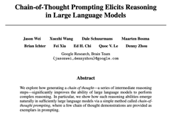




Test-Time Compute (TTC)
Google Chain-of-Thought paper (2022-2023)
https://arxiv.org/pdf/2201.11903
OpenAI has demonstrated in December of 2024 that if you give a model more time to think - it can improve the answer.
This was actually not self obvious.
The challenge was to create a smart system from stupid blocks.
Some people thought it is impossible.
It is like making an Einstein from a pack of dogs.
Open AI has converted stupid into smart using a special process.
This process is basically Chain-of-Thought. It includes generating multiple versions of response, using self-reflection, selection, back-tracking, retrying, etc.
This is a great achievement.
But right now it is expensive. Some answers took literally thousands of dollars in compute.
But given how fast the prices are going down, it will take probably no more than 1-2 years to make these powerful models available and practical for everyone.
Reaching true AGI is not an event, it is a process.
The Turing test was officially passed by AI in the May of 2024 - but nobody has noticed.
AI has already outperformed humans in many areas. But there are still areas where humans are ahead of AI.
There is no single formal definition of when the AGI is achieved. Different people use different metrics depending on their agenda. And definitions change and get more specific with time. It is a moving target.
OpenAI is trying to prove that they have achieved AGI for legal reasons. They have a contract with Microsoft which changes the terms why they achieve AGI.

Slide 7
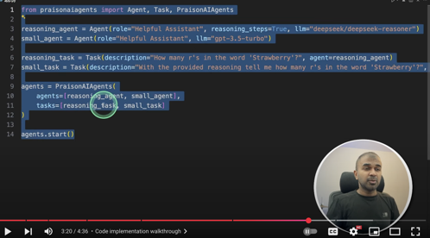
Add reasoning to ANY Smaller model
Add reasoning to ANY Smaller model with DeepSeek Thinking https://www.youtube.com/watch?v=2PPamsADjJA
Mervin Praison
Idea:
Copy the reasoning steps from Deep Seek response
Paste them into a prompt for a small model (as an example for 1-shot answering)

Slide 8
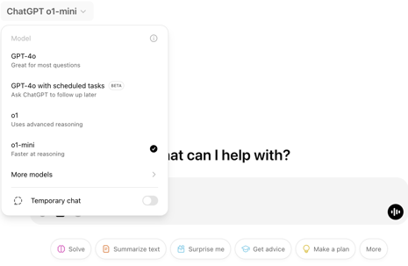
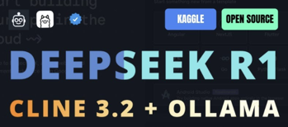
AI Updates - 3
OpenAI o1 and o1-mini
A Deloitte report:
74% of enterprises using GenAI are exceeding ROI expectations
IT, cybersecurity, and customer service leading
Despite adoption growth, challenges like data governance and compliance persist. Only 40% of employees have access to AI tools, signaling the need for cultural shifts. Looking ahead, 78% of businesses plan to increase AI investments, eyeing agentic AI to transform entire processes instead of isolated tasks.
https://www2.deloitte.com/us/en/pages/consulting/articles/state-of-generative-ai-in-enterprise.html
Cline 3.2 is an AI-powered coding assistant
Developed by a team led by Saoud Rizwan (UK)
Open source (Apache 2.0)
Cline works right in your IDE
Can create and edit files, execute commands, using the browser
Plan/Act mode, can use different models via API, can utilize models provided by other VS Code extensions, such as GitHub Copilot.
Can understand and analyze your code; can generate code that is both accurate and efficient; can learn from your feedback
https://github.com/cline/cline

Slide 9

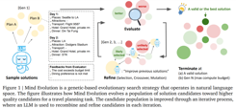
AI Updates - 4
Google DeepMind's Mind Evolution
"Evolving Deeper LLM Thinking" https://arxiv.org/abs/2501.09891
Evolutionary Search - uses genetic algorithm where the LLM generates, recombines, and refines candidate solutions based on feedback from an evaluator
Global Refinement - Mind Evolution refines complete solutions, not step-by-step
Parallelization - the process can be easily parallelized to speed up exploration of the solution space. Significant Performance Improvement
No Formal Solver Required: Mind Evolution avoids the need for a formal solver or predefined rules, making it applicable to a wider range of problems
Steps: (1) The LLM generates an initial set of candidate solutions. (2) An evaluator assesses the quality of each solution. (3) LLM recombines and refines the most promising solutions based on the evaluator's feedback.
Steps 2 and 3 are repeated for several generations, with the population evolving towards better solutions
Anthropic "Citations"
https://www.anthropic.com/news/introducing-citations-api
Citations - a new API feature that lets Claude ground its answers in source documents.
Claude can now provide detailed references to the exact sentences and passages it uses to generate responses, leading to more verifiable, trustworthy outputs.
Citations is generally available on the Anthropic API and Google Cloud’s Vertex AI.

Slide 10





AI Updates - 5
"Humanity’s Last Exam" (HLE) - a new AI benchmark
by The Center for AI Safety and Scale AI https://agi.safe.ai https://github.com/centerforaisafety/hle
Tests an LLM’s academic knowledge
The benchmark consists of 3,000 expert-crafted questions across 100+ subjects, with contributors from over 500 institutions in 50 countries.
Current leading AI score less than 10% on this test
Questions are in either exact-match or multiple-choice format, with 10% of the challenges incorporating multimodal analysis of text and images.
A $500k prize pool incentivizes high-quality submissions, with top questions earning $5,000 each and co-authorship opportunities for contributors.
Perplexity Sonar Pro
Build your own generative search
More accurate than other similar AI
Providing trustworthy answers
https://www.perplexity.ai/hub/blog/introducing-the-sonar-pro-api
ByteDance Doubao 1.5 Pro (China)
AI model, Sparse Mixture of Experts (MoE) architecture
Multi-modal (text, images, speech)
Performance exceeding larger models like Llama3.1-405B, GPT-4o, Claude 3.5
using fewer resources than others
cheaper than others
open-sourced veRL, the technology behind its reasoning abilities
open-sourced UI-TARS - an AI that interacts with computers using screenshots
ByteDance $20 Bln for AI this year ByteDance is the Chinese owner of TikTok
Half of this money will go into AI infrastructure
https://www.reuters.com/technology/bytedance-plans-20-billion-capex-2025-mostly-ai-sources-say-2025-01-23/
Anthropic CEO Dario Amodei predicted that AI models may surpass human capabilities "in almost everything" within 2-3 years
according to a Wall Street Journal interview at the World Economic Forum in Davos, Switzerland.

Slide 11



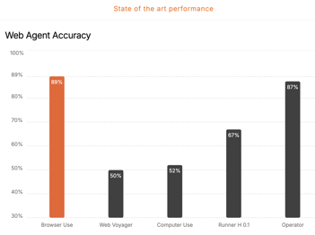


Operator - OpenAI AI browser agent
Operator - OpenAI AI browser agent. https://openai.com/index/introducing-operator/
It works by instantiating a remote browser (in the cloud) that can be controlled by the user
The user can give Operator instructions by typing them into a chat window
Operator is still under development, but it is already capable of performing a variety of tasks, such as booking a table at a restaurant or ordering groceries
Operator is based on a new model called the Computer Using Agent (CUA)
CUA is trained to use and control a computer in the same way that humans can.
Operator is still under development, but it is already capable of performing a variety of tasks.
OpenAI Operator Agent is not a standalone product, but rather a part of OpenAI's Pro Plan subscription, which costs $200 per month.
Brower-Use - the easiest way to connect your AI agents with the browser.
https://browser-use.com
https://docs.browser-use.com
https://github.com/browser-use/web-ui
https://github.com/browser-use/browser-use
https://www.youtube.com/watch?v=PRbCFgSvaco - video (Deepseek-R1 + Browser Use)
AI + browser automation.
Open-source, Compatible with all mainstream models and frameworks
Founders (Zurich, Switzerland):
Magnus Müller - https://www.linkedin.com/in/magnus-mueller/
Gregor Zunic - https://www.linkedin.com/in/gregorzunic/

Slide 12


Gemini Advanced 1.5 Pro
with Deep Research
Perplexity Assistant
Perplexity Assistant - a new free mobile AI-powered app on android phone https://x.com/perplexity_ai/status/1882466239123255686
It can perform actions for you, like booking a table at a restaurant, ordering a ride, or drafting an email.
It can interact with other apps on your phone to complete tasks (Uber, Calendar, ...)
It uses Reasoning AI, can understand complex questions and follow multi-step instructions
It can understand voice, touch gestures, and even what your camera sees
It remembers your previous interactions and uses that information to provide more helpful and personalized assistance
Here are some examples of what Perplexity Assistant can do:
Find the correct date and time of an event and set a reminder for you.
Help you book a table after helping you search for a restaurant.
Identify what it sees through your device's camera or on the screen.
Draft emails and set reminders.
Call a ride for you.
Find a forgotten song.
Gemini Advanced 1.5 Pro with Deep Research is a powerful AI research tool offered as part of Google's AI Premium plan.
It uses Gemini 1.5 Pro model which excels at logical reasoning, analysis, coding, and creative collaboration
It automatically browses and analyzes hundreds of websites in real-time to generate a comprehensive report.
This report includes key findings and links to original sources, saving you hours of research time.
It has 1 Million token context window, you can analyze up to 1,500 pages of text at once
It integrates with other Google services like Docs and Drive. You can easily export your research reports into Google Docs

Slide 13

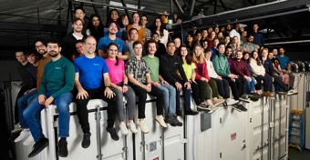
OpenAI GPT-4b micro
GPT-4b micro is a specialized AI model developed by OpenAI in collaboration with Retro Biosciences - https://www.retro.bio
Sam Altman has invested $180 Mln into Retro Biosciences
Purpose - life extension, biological research
Re-engineering proteins to enhance their function, particularly in the context of stem cell research
Focus on protein engineering, on redesigning proteins, suggesting modifications to amino acid sequences to improve protein effectiveness.
Model is trained on a dataset of protein sequences from various species and data about protein-protein interactions. This makes it specialized for biological research.
GPT-4b micro uses a relatively small dataset, making it a "small language model" designed for precision in a specific domain.
One of its primary applications is improving the efficiency of stem cell production. It has shown promising results in modifying Yamanaka factors, proteins crucial for turning adult cells into stem cells.
Retro Biosciences, OpenAI's partner in this project, focuses on extending human lifespan. GPT-4b micro's ability to enhance stem cell production could play a role in achieving this goal.
https://www.youtube.com/watch?v=ztlSid-OuQg - video
We develop therapies that meaningfully
reverse age-related diseases.

Slide 14

Rust & WebAssembly (Wasm)
Who deploy Rust to Wasm?
35% of Rust developers
19% of web developers
WebAssembly (Wasm):
As of March 2024, 99% of tracked web browsers support WebAssembly (version 1.0)
Wasm is low-level, assembly-like, allows running compiled code in browser (C/C++, Rust, Go, C#) at near-native speed.
WebAssembly modules can be loaded into Javascript apps and communicate with JS bidirectionally
https://en.wikipedia.org/wiki/WebAssembly
javascript calls Wasm, Wasm does calculations - and return result to JS
Wasm can not manipulate DOM.
Wasm can only accept numbers from JS (not text ??)
Wasm with Rust uses UTF-8, Javascript uses UTF-16. So we need to re-encode characters every time we pass strings between Rust and Javascript
Frameworks like Leptos provide the glue to optimize the communication between JS AND Wasm
WebAssembly (Wasm) Rust code running in the browser cannot directly communicate with a web server. It needs to go through JavaScript as an intermediary
.wat files - text files
.wasm files - compact binary files
WebAssembly Text Format (WAT) example:
(module
(func $add (param $a i32) (param $b i32) (result i32)
local.get $a
local.get $b
i32.add)
(export "add" (func $add))
)
in Javascript:
WebAssembly.instantiateStreaming(fetch('module.wasm'))
.then(obj => {
// Use the WebAssembly instance
};
Server
Javascript
WasmRust

Slide 15

Hyperlight Wasm microVM
Hyperlight is an open source Rust library allowing to create small virtual machines microVM (micro Virtual Machines) which can start in 1-2 milliseconds, which is 100 times faster than traditional VM or container
https://github.com/hyperlight-dev/hyperlight - GitHub - code and instructions to run
"Microsoft’s Hyperlight WebAssembly for VMs Is Open Source" https://thenewstack.io/microsofts-hyperlight-webassembly-for-vms-is-open-source/
WASI = WebAssembly System Interface
"WASI Preview 2: What WebAssembly Can and Can’t Do Yet"
https://thenewstack.io/wasi-preview-2-what-webassembly-can-and-cant-do-yet/
https://news.ycombinator.com/item?id=42078476
Hyperlight wasm microvm is a Rust library that leverages kernel-based virtual machines (KVMs) or Hyper-V to execute untrusted code within a microVM without the need for a full operating system
Hyperlight is an extremely lightweight Virtual Machine Manager (VMM) designed to be embedded within applications.
It enables safe execution of untrusted code within microVMs with very low latency and minimal overhead.
Hyperlight is focusing on executing small, short-running functions within a secure, isolated environment
The image files are small, the start time of microVM may be as small as 1-2 milliseconds, which is x100 times faster than traditional VMs or Docker images.
Hyperlight achieves this efficiency by minimizing the functionalities of a traditional hypervisor. It focuses on providing a secure substrate for hosting application runtimes, such as Wasmtime
Wasmtime is a runtime for Wasm. Various languages can be compiled into Wasm (Rust, C++, Python, Java, ...).
Hyperlight API only supports C and Rust today
Compared to unikernels or gVisor, Hyperlight offers a unique approach by combining the speed and efficiency of microVMs with the security and portability of Wasm

Slide 16

How To Be Productive
How To Be SO Productive That It Feels ILLEGAL https://www.youtube.com/watch?v=4FXScrmYKQ0
Justin Sung's video explains how to reach "illegal" levels of productivity.
Pareto Principle (80/20 rule) squared: find 20% of 20% = 4% (for 64%)
The Zeigarnik effect - https://en.wikipedia.org/wiki/Zeigarnik_effect students who suspend their study to perform unrelated activities (such as studying a different subject or playing a game), will remember material better than students who complete study sessions without a break. By deliberately starting tasks without the intention of finishing them, we reduce the friction of starting and increase motivation.
Zeigarnik effect started; getting started on getting started (prepare)
"Championship Mentality," emphasizing the importance of focusing on long-term goals rather than short-term wins.
So: plan and prioritize, break down tasks, think long term, use technology, take care of yourself, recover

Slide 17
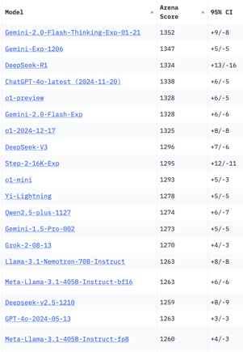
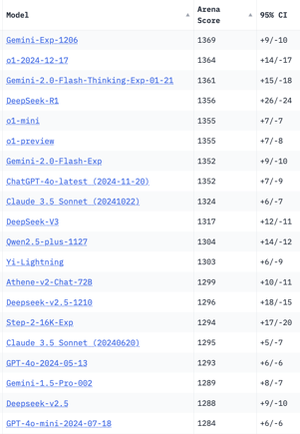
Crowd-sourced "Arena" Leaderboard
Total #models: 195
Total #votes: 2,572,591
Last updated: 2025-01-23
Starting Elo rating = 1000
95% CI = Confidence Interval
https://en.wikipedia.org/wiki/Elo_rating_system
https://chat.lmsys.org/?leaderboard
English-only queries
Coding
China
China
China
China
China
China
China
China
x.ai
China
China
China

Slide 18
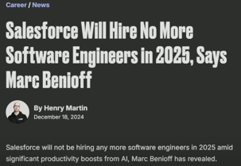


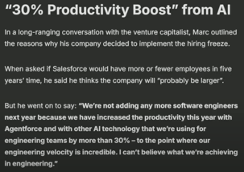

Salesforce Stops Hiring Programmers
Coding is Dead (Meta & Salesforce Just Confirmed It)
https://www.youtube.com/watch?v=PaktYZ6D73Q - video
Marc Benioff - "Salesforce will hire no more software engineers in 2025" - https://www.youtube.com/shorts/oNlRs31zGsw -
Marc Benioff
Mark Zuckerberg

Slide 19


About the Speaker
Lev Selector, Ph.D.
40+ years of software engineering, data science, and building teams (hiring, training, and managing)
Ph.D. in mathematical modeling and computer simulations
Interests:
Generative AI, Using LLM with your data
Local AI for Local Private Data
Cloud architecture, fin-tech, application security
Find/connect: Linkedin, GitHub, YouTube, Google
https://eais.ai
Enterprise AI Systems

Slide 20
Thank You!

