Slide 1


AI Updates
March 07, 2025
Alibaba QwQ-32B
Inception Labs - Mercury diffusion LLM
Jamba 1.6 from AI21 Labs
DeepSeek R2
Nvidia Blackwell Ultra & Vera Rubin
Anthropic Claude Code
Identify models from output with 97.1% accuracy
TSMC $100 Bln building 3 plants in the US
NextGenAI - consortium of 15 research institutions
Microsoft is shutting down Skype
Fast Growth of AI Companies
NVIDIA dominates the AI market
China buys Nvidia through other countries
Apple Studio 512GB
Sutton and Barto win the Turing Award for RL
China Fantastic Four
Larry Page Dynatomics - AI designs
Mistral OCR
Manus AI Assistant
Google DeepMind - Project Astra
Cohere Aya Vision
TokenSwift - fast generation of long sequences
Microsoft LongRoPE2 Context Window Scaling
Microsoft Dragon Copilot for Healthcare
Sesame CSM - Conversational Speech Model
Structured data extraction
Chain of Draft
Google Data Science Agent in Colab
Crowd-sourced "Arena" Leaderboard
WebDev Arena Leaderboard
Jobs
AI Subscriptions

Slide 2
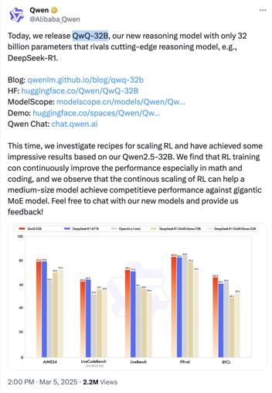

Alibaba QwQ-32B
QwQ-32B - new reasoning model with only 32 Bln params
Outperforms DeepSeek-R1 and OpenAI o1-mini
Open-source Apache 2.0 license
It rivals DeepSeek-R1, which is x20 times bigger
Priced at just $0.20 per 1 Mln in/out tokens, which is x10 times cheaper than R1 and o1-mini.
Blog: https://qwenlm.github.io/blog/qwq-32b
HF: https://huggingface.co/Qwen/QwQ-32B
ModelScope:https://modelscope.cn/models/Qwen/QwQ-32B
Demo: https://huggingface.co/spaces/Qwen/QwQ-32B-Demo
Qwen Chat: https://chat.qwen.ai
Ollama: https://ollama.com/library/qwq:32b-q4_K_M ollama run qwq:32b-q4_K_M # 20GB file
QwQ-32B is based on Qwen2.5-32B
RL training can continuously improve the performance especially in math and coding
Continous scaling of RL can help a medium-size model achieve competitive performance against gigantic MoE model

Slide 3
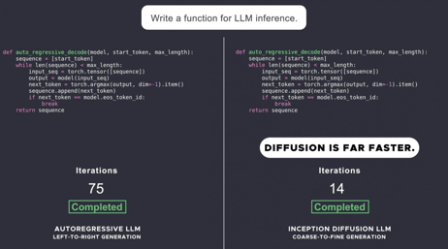
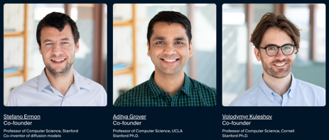
Inception Labs - Mercury diffusion LLM
Mercury - family of dLLMs (diffusion LLMs)
First successful application of diffusion to discrete data such as text and code
Mercury is up to 10x faster than frontier speed-optimized LLMs (over 1000 tokens/sec on NVIDIA H100s)
Mercury Coder - available to test in a playground
https://chat.inceptionlabs.ai
https://www.inceptionlabs.ai
https://www.inceptionlabs.ai/news
https://x.com/ArtificialAnlys/status/1894932634322772372
https://machine-learning-made-simple.medium.com/is-the-mercury-llm-the-first-of-a-new-generation-of-llms-b64de1d36029
https://www.youtube.com/watch?v=X1rD3NhlIcE - video
Current LLMs are autoregressive, meaning that they generate text left to right, one token at a time, sequentially. Diffusion models operate with a "coarse-to-fine" generation process, where the output is refined from pure noise over a few "denoising" steps
Diffusion models are not restricted to only considering previous output, they are better at reasoning and at structuring their responses. And because diffusion models can continually refine their outputs, they can correct mistakes and hallucinations.
For these reasons, diffusion powers all of the most prominent AI solutions for video, image, and audio generation, including Sora, Midjourney, and Riffusion.
Diffusion models are usually relatively small (can run locally)
Inception Labs, Palo Alto, CA
founded by professors from Stanford, UCLA, and Cornell

Slide 4
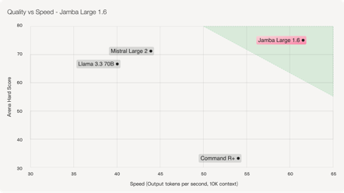

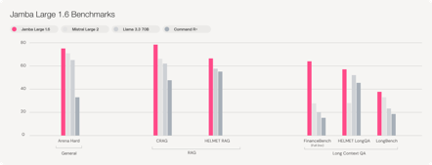
Jamba 1.6 from AI21 Labs
Jamba 1.6 from AI21 Labs - https://www.ai21.com/jamba/
open model for private enterprise, outperfors Cohere, Mistral, Llama
available on AI21 Studio and @Hugging Face
256K context window
Jamba 1.6 chat model: 398B total parameters (94B active)
Mamba & Jamba models:
Mamba was developed by researchers from Carnegie Mellon University and Princeton University (December 2023) as a new state space model (SSM) architecture focused on efficient sequence modeling, particularly for handling long sequences with linear complexity.
Jamba is a hybrid model developed by AI21 Labs in Israel, combining the Transformer architecture with Mamba's state space model (SSM) technology. It incorporates a mixture-of-experts (MoE) module
Jamba 1.5 - released in July 2024 - long-context language capabilities, speed, efficiency, 398B params, comparable with Gemma-2-27B-it or Gemini-1.5-Flash - https://openlm.ai/chatbot-arena/
Jamba 1.6 - released March 6, 2025 - latest improved version. It outperforms models from Mistral, Meta, and Cohere in several benchmarks
AI21 Labs - startup, since 2017, Tel Aviv, Israel & in New York, USA
founded in Nov 2017 by Amnon Shashua, Yoav Shoham, Ori Goshen
AI21 received $336 Mln in funding, valuation $1.4 Bln

Slide 5
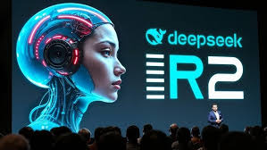
DeepSeek R2
DeepSeek R2 - upcoming model
Improved version of DeepSeek R1:
Enhanced coding capabilities
More languages (multilingual)
Generally superior logical reasoning
Cost-efficiency and accessibility
Likely multimodal (image, video) ?

Slide 6
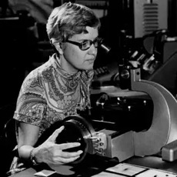
Nvidia Blackwell Ultra & Vera Rubin
Nvidia confirms Blackwell Ultra in 2025 and Vera Rubin GPUs in 2026
2025: Blackwell 300-series (Blackwell Ultra) GPUs for AI and HPC
2026: Vera Rubin - TSMC's 3nm process, HBM4 memory
https://www.tomshardware.com/pc-components/gpus/nvidia-confirms-blackwell-ultra-and-vera-rubin-gpus-are-on-track-for-2025-and-2026-post-rubin-gpus-in-the-works
https://www.tomshardware.com/pc-components/gpus/nvidia-rubin-revealed-as-blackwell-successor-powerful-vera-cpu-coming-too
Vera Rubin
American astronomer
(1928-2016)

Slide 7


AI Updates 1
Anthropic Claude Code - agentic coding tool, in beta research preview tasks including adding features and tests, creating pull requests, and generating documentation.
https://devclass.com/2025/02/27/anthropic-previews-claude-code-agentic-coding-capable-but-costly/
Identify models from output with 97.1% accuracy
Mingjie Sun, a researcher at Carnegie Mellon University, and his colleagues developed a machine learning model that analyzed the outputs of five popular LLMs, and was able to distinguish between models with 97.1% accuracy
ChatGPT’s GPT-4o model, for instance, tends to use “utilize” more than other models.
DeepSeek is partial to saying “certainly.”
Google’s Gemini often prefaces its conclusions with the word “essentially,”
Anthropic’s Claude over-uses phrases like “according to” and “according to the text” when citing its sources.
xAI’s Grok stands out as more discursive and didactic, often reminding users to “remember” key points while guiding them through arguments with “not only” and “but also.”
https://www.fastcompany.com/91286162/ai-chatbots-have-telltale-quirks-researchers-can-spot-them-with-97-accuracy

Slide 8
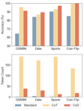
AI Updates 2
Microsoft Dragon Copilot - listen and create notes
AI system for healthcare
Multilanguage ambient listening and note creation
Natural language dictation
Clinical evidence summaries, referral letters, after visit summaries
goal to free clinicians from much of the administrative burden
Google DeepMind - Project Astra - develop a universal AI assistant
Interacting through real-time AI voice and visual processing
Google has begun integrating Astra’s capabilities into Gemini Live, with features like live video and screen sharing
Rolling out to Gemini Advanced subscribers in March 2025
Project Astra is accessible via Android and prototype smart glasses
Sesame CSM - Conversational Speech Model
https://www.sesame.com/research/crossing_the_uncanny_valley_of_voice#demo
https://www.youtube.com/watch?v=ahTQiTt5vjc - good demo
Cohere Aya Vision from open research arm of Cohere
state-of-the-art vision model , 8B and 32B params
supports 23 languages
text to image, image to text, visual question answering
8B outperforms Qwen2.5-VL 7B and Llama-3.2 11B Vision
32B model outperforms Llama 3.2 90B Vision
open weight, available on Kaggle and Hugginface
https://cohere.com/blog/aya-vision
Structured data extraction from unstructured content using LLM schemas
https://simonwillison.net/2025/Feb/28/llm-schemas/
Chain of Draft - thinking faster by writing less (prompting technique from Zoom researchers)
https://arxiv.org/abs/2502.18600
https://www.youtube.com/watch?v=rYnisU10wu0
TokenSwift - accelerate generation of ultra-long sequences
up to 100K tokens, while maintaining quality, lossless
reducing computation time from hours to minutes
https://github.com/bigai-nlco/TokenSwift
Google Data Science Agent in Colab (free Jupyter in cloud)
AI Agent uses Gemini to generate your notebook
Upload your data file, describe your goals (e.g., "Visualize trends," "Build and optimize prediction model", “Fill-in missing values”, “Select the best statistical technique”) - and watch the Data Science Agent get to work
Microsoft LongRoPE2: Near-Lossless LLM Context Window Scaling
extends the effective context window of pre-trained LLMs
https://arxiv.org/abs/2502.20082

Slide 9
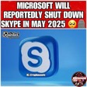


AI Updates 3
TSMC $100 Bln building 3 plants in the US
TSMC announced a $100 billion investment to build three new semiconductor manufacturing plants in the U.S.
TSMC supplies 90% of the world’s most advanced chips to firms like Apple and Nvidia
Microsoft is shutting down Skype in May 2025
https://www.xda-developers.com/microsoft-killing-skype/
Fast Growth of AI Companies
OpenAI is set to close a deal that values the company at $300 billion
Anthropic has raised $3.5 billion at $61.5 billion valuation, up from about $16 billion a little more than a year ago - more than tripling in a year. Expected to generate $2.2B in revenue in 2025
xAI is in talks for a new financing round at $75 billion valuation, up from about $40 billion just two months ago
CoreWeave, AI CLoud, has filed for an IPO, aiming for a valuation above $35 billion. The company’s revenue skyrocketed 700% in 2024 to $1.9 billion, driven by demand for AI computing power. CoreWeave acquires "Weights & Biases" for $1.7 Billion
NextGenAI - consortium with 15 leading research institutions
using AI to accelerate research and transform education
https://openai.com/index/introducing-nextgenai/
NVIDIA dominates the AI market, pulling in $31 billion in Q4 from data center revenue with 70%+ margins.
Microsoft’s AI + CLoud made $3.25 billion
IBM followed with $2 billion mostly from consulting.
China buys Nvidia through other countries
China getting latest Nvidia’s Blackwell chips through third-party traders located in other regions, like Malaysia, Taiwan, and Vietnam
https://techcrunch.com/2025/03/03/chinese-buyers-are-getting-nvidia-blackwell-chips-despite-u-s-export-controls/
Malaysia
Taiwan
Vietnam
Singapore
China

Slide 10
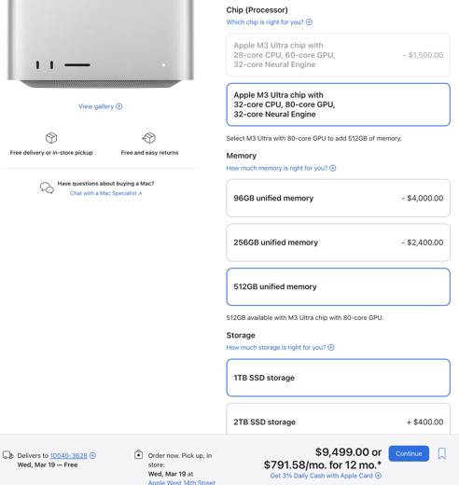

Apple Studio 512GB
Apple announced several new products:
MacBook Air with M4 chip (and discontinue M2 & M3)
Mac Studio with the M4 Max and M3 Ultra chips, 512GB RAM !
iPad Air with M3 chip
base Ipad, with an A16 chip, doubling the starting storage
iPhone 16e
PolySoft - affordable Mac storage expansion (x2 times cheaper):
https://www.kickstarter.com/projects/polysoftservices/studio-drive
https://www.youtube.com/watch?v=6ze3kEj4IqU

Slide 11
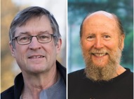
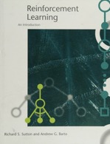
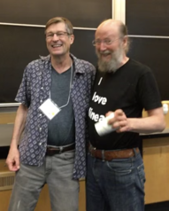

Sutton and Barto win the Turing Award for RL
"Reinforcement Learning: An Introduction" by Richard S. Sutton and Andrew G. Barto (1998) is a foundational textbook that presents RL as a unified field within machine learning and artificial intelligence.
RL - learning from interaction rather than from provided examples. RL vs supervised and unsupervised learning
RL - problem and solutions. How agents can learn optimal behavior through trial and error with delayed rewards
How an agent can learn from interaction to achieve a goal.
Markov decision processes as the formal framework for modeling sequential decision-making problems
Dynamic programming methods for computing optimal policies when a model of the environment is available
Monte Carlo methods that learn directly from experience without requiring a model
Temporal-difference learning, which combines ideas from dynamic programming and Monte Carlo methods
Function approximation techniques to handle large state spaces
Policy gradient methods for directly optimizing policies
The exploration-exploitation dilemma in reinforcement learning
Turing Award Goes to Pioneers of Reinforcement Learning
Andrew Barto and Richard Sutton
at the University of Massachusetts, Amherst
"Reinforcement Learning: An Introduction" 1998 book
Positive reinforcement "good puppy" training:
rewarding desired behaviors

Slide 12
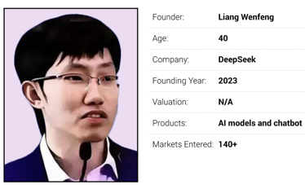
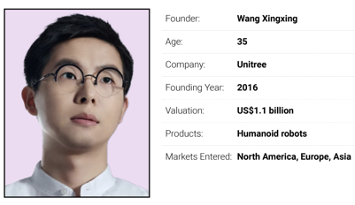
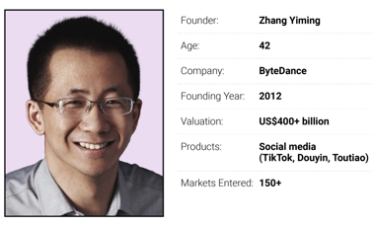
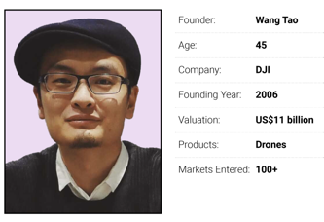
China Fantastic Four
New generation of Chinese entrepreneurs - start-up founders known as the “Fantastic Four”
https://www.scmp.com/tech/big-tech/article/3300594/chinas-fantastic-four-new-breed-entrepreneurs-reshaping-global-tech-landscape

Slide 13


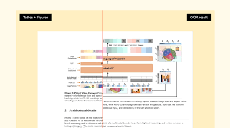
AI Updates 4
Larry Page Dynatomics AI designs
Google co-founder Larry Page is building a new company called Dynatomics - https://dynatomics.com
The goal is to use AI to create “highly optimized” designs for objects and then have a factory build them. The company is run by Chris Anderson, previously the CTO of Page-backed electric airplane startup Kittyhawk ( https://www.kittyhawk.aero ).
https://techcrunch.com/2025/03/06/google-co-founder-larry-page-reportedly-has-a-new-ai-startup/
Mistral OCR AI model converts documents into markdown
document as input prompt, markdown document as output
AI comprehends documents (images, PDFs)
Extracts content (text, tables, formulas, images) into a markdown document
It is multilingual and multimodal
It is very fast
Currently only available as self-hosting option to selected organizations dealing with highly sensitive or classified information
https://mistral.ai/en/news/mistral-ocr
https://www.youtube.com/watch?v=6lRBm0KnzBI - demo

Slide 14
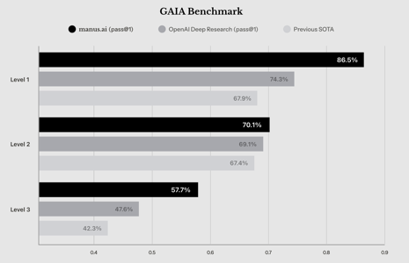
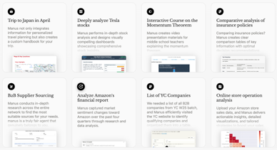
Manus AI Assistant
Manus AI Assistant
Manus = "hand" (Latin word)
a general AI agent as your assistant
resume screening and property research, accessing its own independent computer instance, web browsing, coding, and creating visuals
handle tasks on sites like Upwork and Fiverr.
outperformed leading general-purpose assistants like ChatGPT and Gemini on the GAIA benchmark (General AI Assistant)
Currently operates on an invite-only basis
Planning to open-source later this year.
https://manus.im
https://www.youtube.com/watch?v=K27diMbCsuw - video

Slide 15
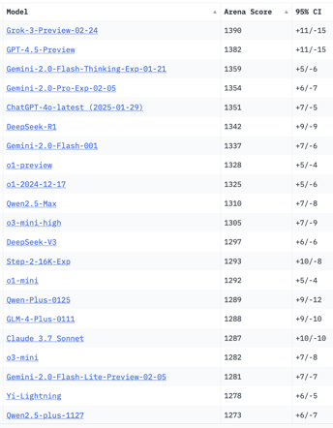
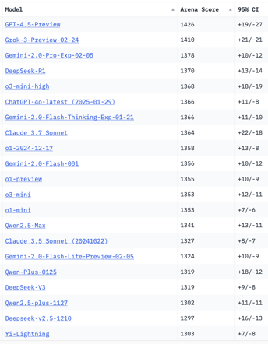
Crowd-sourced "LM Arena" Leaderboard
Total #models: 211
Total #votes: 2,736,442
Last updated: 2025-03-02
Starting Elo rating = 1000
95% CI = Confidence Interval
https://en.wikipedia.org/wiki/Elo_rating_system
https://chat.lmsys.org/?leaderboard
https://lmarena.ai/?leaderboard
English-only queries
Coding
x.ai
x.ai
China
China
China
China
China
China
China
China
China
China
China
China
China
China
China

Slide 16
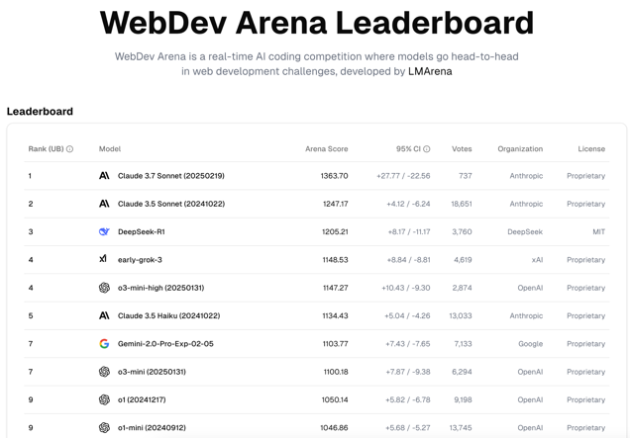
WebDev Arena Leaderboard
https://web.lmarena.ai/leaderboard

Slide 17
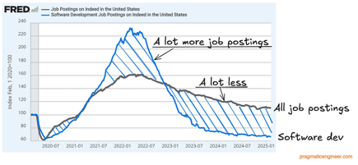
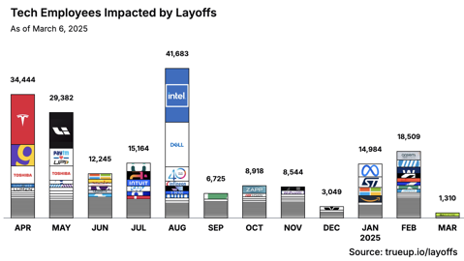
Jobs
Layoffs, Jobs:
https://layoffs.fyi
https://techcrunch.com/2025/02/13/tech-layoffs-2024-list/
https://blog.pragmaticengineer.com/software-engineer-jobs-five-year-low/
https://fred.stlouisfed.org/series/IHLIDXUS
The latest layoffs across US tech companies
https://news.crunchbase.com/startups/tech-layoffs/
https://www.trueup.io/layoffs
in 2025: so far 34,803 workers (167 layoffs, 535 people per day). for week ending Feb. 28, 2025: at least 6,071, including:
Autodesk - 1,350 people
Hewlett-Packard - 2,000 people
Onsemi - 2,400 people
In 2024: At least 95,667 workers
In 2023: More than 191,000 workers
In 2022: More than 93,000 workers

Slide 18
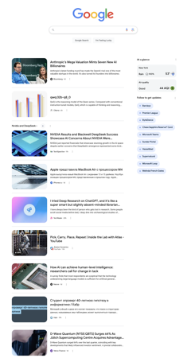
AI Subscriptions
Google Discover feed on Google.com
Youtube subscriptions
https://www.youtube.com/@Fireship
https://www.youtube.com/@matthew_berman
https://www.youtube.com/@AndrejKarpathy
https://www.youtube.com/@SirajRaval
https://www.youtube.com/@airevolutionx
https://www.youtube.com/@1littlecoder
https://www.youtube.com/@MervinPraison
https://www.youtube.com/@TrelisResearch
https://www.youtube.com/@WesRoth
https://www.youtube.com/@TheAiGrid
https://www.youtube.com/@code4AI
https://www.youtube.com/@UseAI
https://www.youtube.com/@LiamOttley
https://www.youtube.com/@Augmented_AI
https://www.youtube.com/@JuliaMcCoy
https://www.youtube.com/@Web3nity
https://www.youtube.com/@intheworldofai
https://www.youtube.com/@TwoMinutePapers
https://www.youtube.com/@peterdiamandis
https://www.youtube.com/@AIDailyBrief
https://www.youtube.com/@NoPriorsPodcast
https://www.youtube.com/@KevinStratvert
https://www.youtube.com/@MattVidPro
https://www.youtube.com/@AICoffeeBreak
https://www.youtube.com/@Analyticsvidhya
https://www.youtube.com/@sullyomarr
https://www.youtube.com/@DrOsbert
https://www.youtube.com/@GoogleDevelopers
https://www.youtube.com/@iamAImaster
Email subscriptions:
The Batch - https://www.deeplearning.ai/the-batch , https://DeepLearning.AI
TLDR AI - https://tldr.tech/ai
The AI Break - https://theaibreak.substack.com
AI News - https://smol.ai
Forward Future - https://www.forwardfuture.ai
Daily Zaps - https://www.dailyzaps.com
The Rundown AI - https://www.therundown.ai
Latent Space - https://www.latent.space
The AI Journal - https://theaijournal.substack.com
Medium Daily Digest - https://medium.com
AI Secret - https://aisecret.us
Marktechpost AI - https://www.airesearchinsights.com
Daily AI - https://daily.ai - platform for many newsletters
AlphaSignal - https://alphasignal.ai
Nvidia Developer Relations - https://developer.nvidia.com
Analytics Vidhya - https://www.analyticsvidhya.com
Peter Diamandis - https://www.diamandis.com/subscribe
ListedAI - https://www.listedai.co

Slide 19


About the Speaker
Lev Selector, Ph.D.
40+ years of software engineering, data science, and building teams (hiring, training, and managing)
Ph.D. in mathematical modeling and computer simulations
Interests:
Generative AI, Using LLM with your data
Local AI for Local Private Data
Cloud architecture, fin-tech, application security
Find/connect: Linkedin, GitHub, YouTube, Google
https://eais.ai
Enterprise AI Systems

Slide 20
Thank You!

