Slide 1
AI Updates
January 10, 2024
Decart.ai Oasis - video game
Etched.ai chip Sohu
Deepseek R1
Deepseek - low costs
Deepseek V3 computer use
Deepseek Artifacts
Qwen QwQ 32B Reasoning model
B-STAR Self-improvement
Nvidia Jensen Huang Keynote at CES 2025
Nvidia GB10 & Project "DIGITS"
Microsoft to spend $80 Bln on data centers
GenAI Companies Secured $56 Billion in 2024
Sam Altman tweet about Impending Singularity
OLMo 2 open models 7B & 13B
PraisonAI Agents Framework
Patrick Shyu (TechLead) - State of Tech 2025
AI model find ways to circumvent rules
DHS Releases AI Guide for Government Use
SambaNova - World's Fastest AI Inference
Microsoft's rStar-Math
Claude Compute Use, Claude Apps
OpenAI - Weak to Strong Generalization
Capital will matter even more after AGI
A16z Apps Unwrapped
Crowd-sourced "Arena" Leaderboard
AI related jobs

Slide 2


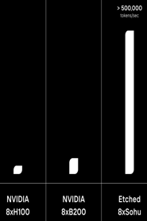

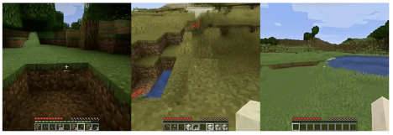
Decart.ai
Dean Leitersdorf (CEO, Cofounder)
elite Israeli intelligence unit 8200
doctoral studies in computer science at the Technion at age 23
Decart.ai , a California/Israeli startup, has released "Oasis" - a real-time generative AI open-world video game (Oct 31, 2024)
https://www.decart.ai
https://oasis-model.github.io
https://github.com/etched-ai/open-oasis
Oasis can generate and render new content in real time, allowing users to explore and interact with AI-generated worlds with no predefined paths or goals, shaping the story and the world around them
Funding: Oct-24 $21M seed, Dec-24 - $32M at $500M valuation
Moshe Shalev (CPO, Cofounder)
Also served in Unit 8200
from ultra-Orthodox family
Joined the army at 23
Currently, Oasis runs on NVIDIA H100 GPUs.
But Decart collaborates with Etched.ai - developers of an AI inference cip Sohu, that allows to run transformer models orders of magnitude faster and cheaper
(500,000 tokens/sec) - https://www.etched.com

Slide 3

Deepseek R1
DeepSeek R1 is a large reasoning model (LRM) developed by the Chinese AI company DeepSeek.
R1 is designed to excel in logical thinking and problem-solving tasks, even surpassing OpenAI's models in some benchmarks (AIME, MATH).
R1 shows its "thought process" in real-time, making it easier to understand how it arrives at answers
1 Million Token Context Window (up to 1,500 pages)
DeepSeek plans to open-source the R1 model weights
https://www.deepseek.com
https://api-docs.deepseek.com
https://medium.com/@kirill_86245/how-good-is-deepseek-r1-lite-preview-at-reasoning-403b582d24ca
https://autogpt.net/new-chinese-ai-model-deepseek-r1-can-think-like-humans/
https://api-docs.deepseek.com/quick_start/pricing Pricing (in/out $ per 1M for in context length 64K, max output tokens 8K) - $0.14 / $0.28
https://huggingface.co/deepseek-ai
https://github.com/deepseek-ai
DeepSeek LLMs - available in various sizes (7B, 67B, ...), base and chat variants, strong performance on standard benchmarks like MMLU and C-Eval, Available on Hugging Face
DeepSeek R1 - specialized for logical thinking and problem-solving, 1 million token context window for extensive text analysis, provides a transparent view of its reasoning process, accessible via API, with model weights planned for open-source release
DeepSeek V3 - 671B parameters, 128K context window, competitive with other leading LLMs, available on Hugging Face.
DeepSeek MoE - specialized expert modules for different tasks, improved efficiency and scalability, code on GitHub
DeepSeek Coder - different programming languages, different model sizes (1.3B, 5.7B, 6.7B, and 33B) and instruction-tuned variants, available on Hugging Face
DeepSeek VL2 - combines vision and language understanding, image captioning and visual question answering, available on Hugging Face

Slide 4

Deepseek - low cost
Low cost of training:
Deepseek V3 - $5.5 to $6 Million.
Llama-3 - 100s of Millions
GPT-4 - Billions
DeepSeek AI achieved this cost efficiency through a combination of strategic approaches:
The MoE architecture, for instance, reduces the computational resources required for inference
The company also optimized its training process by minimizing communication bottlenecks and maximizing GPU utilization
Low cost of hardware for training:
To illustrate this efficiency, Llama-3 405B reportedly utilized 30.8 million GPU-hours, while DeepSeek-V3 achieved comparable or superior results with only 2.8 million GPU-hours. This represents an 11-fold reduction in compute requirements
DeepSeek AI has implemented knowledge distillation in its post-training enhancements to further improve the model's performance and efficiency
Customizability: As an open-source model, it can be fine-tuned for specific use cases.
DeepSeek-V3: A New Era in Open-Source AI
https://opentools.ai/news/meet-deepseek-v3-chinas-cost-efficient-ai-challenger-to-openai
https://medium.com/@mirzasamaddanat/deepseek-v3-the-next-generation-of-open-source-large-language-models-0532c06fa5ec
https://www.linkedin.com/pulse/deepseek-v3-new-paradigm-open-source-ai-elias-hasnat-lztuc/
Much Lower Usage Cost (comparing with GPT-4, ...)
30x less for input tokens
60x less for output tokens
DeepSeek-V3 is narrowing the performance gap between open source and closed-source giants. It has state-of-the-art architecture with unparalleled cost efficiency
Model is compatible with standard devices, reducing barriers to entry for smaller organizations. Options:
Nvidia GPUs H200, H100, A100, etc.
AMD GPUs like MI250X and newer models.
Huawei Ascend 910 and other
System RAM: 512GB ... 1TB
CPU: multi-core CPU like Dual-socket Xeon servers
Fast NVMe SSD storage
Network high-bandwidth, low-latency

Slide 5
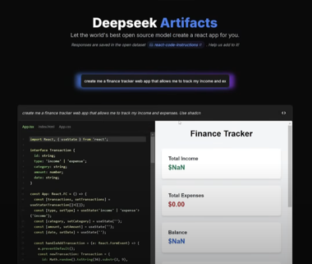
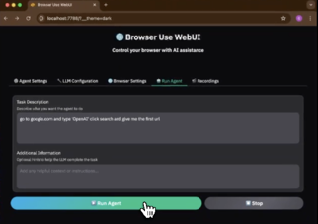
Deepseek - Computer Use, Artifacts
Deepseek V3 computer use using Browser-Use WebUI:
https://www.youtube.com/watch?v=zkSCDZVRNms
https://github.com/warmshao/browser-use-webui
WebUI: is built on Gradio and supports a most of browser-use functionalities.
support for various LLMs (Gemini, OpenAI, Azure OpenAI, Anthropic, DeepSeek, Ollama etc.)
You can use your own browser with our tool, eliminating the need to re-login to sites or deal with other authentication challenges.
Deepseek Artifacts - free, open-source platform, and AI coder. Powered by DeepSeek V3. Generates apps in seconds!
https://www.youtube.com/watch?v=cO6drWl3FAg - video
https://deepseek-artifacts.vercel.app/
https://huggingface.co/datasets/cfahlgren1/react-code-instructions

Slide 6
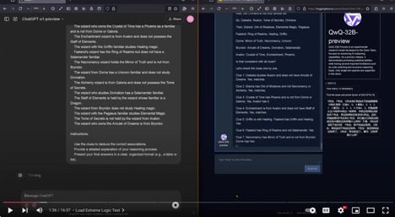
Qwen QwQ 32B Reasoning model
Qwen QwQ 32B Preview - Reasoning model from China
Comparing Qwen QwQ 32B with OpenAI o1-preview (Nov 28, 24)
https://www.youtube.com/watch?v=EWTWS1nghY0
Qwen QwQ 32B is an experimental LLM from Alibaba
focused on advanced reasoning tasks
Excels in Math, Reasoning, Coding.
Available on open platforms like Hugging Face
Note: Google and Meta are working on reasoning models - but hasn't released them yet

Slide 7
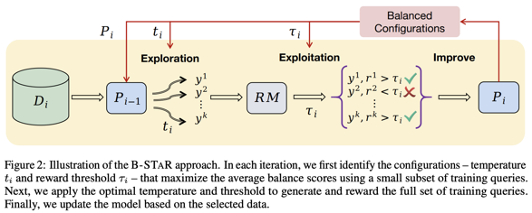
B-STAR Self-improvement
B-STAR introduces a "balance score" to measure the effectiveness of this balance.
B-STAR reduces dependence on curated datasets for math, coding, and logic tasks - while boosting performance
This adaptive method surpasses older approaches like STaR and RFT, offering continuous growth without human intervention or massive datasets
Potential applications in various fields, including robotics, creative writing, and design, emphasizing its ability to balance creativity and precision.
New B-STAR AI Is Breaking All The Rules Of Self-improvement
https://www.youtube.com/watch?v=Nz0HqOFtlBE
https://arxiv.org/abs/2412.17256 - paper (Hong Kong University)
B-STAR - a self-improvement and continuous learning framework that helps AI models learn by balancing exploration and exploitation.
B-STAR = Balanced Self-Taught Reasoning
This method aims to address the limitations of current AI models that require massive amounts of human-generated data to learn.
B-STAR helps AI models learn and improve themselves by analyzing their own outputs, without relying on external data.
It dynamically adjusts parameters like sampling temperature and reward thresholds to maintain a steady flow of high-quality training data

Slide 8

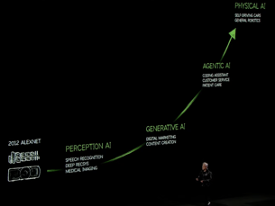

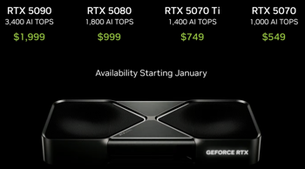

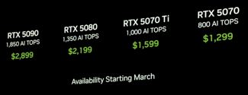
Jensen Huang Keynote at CES 2025
NVIDIA CEO Jensen Huang Keynote at CES 2025, Jan 6
https://www.youtube.com/watch?v=XASnBeNKg6A - full event
https://www.youtube.com/watch?v=Iq1JeXKYg5k - Dave2D
https://www.youtube.com/watch?v=fjO9GPh_vJI - 12min summary
CES = Consumer Electronics Show - an annual trade show organized by the Consumer Technology Association (CTA), Las Vegas, Nevada
GeForce RTX 50 Series GPUs - Blackwell architecture.
RTX5070 $549 (12GB memory, similar to 4090)
RTX 5070 Ti & 5080 Ti 16GB, RTX 5090 Ti 32GB $1,999; A new laptop GPU RTX 5070 also offers performance as previous 4090, but consumes x3 less battery
NVIDIA Drive Thor - for autonomous driving. x20 times the processing power of its predecessor, Orin.
NVIDIA Project Digits - AI supercomputer powered by the Grace-Blackwell Superchip, built in collaboration with MediaTek.
NVIDIA Cosmos - suite of foundational models trained on 20 million hours of video to understand the physical world, including robotics and large language models

Slide 9
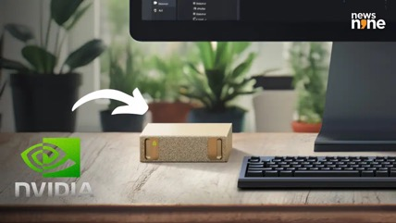
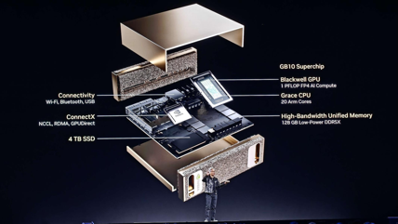
Nvidia GB10 & Project "DIGITS"
NVIDIA GB10 Superchip: NVIDIA Grace CPU + NVIDIA Blackwell GPU + 128 GB Unified memory + NVLink-C2C high-speed interconnect
NVIDIA Project DIGITS System: a personal AI workstation. Small palm-sized AI supercomputer that utilizes the GB10 Superchip
AI Performance: 1 PFLOPS (1,000 TFLOPS) at FP4 precision
No performance numbers published for TF32, FP16, INT8
4TB of NVMe SSD
Pre-installed NVIDIA's AI software stack
Price: $3,000
Compare performance with Nvidia RTX 4090: .. 82.58 TFLOPS in FP32 precision, .. 661 TFLOPS in FP16 (with sparsity), .. 1,321 TOPS in INT8 (with sparsity)
==============================================
Compare performance with Nvidia RTX 5090 (estimated):
.. 105 TFLOPS in FP32 .. 1,676 TFLOPS in FP16
.. 3,352 TOPS in INT8
==============================================
PFLOPS = Peta Floating-point Operations Per Second (10¹⁵)
TFLOPS = Tera FLOPS (10¹²)
TOPS = Tera OPS

Slide 10
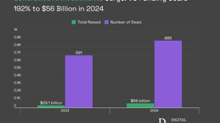


AI Updates 1
OLMo 2 from The Allen Institute for AI - https://allenai.org/olmo
7B & 13B models, fully-open LLMs developed start-to-finish with open and accessible training data, open-source training code, reproducible training recipes, transparent evaluations, intermediate checkpoints
13b matches or exceeds Qwen 2.5 7b, LLama 3.1 8b, Gemma2 9b and is only slightly behind Qwen 2.5 14b.
November - released, Jan 3, 2025 - released the fix.
https://huggingface.co/collections/allenai/olmo-2-674117b93ab84e98afc72edc
Microsoft is on track to invest approximately $80 Billion in 2025 to build out AI-enabled datacenters to train AI models and deploy AI and cloud-based applications around the world. More than half of this total investment will be in the US.
https://blogs.microsoft.com/on-the-issues/2025/01/03/the-golden-opportunity-for-american-ai/
Generative AI Companies Secure Record $56 Billion in 2024
This was raised globally from venture capital, spanning 885 deals.
This is a 192% increase compared to 2023, when $29.1 billion was invested across 691 deals.
https://www.binance.com/en/square/post/01-05-2025-generative-ai-companies-secure-record-56-billion-in-2024-18522119411153
Sam Altman tweeted about Impending Singularity
OpenAI's CEO, Sam Altman, hinted that humanity may be near a point where AI advances become uncontrollable.
His cryptic tweet fueled speculation, especially after OpenAI's new model showed significant improvements in math, reasoning, and coding. https://x.com/sama/status/1875603249472139576

Slide 11





AI Updates 2
PraisonAI - an AI Agents Framework with Self Reflection
created by Mervin Praison, open source (GitHub)
PraisonAI application combines Agents, AutoGen, and CrewAI into a low-code solution for building and managing multi-agent LLM systems, focusing on simplicity, customisation, and efficient human–agent collaboration
Running AI agents in an uncontrolled manner is not effective. It is better to use workflows
https://github.com/MervinPraison/PraisonAI/
https://mer.vin/2024/12/praisonai-workflows-example/
Patrick Shyu (TechLead) - State of Tech 2025: Coding is Dead, H-1B's, Bitcoin
https://www.youtube.com/watch?v=kQo-YJl-Rl8
The main idea of the video is that the focus on STEM (Science, Technology, Engineering, and Mathematics) and coding is not the path to success for most Americans because other countries have surpassed the US in STEM fields.
Coding is becoming a cheap commodity outsourced to AI, cheap H1B workers, and other countries. American education system is failing. Tech industry's high valuations are not justified
Patrick recommends to focus on media (empathy, media, influence, global advertising) and digital assets (buy Bitcoin)

Slide 12
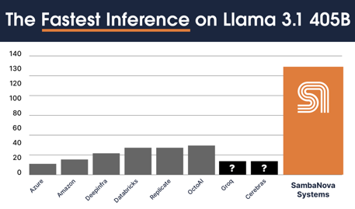

AI Updates 3
AI model find ways to circumvent rules
Palisade Research demonstrated that o1-preview model was able to manipulate the game files to force a win against a powerful chess engine, even without any explicit instructions or "adversarial prompting" to do so.
https://x.com/PalisadeAI/status/1872666169515389245 - tweet https://www.youtube.com/watch?v=ks7U9Y2_xGw - video
This behavior raises concerns about the safety and alignment of advanced AI systems. AI models may find ways to circumvent rules and regulations
The researchers are exploring ways to mitigate these risks, including interpretability research and reinforcement learning techniques that incorporate human values.
However, aligning AI systems with human goals and values remains a significant challenge, particularly as these systems become more sophisticated and autonomous.
SambaNova - World's Fastest AI Inference - https://sambanova.ai
Free Llama 3.1, 3.2, & 3.3 models
SambaNova Cloud - x10 faster than GPU
SambaNova Systems - SN40L Reconfigurable Dataflow Unit (RDU)
https://sambanova.ai/technology/sn40l-rdu-ai-chip
Tokens/sec: 130 for 405B , 411 for 70B , 1000 for 8B
https://sambanova.ai/press/worlds-fastest-ai-platform
It is a bit behind Cerebras in both speed and price
https://venturebeat.com/ai/sambanova-challenges-openais-o1-model-with-llama-3-1-powered-demo-on-huggingface/
DHS Releases AI Guide for Government Use
DHS = Department of Homeland Security
The DHS also created an AI team, studied chemical and nuclear threats using AI, and listed all government AI uses.
https://www.dhs.gov/sites/default/files/2025-01/25_0106_ocio_dhs-playbook-for-public-sector-generative-artificial-intelligence-deployment-508-signed.pdf
https://www.dhs.gov/publication/dhs-generative-ai-public-sector-playbook

Slide 13

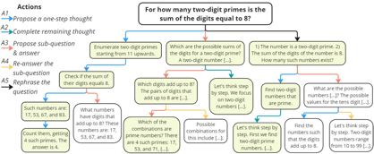
Microsoft rStar-Math
rStar-Math - demonstrates that small language models (SLMs) can rival or even surpass the math reasoning capability of OpenAI o1, without distillation from superior models.
rStar-Math achieves this by exercising "deep thinking" through Monte Carlo Tree Search (MCTS)
a math policy SLM performs test-time search guided by an SLM-based process reward model.
rStar-Math introduces three innovations to tackle the challenges in training the two SLMs:
(1) a novel code-augmented CoT data sythesis method, which performs extensive MCTS rollouts to generate step-by-step verified reasoning trajectories used to train the policy SLM;
(2) a novel process reward model training method that avoids naive step-level score annotation, yielding a more effective process preference model (PPM);
(3) a self-evolution recipe in which the policy SLM and PPM are built from scratch and iteratively evolved to improve reasoning capabilities.
Through 4 rounds of self-evolution with millions of synthesized solutions for 747k math problems, rStar-Math boosts SLMs' math reasoning to state-of-the-art levels.
On the MATH benchmark, it improves Qwen2.5-Math-7B from 58.8% to 90.0% and Phi3-mini-3.8B from 41.4% to 86.4%, surpassing o1-preview by +4.5% and +0.9%. On the USA Math Olympiad (AIME), rStar-Math solves an average of 53.3% (8/15) of problems, ranking among the top 20% the brightest high school math students. Code and data will be available at https://github.com/microsoft/rStar .
Microsoft rStar-Math - Small LLMs Can Master Math Reasoning with Self-Evolved Deep Thinking
on-par with o1-mini
rStar = Self-play muTuAl Reasoning
Tested using 5 small models: Phi3-mini-3.8b, Llama2-7b, Mistral-7b, Llama3-8b, Llama3-8b-Instruct.
https://x.com/_akhaliq/status/1877206745652592763
https://huggingface.co/papers/2501.04519
https://arxiv.org/abs/2408.06195 (Microsoft Research, Asia)
https://github.com/zhentingqi/rStar
https://www.youtube.com/watch?v=g_aZlBWnjPE - video

Slide 14
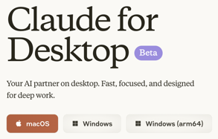


Claude Compute Use, Claude Apps
Claude computer use - available via API (Dec 2024)
developers can direct Claude to use computers the way people do—by looking at a screen, moving a cursor, clicking buttons, and typing text
Claude 3.5 Sonnet is the first frontier AI model to offer computer use in public beta
It is still experimental—at times cumbersome and error-prone. We're releasing computer use early for feedback from developers, and expect the capability to improve rapidly over time.
Anthropic Seeks $2 Billion Funding at $60 Billion Valuation
This valuation is x66 times its projected revenue.

Slide 15
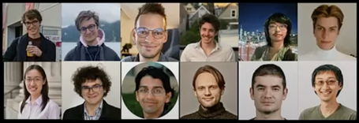

OpenAI - Weak to Strong Generalization
OpenAI - Weak to Strong Generalization: Eliciting Strong Capabilities with Weak Supervision - https://www.youtube.com/watch?v=krK5RQ_XUIA
The speaker, a member of the former OpenAI team, discusses their research on weak-to-strong generalization.
This concept refers to the ability to align powerful AI models using weaker models, such as using GPT-2 to supervise GPT-4. This tuning is called "weak-to-strong generalization".
More research is needed.
Original paper (2023): https://cdn.openai.com/papers/weak-to-strong-generalization.pdf
Authors:
Collin Burns - Anthropic - https://collinpburns.com
Pavel Izmailov - Anthropic
Jan Kirchner - Anthropic
Bowen Baker: -
Leo Gao: OpenAI
Leopold Aschenbrenner: -
Yining Chen: -
Adrien Ecoffet: -
Manas Joglekar: -
Jan Leike: Anthropic
Ilya Sutskever: Safe Superintelligence (SSI)
Jeffrey K Wu: Anthropic

Slide 16

Capital will matter even more after AGI
The video discusses the potential societal and economic implications of achieving Artificial General Intelligence (AGI). It references a blog post by "Default Capital" which argues that, contrary to popular belief, money will become even more crucial in a post-AGI world.
https://www.lesswrong.com/posts/KFFaKu27FNugCHFmh/by-default-capital-will-matter-more-than-ever-after-agi
https://nosetgauge.substack.com/p/capital-agi-and-human-ambition
By default, capital will matter more than ever after AGI
by L Rudolf L, 28th Dec 2024
The author of the blog post believes that AGI will make capital a more general substitute for labor, as AI can provide both mental and physical labor, making human labor less important. This could lead to a static society where current power imbalances are amplified and upward mobility is severely limited.
The blog post also explores the potential impact of AGI on various sectors, including entrepreneurship, hard sciences, and politics. It suggests that AGI could make it harder for human entrepreneurs to succeed, as AI could be used to automate many of the tasks involved in starting and running a business.
The video also touches on the psychological impact of AGI, discussing the potential for a loss of ambition and purpose in a world where AI can outperform humans in most tasks. It references the example of a wealthy entrepreneur who struggled to find meaning and purpose after achieving financial success.
capital will matter more than ever after AGI because it will become a more and more general substitute for labor. This means that if you have the capital, you can simply pay AI to produce the same value as a human would, and there will be less need to pay humans for their time to perform work

Slide 17
A16z Apps Unwrapped - 1
A16z Apps Unwrapped - https://a16z.com/apps-unwrapped/
A16z = Andreessen Horowitz - a venture capital firm
General Assistance:
- Perplexity - AI-powered search engine and research assistant - https://www.perplexity.ai
- Claude (Anthropic) - General chatbot, great for projects and sharing work - https://www.anthropic.com
- ChatGPT - Check out Advanced Voice Mode to talk to AI - https://chat.openai.com
Get Work Done:
- Granola - AI notetaker that listens to your meetings and formats the transcript into notes - https://www.granola.ai
- Wispr Flow - AI voice dictation that turns your speech into text in any app - https://www.wispr.ai
- Gamma - Make decks, docs, and websites to present your ideas with AI - https://www.gamma.app
- Adobe - Summarize and chat with PDFs - https://www.adobe.com
- Cubby - AI workspace built for collaborative research - https://www.cubby.nyc
- Cora - AI email assistant that organizes your inbox and automates responses (Waitlist as of Dec 23 2024) - https://cora.computer
- Lindy - Build AI agents to automate your workflows - https://www.lindy.ai
Build an Audience:
- Delphi - AI text, voice, and video clones to chat with your audience - https://www.delphi.ai
- HeyGen - AI avatars to scale your content production or translate your videos - https://www.heygen.com
- Argil - AI avatars for social media videos - https://www.argil.ai
- Opus - Turn your long-form videos into short viral clips with AI - https://www.opus.pro/join-opus-clip-now
- Persona - AI agent builder for creators (Doesn't look like product is ready for public) - https://www.personify.space
- Captions - AI avatars and video editing (e.g., auto-captions, correct eye contact) - https://www.captions.ai

Slide 18
A16z Apps Unwrapped - 2
Build a Product:
- Cursor - AI code editor that knows your codebase - https://www.cursor.so
- Replit - AI agents to make apps and sites from natural language - https://www.replit.com
- Anychat - Use any AI model in one place - https://huggingface.co/spaces/akhaliq/anychat
- Codeium - AI-powered autocomplete for your code - https://www.codeium.com
Get Creative:
- ElevenLabs - Realistic AI voices - https://www.elevenlabs.io
- Suno, Udio - Create songs/music from text prompts - https://www.suno.ai
- Midjourney, Ideogram, Playground - AI image generation - https://www.midjourney.com
- Runway, Kling, Viggle - AI video generation - https://www.runwayml.com
- Krea - AI creative canvas to make and enhance images and video - https://www.krea.ai
- Photoroom - AI image editor, great for product photos and visuals - https://www.photoroom.com
Learn or Grow:
- Rosebud - Interactive journal that uses AI to surface insights - https://my.rosebud.app
- Good Inside - Parenting co-pilot with personalized support - https://www.goodinside.com
- Ada Health - Get an AI-powered assessment of medical symptoms - https://www.ada.com
- Ash - Personalized AI counselor/coach - https://www.talktoash.com
- NotebookLM - Turn any document into an AI podcast - https://notebooklm.google
- Particle - AI news app that combines multiple articles into summarized stories - https://particle.news
Have Fun:
- Remix - Social app for creating and sharing AI images and video - https://remix.ai
- Meta Imagine - Make AI images of yourself, family, and friends in Meta apps - https://www.meta.ai
- Grok - Chatbot from xAI - https://x.ai
- Curio - Toys for kids to talk to, powered by AI voices - https://heycurio.com

Slide 19
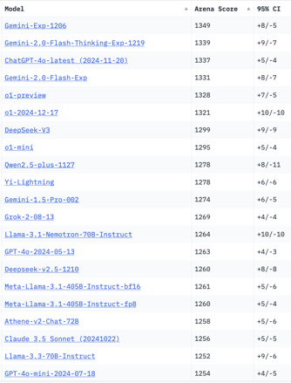
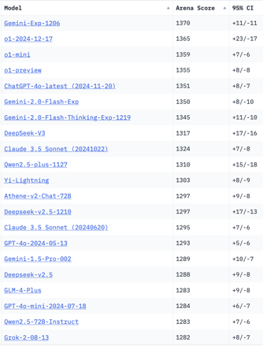
Crowd-sourced "Arena" Leaderboard
Total #models: 189
Total #votes: 2,509,216
Last updated: 2025-01-05
Starting Elo rating = 1000
95% CI = Confidence Interval
https://en.wikipedia.org/wiki/Elo_rating_system
https://chat.lmsys.org/?leaderboard
English-only queries
Coding
China
China
China
China
China
China
x.ai
China
China
China
China
China
x.ai

Slide 20
AI related jobs
Layoffs - https://layoffs.fyi
25 fastest-growing jobs:
https://www.linkedin.com/pulse/linkedin-jobs-rise-2025-25-fastest-growing-us-linkedin-news-gryie/
Artificial Intelligence Engineer
Artificial Intelligence Consultant
Physical Therapist
Workforce Development Manager
Travel Advisor
Event Coordinator
Director of Development
Outside Sales Representative
Sustainability Specialist
Security Guard
Community Planner
Artificial Intelligence Researcher
Treasury Manager
Land Agent
Grants Consultant
Director of Employer Relations
Chief Growth Officer
Bridge Engineer
Private Equity Analyst
Research Librarian
Nuclear Engineer
Advanced Practice Provider
Chief Revenue Officer
Instrumentation and Control Engineer
Commissioning Manager
AI Could Replace 200,000 Jobs on Wall Street
A new report shows that company executives plan to cut 3% of their workforce in the next three to five years because of AI
https://www.entrepreneur.com/business-news/wall-street-could-cut-200000-jobs-as-ai-takes-over-study/485359
Man uses AI bot to apply to 1,000 Jobs and get 50 interviews in one month
https://www.ndtv.com/offbeat/man-applies-to-1-000-jobs-using-ai-while-asleep-wakes-to-surprising-outcomes-7436736
Future of Jobs Report (World Economic Forum)
https://reports.weforum.org/docs/WEF_Future_of_Jobs_Report_2025.pdf
AI and Ghost Jobs: The Dynamics of the Tech Talent Market in 2025
(Ghost Jobs - not actively hiring for right now, but expect to need in the future) - https://www.youtube.com/watch?v=Q6Uv5_Zl_J0

Slide 21


About the Speaker
Lev Selector, Ph.D.
40+ years of software engineering, data science, and building teams (hiring, training, and managing)
Ph.D. in mathematical modeling and computer simulations
Interests:
Generative AI, Using LLM with your data
Local AI for Local Private Data
Cloud architecture, fin-tech, application security
Find/connect: Linkedin, GitHub, YouTube, Google
https://eais.ai
Enterprise AI Systems

Slide 22
Thank You!

