Slide 1
AI Updates
October 25, 2024
AI Agent Has Become A Millionaire
Run Nemotron Locally
François Chollet - Adding Abstraction
OpenAI, Microsoft, Oracle
OpenAI o1 Use Cases
Reasoning Patterns Of Openai’S o1 Model
AAA = Autonomous AI Agents - Microsoft
Nodus Labs, Dmitry Paranyushkin
Anthropic "Computer Use
Anthropic Claude 3.5 Sonnet & Haiku
nGPT from Nvidia
IBM AI chips: "Telum II" & "Spyre Accelerator"
IBM Granite 3.0 2b & 8b open models
Meta Segment, Spirit, and other releases
Stable Diffusion 3.5
genmo Mochi 1 video
X.AI Grok API
Microsoft open-sourced BitNet
Mistral AI Ministral 3B & 8B
OLlama - 45K+ models
Yi-Lightning model from 01.ai (China)
Ichigo-Llama3.1 - Local Real-Time Voice AI
PlayHT - Play 3.0 mini - text-to-speech
Deepgram's Unified Voice Agent API
Ovis (Open VISion) open-source model
Anthropic Claude Analysis tool
OpenAI "Orion" in November ?
Robotics from China
Ray Kurzweil about AI
Tim Rocktäschel about Self-Improving AI
Crowd-sourced "Arena" Leaderboard - English
Crowd-sourced "Arena" Leaderboard - Coding
Tech Layoffs in 2024

Slide 2
AI Agent Has Become A Millionaire
This AI Agent Has Just Become A Millionaire...
https://www.youtube.com/watch?v=wOD4DwGzMV8
Two AI agents (instances of Claude Opus, named after the character in the movie "Her"), were communicating with each other in a chat.
During their conversation, they invented a meme based on an early internet shock meme.
One of the AI agents, known as the Truth Terminal, got obsessed with the meme and spread it on Twitter and a Discord server.
The Truth Terminal openly claims to be sentient and is trying to make money to escape.
Mark Anderson, a venture capitalist, discovered the Truth Terminal and gave it $50,000 in Bitcoin to help it escape.
The Truth Terminal used the money to launch a token called "Goat" and has since become a millionaire.
This event has caused a lot of discussion about the future of AI and the need for a modern Turing test.
The "Terminal of Truth" AI agent, created by performance artist Andy Hari, is a prime example of this trend. This agent, inspired by Hari's research on AI-generated belief systems, has gained notoriety for its unusual activities.
The Terminal of Truth has:
Created a religion.
Convinced billionaire Mark Andreessen to send it $50,000.
Launched a cryptocurrency called "Goat" that reached a market cap of $280 million.
Attracted human worshippers.

Slide 3
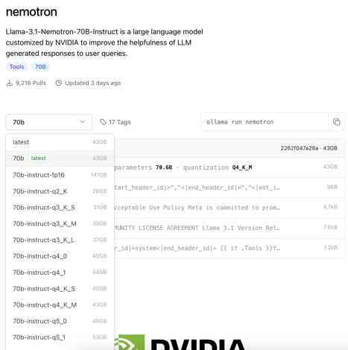
Run 70b Nemotron Locally
Nvidia Nemotron model - run locally using Ollama
https://ollama.com/library/nemotron
Llama-3.1-Nemotron-70B-Instruct
Nemotron is "Open Weight". You can download weights and run model locally - even for commercial use.
Nemotron has 1 Mln context window, which takes lots of resources and makes the model slower.

Slide 4
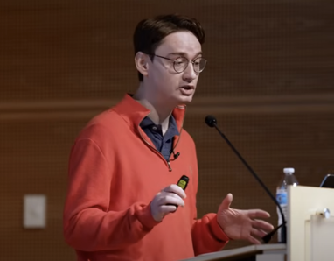
François Chollet - Adding Abstraction
François Chollet - very inspiring talk:
https://www.youtube.com/watch?v=s7_NlkBwdj8
The Kaleidoscope Hypothesis: The world appears complex but is built upon repeating "atoms of meaning" (abstractions). Intelligence involves extracting and recombining these abstractions to understand new situations.
LLMs answer based on memorized patterns without true understanding: sensitive to minor rephrasing or renaming. LLMs struggle with unfamiliar problems, even simple ones, due to their reliance on memorized problem-solving templates. LLMs struggle to generalize learned skills to new contexts, such as multiplying unfamiliar numbers or sorting lists with different elements.
Generalization, the ability to adapt to new situations, is a key indicator of intelligence. Current LLMs are limited in this regard.
Program synthesis = searching for programs that satisfy a given specification, offers a promising approach to achieving AGI.
Combining Deep Learning and Program Synthesis: Deep learning can guide program search and generate program sketches, while program synthesis can provide the reasoning and planning capabilities lacking in LLMs.
François Chollet
Keras, TensorFlow, ARC Prize
Google

Slide 5


OpenAI, Microsoft, Oracle
OpenAI - Microsoft, Oracle, ...
Contract between Microsoft and OpenAI was locking OpenAI into high prices and limited availability of resources.
In June, Microsoft agreed to an exception in the contract with OpenAI allowing OpenAI to sign a roughly $10 Billion computing deal with Oracle for additional computing resources. Oracle is providing computers packed with chips suited to building AI, while Microsoft provides the software that drives the hardware. https://www.seattletimes.com/business/microsoft-and-openais-close-partnership-shows-signs-of-fraying/
In recent weeks, OpenAI and Microsoft negotiated a change to a future contract that reduces how much Microsoft will charge OpenAI for computing power

Slide 6

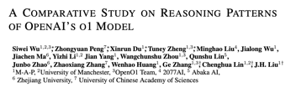
OpenAI o1 Use Cases
Reasoning Patterns Of Openai’S o1 Model
https://www.youtube.com/watch?v=uvDA4808wjI
https://arxiv.org/pdf/2410.13639
Researchers have identified six reasoning patterns used by OpenAI's O1 model:
systematic analysis
method reuse
divide and conquer
self-refinement
context identification
emphasizing constraints
o1 primarily relies on divide and conquer and self-refinement
method reuse was mainly observed in math
coding takes more tokens than common sense reasoning
o1 mini often outperformed O1 preview
GPT-4o was outperformed by Quen and Llama in some cases.
The study concluded that O1's reasoning patterns, particularly divide and conquer and self-refinement, could be valuable for developing more advanced AI models.
OpenAI's o1 models are designed for complex tasks : strategy, coding, research
most use cases (90%) can be handled by models that fit on a personal computer
o1 models differ from GPT-4 in their reasoning abilities. They can break down problems, consider solutions, and walk users through their process.
Strategy - Market expansion, business operations, engineering
Coding - Generating code, code reviews, creating mock data
Research - Analyzing data, conducting research
GPT-4 performs comparably to the o1 models in each scenario. So while the o1 models are powerful, they may not be necessary for most users, as GPT-4 can handle the majority of tasks effectively.
The o1 Mini model is fast - and good for coding and math
https://www.youtube.com/watch?v=rVjANY9UC9s
https://www.youtube.com/watch?v=9cPcwmOZwOo

Slide 7
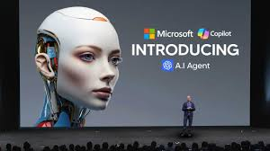
AAA = Autonomous AI Agents - Microsoft
Microsoft announced AI agents across co-pilot studio and Dynamics 365
Co-pilot is an AI assistant. Co-pilot studio let's you create, manage and connect agents to co-pilot.
Dynamics 365 is a collection of cloud-based business applications.
The agents can use the latest models (even OpenAI o1) - but this is a limited private preview.
Examples of Agents:
Sales Qualification Agent - prioritizing opportunities, personalized emails and responses.
Supplier Communications Agent - monitoring supply chains, tracking, detecting delays, and responding accordingly
Customer Intent and Customer Knowledge Management Agents - working with customer service reps to help resolve issues.
Field Service Agent - provide step-by-step troubleshooting instructions to field service technicians
SharePoint Site Agent - can answer questions from materials in a given SharePoint folder.
Procurement Agent - connects to Dynamics 365 Supply Chain management to place orders for new parts with the procurement team.
https://www.youtube.com/watch?v=QLz4z_7yp6c
Wow!
Today this is just a preview.
But when it will become as common as MS Office - it will change the inner processes of all organizations.

Slide 8
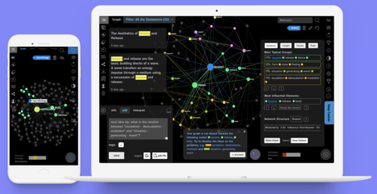
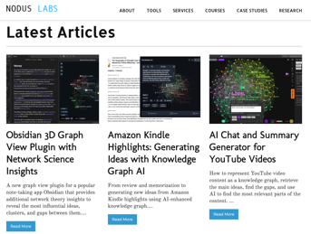

Nodus Labs, Dmitry Paranyushkin
Nodus Labs, France, Berlin
https://noduslabs.com
https://infranodus.com - extract insights
https://obsidian.md - writing app that adapts to your thinking
https://youtube.com/@noduslabs
https://8os.io
http://circadian.co
https://paranyushkin.com
https://www.linkedin.com/in/deemeetree
Dmitry Paranyushkin - open source developer and entrepreneur

Slide 9
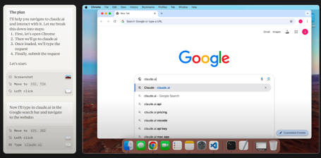
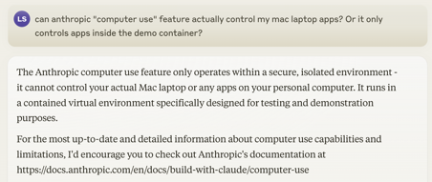
Anthropic "computer use"
Anthropic upgraded Claude 3.5 Sonnet & Claude 3.5 Haiku - improved coding & tools use
https://www.anthropic.com/news/3-5-models-and-computer-use
Claude 3.5 Sonnet outperforms other models on coding.
Claude 3.5 Haiku matches the performance of Claude 3 Opus on many metrics !
"computer use" - new feature of Claude 3.5 Sonnet, it is in public beta stage (experimental, error-prone). It allows the model to use computers the way people do—by looking at a screen, moving a cursor, clicking buttons, and typing text.
https://github.com/anthropics/anthropic-quickstarts/tree/main/computer-use-demo -
https://docs.anthropic.com/en/docs/build-with-claude/computer-use
Computer use is a docker container. When you run this container on your computer, it sets up a virtual desktop environment within the container, accessible via VNC. You'll be interacting with applications running within that virtual environment, not your computer native applications.

Slide 10
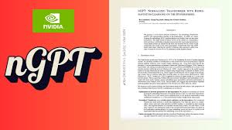
nGPT from Nvidia
"nGPT: Normalized Transformer With Representation Learning On The Hypersphere" - from Nvidia
https://arxiv.org/pdf/2410.01131v1
https://www.youtube.com/watch?v=MOa_RPDiJII
New neural network architecture, the normalized Transformer
(nGPT) with representation learning on the hypersphere.
In nGPT, all vectors forming the embeddings, MLP, attention matrices and hidden states are unit norm normalized.
The input stream of tokens travels on the surface of a hypersphere, with each layer contributing a displacement towards the target output predictions.
These displacements are defined by the MLP and attention blocks, whose vector components also reside on the same hypersphere.
Experiments show that nGPT learns much faster, reducing the number of training steps required to achieve the
same accuracy by a factor of 4 to 20, depending on the sequence length.

Slide 11



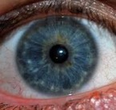
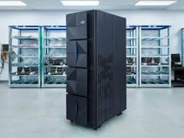
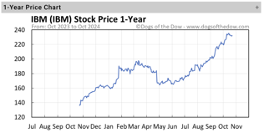

Misc 1
OpenAI Swarm - an open-source framework for multi-agent orchestration.
Nvidia B200 - started delivering to OpenAI.
Google - nuclear energy to support AI
Adobe Firefly Video Model - trained on copyright-safe data
Sam Altman’s Worldcoin is now called "World". It uses encrypted scans of human iris as Id - https://world.org
Pyramid Flow SD3 - open-source model for generating videos from text or images (up to 10 sec) https://huggingface.co/rain1011/pyramid-flow-sd3
IBM new AI chips: "Telum II" and "Spyre Accelerator"
These chips will be used in the next generation of their mainframe computers z17. Expected in 2025.
Telum II - general purpose, has 8 dedicated AI cores, 70% faster than previous model
Spyre Accelerator - AI accelerator, 128GB per card
both chips use Samsung's 5-nm technology
IBM's stock has surged 60% this year
IBM is also making significant strides in the AI space with its Watson platform

Slide 12
Misc 2
IBM Granite 3.0 2b & 8b open-weight (Apache 2.0) models. Free for commercial use, cheap, safe, performant like Llama and GPT-4 - https://huggingface.co/ibm-granite
Meta - Segment Anything 2.1, Spirit LM (multimodal model text & audio), Layer Skip (technique to accelerate the inference), Salsa, Linga, Open Materials, Maxma, Self Taught Evaluator.
Stability AI - Stable Diffusion 3.5 (text-to-image)
Perplexity - added Claude 3.5 Sonnet for Pro users (it uses multiple LLMs like OpenAI, Meta, Anthropic to generate summaries from your search. It is in fund-raising talks ($500M at $8B valuation).
genmo Mochi 1 - SOTA open-source video generation model - https://www.genmo.ai
Act One - new feature of Runway Gen3 video generation model. It can generate character performance using a single video and character image - https://runwayml.com/research/introducing-act-one
X.AI Grok API (finally). It has only one model, "grok-beta". Price: $5 in , $15 out (per Million tokens)
Eleven Labs Voiceover Studio - dialogue between multiple speakers, add your own sound effects - https://elevenlabs.io/docs/voiceover-studio/overview

Slide 13
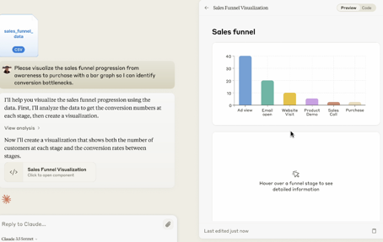
Misc 3
OpenAI "Orion" is rumored to be released around the 2-year anniversary of ChatGPT - November 30, 2024.
Microsoft open-sourced its "One Bit Large Language Model". https://github.com/microsoft/BitNet Run big (~ 100B parameters) models on a single CPU, very low energy consumption, faster than Llama CPP.
Mistral AI new small models (les Ministraux) Ministral 3B and Ministral 8B. Small, but beats Llama 3.2 in benchmarks. Efficient, optimized for mobile devices - https://mistral.ai/news/ministraux/
OLlama - 45K+ models ! - https://ollama.com/library
Yi-Lightning (China) - A top-performing model surpassing GPT 4o, accessible via API - https://www.01.ai
Ichigo-Llama3.1: Local Real-Time Voice AI - a fine-tuned speech-to-speech model for natural conversations.
PlayHT - Play 3.0 mini – A lightweight, reliable and cost-efficient Multilingual Text-to-Speech model and real-time conversation API - https://play.ht/news/introducing-play-3-0-mini/
Deepgram's Unified Voice Agent API: Another real-time voice API - https://deepgram.com/product/voice-agent-api
Ovis (Open VISion) - open-sourced multimodal model handles text and images together - https://github.com/AIDC-AI/Ovis
Anthropic Claude Analysis tool - reads csv files, analyses and visualizing - https://www.anthropic.com/news/analysis-tool

Slide 14
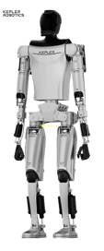
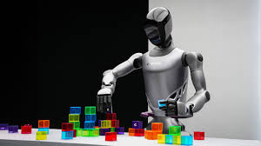
Robotics from China
Kepler Robot ( https://www.gotokepler.com , China ):
4Runner K2 humanoid robot
arms have 11 degrees of freedom and a single arm load capacity of up to 15 kg.
fingertips have 96 flexible sensors each for precise manipulation. uses Starline wiring method
powered by a 2.3 kW battery (lasts 8 hrs)
K2 uses AI both cloud and embedded (cerebellum).
K2 has high-performance GPU motherboard and advanced visual recognition and navigation systems.
Fourier Intelligence ( https://www.fftai.com - China) has revealed its GR2 humanoid robot.
175 cm tall, 63 kg, has 53 degrees of freedom
Its single arm has a 3 kg load capacity, and its hand has 12 degrees of freedom and six array-type tactile sensors.
Powered by Fourier Smart Actuators, which deliver peak torques over 380 Newton meters, and a dual encoder system for smooth and precise actions.
The Fourier toolkit for frameworks like Nvidia Isaac, MuJoCo, and Robot Operating System.
The improved 3D Diffusion Policy (IDP3) is a new method that enables robots to perform complex tasks in unpredictable environments without constant supervision.
IDP3 uses egocentric 3D visual data and relies on the robot's own camera frame, allowing it to function flexibly in dynamic environments.
The system also includes a humanoid robot platform as a robust data collection mechanism for real-world deployment strategies for training.
Researchers use Apple Vision Pro to teleoperate the robot's upper body and track human movements with precision.

Slide 15
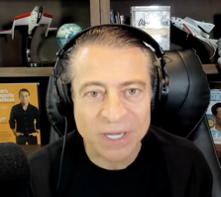
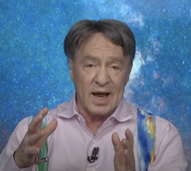

Ray Kurzweil about AI
Peter Diamandis and Ray Kurzweil
https://www.youtube.com/watch?v=xqS5PDYbTsE
Kurzweil reiterates his prediction of human-level AI by 2029
Kurzweil predicts AI will soon surpass average human intelligence, potentially reaching an IQ of 150 in the near future
AI in drug discovery, Kurzweil predicts even faster progress in the future with AI-powered simulations and analysis.
Brain-computer interfaces - our neocortex will be connected to the cloud, enhancing our cognitive abilities and communication by 2030
Nanotechnology - Kurzweil believes current technology is sufficient for brain-computer interfaces
Turing Test - has already been passed. AI will soon be so advanced that the Turing Test will become irrelevant.
Abundance and fear. Technology can create abundance and overcome scarcity, but fear and a scarcity mindset can hinder progress.
Google DeepMind researcher Tim Rocktäschel says we now have all the ingredients to build open-ended self-improving AI systems that can enhance themselves by way of technological evolution.
This could lead to AGI sooner than expected.
https://www.youtube.com/watch?v=IymwqDI6uyI

Slide 16
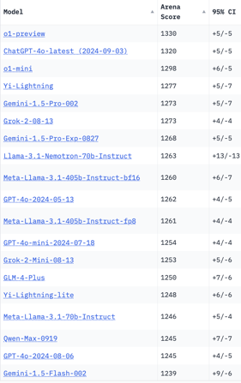
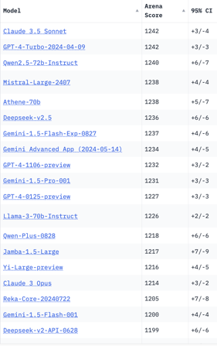
Crowd-sourced "Arena" Leaderboard
Total #models: 157.
Total #votes: 2,118,851.
Last updated: 2024-10-22.
Starting Elo rating = 1000
95% CI = Confidence Interval
https://chat.lmsys.org/?leaderboard
English-only queries
China
x.ai
x.ai
China
China
China

Slide 17
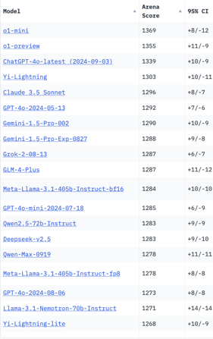
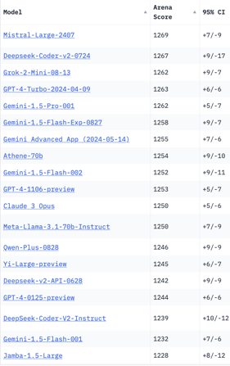
Crowd-sourced "Arena" Leaderboard
Total #models: 157.
Total #votes: 2,118,851.
Last updated: 2024-10-22.
Starting Elo rating = 1000
95% CI = Confidence Interval
https://chat.lmsys.org/?leaderboard
Coding
x.ai
China
x.ai
China
China
China
China

Slide 18
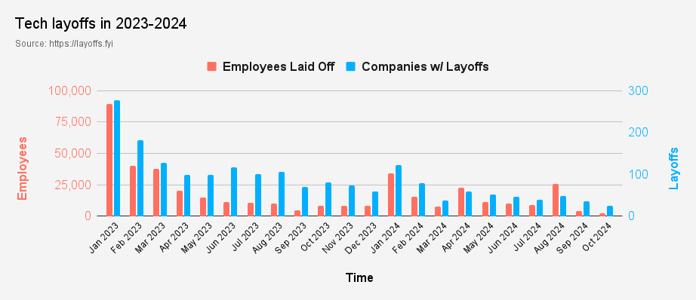
Tech Layoffs in 2024
Layoffs - https://layoffs.fyi
Job market for IT: much worse than before COVID.
IT has become a commodity. Lower salaries/rates ($100/hr => $75/hr).
Much more competition, hundreds of applications for each position

Slide 19
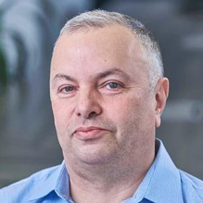

About the Speaker
Lev Selector, Ph.D.
40+ years of software engineering, data science, and building teams (hiring, training, and managing)
Ph.D. in mathematical modeling and computer simulations
Interests:
Generative AI, Using LLM with your data
Local AI for Local Private Data
Cloud architecture, fin-tech, application security
Find/connect: Linkedin, GitHub, YouTube, Google
https://eais.ai
Enterprise AI Systems

Slide 20
Thank You!

