Slide 1
AI Updates
February 28, 2025
Claude 3.7
ChatGPT-4.5
Alibaba QwQ-Max-Preview reasoning model
Meta Llama3-SWE-RL-70B reasoning model
Microsoft Phi-4-multimodal
Zhaoxin CPU server runs DeepSeek's 671B
Voice-based AI applications are improving rapidly
AI Infrastructure Spending Surge for 2025
DeepEP from DeepSeek
DeepGEMM library from DeepSeek
Coconut by Meta - Vector-Based AI Reasoning
ElevenLabs’ Scribe speech-to-text model
Stanford OctoTools
Amazon's new Alexa+ - $20/mo
Tencent Hunyuan Turbo S AI model outruns DeepSeek
Google AI Co-scientist
LLMs ready to replace OCR solutions
olmOCR from Allen Institute for AI
Vibe Coding, prompt as code behind the code
Sakana AI - AI CUDA Engineer - optimized kernels
Helix - Home Robot from Figure AI
Google wins contract with Salesforce
Crunchbase’s AI predicts startup success with 95% accuracy
Crowd-sourced "Arena" Leaderboard
WebDev Arena Leaderboard
Jobs

Slide 2
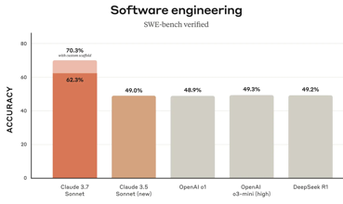
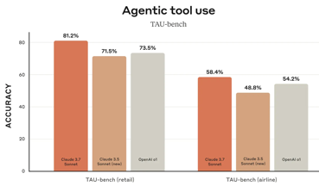

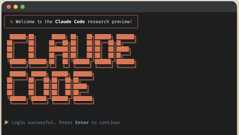
Claude 3.7
Claude 3.7 Sonnet and Claude Code
Claude 3.7 Sonnet - new version, available on all plans and API
Has a hybrid reasoning model
Claude 3.7 Sonnet can produce near-instant responses or extended, step-by-step thinking that is made visible to the user
Claude 3.7 Sonnet shows particularly strong improvements in coding and front-end web development
Claude 3.5 Haiku is used as a model selector to switch from near-instant responses and extended, step-by-step thinking
New - GitHub integration allows to connect code repositories directly to Claude
Claude Code - command line tool for agentic coding, limited preview
https://www.anthropic.com/news/claude-3-7-sonnet

Slide 3


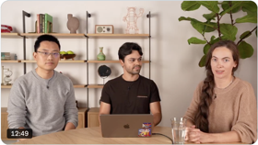
ChatGPT-4.5
Feb 27 OpenAI GPT-4.5 "Orion" released research preview of GPT-4.5 https://openai.com/index/introducing-gpt-4-5/ https://www.youtube.com/watch?v=FW2XOIxaNqg - FireShip Summary
now released to Pro and API, next week - to Plus and Team
non-reasoning (upgrade over gpt-4o)
largest and best model for chat yet
feels more natural, improved "vibes" (warmth and intuitiveness)
reduced hallucinations
broader knowledge base
improved ability to follow user intent
greater at Emotional Intelligence
better at writing, coding, solving problems.
scaled up pre-training and post-training
scaled unsupervised learning - better pattern recognition,
better ability to draw connections
and generate creative insights without reasoning
has access to the latest up-to-date information with search
supports file & image uploads
can use canvas to work on writing and coding
not multimodal yet (no voice mode, video, and screen sharing)
GPT-4.5 is very large, compute-intensive, and very expensive - typical query costs on average $68 / 1M tokens

Slide 4

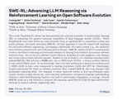
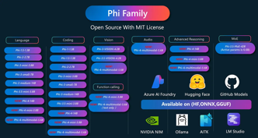
More New Models
Alibaba QwQ-Max-Preview reasoning model to challenge DeepSeek R1, OpenAI o1 - https://qwenlm.github.io/blog/qwq-max-preview/
Alibaba pledges to invest $53 billion on cloud and AI infrastructure in the next 3 years
https://www.scmp.com/tech/big-tech/article/3300018/alibaba-previews-new-ai-reasoning-model-challenge-deepseek-r1-openai-o1
Meta Llama3-SWE-RL-70B - new Reasoning model.
Advancing LLM Reasoning via Reinforcement Learning on Open Software Evolution Trained on top of Llama 3
Achieves 41.0% solve rate on SWE-bench (SWE = SoftWare Engineering)
https://arxiv.org/abs/2502.18449
https://x.com/_akhaliq/status/1894584315352076608
Microsoft Phi-4-multimodal - small LM
Phi-4 first introduced in December 2024, open-source (MIT)
Phi-4, Phi-4-mini, Phi-4-multimodal
Strong reasoning capabilities, math, logic
Multimodal model supports text, images, speech
Function Calling, multilingual, enhanced safety
Available at Hugging Face, Azure AI Foundry Model Catalog, and GitHub Models.
https://ollama.com/library/phi4 (December - January)

Slide 5
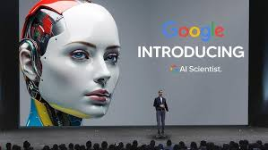
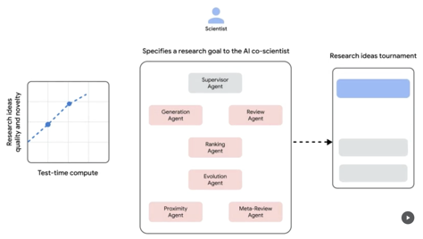
Google AI Co-scientist
AI Co-scientist - a multi-agent AI system
built with Gemini 2.0 as a virtual scientific collaborator
helps scientists generate novel hypotheses and research proposals
https://research.google/blog/accelerating-scientific-breakthroughs-with-an-ai-co-scientist/

Slide 6
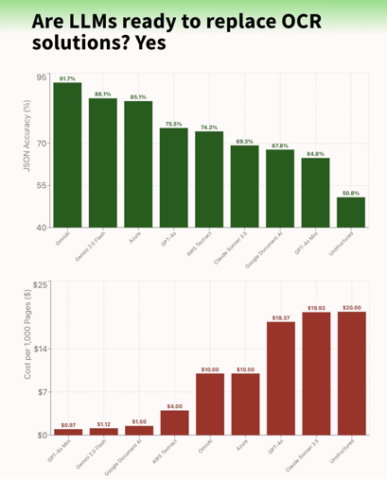

LLMs ready to replace OCR solutions
LLMs ready to replace OCR solutions
Yes, the OmniAI OCR Benchmark compared OCR providers against LLMs across accuracy, cost, and latency metrics showing Multimodal LLMs are not only better, they are also cheaper with Gemini 2.0 Flash offering the best price-performance!
https://x.com/_philschmid/status/1893926592977477751
olmOCR from Allen Institute for AI
Convert docs into plain text
https://huggingface.co/collections/allenai/olmocr-67af8630b0062a25bf1b54a1

Slide 7

Vibe Coding
Vibe coding - coding without even looking at the code - by Andrej Karpathy
https://x.com/karpathy/status/1886192184808149383
Video demo:
https://www.youtube.com/watch?v=5k2-NOh2tk0
There's a new kind of coding I call "vibe coding", where you fully give in to the vibes, embrace exponentials, and forget that the code even exists.
It's possible because the LLMs (e.g. Cursor Composer w Sonnet) are getting too good. Also I just talk to Composer with SuperWhisper so I barely even touch the keyboard.
I ask for the dumbest things like "decrease the padding on the sidebar by half" because I'm too lazy to find it.
I "Accept All" always, I don't read the diffs anymore.
When I get error messages I just copy paste them in with no comment, usually that fixes it.
The code grows beyond my usual comprehension, I'd have to really read through it for a while.
Sometimes the LLMs can't fix a bug so I just work around it or ask for random changes until it goes away.
It's not too bad for throwaway weekend projects, but still quite amusing.
I'm building a project or webapp, but it's not really coding - I just see stuff, say stuff, run stuff, and copy paste stuff, and it mostly works.
Claude
my_prompt.txt
----------------------
----------------------
"code behind the code"
in natural language
----------------------
----------------------
my_code.py
----------------------
----------------------
----------------------
----------------------
----------------------
----------------------
https://www.youtube.com/@AndrejKarpathy
Feedback

Slide 8

AI Updates
Sakana AI - AI CUDA Engineer - agentic framework from Sakana AI
Automates converting PyTorch into optimized CUDA kernels
It uses AI to generate and refine CUDA code
Achieved 10–100x speedups over standard PyTorch operations
Up to 5x faster than existing production-grade CUDA kernels
Uncovered optimizations that even expert engineers might miss, demonstrating AI’s ability to “invent” better hardware-level solutions
Released with 17,000 verified CUDA kernels and benchmark results showing 50x gains over unoptimized code.
Crunchbase’s AI predicts startup success with 95% accuracy
Abandoning historical data in favor of predictive intelligence
Forecasts acquisitions and company growth
https://venturebeat.com/ai/crunchbases-ai-can-predict-startup-success-with-95-accuracy-will-it-change-investing/
Helix - Home Robot from Figure AI
Understands spoken instructions and can handle unfamiliar objects
Uses a large model for understanding
Uses a smaller, faster model for precise movements
Figure showed robots putting away unseen groceries using voice commands
Helix needs little training data
https://x.com/adcock_brett/status/1886860098980733197
https://www.figure.ai/news/helix
https://opentools.ai/news/meet-helix-figure-ais-new-humanoid-robot-taking-ordersand-controlat-home
Google wins $2.5 Bln contract with Salesforce against Microsoft
Salesforce Agentforce will be able to use Google’s Gemini models
https://www.salesforce.com/news/press-releases/2025/02/24/google-partnership-expansion-gemini-agentforce/

Slide 9
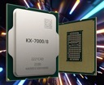

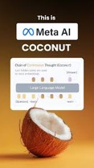

AI Updates
Zhaoxin CPU server runs DeepSeek's 671B
Zhaoxin is a Chinese CPU maker
Claims its 64-core server CPUs can run DeepSeek's 671B model without GPUs
https://www.tomshardware.com/pc-components/cpus/chinese-cpu-maker-zhaoxin-rolls-out-deepseek-support-to-all-processors-entire-product-lineup-now-runs-deepseek-llms-natively
DeepEP from DeepSeek - a communication library for Mixture-of-Experts (MoE) and expert parallelism (EP)
https://github.com/deepseek-ai/DeepEP
DeepGEMM library from DeepSeek
GEMMs = General Matrix Multiplications
clean and efficient FP8 GEMMs with fine-grained scaling
supports both normal and Mix-of-Experts (MoE) grouped GEMMs
written in CUDA, the library has no compilation need during installation
https://github.com/deepseek-ai/DeepGEMM
Voice-based AI applications are improving rapidly
Two approaches: direct voice-in / voice-out models and pipeline/agentic workflow
use "Pre-response" technique to reduce latency
RealAvatar reduced latency from 5-9 seconds to 0.5-1 seconds
AI Infrastructure Spending Surge for 2025:
- Amazon: $105B (35% increase)
- Alphabet: $75B (up from $52.5B)
- Meta: $65B (up from $39.2B)
- Microsoft: ~$94B (following 83% rise in 2024)
ElevenLabs’ Scribe speech-to-text model
supports over 99 languages
https://techcrunch.com/2025/02/26/elevenlabs-is-launching-its-own-speech-to-text-model/
Coconut by Meta - Vector-Based AI Reasoning
process chains of thought as vectors instead of text. Outperformed traditional text-based reasoning on certain datasets, Allows for more efficient processing with fewer tokens

Slide 10
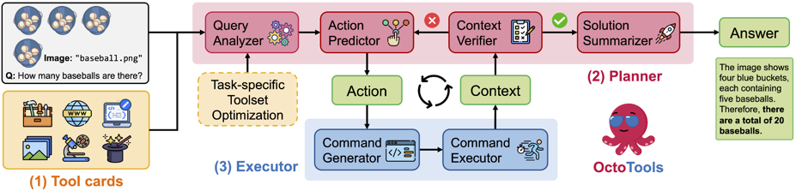
Stanford OctoTools
Stanford OctoTools - Open Source Complex Reasoning Agentic Framework with Extensible Tools
OctoTools introduces standardized tool cards, a planner for both high-level and low-level planning, and an executor
https://octotools.github.io - code
https://arxiv.org/pdf/2502.11271 - paper
https://huggingface.co/spaces/OctoTools/octotools - demo
https://octotools.github.io/#visualization - visualization examples

Slide 11


More AI Updates
Amazon's new Alexa+ - $20/mo (or free with Amazon Prime)
AI-powered digital assistant
Can handle complex tasks like making reservations or buying tickets
It uses different AI models to choose the best one for each job
Alexa+ remembers your preferences and keeps track of conversations.
It works with many services
Tencent Hunyuan Turbo S AI model Can Outrun DeepSeek
Chinese tech giant Tencent said its new artificial intelligence model is faster than that of DeepSeek
The company’s Hunyuan Turbo S AI model was built to respond as instantly as possible - thus distinguishing itself from the deep reasoning offered by DeepSeek, a China-based AI startup.
https://www.pymnts.com/news/artificial-intelligence/2025/tencent-says-new-ai-model-can-outrun-deepseek/?utm_source=substack&utm_medium=email

Slide 12
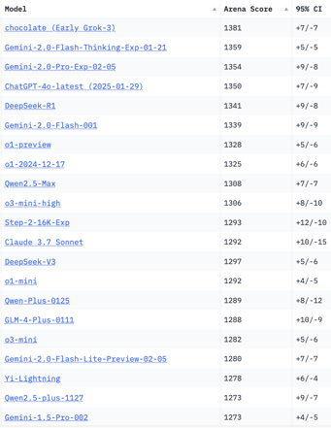
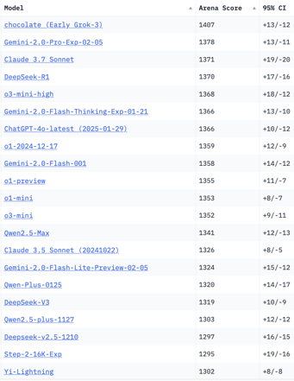
Crowd-sourced "LM Arena" Leaderboard
Total #models: 209
Total #votes: 2,725,075
Last updated: 2025-02-27
Starting Elo rating = 1000
95% CI = Confidence Interval
https://en.wikipedia.org/wiki/Elo_rating_system
https://chat.lmsys.org/?leaderboard
https://lmarena.ai/?leaderboard
English-only queries
Coding
x.ai
x.ai
China
China
China
China
China
China
China
China
China
China
China
China
China
China
China
China

Slide 13
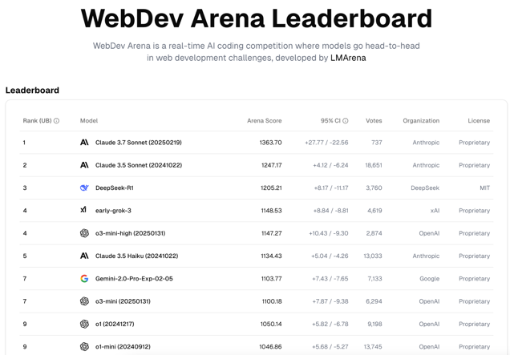
WebDev Arena Leaderboard
https://web.lmarena.ai/leaderboard

Slide 14
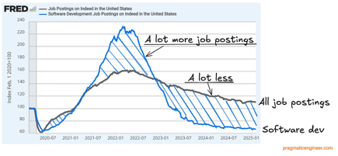
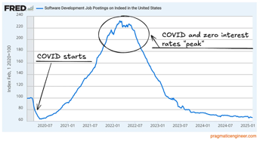
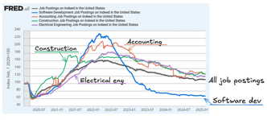
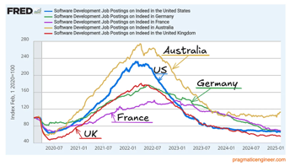
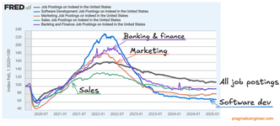
Jobs
Layoffs:
https://layoffs.fyi
https://techcrunch.com/2025/02/13/tech-layoffs-2024-list/
https://blog.pragmaticengineer.com/software-engineer-jobs-five-year-low/

Slide 15


About the Speaker
Lev Selector, Ph.D.
40+ years of software engineering, data science, and building teams (hiring, training, and managing)
Ph.D. in mathematical modeling and computer simulations
Interests:
Generative AI, Using LLM with your data
Local AI for Local Private Data
Cloud architecture, fin-tech, application security
Find/connect: Linkedin, GitHub, YouTube, Google
https://eais.ai
Enterprise AI Systems

Slide 16
Thank You!

