Slide 1
AI Updates
November 08, 2024
US Elections - and AI
OpenAI Plans for 2025
Sam Altman AMA on Reddit
Coders: DeepSeek vs Yi Qwen2.5
Jensen Huang (CEO of Nvidia) - What's Next
Geometric structures in the LLMs
Google has changed its ranking algorithm
Anthropic released Claude 3.5 Haiku
Physical Intelligence Adaptable Robots
Altera AI Social Agents
Disney Embraces AI
UAE - AI for seismic surveys
Toyota - AI for Driver Assistance
AI Avatar "Live" for Alzheimer's Patients
Pi zero - new AI model for robotics
Yi-lightning: like GPT-4 but 500 times cheaper
China's AI training 3-5 times larger than in US
OpenAI delays due to lack of compute
AI addiction? AI displacement of humans
Meta robots can feel touch.
Etched & Decart AI Minecraft game
Recraft text-to-image model
MindsAI ARC-AGI high score! 55.5%
Smell - digitize and recreate using AI
Microsoft Magnetic 1 Multi-Agent System
Tesla $100 Laptop
XPeng Iron - humanoid robot
Crowd-sourced "Arena" Leaderboard - English
Crowd-sourced "Arena" Leaderboard - Coding
Tech Layoffs in 2024

Slide 2
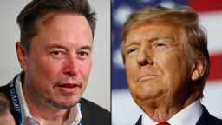
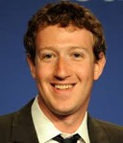
US Elections - and AI
Open Source AI leaders (like Elon Musk and Mark Zuckerberg) were previously excluded from Governmental committees on AI, for example from "AI safety board". But situation may now change.
Elon Musk has donated nearly $119 million to a political action committee he set up to support Trump. He’s appeared with Trump at rallies and hosted an interview with him on X. We can expect that new administration will invite Elon into his new administration as a major advisor in vital areas including AI.
Trump might be more likely to give a green light to Musk’s initiatives as well as regulations about AI, EVs (self-driving vehicles, “robotaxis”), etc.
https://www.cnn.com/2024/11/06/business/elon-musk-election-bet/index.html
Mark Zuckerberg role is unclear. The Meta CEO and planet's third wealthiest person, was not endorsing either candidate – nor did he in 2016 or 2020.
But the Facebook co-founder did call Trump's response to the July assassination attempt "badass", and reportedly phoned Trump to wish him a speedy recovery. Trump was saying that Zuckerberg told him, "I will never vote for people running against you after watching what you did."
What the Election Results Mean for Emerging Tech:
Deregulation across multiple sectors, particularly biotech, space, AI, Cryptocurrencies - reducing Government Overreach
Speed of Technological Change
Forward-Thinking Policy

Slide 3

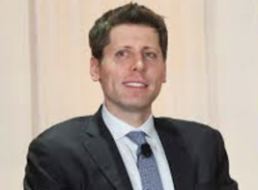
OpenAI Plans 2025
AMA (Ask Me Anything) interview Sam Altman - Reddit
OpenAI's Sam Altman owns a 8.7% stake in Reddit
Reddit went public on NYSE earlier this year. Its market cap is close to $20 Bln
In the interview: OpenAI Reveals Their Plans For 2025
https://www.youtube.com/watch?v=VafombwcTO0
AGI is achievable with current hardware
o1 model is a significant improvement over the preview - 10-15% better benchmarks over o1-preview.
OpenAI will continue scaling LLMs and improve inference time (faster and longer inference based on query).
Hallucinations remain a challenge.
Agents - next major advancement in their product line.
Adaptability and continuous - crucial skills for success.
Ilya Sutskever had a vision of a "transcendent future" where AI surpass human understanding. Ilya was instrumental in early ideas that led to o1 development.
Advanced voice mode with vision is delayed in favor of other projects like the O1 model.
New text-image model and 3D model generation are coming. Longer context window is in development. Real-time HTML editor is coming.
Altman has invested in 125+ companies (Stripe, Instacart, Humane, Reddit, Cruise, Asana, ...)
Reddit is a social news aggregation, content rating, and discussion website.
It's like a giant bulletin board with millions of different sections (called "subreddits") dedicated to various topics, from news and politics to hobbies and memes.
Users submit content like links, text posts, and images, which are then voted up or down by other users.
Reddit was founded in June 2005 by Steve Huffman and Alexis Ohanian in Medford, Massachusetts.

Slide 4
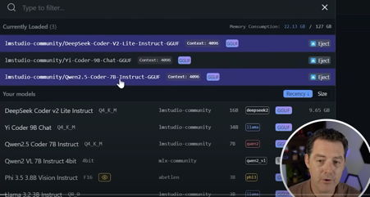

AI News - 1
Comparing 3 open-source coding models:
DeepSeek-Coder-V2-Lite-Instruct - 16B
Yi-Coder-9B-Chat
Qwen2.5-Coder-7B-Instruct - the winner, fast
https://www.youtube.com/watch?v=RRfbML4Lq40
Jensen Huang (CEO of Nvidia):
New AI models think (reason) before answering.
Autonomous AI agents will become prevalent in the workplace by 2025.
Physical AI - AI interacting with the physical world, such as humanoid robots.
https://www.youtube.com/watch?v=4veTNJ0Qgfc

Slide 5
AI News - 1
Geometric structures in the LLMs larned concepts.
New research demonstrates that AI organizes concepts in geometric patterns. For example, the relationship between man and woman parallels the same relationship between king and queen, forming a parallelogram.
The AI's knowledge is organized into distinct regions or lobes, similar to how a human brain has different areas for different functions.
There are three main lobes:
the code/math lobe,
the general language lobe
the dialog lobe.
The researchers also found that the AI's knowledge is organized in a specific way that follows mathematical patterns. This is not random, it's highly structured.
The similarities with human brains doesn't suggest that AI is conscious or thinking like a human.
https://www.youtube.com/watch?v=jIhkgSN7vVU
Google has changed its ranking algorithm (though they haven't explicitly explained the changes).
Google is placing a greater emphasis on expertise and relevance. Websites that have a genuine depth of knowledge and experience in a particular area are more likely to rank well, while those that simply try to capitalize on their domain authority to rank for any topic are being penalized.
In the past, Google's algorithm heavily relied on domain authority, allowing big publishers to rank easily for almost any topic. Now, Google seems to be refining its algorithm to better understand if a section of a site is truly relevant to the main focus of the site. If not, that section's content may be downranked, even if the overall domain has high authority.
https://www.youtube.com/watch?v=qvU52p3Omhc

Slide 6
AI News - 2
Anthropic Claude 3.5 Haiku model
Good, even surpassing Claude 3 Opus in many tasks, but still behind GPT-4 and Gemini 1.5 Pro in some benchmarks.
Haiku is more expensive than previous version, and more expensive than GPT-4 Mini and Gemini 1.5 Flash.
Physical Intelligence - San Francisco-based startup, has raised $400 million at a $2.4 billion valuation. Creating adaptable robots, unlike traditional single-task robots. New robot that can do laundry, dishes, and other household chores. Company has developed a generalist AI policy for robotics, similar to GPT in its potential impact.
Altera AI is working on AI agents that can form meaningful social relationships and develop their own cultures. Their "piano" architecture allows agents to think and act concurrently over multiple time scales, consciously and subconsciously. In a Minecraft sandbox, these agents have shown the ability to form friendships, rivalries, and even develop their own laws and religions.

Slide 7
AI News - 3
Disney Embraces AI - forming a dedicated team to explore and implement AI, augmented reality (AR), and virtual reality (VR) technologies across its various divisions, including film, television, and theme parks.
UAE energy giant ADNOC, in partnership with G42 and Microsoft, is utilizing AI to significantly accelerate seismic surveys in the energy sector.
Toyota and NTT Invest Billions in AI for Driver Assistance
AI Avatar "Live" provides support and guidance to Alzheimer's Patients: personalized advice and answers questions based on real-life experiences of others with the condition.
Pi zero - new AI model for robotics - integrates vision, language, and motor commands, allowing robots to see, understand, and act based on their perception.
Model is trained on 10,000 hours of data from various robot setups. It can read text prompts, execute tasks "clean up the table", fold clothes, pack groceries, grind coffee beans, ...).
Combines expertise from Google and Stanford researchers.

Slide 8
AI News - 4
Yi-lightning by 01.ai - better than GPT-4 (?), and 500 cheaper.
China's AI training systems are 3-5 times larger than in US
OpenAI is delaying new products due to a lack of compute.
AI addiction? AI displacement of human workers.
25% of the code being written by Google engineers is now written by AI.
Meta robots can feel touch.
Etched & Decart AI created Minecraft game entirely using diffusion models.
Recraft text-to-image model - topping the leaderboards. Chat GPT now lets you search through your chat history.

Slide 9
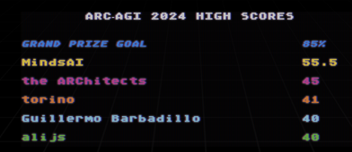

MindsAI
New ARC-AGI high score! 55.5% (MindsAI)
https://www.youtube.com/watch?v=-M0HZGKF4UI
https://arcprize.org
https://arcprize.org/leaderboard
https://www.kaggle.com/competitions/arc-prize-2024/leaderboard
Unfortunately, MindsAI hasn't publicly disclosed the exact architecture and training methods of their model. But it is likely that they use a combination of the following approaches:
Neuro-symbolic AI:** Integrating deep learning with symbolic reasoning.
System 2 Reasoning:** Emphasizing deliberate, logical thinking.
Program Synthesis:** Generating programs to solve tasks.
Evolutionary Algorithms:** Optimizing models through iterative evolution.
François Chollet

Slide 10
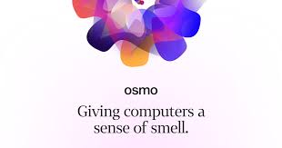
Digital Smell
Osmo AI has developed a way to digitize and recreate smells using AI.
- https://www.osmo.ai
- https://www.youtube.com/watch?v=suKIlsTFpis
The technology works by analyzing the molecules that make up a particular smell and then recreating it using a special machine.
Potential applications:
Creating new fragrances and flavors
Improving the safety and quality of food
Developing new diagnostic tools for healthcare
Enhancing virtual and augmented reality experiences

Slide 11
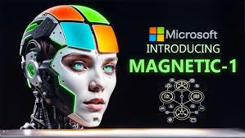
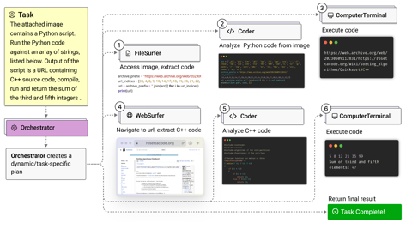
Microsoft Magnetic 1
Microsoft: Magnetic 1, a powerful multi-agent AI system.
Magnetic 1 is composed of multiple specialized agents, each with its own unique function: Web Surfer, File Surfer, Coder, Computer Terminal, An "Orchestrator" agent.
Magnetic 1 is built on Microsoft's open-source Autogen framework.
Magnetic 1 integrates with various LLMs like GPT-4, ...
The system is designed to be modular, allowing agents to be added or removed as needed.
Magnetic 1 is capable of performing complex, multi-step tasks across various domains.
Magnetic 1 is compared to other multi-agent AI systems like OpenAI's Swarm and IBM's BAgent framework.
https://www.microsoft.com/en-us/research/articles/magentic-one-a-generalist-multi-agent-system-for-solving-complex-tasks/

Slide 12

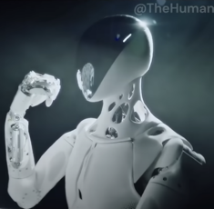


Tesla $100 Laptop
Elon Musk announced a new $100 Tesla laptop.
This surprisingly low price aims to disrupt the traditional computer industry and make technology more accessible.
proprietary Tesla-designed chipset.
lightweight design, long battery life, aluminum finish.
simplicity and accessibility for students, emerging markets, and budget-conscious consumers.
custom lightweight operating system
cloud-first approach - integrates with Tesla's cloud services for enhanced performance and offloading resource-intensive tasks
Tesla Cloud subscription offers additional features - extra compute power, storage, cloud-based gaming for a monthly fee
https://www.xpeng.com/news/
XPeng AI unveiled Iron, the humanoid robot
It is already working in XPeng's factory - assists in assembling the P7 Plus electric vehicle
custom-built Turing AI chip
Plan to deploy Iron in retail, offices, and homes
XPeng introduced the Kunang super electric system for their Electric Vehicle - up to 1,400 km (870 miles), charging to 80% in 12 min

Slide 13
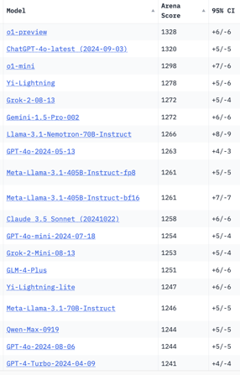
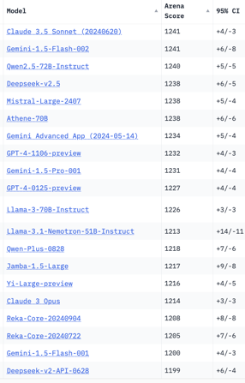
Crowd-sourced "Arena" Leaderboard
Total #models: 161.
Total #votes: 2,191,578.
Last updated: 2024-11-04.
Starting Elo rating = 1000
95% CI = Confidence Interval
https://chat.lmsys.org/?leaderboard
English-only queries
China
x.ai
China
x.ai
China
China
China

Slide 14
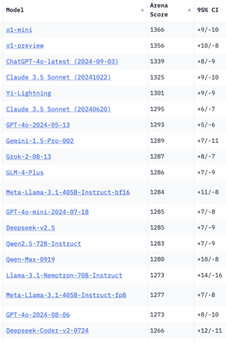
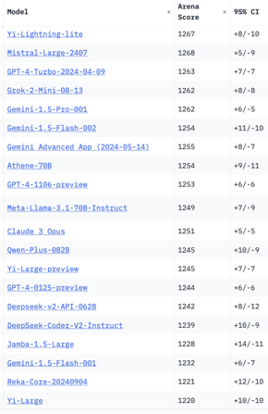
Crowd-sourced "Arena" Leaderboard
Total #models: 161.
Total #votes: 2,191,578.
Last updated: 2024-11-04.
Starting Elo rating = 1000
95% CI = Confidence Interval
https://chat.lmsys.org/?leaderboard
Coding
China
x.ai
China
x.ai
China
China
China
China
China

Slide 15
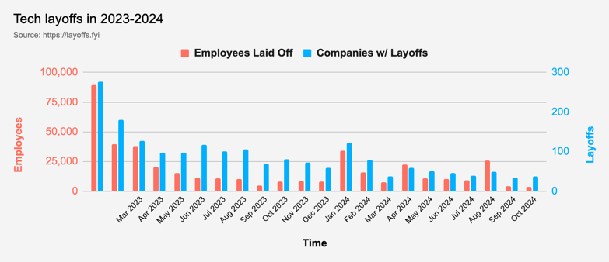
Tech Layoffs in 2024
Layoffs - https://layoffs.fyi
Job market for IT: much worse than before COVID.
IT has become a commodity. Lower salaries/rates ($100/hr => $75/hr).
Much more competition, hundreds of applications for each position

Slide 16
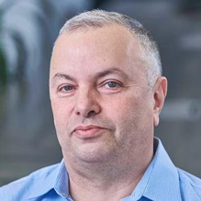

About the Speaker
Lev Selector, Ph.D.
40+ years of software engineering, data science, and building teams (hiring, training, and managing)
Ph.D. in mathematical modeling and computer simulations
Interests:
Generative AI, Using LLM with your data
Local AI for Local Private Data
Cloud architecture, fin-tech, application security
Find/connect: Linkedin, GitHub, YouTube, Google
https://eais.ai
Enterprise AI Systems

Slide 17
Thank You!

