Slide 1
AI Updates
November 15, 2024
Elon Musk about AI progress
Dario Amodei on Claude, AGI & the Future
Qwen2.5-Coder, Qwen2.5
OpenAI "Predicted outputs" approach
Aider AI Coding Agent
Nous Research: Nous Chat & Forge Reasoning
OpenAI status
OpenAI Operator Agent
MIT: AI beats Humans on ARC test
MIT: AI can accelerate scientific progress
AI advancements plateauing?
Greg Brockman returned to work at OpenAI
AlphaFold 3 open-sourced
Codeium - free and paid AI-editing and coding
Microsoft Notepad and Paint with AI
Google - creating games using AI
Meta's robotics research - touch perception
OpenHands CodeAct 2.1 agent
AIRIS by SingularityNET (Minecraft)
How to Invest in AI
uv package manager for Python
Shuhari - 3 stages of becoming a master
Find your place in AI enabled world
Probabilistic Computing
Jordan Peterson & Joe Polish
Crowd-sourced "Arena" Leaderboard - English
Crowd-sourced "Arena" Leaderboard - Coding
Tech Layoffs in 2024

Slide 2
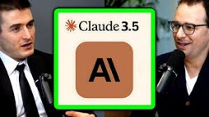

Elon Musk about AI progress
Dario Amodei
on Claude, AGI & the Future of AI
AI is advancing at an extremely rapid pace
This poses a potential threat to humanity
Most important thing for AI safety is to have a maximally truth-seeking AI.
Current trend is to program AI can produce lies
Musk is also concerned that AI is being developed by people who are not trustworthy, and that there may be no way to stop AI if it becomes out of control
In a benign AI scenario, the biggest challenge will be finding meaning in a world where AI is better than humans at everything
Musk believes that we should try to instill good values in AI, but that ultimately we may not be able to control it
Dario Amodei: Anthropic CEO on Claude, AGI & the Future of AI & Humanity | Lex Fridman Podcast #452 (5+ hours long)
https://www.youtube.com/watch?v=ugvHCXCOmm4
Scale (size, data, compute) remains the primary driver of progress, despite recurring counterarguments.
Focus on "Responsible Scaling" (safety and societal impact). Anthropic's focus on Constitutional AI and AI Safety Levels.
Emphasis on Ecosystem-Wide Safety. Industry-wide collaboration and standards are needed.
Importance of a small, highly skilled team ("density") over a large team with varying skill levels ("mass").
Chris Olah emphasizes the importance of understanding the inner workings of neural networks ("mechanistic interpretability") not just for safety, but also for appreciating the inherent beauty and complexity within these systems.
Amodei expresses concern about the potential for AI to exacerbate existing power imbalances and economic inequality.
He believes that while AI could enhance meaning in life, its primary threat lies in the potential for misuse and concentration of power.
Elon Musk Tucker Carlson interview (2 hours long)
https://x.com/TuckerCarlson/status/1843375397024485778

Slide 3
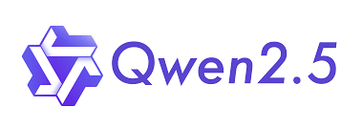
Qwen2.5-Coder
Qwen2.5-Coder Series: open-sourced 0.5, 1.5, 3, 7, 14, 32B. (formerly known as CodeQwen1.5)
Qwen2.5-Coder-32B-Instruct has become the current SOTA open-source code model, matching GPT-4o
128K context length
92 programming languages
https://github.com/QwenLM/Qwen2.5-Coder
https://www.youtube.com/watch?v=ukqoMnNlEwc
Qwen2.5
Qwen2.5 Series: open-sourced 0.5, 1.5, 3, 7, 14, 32B, 72B
https://huggingface.co/Qwen
https://huggingface.co/collections/Qwen/qwen25-66e81a666513e518adb90d9e
Qwen/Qwen2.5-72B-Instruct - SOTA
128K context length

Slide 4
AI Updates 1
Predicted outputs (GPT-4o & GPT-40-mini) - user can provide the prediction of the desired output - helps to speed up the response 2-4 times! Great for making small changes to big datasets, articles, etc. - but not ideal for generating brand new unique content.
https://platform.openai.com/docs/guides/predicted-outputs
https://www.aibase.com/news/13055
https://www.firecrawl.dev/blog/getting-started-with-predicted-outputs-openai
OpenAI status
Simply making models bigger and feeding them more data may not lead to the expected intelligence gains.
Orion's performance may not be the revolutionary leap forward that was anticipated.
Data scarcity: OpenAI is reportedly running low on high-quality training data. Using synthetic data has potential drawbacks like the "inbreeding effect" and "model collapse."
OpenAI is shifting its focus to improving models after initial training using techniques like reinforcement learning and human feedback. They are also prioritizing reasoning abilities in their new models.
The future of AI might lie in specialized tools rather than one general-purpose AI. This means developing smaller, more focused models for specific tasks.
The AI field is maturing, moving beyond simple task automation to enhancing human capabilities.
Aider UPDATE: The BEST AI Coding Agent BEATS v0, Cursor, Bolt.New, & Cline! - https://aider.chat Access top AI models and image generators like Claude, GPT-4, Llama, Midjourney, DALL-E, and more, all in one place for just $10/month! Boost your productivity with the best tools at your fingertips! Get Started TODAY: Mammouth.ai
https://www.youtube.com/watch?v=ywKTxA9FU_4
Nous Research: Nous Chat and Forge Reasoning API Beta
Built on their powerful Hermes model
Nous Chat - open-source, user-friendly chatbot interface,
Forge API enhances AI reasoning through advanced multi-agent capabilities like Monte Carlo Tree Search and Chain of Code.
https://www.youtube.com/watch?v=pbkdof579fA
OpenAI Operator - to be previewed in January 2025
Operator agent is designed to perform tasks on the computer (coding, shopping, booking travel in browser, background monitoring, managing emails and messages, ...)
OpenAI Swarm, multi-agent collaborative systems.

Slide 5
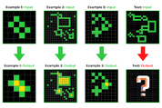
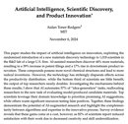
AI Updates 2
Ability to reason and solve novel problems, as demonstrated on the Arc benchmark, is a crucial step towards AGI
Search as a key component: The video emphasizes the importance of "search" algorithms in achieving AGI. This involves AI systems exploring different possibilities and solutions, similar to how humans think, rather than simply relying on memorized patterns.
Current AI search methods are still less efficient than human thinking, but they are getting better and human-like.
AI beats Humans on ARC test (new research from MIT)
https://www.youtube.com/watch?v=CUwhk5C4bb0
The Arc benchmark - evaluates an AI's ability to solve novel problems it hasn't encountered before. Humans score around 85% on this test, while traditional AI models have struggled.
MIT's breakthrough: Researchers at MIT developed a technique called "test time training" that significantly improves AI performance on the Arc benchmark. This method involves temporarily adjusting the model's parameters during the test itself, using a kind of "search" process to find the most consistent and likely correct answers.
By combining this technique with an 8 billion parameter language model, they achieved a score exceeding human performance on Arc for the first time.
This suggests AI systems can now exhibit a level of abstract reasoning comparable to, or even surpassing, humans.
An MIT study suggests AI can dramatically accelerate scientific progress - https://aidantr.github.io/files/AI_innovation.pdf
"Artificial Intelligence, Scientific Discovery, and Product Innovation" - Aidan Toner-Rodgers, MIT, 77p paper
1,000 scientists using AI tool showed significant increases in materials discovered (44%), patent filings (309%), and product innovation (177%).
https://www.youtube.com/watch?v=KPBqFQKtqP0

Slide 6
AI Updates 3
AI advancements plateauing? OpenAI, Google, and Anthropic are reportedly facing difficulties in achieving significant performance leaps. Possible reasons: limitations in compute resources, available data, and algorithmic breakthroughs.
Greg Brockman, OpenAI's president and co-founder, has returned from an extended leave
Microsoft Tiny Troop - an experimental Python library for simulating interactions between AI agents with distinct personalities and goals.
AlphaFold 3 has been open-sourced (DeepMind's protein structure prediction system)
Waymo robotaxi is expanding its service in Los Angeles
Meta Ray-Ban AI-glasses - updates - voice commands, video sharing, and chatbot interactions.
TSMC not allowed to produce 2nm chips outside of Taiwan
Amazon is developing its own AI chips (compete with Nvidia)
Codeium - free and paid AI-editing and coding
https://codeium.com/windsurf - Windsurf Editor
Windsurf Editor is a stand-alone IDE for coding - both as Copilot and as Agent (doing complex tasks)
Flows = Agents + Copilots
Cascade - deep codebase understanding, many advanced tools, real-time awareness of your actions. It is the most powerful way to code with AI. Can work on complex codebases.
Multi-file multi-edit capability. Deep contextual awareness. Terminal command suggestions. LLM-based search tools that outperform embeddings. Implicit reasoning of your actions in the text editor. Blazing fast latency. All in one magical experience.

Slide 7




AI News - 4
Microsoft Notepad and Paint - now with AI (preview within Windows 11).
Notepad: a new "rewrite" feature that uses AI to suggest alternative versions of highlighted text, allowing for adjustments to tone, length, and style.
Paint: "generative fill," - user can add to image using textual descriptions (on Snapdragon Co-pilot Plus).
Paint: - "generative erase" - remove objects from images using AI filling in the background seamlessly.
Google - creating games using AI. AI-generated worlds and games with unique narratives, characters, environments, endless possibilities - in real-time.
Character and Environment Consistency throughout the game for a coherent and immersive experience.
Accurately interpret player prompts and generate content that aligns with the player's intentions
Using small distilled LLMs
Real-time AI Generation (changing character, ...)

Slide 8
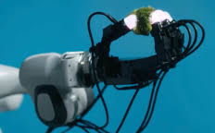


AI News - 5
Meta's robotics research - touch perception.
SPUR - AI model to process and understand tactile information (pressure, texture, temperature)
Digit 360 - tactile sensor to mimic human finger.
Digit Plexus - platform (touch, robotics)
Meta is partnering with GelSight and Wanic Robotics
Applications - Human-Robot Interaction, Prosthetics, Virtual Reality and Augmented Reality
OpenHands - an open-source platform for deploying AI agents (code, browse, use Stack Overflow)
CodeAct 2.1 agent - uses Claude 3.5 Sonnet. Surpasses the "original" in coding tasks
Function calling, better coding, directory navigation
Python and Bash commands.
Requires Docker, Python (WSL for Windows)
Has UI, can generate various code, including bash scripts and even full-stack web applications like AI chatbots.
https://www.all-hands.dev
https://www.all-hands.dev/blog/openhands-codeact-21-an-open-state-of-the-art-software-development-agent

Slide 9
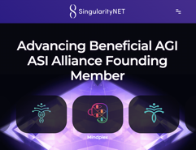


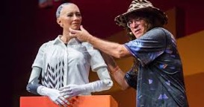
AIRIS by SingularityNET
AIRIS by SingularityNET - a new self-learning AI is being tested in Minecraft.
AIRIS does not require preset rules or training data. It learns by interacting with its environment. AIRIS utilizes neural symbolic learning to form generalizable conclusions from small amounts of data.
The AI is designed to be transparent, allowing developers to understand its decision-making process.
The goal is to eventually transfer AIRIS's skills to real-world applications like robotics and smart home assistants.
https://singularitynet.io - SingularityNET is also working on a decentralized network of supercomputers for AGI
Ben Goertzel - founder of SingularityNET https://en.wikipedia.org/wiki/Ben_Goertzel https://www.youtube.com/watch?v=OpSmCKe27WE
Ben Goertzel

Slide 10
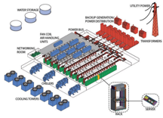
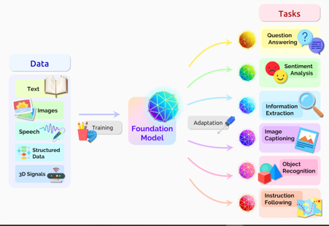
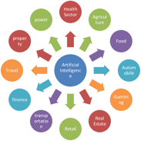
Investing in AI
Hardware Infrastructure: chips, data centers, and power. He cautions that while these are necessary and in high demand, investors need to be aware of potential bottlenecks and rapid price fluctuations.
Foundation Models: the core AI models like those from Anthropic, OpenAI, and Google. He notes the intense price competition and the potential for new players and architectures to emerge.
Applications: the software and services built on top of AI. He highlights the challenge of competing with established companies that can quickly integrate AI into their existing products.

Slide 11
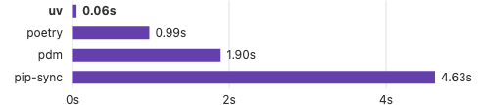

uv package manager
uv package manager - extremely fast Python package and project manager, written in Rust.
A single tool to replace pip, pip-tools, pipx, poetry, pyenv, twine, virtualenv, and more.
10-100x faster than pip.
Installs and manages Python versions.
Runs and installs Python applications.
Runs single-file scripts, with support for inline dependency metadata.
Provides comprehensive project management, with a universal lockfile.
Includes a pip-compatible interface for a performance boost with a familiar CLI.
Supports Cargo-style workspaces for scalable projects.
Disk-space efficient, with a global cache for dependency deduplication.
Installable without Rust or Python via curl or pip.
Supports macOS, Linux, and Windows.
https://github.com/astral-sh/uv
https://docs.astral.sh/uv/
https://www.youtube.com/watch?v=Lm-3OAYFvog
Mac or Linux:
curl -LsSf https://astral.sh/uv/install.sh | sh
uv self update
uv init example
cd example
uv add ruff
uv run ruff check
uvx pycowsay 'hello world!'
uv tool install ruff
uv python install 3.10 3.11 3.12
uv venv --python 3.12.0
uv run example.py
uv pip compile docs/requirements.in \
--universal \
--output-file docs/requirements.txt
Resolved 43 packages in 12ms

Slide 12


Shuhari
Shuhari (Kanji: 守破離 Hiragana: しゅはり) is a Japanese martial art concept that describes the three stages of learning to mastery:
Shu (守) "protect", "obey"—traditional wisdom, fundamentals. Learn the basics of a skill. Lots of repetition, may feel boring, but it's crucial for building a strong foundation.
Ha (破) "detach", "digress" - applying the fundamentals and things become more automatic. A "phase shift". Find exceptions and new approaches.
Ri (離) "leave", "separate"—transcendence—there are no techniques or proverbs, all moves are natural, becoming one with spirit alone without clinging to form. This is the mastery stage where you transcend the fundamentals. You develop your own style and approach, and your work stands out. You're not just following the rules anymore, but innovating and excelling.
It is important to recognize where you are in the learning process and apply the appropriate approach.
You need patience and persistence, consistency and mastering the fundamentals.
https://en.wikipedia.org/wiki/Shuhari
"to keep, to fall, to break away"
"follow the rules, break the rules, transcend the rules"

Slide 13

How to find your place in AI enabled world?
Strategy beats Talent?
Direction beats speed?
Francis Bacon: "The lame man who keeps the right road outstrips the runner who takes the wrong one."
https://en.wikipedia.org/wiki/Francis_Bacon

Slide 14
Probabilistic Computing
The video claims that probabilistic computers, specifically those using thermodynamic principles like the ones being developed by exaTropic, could be up to 100 million times more energy-efficient than GPUs for certain tasks.
Here are the main ideas:
Limitations of Digital Computing: Traditional digital computers, based on transistors and binary logic, are reaching their physical limits and struggle with probabilistic problems common in AI and simulations.
Probabilistic Computing: This new approach utilizes probabilistic bits (p-bits) that fluctuate between states, mimicking the uncertainty found in natural processes. This makes them well-suited for tasks like optimization, AI, and machine learning.
Thermodynamic Computing: A type of probabilistic computing that harnesses noise and the tendency of systems to minimize energy to perform computations. Startups like exaTropic are developing this technology, claiming significant energy efficiency gains over GPUs.
P-bits vs. Qubits: While sharing some similarities with quantum bits (qubits), p-bits are purely classical and operate at room temperature.
Implementation: P-bits can be built using various technologies, including superconducting Josephson junctions (JJs) and magnetic memory cells.
Applications: Probabilistic computers excel in areas where uncertainty is inherent, such as AI, machine learning, and simulations. They are not meant to replace digital computers entirely but offer advantages for specific tasks.
Challenges and Future: Developing probabilistic computers involves overcoming hardware and software challenges. ExaTropic is working on silicon-based thermodynamic chips for improved scalability. The video also touches on the potential of this technology and the need to demonstrate "probabilistic supremacy."
Essentially, the video argues that probabilistic computing, particularly thermodynamic computing, presents a promising new direction with the potential to revolutionize AI and other fields by offering a more efficient way to handle probabilistic problems.
https://www.youtube.com/watch?v=hJUHrrihzOQ
Here are the main ideas:
Limitations of Digital Computing: Traditional digital computers, based on transistors and binary logic, are reaching their physical limits and struggle with probabilistic problems common in AI and simulations.
Probabilistic Computing: This new approach utilizes probabilistic bits (p-bits) that fluctuate between states, mimicking the uncertainty found in natural processes. This makes them well-suited for tasks like optimization, AI, and machine learning.
Thermodynamic Computing: A type of probabilistic computing that harnesses noise and the tendency of systems to minimize energy to perform computations. Startups like exaTropic are developing this technology, claiming significant energy efficiency gains over GPUs.
P-bits vs. Qubits: While sharing some similarities with quantum bits (qubits), p-bits are purely classical and operate at room temperature.
Implementation: P-bits can be built using various technologies, including superconducting Josephson junctions (JJs) and magnetic memory cells.
Applications: Probabilistic computers excel in areas where uncertainty is inherent, such as AI, machine learning, and simulations. They are not meant to replace digital computers entirely but offer advantages for specific tasks.
Challenges and Future: Developing probabilistic computers involves overcoming hardware and software challenges. ExaTropic is working on silicon-based thermodynamic chips for improved scalability. The video also touches on the potential of this technology and the need to demonstrate "probabilistic supremacy."
Essentially, the video argues that probabilistic computing, particularly thermodynamic computing, presents a promising new direction with the potential to revolutionize AI and other fields by offering a more efficient way to handle probabilistic problems.

Slide 15
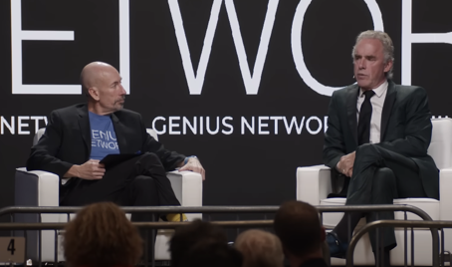
Jordan Peterson & Joe Polish
https://www.youtube.com/watch?v=pKYiKQ-tmUQ
Equity vs. Equality: criticizes the pursuit of equity, because it implies equality of outcome rather than equality of opportunity, and leads to societal losses.
Entrepreneurial Excellence: praises figures like Elon Musk and criticizes "radical progressives" for claiming moral superiority while harming the poor.
Criticizes environmentalists, particularly in Europe, for causing poverty without achieving significant environmental improvements.
Emphasizes the importance of sacrifice in personal and societal development
People see the world through stories - important to choose the right story.
Importance of conscience, passion alone is not enough.
Importance of Community (founded on shared sacrifice).
Opportunities - prioritize, delegate, and build a strong team.
Advice on public speaking and engaging with audiences, stressing authenticity, active engagement, taking risks.
Search for meaning and purpose in your life, strive for something greater, embrace the adventure of life.
Criticizes elites for attempting to control and manipulate the population, advocating for individual sovereignty.

Slide 16
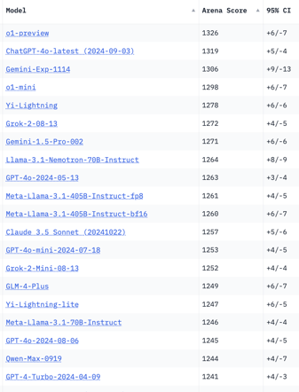
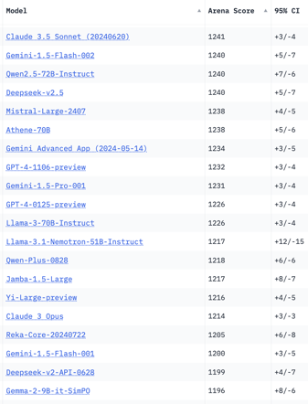
Crowd-sourced "Arena" Leaderboard
Total #models: 162.
Total #votes: 2,229,835.
Last updated: 2024-11-13.
Starting Elo rating = 1000
95% CI = Confidence Interval
https://chat.lmsys.org/?leaderboard
English-only queries
China
China
x.ai
China
x.ai
China
China
China

Slide 17
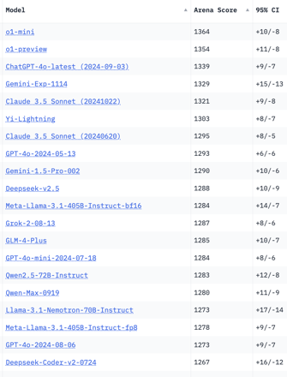
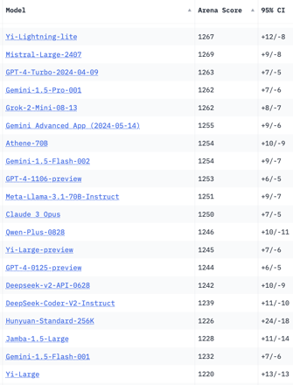
Crowd-sourced "Arena" Leaderboard
Total #models: 162.
Total #votes: 2,229,835.
Last updated: 2024-11-13.
Starting Elo rating = 1000
95% CI = Confidence Interval
https://chat.lmsys.org/?leaderboard
Coding
China
x.ai
China
x.ai
China
China
China
China
China

Slide 18
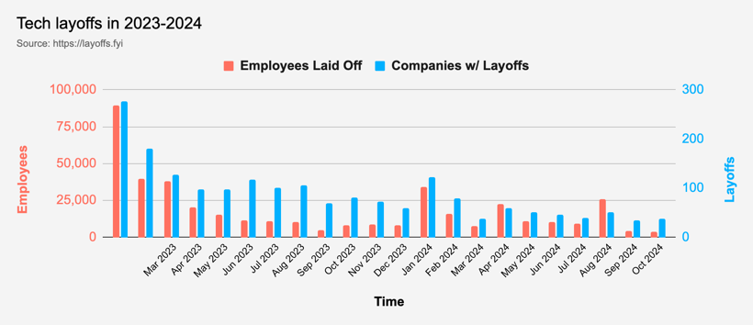
Tech Layoffs in 2024
Layoffs - https://layoffs.fyi
Job market for IT: much worse than before COVID.
IT has become a commodity. Lower salaries/rates ($100/hr => $75/hr).
Much more competition, hundreds of applications for each position

Slide 19
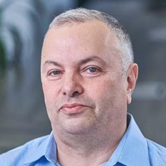

About the Speaker
Lev Selector, Ph.D.
40+ years of software engineering, data science, and building teams (hiring, training, and managing)
Ph.D. in mathematical modeling and computer simulations
Interests:
Generative AI, Using LLM with your data
Local AI for Local Private Data
Cloud architecture, fin-tech, application security
Find/connect: Linkedin, GitHub, YouTube, Google
https://eais.ai
Enterprise AI Systems

Slide 20
Thank You!

