Slide 1
"[The] pace of innovation is all that matters in the long run"
- Elon Musk
AI Updates
October 04, 2024
"AI is the first technology that has no limit"
- Bill Gates
OpenAI DevDay - towards self-tasking agents
OpenAI Realtime Voice API
OpenAI Prompt Caching, Model Distillation
OpenAI Vision Fine Tuning
OpenAI has raised $6.6B + $4B Credit line
OpenAI ChatGPT Canvas
ChatGPT's new shortcut feature
Salesforce Agentforce
Liquid AI Non-transformer Models (less compute)
Software: from code to weights
Microsoft Copilot Labs and Copilot Vision
Microsoft Paint - AI fill and erase features
AI bots now beat 100% of image CAPTCHAs
Who Wins from AI
Google works on models with advanced reasoning
Google Deepmind AlphaChip - for fast chip design
Google Releases Gemini1.5 Flash-8B
Pythagora - talk to build apps from scratch
Apple MM1.5 (Multimodal LLM)
RLHF with Mixture of Judges
LexEval Benchmark in Legal Domain
Pinterest - use AI to improve images
FLUX1.1 [pro] and BFL API
Durk Kingma (AI founder) joins Anthropic
Crowd-sourced "Arena" Leaderboard - English
Crowd-sourced "Arena" Leaderboard - Coding
Tech Layoffs in 2024

Slide 2
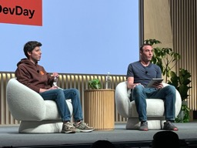

OpenAI DevDay October 1st
OpenAI DevDays in San Francisco, CA
November 6, 2023
October 1, 2024
OpenAI Dev Day - from Sam Altman’s Presentation
Progress Toward AGI and AI Agents:
In 2025 AI agents will become truly functional (o1, ...)
The definition of AGI is becoming blurred as we approach it
Level Two AGI (o1) - significant progress
Acceleration of Scientific Discovery:
Use AI for increasing the rate of scientific discovery
pivotal milestone when AI will become better than humans
AI Agents Transforming Work and Productivity:
Agents as Virtual Employees. Speed: hours (agent) vs months(human). Scale: use 100s of AI agents for complex tasks
Safety and Alignment as Priorities:
Iterative Deployment as a key safety mechanism
o1 is the most capable and the most aligned
Building new models first, then make them safer over time
Anticipated Advancements: https://openai.com/news/product
Rapid Model Improvement - in 3 months o1 will support function calling, system prompts, and structured outputs
Realtime Voice API (like speech-to-speech) https://openai.com/index/introducing-the-realtime-api/
Prompt Caching - faster & cheaper responses https://openai.com/index/api-prompt-caching/
Model Distillation - specialized models (faster, cheaper, better). https://openai.com/index/api-model-distillation/
GPT-4o Vision Fine Tuning on images - detection, extraction https://openai.com/index/introducing-vision-to-the-fine-tuning-api/
José Gregorio Argomedo
https://www.rsm.global/chile/en/people/jose-gregorio-argomedo
Autonomous AI agents for complex tasks (self-tasking agents) - could drastically reshape industries and redefine productivity. Consider how upcoming AI models like o2 and o3 could shape our future work.
We should start envisioning how the ability to create self-tasking agents will transform our operations and the industry as a whole.

Slide 3
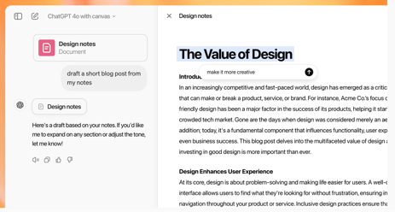
OpenAI
OpenAI ChatGPT Canvas opens in a separate window, allowing you and ChatGPT to collaborate on a project.
https://openai.com/index/introducing-canvas/
OpenAI has raised $6.6B in new funding at a $157B valuation.
https://openai.com/index/scale-the-benefits-of-ai Investors include Microsoft, Nvidia, SoftBank, MGX, ...
OpenAI revenue projections:
2024 - anticipates $3.7B (and $5B loss due to tech costs)
2026 - $25B
2029 - $100B
OpenAI has secured a new $4 Billion revolving credit line, the ChatGPT maker said on Thursday, a day after it closed a $6.6 billion funding round that cemented its position as one of the most valuable private companies in the world.
OpenAI: from last devday to this one:
*98% decrease in cost per token from GPT-4 to 4o mini
*50x increase in token volume across our systems
*excellent model intelligence progress
ChatGPT's new shortcut feature:
type "/" in the input field followed by "picture" or "search" or "reason", for example:
/picture quantum computer
/search quantum computer
/reason explain quantum computing
No Rivals Allowed
Elon Musk posted "OpenAI is evil" on X in response to reports that the OpenAI asked investors to avoid funding competing AI firms like Anthropic and Musk’s xAI.

Slide 4
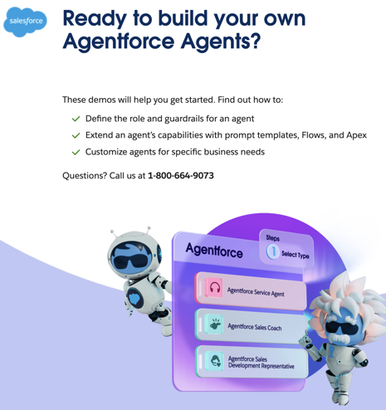

Salesforce Agentforce
Salesforce Agentforce
New AI platform - build and deploy custom AI agents
Automate tasks, provide information, and interact with customers
AI agents are customizable (sales, service, marketing, ...)
Low-code development
Integration with Salesforce leveraging your existing data and workflows.
Multi-channel - chat, email, phone, and even social media
Two types of agents: autonomous (working independently) and assistive (helping humans)
Star Wars CLone Troopers

Slide 5
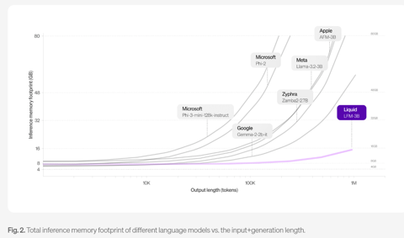
Liquid AI Non-transformer Models
Liquid AI - new Liquid Foundation Models (LFMs)
https://www.liquid.ai/liquid-foundation-models
NOT transformer
NOT open source
Less compute
Reduced memory footprint
Outperform larger transformer models
1.3B, 3.1B, and 40.3B MoE (12B activated)
32k token context length
Memory vs output length

Slide 6
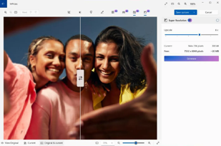
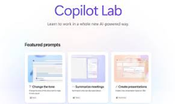
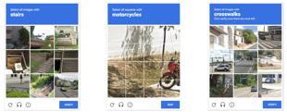
Misc 1
Software: from code to weights
from executing human readable code
to inferencing deeplearning network weights
Microsoft Paint is getting Photoshop-like generative AI fill and erase features
https://www.theverge.com/2024/10/1/24259239/microsoft-paint-generative-erase-fill-photos-upscaling
Microsoft - Copilot Labs and Copilot Vision :
https://www.microsoft.com/en-us/microsoft-copilot/blog/2024/10/01/introducing-copilot-labs-and-copilot-vision/
Microsoft Copilot Labs - testing ground for experimental AI features. Copilot Pro users use it to get early access to experimental AI features
Vision = "see" and interact with elements on your screen
Example: you see a pair of shoes you like on the screen. You can ask Copilot Vision, "Will these shoes go with my blue jeans and white shirt?" Copilot Vision analyzes the image of the shoes and your description of your outfit, then provides a response based on its understanding of color coordination and fashion trends.
AI bots now beat 100% of image CAPTCHAs
https://arxiv.org/abs/2409.08831
So now bots can pass through as humans ...

Slide 7


Misc 2
Pythagora - talk to build apps from scratch
https://www.pythagora.ai
Pythagora can create apps with more than 10K lines of code
Current version provides an almost magical experience in the range of 3K to5K lines of code.
And is constantly being improved
Who Wins from AI
Big Tech Firms (Google, Amazon, Microsoft, Meta, Apple, ...)
Computing infrastructure & chipmakers (NVIDIA, Qualicom, Micron, Intel, AMD, Samsung, TSMC, IBM, SK Hynix, Groq, Cerebras, Google, SambaNova, ARM, Huawei, ...)
Data, domain-specific data
IP (Intellectual Property) Lawyers
The Big 4 (Deloitte, EY, KPMG, and PwC), financial firms, ...
Certain countries (China, US)
human-centric skills (social workers, therapists, educators, ...)
Apple MM1.5 (Multimodal LLM)
new family of multimodal LLMs
text-rich image understanding, multi-image reasoning
from 1B to 30B parameters
dense and mixture-of-experts (MoE) variants
MM1.5-Video for video understanding
MM1.5-UI for mobile UI understanding
https://arxiv.org/abs/2409.20566
Google works on models with advanced reasoning
Google authored CoT (Chain of Thought) in 2022 - https://research.google/blog/language-models-perform-reasoning-via-chain-of-thought/
Google is now developing AI models similar to OpenAI’s o1 that use CoT for complex, multi-step problems (Bloomberg)
https://www.bloomberg.com/news/articles/2024-10-02/google-is-working-on-reasoning-ai-chasing-openai-s-efforts
RLHF with Mixture of Judges
Meta: using a mixture of judges models to properly perform multi task RLHF in post training (RLHF = Reinforcement Learning with Human Feedback) - https://arxiv.org/abs/2409.20370
Google Deepmind AlphaChip - for fast chip design
(AlphaGo, AlphaZero, AlphaFold, AlphaCode, ...)
https://www.nature.com/articles/s41586-024-08032-5
https://deepmind.google/discover/blog/how-alphachip-transformed-computer-chip-design
LexEval
LexEval - a benchmark to evaluate LLMs in the legal domain
https://github.com/cshaitao/lexeval
Google Releases Gemini1.5 Flash-8B
https://developers.googleblog.com/en/gemini-15-flash-8b-is-now-generally-available-for-use/

Slide 8

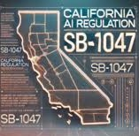



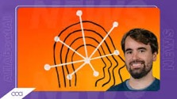
Misc 3
Californian Governor Gavin Newsom has vetoed the state's SB 1047 bill, which aimed to regulate large AI models.
He emphasized the need for evidence-based regulations and warned against overly stringent rules that could stifle innovation.
Pinterest - use AI to improve images
adding lifestyle backgrounds generated by AI
automation campaign features to support advertisers
https://newsroom.pinterest.com/news/introducing-new-ai-and-automation-campaign-features-to-support-advertisers/
FLUX1.1 [pro] and the BFL API
text to image, high quality
developed by Black Forest Labs (Germany).
FLUX1.1 [pro] provides 6 times faster generation + better image quality, prompt adherence, and diversity
FLUX.1 [pro] - speed improved x2
https://blackforestlabs.ai/announcing-flux-1-1-pro-and-the-bfl-api/
Durk Kingma, one of the lesser-known co-founders of OpenAI, today announced that he’ll be joining Anthropic.
https://www.allaboutai.com/ai-news/anthropic-hires-openai-co-founder-durk-kingma/

Slide 9
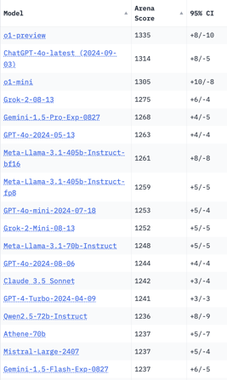
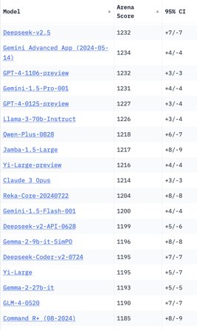
Crowd-sourced "Arena" Leaderboard
Total #models: 149.
Total #votes: 1,951,660.
Last updated: 2024-09-26.
Starting Elo rating = 1000
95% CI = Confidence Interval
https://chat.lmsys.org/?leaderboard
English-only queries

Slide 10
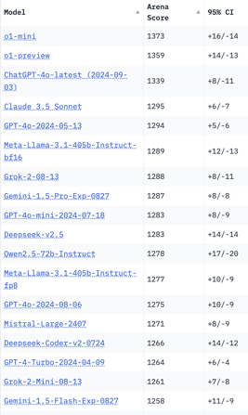
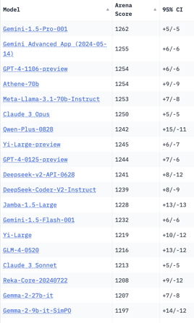
Crowd-sourced "Arena" Leaderboard
Total #models: 149.
Total #votes: 1,951,660.
Last updated: 2024-09-26.
Starting Elo rating = 1000
95% CI = Confidence Interval
https://chat.lmsys.org/?leaderboard
Coding

Slide 11
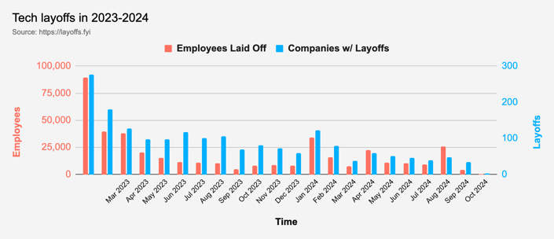
Tech Layoffs in 2024
Layoffs - https://layoffs.fyi

Slide 12
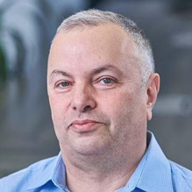

About the Speaker
Lev Selector, Ph.D.
40+ years of software engineering, data science, and building teams (hiring, training, and managing)
Ph.D. in mathematical modeling and computer simulations
Interests:
Generative AI, Using LLM with your data
Local AI for Local Private Data
Cloud architecture, fin-tech, application security
Find/connect: Linkedin, GitHub, YouTube, Google
https://eais.ai
Enterprise AI Systems

Slide 13
Thank You!

