Slide 1
AI Updates
November 01, 2024
GitHub Copilot offers multiple models
GitHub Spark prompt-to-code (in preview)
Grok - finally has vision
Claude can write and execute code (analysis tool)
Perplexity macOS desktop app - really good
Llama 3.2 1b & 3b models are 8bit quantized
Cerebras inference Llama3-70b at 2,100 tok/sec
TSMC in Arizona has outpaced Taiwan
Waymo self-driving cars has raised $5.6 Bln
Red Panda image generation model
Google Project Jarvis - agent inside Chrome
Stable Diffusion 3.5 medium is released
Genmo's Mochi 1 open-source video generation
Meta’s Llama-4 expected early 2025
Meta's own real time search engine
Meta's MovieGen AI - videos with sound
Elon Musk xAI is raising funds at $40 Bln valuation
xAI - 100K GPU xAI Colossus Cluster
Google Shopping - will use AI
Trend: Agents replacing chatbots
Ameca "Cyber Date" - humanoid robots
OpenAI's Canvas
Microsoft Co-pilot Updates
Google Gemini 2.0 in December ?
Apple M4 Chip and Apple Intelligence
Linux Patch
Text to Video
Crowd-sourced "Arena" Leaderboard - English
Crowd-sourced "Arena" Leaderboard - Coding
Tech Layoffs in 2024

Slide 2



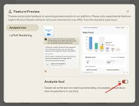







AI News - 1
GitHub Copilot - now offers selection of models (including Claude 3.5, Sonnet, Gemini 1.5 Pro, and even o1 preview).
GitHub Spark - prompt-to-code (in preview)
Grok - finally has vision - understand images/memes
Claude can now write and execute code (analysis tool) - https://www.anthropic.com/news/analysis-tool
Perplexity macOS desktop app - really good
Llama 3.2 1b & 3b models are 8bit quantized - much faster inference, low compute/memory requirements
Cerebras inference x3 faster (Llama3-70b at 2,100 tok/sec)
TSMC (Taiwan Semiconductor Manufacturing Company) in Arizona has outpaced production in Taiwan.
Waymo (self-driving cars) has raised $5.6 Bln
Red Panda image generation model - beats all other models
https://www.tomsguide.com/ai/mysterious-new-red-panda-ai-image-generator-appears-out-of-nowhere-is-this-a-new-dall-e
https://artificialanalysis.ai/text-to-image/arena?tab=Leaderboard
Project Jarvis - Google agent inside Chrome browser (in dev, using Gemini 2.0, large context window, can work across multiple web pages)
Stable Diffusion 3.5 medium is released

Slide 3
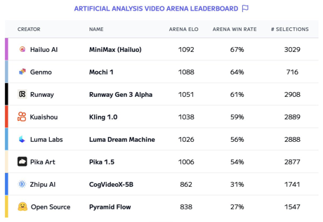

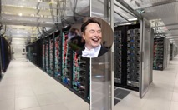
AI News - 2
Meta’s Llama-4 AI Models Are Training on a GPU Cluster bigger than 100,000 H100s ("Bigger Than Anything Else"). An initial launch expected early next year.
Meta is working on improving Llama's reasoning abilities.
Meta is developing their own search engine to add real time search result data to their LLM chatbot (and reduce dependency on Google and Bing). This will work in Facebook, Instagram, WhatsApp, ... So Meta's AI search will be providing real-time answers about current events, markets, ...
Meta's MovieGen AI - generate videos with sound - 1080p, 16 frames/sec - https://ai.meta.com/research/movie-gen/
Genmo's Mochi 1 - new open-source video generation model takes second place on the Artificial Analysis video leaderboard .. https://artificialanalysis.ai/leaderboards/models .. https://artificialanalysis.ai/text-to-video/arena
Elon Musk xAI is in talks to raise funds at a $40 Bln valuation.
xAI - 100K GPU xAI Colossus Cluster
Google Shopping - will use AI
Trend: Agents replacing chatbots

Slide 4
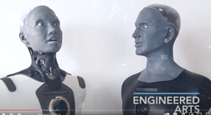
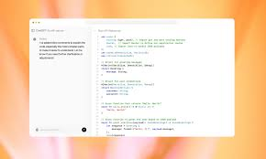


AI News - 3
Ameca "Cyber Date" - two humanoid robots communicating with each other .. https://www.youtube.com/watch?v=HFEOg352zgk .. https://www.youtube.com/@EngineeredArtsLtd
OpenAI's Canvas - collaborative workspace for tex, code, ...
Microsoft Co-pilot Updates: Co-pilot Daily (news), Co-pilot Plus PCs (Recall, Click to, ...)
Google Gemini 2.0 in December? It may have "test time compute" to enhance reasoning. Multimodal (audio, video, and images), Long context window, Overall improvements.
Google's reasoning model - project led by Noam Shazeer

Slide 5
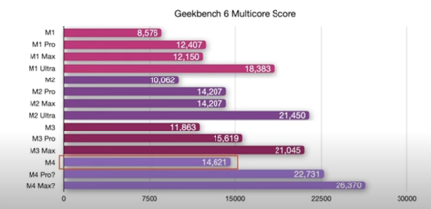
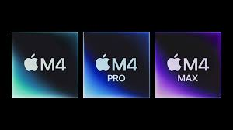


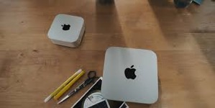

Apple M4 Chip
October 28,29,30 - M4 announcements from Apple
(shipping starts November 8th):
M4 iMac 24" - up to 32GB RAM
M4 Mac mini - up to 64GB RAM
M4 MacBook Pro & Max 14" & 16"
- up to 128GB RAM
M4 is ~20% faster, a bit longer battery life
Apple Intelligence (iOS 18.1) - has some cool features like notification rollups and describing albums in Apple Photos, but overall it's not very impressive.

Slide 6
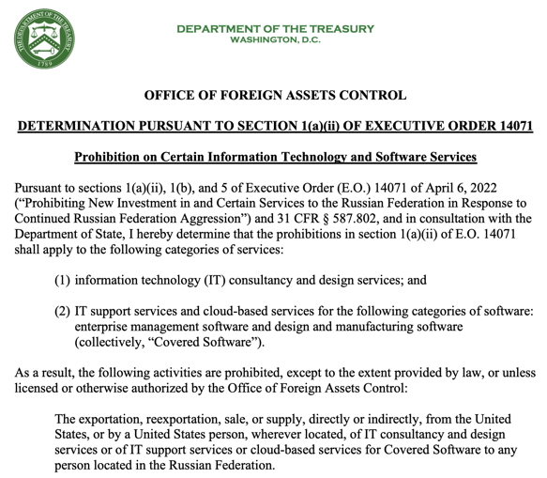
Linux Patch
In October 2024, a patch was merged into the Linux kernel removing many maintainers with Russian email addresses, citing "compliance requirements."
Linus Torvalds, the creator of Linux, defended the patch, stating it was due to US sanctions against Russia
James Bottomley, a prominent Linux kernel developer, clarified that anyone on the US sanctions list cannot be a maintainer.
https://ofac.treasury.gov/media/932951/download?inline
https://www.youtube.com/watch?v=u4PMwpMGTdY

Slide 7
Text to Video
https://notebooklm.google.com/
https://www.youtube.com/watch?v=oSuXs0w1PPY
Google's Notebook LM is gaining popularity and has released new features, including AI podcast feature, the ability to customize podcasts and a business edition.
Upload the documents or provide a web link
select "Generate" option under "Audio overview."
"File" menu, select "Export audio" ...
NotebookLM itself can not convert audio to video.
But we can use other services.
https://www.revid.ai
https://www.descript.com
https://www.kapwing.com/video-editor
google for:
ai text to audio
ai text to video
ai text to podcast
https://www.zdnet.com/article/googles-ai-podcast-tool-transforms-your-text-into-stunningly-lifelike-audio-for-free/
Google's illuminate - the tool trained on AI & science-related Arxiv papers - https://illuminate.google.com
Here are many podcasts converted to animated videos:
https://www.youtube.com/@RohanPaul-AI/videos

Slide 8
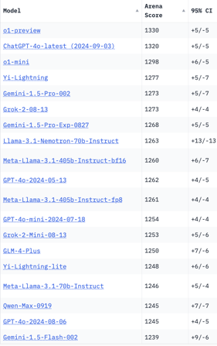
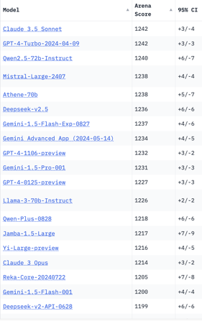
Crowd-sourced "Arena" Leaderboard
Total #models: 157.
Total #votes: 2,118,851.
Last updated: 2024-10-22.
Starting Elo rating = 1000
95% CI = Confidence Interval
https://chat.lmsys.org/?leaderboard
English-only queries
China
x.ai
x.ai
China
China
China

Slide 9
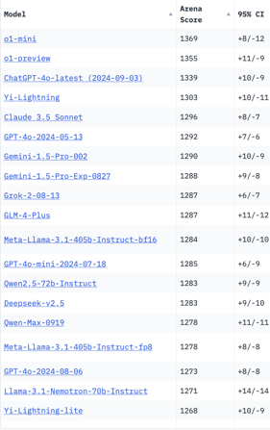
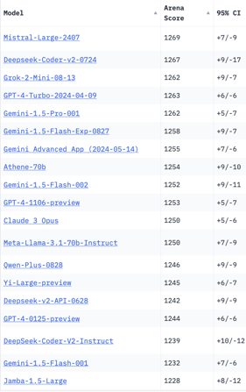
Crowd-sourced "Arena" Leaderboard
Total #models: 157.
Total #votes: 2,118,851.
Last updated: 2024-10-22.
Starting Elo rating = 1000
95% CI = Confidence Interval
https://chat.lmsys.org/?leaderboard
Coding
x.ai
China
x.ai
China
China
China
China

Slide 10
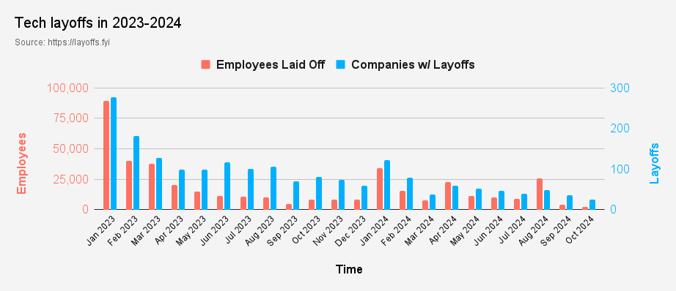
Tech Layoffs in 2024
Layoffs - https://layoffs.fyi
Job market for IT: much worse than before COVID.
IT has become a commodity. Lower salaries/rates ($100/hr => $75/hr).
Much more competition, hundreds of applications for each position

Slide 11


About the Speaker
Lev Selector, Ph.D.
40+ years of software engineering, data science, and building teams (hiring, training, and managing)
Ph.D. in mathematical modeling and computer simulations
Interests:
Generative AI, Using LLM with your data
Local AI for Local Private Data
Cloud architecture, fin-tech, application security
Find/connect: Linkedin, GitHub, YouTube, Google
https://eais.ai
Enterprise AI Systems

Slide 12
Thank You!

