Slide 1

AI Updates
April 4, 2025
Elon Musk Merges xAI and X
Alibaba Qwen Models
"Oversinking" - thinking too much
Yann LeCun "No Way In HELL AGI In 2 Years"
Chain-of-Tools
Nvidia Quantum Research Center
GPT-4o update surpasses GPT-4.5
Mixture-of-Mamba - a new State Space Model (SSM)
Extropic AI chips aiming to outperform Nvidia
Nova Act - Amazon's AI for web browser automation
Humanoid Robots
Find billion dollar idea
Ollama for coding in PyCharm or VS Code
scikit-learn on GPU
OpenVLThinker-7B - Visual Reasoning
Cursor limits content length to 70k tokens
Anthropic - How LLMs "think"
20 ideas for a startup
Zhipu AI GLM series of models
Google TxGemma - open models for Drug Discovery
Isomorphic Labs - Alphabet’s AI drug discovery
Mistral: Ministral 8b - model for Edge & privacy
Runway's Gen-4 AI Video Generator
OpenHands 32B LM for software Engineering
Crowd-sourced "Arena" Leaderboard
Jobs

Slide 2


Elon Musk Merges xAI and X
xAI - an AI startup, has officially acquired X (formerly Twitter) in an all-stock deal.
The move merges two of Musk’s ventures into one to unify data, infrastructure, and distribution under one roof.
Valuations: xAI at $80 billion and X at $33 billion
X.ai and X.com bring together models, compute, talent, 600+ million users, massive amounts of data and a live testing ground for AI applications
Musk is positioning xAI to compete head-to-head with OpenAI, Google DeepMind, and Anthropic. He’s already poached top AI talent, built large-scale infrastructure, and launched Grok 3, a model rivaling industry leaders in key benchmarks.

Slide 3


Alibaba Qwen Models
Alibaba Qwen models:
Proprietary:
Qwen2.5-Max (Jan 2025) - outperforms GPT-4o and DeepSeek-V3 accessible via API, Alibaba Cloud and Higging Face
Open source models:
Qwen2.5-32B (Feb 26)
QwQ-32B (March 6) - reasoning
QVQ-Max (March 28) - 32B visual reasoning model https://qwenlm.github.io/blog/qvq-max-preview/
Qwen2.5-VL-32B-Instruct (March 24) - multimodal
Qwen2.5-Omni-7B (March 26) multimodal, small, cost effective
The main scientists and contributors behind the creation of Qwen models include:
Zhibin Gou: A core contributor with a background linked to Tsinghua University.
Zhihong Shao: Another key contributor from Tsinghua University, who has co-authored papers with Nan Duan (Microsoft Research Asia (MSRA)).
Zhenda Xie: A notable contributor to the development of Qwen models.
An Yang: Credited as the submitter of the Qwen Technical Report on arXiv
QVQ-Max - visual reasoning model
https://qwenlm.github.io/blog/qvq-max-preview/

Slide 4
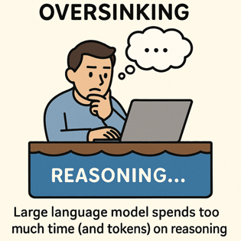
Oversinking - thinking too much
The Danger of Overthinking
The Danger of Overthinking: Examining the Reasoning-Action Dilemma in Agentic Tasks - https://arxiv.org/abs/2502.08235
The AI Reasoning Paradox: Why Agents FAIL - https://www.youtube.com/watch?v=vpNmKN2szt8
oversinking = spending too much time on internal reasoning rather than taking effective actions. Som models take x41 times more tokens than others for reasoning. Higher oversinking scores strongly correlate with lower task success rates
Three symptoms of oversinking: (1) Analysis paralysis: Extensive planning with minimal concrete actions; (2) Rouge actions: Taking actions without waiting for feedback; (3) Premature disengagement: Terminating tasks based on internal assessment
Counter-measures:
Length budgeting
System/model switching
Parallel search
Reinforcement learning with length rewards
Subquadratic attention (Mamba ?)

Slide 5
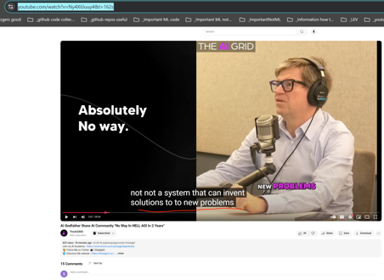
Yann LeCun "No Way In HELL AGI In 2 Years"
Yann LeCun, AI Godfather: "No Way In HELL AGI In 2 Years"
https://www.youtube.com/shorts/MCyZDrrvwvM
https://www.youtube.com/watch?v=Ny4XilJuuy4&t=162s
okay so the first thing you can say is we are not going to get to human level AI by just scaling up LLMs, this is just not going to happen.
There's no way, absolutely no way and whatever you can hear from some of my more adventurous colleagues, it's not going to happen within the next two years.
There's absolutely no way in hell to, pardon my French, the idea that we we're going to have, a country of Genius in the data center. That's complete BS. There's absolutely no way.
What we're going to have maybe is systems that are trained on sufficiently large amounts of data, that any question that any reasonable person may ask will will find an answer through those systems.
And it would feel like you have a PhD sitting next to you. But it's not a PhD you have next to you, it's a system with gigantic memory and retrieval ability. Not a system that can invent solutions to new problems which is really what a PhD is.

Slide 6
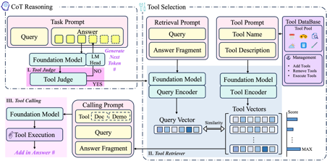
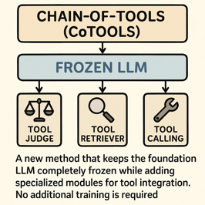
Chain-of-Tools
Chain-of-Tools: Utilizing Massive Unseen Tools in the CoT Reasoning of Frozen Language Models
https://github.com/fairyshine/Chain-of-Tools
https://arxiv.org/abs/2503.16779v1
Challenge - make LLMs use many tools efficiently. Including tools it never seen before.
Chain-of-Tools (CoTools) is a new method that keeps the foundation LLM completely frozen while adding specialized modules for tool integration. No additional training is required.
Three key components:
1) A Tool Judge that determines when to call tools during text generation by analyzing the hidden states of the LLM,
2) A Tool Retriever that selects appropriate tools by matching query vectors with tool vectors derived from tool descriptions, and
3) A Tool Calling component that handles parameter filling and execution.
CoTools outperforms baseline methods across multiple benchmarks
High performance even with hundreds or thousands of tools
For unseen tools specifically, CoTools achieved 10.4% top-1 accuracy and 33.7% top-5 accuracy, while the baseline couldn't handle unseen tools at all (0% accuracy).

Slide 7
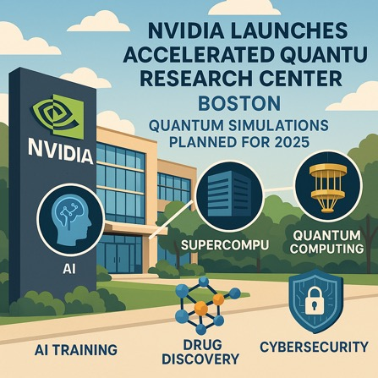
Nvidia Quantum Research Center
Nvidia Accelerated Quantum Research Center (NVAQC)
In Boston, Street address location is not known yet
NVAQC plans to start running quantum simulations in 2025
https://www.youtube.com/watch?v=ZatGE3f1Rl0
https://www.threads.net/@businessnews100/post/DHcxN2AotOZ
https://www.nvidia.com/en-us/solutions/quantum-computing/accelerated-quantum-center/
Idea - integrate AI, supercomputing, and quantum computing
Use AI to help with error correction in quantum computers (boost quantum stability)
NVAQC will do large-scale simulations (quantum processors + classical computers + AI)
Nvidia collaborates with Quantinuum, QuEra, Quantum Machines, Harvard, MIT
Hybrid quantum computing platforms - DGX Quantum and CUDA-Q
Poosible applications - AI training, drug discovery, cybersecurity

Slide 8
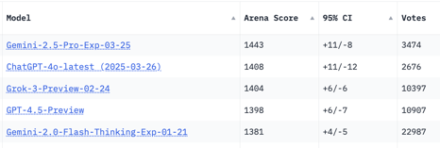
AI Updates 1
Anthropic - How LLMs "think"
Anthropic has developed a new method for peering inside large language models (LLMs) like Claude.
How LLMs process information and make decisions.
The research was published in two papers (links below).
They used "circuit tracing methodology"
The models plan ahead when writing poetry
The models use the same internal blueprint to interpret ideas regardless of language
Sometimes even work backward from a desired outcome instead of simply building up from the facts.
https://transformer-circuits.pub/2025/attribution-graphs/methods.html
https://transformer-circuits.pub/2025/attribution-graphs/biology.html
GPT-4o update surpasses GPT-4.5
Better at following detailed instructions and complex technical and coding problems, Improved intuition and creativity, text-to-image
https://help.openai.com/en/articles/6825453-chatgpt-release-notes
https://openai.com/chatgpt/team/
https://x.com/OpenAI/status/1905331956856050135
20 ideas for a startup
https://x.com/gregisenberg/status/1906066968068719016
Zhipu AI (since 2019, China's startup from a Tsinghua University) has developed the GLM series of models. GLM4 outperforms OpenAI's GPT-4. Funded by government. Released a free AI agent called AutoGLM Rumination . It uses Zhipu's proprietary models (GLM-Z1-Air and GLM-4-Air-0414). GLM-Z1-Air matches DeepSeek's R1 in performance while running up to x8 times faster and requiring only 1/30 of the computing resources. It will be available for free (compare to $199/mo for Manus)
https://www.reuters.com/technology/artificial-intelligence/chinas-zhipu-ai-launches-free-ai-agent-intensifying-domestic-tech-race-2025-03-31/
OpenVLThinker-7B - A RL-Model for Complex Visual Reasoning and Step-by-Step Problem Solving in Multimodal Systems (UCLA - University of California, Los Angeles) https://www.marktechpost.com/2025/03/28/ucla-researchers-released-openvlthinker-7b-a-reinforcement-learning-driven-model-for-enhancing-complex-visual-reasoning-and-step-by-step-problem-solving-in-multimodal-systems/
Cursor limits content length to 70k tokens https://forum.cursor.com/t/the-whole-200k-context-window-of-claude-3-7-sonnet-max/69736

Slide 9
AI Updates 2
Google TxGemma - open models for Drug Discovery
https://www.infoq.com/news/2025/03/txgemma-google-deepmind/
https://developers.googleblog.com/en/introducing-txgemma-open-models-improving-therapeutics-development/
TxGemma predicts and explains its drug effectiveness predictions.
Trained on 7 Mln examples
Three sizes: 2B, 9B, and 27B parameters
Classification – Predicting whether a molecule can cross the blood-brain barrier.
Regression – Estimating drug binding affinity.
Generation – Inferring reactants from chemical reactions.
In benchmark tests, the 27B Predict model outperformed or matched specialized models on 64 of 66 key tasks.
TxGemma-Chat - researches can ask questions, multi-turn discussions.
A fine-tuning example Colab notebook, allowing researchers to adjust the model for their own data.
Agentic-Tx - multi-step research Agent workflow
Mistral: Ministral 8b - model for Edge & private computing
https://openrouter.ai/mistral/ministral-8b
Eefficiency in knowledge-intensive tasks, commonsense reasoning, and function-calling
Specialized interleaved sliding-window attention mechanism, enabling faster and more memory-efficient inference.
Ministral 8B excels in local, low-latency applications such as offline translation, smart assistants, autonomous robotics, and local analytics.
Up to 128k context length
Can function as a performant intermediary in multi-step agentic workflows
Outperforms comparable models like Mistral 7B across benchmarks
Runway's Gen-4 AI Video Generator
maintains character and scene consistency across different shots and angles
Users can generate 5-10 second clips at 720p resolution
The model uses reference images and descriptions to create consistent outputs
Isomorphic Labs - Alphabet’s AI drug discovery platform raises $600M from Thrive
accurately predicting the 3D structure, model biological systems, predict drug interactions within body, design novel therapeutic molecules, accelerating Drug Discovery, collaboration with large pharmaceutical companies
https://techcrunch.com/2025/03/31/alphabets-ai-drug-discovery-platform-isomorphic-labs-raises-600m-from-thrive/
OpenHands LM - 32B model for software Engineering
https://x.com/allhands_ai/status/1906760162406285442 a 32B model with matching performance on software engineering tasks benchmarks like SWE-Bench Verified. This is 20 times smaller than the DeepSeek model!

Slide 10
AI Updates 3
Mixture-of-Mamba - a new State Space Model (SSM)
Mixture-of-Mamba: Enhancing Multi-Modal State-Space Models with Modality-Aware Sparsity
https://arxiv.org/abs/2501.16295v1
Multi-modal pretraining (text, image, speech).
1.4B parameters, requires much less FLOPs (25-42% of base model)
Extropic startup - AI chips, aiming to outperform Nvidia https://opentools.ai/news/extropic-the-startup-challenging-nvidias-ai-dominance
Nova Act - Amazon's AI for web browser automation
xxxx
https://labs.amazon.science/blog/nova-act

Slide 11
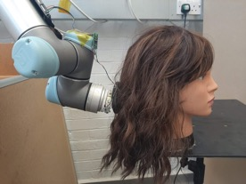
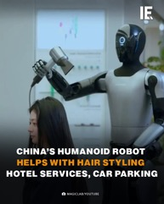
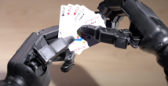
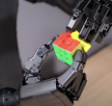
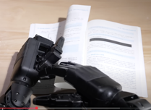
Humanoid Robots
Robots brush and style your hair
Unitree Dex5 Dexterous Hand
https://www.youtube.com/watch?v=0rwYOa7pJCs

Slide 12
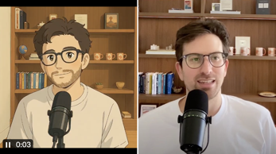
Find billion dollar idea
Framework to find the next cursor-like billion dollar idea
by Greg Isenberg:
look for skilled professionals who spend 6+ hours a day in a specific software tool - the more arcane, the better
identify tasks within their workflow that require deep expertise but follow patterns - these are ripe for ai assistance
focus on industries with high hourly rates ($100+) where time savings translate directly to revenue or cost reduction
seek workflows with specialized vocabulary that generic ai struggles with but domain-specific ai could master
prioritize tasks that involve both creativity and technical constraints - the sweet spot for human-ai collaboration
build for existing interfaces people already know rather than forcing new workflows
start with a tiny, almost embarrassingly specific niche - e.g., not "legal" but "divorce proceedings in california"
solve for the 80% case that's repetitive, leaving humans to handle the complex 20%
the best opportunities feel like "ai-enhanced superpowers" rather than "ai replacements"
if it can be on the cloud, that's a good sign
- https://x.com/gregisenberg/status/1906332104381620473
Just feed this post into Grok - and ask is to generate ideas :)

Slide 13
Ollama for coding in PyCharm or VS Code
How to use Ollama for coding in PyCharm or VS Code:
In PyCharm:
go to Settings > Plugins
and type ollama, AI, LLM, etc.
consider these plugins:
- ProxyAI : 4.24, 585K
- DevoxxGenie : 4.54, 16K
- MyOllamaEnhancer : 4.48, 2K
- OllamAssist : 4.04, 3K
In VS Code go to extensions - and search:
@popular ollama
@popular copilot
@popular ChatGPT
For example:
- Codeium (creators of Windsurf)
- Cline
- ChatGPT Copilot (works with Ollama)
- Ollama Autocoder
- Ollama Copilot
- ...
Qwen2.5-32B
QwQ-32B - reasoning too much
mistral-Small
Mistral-Codestral
gemma3:27b
DeepSeek-R1
DeepSeek V3.1 Coder
OpenHands LM - 32B
abacus.ai AppLLM for Vibe coding

Slide 14
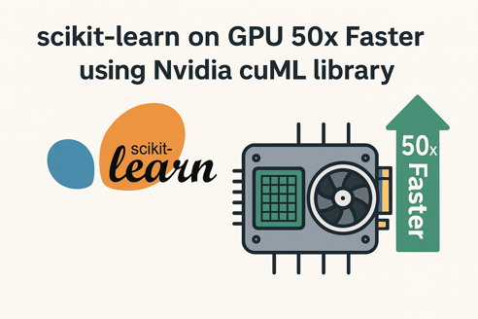
scikit-learn on GPU
Nvidia "cuML" can accelerate scikit-learn
up to 50 times faster for some algorithms
Supported algorithms include random forests, k-means clustering, principal component analysis (PCA), and others.
Unsupported operations automatically fall back to CPU execution.
To enable GPU acceleration, you simply load the cuML extension in your Python environment:
%load_ext cuml.accel

Slide 15
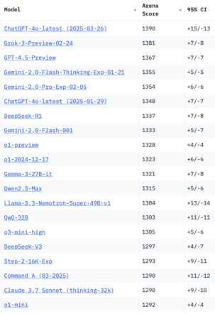
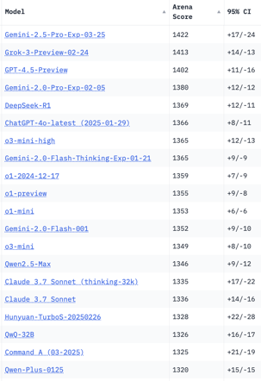
Crowd-sourced "LM Arena" Leaderboard
Total #models: 220
Total #votes: 2,816,680
Last updated: 2025-03-25
Starting Elo rating = 1000
95% CI = Confidence Interval
https://en.wikipedia.org/wiki/Elo_rating_system
https://chat.lmsys.org/?leaderboard
https://lmarena.ai/?leaderboard
English-only queries
Coding
x.ai
x.ai
China
China
China
China
China
China
China
China
Cohere
China
Cohere
China

Slide 16


About the Speaker
Lev Selector, Ph.D.
40+ years of software engineering, data science, and building teams (hiring, training, and managing)
Ph.D. in mathematical modeling and computer simulations
Interests:
Generative AI, Using LLM with your data
Local AI for Local Private Data
Cloud architecture, fin-tech, application security
Find/connect: Linkedin, GitHub, YouTube, Google
https://eais.ai
Enterprise AI Systems

Slide 17
Thank You!

