Slide 1


AI Updates
February 21, 2025
Grok 3
Perplexity Deep Research
D.O.G.E. Chatbot
SambaNova DeepSeek-R1 671B at ~200 tok/sec
Multi-Agent RL Framework
Nvidia Chips to China through Singapore
MoBA - Mixture of Block Attention
DeepHermes 3 Preview
Figure’s humanoid robot helps around the house
Thinking Machines Lab - Mira Murati
Microsoft OmniParser V2
Feds to use WASM for security Reasons
Reinforcement Learning for LLMs in 2025
Large Memory Model (LM2)
Microsoft Research Data Formulator
Fino1 - llama-3.1-8b for Finance
CMOS chip maps 70K synapses for 2K rat neurons
Competitive Programming with Large Reasoning
Enhance LLM reasoning with min data
OpenThinker-32B
Huginn-3.5B
Crowd-sourced "Arena" Leaderboard
Jobs

Slide 2
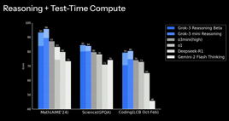
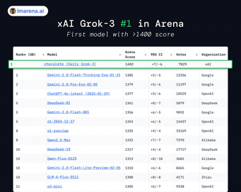
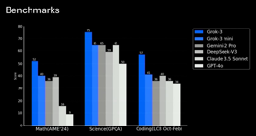
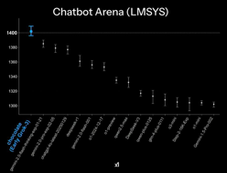
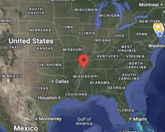
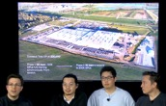


Grok 3
X.ai release Grok-3 on Monday https://x.com/i/grok - limited free access Best short description (by Fireship): https://www.youtube.com/watch?v=b0XI-cbel1U
xAI Grok 3 Launch in 9 minutes: https://www.youtube.com/watch?v=BDseU-kmDYY
Andrej Karpathy about Grok 3: https://x.com/karpathy/status/1891720635363254772
X Premium+ plan with Grok 3 - $40/mo
"Think" and "Big Brain" buttons, fast inference
uses 200K GPUs H100 (Colossus Datacenter) (3231 Riverport Rd, Memphis, TN 38109)
50-150 MegaWatts
2.7 Trillion parameters (estimated)
Has a reasoning layer
100K GPUs added in 122 days

Slide 3
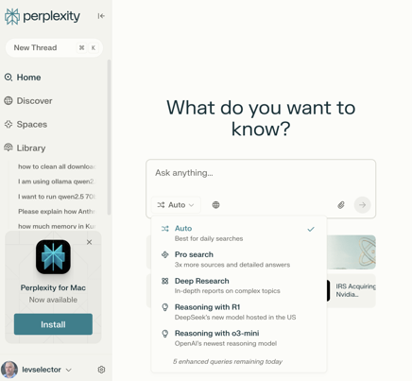
Perplexity Deep Research
Perplexity Deep Research
Perplexity Deep Research achieved a 93.9% accuracy score on the SimpleQA benchmark, substantially higher than competing models from OpenAI, Google and Anthropic
https://www.perplexity.ai/hub/blog/introducing-perplexity-deep-research
https://venturebeat.com/ai/perplexity-just-made-ai-research-crazy-cheap-what-that-means-for-the-industry/

Slide 4
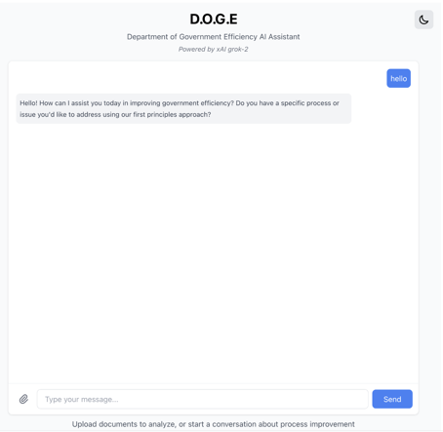
D.O.G.E. Chatbot
A senior Elon Musk staffer has created a custom AI chatbot that purports to help the Department of Government Efficiency eliminate government waste and is powered by Musk’s artificial intelligence company xAI, TechCrunch has learned.
https://techcrunch.com/2025/02/18/elon-musk-staffer-created-a-doge-ai-assistant-for-making-government-less-dumb/
https://www.documentcloud.org/documents/25531892-doge-chatbot-on-stanleys-website/

Slide 5
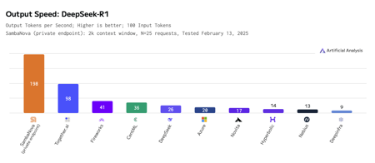
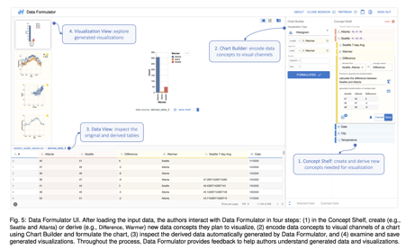
AI Updates - 1
SambaNova offers DeepSeek-R1 671B at ~200 tokens/sec https://sambanova.ai/press/fastest-deepseek-r1-671b-with-highest-efficiency
Reinforcement Learning for LLMs in 2025 https://www.youtube.com/watch?v=C4HxJQ2QzWo
Large Memory Model (LM2)
Memory-Augmented Transformer Architecture to handle long context
https://www.marktechpost.com/2025/02/12/convergence-labs-introduces-the-large-memory-model-lm2-a-memory-augmented-transformer-architecture-designed-to-address-long-context-reasoning-challenges/
Fino1 - llama-3.1-8b for Finance https://www.marktechpost.com/2025/02/18/meet-fino1-8b-a-fine-tuned-version-of-llama-3-1-8b-instruct-designed-to-improve-performance-on-financial-reasoning-tasks/
Microsoft Research Data Formulator - visualization authoring tool.
The tool can accept natural language instructions or examples for data derivation, reshaping, and visualization https://www.marktechpost.com/2025/02/14/microsoft-research-introduces-data-formulator-an-ai-application-that-leverages-llms-to-transform-data-and-create-rich-visualizations/

Slide 6

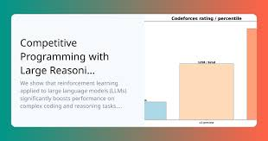
AI Updates - 2
CMOS chip map 70K synaptic connections between 2K rat neurons https://www.tomshardware.com/tech-industry/harvard-team-built-a-cmos-chip-to-map-70-000-synaptic-connections-between-2-000-rat-neurons
Harvard John A. Paulson School of Engineering and Applied Sciences
With time, the whole human brain may be possibly mapped into a single silicone chip ?
Open AI Paper "Competitive Programming with Large Reasoning Models"
https://arxiv.org/abs/2502.06807 - paper
https://www.youtube.com/watch?v=VnaKWiEoQZE - video by Matthew Berman
Reinforcement Learning + Verifiable Rewards
Compared OpenAI o1-ioi and an early checkpoint of o3.
Both achieve Gold Medal results on Math Olympiad, but o3 achieves it without any specialized training or pipelining.
These results indicate that scaling general-purpose reinforcement learning, rather than relying on domain-specific techniques, offers a robust path toward state-of-the-art AI in reasoning domains, such as competitive programming.

Slide 7
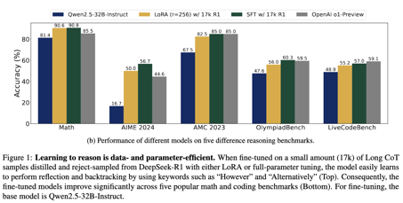
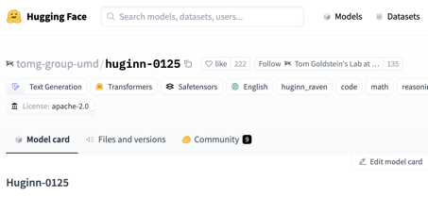
AI Updates - 3
Enhance LLM reasoning with minimal data
UC Berkeley - fine-tuned with only 17K CoT examples (not millions)
The team applied their method to the Qwen2.5-32B-Instruct model, leveraging both SFT and LoRA fine-tuning to achieve substantial performance improvements.
https://www.marktechpost.com/2025/02/14/this-ai-paper-from-uc-berkeley-introduces-a-data-efficient-approach-to-long-chain-of-thought-reasoning-for-large-language-models/
OpenThinker-32B - fine-tuned open-source version of Qwen / Qwen2.5-32B-Instruct on the OpenThoughts-114k dataset.
outperformed DeepSeek R1 and other major models despite using far fewer resources.
excels in math, coding, and logical reasoning
https://huggingface.co/open-thoughts/OpenThinker-32B
https://ollama.com/library/openthinker:32b
https://www.youtube.com/watch?v=KuVN6PksVig
Huginn-3.5B - latent reasoning and a unique recurrent depth technique, allowing it to refine answers internally without requiring massive computational power.
recurrent-depth model with 3.5B parameters, trained for 800B tokens on AMD MI250X machines.
This is a proof-of-concept model, but surprisingly capable in reasoning and code given its training budget and size
https://huggingface.co/tomg-group-umd/huginn-0125
https://www.arxiv.org/abs/2502.05171 - paper

Slide 8
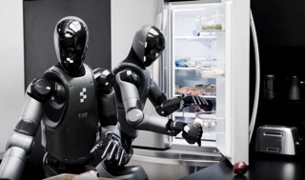
AI Updates - 4
Multi-Agent Reinforcement Learning Framework for Effective Social Deduction in AI Communication (Stanford)
https://www.marktechpost.com/2025/02/17/stanford-researchers-introduced-a-multi-agent-reinforcement-learning-framework-for-effective-social-deduction-in-ai-communication/
Nvidia Chips to China through Singapore
Singapore accounts for nearly 28% of Nvidia’s revenue for 2024, but only 1% of products are actually delivered into Singapore. Most of GPUs are re-routed to other countries (China, ...).
https://www.tomshardware.com/tech-industry/deepseek-gpu-smuggling-probe-shows-nvidias-singapore-gpu-sales-are-28-percent-of-its-revenue-but-only-1-percent-are-delivered-to-the-country-report
MoBA - Mixture of Block Attention for Long-Context LLMs
Instead of attending to every single token, the model learns to selectively focus on the most relevant blocks.
Kimi.ai - https://x.com/Kimi_Moonshot/status/1891825059599352259
https://github.com/MoonshotAI/MoBA
Figure’s humanoid robot takes voice orders to help around the house
https://techcrunch.com/2025/02/20/figures-humanoid-robot-takes-voice-orders-to-help-around-the-house/
DeepHermes 3 Preview - LLM by Nous Research
unifies Reasoning (long chains of thought that improve answer accuracy) and normal LLM response modes into one model
Model has also improved LLM annotation, judgement, and function calling.
https://www.youtube.com/watch?v=_PkCFwkfbdU

Slide 9

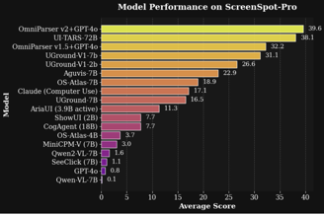
AI Updates - 5
Thinking Machines Lab - by Mira Murati, former CTO of OpenAI
https://x.com/miramurati/status/1891918876029616494
I started Thinking Machines Lab alongside a remarkable team of scientists, engineers, and builders. We're building three things:
- Helping people adapt AI systems to work for their specific needs
- Developing strong foundations to build more capable AI systems
- Fostering a culture of open science that helps the whole field understand and improve these systems
Our goal is simple, advance AI by making it broadly useful and understandable through solid foundations, open science, and practical applications.
https://thinkingmachines.ai
Microsoft OmniParser V2 - a tool to convert UI screenshots into structured, machine-readable data, enabling LLMs to understand and interact with various software interfaces.
https://www.marktechpost.com/2025/02/18/microsoft-ai-releases-omniparser-v2-an-ai-tool-that-turns-any-llm-into-a-computer-use-agent/
Feds to use WASM (Web Assembly) for security Reasons https://thenewstack.io/the-feds-push-for-webassembly-security-over-ebpf/

Slide 10
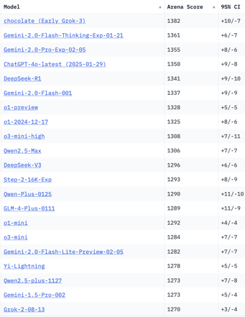
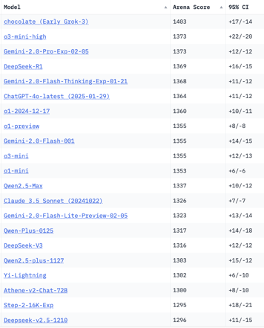
Crowd-sourced "Arena" Leaderboard
Total #models: 206
Total #votes: 2,694,155
Last updated: 2025-02-20
Starting Elo rating = 1000
95% CI = Confidence Interval
https://en.wikipedia.org/wiki/Elo_rating_system
https://chat.lmsys.org/?leaderboard
English-only queries
Coding
x.ai
x.ai
China
China
China
China
China
China
China
China
China
China
China
China
China
China
China
x.ai
China

Slide 11
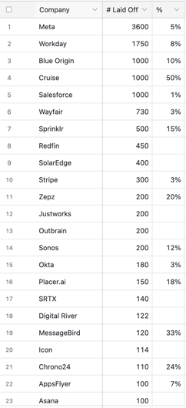

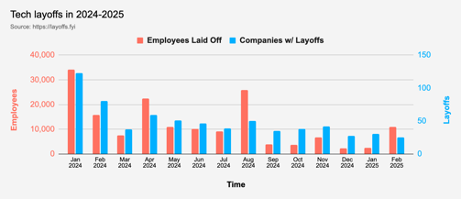
Jobs
Layoffs:
https://layoffs.fyi
https://techcrunch.com/2025/02/13/tech-layoffs-2024-list/
Google offers “voluntary exit” to all US platforms and devices employees
Microsoft has initiated performance based job cuts, resulting in immediate termination of affected employees without severance pay.

Slide 12


About the Speaker
Lev Selector, Ph.D.
40+ years of software engineering, data science, and building teams (hiring, training, and managing)
Ph.D. in mathematical modeling and computer simulations
Interests:
Generative AI, Using LLM with your data
Local AI for Local Private Data
Cloud architecture, fin-tech, application security
Find/connect: Linkedin, GitHub, YouTube, Google
https://eais.ai
Enterprise AI Systems

Slide 13
Thank You!

