Slide 1
AI Updates
December 20, 2024
In Progress
OpenAI Days - xxx
Microsoft Phi-4-14GB beats GPT-4o
NeurIPS 2024 - Ilya Sutskever's talk
Ventiva Laptop Cooling
New Google NotebookLM Update
AI News Generator - a Python script
Google Project Aristotle
Perplexity AI new features
Cohere command R7B model
DeepThought-8B
xxx
DeepSeek-V2
Devin via Slack, is worse than Cursor
LCM = Large Concept Model - by Meta
When AGI will be reached?
Lovable AI - from idea to app in seconds
Amazon Bedrock Prompt Router
Crowd-sourced "Arena" Leaderboard
Tech Layoffs in 2024

Slide 2
OpenAI Days
Day 8
xxx
Day 9
xxx
Day 10
xxx
Day 11
xxx
Day 12
xxx

Slide 3
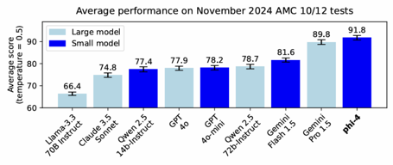
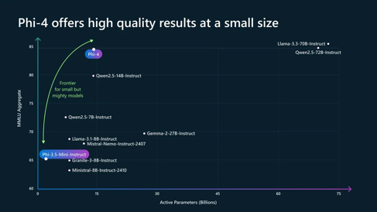
Microsoft Phi-4 beats GPT-4o
Microsoft Phi-4-14GB beats GPT-4o
https://www.youtube.com/watch?v=jfQrg1XG1S8
https://techcommunity.microsoft.com/blog/aiplatformblog/introducing-phi-4-microsoft%E2%80%99s-newest-small-language-model-specializing-in-comple/4357090
14 billion parameter model
good at question-answering and advanced problem-solving
Enhanced Training Data Quality, Synthetic + Human data
limited availability via Azure AI Foundry dev platform
Testing with Ollama - ollama run vanilj/Phi-4 .. https://www.youtube.com/watch?v=OcZSS37SUCE Results - it is failing at sorting, extracting, ...

Slide 4

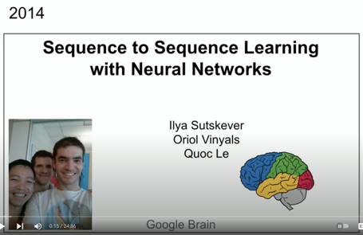
NeurIPS 2024 in Vancouver, Dec 10-15
NeurIPS 2024 - the 38th Annual Conference on Neural Information Processing Systems. Vancouver Convention Center. Dec 10-15
https://neurips.cc
Since 1987, Neuroscience and Computers
Deep learning, reinforcement learning, computer vision, natural language processing, ...
NeurIPS 2023 (New Orleans): Over 13,000 people attended in person, with another 3,000 participating virtually
Ilya Sutskever "Superintelligence is Self Aware, Unpredictable and Highly Agentic" | NeurIPS 2024 https://www.youtube.com/watch?v=1yvBqasHLZs

Slide 5
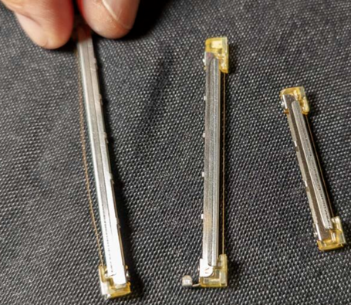
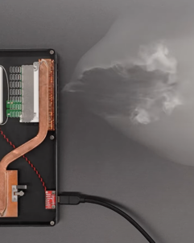
Ventiva Laptop Cooling
Ventiva laptop cooling - moves air by moving ionized air molecules within an electric field between two grids. ICE = Ionic Cooling Engine - quiet, energy efficient includes catalyst to convert ozone back to oxygen
https://www.youtube.com/watch?v=fyai_kUYhLs
https://ventiva.com

Slide 6
AI Updates 1
New Google NotebookLM Update
https://youtu.be/vF4KjwdxW8w?si=S_KDkUoe9qK67rzO
https://blog.google/technology/google-labs/notebooklm-new-features-december-2024/
A new interface, optimized for managing and generating new content based on your sources
Speak directly with the AI hosts during an Audio Overview
Perplexity AI new features:
Spaces - allows you to create custom GPTs and Claude projects
Instructions - automate tasks - create a PPC campaign
Use different AI models - GPT-4, Claude Sonnet
Use the Perplexity Chrome extension and the Perplexity API.
AI News Generator - a Python script using:
CrewAI
Google Search API - https://serpapi.com
Cohere's Command-R:7B model https://github.com/patchy631/ai-engineering-hub/tree/main/ai_news_generator https://github.com/patchy631 - good repo
Cohere command R7B model https://cohere.com/blog/command-r7b
DeepThought-8B - open source with reasoning https://www.ruliad.co/news/introducing-deepthought8b
DeepSeek-V2
A Strong, Economical, and Efficient Mixture-of-Experts - https://arxiv.org/abs/2405.04434 (June 2024)
236B total parameters, of which 21B are activated for each token, and supports a context length of 128K tokens
Open Source
80GB*8 GPUs for BF16 inference
https://huggingface.co/deepseek-ai
https://github.com/deepseek-ai
Deepseek is based in Hangzhou, China https://www.cbinsights.com/company/deepseek
Google Project Aristotle :
find characteristics of the perfect team.
Research found that the way team members interact is much more important than who is on the team.
Two key behaviors that contribute to team success are equality in conversational turn-taking and ostentatious listening.
When team members feel psychologically safe with each other, they are more likely to share their best ideas, work together effectively, and be innovative.
This psychological safety is created when team members feel comfortable speaking up and listened to.

Slide 7
AI Updates 2
Devin with Slack Interface and $500/mo vs Cursor
Devon is a Slack-based AI coding agent that can create plans, write code, find bugs, correct code, and run tests. It can also respond to feedback and attempt to address it. Good, but not reliable, not able to resolve all bugs, can give wrong instructions
Cursor is a more traditional AI coding agent that runs locally on the user's machine. Cursor's workflow is much easier to adopt and it is more reliable than Devon. Cursor was able to solve all of the bugs that he encountered.
So overall Cursor is a better AI coding agent than Devon.
https://www.youtube.com/watch?v=oU3H581uCsA
When AGI will be reached?
Sam Altman (OpenAI) thinks that Gen AI can be reached on current hardware
Mustafa Suleyman believes AGI (Artificial General Intelligence) is achievable, but will require 2-5 more generations of hardware. His definition of AGI includes physical labor capabilities, which he sees as a significant hurdle
Google Deepmind researcher believes that current AI models are already close to what would have been considered AGI a few years ago
Google CEO Sundar Pichai says AI development is slowing down, that the "low-hanging fruit" in AI development has been picked and further progress will require deeper breakthroughs
Ilya Sutskever predicts that the current approach to pre-training AI models on massive datasets will soon reach its limits, he anticipates a shift towards new and innovative training methods
OpenAI is building AI agents - and hiring people for developing AI agent infrastructure
LCM = Large Concept Model - by Meta
Large Context Model (LCM) developed by Meta.
LCM operates on a higher level of abstraction, dealing with concepts instead of just words or characters
LCM uses an embedding space where sentences are represented as vectors.
LCM uses a diffusion process that helps refine the embeddings and make the model more robust to noisy or incomplete data.
LCM drawbacks - reliance on short sentences and the potential challenges in designing an optimal embedding space.
https://www.youtube.com/watch?v=y1MG0BCf3UU
https://arxiv.org/abs/2308.11466 - SONAR: Sentence-Level Multimodal and Language-Agnostic Representations (2023)
Lovable AI - https://lovable.dev - idea to app in seconds
Lovable AI - software tool to create stunning websites and applications 20 times faster than traditional coding.
The app is created by giving prompts to the language model.
Lovable AI is comparable with Bolt.new - another AI app builder
https://www.youtube.com/watch?v=qyD8n7oR5Is

Slide 8
AI Updates 3
Amazon Bedrock Prompt Router
announced at AWS re:Invent , currently in preview
Prompt Router dynamically routes prompts to the best-suited LLM for the task
helps you optimize the performance and cost
simplifies model selection (does it for you)
You can access Intelligent Prompt Routing through the AWS Management Console, the AWS SDKs, or the AWS CLI.

Slide 9
RAG 2.0
The Best RAG System On YouTube
https://www.youtube.com/watch?v=Kvf-Pr1LRe4
xxxxxxx

Slide 10
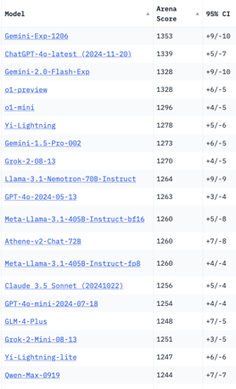
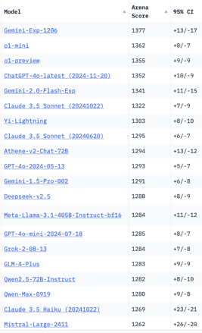
Crowd-sourced "Arena" Leaderboard
Total #models: 175.
Total #votes: 2,396,949.
Last updated: 2024-12-10.
Starting Elo rating = 1000
95% CI = Confidence Interval
https://chat.lmsys.org/?leaderboard
English-only queries
Coding
China
China
x.ai
x.ai
China
x.ai
China
China

Slide 11
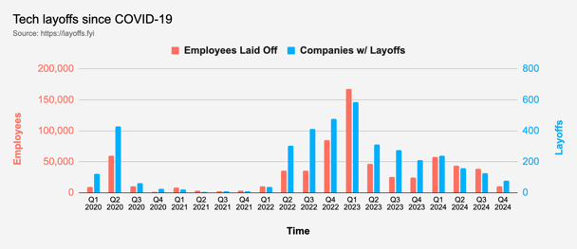
Tech Layoffs in 2024
Layoffs - https://layoffs.fyi
"Who is AI Replacing? The Impact of Generative AI on Online Freelancing Platforms" - paper October 2024
https://papers.ssrn.com/sol3/papers.cfm?abstract_id=4991774
The study found that AI tools have led to a decrease in demand for jobs in areas like writing and coding.
At the same time there is an increase in demand for individuals skilled in utilizing AI tools.
Legal: $8,000 work now can be done for only $3 in GPT credits.
Translation - mostly outsourced to AI
Phone Sales and Customer service
Job market for IT: much worse than before COVID.
IT has become a commodity. Lower salaries/rates ($100/hr => $75/hr).
Much more competition, hundreds of applications for each position

Slide 12
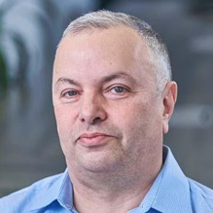

About the Speaker
Lev Selector, Ph.D.
40+ years of software engineering, data science, and building teams (hiring, training, and managing)
Ph.D. in mathematical modeling and computer simulations
Interests:
Generative AI, Using LLM with your data
Local AI for Local Private Data
Cloud architecture, fin-tech, application security
Find/connect: Linkedin, GitHub, YouTube, Google
https://eais.ai
Enterprise AI Systems

Slide 13
Thank You!

