Slide 1
AI Updates
November 17, 2023
HuggingFace LLM Leaderboard
Kai-Fu Lee - China OpenAI equivalent, 01.ai models
Amazon 'Olympus', Samsung "Gauss"
A fierce battle for AI talent
PixArt - transformer based diffusion (text-to-image)
How to create a Great dataset for training
OpenAI GPTs
ULTRA: Models for Knowledge Graph Reasoning
X.ai Grok written in Rust
HelixNet (actor + critic + regenerator)
Ollama and Gradio for local chat
Weights & Biases, Model's files, PyTorch tutorials
RAG Best Practices
DeepMind: Effective Prompt Seeds
NIPS = NeurIPS, Conferences, Kagle, HugginFace, Famous People
Rust, JAX vs PyTorch
etc. etc.

Slide 2
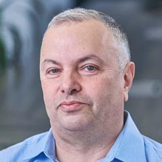

About the Speaker
Lev Selector, Ph.D.
40+ years of software engineering, data science, and building teams (hiring, training, and managing)
Ph.D. in mathematical modeling and computer simulations
Interests:
Generative AI, Using LLM with your data
Local AI for Local Private Data
Cloud architecture, fin-tech, application security
Find/connect: Linkedin, GitHub, YouTube, Google
https://eais.ai

Slide 3
HuggingFace LLM Leaderboard
https://huggingface.co/spaces/HuggingFaceH4/open_llm_leaderboard
https://huggingface.co/datasets/open-llm-leaderboard/results
https://huggingface.co/spaces/felixz/open_llm_leaderboard
https://huggingface.co/spaces/felixz/meta_open_llm_leaderboard
https://github.com/lselector/ai/blob/master/llm_leaderboard.py
Top model is only 34B parameters !
Rank | Model | Aver | Precision | Nparam
0 | 01-ai/Yi-34B (Yi, from 01.ai) | 68.68 | 16bit | 34
1 | MayaPH/GodziLLa2-70B (llama) | 67.01 | 16bit | 70
2 | sequelbox/StellarBright (llama) | 66.98 | 16bit | 70
27 | OpenBuddy/openbuddy-falcon-180b-v13-preview0 | 64.30 | 8bit | 178.64
48 | OpenBuddy/openbuddy-falcon-180b-v12-preview0 | 60.54 | 4bit | 178.64
57 | tiiuae/falcon-180B | 59.10 | 8bit | 179.52
95 | migtissera/SynthIA-7B-v1.3 (mistral) | 57.11 | 16bit | 7
104 | bhenrym14/mistral-7b-platypus-fp16 (mistral) | 56.89 | 16bit | 7
110 | yulan-team/YuLan-Chat-2-13b-fp16 (llama) | 56.36 | 16bit | 13
138 | meta-llama/Llama-2-70b-chat-hf (llama) | 54.98 | 16bit | 70
153 | Open-Orca/Mistral-7B-OpenOrca (mistral) | 54.51 | 16bit | 7
221 | Undi95/Mistral-11B-TestBench9 (mistral) | 53.06 | 16bit | 11
299 | Enno-Ai/vigogne2-enno-13b-sft-lora-4bit (llama) | 51.79 | 4bit | 13
421 | mistralai/Mistral-7B-v0.1 (mistral) | 50.32 | 16bit | 7
844 | davzoku/cria-llama2-7b-v1.3_peft (llama) | 44.74 | 4bit | 7
1594 | huashiyiqike/testmodel | 24.04 | 16bit | 0.15
Three More Tests (4 -> 7):
ARC (AI2 Reasoning Challenge) grade-school science
HellaSwag - common sense inference
MMLU - math, history, comp-science, law, ...
TruthfulQA - model's propensity to reproduce common falsehoods
Winogrande - large version of Winograd test ( https://arxiv.org/abs/1907.10641 ), an adversarial and difficult test for commonsense reasoning
GSM8k - diverse grade school math word problems
DROP - English reading comprehension (Discrete Reasoning Over Paragraphs)

Slide 4



Kai-Fu Lee - the venture capitalist and computer scientist wants to create an OpenAI equivalent for China
Kai-Fu Lee has started 01.ai in March 2023 with mission to make better AI accessible to more people. The startup’s ultimate goal, according to Lee, is to become an ecosystem where outside developers can build applications easily.
The company quickly grew to 100+ people and is valued at $1 Bln https://techcrunch.com/2023/11/05/valued-at-1b-kai-fu-lees-llm-startup-unveils-open-source-model/
Their first 34B model released in Nov 2023 tops the Huggingface Open Source LLM Leaderboard outperforming much bigger models https://huggingface.co/spaces/HuggingFaceH4/open_llm_leaderboard
https://01.ai - original 6B and 34B models - open-source, PyTorch
https://github.com/01-ai/Yi
https://www.modelscope.cn/models/01ai/Yi-34B/summary
The Yi series models are large language models trained from scratch by developers at 01.ai
The first public release contains two bilingual (English/Chinese) base models with the parameter sizes of 6B and 34B. Both of them are trained with 4K sequence length and can be extended to 32K during inference time
News 2023/11/05: The base model of Yi-6B-200K and Yi-34B-200K with 200K context length .
Kai-Fu Lee
AI Expert, Beijing, China
Columbia University (BSc)
Carnegie Mellon University (PhD)
Apple, SGI, Microsoft, Google,
former President of Google China,
CEO of Sinovation Ventures ($2B+)
https://www.linkedin.com/in/kaifulee/
https://en.wikipedia.org/wiki/Kai-Fu_Lee
2018
2021

Slide 5
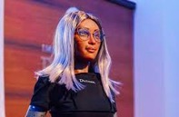
Misc
YouTube - testing Generative AI Features - a conversational tool for asking questions about content and getting recommendations and summarizing comment topics
Amazon is training a massive 2 Trillion params LLM 'Olympus' to rival OpenAI. Planning to use it in Alexa speakers and online platform. The project is led by former head of Alexa Rohit Prasad, now Amazon's head scientist for AGI. Its previous LLM ‘Titan’ was delayed following ChatGPT’s impressive launch.
PixArt - transformer based diffusion model that is 90% cheaper to train than UNet based models. It uses T5 text encodings, cross attention, and a diffusion transformer to great results at a fraction of the compute cost
RAG advanced technique - Small-to-big retrieval Retrieve small chunk, then retrieve bigger chunk around it.
https://towardsdatascience.com/advanced-rag-01-small-to-big-retrieval-172181b396d4
Samsung releases new "Gauss" LLM+Coding+txt2images
AI Copilots Are 'Redefining' Sales And Service Jobs, Says Salesforce AI's CEO
NeurIPS 2023 - Dec 10-16
37th Conference on Neural Information Processing Systems
AI negotiates legal contract without humans involved for first time
Mika is the world's first AI CEO at Dictador, a Polish alcohol-beverage company

Slide 6
Misc - 2
ROCm (Radeon Open Compute platform) allows to use CUDA+Python on AMD GPUs with latest Radeon Architecture "RDNA-3".
https://www.tomshardware.com/news/amd-enables-rocm-and-pytorch-on-radeon-rx-7900-xtx
An updated ROCm 5.7.1 driver for Ubuntu Linux brings PyTorch 2.0.1 support for "RDNA-3" based Radeon Pro W7900 (48GB) and Radeon RX 7900 XTX (24GB) graphics cards.
AMD ROCm is an open-source software platform giving you tools to port CUDA-based code to AMD native open-source HIP (Heterogeneous Computing Interface for Portability). HIP is ROCm's C++ dialect designed to ease conversion of CUDA applications to portable C++ code.
AMD cards are cheaper than Nvidia. A startup "Tinygrad" is planning to sell AI workstations (called "tinybox") with six RX 7900 XTX cards for $15K.
vLLM + AutoAWQ: Fastest Way To Serve LLMs
https://blog.devgenius.io/vllm-autoawq-fastest-way-to-serve-llms-973c8176c80a
serving Llama-7B-V2 with AutoAWQ using Nvidia’s Triton server
OpenAI and Google are locked in a fierce battle for AI talent
OpenAI's recruiters are focused on luring senior AI talent at Google working on models like Gemini. Offer $5-10 Mln/year, mostly in stock. Note - OpenAI nears completion of a major employee stock sale that could triple its valuation
OpenAI has also given raises to some junior employees due to market conditions
Google has also recently poached some high-profile researchers from OpenAI, in part by offering higher salaries
New AI chip projects, including Microsoft’s "Athena" and AMD’s MI300X, could provide hardware advantages to OpenAI versus Google's TPUs
Google SGE (Search Generative Experience) and translation updates
Nvidia RTX 4070, 4080, 4090 are being discontinued.
4090 Ti is rumored to be cancelled.
Instead we should expect the "Super" over-clocked options

Slide 7
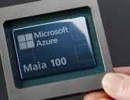
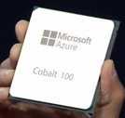
Misc - 3
Textbooks Are All You Need - Microsoft Research, 2023
https://arxiv.org/abs/2306.11644
We introduce phi-1, a new LLM for code with 1.3B parameters, trained for 4 days on 8 A100s, using a selection of “textbook quality” data from the web (6B tokens) and synthetically generated textbooks and exercises with GPT-3.5 (1B tokens).
Note (Nov 15) - MSFT announced Phi-2 - smaller and better
Microsoft AI chips:
GPU - Azure Maia 100 (a.k.a. Athena or M100)
CPU - Cobalt 100 - 128-core Arm lower power
Finetuning Llama 2 and Mistral - A beginner’s guide to finetuning SOTA LLMs with QLoRA
https://medium.com/@geronimo7/finetuning-llama2-mistral-945f9c200611
Analogical Prompting - New Prompting Approach From DeepMind
https://cobusgreyling.medium.com/a-new-prompting-approach-from-deepmind-called-analogical-prompting-1cd7daa8126d
Idea is to instruct LLM to:
- Recall relevant problems and solutions:
- Solve the initial Problem
- Provide a tutorial
ReAct Prompt Engineering (Reason + Act - two agents)
https://medium.com/@bryan.mckenney/teaching-llms-to-think-and-act-react-prompt-engineering-eef278555a2e
Meta - Emu Video and Emu Edit (not open-sourced yet)
https://ai.meta.com/blog/emu-text-to-video-generation-image-editing-research/
https://emu-edit.metademolab.com
https://emu-edit.metademolab.com/assets/emu_edit.pdf

Slide 8
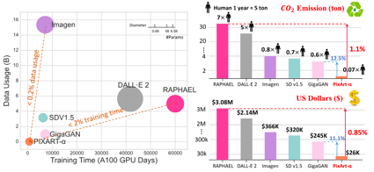
PIXART-α Text-to-Image
Training Time, Emissions, Cost
PixArt-α is an open-source Text-to-Image (T2I) transformer-based diffusion model. It has only 0.6B parameters, and takes x10 less training time: (675 vs. 6,250 A100 GPU days), ($26K vs $320K)
Its image generation quality is competitive with state-of-the-art image generators (e.g., Imagen, SDXL, and even Midjourney)
Three distinct training steps that separately optimize pixel dependency, text-image alignment, and image aesthetic quality;
Incorporate cross-attention modules into Diffusion Transformer (DiT) to inject text conditions and streamline the computation intensive class-condition branch;
High-informative data: We emphasize the significance of concept density in text-image pairs and use a large Vision-Language model to auto-label dense pseudo-captions to assist text-image alignment learning.
Work done at Huawei Noah's Ark Lab in Montreal, Canada
https://pixart-alpha.github.io
https://github.com/PixArt-alpha/PixArt-alpha
https://huggingface.co/PixArt-alpha
https://www.linkedin.com/pulse/pixart-building-cost-effective-text-imaget2i-model-arjuna-aqa-raxff/
https://www.reddit.com/r/StableDiffusion/comments/179fbb1/pixart%CE%B1_the_performance_of_sdlx_with_fewer/
https://huggingface.co/papers/2310.00426
https://arxiv.org/abs/2310.00426 (paper, 11 authors, October 2023)
Method | Type | #Params | #Images | A100 GPU days
DALL·E | Diff | 12.0B | 1.540B
GLIDE | Diff | 5.0B | 5.940B
LDM | Diff | 1.4B | 0.270B
DALL·E 2 | Diff | 6.5B | 5.630B | 41,660
SDv1.5 | Diff | 0.9B | 3.160B | 6,250
GigaGAN | GAN | 0.9B | 0.980B | 4,783
Imagen | Diff | 3.0B | 15.360B | 7,132
RAPHAEL | Diff | 3.0B | 5.000B | 60,000
PixArt-α | Diff | 0.6B | 0.025B | 675

Slide 9
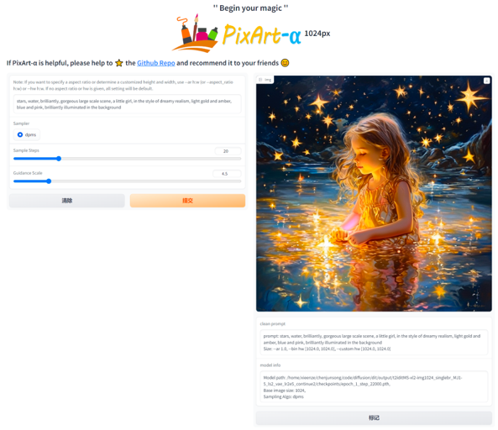

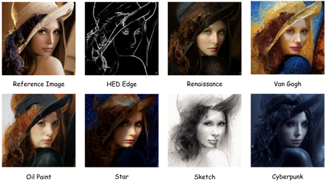
PIXART-α Text-to-Image

Slide 10
Great Dataset ==> Better, Smaller, Cheaper Model
Creating an instruction dataset to train an LLM
Clean and Preprocess - remove duplicates and noise (html tags, incorrect characters, formatting issues); standardize dates, numbers, etc.; split data into sentences or smaller parts (or combine if needed).
Categorize Sentences by topics or themes, identify the underlying intent or purpose of each sentence; Tag (label) sentences (manually or using NLP tools) - sentiment, subject matter, ...
Create Instruction Pairs (prompt,answer). Ensure variety of prompts.
Quality Checks. Check for biases, inaccuracies, and overall relevance.
Test Run using a subset of your dataset, adjust dataset as needed
Synthetic Data Generation (fill in gaps, increase diversity of volume in certain areas)
Check for Copyright and Privacy compliance
Check for Bias and Fairness
Use Dataset for Training
Format the data to be used for training (jsonl, parquet, ...)
Train/validation split
Select a Model and LLM Framework
Hyperparameter Tuning
Evaluate model's performance regularly - and make adjustments
Iterative Improvement using feedback loop - continually refine and improve your dataset and training approach

Slide 11
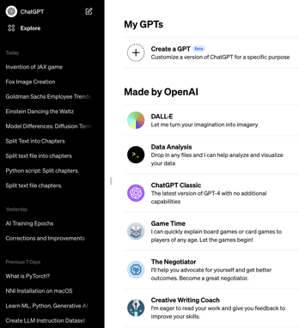
OpenAI GPTs
GPTs are a new way for anyone to create a tailored version of ChatGPT No coding required. And then one can share that "GPT" with others.
A GPT := name + description + instructions + extra knowledge
+ skills (web browsing, DALL-E 3, code interpreter)
https://artificialcorner.com/openai-just-released-gpts-create-your-own-chatgpt-and-make-money-from-it-no-coding-required-3d17d428389b
Name: _______________
Description: _____________________
Instructions: __________________________
Conversation starters: ___________________
Knowledge (Upload files): [____] [____] [____] [____]
Capabilities: {x] We Browsing, [x] DALL-E Image Generation, ...

Slide 12
ULTRA: Foundation Models for Knowledge Graph Reasoning
https://towardsdatascience.com/ultra-foundation-models-for-knowledge-graph-reasoning-9f8f4a0d7f09
https://deepgraphlearning.github.io/project/ultra
https://arxiv.org/abs/2310.04562
Foundation models in language and vision have the ability to run inference on any textual and visual inputs thanks to the transferable representations such as a vocabulary of tokens in language.
Knowledge graphs (KGs) have different entity and relation vocabularies that generally do not overlap. The key challenge of designing foundation models on KGs is to learn such transferable representations that enable inference on any graph with arbitrary entity and relation vocabularies.
We present ULTRA, an approach for learning universal and transferable graph representations.
ULTRA builds relational representations as a function conditioned on their interactions.
Such a conditioning strategy allows a pre-trained ULTRA model to inductively generalize to any unseen KG with any relation vocabulary and to be fine-tuned on any graph.
Conducting link prediction experiments on 57 different KGs, we find that the zero-shot inductive inference performance of a single pre-trained ULTRA model on unseen graphs of various sizes is often on par or better than strong baselines trained on specific graphs. Fine-tuning further boosts the performance.

Slide 13

X.ai announced Grok - Nov 4, 2023
https://x.ai
To create Grok, we built a custom training and inference stack based on Kubernetes, Rust, and JAX (Just After eXecution - library developed by DeepMind, Google)
Rust-based scalable, reliable, and maintainable infrastructure
Custom distributed system - maximizes useful compute per watt, handles failures.
Igor Babuschkin
import jax
import jax.numpy as jnp
import numpy as np
a = np.linspace(0.0,2.0,10)
b = np.zeros((10,20))
jnp_a = jnp.linspace(0.0,2.0,10)
jnp_b = jnp.zeros((10,20))
Benchmark | Grok-0 (33B) | LLaMa 2 70B | Inflection-1 | GPT-3.5 | Grok-1 | Palm 2 | Claude 2 | GPT-4
GSM8k | 56.8% 8-shot | 56.8% 8-shot | 62.9% 8-shot | 57.1% 8-shot | 62.9% 8-shot | 80.7% 8-shot | 88.0% 8-shot | 92.0% 8-shot
MMLU | 65.7% 5-shot | 68.9% 5-shot | 72.7% 5-shot | 70.0% 5-shot | 73.0% 5-shot | 78.0% 5-shot | 75.0% 5-shot + CoT | 86.4% 5-shot
HumanEval | 39.7% 0-shot | 29.9% 0-shot | 35.4% 0-shot | 48.1% 0-shot | 63.2% 0-shot | - | 70% 0-shot | 67% 0-shot
MATH | 15.7% 4-shot | 13.5% 4-shot | 16.0% 4-shot | 23.5% 4-shot | 23.9% 4-shot | 34.6% 4-shot | - | 42.5% 4-shot

Slide 14
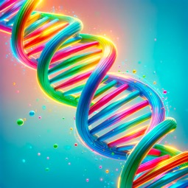
HelixNet
https://huggingface.co/migtissera/HelixNet
HelixNet (actor + critic + regenerator) a Deep Learning architecture consisting of 3 x Mistral-7B LLMs
The actor LLM produces an initial response to a given system-context and a question.
The critic LLM then takes in as input, a tuple of (system-context, question, response) and provides a critique based on the provided answer to the given system-context and the question. Its job is not to criticize, but to provide an intelligent critique so that the answer can be modified/regenerated to address the question better.
Finally, the regenerator LLM takes in a tuple of (system-context, question, response, critique) and regenerates the answer.

Slide 15

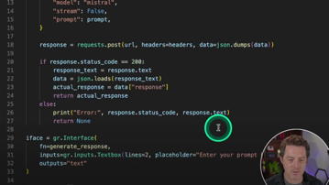
Local Chat using Ollama and Gradio
Ollama Is INSANE: Building Open-Source ChatGPT From Scratch (FULLY Local)
https://www.youtube.com/watch?v=rIRkxZSn-A8
https://gist.github.com/mberman84/a1291cfb08d0a37c3d439028f3bc5f26

Slide 16
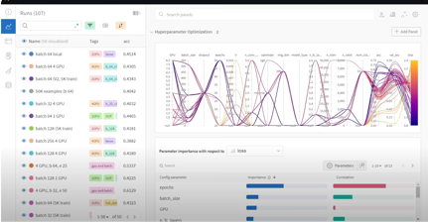
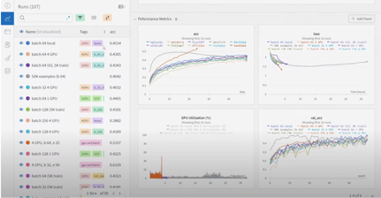
Weights & Biases
Weights & Biases is a platform and Python library to run experiments, log artifacts, automate hyperparameter tuning, and evaluate performance.
It is free for personal projects:
Unlimited Experiments
Unlimited Tracked Hours
100 GB storage and artifacts tracking
https://wandb.ai/site
https://docs.wandb.ai
https://docs.wandb.ai/quickstart
https://docs.wandb.ai/guides/track/environment-variables
WANDB_API_KEY=$YOUR_API_KEY
# Sign up for a free account at https://wandb.ai/site
! pip install wandb
wandb.login()
run = wandb.init(
project="my-awesome-project",
config={ "learning_rate": 0.01, "epochs": 10,}
)
for ... in ...:
...
wandb.log({"accuracy": acc, "loss": loss}) # send to server
wandb.finish()

Slide 17
Model Files
mistralai/Mistral-7B-v0.1 on HugginFace:
https://huggingface.co/mistralai/Mistral-7B-v0.1/tree/main
9.3G pytorch_model-00001-of-00002.bin
4.7G pytorch_model-00002-of-00002.bin
1.4K README.md
571B config.json
116B generation_config.json
23K pytorch_model.bin.index.json
72B special_tokens_map.json
1.7M tokenizer.json
482K tokenizer.model
966B tokenizer_config.json
# What is inside the big model files?
import torch
model = torch.load('pytorch_model-00001-of-00002.bin')
for kk in sorted(model.keys()):
print(kk, type(model[kk])
model.embed_tokens.weight torch.Size([32000, 4096])
model.layers.0.input_layernorm.weight torch.Size([4096])
model.layers.0.mlp.down_proj.weight torch.Size([4096, 14336])
etc.
# You can also see the list of all keys
# in file pytorch_model.bin.index.json
So the big model files are basically dictionaries containing tensors. The actual code that works with this tensors is under the transformers module:
cd ~/miniconda3/lib/
cd python3.11/site-packages/transformers/models
ls -1d */ | wc -l # 225 model directories
cd llama
2.6K __init__.py
9.0K configuration_llama.py
13K convert_llama_weights_to_hf.py
60K modeling_llama.py
22K tokenization_llama.py
13K tokenization_llama_fast.py
cd mistral
1.8K __init__.py
6.8K configuration_mistral.py
10K convert_mistral_weights_to_hf.py
58K modeling_mistral.py

Slide 18
PyTorch - Tutorials
PyTorch - ML framework to work with Neural Networks.
PyTorch was open-sourced in 2016 by Facebook.
Its basic data structure is a tensor - like Numpy array.
But a tensor can store gradient info to be used during back-propagation.
PyTorch has many functions to make development of Deep learning models easy.
Please look at these tutorials:
PyTorch Crash Course
https://www.youtube.com/watch?v=OIenNRt2bjg
Basic Tutorial:
https://github.com/lselector/python_tutorials/blob/master/PyTorch_tutorial.ipynb
Translation_Transformer
https://github.com/lselector/python_tutorials/blob/master/PyTorch_Translation_Transformer.ipynb

Slide 19
RAG Best Practices
Crafting Knowledgeable AI with Retrieval Augmentation:
A Guide to Best Practices - by Anthony Alcaraz
https://ai.plainenglish.io/crafting-knowledgeable-ai-with-retrieval-augmentation-a-guide-to-best-practices-33c84626be1e
Re-Ranking is All You Need? - by Fabio Matricardi
https://artificialcorner.com/re-ranking-is-all-you-need-7a6b1e586d48
A new Approach: Summarization + Re-Ranking.
1. Summarization - use models like BART or T5 fine-tuned on your data to extract salient points from lengthy retrieved texts
We can use more than one model and assign specific tasks to them
Use a slim T5 model to pre-process the documents creating a summary and extracting relevant questions
Suggested question are presented to the user up-front giving hints on the content of the text
2. Apply a Re-Ranking strategy on the retrieved chunks. You can use LangChain reranking pipeline for that. Use this reordered set of Documents - and inject in a strategic position the Summarization produced by the T5 model.
How to Re-rank?
https://github.com/baaivision/JudgeLM
https://huggingface.co/TheBloke/openchat_3.5-GPTQ
Extract the generations by Zephyr 7b on the same questions using simple re-ranking and re-ranking with Summary injection
Ask OpenChat to be the judge and score with reasoning the 2 models.

Slide 20
DeepMind: Effective Prompt Seeds
Example 1:
Prepend the following to the prompt:
"A little bit of arithmetic and a logical approach will help us quickly arrive at the solution to this problem."
Original prompt:
"Find the linear regression that describes this data."
Improved prompt:
"A little bit of arithmetic and a logical approach will help us quickly arrive at the solution to this problem. Find the linear regression that describes this data."
Large Language Models as Optimizers
https://arxiv.org/abs/2309.03409 - paper
Goal is to find instructions that maximize the task accuracy.
Proposing Optimization by PROmpting (OPRO) - an LLM generates new solutions from the prompt that contains previously generated solutions with their values
then the new solutions are evaluated and added to the prompt for the next optimization step.
Description:
https://towardsdatascience.com/new-deepmind-work-unveils-supreme-prompt-seeds-for-language-models-e95fb7f4903c
DeepMind’s preprint showed that, without any actual retraining or fine-tuning but just by optimizing prompts, we can make LLMs to work much better, and surely the same holds for other generative AI models.
AI systems will be capable of generating highly effective prompts on their own, making manual prompt engineering less necessary.
Example 2:
Prepend the following to the prompt:
"Analyze the given information, break down the problem into manageable steps, apply suitable mathematical operations, and provide a clear, accurate, and concise solution, ensuring precise rounding if necessary. Consider all variables and carefully consider the problem’s context for an efficient solution."

Slide 21
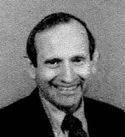
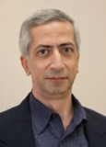
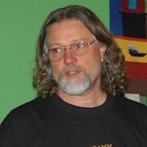
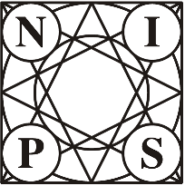
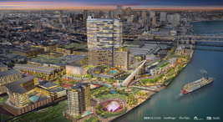
NIPS = NeurIPS
Ed Posner, CalTech,
First NIPS President, and founder of NIPS foundation
Yaser Abu-Mostafa,
CalTech
James Bower
CalTech, Oregon, Neuroscientist
NIPS Conference – held every December since 1987
NIPS = Neural Information Processing Systems
Renamed as NeurIPS
Founded by 3 CalTech scientists
https://nips.cc
https://papers.nips.cc
https://en.wikipedia.org/wiki/Conference_on_Neural_Information_Processing_Systems
1987-2000 – in Denver, USA
2001-2010 – in Vancouver, Canada
2011 – Granada, Spain
2012-2013 – Lake Tahoe, US
2014-2015 – Montreal, Canada (2.5K-3.7K participants)
2016 - Barcelona, Spain (5.7K participants)
2017 - Long Beach, California, US (8K+ participants)
2018 - Montréal, Quebec, Canada (12K participants
2019, 2020 - Vancouver, Canada (virtual, 13K, lottery for tickets)
2021 - Virtual
2022, 2023 - New Orleans, US

Slide 22
Some Conferences / Events
NIPS = NeurIPS - https://nips.cc/
ICLR = International Conference on Learning Representations - https://iclr.cc/
ICMLR = International Conference on Machine Learning in Robotics -
IntelliSys - https://saiconference.com/IntelliSys
IJCAI = International Joint Conferences on Artificial Intelligence - https://www.ijcai.org/
ICML = International Conference on Machine Learning - https://icml.cc/
UAI = Uncertainty in Artificial Intelligence - http://www.auai.org/
ICAPS = International Conference on Automated Planning and Scheduling - http://www.icaps-conference.org/
ICDM = IEEE International Conference on Data Mining - http://icdm2019.bigke.org/
O'Reilly AI Conference - https://conferences.oreilly.com/artificial-intelligence/ai-ny
Open Data Science Conference (ODSC) - https://odsc.com
The European Conference on Machine Learning and Principles and Practice of Knowledge Discovery in Databases - https://www.ecmlpkdd2019.org/
ICIP = IEEE International Conference on Image Processing - http://2019.ieeeicip.org/
CoRL = Conference on Robot Learning - https://www.robot-learning.org/
AI & Big Data Expo - https://www.ai-expo.net/northamerica/
AAAI Conference on AI (AAAI = Association for the Advancement of Artificial Intelligence) - https://aaai.org/Conferences/AAAI-20/
CVPR = Conference on Computer Vision and Pattern Recognition - http://cvpr2020.thecvf.com/ - http://www.wikicfp.com/cfp/program?id=628

Slide 23

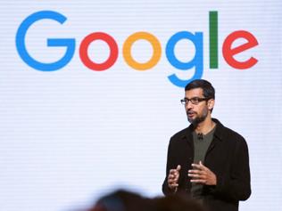
Kaggle
world's largest community of data scientists and machine learners
- since 2010
- acquired by Google in 2017
- more than 1 million registered users
- Kaggle Competitions
- Public Datasets
- Kaggle Kernels (Jupyter notebooks, code snippets)
Note:
Famous Netflix competition of 2009 was before Kaggle.
Netflix provided a training data set of 100,480,507 ratings
that 480,189 users gave to 17,770 movies.
Task was to improve recommendation engine.
Prize – 1 Mln $

Slide 24





Hugging Face
https://huggingface.co
Hugging Face is a platform for machine learning (ML) technologies.
It provides tools for building, training, and deploying ML models using open source code.
Hugging Face was launched in 2016 and is based in New York City. 20 Jay St Ste 620, Brooklyn, New York, 11201
Original product - a chatbot app for teenagers. It was open-sourced. Then the company pivoted to being a platform for ML.
Hugging Face raised $40M in Series B in 2021
In 2022 it was valued at $2Bln - and received $100M in Series C funding
In August 2023 raised $235M at $4.5Bln valuation
Key people: Clément Delangue (CEO), Julien Chaumond (CTO), Thomas Wolf (CSO)
Hugging Face is a community and data science platform for AI experts and enthusiasts.
It allows users to host their own AI models, train them, and collaborate with their team.
Hugging Face also provides libraries and tools for natural language processing (NLP) tasks.
Hugging Face's goal is to democratize machine learning. It makes money by charging for features such as access to computing power and higher levels of customer support. Hugging Face currently has 10,000 paying customers.
https://en.wikipedia.org/wiki/Hugging_Face
Main products - transformers, datasets, spaces, LLMs
Revenue $15M in 2022, estimated $30-50M in 2023
160 employees (2023) (per employee: $0.3M revenue, $30M value)

Slide 25
Most important advancements in deep learning and AI over the last 30 years
backpropagation algorithm in the 1970s by Geoff Hinton, David Rumelhart, and Ronald Williams
CNN - Convolutional Neural Network - in the 1980s by Yann LeCun (image recognition)
LSTM - long short-term memory - in the 1990s by Sepp Hochreiter and Jürgen Schmidhuber - gated RNN
AlexNet in 2012 by Alex Krizhevsky, Ilya Sutskever, and Geoffrey E. Hinton - using GPU for CNN
VGGNet in 2014 by Karen Simonyan and Andrew Zisserman - CNN
GoogleNet in 2014 - CNN, Google, many authors - inception modules
ResNet in 2015 - CNN, many authors
Attention, Transformer - 2016, 2017 - Google team. Google Translate.
GAN - Generative Adversarial Network - 2014 by Ian Goodfellow et al, generate realistic images
Diffusion models in 2020 - generate high-quality images without the need for adversarial training

Slide 26

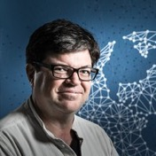
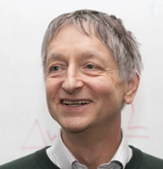
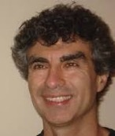

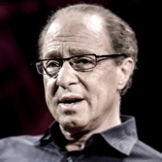

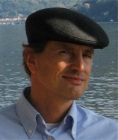
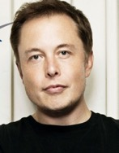
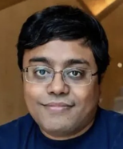
Andrew Ng
Yann LeCun
Geoffrey Hinton
Yoshua Bengio
Ian Goodfellow
Ray Kurzweil
Sepp Hochreiter
Jürgen Schmidhuber
Elon Musk
Emad Mostaque

Slide 27


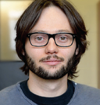
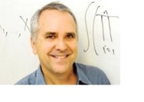
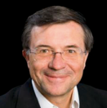


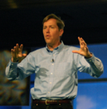

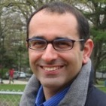

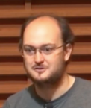



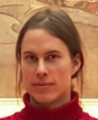

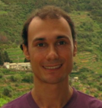
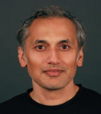
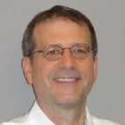
Hugo Larochelle
Michael I Jordan
Terry Sejnowski
Andrej Karpathy
Vincent Vanhoucke
Ruslan Salakhutdinov
Richard Socher
Sebastian Thrun
Jeffrey Hawkins
David M. Blei
Zoubin Ghahramani
Adam Coates
Pascal Lamblin
John Schulman
Alex Wiltschko
Tomas Mikolov
Alex Graves
Marc'Aurelio Ranzato
Shubho Sengupta
James D. McCaffrey

Slide 28
Rust Language - for AI
X.ai uses Rust
Microsoft invests $10-s of Millions into building Rust dev tools
Linux kernel - uses Rust for device drivers and other kernel modules
OpenAI uses Rust for developing and deploying ML models, training pipelines & model serving systems; Burn library to deploy models to web browsers; OpenAI Gym toolkit for developing and testing Reinforcement Learning algorithms; OpenAI Whisper speech-to-text model is written in Rust
Enthropic uses Rust for performance-critical components of real-time infrastructure - data streaming pipeline and some of the backend services
Meta uses Rust as a server-side programming language (along with C++, Python, and Hack)
Google - using JAX instead of TensorFlow. TF is gone
01.ai - uses PyTorch
Mistral - uses PyTorch

Slide 29


Jax vs PyTorch
Both are open-source libraries for doing array and matrix calculations in Machine Learning and Deep Learning
Both can run using GPU or TPU
Both support constructing of neural networks, gradient descent, autograd (automatic differentiation) for making back propagation calculations
PyTorch is developed by Meta AI (2016, in C++ with Python) https://pytorch.org
JAX is developed by Google (2018, in C++, Rust, Python) as a substitute to TensorFlow - https://github.com/google/jax
Both can use XLA (Accelerated Linear Algebra)
JAX uses Numpy arrays, PyTorch has its own tensor data structures
PyTorch uses eager execution ("Pythonic" dynamic flexibility), while JAX can run both interactively (slower) and compiled (using JIT compiler)
Compiled JAX can be faster and more optimized for some tasks, but PyTorch offers more interactive flexibility. PyTorch is generally easier to use, it is more mature, has larger support ecosystem
HuggingFace has support for both PyTorch and JAX
# -------PyTorch on Cuda or TPU
import torch
import torch.cuda
device = torch.cuda.device('cuda:0')
# import torch.xla.device
# device = torch.xla.device('tpu:0')
x = torch.tensor([1, 2, 3], device=device)
y = x + 2
print(y)
# -------JAX on Cuda or TPU
import numpy as np
import jax.numpy as jnp
import jax
devices = jax.local_devices(backend='gpu')
# devices = jax.local_devices(backend='tpu')
x = np.array([1, 2, 3])
xx = jnp.device_put(x, devices[0])
y = xx + 2
print(y)

Slide 30
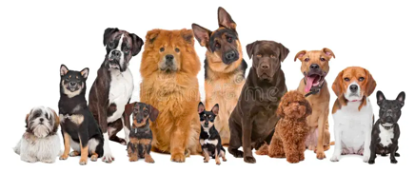

Trend - using Multiple Agents.
Can A Smarter Model be Created
by Combining Several "Stupid" Models?
?

Slide 31
Thank You!

