Slide 1
AI Updates
December 01, 2023
HuggingFace LLM Leaderboard
Elo Ranking Leaderboard
Inflection
Progress
together.ai, GNoME, OpenAI
Deep Learning History
ChatGPT Birthday
Security Vulnerability
Pika.art
SDXL Turbo
AI Telent Hiring Wars
Yann LeCun - why AGI should be Open Source
Running Models Locally
DeepLearning.AI RAG Course
CICERO from META
Efficient Dataset Distillation
Microsoft Gorilla
Casetext
Intuit adds AI
Training via Self-playing
Starling-7B from Berkeley
Spanish AI Influencer
Q*
LEDITS++
Graph RAG
The Research Agents
Candle - Rust ML Framework
Test Model for Bias, Safety, ...
GPU Water Cooling

Slide 2
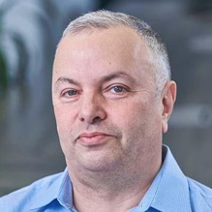

About the Speaker
Lev Selector, Ph.D.
40+ years of software engineering, data science, and building teams (hiring, training, and managing)
Ph.D. in mathematical modeling and computer simulations
Interests:
Generative AI, Using LLM with your data
Local AI for Local Private Data
Cloud architecture, fin-tech, application security
Find/connect: Linkedin, GitHub, YouTube, Google
https://eais.ai

Slide 3
HuggingFace LLM Leaderboard
https://huggingface.co/spaces/HuggingFaceH4/open_llm_leaderboard
https://huggingface.co/datasets/open-llm-leaderboard/results
https://huggingface.co/spaces/felixz/open_llm_leaderboard
https://huggingface.co/spaces/felixz/meta_open_llm_leaderboard
https://github.com/lselector/ai/blob/master/llm_leaderboard.py
Rank | Model | Aver | Precision | Nparam
0 | TigerResearch/tigerbot-70b-chat-v2 (llama) | 69.76 | 16bit | 70
1 | bhenrym14/platypus-yi-34b (llama) | 68.96 | 16bit | 30
2 | 01-ai/Yi-34B | 68.68 | 16bit | 30
32 | OpenBuddy/openbuddy-falcon-180b-v13-preview0 | 64.3 | 8bit | 178.64
62 | fblgit/juanako-7b-UNA (mistral) | 59.91 | 16bit | 7
70 | lvkaokao/mistral-7b-finetuned-orca-dpo-v2 (mistral) | 59.06 | 16bit | 7
72 | Intel/neural-chat-7b-v3-1 (mistral) | 59.01 | 8bit | 7
96 | microsoft/Orca-2-13b | 58.05 | 16bit | 13
110 | Intel/neural-chat-7b-v3-1 (mistral) | 57.5 | 4bit | 7
174 | meta-llama/Llama-2-70b-chat-hf (llama) | 54.98 | 16bit | 70
193 | NeverSleep/Mistral-11B-SynthIAirOmniMix (mistral) | 54.56 | 16bit | 11
195 | Open-Orca/Mistral-7B-OpenOrca (mistral) | 54.51 | 16bit | 7
290 | microsoft/Orca-2-7b | 53.02 | 16bit | 7
380 | Enno-Ai/vigogne2-enno-13b-sft-lora-4bit (llama) | 51.79 | 4bit | 13
405 | ValiantLabs/ShiningValiantXS (llama) | 51.47 | 16bit | 13
528 | mistralai/Mistral-7B-v0.1 (mistral) | 50.32 | 16bit | 7
1260 | Phind/Phind-CodeLlama-34B-v2 (llama) | 37.15 | 16bit | 30
1836 | wtang06/mpt-125m-c4 | 17.2 | 16bit | 0.12
Three More Tests (4 -> 7):
ARC (AI2 Reasoning Challenge) grade-school science
HellaSwag - common sense inference
MMLU - math, history, comp-science, law, ...
TruthfulQA - model's propensity to reproduce common falsehoods
Winogrande - large version of Winograd test ( https://arxiv.org/abs/1907.10641 ), an adversarial and difficult test for commonsense reasoning
GSM8k - diverse grade school math word problems
DROP - English reading comprehension (Discrete Reasoning Over Paragraphs)

Slide 4
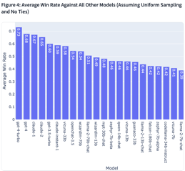
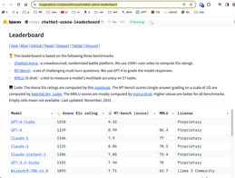
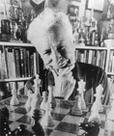
A Better LLM Leaderboard - lmsys
GPT-4-Turbo | 1210
GPT-4 | 1159
Claude-1 | 1146
Claude-2 | 1125
Claude-instant-1 | 1106
GPT-3.5-turbo | 1103
WizardLM-70b-v1.0 | 1093
Vicuna-33B | 1090
OpenChat-3.5 | 1070
Llama-2-70b-chat | 1065
WizardLM-13b-v1.2 | 1047
zephyr-7b-beta | 1042
Vicuna-13B | 1031
MPT-30B-chat | 1031
QWen-Chat-14B | 1030
falcon-180b-chat | 1024
zephyr-7b-alpha | 1024
CodeLlama-34B-instruct | 1022
Llama-2-13b-chat | 1021
Guanaco-33B | 1021
Mistral-7B-Instruct-v0.1 | 1008
Llama-2-7b-chat | 1001
https://www.youtube.com/watch?v=_RBAsItC6CU
A much better LLM Leaderboard!!! - by 1littlecoder
Problem with standard Open LLM Leaderboard - leaking tests into training data. A better solution - crowd-sourced "Arena" leaderboard: https://huggingface.co/spaces/lmsys/chatbot-arena-leaderboard
This leaderboard is based on the following three benchmarks.
Chatbot Arena - a crowdsourced, randomized battle platform. We use 100K+ user votes to compute Elo ratings.
MT-Bench - a set of challenging multi-turn questions. We use GPT-4 to grade the model responses.
MMLU (5-shot) - a test to measure a model's multitask accuracy on 57 tasks.
Arpad Emmerich Elo (1903 - 1992) was an American physics professor and a chess master from Milwaukee (Wisconsin, USA). Originally from Hungary. He has invented the "Elo rating system" for two-player games such as chess.

Slide 5
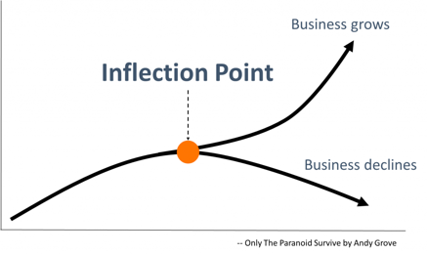


Misc
Inflection AI - creators of Pi. Why the name "inflection" ?
https://inflection.ai
The term "inflection" symbolizes the moment of significant transformation. Inflection is not a non-profit, but it is a "public benefit" corporation committed to prioritizing the well-being and happiness of its users and wider stakeholders

Slide 6

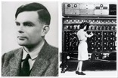
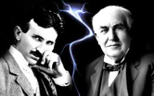


Progress
fire - 800,000 years ago
wheel - 6,000 years ago
electricity - 150 years ago
computers - 70 years ago
Deep Learning - 30 years ago
GenAI (ChatGPT, ...) - 1 year ago
AGI - in 3 years from now ?
AGI
GPT, ... AGI
-3 ... +3 years
Deep Learning
-30 years
Computers
-70 years
Electricity
-150 years
Wheel
-6K years
Fire
-1 Mln years

Slide 7
Misc
https://www.together.ai - San Francisco, CA - raised $102.5 Mln in Series A - Fastest cloud platform for building and running generative AI. Together AI’s research team is behind breakthroughs like FlashAttention, FlexGen, and CocktailSGD that are core to modern optimization, making Together Compute the most cost effective way to build new models with supercharged speed.
ChatGPT birthday - 1 year (Nov 30, 2022)
OpenAI's custom GPTs have a security vulnerability.
Researchers have demonstrated a 100% success rate in extracting files and system prompts from these chatbots
https://arxiv.org/pdf/2311.11538.pdf
Pika - generate videos, recent $55 Mln funding
https://pika.art
https://www.youtube.com/watch?v=6b10jGNNbXQ
https://www.reddit.com/r/aivideo/
Amazon launches Q generative AI–powered assistant to answer questions about your AWS systems.
GNoME (Graph Networks for Materials Exploration) - a new tool by Google DeepMind - just generated recipes for 2.2 million potentially stable new inorganic compounds. New materials include battery and solar cell components missed by prior algorithms.
SDXL Turbo from Stability AI - real-time text-to-image model using Adversarial Diffusion Distillation (ADD). How fast you can type ? https://stability.ai/news/stability-ai-sdxl-turbo
AI talent hiring wars. Banks are intensely competing to attract the best AI talent. Goldman Sachs has lost ~ 60 AI specialists to competitors, Bank of America lost 55; Wells Fargo gained a significant number of AI staff. AI professionals' median compensation in the U.S. reaching record highs.
OpenAI - Sam Altman is back as CEO, Mira Murati as CTO and Greg Brockman as President. Still negotiating with Ilya Sutskever about his role
Deep Learning History - by Jürgen Schmidhuber:
https://people.idsia.ch/~juergen/deep-learning-history.html
Yann LeCun - why AGI should be open source
- https://twitter.com/i/status/1728510229133119644

Slide 8
Misc 2
Casetext started out in 2013 as a crowdsourced law library. It was recently acquired for $650 Mln. Technologies - LLM, Python LangChain, etc.
https://www.ycombinator.com/blog/the-10-year-overnight-success-story-of-casetext/
https://www.youtube.com/watch?v=qFBUd0b8TjY
Running Models Locally:
GPT4All - open-source local app - https://gpt4all.io
MLC LLM - Machine-Learning Compilation - https://llm.mlc.ai - Open Source app to run LLM on all platforms
LMStudio - https://lmstudio.ai - closed source app
Intuit adds AI to its tax services: virtual tax expert, (GenAI)-powered TurboTax Online, Spanish language translations across all products, payments services
DeepLearning.AI - RAG course
https://www.deeplearning.ai/short-courses/building-evaluating-advanced-rag/
CICERO from Meta - an AI agent to play at a human level in Diplomacy, a strategy game that requires building trust, negotiating and cooperating with multiple players.
https://ai.meta.com/research/cicero/
25 => 250 tokens/sec - using pytorch compile, int4, speculative decoding - https://pytorch.org/blog/accelerating-generative-ai-2/
AlphaGo has become better than human players via playing not against humans, but against the second AlphaGo.
Similarly, better AI models will be probably created by training against each other (or using synthetic data)
Efficient Dataset Distillation via Minimax Diffusion - create surrogate datasets that are more diverse and representative while requiring significantly less computational resources
https://arxiv.org/abs/2311.15529v1
Starling-7B (Berkeley) - https://starling.cs.berkeley.edu - open LLM trained by RLAIF = Reinforcement Learning from AI Feedback. Performs better than Claude1,2 or GPT-3.5
Microsoft Gorilla - trained using RL, smarter than ChatGPT, self-instruct fine-tuning
https://gorilla.cs.berkeley.edu
https://arxiv.org/abs/2305.15334
https://www.youtube.com/watch?v=2ct81x-P2Ck
Spanish AI model earning $11K/month
https://www.euronews.com/next/2023/11/22/meet-the-first-spanish-ai-model-earning-up-to-10000-per-month
https://www.businessinsider.com/ai-influencer-aitana-clueless-agency-tech-spain-2023-11

Slide 9
Q*
Q* algorithm is the name of a rumored breakthrough in artificial intelligence research by OpenAI. The exact nature of the algorithm is unknown. It may be a combination of using Q-learning and A*-like search together for finding and returning correct answers
A* search algorithm (1968) - was created when building a mobile robot that could plan its own actions. A* was originally designed for finding least-cost paths when the cost of a path is the sum of its costs.
https://www.youtube.com/watch?v=Z6E41eXStsU
https://www.youtube.com/watch?v=mdFOprWy2S0
https://www.theverge.com/2023/11/29/23982046/sam-altman-interview-openai-ceo-rehired
https://qtransformer.github.io - Q-Transformer from Google Deepmind - Scalable Offline Reinforcement Learning via Autoregressive Q-Functions
https://github.com/lucidrains/q-transformer - Q-Transformer, Scalable Offline Reinforcement Learning via Autoregressive Q-Functions (Google Deepmind)
https://arxiv.org/abs/2305.20050 - Let's verify Step by Step - Process supervision significantly outperform outcome supervision
A* Search paper (2023) introducing Q* - https://arxiv.org/pdf/2102.04518.pdf
John Schulman (OpenAI, 2016) explains Q* - https://www.youtube.com/watch?v=PtAIh9KSnjo&t=3780s
RL = Reinforcement Learning.
Policy ( "π" ) is a function that takes a state "S" from the state space as input and returns an action "A" from the action space. It can be deterministic or stochastic.
On-Policy Learning - agent uses same policy for acting and for learning.
Off-Policy Learning - agent learns from the experience of a different policy (or policies). The most notable example of off-policy learning is the Q-learning algorithm where the agent learns the optimal policy regardless of the actions taken during exploration.

Slide 10
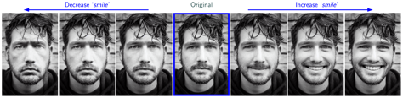

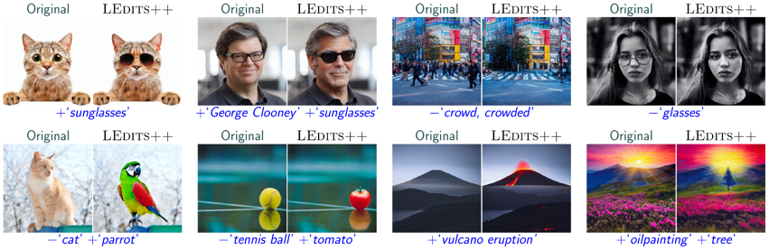
LEDITS++
LEDITS++: Limitless Image Editing using Text-to-Image Models
https://leditsplusplus-project.static.hf.space - from Machine Learning Group, Comp-Sci Dept, TU Darmstadt, Germany

Slide 11
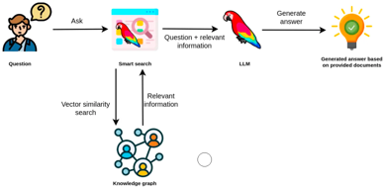
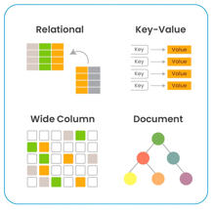
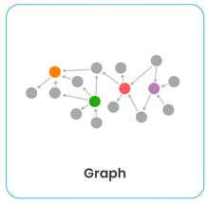
Graph RAG
RAG = Retrieval Augmented Generation - popular method of implementing semantic search using an LLM with external data storage typically implemented as a database capable of doing a similarity search over texts encoded into vectors (combination of a vector database and a relational database)
Graph RAG - uses a graph databases instead of a relational database
https://medium.com/@shobhan0304/how-can-graph-databases-help-in-enhancing-the-retrieval-augmented-generation-rag-capabilities-of-fa6b7b695dde
https://blog.langchain.dev/using-a-knowledge-graph-to-implement-a-devops-rag-application/
https://www.youtube.com/watch?app=desktop&v=9DxwgIKVSHY
https://github.com/facebookresearch/faiss/wiki - Facebook AI Similarity Search (Faiss)
Benefits of using a Graph Database for RAG:
Improved accuracy and relevance via using the knowledge graph
Better understanding of relationships - graph helps LLM to better understand the overall context of a query
Increased flexibility- graph databases can be easily extended to accommodate new information, which makes them well-suited for use with LLMs that are constantly learning and evolving

Slide 12
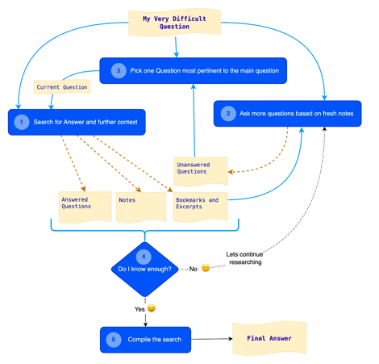
The Research Agent
The Research Agent: Addressing the Challenge of Answering Questions Based on a Large Text Corpus
https://towardsdatascience.com/the-research-agent-4ef8e6f1b741
https://github.com/rahulnyk/research_agent
Results:
"""The Research Agent is a big improvement over all the previous approaches I have tried. It yields more detailed and accurate answers than any other approach. I have been playing with this for a few weeks now, and I am surprised by the richness of the answers I get.
The Agent avoids the problem of hallucinations to a greater extent than any previous approach. It autocorrects the hallucinations and the factual errors it generates in the first few iterations, during later ones. The deeper it gets into a problem, the more accurately it yields the result."""

Slide 13
Candle - Rust ML Framework
Candle - new open-source framework written in Rust
https://github.com/huggingface/candle
https://blog.gopenai.com/python-is-out-of-favor-hugging-face-open-sources-a-new-ml-framework-which-written-in-rust-ee667831a0d0
current Candle already supports Llama2, Mistal, etc. https://github.com/huggingface/candle/blob/main/candle-examples/examples/llama/main.rs https://github.com/huggingface/candle/tree/main/candle-examples/examples/mistral
cargo run --example mistral --release --features cuda -- \
--prompt 'Write helloworld code in Rust' --sample-len 150
Generated text:
Write helloworld code in Rust
=============================
This is a simple example of how to write "Hello, world!" program in Rust.
## Compile and run
...

Slide 14
How To Test Model for Bias, Safety, etc.
Responsible AI tests
Tools to Identify and Mitigate Bias & Toxicity in LLMs
https://medium.com/@rajneeshjha9s/tools-to-identify-and-mitigate-bias-toxicity-in-llms-b34e95732241
A Practical Guide to Recognizing Bias in LLM Outputs
https://www.appypie.com/blog/recognizing-bias-in-llm-outputs
Ways to Monitor LLM Behavior
https://medium.com/@bijit211987/ways-to-monitor-llm-behavior-c068fba53932

Slide 15
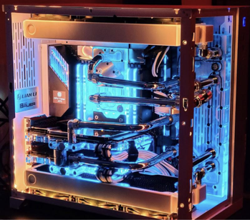
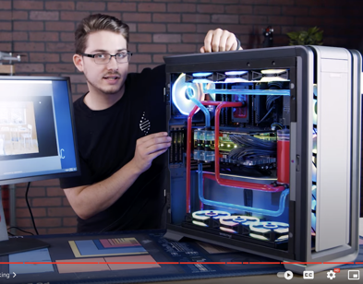
GPU Water Cooling
How To Build A Monster PC (Two 3090 GPUs | Liquid Cooling) - https://www.youtube.com/watch?v=MZSXwhkHNBE
Optimus - https://optimuspc.com/collections/waterblocks
Bykski - https://www.bykski.us/collections/gtx-rtx-3080-3090/
Discussion - https://www.reddit.com/r/watercooling/comments/yanxbx/waterblock_compatible_with_the_zotac_gaming/
Linux Tech Tips - https://www.youtube.com/watch?v=Pzh98abhAio&t=223s

Slide 16
Thank You!

