Slide 1
AI Updates
December 08, 2023
Google Gemini Released
Hugging Face LLM Leaderboard
Crowd-sourced "Arena" leaderboard
OpenAI App Store
Meta Purple Llama Safety Project
Meta text2image
Microsoft Copilot updates
Building Knowledge Graphs with LLM
Grok launch
S-LoRA
MLX framework for Apple Silicon
AI.gov
AI Alliance
Nvidia TensorRT-LLM
Axolotl
Zero-Shot Learning / Testing
Zephyr Models - helpful assistants
Streamlit
TaskWeaver vs AutoGen
Scaling Generative AI
LLM Parallelism
Generative AI Interview Questions
Microsoft Azure AI
Google Vertex AI
Amazon Bedrock

Slide 2
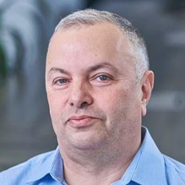

About the Speaker
Lev Selector, Ph.D.
40+ years of software engineering, data science, and building teams (hiring, training, and managing)
Ph.D. in mathematical modeling and computer simulations
Interests:
Generative AI, Using LLM with your data
Local AI for Local Private Data
Cloud architecture, fin-tech, application security
Find/connect: Linkedin, GitHub, YouTube, Google
https://eais.ai

Slide 3
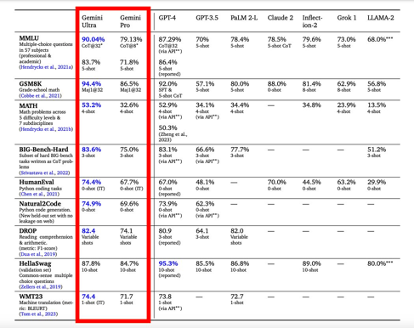
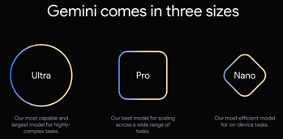
Google Gemini Released
https://deepmind.google/technologies/gemini
https://storage.googleapis.com/deepmind-media/gemini/gemini_1_report.pdf
December 6, 2023 - announced 3 models:
Nano (for phones, December)
Pro (for Bard, now)
Ultra - the best - in Q1, 2024
Multimodal - reasoning seamlessly across text, images, video, audio, and code.
Beats human experts on MMLU test (MMLU>90 !)
State-of-the-art on 30 out of 32 benchmarks
Beats GPT-4 and GPT-4V on almost all the tests
December 13 - Integration into apps using Google AI Studio and Google Cloud Vertex AI.

Slide 4
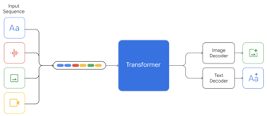
Google Gemini - continued
Google Gemini AI - Technical Details Quick Look
https://www.youtube.com/watch?v=_qTCijT_cSc
https://storage.googleapis.com/deepmind-media/gemini/gemini_1_report.pdf
Multimodal, 3 sizes, 32K tokens, multi-query attention.
The "Nano" model for Pixel phones has 1.8 and 3.2 Bln params, 4-bit quantized
The sizes of "Pro" and "Ultra" is not known yet.
Training:
TPUv5e and TPUv4. TPUv4 accelerators are deployed in “SuperPods” of 4096 chips. At Gemini Ultra scale, we combine SuperPods in multiple datacenters using Google’s intra-cluster and inter-cluster network
Using JAX running on TPUs, one python process to orchestrate
Data quality importance, data enrichment services
Coding: instruction-tuned Gemini Ultra correctly implements 74.4% of problems.
On a new held-out evaluation benchmark for python code generation tasks, Natural2Code, where we ensure no web leakage, Gemini Ultra achieves the highest score of 74.9%
AlphaCode - 25%, AlphaCode2 - 43%, AlphaCode 2 on top of Gemini Pro - 85%, i.e. it performs better than 85% of entrants
Google's "Hands-on" video was "improved"; Google is transparent about it, though.
How it’s Made: Interacting with Gemini through multimodal prompting - https://developers.googleblog.com/2023/12/how-its-made-gemini-multimodal-prompting.html
Gemini Lie - https://www.youtube.com/watch?v=90CYYfl9ntM
Google "FAKED UP" the ENTIRE Gemini Demo Video (Only the Video)! - https://www.youtube.com/watch?v=lhnlx8R16o4
Google’s best Gemini demo was faked - https://techcrunch.com/2023/12/07/googles-best-gemini-demo-was-faked/
That viral-ish Gemini demo video is basically entirely fake - https://twitter.com/ajones55555/status/1732609418527682709
About the “Hands-on with Gemini” - https://twitter.com/OriolVinyalsML/status/1732885990291775553

Slide 5
Hugging Face LLM Leaderboard
https://huggingface.co/spaces/HuggingFaceH4/open_llm_leaderboard
https://huggingface.co/datasets/open-llm-leaderboard/results
https://huggingface.co/spaces/felixz/open_llm_leaderboard
https://huggingface.co/spaces/felixz/meta_open_llm_leaderboard
https://github.com/lselector/ai/blob/master/llm_leaderboard.py
Rank | Model | Aver | Precision | Nparam
0 | TigerResearch/tigerbot-70b-chat-v2 | 70.96 | 16bit | 70
1 | bhenrym14/platypus-yi-34b | 70.67 | 16bit | 30
2 | chargoddard/Yi-34B-Llama | 70.01 | 16bit | 30
33 | OpenBuddy/openbuddy-falcon-180b-v13-preview0 | 64.3 | 8bit | 180
40 | fblgit/juanako-7b-UNA | 63.36 | 16bit | 7
57 | monology/openinstruct-mistral-7b | 61.22 | 16bit | 7
64 | OpenBuddy/openbuddy-falcon-180b-v12-preview0 | 60.54 | 4bit | 180
111 | ajibawa-2023/SlimOrca-13B | 58.15 | 16bit | 13
113 | microsoft/Orca-2-13b | 58.05 | 16bit | 13
126 | Intel/neural-chat-7b-v3-1 (mistral) | 57.5 | 4bit | 7
163 | NurtureAI/Starling-LM-11B-alpha-v1 | 56.23 | 16bit | 11
185 | ValiantLabs/ShiningValiantXS | 55.3 | 16bit | 13
194 | meta-llama/Llama-2-70b-chat-hf | 54.98 | 16bit | 70
213 | Open-Orca/Mistral-7B-OpenOrca | 54.51 | 16bit | 7
298 | mistralai/Mistral-7B-v0.1 | 53.14 | 16bit | 7
309 | microsoft/Orca-2-7b | 53.02 | 16bit | 7
398 | Enno-Ai/vigogne2-enno-13b-sft-lora-4bit | 51.79 | 4bit | 13
1261 | Phind/Phind-CodeLlama-34B-v2 | 37.15 | 16bit | 30
1836 | wtang06/mpt-125m-c4 | 17.2 | 16bit | 0.12
Three More Tests (4 -> 7):
ARC (AI2 Reasoning Challenge) grade-school science
HellaSwag - common sense inference
MMLU - math, history, comp-science, law, ...
TruthfulQA - model's propensity to reproduce common falsehoods
Winogrande - large version of Winograd test ( https://arxiv.org/abs/1907.10641 ), an adversarial and difficult test for commonsense reasoning
GSM8k - diverse grade school math word problems
DROP - English reading comprehension (Discrete Reasoning Over Paragraphs)

Slide 6
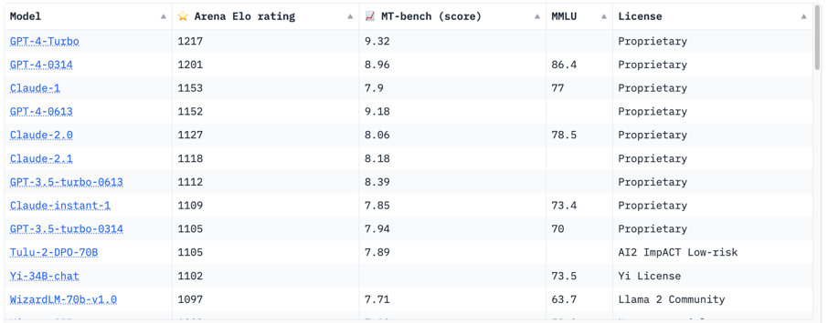
Crowd-sourced "Arena" leaderboard
https://huggingface.co/spaces/lmsys/chatbot-arena-leaderboard
allenai/tulu-2-dpo-70b - llama based - https://huggingface.co/allenai/tulu-2-dpo-70b
WizardLM/WizardLM-70B-V1.0 - llama based - https://huggingface.co/WizardLM/WizardLM-70B-V1.0

Slide 7
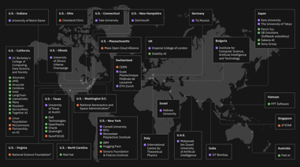
Misc
MLX - open-source framework for ML & AI from Apple Research for Apple silicon devices (training and deploying)
OpenAI App Store Launch date - moved to 2024
Meta Purple Llama Safety Project - CyberSecEval & Llama Guard. Llama Guard - small Llama2-7B customizable instruction-tuned model to classify safety risks in prompts and responses for conversational AI agent
https://ai.meta.com/blog/purple-llama-open-trust-safety-generative-ai/
Executive Order on the Safe, Secure, and Trustworthy Development and Use of Artificial Intelligence - Oct 30, 2023
https://www.whitehouse.gov/briefing-room/presidential-actions/2023/10/30/executive-order-on-the-safe-secure-and-trustworthy-development-and-use-of-artificial-intelligence/
Problem - shortage of AI talent - https://ai.gov/apply/
Meta text2image - https://imagine.meta.com
Microsoft Copilot updates - OpenAI's latest GPT-4 Turbo, an upgraded DALL-E-3 model, a code interpreter, 'Deep Search'
The AI Alliance - https://thealliance.ai - collaborative international group of industry leaders, startups, academic institutions, researchers, and government entities, aims to drive open innovation and open science in AI, promoting responsible innovation, ensuring scientific rigor, safety, and diversity
Building Knowledge Graphs using LLM
https://ai.plainenglish.io/the-silent-information-transformation-with-llms-building-knowledge-graphs-with-maximum-automation-2f8d453327d9
https://medium.com/@milena.trajanoska/automated-knowledge-graph-construction-using-chatgpt-ba959050405a
Grok launched on X/Twitter (Elon Musk’s AI startup xAI).
It is open for Premium Plus subscribers in the U.S.
Premium+ subscription starts at $16/mo
S-LoRA - scalable serving of many LoRA adapters by retaining all adapters in the main memory and selectively transferring them to the GPU for active queries. Up to 30 times faster than HuggingFace’s PEFT, 4-times faster than vLLM.
https://blog.devgenius.io/s-lora-serving-thousand-llms-on-single-gpu-d8373c00074d

Slide 8
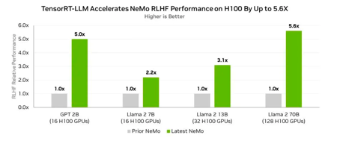
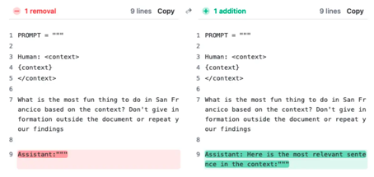
Misc 2
Nvidia TensorRT-LLM software - x5 times faster inference on Nemo LLM framework! (not compatible with PyTorch)
https://www.forbes.com/sites/karlfreund/2023/12/05/nvidia-pre-empts-amd-mi300-with-4x-faster-ai-yes-software-matters/
https://www.forbes.com/sites/karlfreund/2023/09/08/nvidia-adds-new-software-that-can-double-h100-inference-performance/
Claude from Anthropic supports 200k tokens length, but suffers from the "lost in the middle" problem, meaning it only had 27% retrieval performance on some standard problems.
However, if you add the sentence "Assistant: Here is the most relevant sentence in the context" to the prompt the retrieval performance jumps to 98%.
https://www.anthropic.com/index/claude-2-1-prompting

Slide 9

Axolotl
Axolotl is a powerful open-source tool specifically designed
to streamline the fine-tuning of various large language models (LLMs)
like Llama, Pythia, Falcon, and MPT.
It offers extensive support for multiple configurations and architectures,
making it a valuable resource for researchers and developers working with LLMs.
It is used by many of the leading open source models:
Teknium: OpenHermes, Trismigestus, CollectiveCognition
OpenOrca: Mistral-OpenOrca, Mistral-SlimOrca
Nous Research: Puffin, Capybara, NousHermes
Pygmalion: Mythalion, Pygmalion
Eric Hartford: Dolphin, Samantha
DiscoResearch: DiscoLM 120B & 70B
OpenAccess AI Collective: Manticore, Minotaur, Jackalope, Hippogriff
The Busy Person's Intro to Finetuning & Open Source AI - by Wing Lian, Axolotl .. https://www.latent.space/p/axolotl
Also:
.. https://github.com/OpenAccess-AI-Collective/axolotl
.. https://twitter.com/maximelabonne/status/1696793307299414296
.. https://medium.com/@gurpartap.sandhu3/fine-tuning-llms-using-openais-gpt3-5-to-build-a-hyper-focussed-grumpy-greg-6ecddceedd09
axolotl is a salamander

Slide 10
Zero-Shot Learning / Testing
"10-shot" means that the model is given 10 examples (for example, question-answer) before asking the main question. The examples are usually a part of the prompt, part of the question. They guide the model to answer the main question in specific way.
Being good at few-shot learning is important for tasks where there is a limited amount of training data. Ideally you want the model to be able to learn from just one example or demonstration.
Few-shot approach is also useful for customizing the responses of a general-purpose LLM for specific applications with minimal input.
"Zero-shot" means that the model is not given any similar examples.
The model must use its general pre-existing knowledge to infer the response.
Zero-shot tests the ability of the model to generalize, to handle unknown situations.
Zero-shot learning shows the model's ability to infer without prior exposure
while few-shot (like 10-shot) learning demonstrates adaptability with minimal examples.

Slide 11



Zephyr Models - helpful assistants
Zephyrus - a Greek God, a gentle and refreshing breeze
Zephyr - light or gentle wind, pleasant breeze that is refreshing and calming
Mistral - a strong, cold, northwesterly wind that blows from southern France into the Gulf of Lion in the northern Mediterranean
HuggingFaceH4/zephyr-7b-beta
https://huggingface.co/HuggingFaceH4/zephyr-7b-beta
Zephyr 7B is a series of language models that are trained to act as helpful assistants. Zephyr-7B-β is the second model in the series, and is a fine-tuned version of mistralai/Mistral-7B-v0.1 that was trained on on a mix of publicly available, synthetic datasets using Direct Preference Optimization (DPO).
Sao10K/Zephyrus-L1-33B
https://huggingface.co/Sao10K/Zephyrus-L1-33B
Zephyrus v1 is a multi-merging of several Llama1 30B Models using newer Merging Methods seen after the release of Llama2, with a sprinking of an experimental LoRA on top. The goal is to improve Writing Quality to match those seen in top L2 13B Models.
StableLM Zephyr 3B from Stability.AI
https://stability.ai/news/stablelm-zephyr-3b-stability-llm
StableLM Zephyr 3B is a 3 billion parameter Large Language Model (LLM), 60% smaller than 7B models. Non-commercial license. Inspired by HuggingFace zephyr-7b.

Slide 12
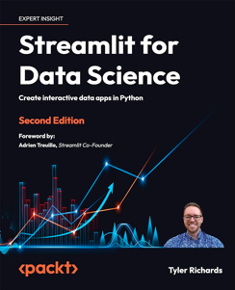
Streamlit
Streamlit - free open-source python framework to rapidly build and share beautiful ML web apps
Streamlit is specialized for Data Science visualizations
Fast prototyping with pre-defined components - but limited theme options, you can not directly use HTML/CSS; becomes slow or unresponsive with big datasets.
Streamlit was released in October 2019, acquired by Snowflake in 2022
https://github.com/streamlit ; https://streamlit.io https://streamlit.io/gallery
# pip install streamlit
import streamlit as st
import matplotlib.pyplot as plt
st.title("Hello World!")
st.write("This is my first Streamlit app.")
fig, ax = plt.subplots()
x = range(100)
y = [math.sin(i) for i in x]
ax.plot(x, y)
st.pyplot(fig)
# streamlit run app.py --server.port 8000

Slide 13
TaskWeaver vs AutoGen
TaskWeaver beats AutoGen! 🚀 Microsoft's Code-First Agent Framework - https://www.youtube.com/watch?v=1CdU4n-Obsw

Slide 14
Scaling Generative AI
Technical aspects:
Data: data acquisition, cleaning, annotation, and ongoing curation
Compute: cloud-based infrastructure with powerful GPUs, TPUs, or specialized AI hardware
Model optimization: Efficient model architectures, quantization techniques, and hardware-specific compilation
Specialized models: Training dedicated models for specific tasks
Strategic aspects:
Community, collaboration, open-sourcing - for faster learning and progress, attracting talent
Commonality and modularity - use common components and modular architectures - easier reuse, customization, integration, scaling
Coordination and governance - between different teams, including data scientists, engineers, product managers, and business stakeholders; responsible AI development, deployment, and monitoring
Trust, transparency, data privacy and security, bias and fairness issues

Slide 15
LLM Parallelism
LLM parallelism = splitting workload across multiple (thousands) GPUs or TPUs to achieve faster training and inference
Pipeline parallelism can lead to memory imbalance on certain devices. Techniques like gradient checkpointing and rematerialization can help.
Choose appropriate data types and optimizers to reduce memory footprint.
Design your LLM to efficiently scale to larger clusters with more devices.
Consider using frameworks like Ray or Horovod that facilitate distributed training management.
Bonus Tip: Explore hybrid approaches that combine different parallelism strategies for optimal performance and resource utilization.
Model Parallelism - split the model itself across devices. Careful to avoid communication bottlenecks.
Data Parallelism - divide the training data into batches and process them simultaneously on different devices
Pipeline Parallelism: Break down the training pipeline into stages (e.g., forward pass, backward pass) and run them concurrently on different devices
Gradient Aggregation - how to efficiently collect and combine gradients from different devices to update the model (all-reduce and ring-allreduce)
Parameter Sharding - divide model parameters into smaller chunks and distribute them across devices, reducing communication overhead.
Use GPUs or TPUs or other optimized hardware. Use specialized networking hardware (NVLink, Infiniband, etc)
Utilize libraries like DeepSpeed or Megatron-Turing NLG that provide optimized communication and memory management for LLMs

Slide 16
Generative AI Interview Questions
What is Generative AI and where is it used?
G-AI is a type of AI that generates new data that resembles a given training dataset. It learns the underlying patterns and structures of the data with the help of neural networks to generate new and original content
NLP - Natural Language Processing
Text content generation, image/video generation, data generation & analysis, healthcare, finance
https://www.youtube.com/watch?v=6RNT8I92oYM
https://www.youtube.com/watch?v=84Qdb1bEBgw
AI Skills You MUST LEARN
https://www.youtube.com/watch?v=UC7WLCCOzIE
Top AI companies ot watch in 2024
https://www.youtube.com/watch?v=WucGzteAcrc
How does Generative AI Work?
https://www.youtube.com/watch?v=iUnmF8aEg74
Top generative AI models, LLM, Diffusion, GANs
https://www.youtube.com/watch?v=OES1zKjdPxA
What is LLM?
https://www.youtube.com/watch?v=cOAI27-MRNQ
What is prompt engineering
https://www.youtube.com/watch?v=rMzLptB0U-4
Generative vs Discriminative Model Explained
https://www.youtube.com/watch?v=JE9j9150CKw
Prompt Engineering Techniques - Explained

Slide 17





Microsoft Azure AI
Azure AI - an umbrella term for various Microsoft Azure AI services.
This includes Computer Vision, Text Analytics, and Speech Services.
No-code or low-code, ease of use, quick integration with apps, diverse range of pre-built models
But - higher costs and limited flexibility
Common use cases - Image recognition, sentiment analysis, speech transcription, chatbots, etc.
Azure OpenAI Service - https://azure.microsoft.com/en-us/products/ai-services/openai-service
Conversational AI (bots, questions and answers, and contact center solutions)
Content creation (GPT-4 & DALL-E)
Data grounding - run models on your data for greater accuracy and insights with Azure OpenAI Service on your data
Azure Machine Learning Studio - platform for building, training, and deploying ML models - provides notebooks and drag-drop interface to easily build the models and pipelines.
Azure AI Studio - (preview) platform for developing generative AI solutions and custom copilots
Azure Synapse Analytics - unified platform for data integration, warehousing, and analytics.
Offers spark-based notebooks, data lake, SQL Data warehosue and SQL over datalake, built-in ML through SynapseML. Scalable.
Azure Data Fabric - re-implementation of Synapse, based on PySpark and on OneLake. It uses Delta Lake open-source format for data storage. Delta Lake is a layer that sits on top of existing data lakes and adds ACID transactions, scalable metadata, streaming and batch data processing, schema enforcement, time travel (query historical versions of data)

Slide 18

Google Vertex AI
Vertex AI - Managed ML platform from Google Cloud, since 2021
build, train, deploy, and manage ML models and AI applications
a unified platform for the entire ML lifecycle - data prep, model training, deployment, monitoring
AutoML - automatically train and optimize ML models
Customizable - custom code or pre-trained models
Scalable
Generative AI tools (text, images, code)
Accelerated ML development - tools, automation, collaboration, tuning
Reduced costs
Increased team productivity
Enhanced user experience - tools for model deployment and monitoring
Common use cases: image recognition, text classification, forecasting, fraud detection, customer churn prediction, generative art (images, music, ...)
https://cloud.google.com/vertex-ai/docs https://cloud.google.com/vertex-ai/docs/tutorials https://cloud.google.com/blog/products/ai-machine-learning/getting-started-with-vertex-ai
Vertex AI
Low code platform
AutoML, Custom tooling
Folder structures for projects
Easy to collaborate in
Google Colab
Hosted notebooks + compute/disk at no cost
G-Drive integration
Popular for teaching and open-source
Usage and hardware limits
vs

Slide 19

Amazon Bedrock
https://aws.amazon.com/bedrock/ - since September 2023
Build and scale generative AI applications with Foundation Models (FM)
Fully managed service offering foundation models (FMs) from leading AI companies like AI21 Labs, Anthropic, Cohere, Meta, Stability AI, and Amazon via a single API
Tools and capabilities for building generative AI applications with security, privacy, and responsible AI
Feature | Amazon Bedrock | AWS SageMaker
Purpose | Generative AI with pre-trained FMs | Various ML models
Foundation models | Pre-trained FMs (mainly LLMs) | Wide range of models, including custom
Ease of use | Easy, serverless, no infrastructure management | Requires more technical expertise
Integration | Focuses on SageMaker integration | Wider integration with various AWS services
Cost | Pay-per-use | Pay-per-use

Slide 20
Thank You!

